Slide 1


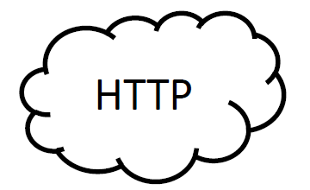






Browser
DOM
App Server
client
Elastic
API Server
(websockets)

Slide 2
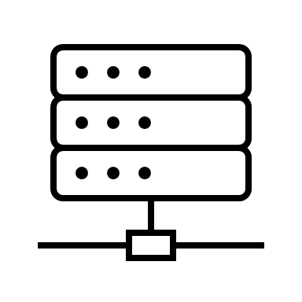


Browser
DOM
App Server
Web
App
Database
API Server
WebSocket's

Slide 3
Organizer
Send /topic/insession/{sessionId}
Request channel
Simple broker
Participants
Message /topic/insession/{sessionId}
Response channel
Participant
Send /queue/insession/{sessionId}
Request channel
Simple broker
Organizer
Message /queue/insession/{sessionId}
Response channel

