Slide 1
ClassCode Progress
André Santos
Ricardo Henriques
João Magalhães
Pedro Félix
i-on project Group 05

Slide 2
TABLE OF CONTENTS
01
02
03
Prelude
Progress done
Being done..
04
Reschedule

Slide 3
i-on ClassCode
Initiative i-on
i-on ClassCode
Creation and Management of GitHub repositories
Systems for academic use
Open Source development
Improved user experience and increased productivity

Slide 4
Motivation
Other Projects
GitHub Classroom
Slow configuration process for teachers
Missing cloning for local computers
Difficulties in Student identification
Security Gaps in
GitHub tokens
Storage
Slow Cloning Process

Slide 5
Functionalities
Web App
Mobile App
Easy Course/Class/
Assignment creation
Only for Teachers
Better way to integrate Students across Groups and Assignments
Ability to accept or reject write Requests from Web App
Possibility to create local copies for Teacher’s

Slide 6
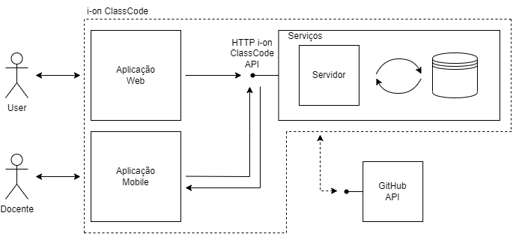
System Architecture

Slide 7






Progress done
User Flow
Web API
Defined web and mobile apps user navigation flow
All the api for the web part – Spring and Kotlin
Data Model
Repository
Definition of entities relations and restrictions
Tests to all repository functions – JDBI and Postgresql 15
Authentication
Services
Structuration of OAuth flow between web app and API
Tests to all services functions - Kotlin

Slide 8
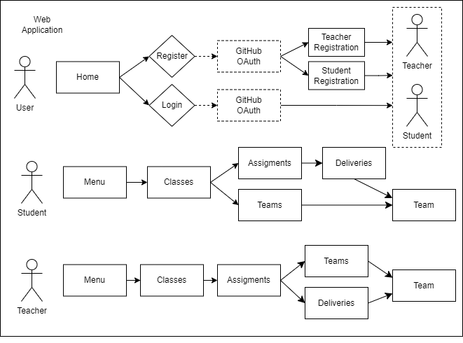
Web App Flow

Slide 9
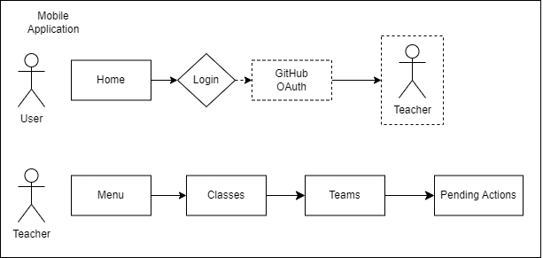
Mobile App Flow

Slide 10
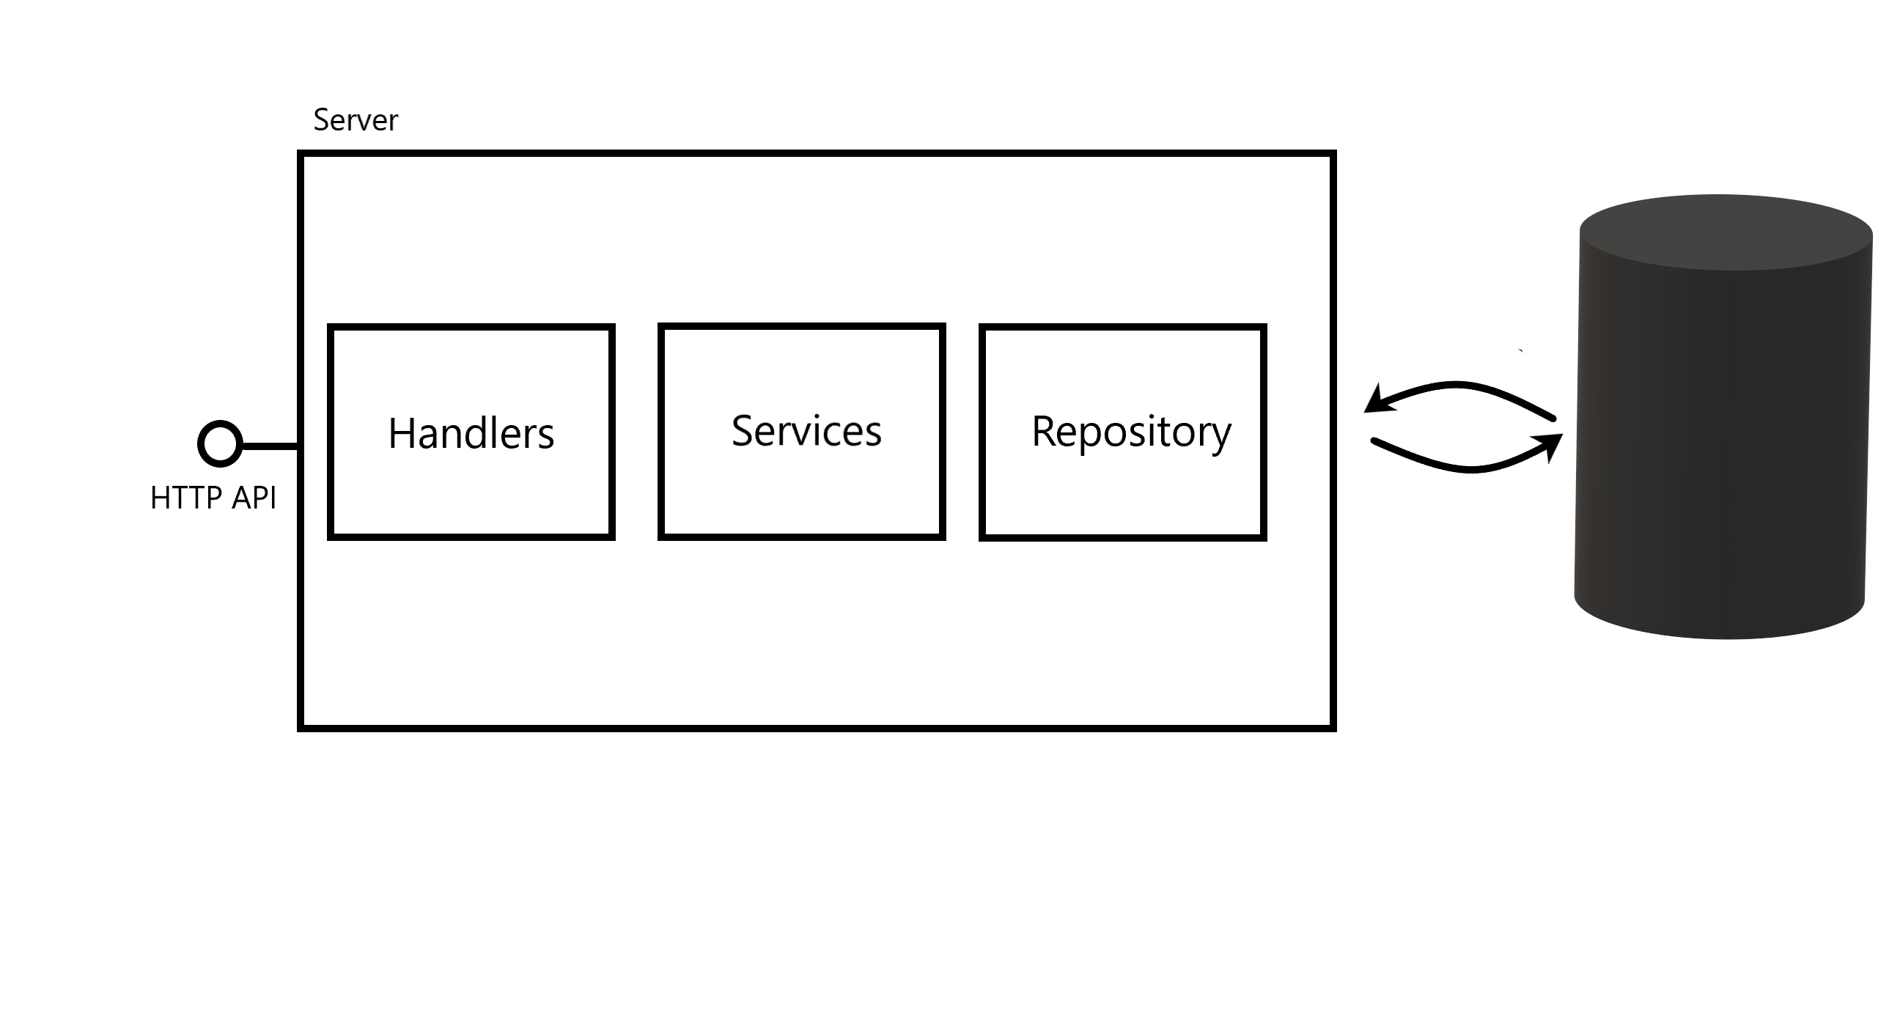
Web API Architecture
Handlers
Services
Only piece that knowns HTTP
Reponses syntax supports Hypermedia
Validates data in request
Maintains system integrity
Uses repository to access data
Repository
Handler Interceptor
Interaction with database
Atomic operations
Transaction per request
Used in authentication process
Validates session cookie

Slide 11
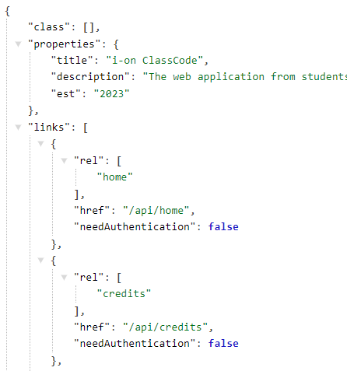
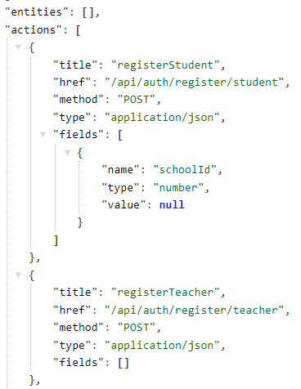
RFC JsonHome and Hypermedia
Web SPA development using hypermedia led to difficulties regarding storage of hypermedia learned routes.
Difficulties were solved by following RFC JsonHome specification.
Instead of specific URL schemas (/courses/1) hypermedia returns URL templates (/courses/{id}).
All hypermedia routes returned in home endpoint.
Hypermedia follows Siren representation specification.

Slide 12
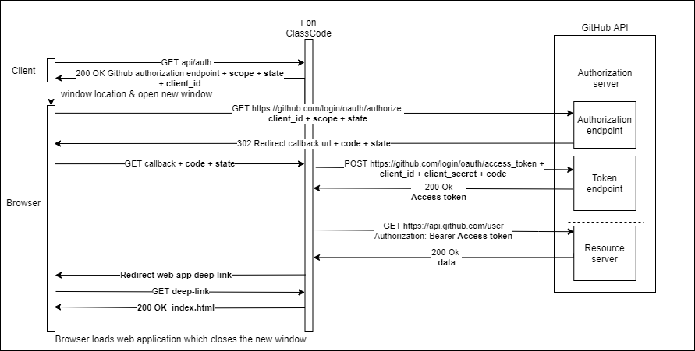
Authentication Flow
Notes:
Enunciar dificuldades por ser uma SPA

Slide 13
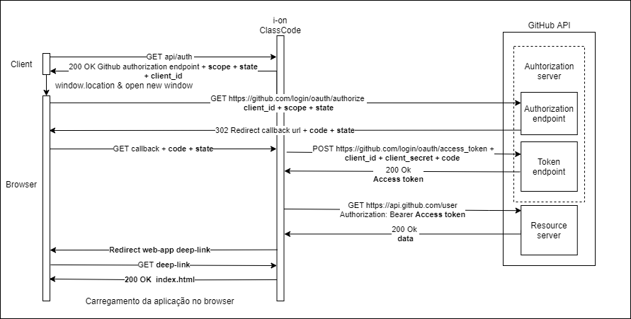
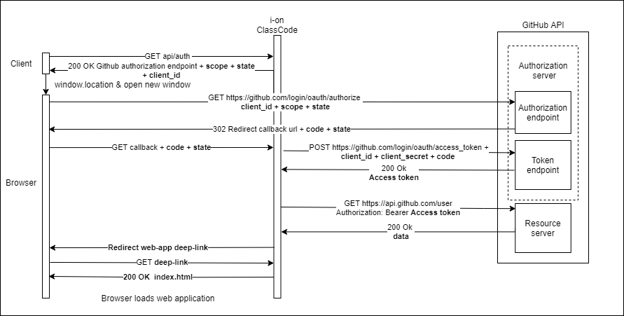
Authentication Challenges
Authentication
Distinction between requests made by web app or the browser.
Only browser requests can be redirected (status code 303).
The authentication process begins with a call to the API which returns the GitHub URL to begin OAuth flow (ClientID, Scope and state included) via browser request.
User authorizes I-on Classcode to use their Github user information.
GitHub redirects to API callback endpoint.
API fetches access token and user info and redirects the browser to a web-app deep-link.
The request made by the browser is made via window.location and normally would imply the loss of application state. To prevent this a new browser window is opened.
The browser makes a request to the server which fallbacks and returns the index.html containing the web application.
The web application react router resolves the deep-link and shows the appropriate UI component.
Notes:
Enunciar dificuldades por ser uma SPA

Slide 14




Being done..
Mobile App
with Jetpack Compose
API Integration Tests
Web App
Documentation
with React

Slide 15
Reschedule
Delayed
Reason
Change
Web Application start date (1 week)
Understanding and implementation of the Authorization Process
Reduce a week from the time to correct bugs (previous 2 weeks)
Mobile Application start date (week and a half)

