Slide 1
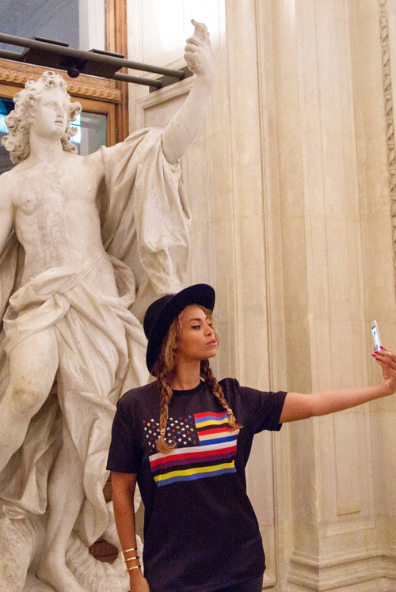
Optimal allocation of attention in user-generated content platforms
Iván Rendo Barreiro
Advisor: Alexandre de Cornière
M2 ETE Thesis
Toulouse School of Economics
27th June 2022

Slide 2
Context
Almost everything is User-Generated Content (UGC) !
Except for Google, the 6 most viewed websites are UGC
Of the 10 most downloaded iPhone apps, 8 are UGC (and 2 messaging services)
Create Content. (Why?) Attention
Users
Platform
Consume Content. Entertainment (YT), Social aspects (IG)
Looking at the distribution of attention…
Some platforms opted for professionalization (few users creating most of the content consumed)
E.g. Twitch, Youtube…
<— “High quality” content, attention concentrated at biggest creators
Others tried to incentivise the creation of content from all users and social interaction
E.g. Instagram (stories introduction), BeReal…
<— “Low quality” content, attention more distributed
2/11

Slide 3
Introduction (I)
Question to answer in this thesis: For a monopolist platform, which is the best way to distribute attention across users such that they are incentivised to create content in a way that maximises its utility (profit/sum of users utilities)?
I focus in the differences between optimal allocations depending on the preferences that users have for consuming quality that has been created by different users.
Social platforms (IG, Snapchat): users prefer to consume content from a lot of creators
VS Entertainment platforms (Youtube, Twitch)… where quality comes first
3/11

Slide 4
Introduction (II)
Question quite studied in Computer Science literature but not in economics,
some (big) differences:
CS literature does not derive an optimal mechanism, but study which of some (exogenously provided) ones is better
They focus on the qualities of the equilibrium, not the utility that agents derive from it or profits of the platform (there are exceptions)
They use different tools. (e.g. algorithmic game theory)
I use a “modified” Principal-Agent model:
The principal (a platform) allocates attention to agents (users) in exchange for them creating quality. Two differences:
No monetary transfers available: payment of attention (which is bounded)
Utility of any user in the platform depends on the transfers (attention) paid to the rest of users.
4/11

Slide 5
Outline
General Model (theoretical framework)
Binary Model (more results)
Ad-funded Platforms (application)

Slide 6

General Model: Framework
Consider a benevolent platform $P$ which has $N$ users.
Each user $i∈[[1,N]]$ is both creator and consumer of (quality of) content.
Production of a unit of content has a cost $θ_{i}$, heterogeneous across users.
Actions
Users: choose the quality of the content created $q_{i}∈R^{+}$
Platform: choose the attention paid to each user $A_{i}∈[0,1]$.
Total attention is bounded: $Σ_{i=1}^{N}A_{i}≤1$.
All users consume the same content, which is decided by the platform through the allocation of attention !
Utility of each user $i∈[[1,N]]$:
Creation utility
Consumption utility
$$U_{i}(A,q)=A_{i}-q_{i}θ_{i}+Σ_{j≠i}(A_{j}q_{j})^{μ}$$
Parameter $μ∈R^{+}$ represents the preference for consuming (quality of) content from different creators. The lower the $μ$, the higher is the preference for variety in creators.
In the consumption utility, I use $A_{j}q_{j}$ and not just $q_{j}$ because the relevant variable is the perceived quality. Otherwise, users derive utility from quality they are not paying attention to.
5/11

Slide 7
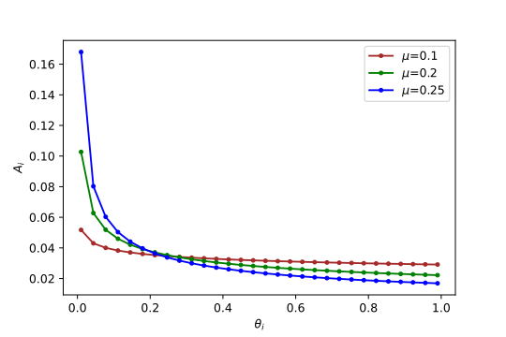
First best problem and results
The platform is benevolent in the sense that maximises the sum of utilities of the users.
Complete Info: Knowing costs $θ=(θ_{1},...,θ_{N})$, the platform offers a contract $\{A_{i}(θ),q_{i}(θ)\}$to each user in which allocates attention $A_{i}$ in exchange for the production of quality $q_{i}$
Problem of the platform:
$$\begin{matrix}\max_{A,q} & \overset{N}{\underset{i=1}{∑}}\left(A_{i}-θ_{i}q_{i}+\underset{j≠i}{∑}{\left(A_{j}q_{j}\right)}^{μ}\right) \\ s.t. & \{\begin{matrix}A_{i}-q_{i}θ_{i}≥0 & (IR) \\ ∑_{i=1}^{N}A_{i}≤1 & (Feasibility1) \\ 0≤A_{i}≤1 & (Feasibility2)\end{matrix}∀i∈[[1,N]]\end{matrix}$$
The IR only concerns creation of content
It is assumed that the platform is open-access and free and therefore any user can consume content even if it does not creates content at all
$$≡\max_{A,q}Σ_{i=1}^{N}U_{i}$$
Example. $N=30$ and equidistant costs.
Lemmas 1 & 2:
If $N$ is large enough and $μ∈(0,1/2)$,
IR binds and Feasibility 2 does not.
Optimal attention shares and qualities:
$$A_{i}^{*}=\frac{θ_{i}^{\frac{μ}{2μ-1}}}{\sum_{j=1}^{N}{θ_{j}^{\frac{μ}{2μ-1}}}}$$
$$q_{i}^{*}=\frac{A_{i}^{*}}{θ_{i}}=\frac{θ_{i}^{\frac{1-μ}{2μ-1}}}{\sum_{j=1}^{N}{θ_{j}^{\frac{μ}{2μ-1}}}}$$
6/11

Slide 8
Moreover…
Proposition 2:
In the First Best setting, the optimal attention allocation with respect to qualities follows a Generalized Tullock Contest:
$$A_{i}^{*}=\frac{q_{i}^{\frac{μ}{1-μ}}}{\sum_{j=1}^{N}{q_{j}^{\frac{μ}{1-μ}}}}$$
In the contests’ literature, the higher $r=\frac{μ}{1-μ}$ the lower levels of participation but the highest top qualities
For simplicity, the second best setting and its relation with the first best is studied in the framework
of $N$ users divided in two types of users, $L$ and $H$, that have costs $θ_{L}<θ_{H}$
(more elegant and tractable seems to be the case of the continuum of agents explored minimally in Appendix B, but its study is left out of this thesis)
7/11

Slide 9
Binary Model
(The first best is a special case of the general case)
Platform $P$ knows $θ_{L}$$<θ_{H}$ and proportions $f_{L}$, $f_{H}$ of users of each type, but not which type is each user.
Assume $N$ is large enough such that it is admissible consider that the actual proportions are the theoretical ones and $N_{k}=f_{k}N$ for $k∈\{L,H\}$.
The platform offers a menu of contracts $\{A_{i},q_{i}\}_{i=L,H}$ where allocates $A_{i}$ in exchange for production of $q_{i}$ and each user chooses its preferred one. They are designed incentivising self-revelation through IC constraint(s)
$$\begin{matrix}\max_{A_{L},A_{H},q_{L},q_{H}} & N_{L}\left(A_{L}-q_{L}θ_{L}+(N-1){\left(A_{L}q_{L}\right)}^{μ}\right)+N_{H}\left(A_{H}-q_{H}θ_{H}+(N-1)(A_{H}q_{H})^{μ}\right) \\ s.t. & \{\begin{matrix}A_{L}-q_{L}θ_{L}≥A_{H}-q_{H}θ_{L} & ({IC}_{L}) \\ A_{H}-q_{H}θ_{H}≥0 & ({IR}_{H}) \\ N_{L}A_{L}+N_{H}A_{H}≤1 & (Feasibility1) \\ 0≤A_{i}≤1 & (Feasibility2),i∈\{L,H\}\end{matrix}\end{matrix}$$
$$≡\max_{A,q}Σ_{i=1}^{N}U_{i}$$
Analytical solutions difficult to get! There is a numerical example next slide.
Proposition 3:
Conjecture 1:
Under standard assumptions, quality of the low-cost type is distorted
Moreover, the direction of the distortion depends on the preference for variety $μ$
$$\{\begin{aligned}q_{L}(μ)^{SB}<q_{L}(μ)^{FB}iffμ<μ^{*} \\ q_{L}(μ)^{SB}=q_{L}(μ)^{FB}iffμ=μ^{*} \\ q_{L}(μ)^{SB}>q_{L}(μ)^{FB}iffμ>μ^{*}\end{aligned}$$
$$∃μ∈\left(0,\frac{1}{2}\right):q_{L}(μ)^{FB}≠q_{L}(μ)^{SB}$$
8/11

Slide 10
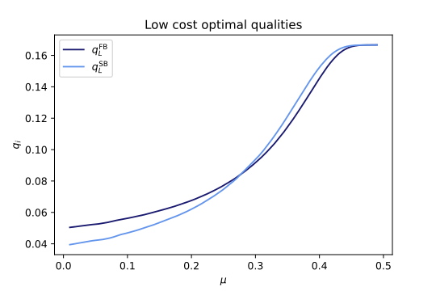
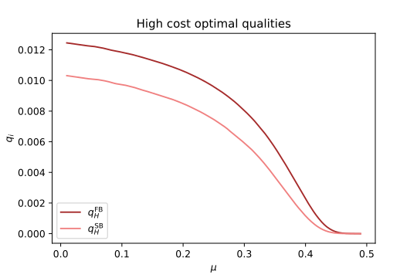
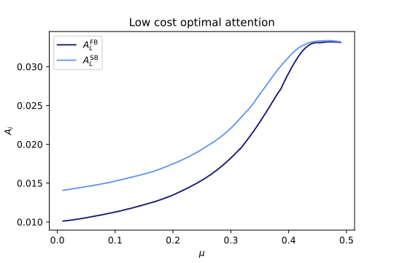
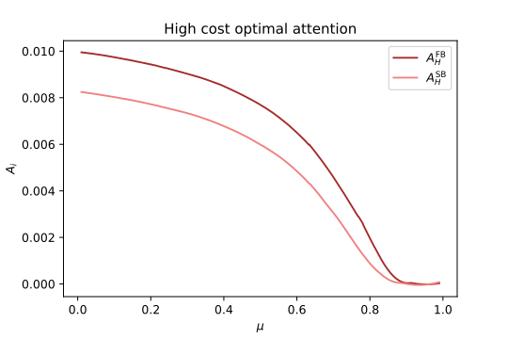
Example: Numerical Solutions
9/11

Slide 11
Application: ad-funded platforms
Platform $P$ is ad-funded and maximises profit.
Same benchmark as in the binary model: two types $L,H$ with costs $θ_{L}<θ_{H}$ and proportions $f_{L},f_{H}$
Platform now allocates $A_{0}∈[0,1]$ attention to ads and gets revenue from it.
Attention allocated to ads
Total utility derived by users
Profit $U^{P}$ is determined by:
$$U^{P}=A_{0}⋅Σ_{i=1}^{N}U_{i}$$
Problem of the platform:
$$\begin{matrix}\max_{A_{0},A_{L},A_{H},q_{L},q_{H}} & A_{0}\left(N_{L}{\left(A_{L}q_{L}\right)}^{μ}+N_{H}{\left(A_{H}q_{H}\right)}^{μ}\right) \\ s.t. & \{\begin{matrix}A_{H}-q_{H}θ_{H}≥0 & ({IR}_{H}) \\ A_{0}+N_{L}A_{L}+N_{H}A_{H}≤1 & (Feasibility1) \\ 0≤A_{i}≤1 & (Feasibility2),i∈\{0,L,H\}\end{matrix}\end{matrix}$$
$A_{L}-q_{L}θ_{L}≥0({IR}_{L})$ Only in First Best
$A_{L}-q_{L}θ_{L}≥A_{H}-q_{H}θ_{L}({IC}_{L})$ Only in Second Best
Propositions 4 and 5: Both in the first and second best settings, the optimal allocation to ads $A_{0}$ is
$$A_{0}=\frac{1}{1+2μ}$$
Does not depend on the info context !
Does not depend in any parameter but $μ$ !
10/11

Slide 12
Conclusion
Takeaways:
In complete information, distribution of attention shaped by preferences on diversity
In the second best, qualities are distorted upwards or downwards depending on $μ$
Different directions in future research:
Make the model continuous
Heterogeneous $μ_{i}$ across agents and platforms
Behavioural aspects (e.g. addiction)
11/11

