Slide 1



Release with Confidence
Open source feature flags for app development
Flagsmith and Quine

Slide 2
Intro
Why are we here?
Who are we?
Who are you? What would you like to discuss?
Why are we here?

Slide 3
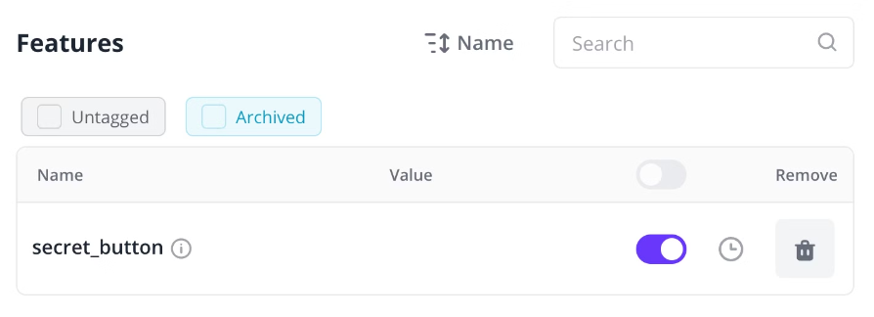
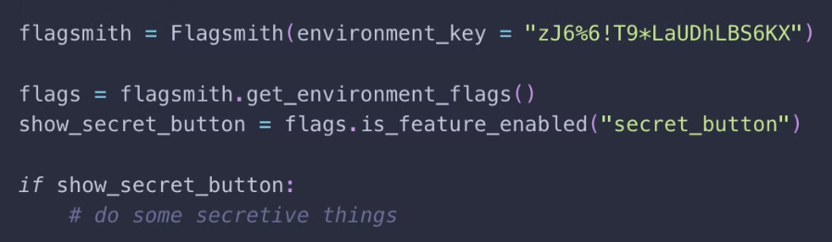
What Are Feature Flags?
Flipping Out Flickr, 2009 (Google for "Flickr Feature Flags")

Slide 4
How Can I Use Feature Flags?
Using feature flags to release with confidence
De-couple Deploy and Release
Segment/Target Users
A/B and Multivariate Tests
1
2
3
4
5
6
Tighter Pull Request Loops
Phased Rollouts + Canary Releases
Increase Cross-Team Velocity

Slide 5
When Not to Use Feature Flags
Use Case Considerations
Unusual use-cases
Don't over use
When they EOL
Unusual legacy stack
Too many flags can be an anti-pattern!
Stale flags are an anti-pattern!
Formal software methods
Potential for outages
Some code is too important/hot path for flagging

Slide 6
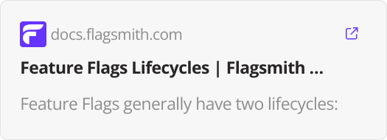
Getting Started with Feature Flags
Some best practices
1
Identify your use cases e.g.
2
Start small!
3
Consider how you want to manage your flags
Everything doesn't need to be wrapped in a flag
Coordinated releases with multiple teams
e.g. Homegrown vs tools
Phased rollouts/canary releases
(Consider open source and things like ​OpenFeature)
4
Consider feature flag lifecycles and technical debt
5
Shift the mindset around release practices
Get used to deploying when the work's ready

Slide 7




Why Flagsmith
Open Sourcehttps://github.com/Flagsmith/flagsmith
Security
Built for Engineers
On-prem/private cloud deployments
Some tools are built for growth teams/product teams.
Transparency
SAML, LDAP etc.
We've focussed on engineers
Partnership with OpenFeature
Built for data-sensitive teams
Built-in user testing
Support
Join us on Discord, chat to us, submit issues on GitHub, etc.
Some options
Open source: https://github.com/Flagsmith/flagsmith
Free app
Ask us if you have questions! (e.g. on Discord)

Slide 8
Q&A

Slide 9
Get Started
⭐ GitHub: https://www.github/com/flagsmith/flagsmith ⭐
Flagsmith: https://www.flagsmith.com/

