Slide 1
Destruction of Steganography
using EDSR and SRGAN
Team Members:
Sabrina Marshal -19BCE1290
Sharon Immanuel-19BCE1630

Slide 2
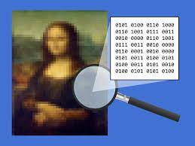
Steganography
Image Steganography refers to the process of hiding data (payload) within an image file (container).
The image selected for this purpose is called the cover image and the image obtained after steganography is called the stego image.
In image steganography, a message is embedded into an image by altering the values of some pixels, which are chosen by an encryption algorithm.

Slide 3
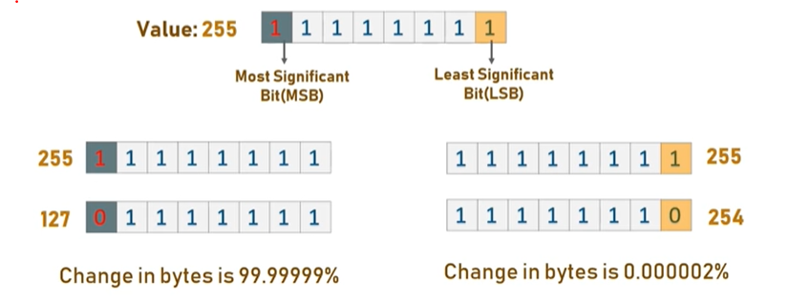
LSB Steganography
Least Significant Bit (LSB) is a technique in which the last bit of each pixel is modified and replaced with the secret message’s data bit.
The idea behind LSB embedding is that if we change the last bit value of a pixel, there won’t be much visible change in the color.

Slide 4
Destruction of steganography
The main goal of steganography is to communicate securely in a completely undetectable manner and to avoid drawing suspicion to the transmission of a hidden data.
Unfortunately most uses of steganography and research around the topic of steganography center around the illegitimate purposes. The illegitimate uses of steganography were also found to be on a global scale and involved national security.

Slide 5
However, many steganalysis algorithms are constrained to work with only a subset of all possible images in the wild or are known to produce a high false positive rate. This results in blocking any suspected image being an unreasonable policy.
A more feasible policy is to filter suspicious images prior to reception by the host machine. We need to optimally destroy steganographic content without compromising the perceptual quality of the original image.

Slide 6
Super Resolution
Image Super Resolution refers to the task of enhancing the resolution of an image from low-resolution (LR) to high (HR).
With the advancement in deep learning techniques in recent years, deep learning-based SR models have been actively explored and often achieve state-of-the-art performance on various benchmarks of SR.

Slide 7
Input to model
DIV2K dataset - consists of 800 training images, 100 validation images, and 100 test images.
RGB input patches of size 48×48 from LR image with the corresponding HR patches.
images are pre-processed by subtracting the mean RGB value of the dataset.
The training data is augmented with random horizontal flips and 90-degree rotations.

Slide 8
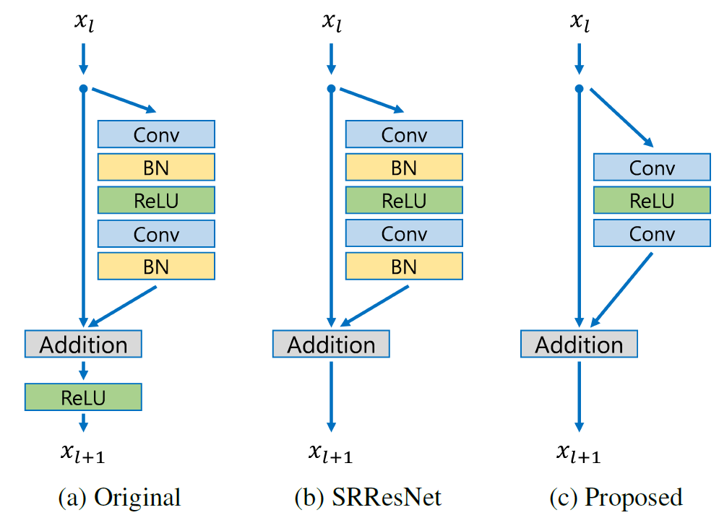
Enhanced Deep Super-Resolution
Network (EDSR)
Modified residual blocks-
Batch normalization is removed.
GPU memory usage is also sufficiently reduced.
saves 40% of memory usage during training, compared to SRResNet.

Slide 9
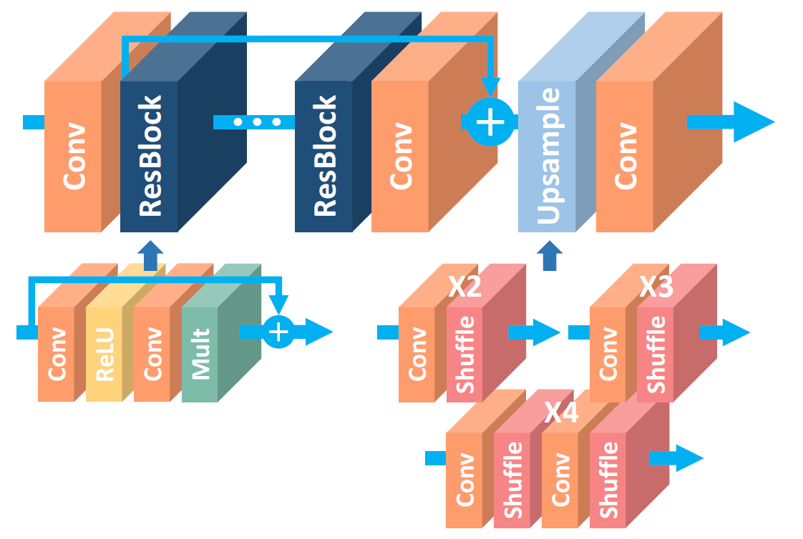
Residual scaling with factor 0.1 is applied at the residual path before adding back to the convolutional path.
No ReLU activation layers outside the residual blocks.
The baseline model is expanded by setting depth B = 32, no. of feature maps F = 256 with a scaling factor 0.1.
When training the model for upsampling factor ×3 and ×4, we initialize the model parameters with pre-trained ×2 network. (training converges much faster than the one started from random initialization)

Slide 10
The significant performance improvement of our model is due to optimization by removing unnecessary modules in conventional residual networks. The performance is further improved by expanding the model size while we stabilize the training procedure.
Outperforms SRCNN, VDSR, SRResNet, won the NTIRE2017 Super-Resolution Challenge

Slide 11
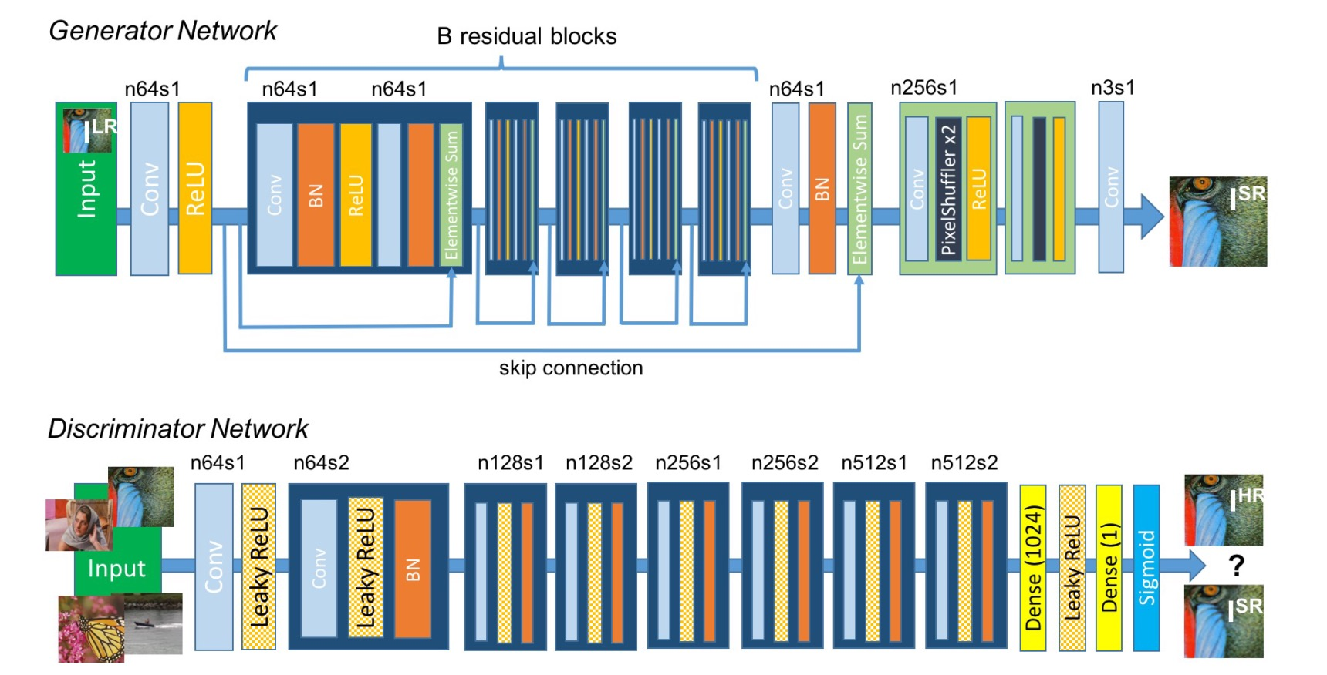
SRGAN

Slide 12
SRGAN uses a GAN-based architecture to generate visually pleasing images. It uses the SRResnet network architecture as a backend, and employs a multi-task loss to refine the results.
The loss consists of three terms:
MSE loss capturing pixel similarity
Perceptual similarity loss, which is used to capture high-level information by using a deep network
Adversarial loss from the discriminator

Slide 13
Pre trained weights
EDSR weights:
EDSR x4 baseline as described in the EDSR paper: 16 residual blocks, 64 filters, 1.52M parameters.
PSNR on DIV2K validation set = 28.89 dB (images 801 - 900, 6 + 4 pixel border included).
Fine tuning with SRGAN:
SRGAN as described in the SRGAN paper: 1.55M parameters, trained with VGG54 content loss.

Slide 14
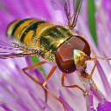
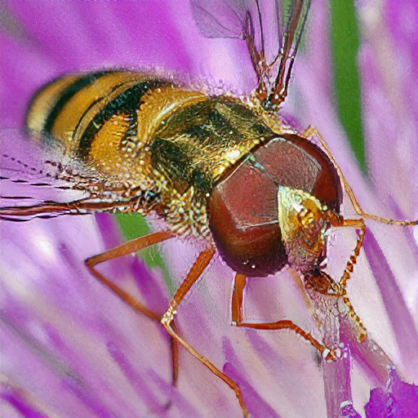
Implementation
LR image (with message)
SR image

Slide 15

Original HR image
SR image

Slide 16
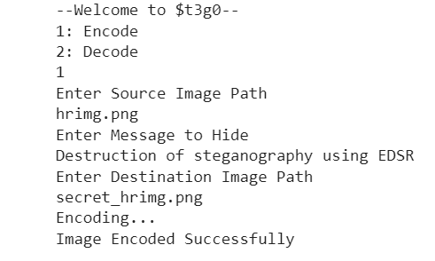
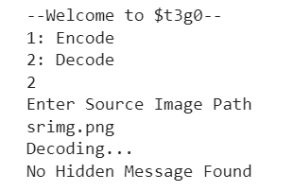
LSB steganography
Steganalysis

Slide 17
Thank You

