Slide 1
Supervised Clustering with SVMs
Thomas Finley, Thorsten Joachims
Cornell University
August 2005

Slide 2
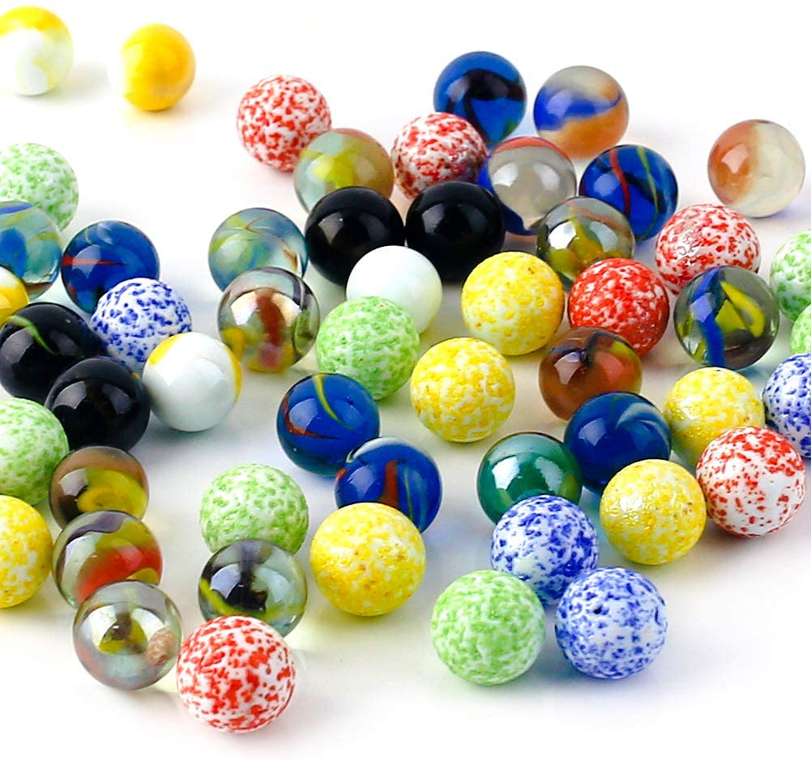
Suppose we want to cluster some marbles: -
Under what criteria can they be categorized: -
By size
By transparency
By color
Any other

Slide 3
How to adjust
Manually:- Manually adjust all the marbles to different clusters.
Semi-Supervised Clustering: - Give them item-pairs and then clustering algorithms to do the clustering.
Supervised Clustering: - Provide a series of item pairs and clustering of that set and then an algorithm learn how to cluster.

Slide 4
Problem Statements
Noun-Phrase(NP) clustering:- For NP clustering we need to cluster all the nouns-phrases that point to one entity in a document.
News story Clustering: - We need to cluster similar news articles together.

Slide 5
Clustering
For a given set of items.
We will find a similarity measure between the item pairs.
And then produce partitioning with respect to the similarity measure such that it increase our objective function.
Objective function here: sum of similarity of pairs in same cluster (Bansal, et al. 2002).
X7
X4
X8
X5
1/Sim(X4, X2)
X10
1/Sim(X5, X10)
X1
X6
X2
1/Sim(X2, X3)
X3
X9

Slide 6
Similarity measure
For each item pair we will define a pairwise feature vector ϕij.
Similarity between i and j is an inner product between ϕij and a learned vector w. Sim(Xi, Xj) = <w, ϕij>.

Slide 7
Naïve training example
Set x with partitioning y. Learn by simple classifier (Ng, Cardie, citation).
Here, positive examples are: -
Φ₁₂, Φ_{34,} Φ_{35,} Φ₄₅
Negative examples are: -
Φ_{13,} Φ_{24,} Φ_{15,} Φ_{25,} etc.
A linear SVM trained on these
will learn a weight vector w.
Sim(xi, xj) = <w, Φ_{ij}>
X7
X4
X8
X2
X1
X5
1/Sim(X4, X2)
X10
1/Sim(X5, X10)
X1
X6
X2
X3
X5
1/Sim(X2, X3)
X3
X4
X9

Slide 8
SVM^{struct}
SVM^{struct}: Adaptation of SVM^{light} for learning functions with complex output space. (Tsochantaridis, et al. 2004)
If Ψ(x, y) gives relationship between the input x and output y. Ψ(x, y) = 1/5^2(φ1,2 + φ3,4 + φ3,5 + φ4,5) then;
SVM^{struct} can learn functions of the form
f(x; w) = argmax _{y∈Y} <w,Ψ(x, y)>

Slide 9
Δ used in clustering
Δ will measure how unrelated two elements are to each other.
For our problem we will be using one more loss variable, i.e., MITRE loss but it is limited to Noun phrase conference only.

Slide 10
Linear constraints
We will define a constraint on all our training set examples. The value of the objective function for the correct clustering for all the examples getting wrongly clustered, we will keep it higher than the value of objective function for wrong clustering. We will also check if the difference between them is at least the loss between wrong and correct clustering. A slack value can be allowed as upper bound for the value.
<w,Ψ(xi, yi)> ≥ <w,Ψ(xi, y)> + Δ(yi, y) − ξi

Slide 11
The Argmax
Our equation is: H(y) = ∆(yi, y) + <w, Ψ(xi, y)> − <w, Ψ(xi, yi)>
- Now we may compute, ŷ = argmax_{y∈Y} H(y)
Real relaxation - (Demaine, Immorlica, 2003), get upper bounded argmax approx., over constrained QP.

Slide 12
SVM^{cluster} vs. PCC
SVM^{cluster} worked better for both MITRE and pair-wise loss for NP conference.
SVM^{cluster} and PCC do not differ significantly for the news clustering.
Noun Phrase | CG | PCC | Default
Test with CG, ∆M | 41.3 | 51.6 | 51.0
Test with CG, ∆P | 2.89 | 3.15 | 3.59
News | CG | CR | PCC | Default
Test with CG, ∆M | 2.36 | 2.43 | 2.45 | 9.45
Test with CG*, ∆P | 2.04 | 2.08 | 1.96 | 9.45
[Here, ΔM refers to MITRE loss while ΔP refers to pair-wise loss]

Slide 13
Inclusion of Δ in Finding Constraint
If we ignore the loss from our function will it affect our results:
H(y) = ∆(yi, y) + <w, Ψ(xi, y)> − <w, Ψ(xi, yi)>.
The result for NP clustering is
better here.
 | With loss | No loss
NP-coreference, ΔM | 41.3 | 41.1
NP-coreference, ΔP | 2.89 | 2.81
News, train CG, test CG | 2.36 | 2.42
News, train CR, test CR* | 2.08 | 2.12
 | Train CG | Train CR
Test CG | 2.36 | 2.43
Test CR* | 2.04 | 2.08
Let’s try under constrained (with greedy CG) versus over constrained (with relaxed CR) for training for the news clustering.
The result we got is better and not significantly different from the other.

Slide 14
Conclusion
We were able to adapt the SVM^{struct} for clustering purpose.
It is a better option to be used when there exists some complex interactions among objects, or if we have to use any special performance measure somewhere.
And this thing is an extend to semi-supervised clustering approaches.

