Slide 1
ECMA International

Slide 2
European Computer Manufacturers Association (ECMA)
Formed in 1961 by major multinational computer hardware manufacturers present in Europe.
Ecma International is a not-for-profit association under Swiss Law/Geneva, established in 1961
Purpose of Ecma: Development and publication of standards/TRs for Information & Communication Technology and Consumer Electronics

Slide 4
ECMAScript
new paradigms

Slide 5
JavaScript
In 1997, a committee (TC39) was created in the ECMA to standardize JavaScript. Thereafter, the JavaScript standards are governed as ECMAScript. Not only JavaScript is based on the ECMAScript language, there are others such as JScript and ActionScript 3 that also do it. Making an analogy, we will say that ECMAScript is the language and JavaScript, JScript and ActionScript 3 are dialects of this language, with JavaScript being its most well-known and used dialect.

Slide 6


Slide 8
what is?
JavaScript was invented by Brendan Eich in 1995, and became an ECMA standard in 1997.
ECMAScript is the official name of the language.
From 2015 ECMAScript is named by year (ECMAScript 2015).
https://es.wikipedia.org/wiki/ECMAScript
https://devcode.la/blog/que-es-y-por-que-aprender-ecmascript/

Slide 9
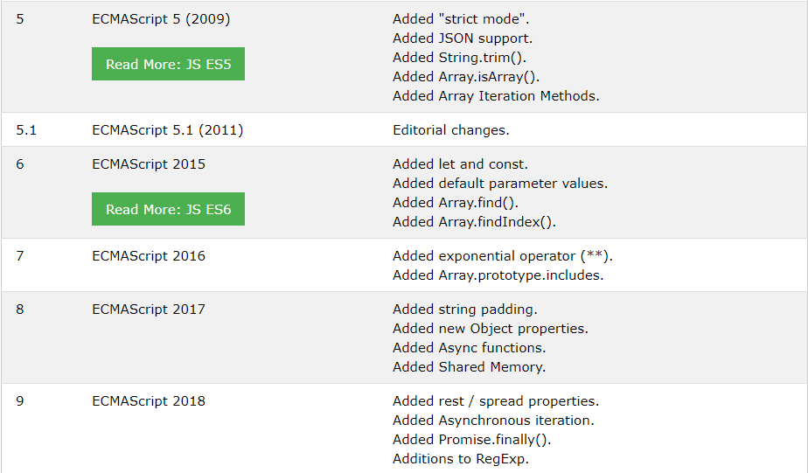
Last versions

Slide 10
Some features

Slide 11
ECMAScript 5 Features
These were the new features released in 2009:
The "use strict" Directive (https://www.w3schools.com/js/js_strict.asp)
String.trim()
Array.isArray()
Array.forEach() (https://www.w3schools.com/js/tryit.asp?filename=tryjs_array_foreach)
Array.map()
Array.filter()
Array.reduce()
Array.reduceRight()
Array.every()
Array.some()
Array.indexOf()
Array.lastIndexOf()
JSON.parse()
JSON.stringify()
Date.now()
Property Getters and Setters
New Object Property Methods

Slide 12
High order functions
Functions that operate on other functions, either by taking them as arguments or by returning them, are called higher-order functions. Since we have already seen that functions are regular values, there is nothing particularly remarkable about the fact that such functions exist. The term comes from mathematics, where the distinction between functions and other values is taken more seriously.
https://eloquentjavascript.net/05_higher_order.html

Slide 13
Higher-order functions allow us to abstract over actions, not just values. They come in several forms. For example, we can have functions that create new functions.
Higher-order functions allow us to abstract over actions, not just values. They come in several forms. For example, we can have functions that create new functions.
function greaterThan(n) {
return m => m > n;
}
let greaterThan10 = greaterThan(10);
console.log(greaterThan10(11));
// → true

Slide 14
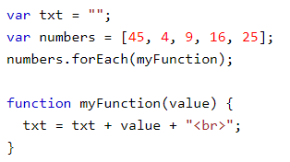
Array.forEach()

Slide 15
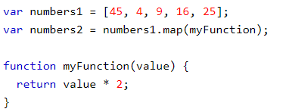
Array.map()

Slide 16
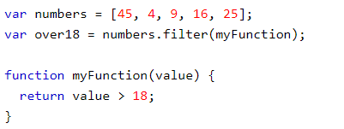
Array.filter()

Slide 17
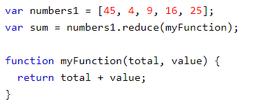
Array.reduce()

Slide 18
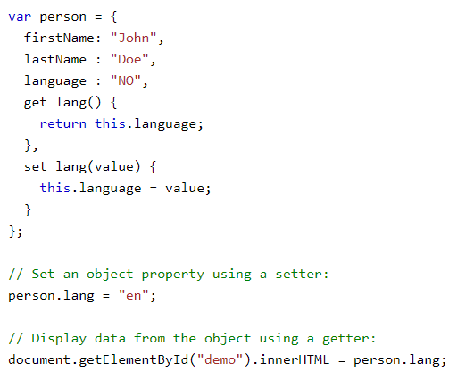
Property Getters and Setters

Slide 19
What is ECMAScript 6?
ECMAScript 6 is also known as ES6 and ECMAScript 2015.
Some people call it JavaScript 6.
This chapter will introduce some of the new features in ES6.
Javascrip Var (function scope)
JavaScript let (block scope)
JavaScript const
Exponentiation (**)
Default parameter values
Array.find()
Array.findIndex()

Slide 20
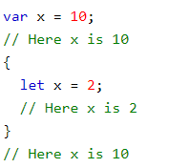
JavaScript let

Slide 21
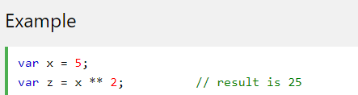
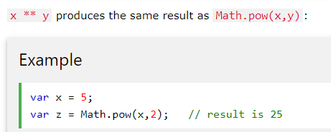
Exponentiation Operator

Slide 22
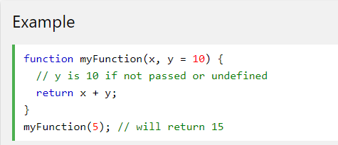
Default Parameter Values

Slide 23
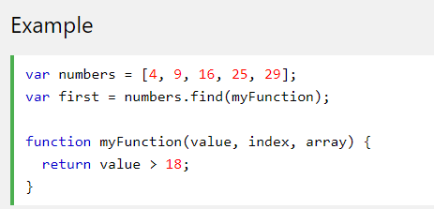
Array.find()

