Slide 1
Template by Kevin Dufendach
Updates at http://sites.google.com/site/dufmedical/jeopardy
VAY Sports Ministry
Practice Game 3
AAA - BBB - CCC
"Blessed are those who keep his testimonies, who seek Him with their whole heart - Phước cho những người gìn giữ chứng cớ Ngài. Và hết lòng tìm kiếm Ngài."
Psalm | Thi thiên 119:2
Bible Challenge
Bible Challenge
Instructions
Rules
Board
not in any way endorsed or affiliated with the Jeopardy Game Show

Slide 2
Instructions
Reset
To start a new game, click the “reset” button on the board slide. This will reset the board, set each player’s score to 0, and randomly move the Daily Double.
Click “Adj Scores” from the board to manually change scores.
Click on the lights at the bottom to start a countdown (click below to change).
Incorrect response: Click the “incorrect” button if the player responds incorrectly, and their score will subtract.
Correct response: Press the “correct” button if the player responds correctly, and the correct response will then be shown.
  To skip viewing the correct response, check the box below
If no one gets the question correct, press the arrow to go to the next slide (or return to the board if the checkbox below is checked).
Troubleshooting:
  Do not delete the value shape (e.g. $400) from any slide. If you don’t like it, you can move it off the screen, but DON’T DELETE IT, and don’t change its text!!!
  Do not delete question slides and copy them in from somewhere else. You can do this to replace “answer” slides, but just not question slides (unless you re-apply the hyperlinks to the board)
  If none of the functions are working, see “Macro Troubleshooting”
Adjust Countdown Timer
Import from Excel Template
(Template available online)
Template by Kevin Dufendach. Original at http://sites.google.com/site/dufmedical/jeopardy
Now hosted at https://github.com/i12know/vaybc

Slide 3
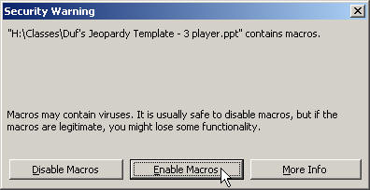
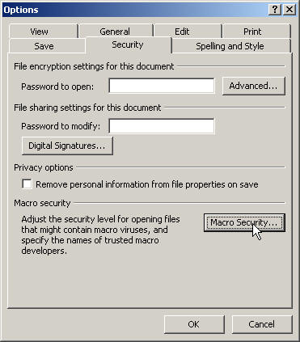
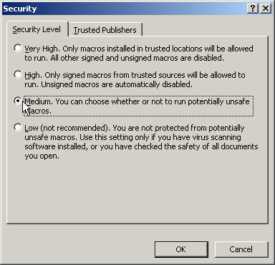
Macro Troubleshooting
If you’re having trouble getting this PowerPoint to work, be sure to “Enable Macros” when opening the file.
If you don’t see this box when you open PowerPoint, your security settings may be set too high. In this case, go to the “Tools” menu and select “Options.” Click on [Macro Security…] and then select “Medium.” Press OK until you return to the show. Now save this file and then re-open it. You should now receive the dialog shown above. Click “Enable Macros”
Note: some of the functions may not work with versions of PowerPoint other than PowerPoint 2010 for Windows. (But tested successfully on PowerPoint 365 version 2409)

Slide 4
Board
C2
The Daily Double is located at:
Move to
reveal location
Instructions
Adj Scores
Rules
Double
Reset
Final
Break
Water
Ground
Air
Fire
Misc.
Don't use
End of
Round 1
$100
$100
$100
$100
$100
$100
$200
$200
$200
$200
$200
$200
$300
$300
$300
$300
$300
$300
$400
$400
$400
$400
$400
$400
$500
$500
$500
$500
$500
$500

Slide 5


Where is it written, “Stolen water is sweet, and bread eaten in secret is pleasant?”
$100

Slide 6
Pr 9:17
$100

Slide 7
What is it that the Spirit, the water, and the blood all agree about?
$200

Slide 8
Jesus Christ (1 Jn 5:6-8)
$200

Slide 9
What water cannot quench?
$300

Slide 10
Love (So. 8:7)
$300

Slide 11
Who are trembling under the waters?
$400

Slide 12
Job 26:5 "The dead tremble under the waters.."
$400

Slide 13
Who was supposed to be crowned "from sea to shining sea" instead of America the Beautiful?
$500

Slide 14
King [Jesus?] (Ps 72:8 "May he have dominion from sea to sea")
$500

Slide 15
Who said, "Our belly clings to the ground"?
$100

Slide 16
Sons of Korah (Ps 44:25)
$100

Slide 17
Where is it written, "Faithfulness springs up from the ground, and righteousness looks down from the sky"?
$200

Slide 18
Ps 85:11
$200

Slide 19
Which animal swallows the ground?
$300

Slide 20
The horse. Job 39:19,24 "Do you give the horse his might.. With fierceness and rage he swallows the ground; he cannot stand still at the sound of the trumpet"
$300

Slide 21
What happened to the ground when God brought the vine [of Israel] out of Egypt?
$400

Slide 22
The ground was cleared by God. Ps. 80:7..9 "O God.. You brought a vine out of Egypt.. You clear the ground for it.."
$400

Slide 23
Which verse describes what happened in Esther 6:11?
$500

Slide 24
Ec 10:7 "I have seen slaves on horses, and princes walking on the ground like slaves"
$500

Slide 25
Which verse is about bad breath: "My breath is strange to my wife, and I am a stench to the children of my own mother"?
$100

Slide 26
Job 19:17
$100

Slide 27
Who have no breath in their mouths?
$200

Slide 28
Idols (Ps 135:17 "they have ears, but do not hear, nor is there any breath in their mouths.")
$200

Slide 29
What TWO actions people do "until the day breathes"?
$300

Slide 30
"Turn" and "Go away" (So. 2:17 and So. 4:6)
$300

Slide 31
What is the occupation of people who "hang in the air, far away from mankind; swing to and fro"?
$400

Slide 32
They are miners (Job 28:1-6)
$400

Slide 33
Which verse confirms the scientific fact that sound, like birds, travel by air?
$500

Slide 34
Ec 10:20 "Do not curse the king, nor in your bedroom curse the rich, for a bird of the air will carry your voice, or some winged creature tell the matter."
$500

Slide 35
Who said, "fire consumes the tents of bribery"?
$100

Slide 36
Eliphaz (Job 15:34)
$100

Slide 37
Who set a city on fire?
$200

Slide 38
Scoffers (Pr 29:8 "Scoffers set a city aflame, but the wise turn away wrath.")
$200

Slide 39
Who has fire coming out from his mouth?
$300

Slide 40
God (Ps 18:8 "devouring fire from his mouth"; v6 referred to Go)
$300
Job 41:21 would be a WRONG answer since it was about "flame", not "fire"

Slide 41
How do you stop the fire of quarreling in the community?
$400

Slide 42
Stop the whisperers [gossipers] (Pr 26:20 "For lack of wood the fire goes out, and where there is no whisperer, quarreling ceases.")
$400

Slide 43
What 2 verses were quoted by Paul in Romans 12:20?
$500

Slide 44
Pr 25:21-22 "If your enemy is hungry, give him bread to eat, and if he is thirsty, give him water to drink, for you will heap burning coals on his head, and the LORD will reward you."
$500

Slide 45


Where in Song of Solomon is God mentioned?
$100

Slide 46
So. 8:6 "jealousy is fierce as the grave. Its flashes are flashes of fire, the very flame of the LORD"
$100

Slide 47
What is the shortest verse in these books you are reading?
$200

Slide 48
Job 3:2, "And Job said"
$200

Slide 49
How do Zophar's speech lengths differ from those of Eliphaz and Bildad?
$300

Slide 50
He spoke only twice, the others spoke three times
$300

Slide 51
What did John write that would be opposed to Job 31:32?
$400

Slide 52
"If anyone comes to you and does not bring this teaching, do not receive him into your house or give him any greeting, for whoever greets him takes part in his wicked works." (2 Jn 1:10-11)
$400

Slide 53
What is the longest verse in the books you are reading?
$500

Slide 54
Either Job 1:5 (305 chars, 57 words) or Ec 9:2 (280 chars, 59 words)
$500

Slide 55
$100

Slide 56
$100

Slide 57
$200

Slide 58
$200

Slide 59
$300

Slide 60
$300

Slide 61
$400

Slide 62
$400

Slide 63
$500

Slide 64
$500

Slide 65
DAILY
DOUBLE
Enter your wager:
$
Go!

Slide 66
Board
A5
B2
Move to
reveal location
The Daily Doubles are located at:
Move to
reveal location
Instructions
Adj Scores
Single
Final
Break
Wealth
Word
Wisdom
Worship
Đủ Thứ Miscellaneous
Don't use
End of
Round 2
$200
$200
$200
$200
$200
$200
$400
$400
$400
$400
$400
$400
$600
$600
$600
$600
$600
$600
$800
$800
$800
$800
$800
$800
$1000
$1000
$1000
$1000
$1000
$100

Slide 67
$200

Slide 68
$200

Slide 69
$400

Slide 70
$400

Slide 71
$600

Slide 72
$600

Slide 73
$800

Slide 74
$800

Slide 75
$1000

Slide 76
$1000

Slide 77
$200

Slide 78
$200

Slide 79
$400

Slide 80
$400

Slide 81
$600

Slide 82
$600

Slide 83
$800

Slide 84
$800

Slide 85
$1000

Slide 86
$1000

Slide 87
$200

Slide 88
$200

Slide 89
$400

Slide 90
$400

Slide 91
$600

Slide 92
$600

Slide 93
$800

Slide 94
$800

Slide 95
$1000

Slide 96
$1000

Slide 97
$200

Slide 98
$200

Slide 99
$400

Slide 100
$400

Slide 101
$600

Slide 102
$600

Slide 103
$800

Slide 104
$800

Slide 105
$1000

Slide 106
$1000

Slide 107
$200

Slide 108
$200

Slide 109
$400

Slide 110
$400

Slide 111
$600

Slide 112
$600

Slide 113
$800

Slide 114
$800

Slide 115
$1000

Slide 116
$1000

Slide 117
$200

Slide 118
$200

Slide 119
$400

Slide 120
$400

Slide 121
$600

Slide 122
$600

Slide 123
$800

Slide 124
$800

Slide 125
$100

Slide 126
$100

Slide 127
DAILY
DOUBLE
Enter your wager:
$
Go!

Slide 128
DAILY
DOUBLE
Enter your wager:
$
Go!

Slide 129
BIBLE CHALLENGE FINAL
Final
Jeopardy
Two verses, One idea
Reveal Topic
Reveal Prompt

Slide 130

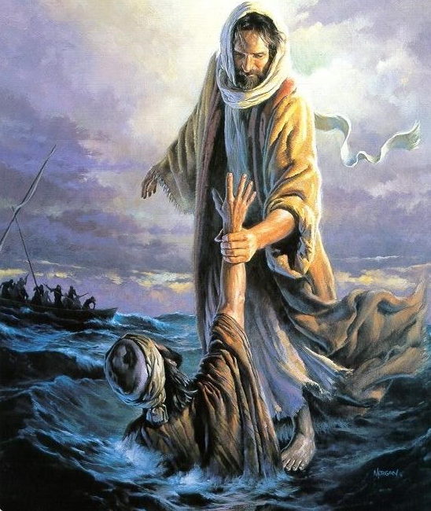
✓
✗
✓
✗
✓
✗
✓
✗
✓
✗
✓
✗
✓
✗
✓
✗
Psalm 18:16 & 144:7
Reveal Answer

Slide 131
Bible Challenge Rules
Single
Double
The game is in a Jeopardy type format which includes: Jeopardy (25 questions), Double Jeopardy (25 questions), and Final Jeopardy (1 question)
Double Jeopardy will only be played in the Semi and Final rounds
In each match a team must have three (3) participants to play, and no more than two (2) alternates per match, No additional substitutions will be allowed during the match
The Bible Challenge host will preside over the game and will make the primary decision. However, only the judges have the authority to overrule the decision if there are discrepancies
Only team captain may approach the host to address concerns about the any discrepancies during the game, if the challenge is overruled by the judges, the team will be penalized an additional 100 points, A maximum of two (2) challenges per match, A challenge is only permitted within thirty (30) seconds of the concluding question
The result of the game will not be changed once the game is over
The VAY-SM Executive Board will make the final decision in an event of a dispute
All recordings of questions and answers are prohibited for participants, coaches, and spectators. This also applies to written notes, or electronic devices including but not limited to the use of video, audio, still-pictures, etc.
No loose-leaf notes permitted during the match

Slide 132
VAY’s Changes to 2016 code
By Bumble in July 2022:
  Reduced fonts, made it 5 columns (by moving the 6th off screen), changed title from “Jeopardy” to “Bible Challege”
  Added JeopardyTheme.mp3, Time-Up.wav to Slide Master Prompt & Final Jeopardy. JeopardyBoardFill.wav sound effect will play when mouse-over the title screen (music files must be in same folder)
  Coded replacement of “~” in Excel import file to new paragraph after “=======“ so that translation could be added easier
  Coded an Audit Trail of scoring on the last slide to support dispute resolution
  Move players 5-8 off screen to make the 4 players version, player 4 off screen to make the 3 players version
July 2023:
  Hanh added “GLA SBC WCC” to the Master Slide 1&2 for Player 1, 2, 3 labels. Note: Replace the content of the text, do NOT delete the TextBox and create new TextBox
  Bumble added Final Jeopardy button in Round 1 Board, Rules button, distributed the music to each slide to make it more suitable for multimedia questions
  Hanh modified Final BC Topic: Change Prompt to Topic, change Response to Final Prompt, add music and Final Answer after the music stops
  Bumble adjusted the Daily Double’s for 5 columns, added check for duplicates

Slide 133
VAY’s Audit Trail (will be wiped by Reset)

