Slide 1
Tooling and benchmarking of a hardware-agnostic compilation toolchain for neutral-atom quantum computers
Emil Khusainov
Adviser: Yanbin Chen
Supervisor: Prof. Dr. Christian B. Mendl
Munich, 04. July 2025
Notes:
My Name, and today I would like to present my Bachelorthesis called "Tooling and benchmarking of a hardware-ahnostic compilation toolchain for neutral-atom quantum computers“
My Adviser is Yanbin Chen and Supervision were by Prof. Mendl

Slide 2
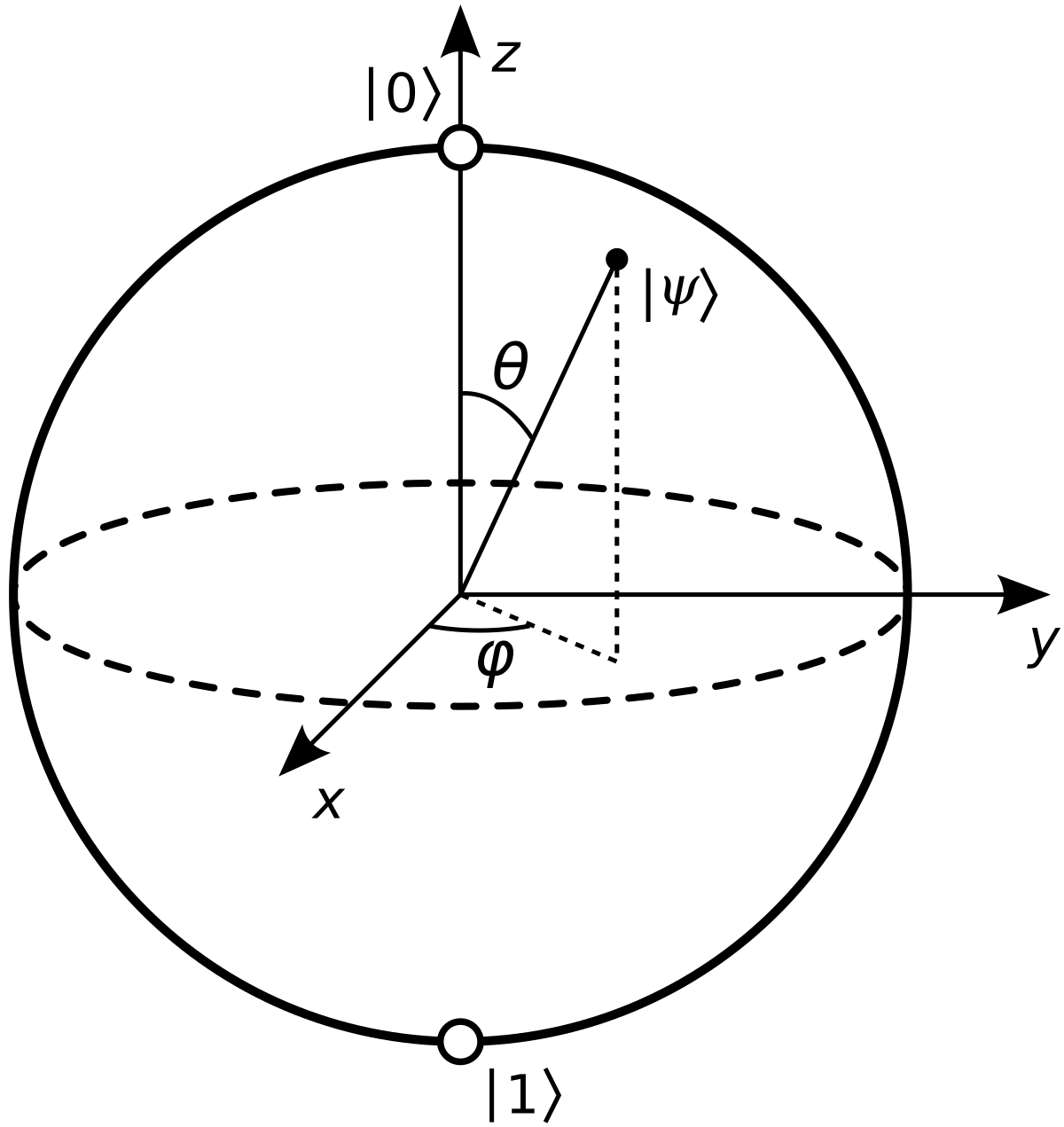
Quantum fundamentals
Qubit as quantum analogue of classical bit, but with superposition of basis states
Possible representation as vector on a Bloch- Sphere
By measurement will collapse in one of the basis state with a certain probability
Key properties: entanglement, no-cloning, superposition, collapse
Notes:
For quantum computations we need quantum analogue of bit called qubit. The main feature of it is superposition and entanglement, what can give an exponential boost in some calculation exercises. An unpleasant features are no-clonning theorem and collapse of state after measuring. Possible representation with a so-called Bloch Vector on Bloch sphere

Slide 3
Quantum hardware architectures
The most popular
Superconducting Qubits
Based on nonlinear LC circuits
QPUs of IBM, Google
Pro:
Fast gates
Easy electronic
Good scalable and designable
Con:
Short coherence time
Necessity in low temperatures
Trapped-Ion Qubits
Based on individual atoms in electomagnetics traps
Used by IonQ
Pro:
Very long coherence times
High fidelity of gates
Con:
Slow gates
Complex system
Notes:
Hardware needed, several possibilities to use specific nature effects to implement, control and interact with qubits.
SuperconductingBig Tech: resonant circuits. Good sides: commercial microwave , good coupling nature.
Bad sides: absolute zero
Trapped IONs: based positive ions and basis states encoded stable electronic levels.
Good sides:
Weak sides: non-trivial scalling due to complex system

Slide 4
Quantum hardware architectures
Currently Emerging
Photonic Qubits
Based on physical states of photons
Pro:
No need in absolute zero temperatures
Low loss transmission in quantum networks
Con:
Probabilistic two-qubit gates
Requires high-quality hardware
Hard scaling
Topological Qubits
Based on non-abelian anions with braiding operations
Hyped Majorana from Microsoft
Pro:
Intrinsic protection against certain errors
Potentially large scalable
Con:
Experimental
Notes:
Some fresh emerging.
Photons implememnts via beam splitters, phase shifters.
Strength sides: room temperature, weak interaction nature -> low decohence , quantum networks
Weak: over 50 scale, calibration
Topological:
Pro: builtin protection

Slide 5
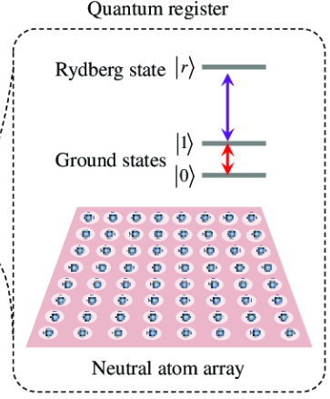
Quantum hardware architectures
Neutral Atom
The most interesting for us now
Based on neutral atoms such as rubidium placed in optical tweezers (SLM)
Hyperfine states of atoms denotes basis states
Rydberg interaction allows CkZ and CZk gates
Rydberg radius => high connectivity
Long coherence time
Raman laser for single rotations
Can be used in DPQA that allows „shuttling“ of qubits in runtime (aka FPDA in classical computing)
Notes:
Laser cooling and microwave pulses to manipulate qubits. Rubidium, Cesium, Strontium placed in optical tweezers. Focused laser SLM.
Rydberg state through Rydberg laser, outermost electron blocks other Rydberg Blockade, so CZ gate is implemented.
Interaction radius bigger => high connectivity and natively multiple C gates (Adv!). Raman frequency, duration, power.
DPQA(Adv!)

Slide 6
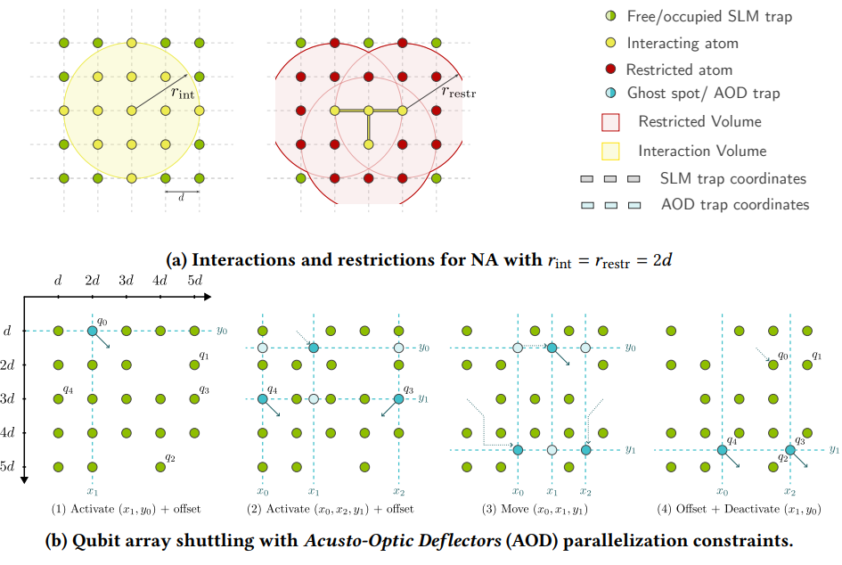
Shuttling
Optical tweezer controlled by SLM, but moveable AOD can take atom from 1 SLM and bring it to another
Notes:
Electromotive Force, alternative SWAP, Rydberg interaction foto, we have interaction radius => high connectivity and multiqubits, and then restriction

Slide 7
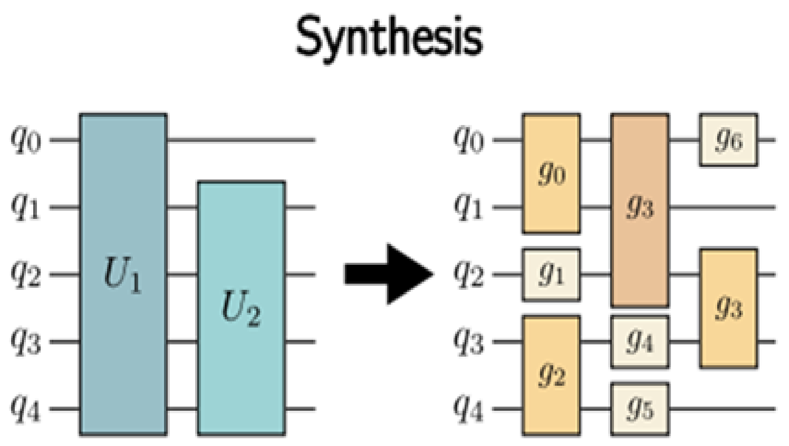
Compilation of quantum circuits
Synthesis
Goal is to transpile a quantum computation into native gate set of the target hardware
By Neutral Atoms target gate set can be wide
Possible Algorithms:
KAK-decomposition
Euler-decomposition
Notes:
To work with architecture and consider advantage compiler is needed. Compiler consists in different steps and toolchains.
First step is .

Slide 8
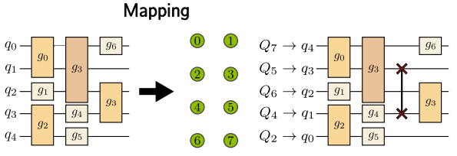
Compilation of quantum circuits
Mapping
Goal is to insert SWAP gates so that all connection between qubits fullified for next gate
Here DPQA Shuttling gives another possibilities for mapping but makes it harder
Interaction radius
Used Algorithms:
SABRE
A*
Notes:
Lose a connectivity problem to make execution possible. To take advantage complexer compiler needed. Mention that all steps are abstract, different compilers different sence , e.g. some counting a placement and optimization also to mapping

Slide 9
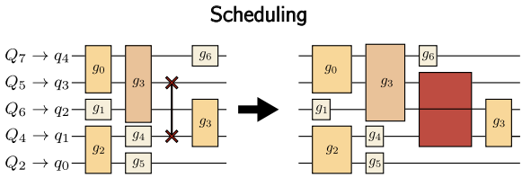
Compilation of quantum circuits
Scheduling
Goal is to determine which gate should be executed next according to hardware restrictions such as number of lasers, their times, crossing paths
Possible Alorithms:
ASAP
ILP

Slide 10
Considered Compilers
HybridMapper from MQT
Doesn't have synthesis step, but gets all possible gates with Architecture file, Synthesis is done independently preprocessing via Qiskit
Uses cost function to determine whether to use SWAP or Shuttling
Has only mapping and scheduling steps, no circuit optimization
Notes:
Our compiler. Correlate gate with specified architecture, it is ist feature, other considered not doing so. Feature a hybridapproach also tries to look ahead.

Slide 11
Considered Compilers
Enola
Shuttling only algorithm
Tries to create a steps where each step has an array where each pair is mutual independent (MIS)
Doesn't consider number of AODs
Built-in synthesis using QisKit
Doesn't consider fidelity of 1 qubits gates
Has a lot of mismatches -> Later
Notes:
Unlike HM only shuttling. Synthesis in rotations and CZ that means no CZ. Maximalis Independent Set

Slide 12
Considered Compilers
DasAtom
Based on Enola and Tetris
Tries to make an independent circuits to minimize Depth (DAC)
Also completely SWAP-Free
Same synthesis as by Enola
Doesn't consider fidelity of 1 qubit gates
Promises an exponential fidelity outperform over Enola (QFT30 414 Times)
Notes:
Divide And Conquer approach. And then connect this subcircuits.

Slide 13
Testing

Slide 14
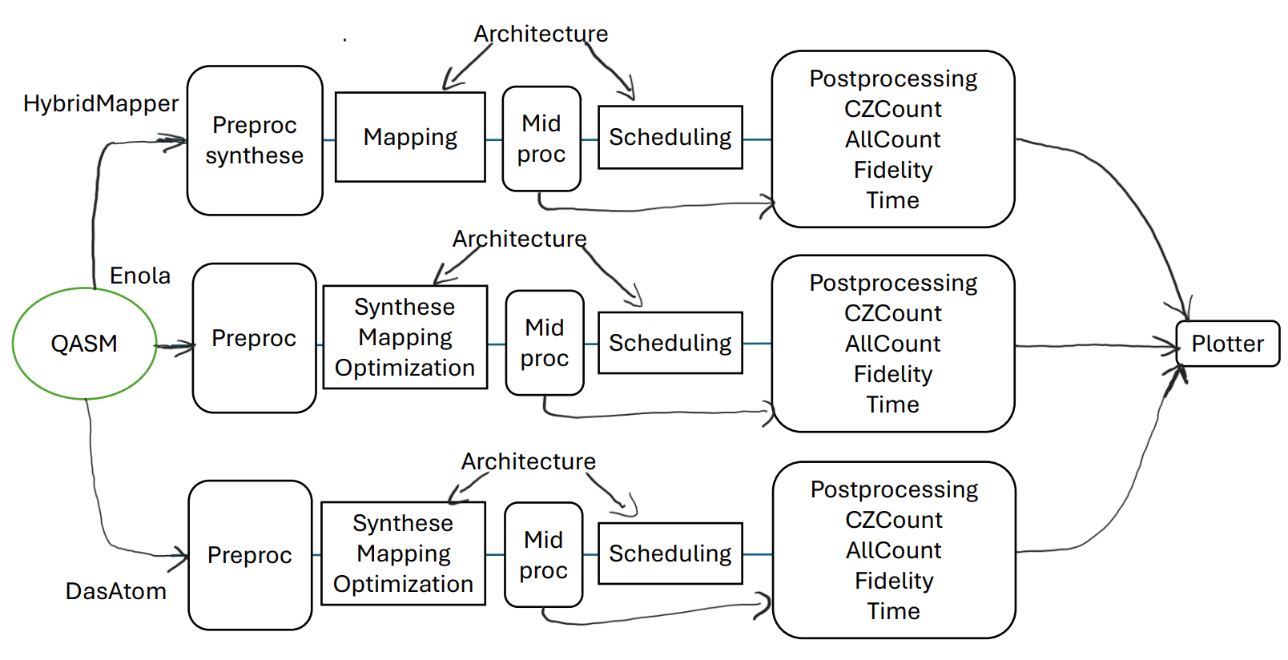
Testing
Simplified Execution Flow
Notes:
Python script for QASM circuits and manages all tool chains since they have differend workflow, inout and output. Thats why non-trivial pre, mid ,pro needed to collect relevant data in simillar form and to take architecture definitions as close as possible. Result metrics. And then plotting a graphs

Slide 15
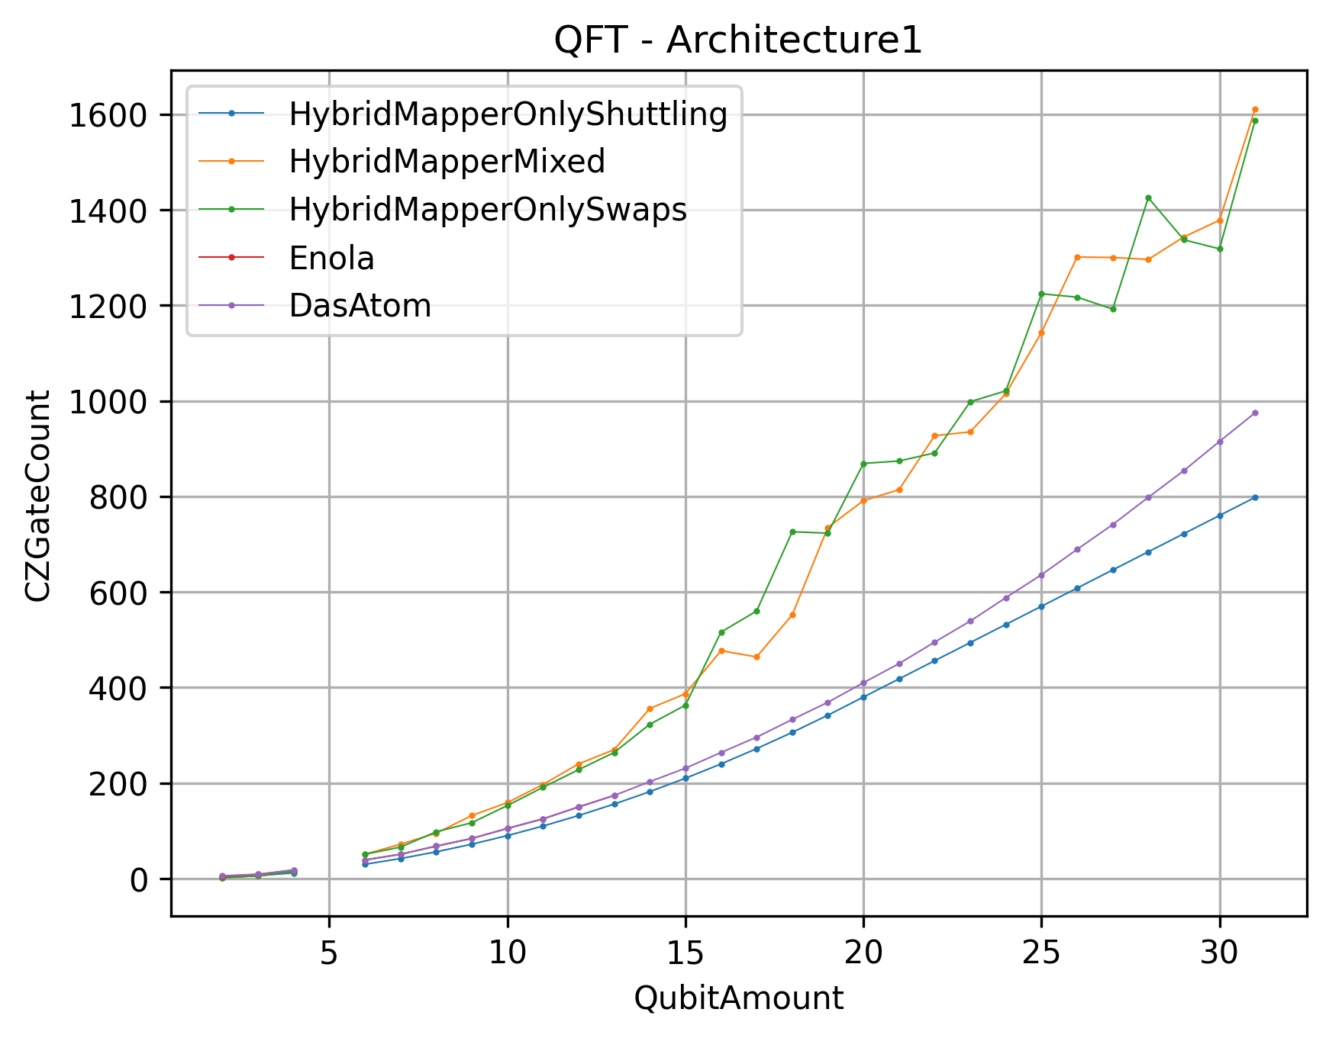
Testing
Interpretation of results
Quantum Fourier Transformation Algorithm 2- 30 Qubits, CZ gate Count
Swap based mapping adds a lot of CZ gates
Enola and DasAtom used the same amount of CZ gates and consider it in fidelity
HybridMapper Shuttling-Only gate count is the best
Notes:
QFT cuz QFT often in corresponding papers.

Slide 16
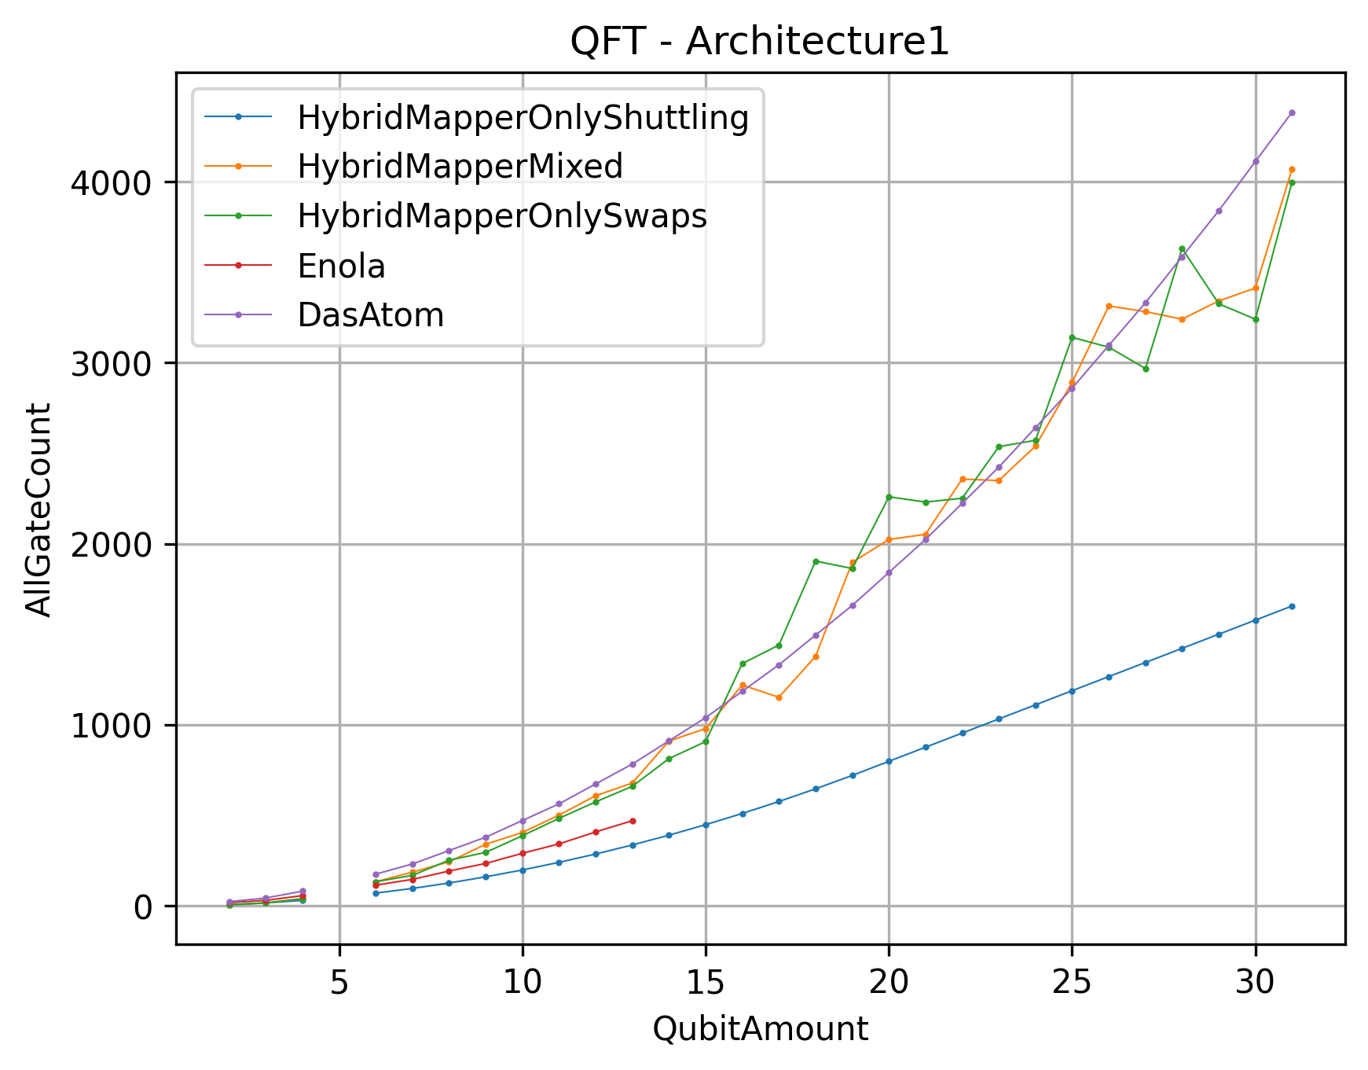
Testing
Interpretation of results
Quantum Fourier Transformation Algorithm 2- 30 Qubits, All gate Count
HybridMapper Shuttling-Only gate count is still the best
DasAtom uses much more gates than Enola
Recap: Enola and DasAtom doesn't consider fidelity of single qubit gates => not fair
Notes:
Recap CZ same, but different single and not consider., Recap DasAtom states exponentially outperform and at the same time not consider it weak sides. Strange and unfair.

Slide 17
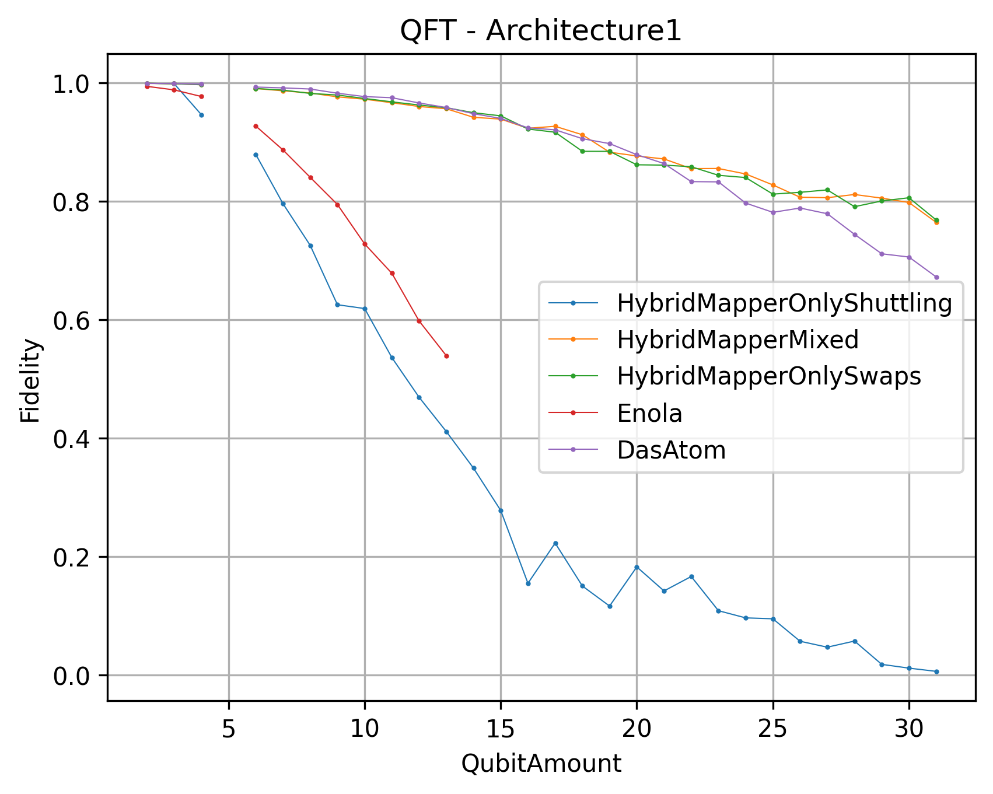
Testing
Interpretation of results
Quantum Fourier Transformation Algorithm 2- 30 Qubits, Fidelity
Enola and HybridMapper in Shuttling fall fast.
At QFT30 Enola has fidelity of 0.00089
Nevertheless, DasAtom has 800 times higher than Enola
DasAtom states 414x better than Enola
Not accurate results but indicative
Notes:
Enola smaller 1 tenth of a percent. Strange behaviour since circuits not very large and complex.

Slide 18
Testing
Example Outputs Enola&DasAtom
Metric/Compiler | Enola | DasAtom
Circuit | qft_indep_qiskit_30.qasm | qft_indep_qiskit_30.qasm
Fidelity Overall | 0.0008991 | 0.7060
Fid. Movement | 0.69376 | 0.9934373
Fid. Coherence | 0.00154 | 0.81603
Gate Count | 2370 | 4111
CZ Gates | 915 | 915
Fid. 1Q | 1(-) | 1(-)
Compile Time s | 14251 | 2.5
Notes:
Try to get insight into the nature of sich discrepancies with exlplicity output for QFT30.
Fidelity different. Fidelity of movement diff but should not be so diff in similar architecture and mid-size-circuit.
Same regarding coherence time, drastically difference.
Single gate in future 0.9999 => 0.8 fid for 2000 gates.
Compile Time

Slide 19
Questions and assumptions
1 qubit gate Fidelity impact?
Why does DasAtom outperform Enola exponentially? Why is there a huge difference between fidelity components?
Arising assumption: Check the used metrics system, unify and fix it if something.
Notes:
It begs question, what impact 1QG.
What is a reason for such outperforming of DasAtom over Enola.
Lets try to find out why and fix that when something.

Slide 20
Equalization
Notes:
Firstly, impact of single qubit gates were added in both tool chains. Bu just powering fidelity of 1 to gate count.

Slide 21
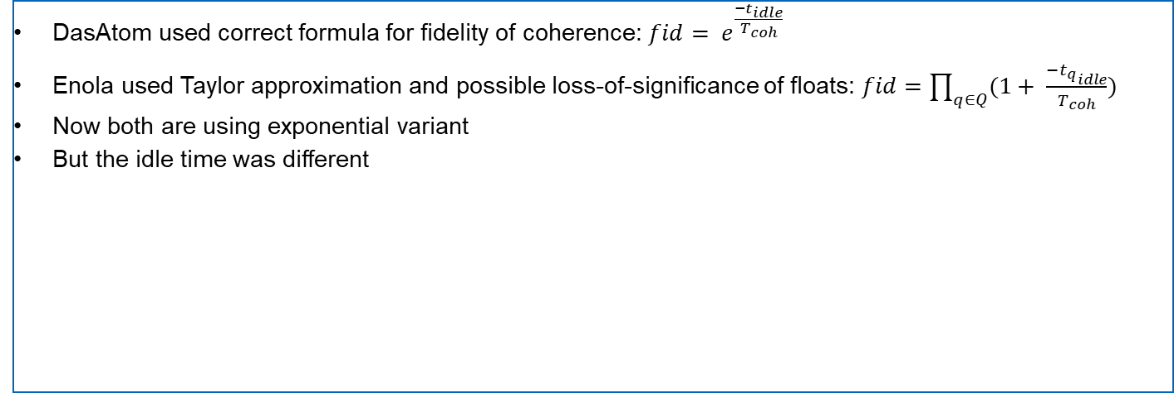
Equalization
Comparing of calculations
Source of coherence fidelity discrepancies
DasAtom used correct formula for fidelity of coherence: $fid= e^{\frac{−t_{idle}}{T_{coh}}}$
Enola used Taylor approximation and possible loss-of-significance of floats: $fid=\prod_{q∈Q}{(1}+ \frac{{−t_{q}}_{idle}}{T_{coh}})$
Now both are using exponential variant
But the idle time was different
Notes:
first order but expanded to single qubits. But this approach can cause a round errors of float and E isnt very expensive op to avoid it,

Slide 22
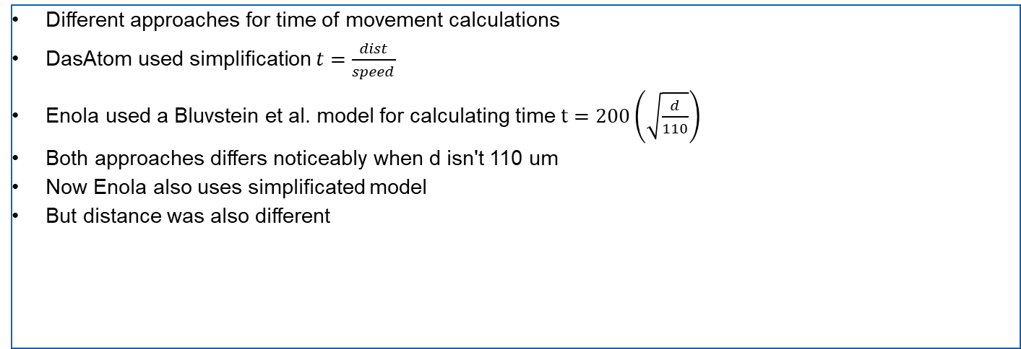
Equalization
Comparing of calculations
Source of time discrepancies
Different approaches for time of movement calculations
DasAtom used simplification $t=\frac{dist}{speed}$
Enola used a Bluvstein et al. model for calculating time $t=200\left(\sqrt{\frac{d}{110}}\right)$
Both approaches differs noticeably when d isn't 110 um
Now Enola also uses simplificated model
But distance was also different
Notes:
By searching in code source of discrepnacies. Idle time is calculated by both during shuttling.linear dependency. Adjusted to speed 55 and average dist 110.
Purpose acceleration and slowdown. deviation of distances ill-conditioned

Slide 23
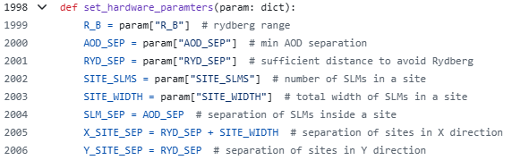
Equalization
Comparing of calculations
Source of idle distance discrepancies
DasAtom distance calculation was fine and made sense
Enola also…
However, Enola doesn't consider transmitted Architecture parameters on mapping step
The problem was an incorrectly implemented transfer of global parameters
Notes:
In DasAtom nothing suspicious was found. The calculation was correct and obviously. Enola calculated simillar and correct but the result were different.
After debugging error was consideration of new arch. Enola doesnt setted it. But in simulations step yes, thats why from outer seems that set. Now evertyhing after adding global works as expected

Slide 24
Final testing

Slide 25
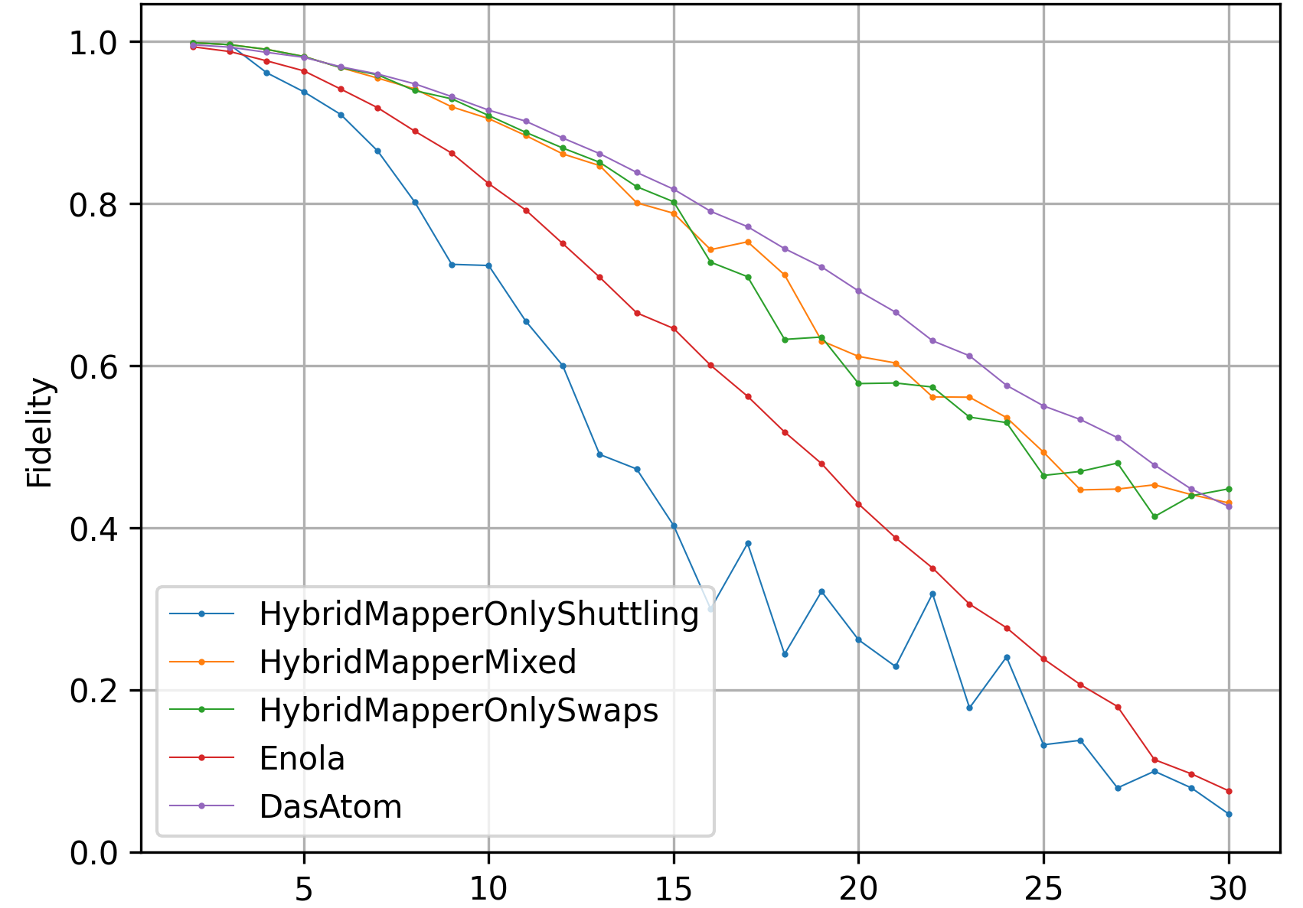
Final testing
Interpretation of results
Quantum Fourier Transformation Algorithm 2- 30 Qubits, Fidelity
Added 1QG fid., correct coherence time and distance, architecture parsing and minor simplifications
Clear differences observed
E.g. Enola has only 5.5 times lower fidelity than DasAtom
Nevertheless, there were a few more fidelity sources that Enola considered, but they weren't turned off
Notes:
To Recap, das atom states a 414 times higher fidelity. And also there are no prerequisites for an exponential difference..

Slide 26
Literature
[1] BlockSphere
[2] SLMArray
[3] Hybrid Circuit Mapping
[4] Compiler Development Neutral Atoms
[5] Enola
[6] DasAtom
[7] Bluvstein
[8] GitHub

Slide 27
Thanks for your attention

