Slide 1


Spatial Sigma-Delta ADC for Massive MIMO Applications
Team Members:
M. Dawood Asghar (Lead)
Mudassir Ali
Jafar Hussain
Supervisor:
Dr. Rashad Ramzan
Dr. Hassan Saif
National University of Computer and Emerging Sciences (FAST-NU),
A.K. Brohi Road, H-11/4, Islamabad-44000, Pakistan
Talha bin Azmat
Sonia Kiran
M. Usman

Slide 2
Contents
Work Distribution
1st Order ∑Δ Modulator Xschem Model
Design and results of Sub-Blocks
Testing Plan
Results
Required Area & Pads
Layout Progress
Timeline
Conclusion

Slide 3
Hierarchy of Work Distribution
Sr. # | Task | Done by:
1 | Schematics of sub-circuits | Dawood Asghar Talha Bin Azmat Jafar Hussain Muhammad Usman
2 | Top Level Schematic for 4th order model
3 | Digital FIR Filter Design
4 | SNR, THD Testing using MATLAB
5 | Dummy Schematic/ Layout (LVS & DRC)
6 | Pre-Checks | Mudassir Ali Sonia nKiran
7 | FFT Analysis using NGSPICE

Slide 4
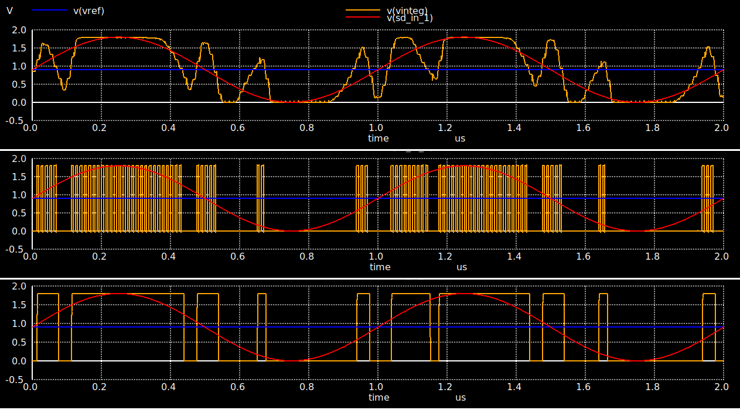
Implementation of First Order ∑Δ Model

Slide 5
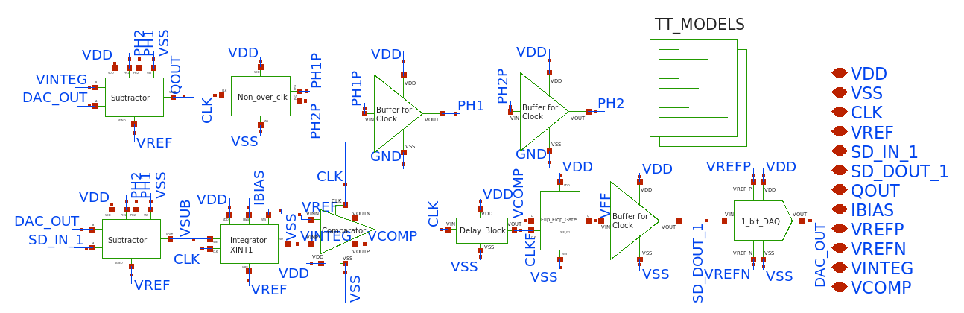
First Order ∑Δ Modulator Xschem Model

Slide 6
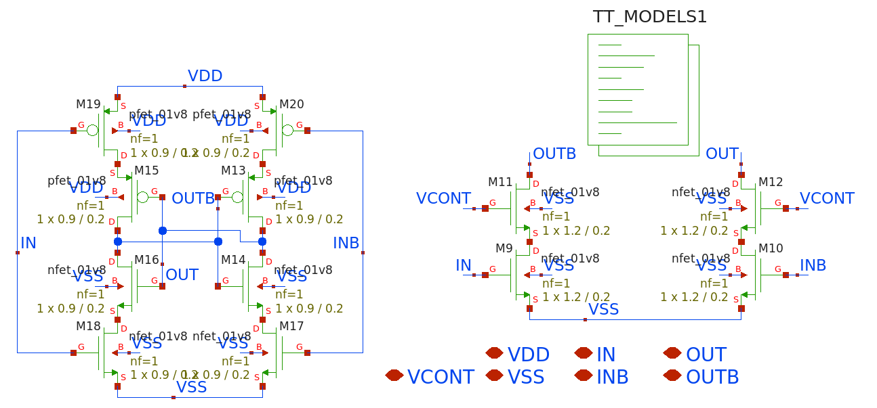
Delay Block for VCO

Slide 7
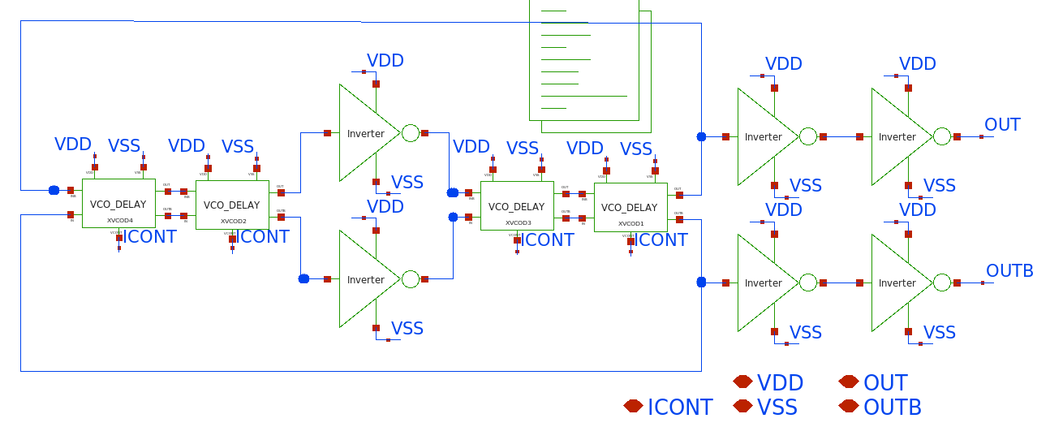
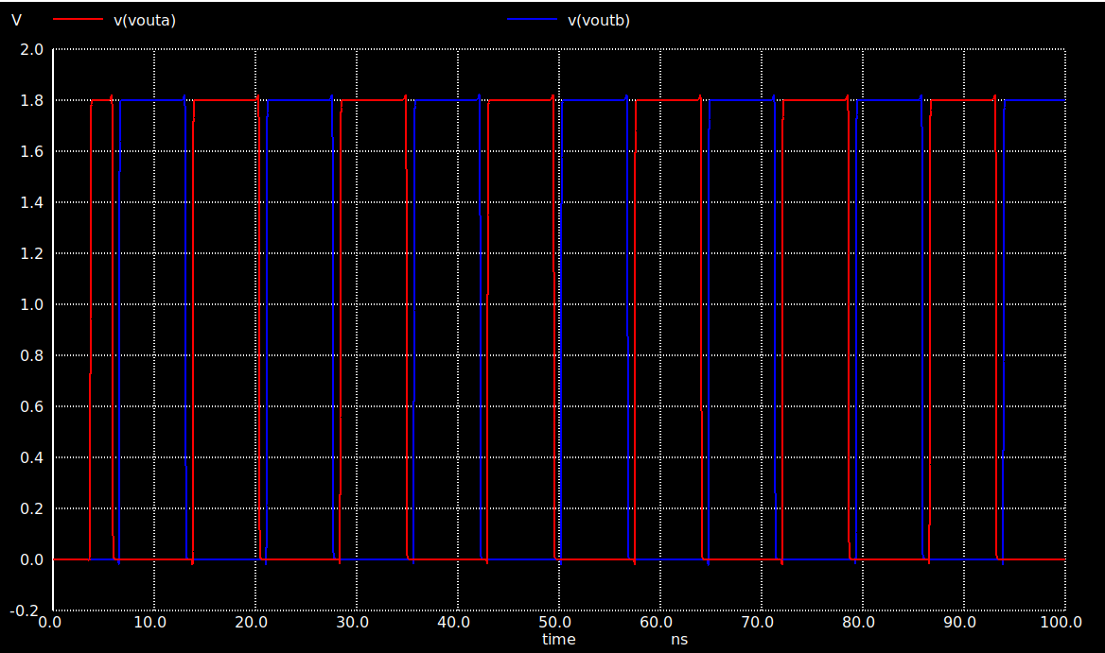
Voltage Controlled Oscillator (VCO)

Slide 8
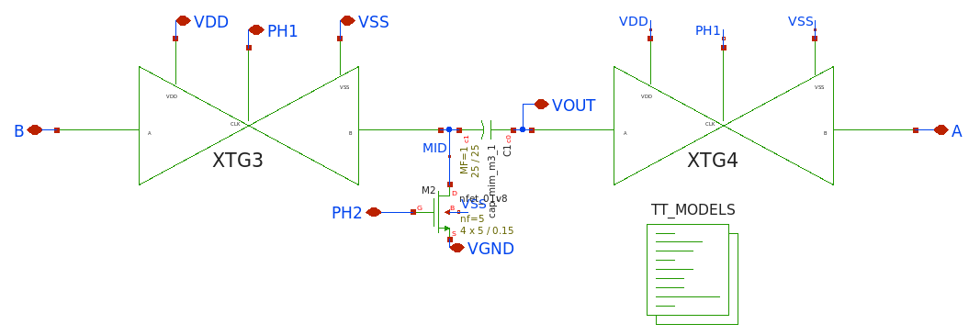
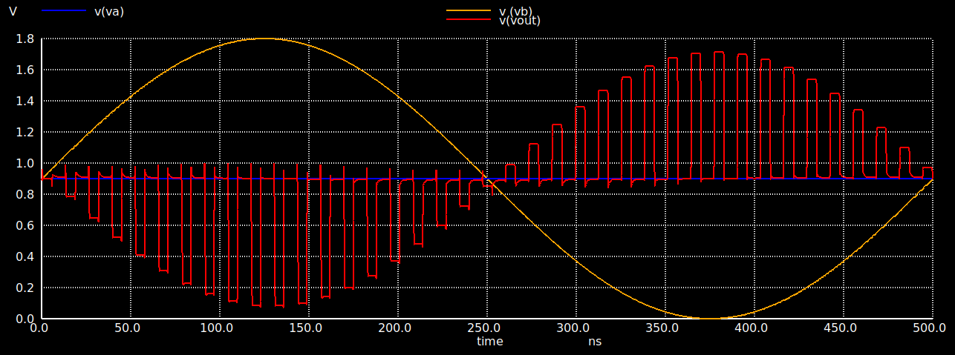
Subtractor Block

Slide 9
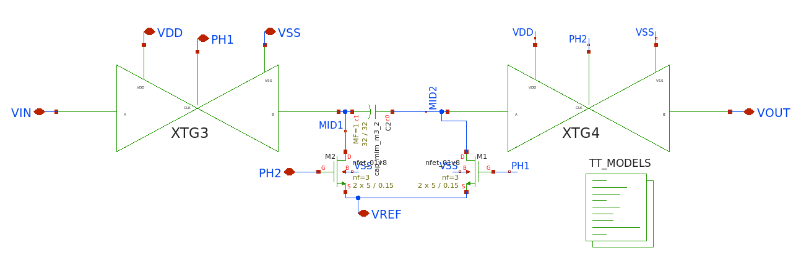
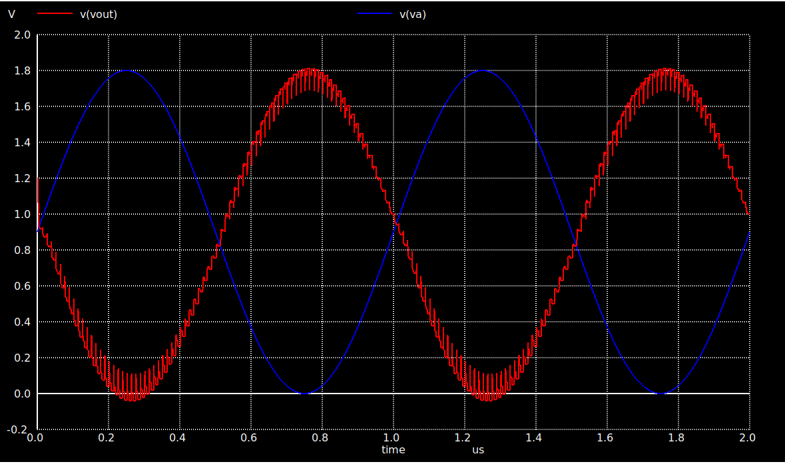
Switch-Cap. Resistor

Slide 10
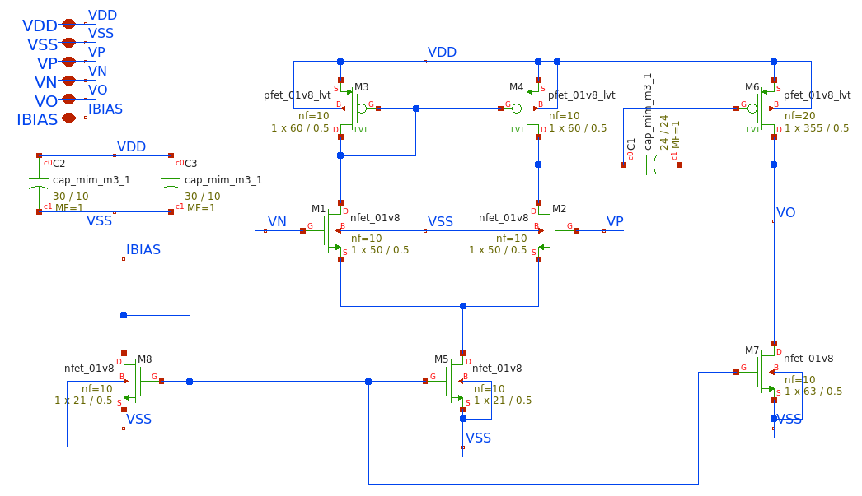
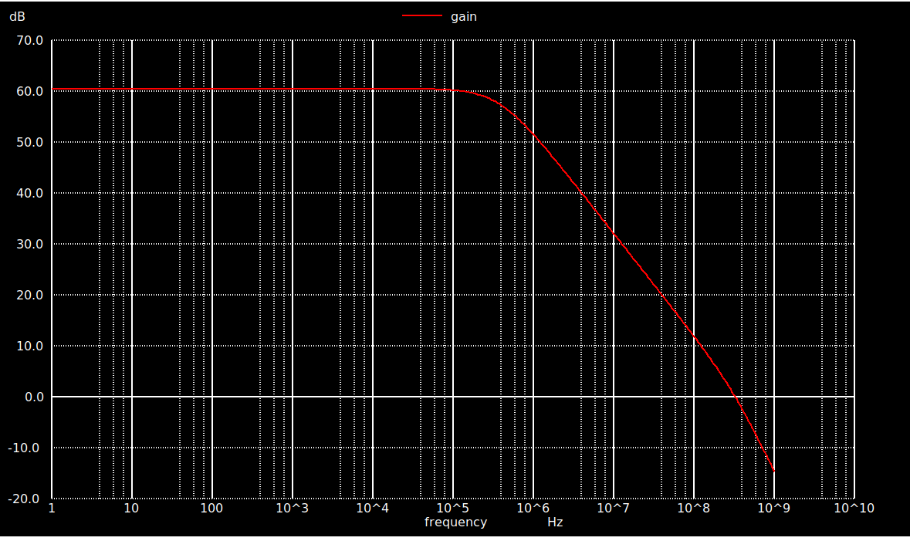
Operational Amplifier
Sr. # | Specs | Value
1 | Gain | 63 dB
2 | Phase Margin | > 60 Degrees
3 | GBW | 2.5e6

Slide 11
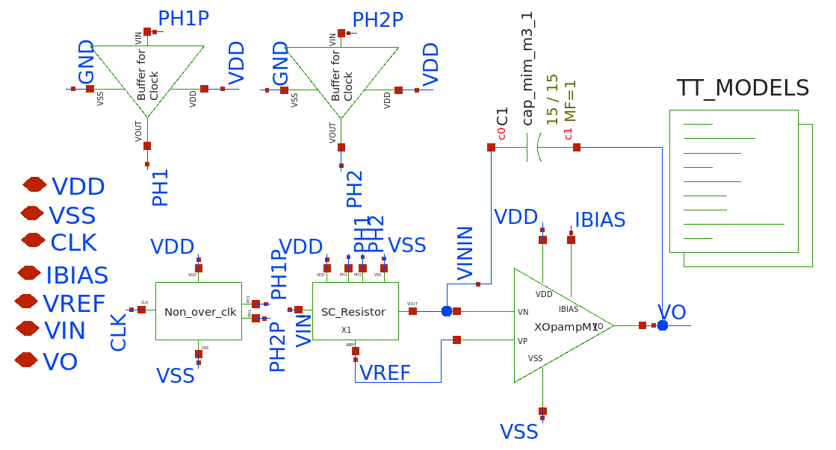
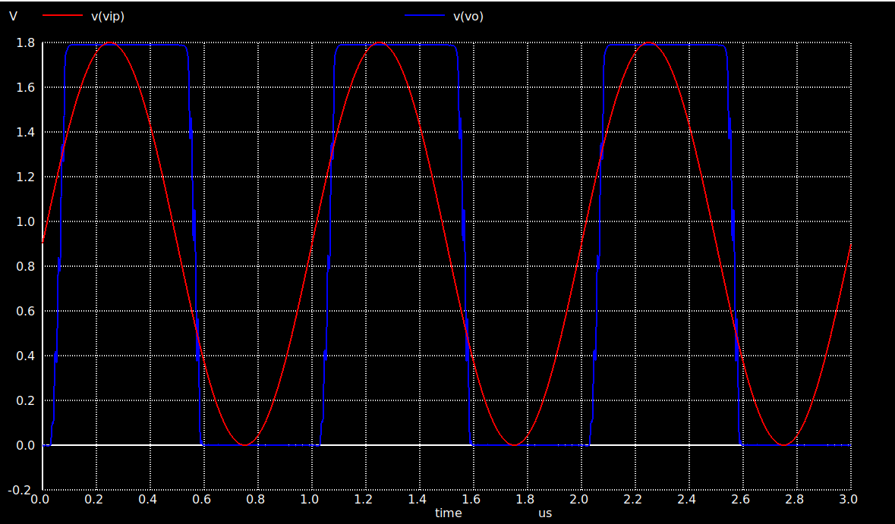
Integrator

Slide 12
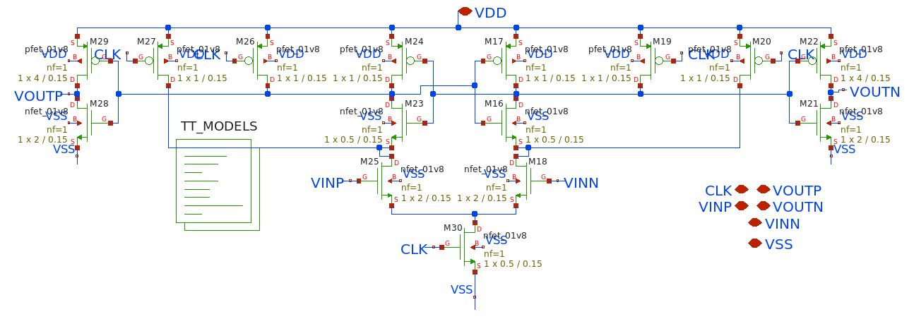
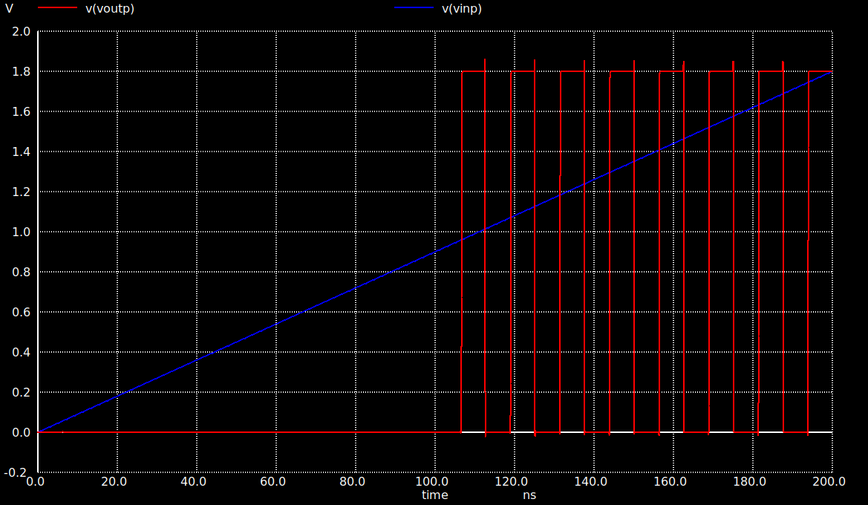
Dynamic Comparator

Slide 13
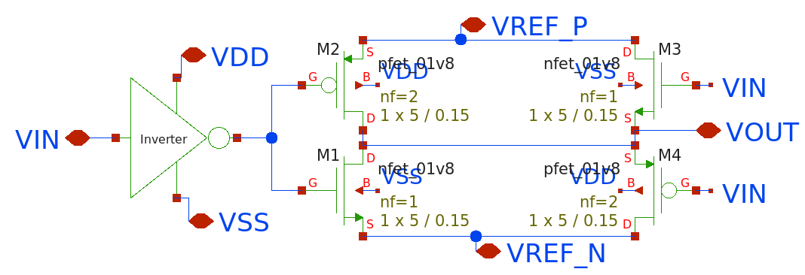
1-Bit DAC

Slide 14
Testing Plan
Xschem results are exported to MATLAB in the form of .csv file
FIR Digital Filter is also implemented on MATLAB using DSP Toolbox to filter out the noise
After filtration THD, SNR, and SFDR is calculated using MATLAB built in Functions
Digital FIR Filter will be realized using MATLAB’s FPGA-in-Loop to test the ADC Chip’s Digital Output

Slide 15
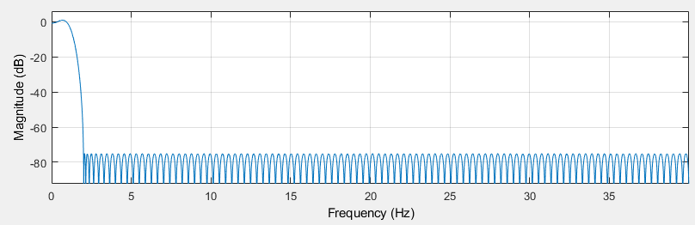
FIR Filter Design
We have designed a Digital FIR Equiripple Filter with the help of FDAtool
Specifications:
Fpass= 1MHz
Fstop= 2MHz
Fs= 80MHz
Order= 203

Slide 16
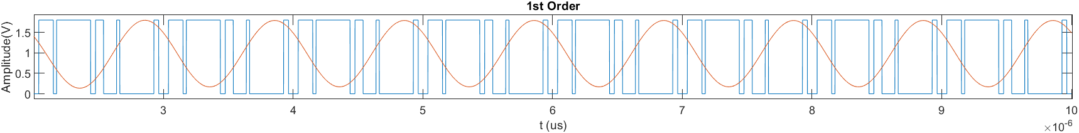
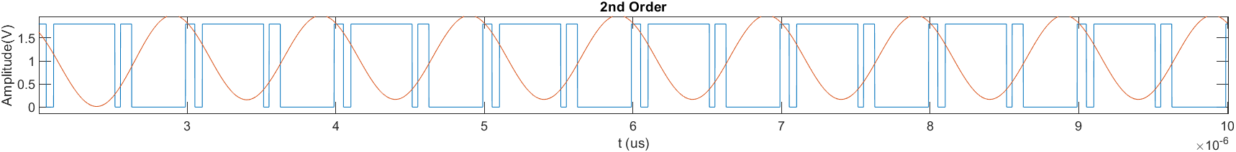
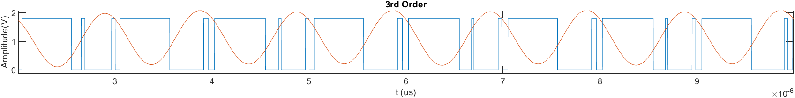
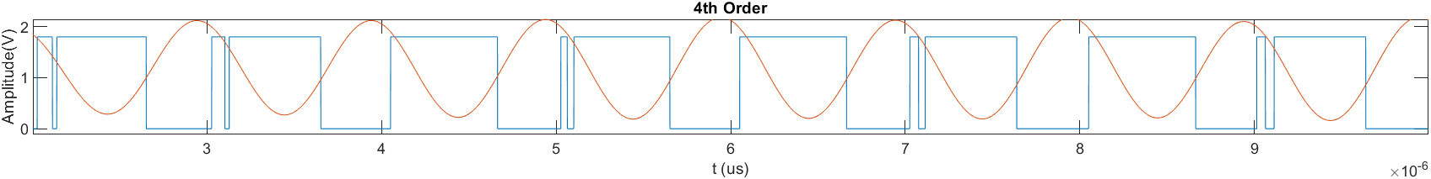
Modulated vs Filtered Signal

Slide 17
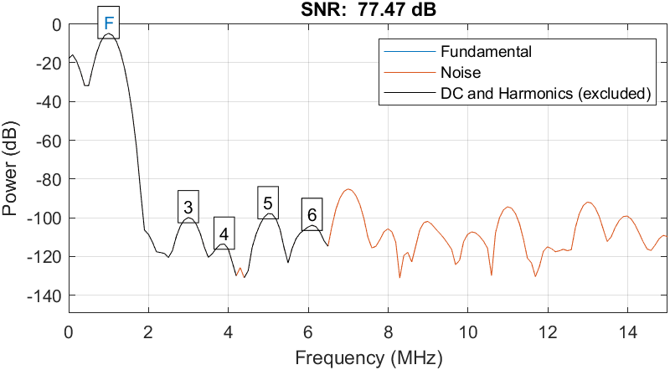
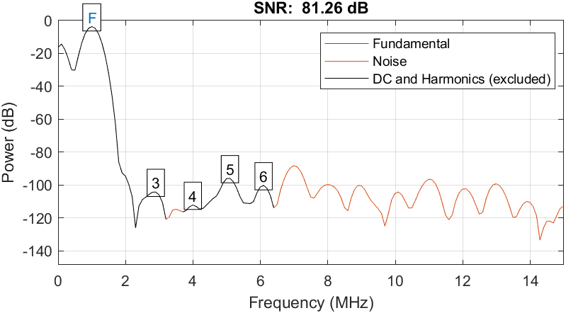
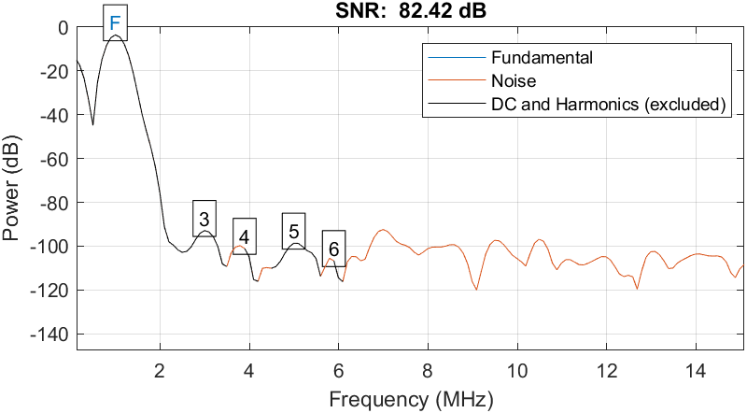
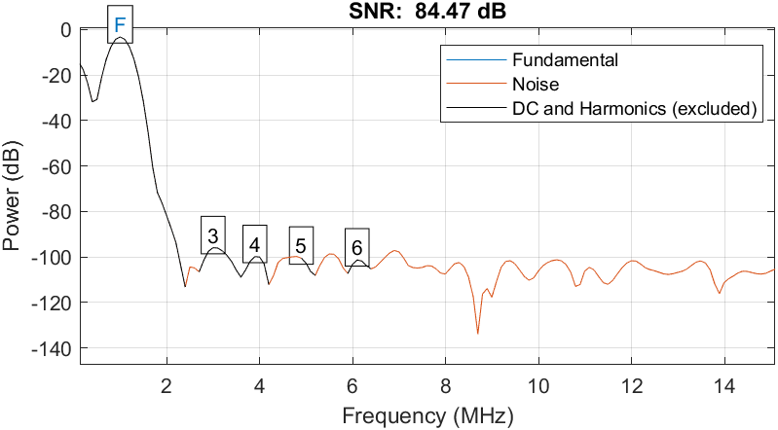
Signal to Noise & Distortion Ratio
| ENOB: 12.6
| ENOB: 13.2
1st Order
2nd Order
| ENOB: 13.4
| ENOB: 13.7
3rd Order
4th Order

Slide 18
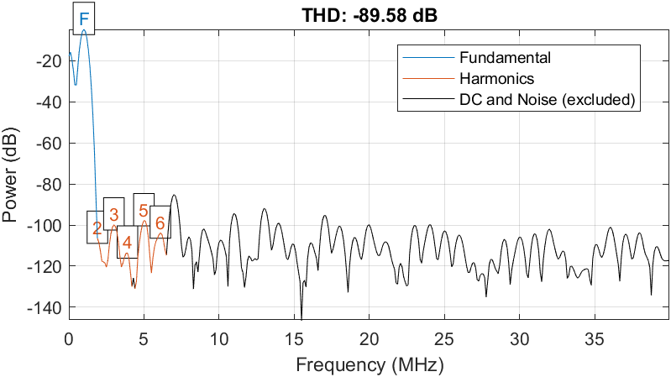
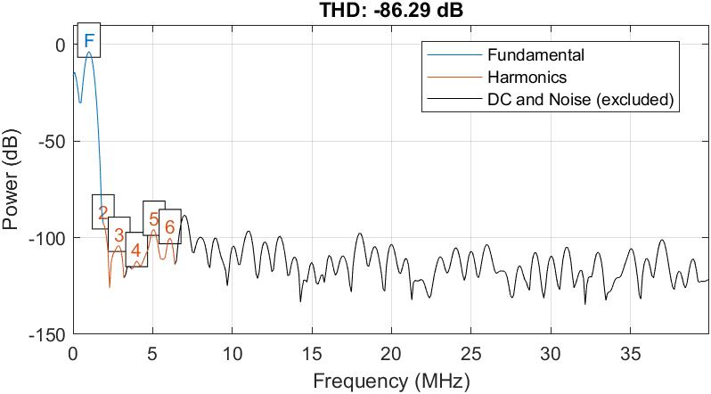
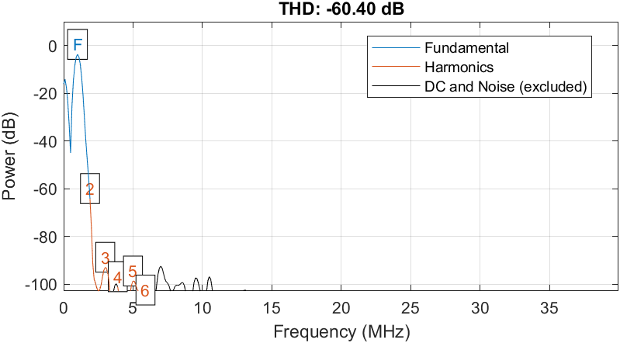
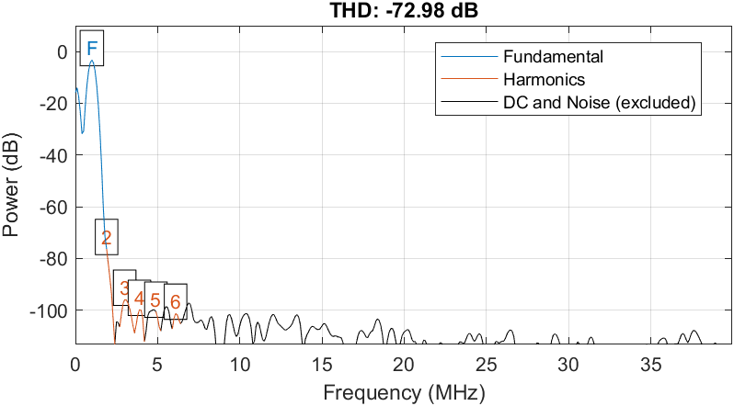
Total Harmonic Distortion
| 0.003 %
| 0.005 %
1st Order
1st Order
2nd Order
| 0.095 %
| 0.022 %
3rd Order
4th Order

Slide 19
Estimated Area & Pad Counts
< 1.5mm
Estimated Area < 1mm x 1.5mm
Test Points = 3
“We are trying to Reduce our Pad Requirement for Top-Level Integration”
< 1mm
Pad Count = 21
Power | Digital I/O | Analog I/O
2 | 8 | 11

Slide 20
Layout Progress
Learnt how to layout on MAGIC (OS EDA Tool) by laying out Dummy Circuit for Pre-Checks.
Clean DRC & LVS (using NETGEN)

Slide 21
Comparison with the State of the Art
Parameter | State of the Art |  |  | This Work
Model | First Order Spatial |  |  | First Order Spatial
OUTPUT | OUT1 | OUT2 | OUT3 | OUT1 | OUT2 | OUT3 | OUT4
fi (MHZ) | 1 | 1 | 1 | 1 | 1 | 1 | 1
fs (MHz) | 80 | 80 | 80 | 80 | 80 | 80 | 80
THD% | 0.83 | 0.01 | 0.15 | 0.003 | 0.005 | 0.095 | 0.022
SNDR(dB) | 57.78 | 66.6 | 67 | 77.47 | 81.26 | 82.42 | 84.47
OSR | 40 | 40 | 40 | 40 | 40 | 40 | 40

Slide 22
Timeline
Month | Goal
Jun, 2022 | Schematic Sub-Blocks Design using Xschem
Jul, 2022 | Top Level Schematic Design using Xschem
Aug, 2022 | Iterative Testing using Using MATLAB
Sep, 2022 | Layout Design using MAGIC
Oct, 2022 | Post Layout Verification/Top Level integration

Slide 23
Conclusion
We have proposed a 4th order Spatial Sigma-Delta (∑Δ) ADC for MMIMO 5G applications with a bandwidth requirement of 2 MHz.
The proposed design operates at oversampling ratio (OSR) of 40.
It provides SNDR of more than 77.4dB.
The implementation on 150nm process utilizes an active area of less than 1.5 mm².
The proposed design is inspired from mathematical modeling presented in MMIMO channel estimation using low resolution ∑Δ ADCs, published in IEEE Access [1].
3

Slide 24
Thank You!
Questions?

