Slide 1
Parallelizing a Neural Network
CS-6A
High Performance Computing
Muhammad Taha 22i-0983
Ibrahim Awais 22i-0878
Rahat Shafi 22i-1061

Slide 2
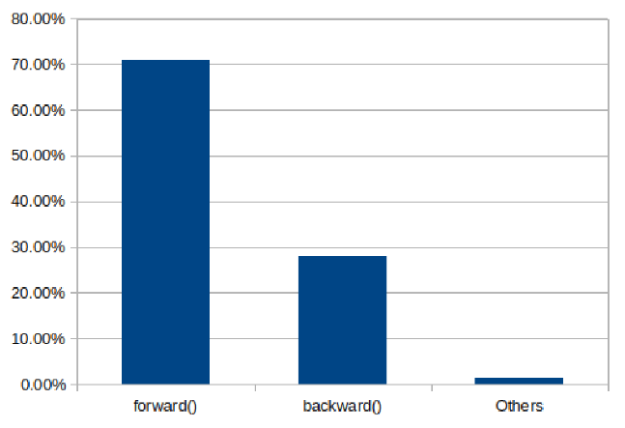
V1: Sequential
Baseline version provided
Simple CPU Implementation
Used for performance comparison with other versions

Slide 3
V2: Naïve Parallelization
Used CUDA to parallelize forward / backward passes, layers of NN
Allocated and freed GPU memory for each image
Ran separate GPU kernels for every image
Did not provide a speedup over the CPU

Slide 4
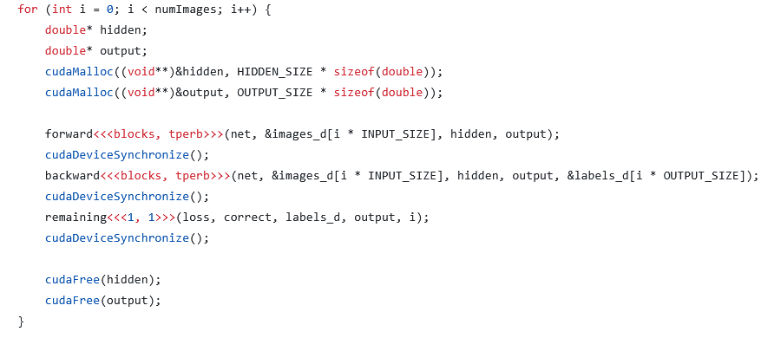
V2: Naïve Parallelization
Frequent memory allocation overhead
Images not processed in batches
Kernel launch overhead

Slide 5
V2: Attempt 2
Uses float instead of double, halves data size doubles memory‐bandwidth & compute throughput.
Parallelizes softmax/sum calculation to be on all threads
Modular kernels for activation, forward and backward passes
No shared memory / atomics, Compiler optimization wins: Simple kernels unlock more ILP and inlining vs. one monolithic kernel.

Slide 6
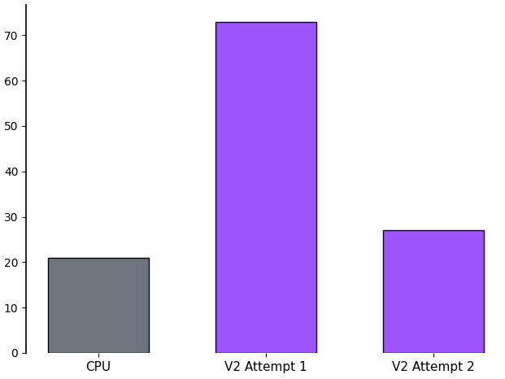
V2: Results
Still not better than sequential!

Slide 7
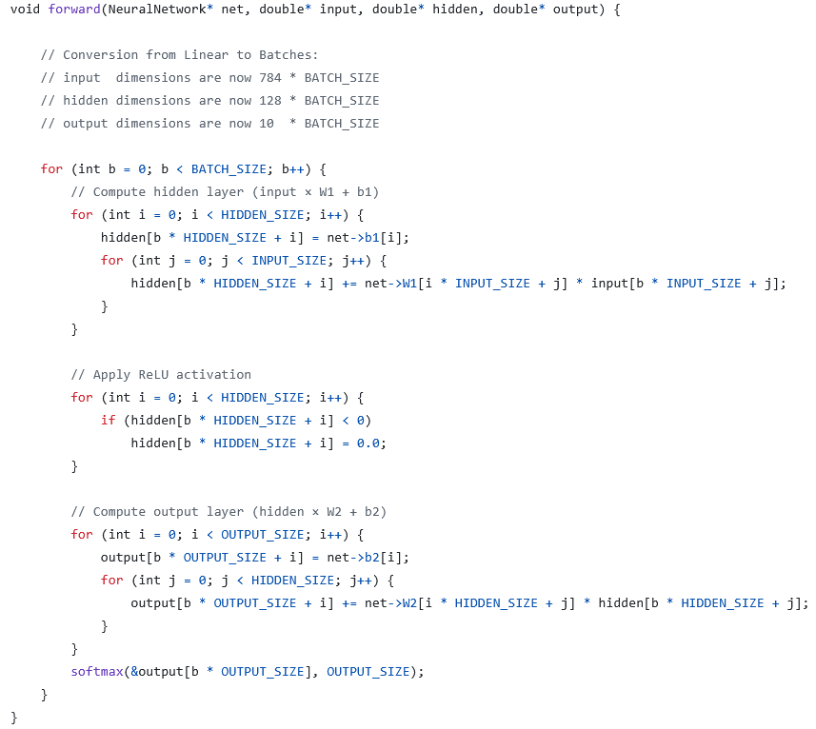
V3: Sequential Changes
Code changed to loop over Batch Sizes
Easier to parallelize
Core logic remains unchanged
Results are the same
Still single-threaded

Slide 8
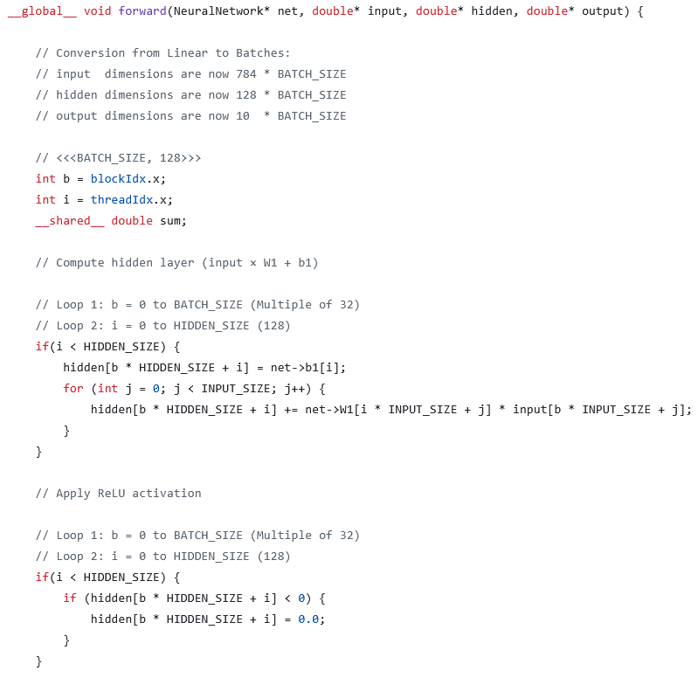
V3: GPU Parallelized

Slide 9
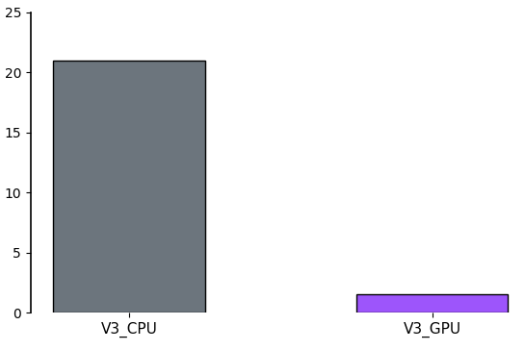
V3: Results
14x Speedup!
0.5s / Epoch

Slide 10
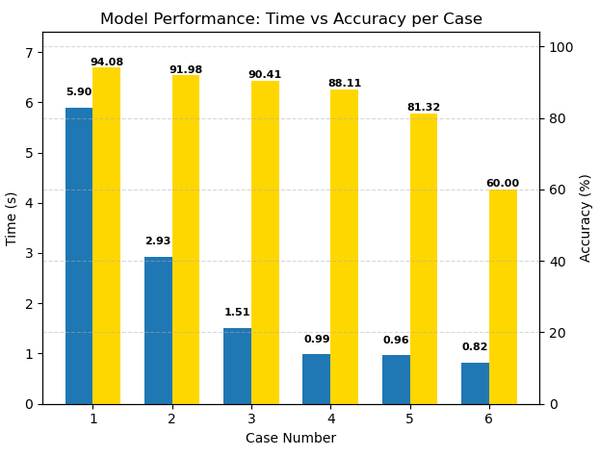
But at a cost.

Slide 11
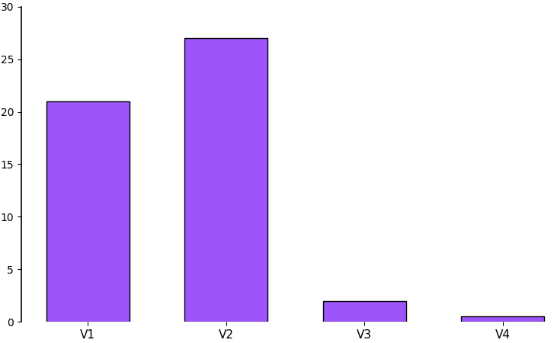
V4: Tensor Core Optimization
Built upon V3 optimizations.
Utilized Tensor Cores for matrix operations
Using __half (16-bit floating point) data types which alone gave 35% speedup over V3
WMMA could be used to further accelerate matrix operations and achieve 3-6x speedup over V3 (42-84x speedup overall)

Slide 12
V5: OpenACC Implementation
Implemented mini-batch training (batch size > 1) for better GPU utilization.
Used OpenACC parallel loop and collapse directives to parallelize matrix operations across batches
Kept weights, activations, gradients on the device to minimize data transfer
Parallelized both forward and backward passes, and every function that iterates over BATCH_SIZE

Slide 13
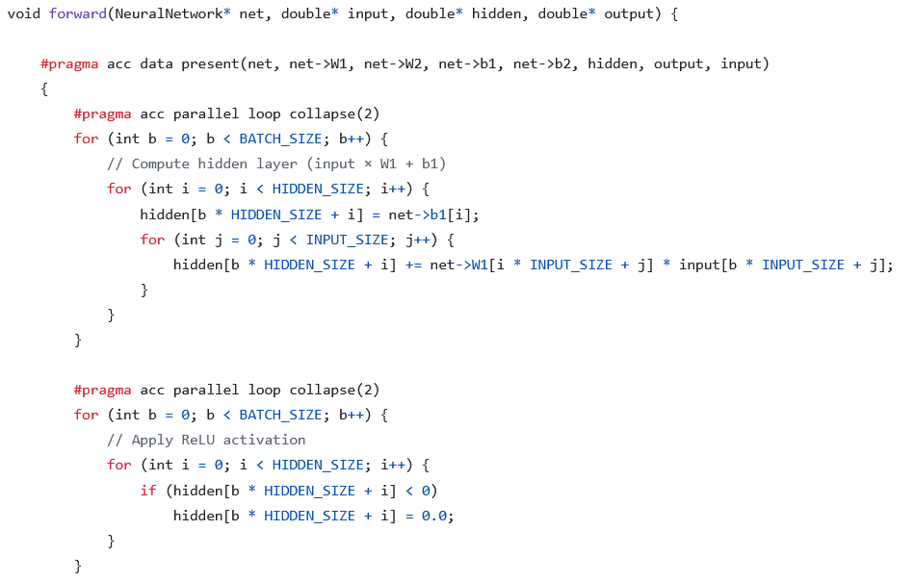
V5: OpenACC Implementation
data present clause ensures data stays on the GPU.
collapse(2) clause parallelizes both the batch and neuron loops.
GPU processes an entire mini-batch in parallel, giving a speedup
Same directives applied for all other loops

Slide 14
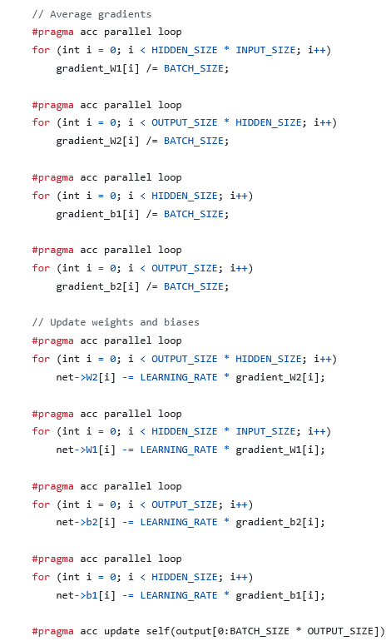
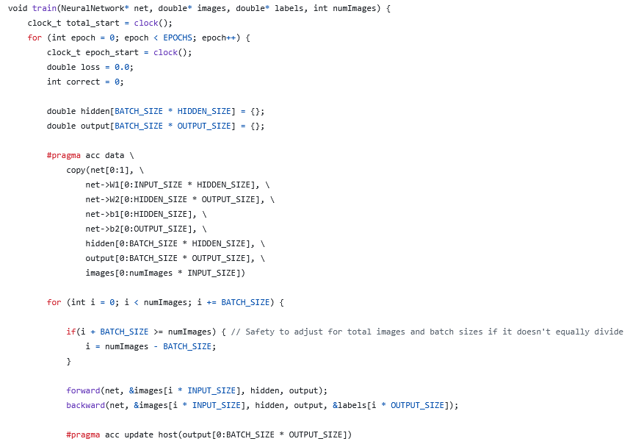
V5: OpenACC Implementation

Slide 15
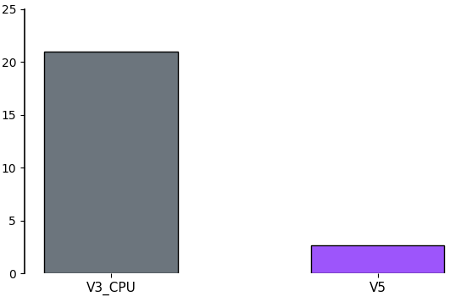
V5: OpenACC Implementation
Parallelized version of Sequential V3
8x speedup!
Not as efficient as V3 GPU: abstraction, kernel fusion, granularity

Slide 16

Thank You!

