Slide 1

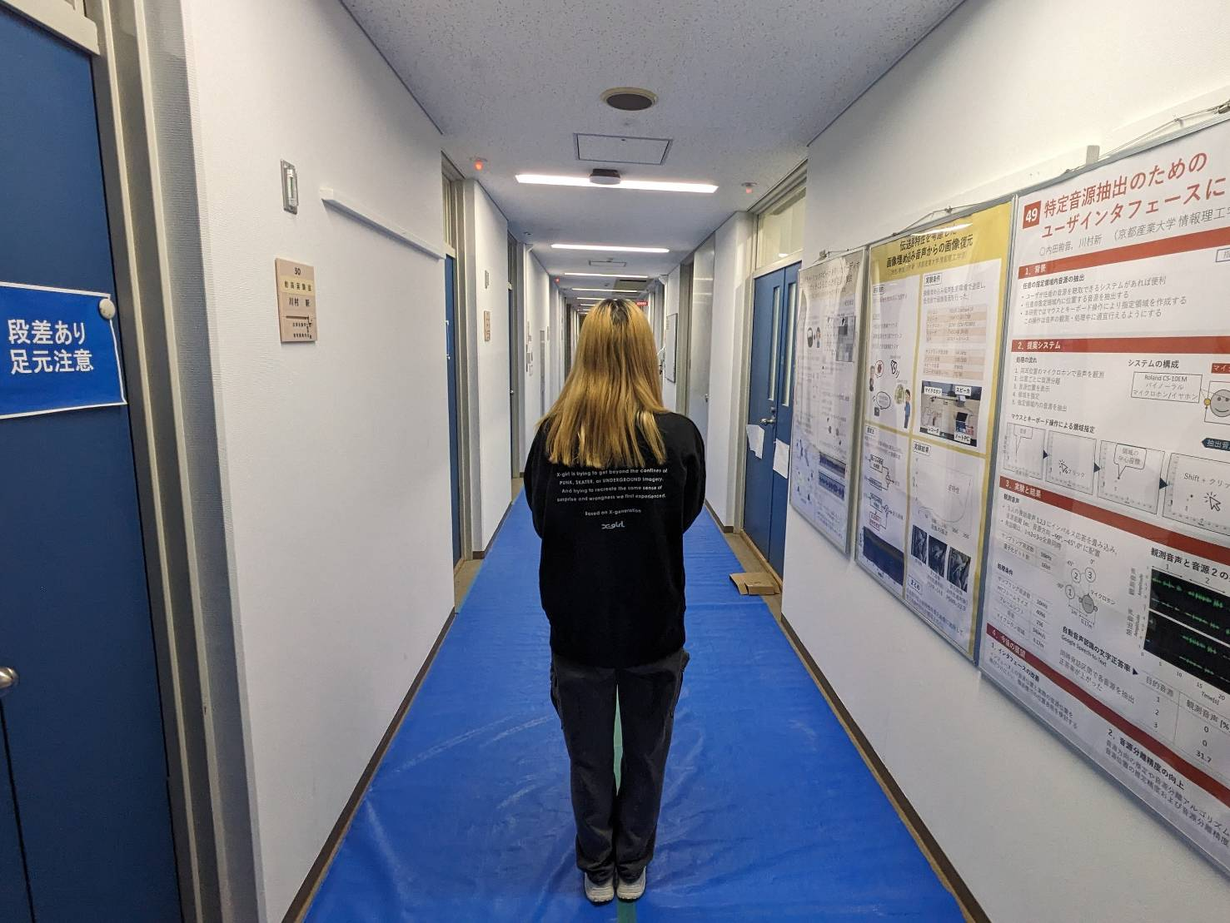
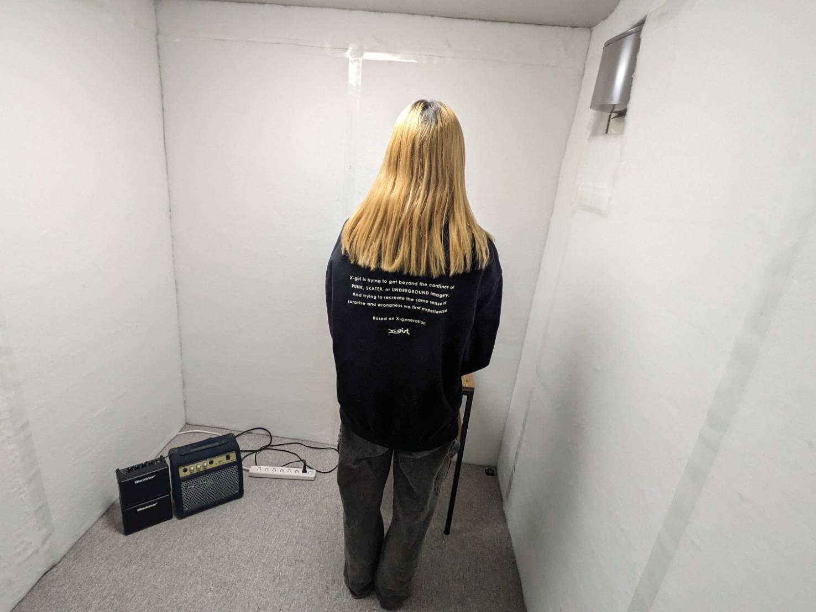








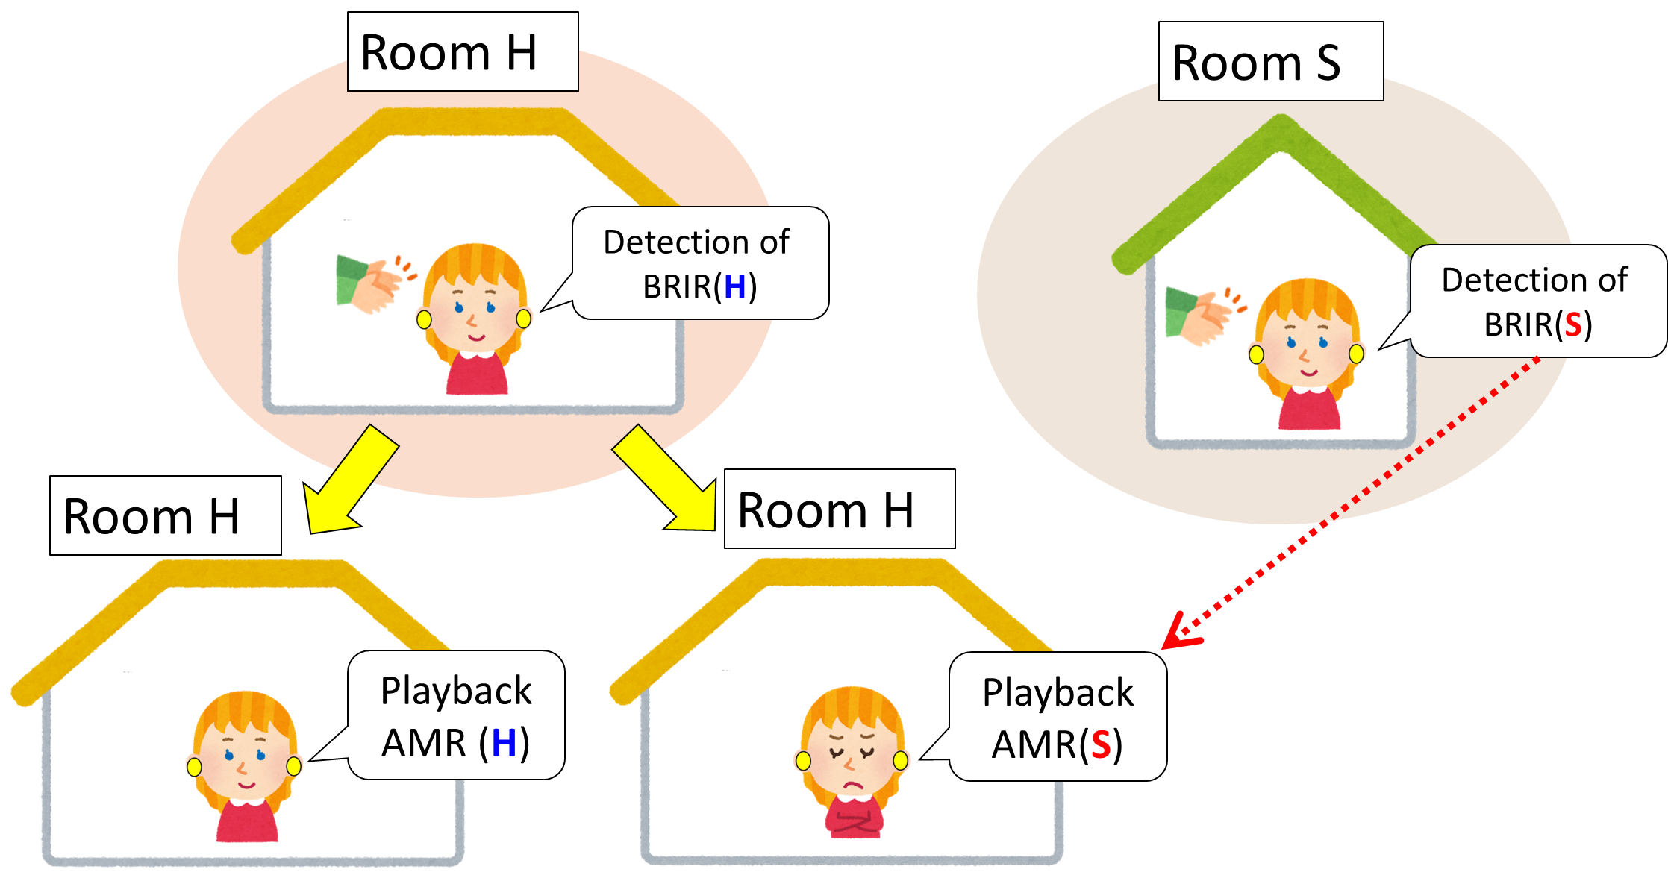


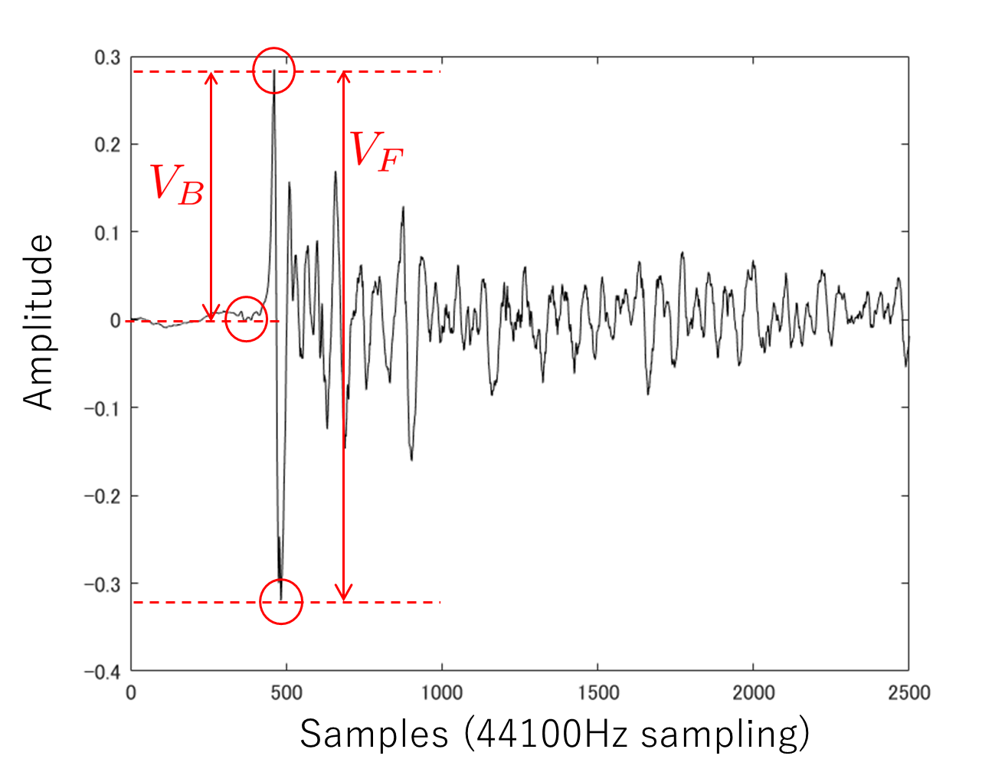
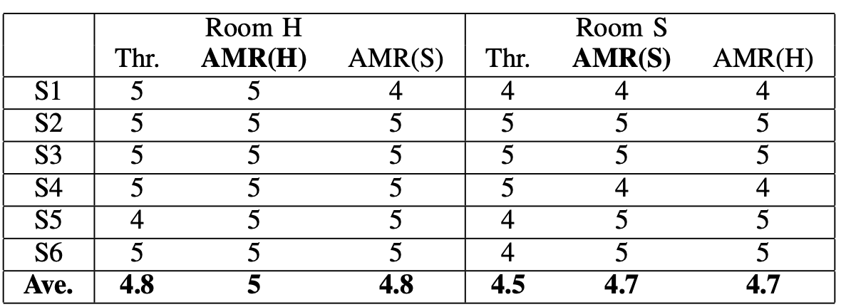
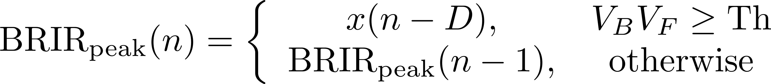


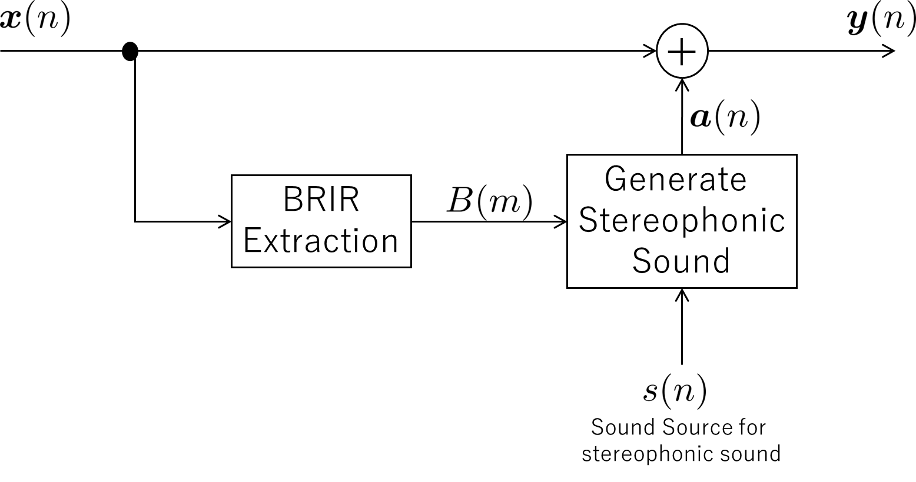


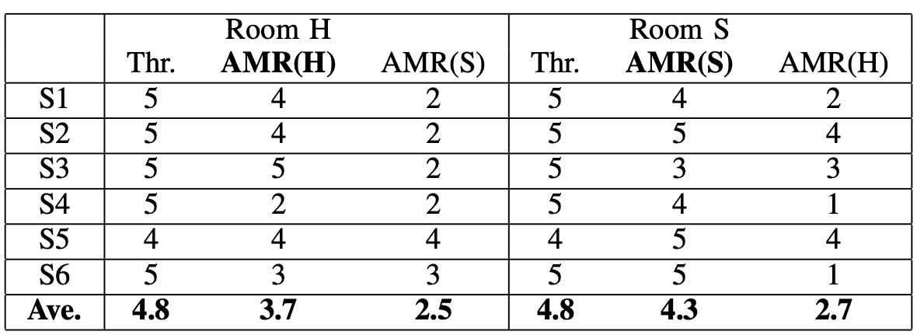



Acoustic Mixed Reality Using
Extracted Clapping Sound as BRIR
◯S. Nishimura, A. Kawamura（Kyoto Sangyo University, Japan）
Research Background
Experimental Setting
Acoustic MR：
Mixed sound of Real and Virtual 3D sounds with BRIR
Sampling Freq. | 44.1kHz
D | 10
Th | 0.3
Length of BRIR | 22050 (0.5s)
Subjects | 6 people
Binaural microphones | Roland CS-10EM
Location | Hallway(Room H) Soundproof(Room S)
*BRIR: Binaural Room Impulse Response
Virtual 3D sound using BRIR
Real bird
clapped from some
directions by herself
Virtual monster
Real sound
Monster really exists
on the right!
Hallway (Room H)
Soundproof room (Room S)
Proposed Method
BRIR is impulse response from acoustic source…
Binaural Microphones
We assume clapping
sounds as BRIR
*AMR(X) : 3D sound made by using BRIR detected in Room X
Rch
Lch
Questions.
Q1. Did you hear the sound coming from the direction where you clapped?
Q2. Did the sound seem to be coming within the room?
Rating | Meaning
5 4 3 2 1 | Excellent Good Average Poor Unacceptable
Waveform of Clapping sound
Experimental Results
Subject no.
Results of subjective test for Q1
BRIR peak detection
: Integer to detect V_{F}
: Threshold
Results of subjective test for Q2
BRIR extraction
based on BRIR peak

