Slide 1
iStocks
Stocks Sangraha AI Database About
iStocks: AI-Powered
Prompt Based Algo Trading Platform
NLP-based trading in English and 40+ Indian regional languages “Buy 100 Reliance stocks when RSI Drops below 30” and Boom your trade executed while you are in office or maybe attending some important environment conference
AI Analysis
Real-Time Data
NLP Chat
Algo Trading
Angle 1.0 – istocks Fine tuned model
17+ Stocks Live
40+ Languages
Prompt-Based
Team iStocks | IIT Roorkee | istocks.codes

Slide 2
THE PROBLEM
90% of Indian Traders Are Losing Money
According to SEBI, over 90% of Indian traders lose money because they cannot access algorithmic trading. The reason: they cannot write code.
30M+
90%+
$11B+
< 3%
Retail traders 21% YoY growth
In net loss SEBI Report 2024
Daily trading volume in India
Have access to algo trading tools
THE OPPORTUNITY
13Cr to 50Cr Demat accounts by 2030
73% of Gen Z want to invest but lack knowledge
$7B+ daily volume from retail and semi-pro
800M+ smartphones — fintech-ready population

Slide 3
OUR SOLUTION
iStocks: NLP-Based Algo Trading - No Code Required
An NLP-based platform that works in English and 40+ Indian regional languages. Set your strategy and let AI execute.
AI Stock Analysis
NLP Database Chat
Prompt Algo Trading
Set and Forget
Angle 1.0 analyzes RSI, MACD, SMA, Bollinger Bands - explains in 40+ Indian languages.
"Compare RELIANCE with TCS" gets instant, data-driven analysis - in your language.
"Buy 100 RELIANCE stocks when RSI drops below 30" - multi-agent AI executes your strategy when all condition mets.
Daily job workers set strategies once - AI executes automatically. Get notified on your phone.
MULTI-AGENT ARCHITECTURE
Natural Language Prompt
>
Trading Analysis Agent
>
Watching Agent
>
Automated Execution

Slide 4
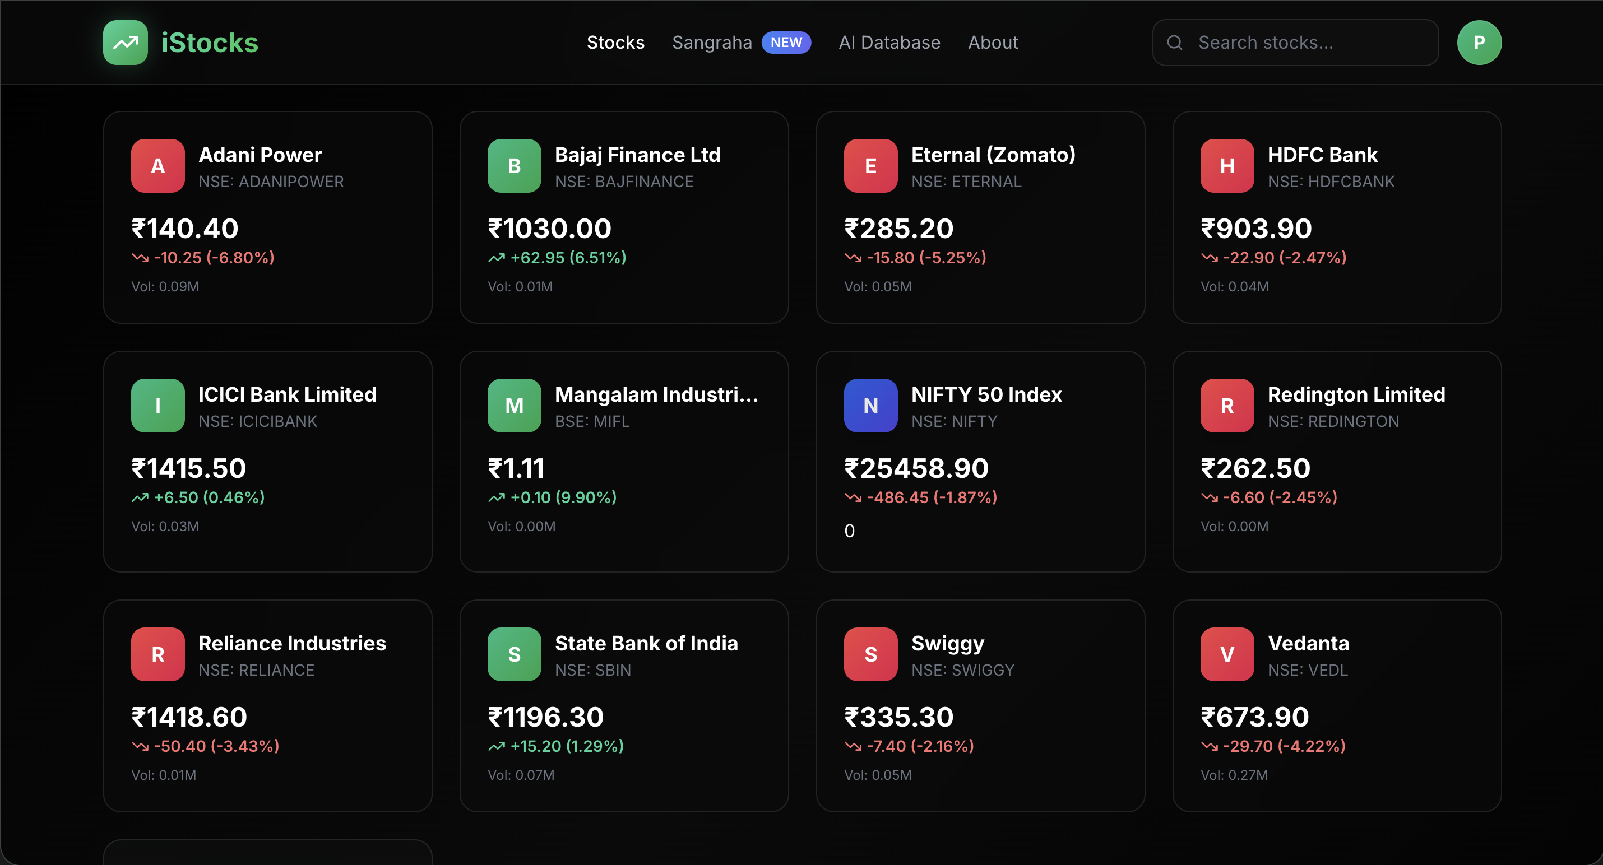
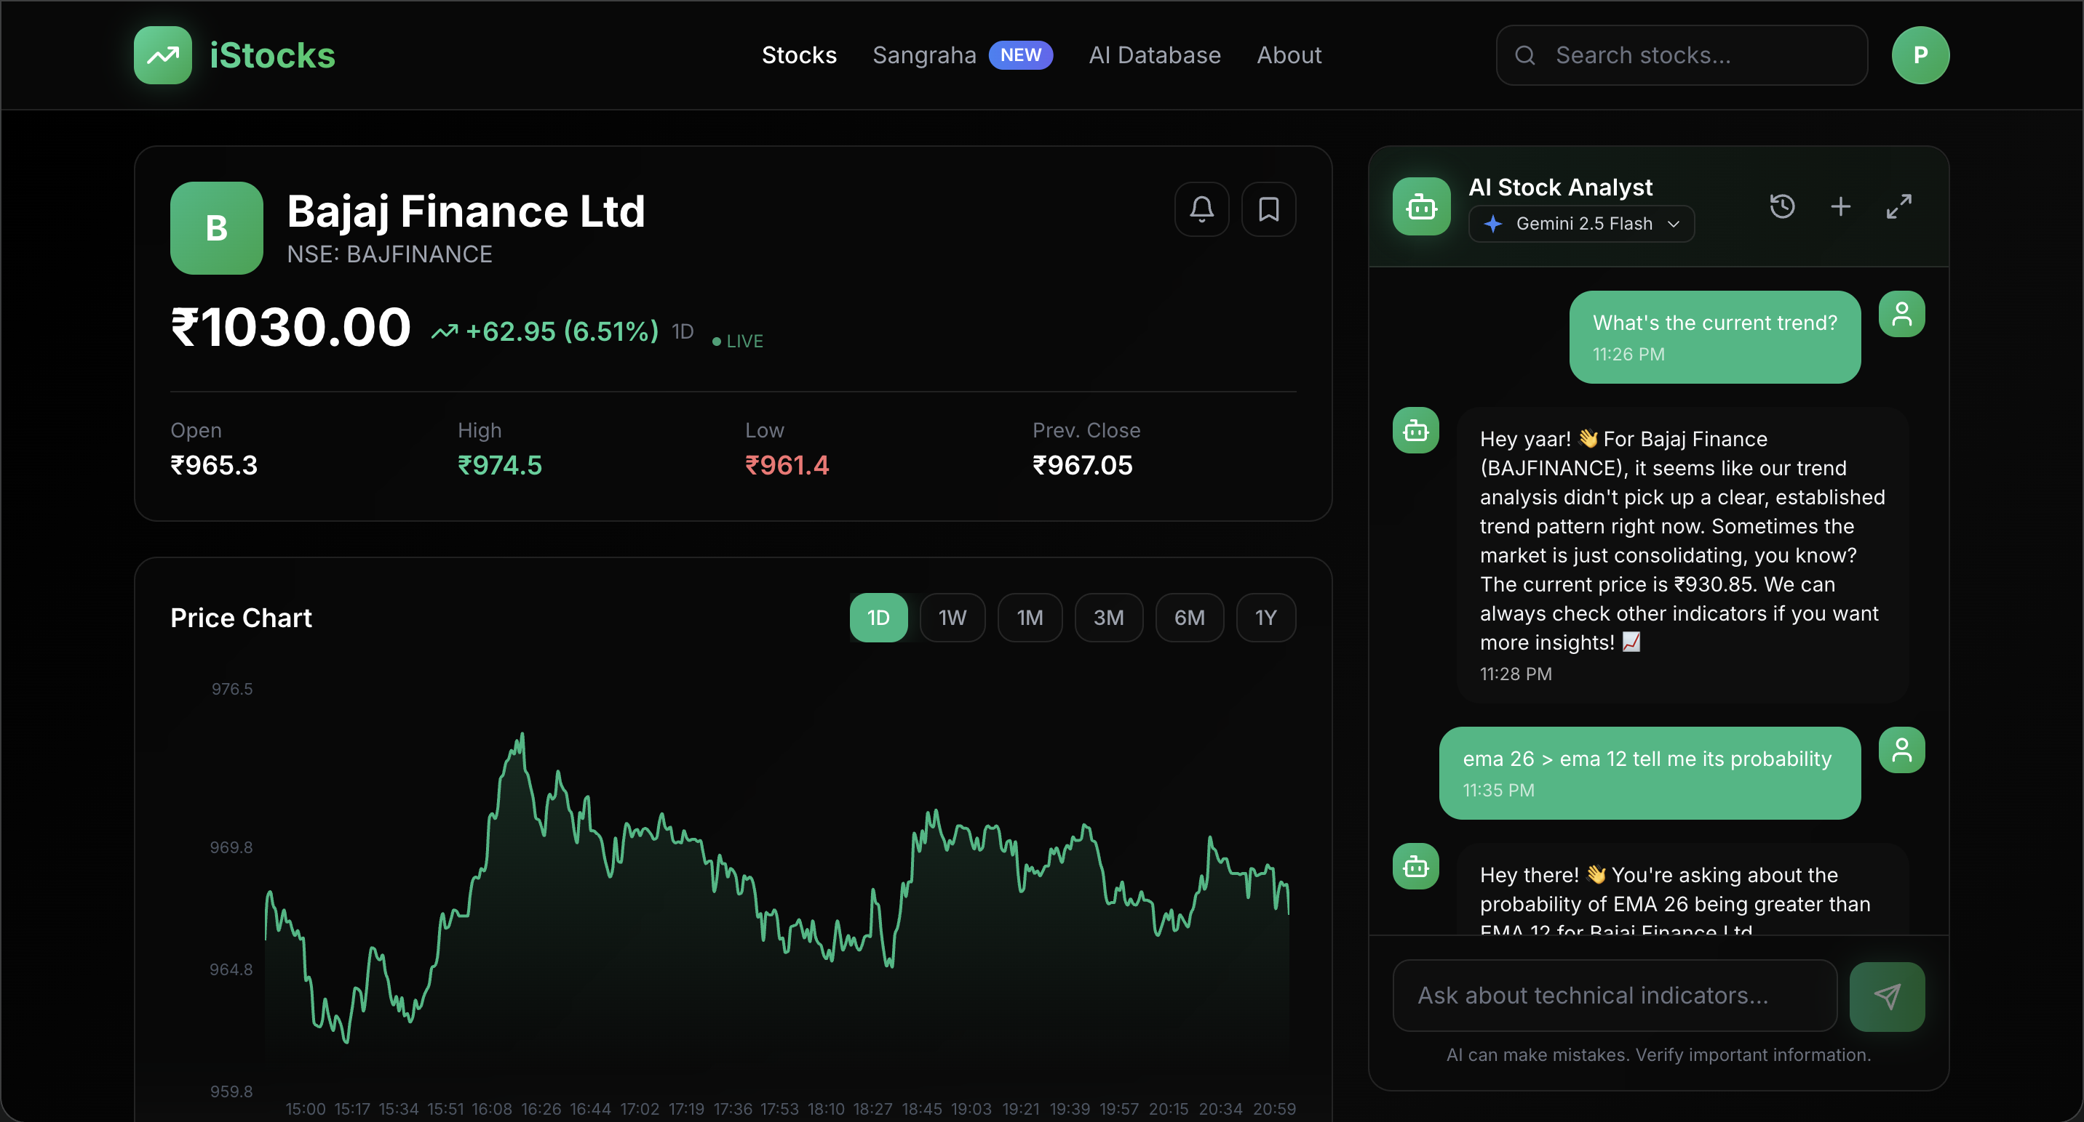
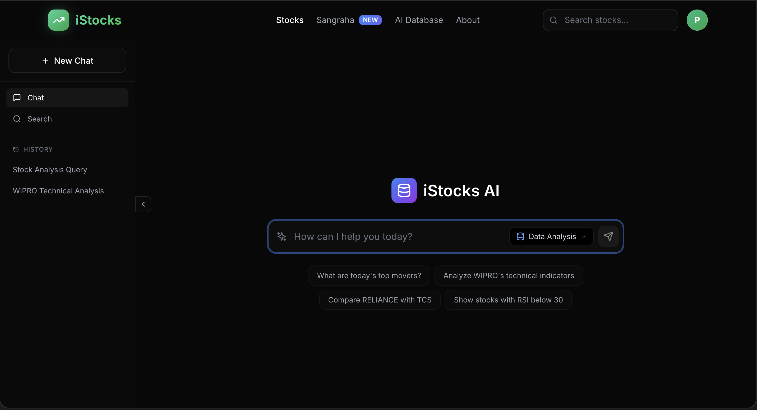
LIVE PRODUCT
Not a Prototype — A Deployed, Working Platform
Live at istocks.codes — open it right now to verify.
Stock Dashboard
AI Stock Analysis
AI Database Chat
LIVE DEMO | istocks.codes

Slide 5
FINANCIAL MODEL
18-Month P&L Projection (Feb 2026 — Jul 2027)
Detailed P&L prepared for AJVC. Full sheet available on request.
$1.65M
$996K
$753K
Month 10-11
Gross Revenue
Net Revenue
PAT (18m)
Breakeven
REVENUE STREAMS
COST STRUCTURE (18m)
Brokerage Charges
$1.52M
Post-SEBI broker license (Jan 2027)
Team (8 FTEs)
$112K
Retail Trader Subs
$84.6K
Pro plan at ~$5/month
Marketing
$130K
Market Data API
$44.6K
CA Subscriptions
$38.5K
Financial professionals
LLM API Cost
$88.5K
Trading Firm Subs
$3.2K
Sub-brokers and small firms
Cloud and Server
$140K
Rent + Admin
$2.6K

Slide 6
USER GROWTH
User Acquisition and Revenue Waterfall
Conservative projections based on channel-wise conversion funnels. 18-month horizon.
Month 1
Month 4
Month 9
Month 12
Month 18
100
>
4,000
>
27,250
>
45,000+
>
75,000+
users
users
users
users
users
Beta users No marketing
Organic + College visits begin
Telegram + Discord channels active
YouTube ads + word of mouth
Multi-channel acquisition
ACQUISITION CHANNELS
College Visits
Trading YouTube
Telegram
Discord
$17.6K
$33.5K
$60.9K
$18.2K
5 colleges/month 250 signups each
2 channels/month 150 signups each
2,000 signups/month Highest volume
600 signups/month Highest quality

Slide 7
SOCIAL IMPACT
Aligned with UN Sustainable Development Goals
SDG 1: No Poverty
SDG 9: Industry, innovation and infrastructure
SDG 10: Reduced Inequalities
90%+ of low-income Indians cannot access the stock market due to language and Algo complexity barriers. iStocks gives them algo trading in their own language.
Innovating a completely new financial system for retail traders, enabling advanced data analysis and AI-assisted trading strategies in their regional languages.
We give institutional- grade financial intelligence to every Indian — in 40+ regional languages, completely code-free.
Financial access for 90%+ low-income Indians
Set strategy, go to work. AI trades for you.
Equal access in every Indian language

Slide 8
COMPETITIVE ADVANTAGE
Why iStocks Wins
First platform in India to enable AI-powered stock analysis and prompt-based algo trading — no code required.
Feature
iStocks
Zerodha
Groww
Smallcase
AI Analysis
Angle 1.0
None
None
None
NL Database Chat
Full SQL
None
None
None
Algo Trading
Prompt-based
API only
None
None
Regional Language
40+ langs
None
None
None
Free Tier
10 queries
Limited
Paid
Paid
Real-Time Data
2s refresh
Yes
Yes
Delayed
40+ Indicators
Yes
Basic
Basic
None

Slide 9
THE ASK
Why We Need $1M and How We Will Use It
Our P&L model shows breakeven in Month 10-11 with $753K PAT over 18 months. The $1M accelerates us to profitability faster and enables global expansion.
40%
25%
20%
15%
$400K
$250K
$200K
$150K
Technology & AI
User Acquisition
Team (8 FTEs)
Compliance
LLM API cost: $88.5K Cloud infra: $140K Market Data API: $44.6K Angle 1.1 scaling
Marketing: $130K College visits: $17.6K YouTube + Telegram Discord channels
Team cost: $112K 2 Founders, 2 Devs 1 Marketing, 1 Legal 1 Mobile Dev
SEBI broker license By Jan 2027 Unlocks brokerage revenue: $1.52M

Slide 10
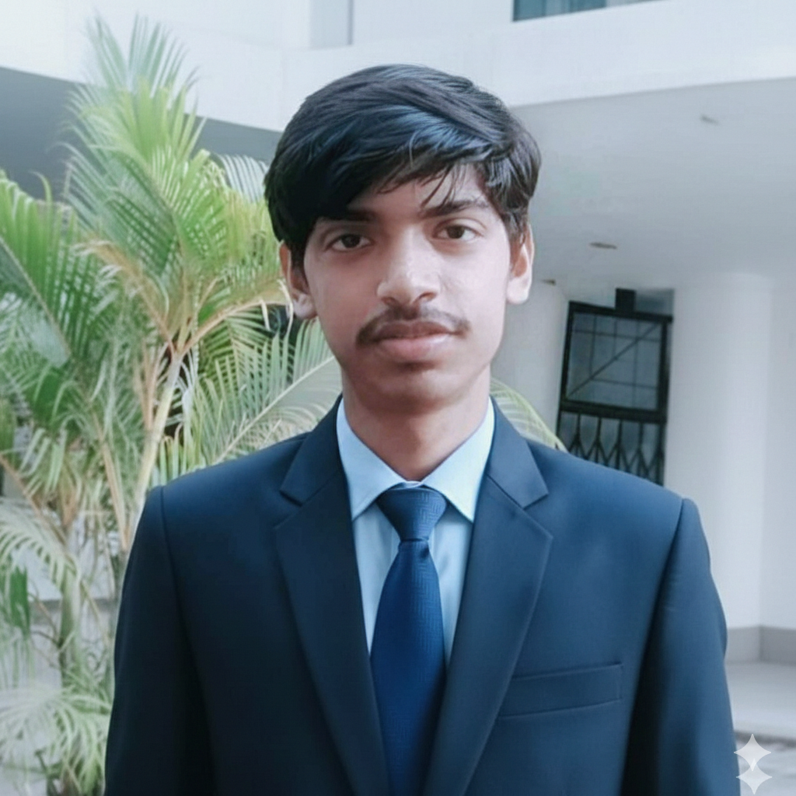
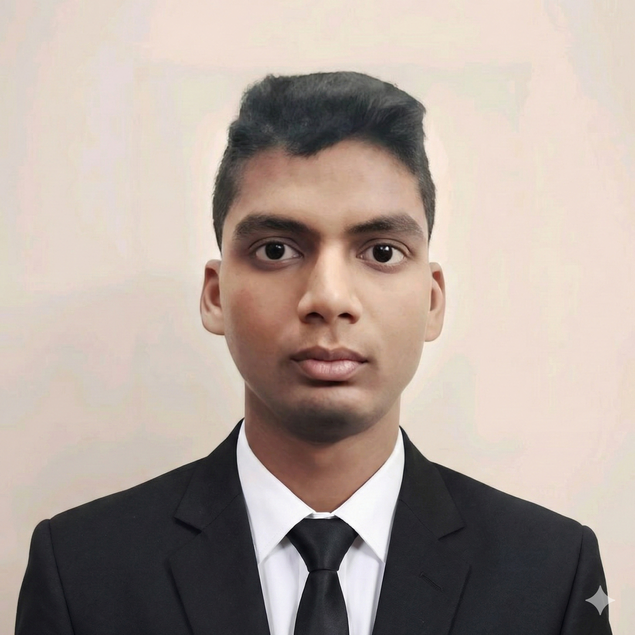
THE TEAM
IIT Roorkee Engineers
Thank You.
Let's make financial intelligence
UNLIMITED.
Priyanshu
Sachin Verma
istocks.codes
Captain | CEO & Product Lead
Co-Founder | Quant Developer
Built : Data analysis agent, Execution agent, UI/UX
Built: Trading analysis agent, Quantitative programming
priyanshu85953@gmail.com
sachinverma70076@gmail.com
IIT Roorkee | Team iStocks
Hult Prize 2026 | UNLIMITED
RESOURCES
Live Platform: istocks.codes
P&L Structure: https://docs.google.com/spreadsheets/d/1FBF0DQ7OvbC6qMLA-DRlWNEC5OXlrWtAetMN43bYvL0/edit?usp=sharing
SDG 1: No Poverty | SDG 8: Economic Growth | SDG 10: Reduced Inequalities

