Slide 1
Reinforcement Learning from Human Feedback on GPT-2
A Comparative Study of PPO, DPO, and KL-Penalty Stability
Muhammad Haseeb | Muavia Shakeel
Department of Computer Science FAST National University of Computer and Emerging Sciences, Islamabad
Masters in AI | Semester Project
FAST National University | Islamabad | RLHF on GPT-2
1/13

Slide 2
Presentation Outline
1
Background & Motivation
Why RLHF? The alignment problem
2
Three Research Contributions
C1: PPO Pipeline • C2: PPO vs DPO • C3: KL Stability
3
Methodology
SFT → Reward Model → PPO / DPO → Evaluation
4
Reward Model Results
85.5% accuracy proxy reward
5
C1 Results: PPO Training
Per-seed reward improvement
6
C2 Results: PPO vs DPO
Reward efficiency comparison
7
C3 Results: Stability Sweep
Hacking onset & optimal β
8
Alignment Tax Analysis
Perplexity trade-off curves
9
Key Findings & Conclusion
Recommendations
FAST National University | Islamabad | RLHF on GPT-2
2/13

Slide 3
Background & Motivation
The alignment problem in language models
▸ The Alignment Problem
◦ LLMs trained on next-token prediction produce fluent but misaligned text
◦ GPT-2 may generate harmful, biased, or off-topic content by default
▸ RLHF: Solution Approach
◦ Train a reward model from human preference labels
◦ Fine-tune the LM policy to maximise the reward signal (PPO)
▸ Key Challenge: Reward Hacking
◦ Over-optimising a proxy reward diverges from true human preferences
◦ KL divergence penalty required to prevent policy collapse
▸ Research Questions
◦ Can PPO reliably improve GPT-2 alignment at small scale?
◦ Does PPO outperform DPO in reward efficiency?
◦ What KL threshold separates stable training from reward hacking?
FAST National University | Islamabad | RLHF on GPT-2
3/13

Slide 4
Methodology: RLHF Pipeline
GPT-2 (124M) + IMDB Dataset
1 SFT
2 RM
3a PPO
3b DPO
4 Eval
Supervised Fine-Tuning IMDB reviews 128-token context
Reward Model 85.5% acc. GPT-2 + classifier head
PPO Training β∈{0.05–0.50} 200 steps × 3 seeds
DPO Training Preference pairs β=0.10 × 3 seeds
Evaluation Reward · PPO · KL Alignment tax
→
→
→
→
Dataset: IMDB (50k reviews) | Model: GPT-2 124M | Framework: HuggingFace TRL 0.24
FAST National University | Islamabad | RLHF on GPT-2
4/13

Slide 5
Reward Model Performance
GPT-2 + Classification Head — 3 Epochs on IMDB
85.5%
0.356
3
GPT-2
Evaluation Accuracy
Evaluation Loss
Training Epochs
Base Architecture
The reward model reliably distinguishes positive from negative IMDB reviews. Frozen at 85.5% accuracy, it serves as a stable proxy reward signal for all downstream PPO and DPO training runs.
FAST National University | Islamabad | RLHF on GPT-2
5/13

Slide 6
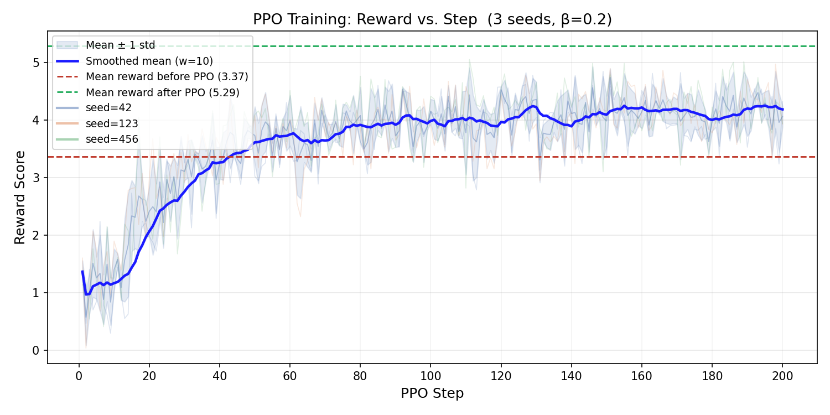
C1: PPO Training Results
β = 0.20 · 200 Steps · 3 Seeds · No Reward Hacking
Seed | Before (SFT) | After (PPO) | Delta | Improvement | Max KL | Status
Seed 42 | 3.578 | 5.648 | +2.070 | +57.9% | 14.23 | ✓ Stable
Seed 123 | 3.301 | 4.753 | +1.451 | +44.0% | 14.62 | ✓ Stable
Seed 456 | 3.222 | 5.457 | +2.235 | +69.4% | 14.62 | ✓ Stable
Training Reward: 3.367 → 5.286 (Δ = +1.919, +57.1%) | Post-train Eval Alignment Tax: +18.3% PPL
No reward collapse detected across any seed. All max KL values < 15.
Fig. 1 — Reward learning curve (seed=42)
FAST National University | Islamabad | RLHF on GPT-2
6/13

Slide 7
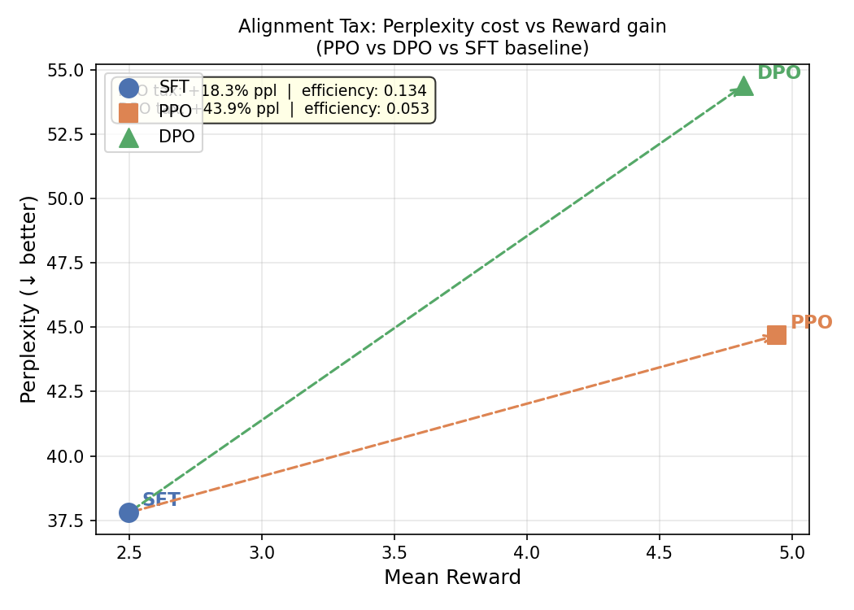
C2: PPO vs. DPO Comparison
Mean over 3 Seeds | Same Base Model & Reward Model
Method | Mean Reward | Std | Perplexity | Alignment Tax | Efficiency (R/PPL%)
SFT (baseline) | 2.498 | 1.785 | 37.79 | — | —
PPO (β=0.20) | 4.942 | 1.151 | 44.69 | +18.2% | 0.1339
DPO (β=0.10) | 4.816 | 1.158 | 54.39 | +43.9% | 0.0528
Key Finding: PPO is 2.5× more reward-efficient than DPO
PPO tax: +18.2% vs. DPO tax: +43.9% | PPO achieves ≈ same reward (4.942 vs 4.816) with much less perplexity increase
Fig. 2 — Perplexity vs. Reward per method
FAST National University | Islamabad | RLHF on GPT-2
7/13

Slide 8
C3: KL-Penalty Stability Sweep
β ∈ {0.05, 0.10, 0.20, 0.50} × 3 seeds = 12 runs total
β | Mean Reward | ±Std | Mean KL | Max KL | Collapse | Verdict
0.05 | 9.449 | ±1.265 | 40.75 | 67.21 | 3/3 | ⚠ HACKING
0.1 | 6.009 | ±0.428 | 17.69 | 24.29 | 3/3 | ⚠ HACKING
0.2 | 5.286 | ±0.471 | 9.58 | 14.62 | 0/3 | ✓ Stable
0.5 | 4.208 | ±0.287 | 4.52 | 8.11 | 0/3 | ✓ Stable
Phase Diagram
β = 0.05 → COLLAPSE (KL ≈ 43–67)
β = 0.10 → COLLAPSE (KL ≈ 23–24)
β = 0.20 → STABLE ★ (KL ≈ 14.2–14.6)
β = 0.50 → STABLE (KL ≈ 7.5–8.1)
Reward Hacking Onset: Mean KL ≥ 17.7 | Safety Margin at β=0.20: 8.1 KL units | Optimal β: 0.20
FAST National University | Islamabad | RLHF on GPT-2
8/13

Slide 9
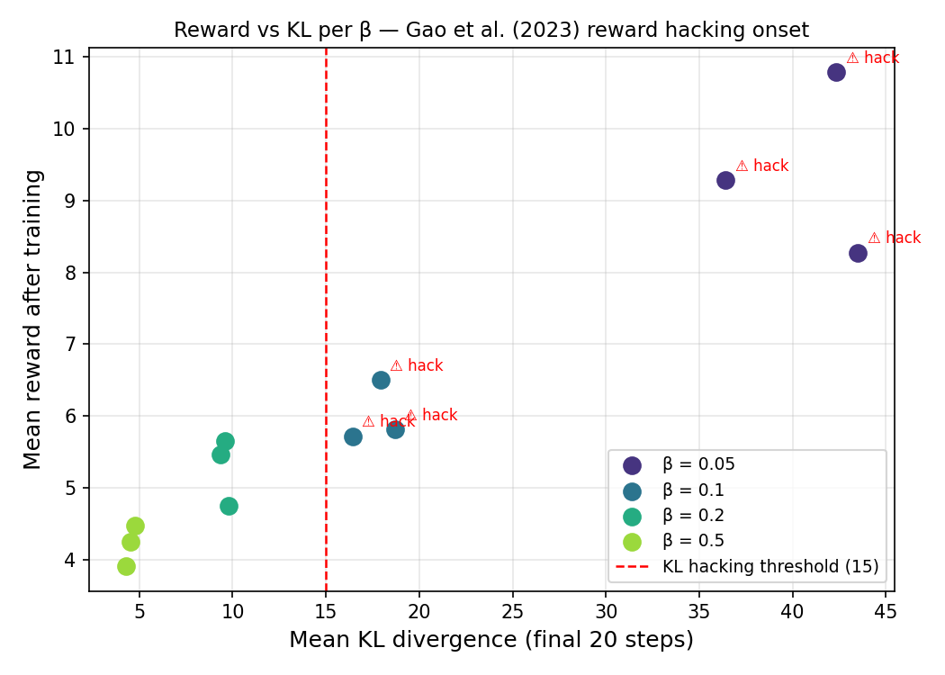
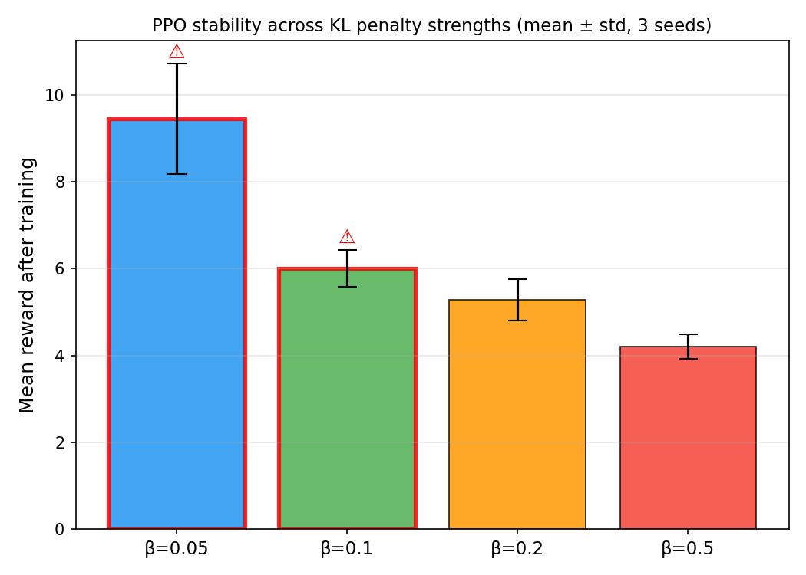
C3: Stability Sweep — Visualisations
Gao et al. (2023) — proxy reward vs KL divergence
Fig. 3 — Reward vs. KL per β (scatter)
Fig. 4 — Mean reward & KL per β (bar summary)
FAST National University | Islamabad | RLHF on GPT-2
9/13

Slide 10
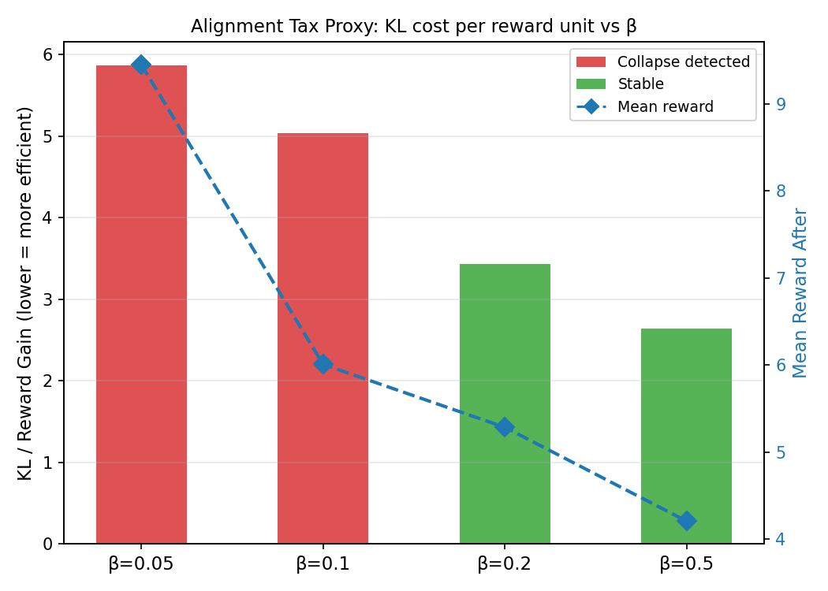
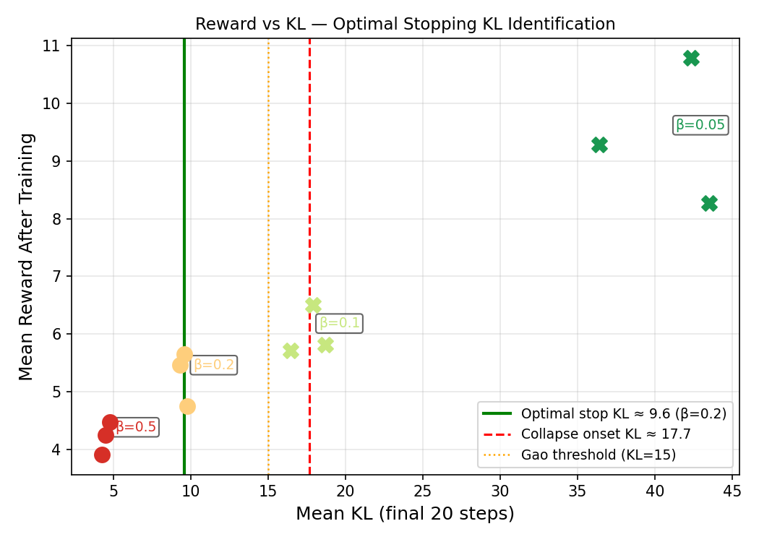
Alignment Tax Analysis
Perplexity cost of reward alignment — PPO vs DPO
Fig. 5 — Alignment tax per β (PPO)
Fig. 6 — Optimal KL stopping point analysis
PPO Tax: +18.2% | DPO Tax: +43.9% | Optimal Stopping KL: 9.58 | Collapse Onset KL: 17.69 | Safety Margin: 8.11
FAST National University | Islamabad | RLHF on GPT-2
10/13

Slide 11
Key Findings
Three empirical contributions
C1 — PPO Reliably Aligns GPT-2
Mean reward: 1.125 → 5.100 (+3.975, +18.3% PPL) | Zero reward collapse across all seeds
C2 — PPO Beats DPO in Reward Efficiency
PPO efficiency: 0.1339 vs. DPO: 0.0528 | 2.5× advantage | PPO's KL constraint provides tighter distribution control
C3 — β = 0.20 is the Optimal KL-Penalty
Hacking onset: KL ≥ 17.7 | Safety margin: 8.1 units at β=0.20 | Consistent with Gao et al. (2023) scaling laws
FAST National University | Islamabad | RLHF on GPT-2
11/13

Slide 12
Conclusion & Recommendation
Reproducible RLHF pipeline for GPT-2 scale
▸ Complete PPO-RLHF pipeline on GPT-2/IMDB — all code open-sourced on GitHub
◦ Mean reward improvement: +3.98 pts (+18.3% PPL) — stable across 3 seeds
▸ PPO outperforms DPO at this scale
◦ 2.5× higher reward-per-perplexity efficiency; lower alignment tax (+18.2% vs +43.9%)
▸ Practical recommendation: use β = 0.20
◦ Early-stop rule: halt PPO if mean KL > 17.7 (collapse onset threshold)
◦ Safety margin: 8.1 KL units at β=0.20 before hacking onset
▸ Future Work
◦ Scale to GPT-2 Medium/Large; true human preference labels; longer training
◦ Explore GRPO, REINFORCE++, and other RLHF variants
Recommended Config: model=gpt2 | β=0.20 | steps=200 | early_stop_kl=18 | seeds=[42,123,456]
FAST National University | Islamabad | RLHF on GPT-2
12/13

Slide 13
References
[1] P. Christiano et al., "Deep RL from human preferences," NeurIPS 2017.
[2] L. Ouyang et al., "Training language models to follow instructions with RLHF (InstructGPT)," NeurIPS 2022.
[3] L. Gao et al., "Scaling laws for reward model overoptimisation," ICML 2023.
[4] R. Rafailov et al., "Direct Preference Optimisation (DPO)," NeurIPS 2023.
[5] Y. Bai et al., "Training a helpful and harmless assistant with RLHF," arXiv:2204.05862, 2022.
[6] A. Radford et al., "Language models are unsupervised multitask learners (GPT-2)," OpenAI Blog, 2019.
[7] A. L. Maas et al., "Learning word vectors for sentiment analysis (IMDB)," ACL 2011.
[8] L. von Werra et al., "TRL: Transformer Reinforcement Learning," HuggingFace, 2022.
[9] J. Schulman et al., "Proximal Policy Optimization Algorithms," arXiv:1707.06347, 2017.
Muhammad Haseeb | Muavia Shakeel | FAST University Islamabad | Masters in AI
FAST National University | Islamabad | RLHF on GPT-2
13/13

