Slide 1
2011
I did not present after this point.
Reason: fetch unit does not use state machines,
so it’s confusing.

Slide 2
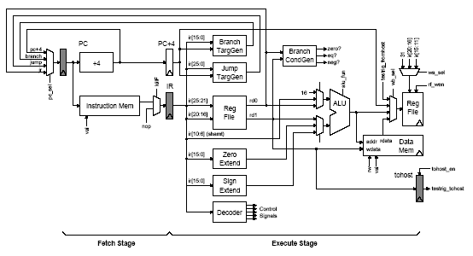
Verilog Design Examples
Greatest Common Divisor
Unpipelined SMIPSv1 processor

Slide 3
GCD in C
int GCD( int inA, int inB)
{ int done = 0;
int A = inA;
int B = inB;
while ( !done )
{ if ( A < B )
{ swap = A;
A = B;
B = swap;
}
else if ( B != 0 )
A = A - B;
else
done = 1;
}
return A;
}
Such a GCD description can be easily written in Behavioral Verilog
It can be simulated but it will have nothing to do with hardware, i.e. it won’t synthesize.
We don’t spend much time on
Behavioral Verilog because it
is not a particularly good language and isn’t useful for
hardware synthesis.

Slide 4
GCD in C
What does the RTL implementation need?
int GCD( int inA, int inB)
{ int done = 0;
int A = inA;
int B = inB;
while ( !done )
{ if ( A < B )
{ swap = A;
A = B;
B = swap;
}
else if ( B != 0 )
A = A - B;
else
done = 1;
}
return A;
}
State
Less-Than Comparator
Equal Comparator
Subtractor

Slide 5
Step 1: Design an appropriate port interface
input_available
result_rdy
idle
result_taken
operand_A
result_data
operand_B
clk
reset

Slide 6
Step 2: Design a datapath which has the functional units
zero?
lt
A = inA; B = inB;
while ( !done )
begin
if ( A < B )
swap = A;
A = B;
B = swap;
else if (B != 0)
A = A - B;
else
done = 1;
End
Y = A;
A
sub
B

Slide 7
Step 3: Add the control unit to sequence the datapath
Control unit should be designed to be either busy or waiting for input or waiting for output to be picked up
A
sel
A
en
B
sel
B
en
B=0
A<B
zero?
lt
A = inA; B = inB;
while ( !done )
begin
if ( A < B )
swap = A;
A = B;
B = swap;
else if (B != 0)
A = A - B;
else
done = 1;
End
Y = A;
A
sub
B

Slide 8
Datapath module interface
module GCDdatapath#( parameter W = 16 )
( input clk,
// Data signals
input [W-1:0] operand_A,
input [W-1:0] operand_B,
output [W-1:0] result_data,
// Control signals (ctrl->dpath)
input A_en,
input B_en,
input [1:0] A_sel,
input B_sel,
// Control signals (dpath->ctrl)
output B_zero,
output A_lt_B
);
A
sel
A
en
B
sel
B
en
B = 0
A < B
zero?
lt
A
sub
B

Slide 9
Connect the modules
wire [W-1:0] B;
wire [W-1:0] sub_out;
wire [W-1:0] a_o;
vcMux3#(W) A_mux
( .in0 (operand_A),
.in1 (B),
.in2 (sub_out),
.sel (A_sel),
.out (a_o) );
wire [W-1:0] A;
vcEDFF_pf#(W) A_pf
( .clk (clk),
.en_p (A_en),
.d_p (a_o),
.q_np (A) );
A
sel
A
en
B
sel
B
en
B = 0
A < B
zero?
lt
A
sub
B

Slide 10
Connect the datapath modules ...
wire [W-1:0] B;
wire [W-1:0] sub_out;
wire [W-1:0] a_o;
vcMux3#(W) A_mux
( .in0 (operand_A),
.in1 (B),
.in2 (sub_out),
.sel (A_sel),
.out (a_o) );
wire [W-1:0] A;
vcEDFF_pf#(W) A_pf
( .clk (clk),
.en_p (A_en),
.d_p (a_o),
.q_np (A) );
wire [W-1:0] b_o;
vcMux2#(W) B_mux
( .in0 (operand_B),
.in1 (A),
.sel (B_sel),
.out (b_o) );
vcEDFF_pf#(W) B_pf
( .clk (clk),
.en_p (B_en),
.d_p (b_o),
.q_np (B) );
assign B_zero = (B==0);
assign A_lt_B = (A < B);
assign sub_out = A - B;
assign result_data = A;
Use structural
verilog
for datapath
registers.
Not quite right:
Continuous assignmnt
combinational
logic is fine for
datapath operators BUT wrap them in a verilog
module and
instantiate structurally!

Slide 11
Control unit requires a state machine for valid/ready signals
reset
WAIT
Waiting for new input operands
input_availble
CALC
Swapping and subtracting
( Done = 1 )
DONE
Waiting for consumer to take the result
result_taken

Slide 12
Implementing the control logic FSM in Verilog
localparam WAIT = 2'd0;
localparam CALC = 2'd1;
localparam DONE = 2'd2;
reg [1:0] state_next;
wire [1:0] state;
vcRDFF_pf#(2,WAIT) state_pf
( .clk (clk),
.reset_p (reset),
.d_p (state_next),
.q_np (state) );
Localparams are not really parameters at all. They are scoped constants.
Not quite right:
For registers in
control logic, use RTL: e.g.
always @(posedge clk)
if (reset)
state <= WAIT;
else
state <= state_next;

Slide 13
Output signals for control logic
reg [6:0] cs;
always_comb
begin
//Default control signals
A_sel = A_SEL_X;
A_en = 1'b0;
B_sel = B_SEL_X;
B_en = 1'b0;
input_available = 1'b0;
result_rdy = 1'b0;
case ( state )
WAIT :
...
CALC :
...
DONE :
...
endcase
end
WAIT: begin
A_sel = A_SEL_IN;
A_en = 1'b1;
B_sel = B_SEL_IN;
B_en = 1'b1;
input_available = 1'b1;
end
CALC: if ( A_lt_B )
A_sel = A_SEL_B;
A_en = 1'b1;
B_sel = B_SEL_A;
B_en = 1'b1;
else if ( !B_zero )
A_sel = A_SEL_SUB;
A_en = 1'b1;
end
DONE: result_rdy = 1'b1;

Slide 14
Next-state logic for Control Logic
reg [1:0] state;
always @(posedge clk)
if (reset)
state <= WAIT;
else
state <= state_next;
always_comb @(*)
begin
// Default is to stay in
the same state
state_next = state;
case ( state )
WAIT :
if ( input_available )
state_next = CALC;
CALC :
if ( B_zero )
state_next = DONE;
DONE :
if ( result_taken )
state_next = WAIT;
endcase
end
reset
WAIT
input_availble
CALC
( B = 0 )
DONE
result_taken
Notes:
Remind how we get into the reset state by resetting the actual state register.

Slide 15
RTL test harness requires proper handling of the ready/valid signals
Generic
Test Source
Generic
Test
Sink
A
sel
A
en
B
sel
B
en
B = 0
A < B
zero?
lt
A
sub
B

Slide 16
Correctness: Compare behavioral and RTL implementations
Test Inputs
C
Model
RTL
Model
Test Outputs
Test Outputs
Identical?

Slide 17
Verilog Design Examples
Greatest Common Divisor
Unpipelined SMIPSv1 processor

Slide 18
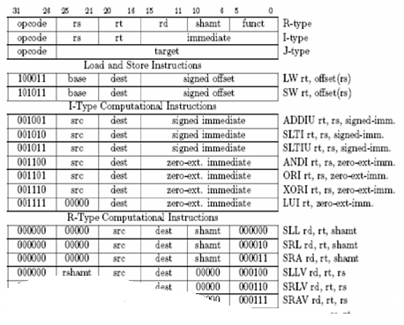
SMIPS is a simple MIPS ISA which includes three variants
SMIPSv1
5 instructions
Lecture examples

Slide 19
SMIPSv1 ISA
Instruction | Semantics | Hardware Requirements
addiu rt, rs, imm | R[rt] := R[rs] + sext(imm) | Needs adder, sext, 1w1r rf port
bne rs, rt, offset | if ( R[rs] != R[rt] ) pc := pc + sext(offset) + 4 | Needs adder, sext, comparator, 2r rf port
lw rt, offset(rs) | R[rt] := M[R[rs] + sext(offset)] | Needs adder, sext, memory read port, 1r1w rf port
sw rt, offset(rs) | M[R[rs] + sext(offset)] = R[rt] | Needs adder, sext, memory write port, 1r1w port

Slide 20
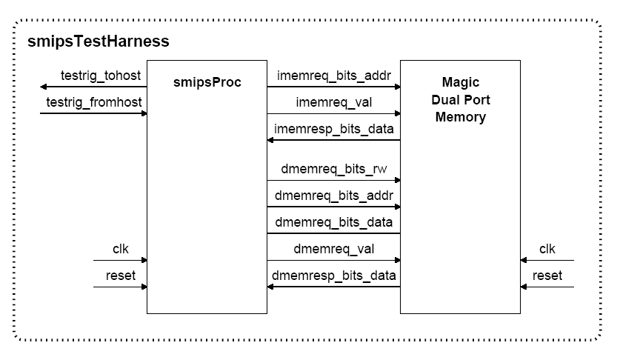
First step: Design a port interface

Slide 21
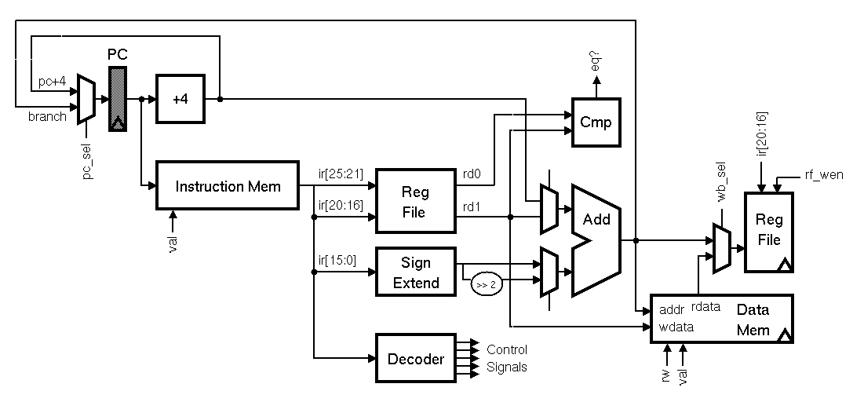
Identify memories, datapaths, and random logic
Step 1: Identify the memories
Step 2: Identify the datapaths
Step 3: Everything else is random logic

Slide 22
Identify the signals to interface with the controller

Slide 23
SMIPSv1 datapath
module smipsProcDpath_pstr
( input clk, reset,
// Memory ports
output [31:0] imemreq_addr,
output [31:0] dmemreq_addr,
output [31:0] dmemreq_data,
input [31:0] dmemresp_data,
// Controls signals (ctrl->dpath)
input pc_sel,
input [ 4:0] rf_raddr0,
input [ 4:0] rf_raddr1,
input rf_wen,
input [ 4:0] rf_waddr,
input op0_sel,
input op1_sel,
input [15:0] inst_imm,
input wb_sel,
// Control signals (dpath->ctrl)
output branch_cond_eq,
output [7:0] tohost_next );
wire [31:0] branch_targ;
wire [31:0] pc_plus4;
wire [31:0] pc_out;
vcMux2#(32) pc_mux
( .in0 (pc_plus4),
.in1 (branch_targ),
.sel (pc_sel),
.out (pc_out) );
wire [31:0] pc;
vcRDFF_pf#(32,32'h0001000) pc_pf
( .clk (clk),
.reset_p (reset),
.d_p (pc_out),
.q_np (pc) );
assign imemreq_addr = pc;
vcInc#(32,32'd4) pc_inc4
( .in (pc),
.out (pc_plus4) );

Slide 24
Register file with 2 combinational read ports and 1 write port
module smipsProcDpathRegfile
( input clk,
input [ 4:0] raddr0, // Read 0 address (combinational input)
output [31:0] rdata0, // Read 0 data (combinational on raddr)
input [ 4:0] raddr1, // Read 1 address (combinational input)
output [31:0] rdata1, // Read 1 data (combinational on raddr)
input wen_p, // Write enable (sample on rising clk edge)
input [ 4:0] waddr_p, // Write address(sample on rising clk edge)
input [31:0] wdata_p // Write data (sample on rising clk edge));
// We use an array of 32 bit register for the regfile itself
reg [31:0] registers[31:0];
// Combinational read ports
assign rdata0 = ( raddr0 == 0 ) ? 32'b0 : registers[raddr0];
assign rdata1 = ( raddr1 == 0 ) ? 32'b0 : registers[raddr1];
// Write port is active only when wen is asserted
always @( posedge clk )
if ( wen_p && (waddr_p != 5'b0) )
registers[waddr_p] <= wdata_p;
endmodule

Slide 25
Verilog for SMIPSv1 control logic
`define LW 32'b100011_?????_?????_?????_?????_??????
`define SW 32'b101011_?????_?????_?????_?????_??????
`define ADDIU 32'b001001_?????_?????_?????_?????_??????
`define BNE 32'b000101_?????_?????_?????_?????_??????
localparam cs_sz = 8;
reg [cs_sz-1:0] cs;
always @(*)
begin
cs = {cs_sz{1'b0}};
casez ( imemresp_data )
// op0 mux op1 mux wb mux rfile mreq mreq tohost
// br type sel sel sel wen r/w val en
`ADDIU: cs ={br_pc4, op0_sx, op1_rd0, wmx_alu, 1'b1, mreq_x, 1'b0, 1'b0};
`BNE : cs ={br_neq, op0_sx2, op1_pc4, wmx_x, 1'b0, mreq_x, 1'b0, 1'b0};
`LW : cs ={br_pc4, op0_sx, op1_rd0, wmx_mem, 1'b1, mreq_r, 1'b1, 1'b0};
`SW : cs ={br_pc4, op0_sx, op1_rd0, wmx_x, 1'b0, mreq_w, 1'b1, 1'b0};
`MTC0 : cs ={br_pc4, op0_x, op1_x, wmx_x, 1'b0, mreq_x, 1'b0, 1'b1};
endcase
end
casez performs simple pattern matching and can be very useful when implementing decoders

Slide 26
Verilog for SMIPSv1 control logic
// Set the control signals based on the decoder output
wire br_type = cs[7];
assign pc_sel = ( br_type == br_pc4 ) ? 1'b0
: ( br_type == br_neq ) ? ~branch_cond_eq
: 1'bx;
assign op0_sel = cs[6];
assign op1_sel = cs[5];
assign wb_sel = cs[4];
assign rf_wen = ( reset ? 1'b0 : cs[3] );
assign dmemreq_rw = cs[2];
assign dmemreq_val = ( reset ? 1'b0 : cs[1] );
wire tohost_en = ( reset ? 1'b0 : cs[0] );
// These control signals we can set directly from the instruction bits
assign rf_raddr0 = inst[25:21];
assign rf_raddr1 = inst[20:16];
assign rf_waddr = inst[20:16];
assign inst_imm = inst[15:0];
// We are always making an imemreq
assign imemreq_val = 1'b1;

Slide 27
Take away points
Follow the simple guidelines to write synthesizable Verilog
Parameterized models provide the foundation for reusable libraries of components
Use explicit state to prevent unwanted state inference and to more directly represent the desired hardware
Begin your RTL design by identifying the external interface and then move on to partition your design into the memories, datapaths, and control logic

Slide 28
Behavioral Verilog: For TestBenchs Only
Characterized by heavy use of sequential blocking statements in large always blocks
Many constructs are not synthesizable but can be useful for behavioral modeling and test benches
Data dependent for and while loops
Additional behavioral datatypes: integer, real
Magic initialization blocks: initial
Magic delay statements: #<delay>
Except for clk generation, use @(negedge clk);
System calls: $display, $assert, $finish

Slide 29
System calls for test harnesses and simulation
reg [ 1023:0 ] exe_filename;
initial
begin
// This turns on VCD (plus) output
$vcdpluson(0);
// This gets the program to load into memory from the
// command line
if ( $value$plusargs( "exe=%s", exe_filename ) )
$readmemh( exe_filename, mem.m );
else
begin
$display( "ERROR: No executable specified!
(use +exe=<filename>)" );
$finish;
end
// Stobe reset
#0 reset = 1;
#38 reset = 0;
end

Slide 30
Some dangers in writing behavioral models
module GCDTestHarness_behav;
reg [15:0] inA, inB;
wire [15:0] out;
GCD_behav#(16) gcd_unit(.inA(inA), .inB(inB), .out(out));
initial
begin
// 3 = GCD( 27, 15 )
inA = 27; inB = 15;
#10;
if (out == 3)
$display("Test gcd(27,15) succeeded, [%x==%x]", out, 3);
else
$display("Test gcd(27,15) failed, [%x != %x]", out, 3);
$finish;
end
endmodule
without some delay out is bogus

Slide 31
********

Slide 32
Execution semantics of Verilog - 1
wire a_i, b_i, c_i;
reg a_o, b_o, c_o;
always @( posedge clk )
a_o <= a_i;
assign b_i = a_o + 1;
always @( posedge clk )
b_o <= b_i;
assign c_i = b_o + 1;
always @( posedge clk )
c_o <= c_i;
Active Event Queue
A
C
B
A
1
B
On clock edge all those events which are sensitive to the clock are added to the active event queue in any order!
2
C

Slide 33
Execution semantics of Verilog - 2
wire a_i, b_i, c_i;
reg a_o, b_o, c_o;
always @( posedge clk )
a_o <= a_i;
assign b_i = a_o + 1;
always @( posedge clk )
b_o <= b_i;
assign c_i = b_o + 1;
always @( posedge clk )
c_o <= c_i;
Active Event Queue
A
C
1
C
B
A
B
1
A evaluates and as a consequence 1 is added to the event queue
B
2
C

Slide 34
Execution semantics of Verilog -3
wire a_i, b_i, c_i;
reg a_o, b_o, c_o;
always @( posedge clk )
a_o <= a_i;
assign b_i = a_o + 1;
always @( posedge clk )
b_o <= b_i;
assign c_i = b_o + 1;
always @( posedge clk )
c_o <= c_i;
Active Event Queue
A
1
2
C
1
C
B
1
B evaluates and as a consequence 2 is added to the event queue
Event queue is emptied before we go to next clock cycle
B
2
C

Slide 35
Non-blocking assignment
Within a “simulation tick” all RHS variables are read first and all the LHS variables are updated together at the end of the tick
Consequently, two event queues have to be maintained – one keeps the computations to be performed while the other keeps the variables to be updated

Slide 36
Non-blocking assignments require two event queues
wire a_i, b_i, c_iA;
reg a_o, b_o, c_o;
always @( posedge clk )
a_o <= A_in;
assign b_i = a_o + 1;
always @( posedge clk )
b_o <= b_i;
assign c_i = b_o + 1;
always @( posedge clk )
c_o <= c_i;
Active Event Queue
A
C
R
B
R
A
R
2
1
1
Non-Blocking Queue
B
C
L
B
L
A
L
2
Variables in RHS of always blocks are not updated until all inputs (e.g. LHS + dependencies) are evaluated
C

Slide 37
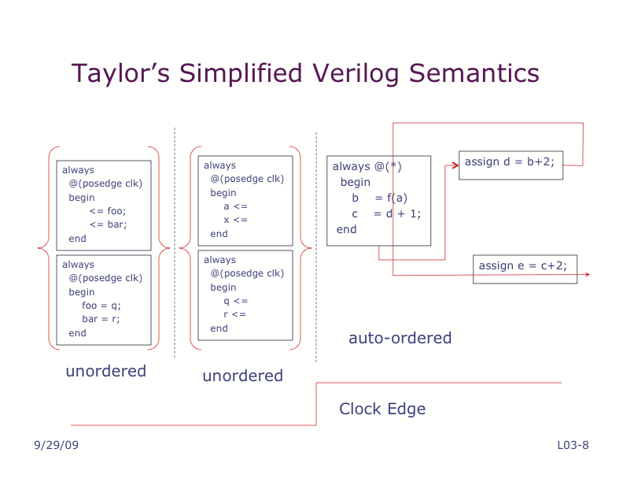
If you treat verilog as a language for coding up hardware you have already
designed on paper/whiteboard, you will not need to rely on this much.
(combinational)
(sequential
right hand side)
(sequential
left hand side)

Slide 38
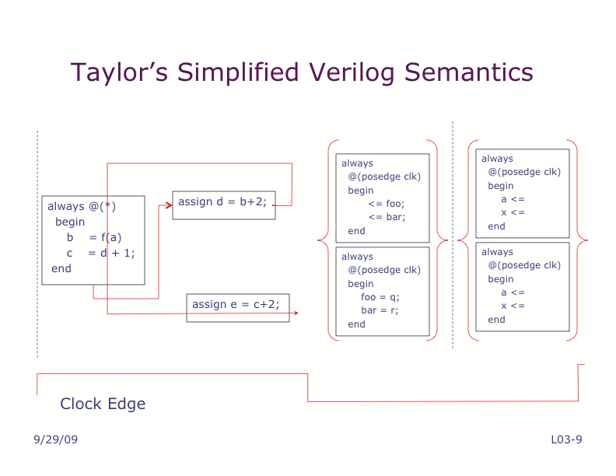

Slide 39
Describe a module called adder which can
be used to generate a family of circuits
according to parameter W (default value is 8.)
not a good name, since it is more than an
Adder.
module adder #(parameter W = 8)
(
input clk,
input [W-1:0] inA, inB,
output [W:0] out,
output isOdd
);
reg [W-1:0] regA, regB;
reg [W:0] regOut;
reg regOdd;
wire [W:0] wireOut;
assign wireOut = regA + regB;
assign out = regOut;
assign isOdd = regOdd;
always@(posedge clk)
begin
regA <= inA;
regB <= inB;
regOut <= wireOut;
regOdd <= out[0];
end
endmodule
Input/
Output Ports
Create physical wires (Even though it says “reg”!)
Generate an addition circuit,
Inputs are regA and regB wires.
Output is connected to wireOut.
Attach wire out to wire regOut;
Attach wire isOdd to wire regOdd;
Create four positive edged-clocked
registers, attacked to clock clk.
The outputs of the registers should
be attached to the regA,regB,regOut, regOdd wires.
Inputs of registers should be attached to
inA, inB, wireOut, out[0] wires.

