Slide 1
Backend Control Logic Design the MBT way
Shown here for a simple MIPS-like design.
Your design has a few differences; for instance it has stalls/restarts from the front end, has memory stalls, different ISA, etc, etc.
Further pipelining of your backend (beyond the 2-way front-end/back-end split) is possible – but get the basic non-pipelined backend working first.

Slide 2
Recap: The Processor Design Algorithm
Once you have an ISA…
Design/Draw the datapath
Identify and instantiate the hardware for your architectural state
Foreach instruction
Simulate the instruction
Add and connect the datapath elements it requires
Is it workable? If not, fix it.
Design the control (single-cycle machine)
Foreach instruction
Simulate the instruction
What control lines do you need?
How will you compute their value?
Modify control accordingly
Is it workable? If not, fix it.

Slide 3
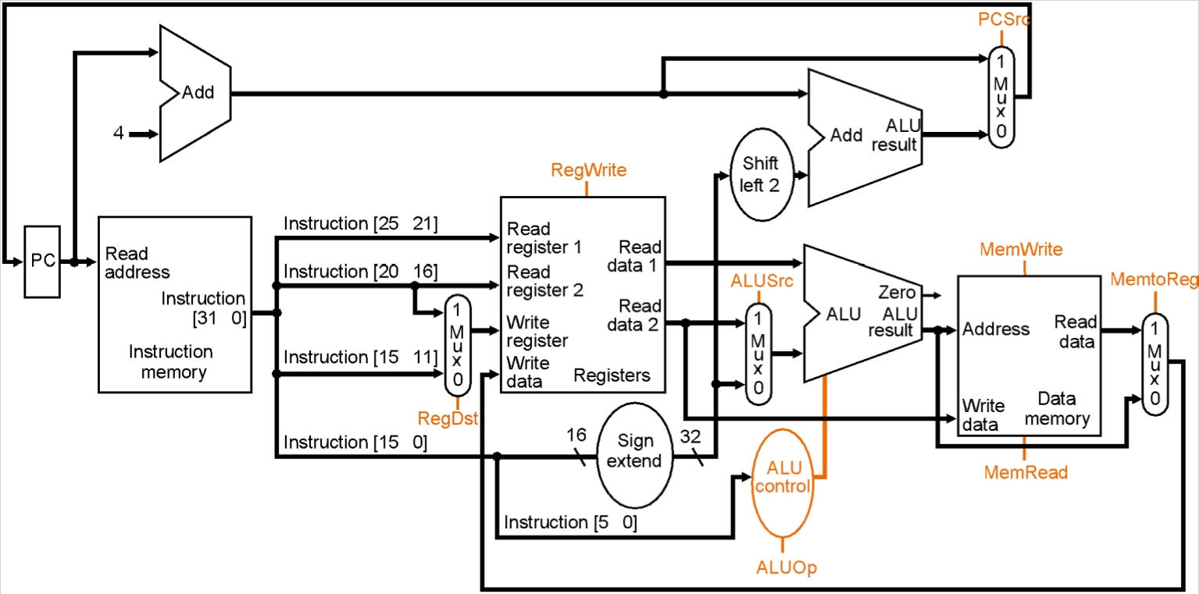
Derive datapath
(You would create this on a blackboard or whiteboard and powerpoint it up.)

Slide 4
Define and Name Control Signals
Signal | == 0 | == 1
RegDst | Write to rd | Write to rt
RegWrite | Register writes suppressed | Register writes occur
ALUSrc | 2nd ALU input is R[rd] | 2nd ALU input is the immediate
ALUop | Multiple bits; value determines the operation the ALU will perform.
This is control, not datapath

Slide 5
Define and Name Control Signals
Signal | == 0 | == 1
PCSrc | PC <= PC + 4 | PC <= PC + 4 + immediate
MemRead | Do not read data memory | Perform read at address
MemWrite | Do not write data memory | Perform write at address
MemtoReg | Present ALU result to register file for write | Present ALU result to register file for write.

Slide 6
Writing Control Logic
- hard part is to not make careless mistakes
- important to structure the code to avoid mistakes
`define LW 32'b100011_?????_?????_?????_?????_??????
`define SW 32'b101011_?????_?????_?????_?????_??????
`define ADDIU 32'b001001_?????_?????_?????_?????_??????
`define BNE 32'b000101_?????_?????_?????_?????_??????
reg writes_rf_c; // aka RegWrite;
always_comb
unique casez (IR)
`LW: writes_rf_c = 1’b1;
‘SW: writes_rf_c = 1’b0;
`BNE: writes_rf_c = 1’b0;
`ADDIU: writes_rf_c = 1’b1;
…
default: writes_rf_c = 1’b0;
endcase
reg writes_dmem_c; // aka MemWrite;
always_comb
unique casez (IR)
‘SW: writes_dmem_c = 1’b1;
…
default: writes_dmem_c = 1b’0;
endcase
Useful Discipline: Always give a default: for unique casez, even if it is empty.
(This enables pass-thru of settings prior to the casez statement; otherwise synthesizer will assume it’s don’t care. )

Slide 7
Single-Cycle Pipeline Is Often Not Ideal
Your data memory, and possibly other structures can only be read on the clock edge: thus, you need at least two cycles, one for fetch, and another for doing loads.
Instructions may require multiple states – perhaps they read the RAM multiple times, or require too many RF ports
Your design needs to respect the refuse signal, which may affect things.
Long cycle time. Timing Analyzer will identify excessively long paths. Increase clock rate by breaking paths up with registers and adding states. To improve performance, have instructions skip states they don’t need.

Slide 8
Solution: Convert to Multicycle Data Path
Update your datapath with new registers, as needed.
Draw Finite State Machine
Mentally simulate on your datapath to ensure correctness. Do you wait enough cycles in your state machine such that all inputs have arrived at each datapath element?
Code Enum to define states
Use always_ff to create state registers.
Code next state logic.
Code Logic that determines control signals at each state
many signals, like muxes, stay steady through all states in the instruction
unless you reuse a resource more than once in an instruction’s execution
write enable signals usually are state dependent – if you write too earlier, you will corrupt state that current instruction needs – usually wait until last cycle
read enables are often state dependent to save power.

Slide 9
Insert Necessary or Existant Registers
pc_sel
rf_wen
dmem_wen
rf_wr_sel
pc_en
imem_ren
dmem_ren

Slide 10
Insert Necessary or Existant Registers
pc_sel
rf_wen
dmem_wen
rf_wr_sel
pc_en
IR_en
dest_sel
imem_ren
dmem_ren

Slide 11
Identify Write/Read Enables
pc_sel
rf_wen
dmem_wen
rf_wr_sel
pc_en
imem_ren
IR_en
dest_sel
dmem_ren

Slide 12
For each instruction’s datapath components, identify longest latency (in cycles) inputs. This is the cycle it “fires” on.
NewPC
Fetch
Execute
Memory
pc_sel
0
1
rf_wen
2
dmem_wen
rf_wr_sel
pc_en
3
IR_en
dest_sel
imem_ren
dmem_ren

Slide 13
Then, code up datapath in structural verilog … and move onto control.

Slide 14
Draw / Debug State machine
pc_en = 1
rf_wen = writes_rf_c;
if (writes_dmem_c)
dmem_wen=1
NewPC
imem_ren=1
Fetch
IR_en=1
~(LW)
pc_en = 1
rf_wen=writes_rf_c
Execute
LW
dmem_ren=1
Memory

Slide 15
Coding Control: Next State Logic (with a little Synthesizable SystemVerilog; remember macros for LW etc from earlier)
typedef enum logic [1:0] { sNewPC, sFetch, sExecute, sMemory } state_s;
state_s substate_r, substate_n;
always_ff @(posedge clk)
substate_r <= reset ? sNewPC : substate_n;
always_comb
unique case (substate_r)
sNewPC: substate_n = sFetch;
sFetch: substate_n = sExecute;
sExecute:
unique casez (IR_r)
`LW: substate_n = sMemory;
default: substate_n = sNewPC;
endcase
sMemory: substate_n = sNewPC;
default: substate_n = sNewPC;
endcase
~(LW)
NewPC
Fetch
Execute
LW
Memory
Useful Discipline: Always give a default: for unique casez, even if it is empty.
(This enables pass-thru of settings prior to the casez statement; otherwise synthesizer will assume it’s don’t care. )

Slide 16
Coding Control: Enables
always_comb
begin
pc_en = 1’b0;
imem_en = 1’b0;
IR_en = 1’b0;
dmem_wen = 1’b0;
dmem_ren = 1’b0;
rf_wen = 1’b0;
unique case (substate_n)
sNewPC:
begin
pc_en = 1’b1;
rf_wen = writes_rf_c;
dmem_wen = writes_dmem_c;
end
sFetch: imem_ren = 1’b1;
sExecute: IR_en = 1’b1;
sMemory: dmem_ren = 1’b1;
default:
endcase
end
pc_en = 1
rf_wen = writes_rf_c;
if (writes_dmem_c)
dmem_wen=1
NewPC
imem_ren=1
IR_en=1
Fetch
Execute
dmem_ren=1
pc_en = 1
rf_wen=writes_rf_c
Memory

Slide 17
Coding Control: Combinationals
- combinational decode logic often does not require state-sensitivity
reg rf_wr_sel; // aka WriteToReg;
always_comb
unique casez (IR_r)
‘LW: rf_wr_sel = 1’b1;
…
default: rf_wr_sel = 1b’0;
endcase
remaining:
dest_sel
ALUSrc
ALUOp
pc_sel
etc…
reg writes_rf_c; // aka RegWrite;
always_comb
unique casez (IR_r)
`LW: writes_rf_c = 1’b1;
‘SW: writes_rf_c = 1’b0;
`BNE: writes_rf_c = 1’b0;
`ADDIU: writes_rf_c = 1’b1;
…
default: writes_rf_c = 1’b0;
endcase
reg writes_dmem_c; // aka MemWrite;
always_comb
unique casez (IR_r)
‘SW: writes_dmem_c = 1’b1;
…
default: writes_dmem_c = 1b’0;
endcase

Slide 18
Fixing Critical Paths: Add registers on slow paths and fix state machine logic accordingly.
NewPC
Fetch
RF
Execute
Memory
pc_sel
0
3
1
rf_wen
2
dmem_wen
rf_wr_sel
pc_en
4
IR_en
dest_sel
imem_ren
dmem_ren

Slide 19
Additional Complexities
reset
PC=0
r0 = 0
etc
NewPC
bootstrapping states
Fetch
Execute
Factorial
Init
Memory
complex
variable-
latency
instruction
Factorial
Iterate
Factorial
Cleanup

