Slide 1
ELEG 3124 SYSTEMS AND SIGNALS
Ch. 1 Continuous-Time Signals
Dr. Jingxian Wu
wuj@uark.edu

Slide 2
OUTLINE
Introduction: what are signals and systems?
Signals
Classifications
Basic Signal Operations
Elementary Signals

Slide 3
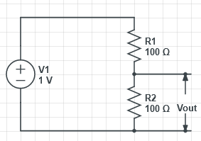
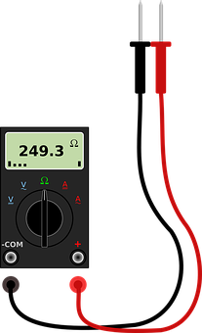
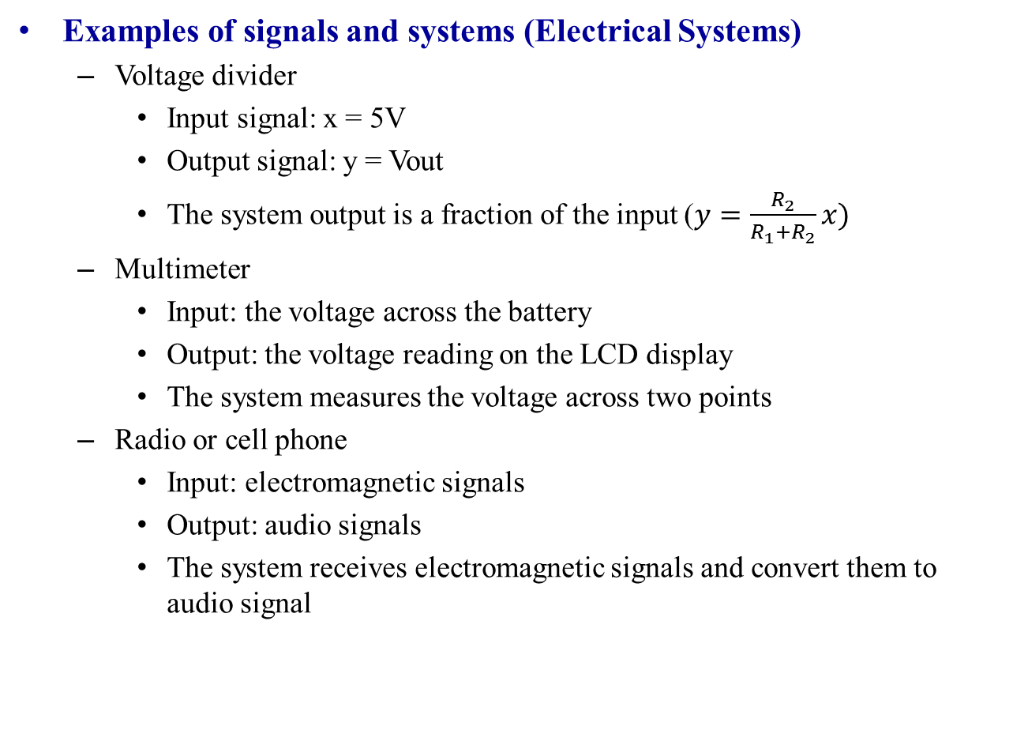
INTRODUCTION
Examples of signals and systems (Electrical Systems)
  Voltage divider
    Input signal: x = 5V
    Output signal: y = Vout
    The system output is a fraction of the input ($y=\frac{R_{2}}{R_{1}+R_{2}}x)$
  Multimeter
    Input: the voltage across the battery
    Output: the voltage reading on the LCD display
    The system measures the voltage across two points
  Radio or cell phone
    Input: electromagnetic signals
    Output: audio signals
    The system receives electromagnetic signals and convert them to audio signal
Voltage divider
multimeter

Slide 4
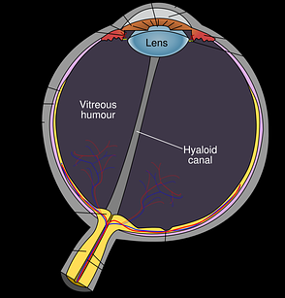
INTRODUCTION
Examples of signals and systems (Biomedical Systems)
  Central nervous system (CNS)
    Input signal: a nerve at the finger tip senses the high
    temperature, and sends a neural signal to the CNS
    Output signal: the CNS generates several output signals
    to various muscles in the hand
    The system processes input neural signals, and generate
    output neural signals based on the input
  Retina
    Input signal: light
    Output signal: neural signals
    Photosensitive cells called rods and cones in the retina convert incident light energy into signals that are carried to the brain by the optic nerve.
Retina

Slide 5

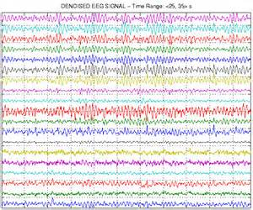
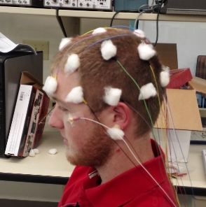

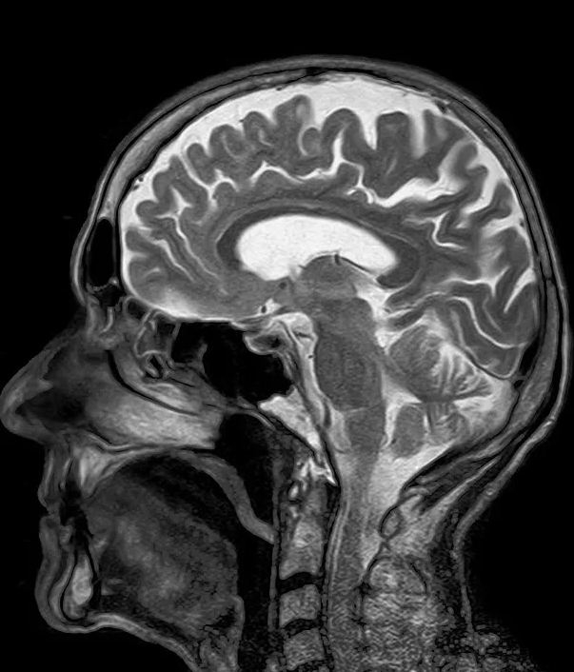
INTRODUCTION
Examples of signals and systems (Biomedical Instrument)
  EEG (Electroencephalography) Sensors
    Input: brain signals
    Output: electrical signals
    Converts brain signal into electrical signals
  Magnetic Resonance Imaging (MRI)
    Input: when apply an oscillating magnetic field at a certain frequency, the hydrogen atoms in the body will emit radio frequency signal, which will be captured by the MRI machine
    Output: images of a certain part of the body
    Use strong magnetic fields and radio waves to form images of the body.
EEG signal collection
MRI

Slide 6
INTRODUCTION
Signals and Systems
  Even though the various signals and systems could be quite different, they share some common properties.
  In this course, we will study:
    How to represent signal and system?
    What are the properties of signals?
    What are the properties of systems?
    How to process signals with system?
  The theories can be applied to any general signals and systems, be it electrical, biomedical, mechanical, or economical, etc.

Slide 7
OUTLINE
Introduction: what are signals and systems?
Signals
Classifications
Basic Signal Operations
Elementary Signals

Slide 8
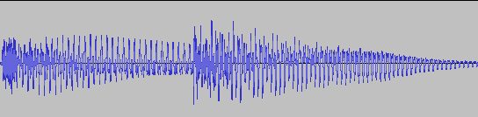
SIGNALS AND CLASSIFICATIONS
8
What is signal?
  Physical quantities that carry information and changes with respect to time.
  E.g. voice, television picture, telegraph.
Electrical signal
  Carry information with electrical parameters (e.g. voltage, current)
  All signals can be converted to electrical signals
    Speech → Microphone → Electrical Signal → Speaker → Speech
audio signal
  Signals changes with respect to time

Slide 9









SIGNALS AND CLASSIFICATIONS
9
Mathematical representation of signal:
  Signals can be represented as a function of time t
  Support of signal:
  E.g.
  E.g.
    and are two different signals!
  The mathematical representation of signal contains two components:
    The expression:
    The support:
      The support can be skipped if
      E.g.

Slide 10
SIGNALS AND CLASSIFICATIONS
10
Classification of signals: signals can be classified as
  Continuous-time signal v.s. discrete-time signal
  Analog signal v.s. digital signal
  Finite support v.s. infinite support
  Even signal v.s. odd signal
  Periodic signal v.s. Aperiodic signal
  Power signal v.s. Energy signal
  ……

Slide 11
OUTLINE
Introduction: what are signals and systems?
Signals
Classifications
Basic Signal Operations
Elementary Signals

Slide 12



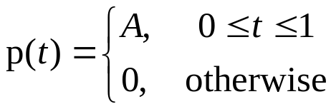

SIGNALS: CONTINUOUS-TIME V.S. DISCRETE-TIME
12
Continuous-time signal
  If the signal is defined over continuous-time, then the signal is a continuous-time signal
    E.g. sinusoidal signal
    E.g. voice signal
    E.g. Rectangular pulse function
Rectangular pulse function

Slide 13



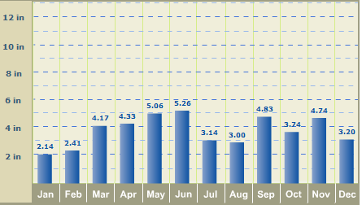




SIGNALS: CONTINUOUS-TIME V.S. DISCRETE-TIME
13
Discrete-time signal
  If the time t can only take discrete values, such as,
  then the signal is a discrete-time signal
  E.g. the monthly average precipitation at Fayetteville, AR (weather.com)
Monthly average precipitation
  What is the value of s(t) at ?
    Discrete-time signals are undefined at !!!
    Usually represented as s(k)

Slide 14
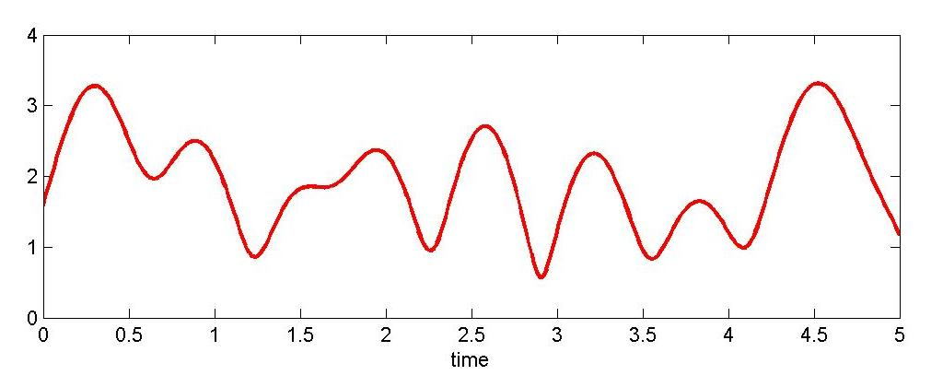
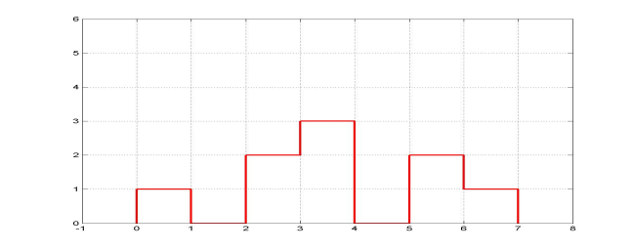
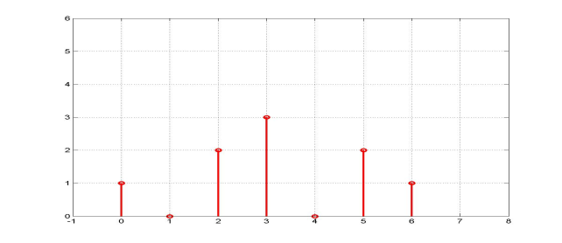
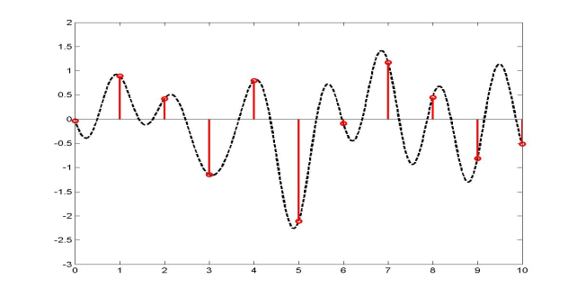
14
SIGNALS: ANALOG V.S. DIGITAL
Analog v.s. digital
  Continuous-time signal
    continuous-time, continuous amplitude→ analog signal
      Example: speech signal
    Continuous-time, discrete amplitude
      Example: traffic light
  Discrete-time signal
    Discrete-time, discrete-amplitude → digital signal
      Example: Telegraph, text, roll a dice
    Discrete-time, continuous-amplitude
      Example: samples of analog signal,
      average monthly temperature
3
2
2
1
1
0
0
3
2
2
1
1
0
0
Different types of signals

Slide 15








SIGNALS: EVEN V.S. ODD
15
Even v.s. odd
  x(t) is an even signal if:
    E.g.
  x(t) is an odd signal if:
    E.g.
  Some signals are neither even, nor odd
    E.g.
  Any signal can be decomposed as the sum of an even signal and odd signal
    proof
even
odd

Slide 16

SIGNALS: EVEN V.S. ODD
Example
  Find the even and odd decomposition of the following signal

Slide 17
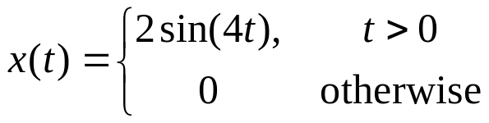
17
SIGNALS: EVEN V.S. ODD
Example
  Find the even and odd decomposition of the following signal
Notes:
U = -t ➔ X(u) = 2sin(4u), u > 0 ➔ x(-t) = 2sin(-4t), t < 0

Slide 18








18
SIGNALS: PERIODIC V.S. APERIODIC
Periodic signal v.s. aperiodic signal
  An analog signal is periodic if
    There is a positive real value T such that
    It is defined for all possible values of t, (why?)
  Fundamental period : the smallest positive integer that satisfies
    E.g.
      So is a period of s(t), but it is not the fundamental period of s(t)

Slide 19





SIGNALS: PERIODIC V.S. APERIODIC
19
Example
  Find the period of
  Amplitude: A
  Angular frequency:
  Initial phase:
  Period:
  Linear frequency:

Slide 20


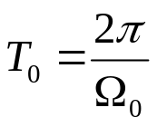
SIGNALS: PERIODIC V.S. APERIODIC
20
Complex exponential signal
  Euler formula:
  Complex exponential signal
  Complex exponential signal is periodic with period
    Proof:
Complex exponential signal has same period as sinusoidal signal!

Slide 21






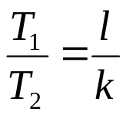

SIGNALS: PERIODIC V.S. APERIODIC
21
The sum of two periodic signals
  x(t) has a period
  y(t) has a period
  Define z(t) = a x(t) + b y(t)
  Is z(t) periodic?
    In order to have x(t)=x(t+T), T must satisfy
    In order to have y(t)=y(t+T), T must satisfy
    Therefore, if
The sum of two periodic signals is periodic if and only if the ratio of the two periods can be expressed as a rational number.
  The period of the sum signal is

Slide 22
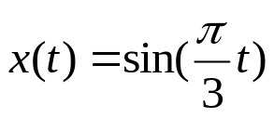
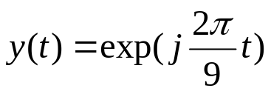
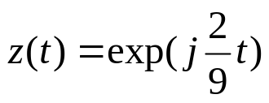




SIGNALS: PERIODIC V.S. APERIODIC
22
Example
  Find the period of
  Is periodic? If periodic, what is the period?
  Is periodic? If periodic, what is the period?
  Is periodic? If periodic, what is the period?
Aperiodic signal: any signal that is not periodic.
Notes:
Tx = 2pi/w = 2 pi/pi/3 = 6
Ty = 2pi/2 = 9
Tz = 2pi/2/9 = 9 pi
Tx/Ty = 6/9 = 2/3, rational, T = lcm(6, 9) = 18
Tx/Tz = 6/(9pi) = 2/(3pi) non-rational

Slide 23


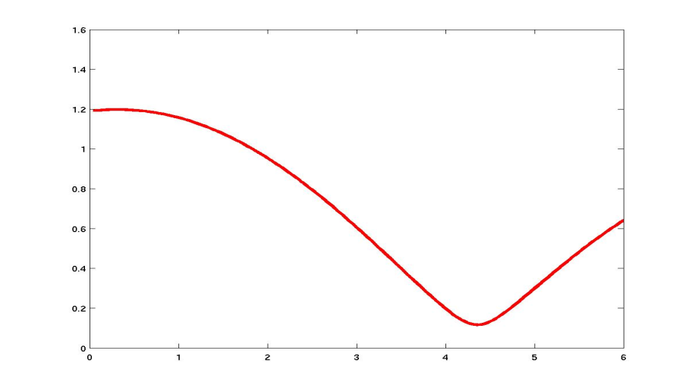





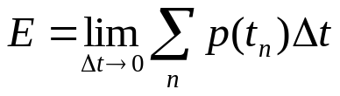
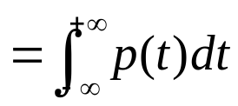

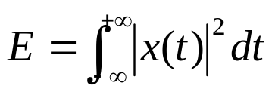
SINGALS: ENERGY V.S. POWER
23
Signal energy
  Assume x(t) represents voltage across a resistor with resistance R.
  Current (Ohm’s law): i(t) = x(t)/R
  Instantaneous power:
  Signal power: the power of signal measured at R = 1 Ohm:
  Signal energy at:
  Total energy
Instantaneous power
  Review: integration over a signal gives the area under the signal.

Slide 24

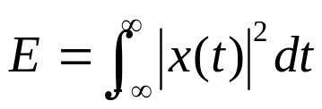

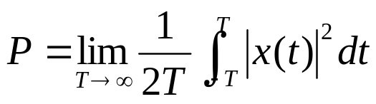

SINGALS: ENERGY V.S. POWER
24
Energy of signal x(t) over
  If then x(t) is called an energy signal.
Average power of signal x(t)
  If then x(t) is called a power signal.
A signal can be an energy signal, or a power signal, or neither, but not both.

Slide 25





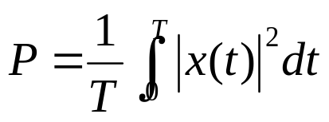
SINGALS: ENERGY V.S. POWER
25
Example 1:
Example 2:
Example 3:
All periodic signals are power signal with average power:
Notes:
1. E = int_0^inf A^2 exp(-2t) dt = A^2 int_0^inf exp(-2t) (-1/2) d(-2t)
= -A^2/2 exp(-2t)_0^inf = -A^2/2 [0-1] = A^2/2
Energy signal
P = E/inf = 0
2. E_T = int_0^T A^2 sin^2(wt+theta) = A^2/2 int_0^T [1 – cos(2wt+2theta)] dt
=A^2/2 int_0^T dt – A^2/2 int_0^T cos(2wt+2theta) dt
= A^2/2 T – A^2/2 int_0^T cos(2wt+2theta) d(2wt+2theta) 1/2w
= A^2/2 T-A^2/2 sin(2wt+2theta)_0^T 1/2w
= A^2/2 T – A^2/(4w) [sin(2wT+2theta) – sin(2theta)]
= A^2/2 T
P = A^2/2 ➔ power signal
Sin^2(x) = [1-cos(2x)]/2
wT = 2pi

Slide 26
OUTLINE
Introduction: what are signals and systems?
Signals
Classifications
Basic Signal Operations
Elementary Signals

Slide 27


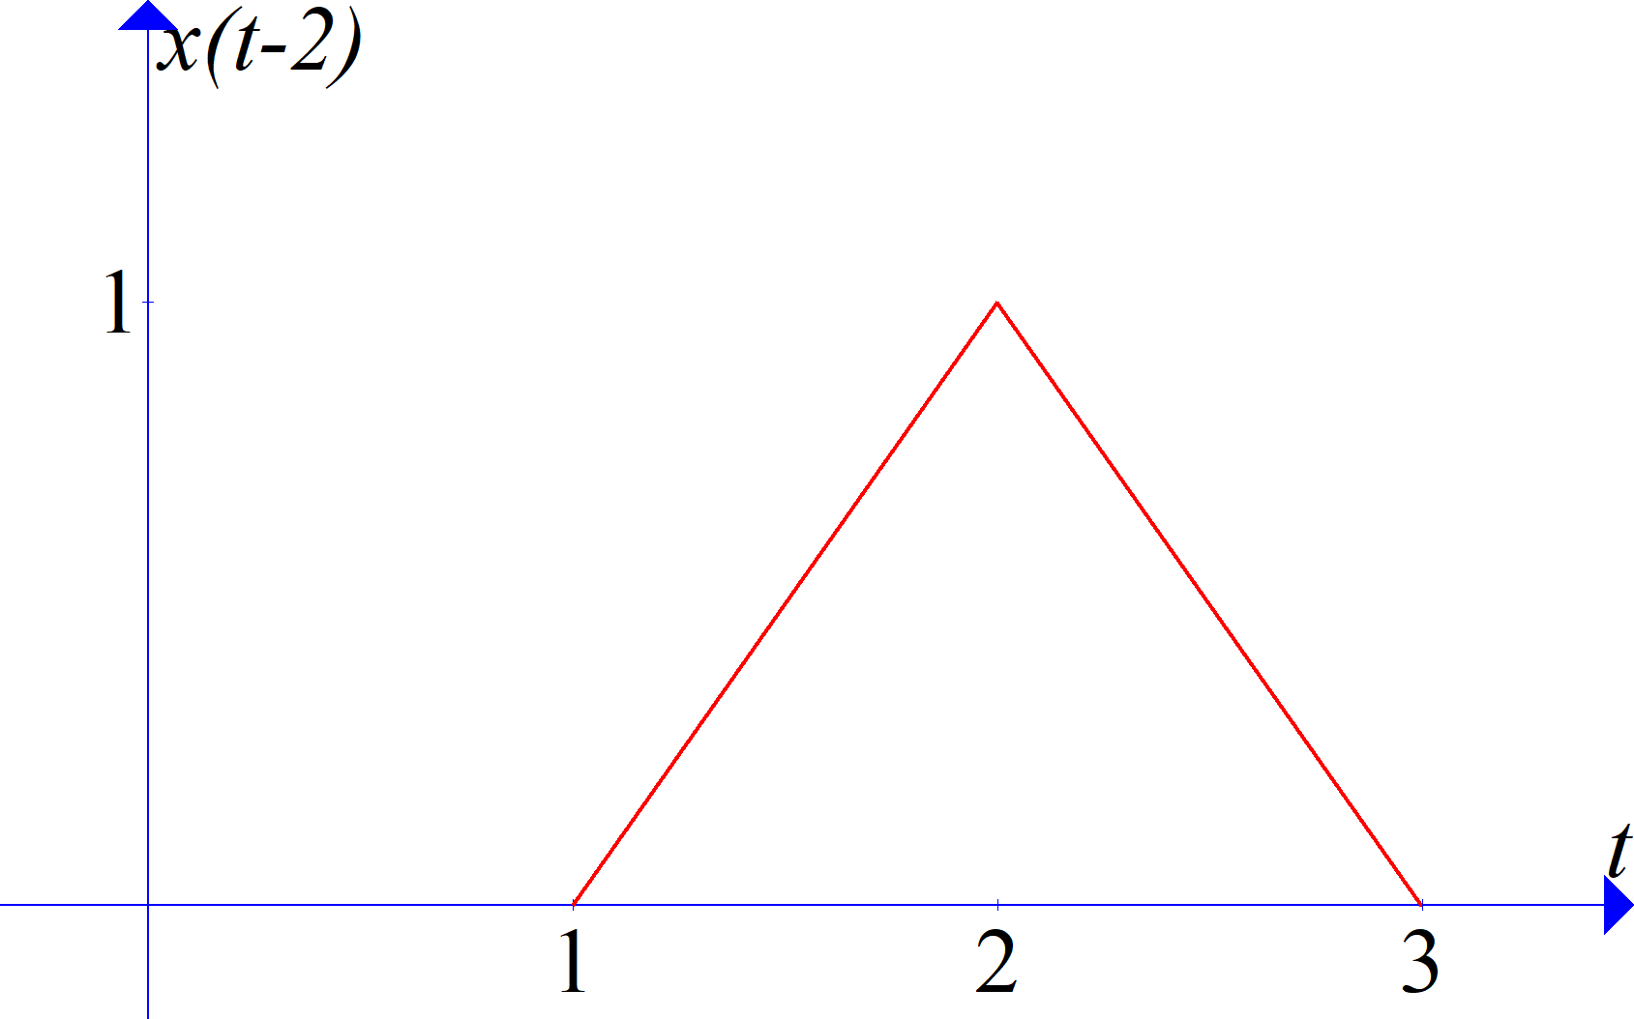
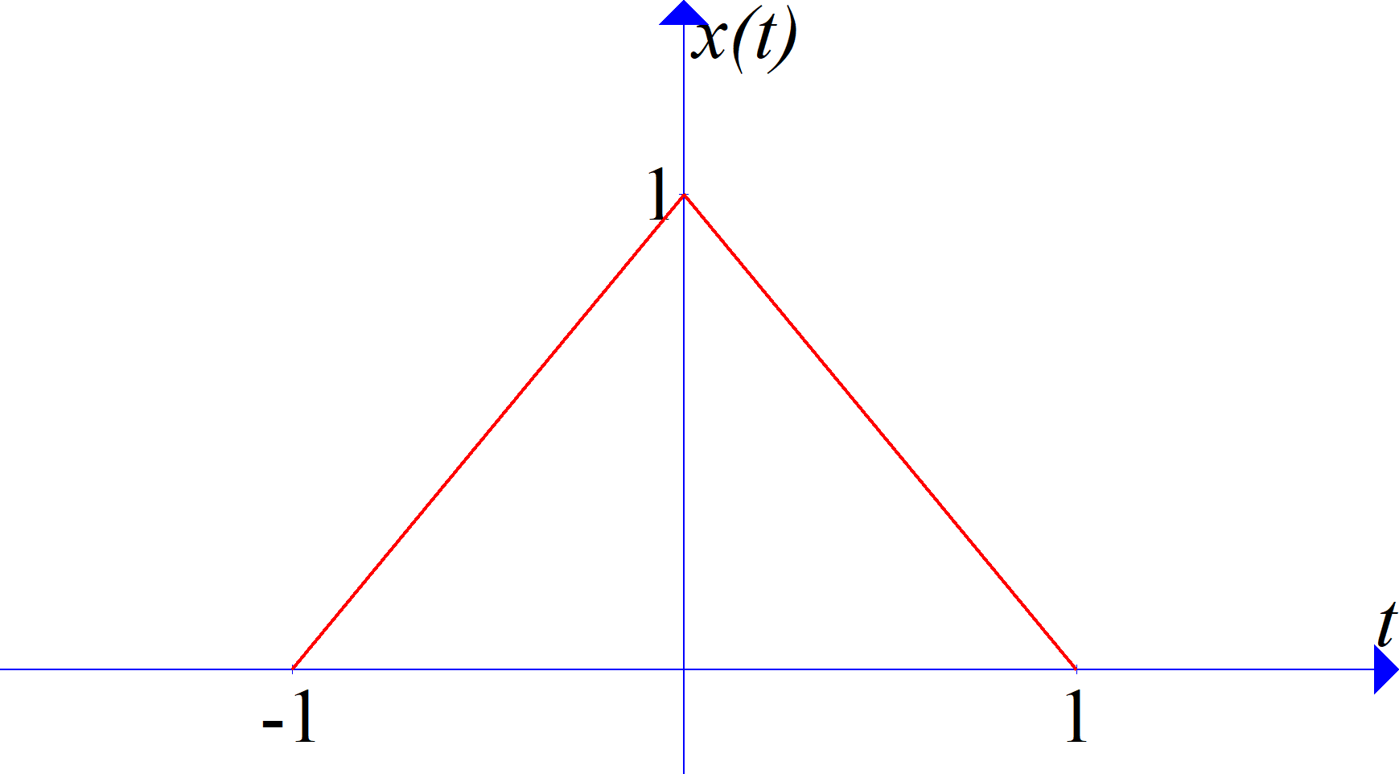




OPERATIONS: SHIFTING
27
Shifting operation
  : shift the signal x(t) to the right by
Shifting to the right by two units
  Why right?

Slide 28
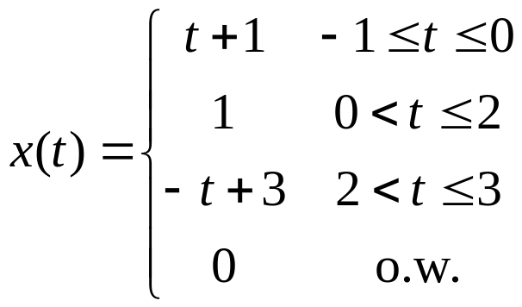

OPERATIONS: SHIFTING
28
Example
  Find
Notes:
(t+3)+1, -1 leq t+3 leq 0
1, 0 < t+3 leq 2
-(t+3)+3, 2 < t+3 leq 3
0, o.w
t+4, -4 leq t leq -3
1, -3 < t leq -1
-t, -1 < t leq 0
0, o.w.

Slide 29

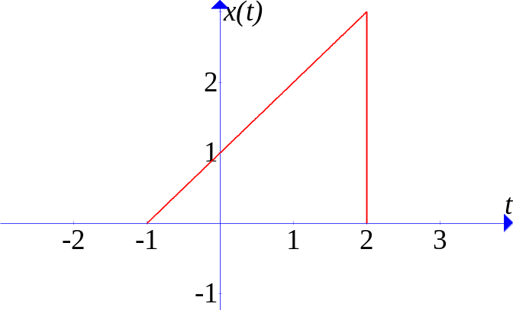
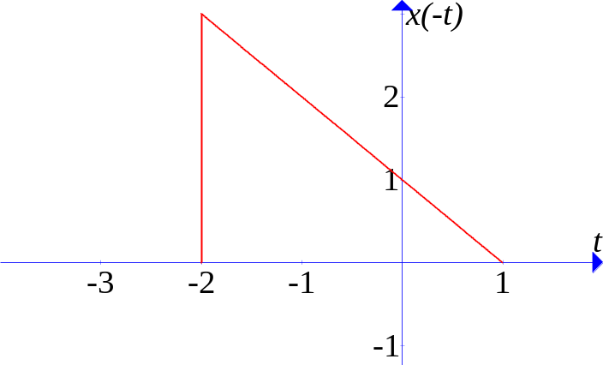
OPERATIONS: REFLECTION
29
Reflection operation
  is obtained by reflecting x(t) w.r.t. the y-axis (t = 0)
Reflection

Slide 30
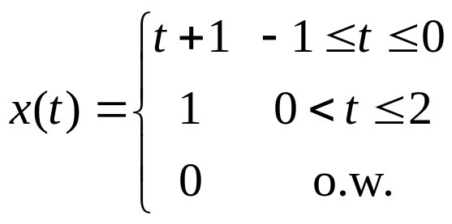
OPERATIONS: REFLECTION
30
Example:
  Find x(3-t)
The operations are always performed w.r.t. the time variable t directly!
Notes:
(3-t)+1, -1 leq 3-t leq 0
1. 0 < 3-t leq 2
0 o.w.
-t+4 3 leq t leq 4
1 leq t < 3
0 o.w.
y(t) = x(-t): reflection x(t)
y(t-3) = x(-(t-3))=x(-t+3): move y(t) to the right by 3

Slide 31



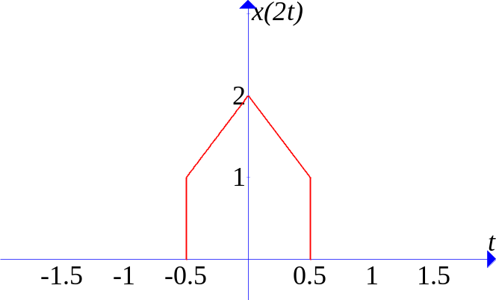
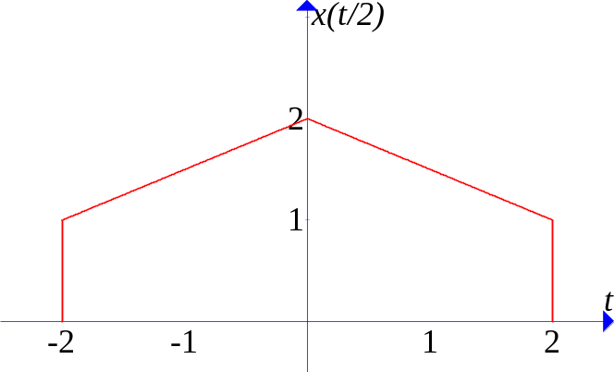
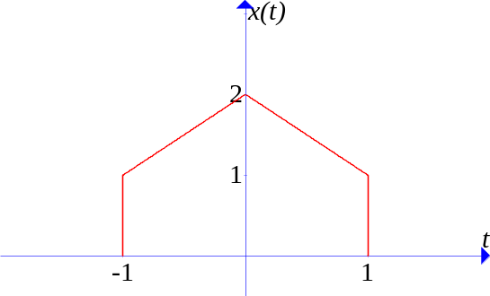
OPERATIONS: TIME-SCALING
31
Time-scaling operation
  is obtained by scaling the signal x(t) in time.
    , signal shrinks in time domain
    , signal expands in time domain
Time scaling

Slide 32


OPERATIONS: TIME-SCALING
32
Example:
  Find
  scale the signal by a: y(t) = x(at)
  left shift the signal by b/a: z(t) = y(t+b/a) = x(a(t+b/a))=x(at+b)
The operations are always performed w.r.t. the time variable t directly (be careful about –t or at)!
Notes:
3t-6+1 -1 leq 3t-6 leq 0
1 0 < 3t-6 leq 2
-(3t-6)+3 2 < 3t-6 leq 3
0 o.w.
3t-5 5/3 leq t leq 2
1 2 < t leq 8/3
-3t+9 8/3 < t leq 3
0 o.w.

Slide 33
OUTLINE
Signals
Classifications
Basic Signal Operations
Elementary Signals

Slide 34
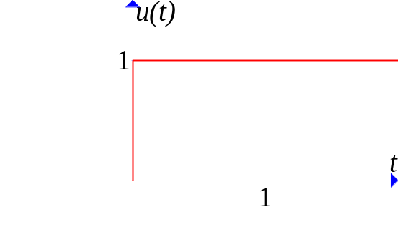
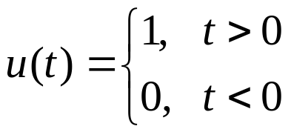
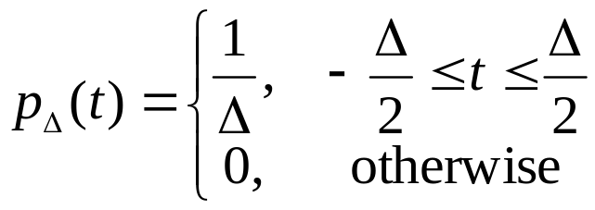
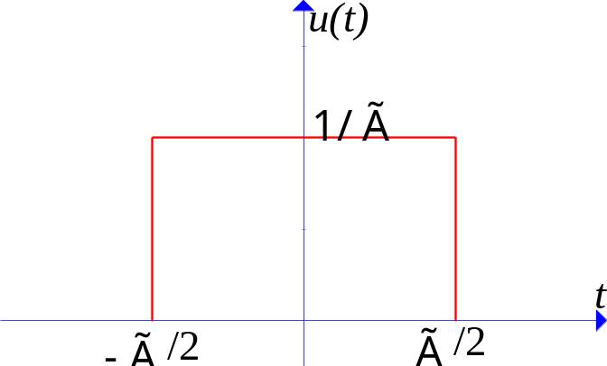

ELEMENTARY SIGNALS: UNIT STEP FUNCTION
34
Unit step function
Unit step function
Example: rectangular pulse
  Express as a function of u(t)
Rectangular pulse

Slide 35




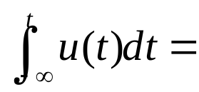
ELEMENTARY SIGNALS: RAMP FUNCTION
35
The Ramp function
Unit ramp function
  The Ramp function is obtained by integrating the unit step function u(t)
Notes:
int_0^t 1 dt = t|_0^t = t

Slide 36
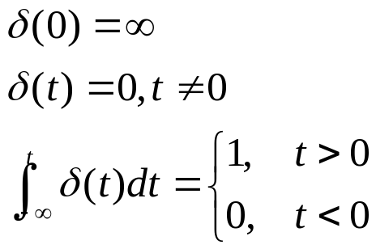


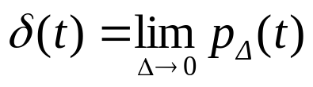

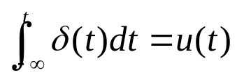
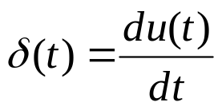
ELEMENTARY SIGNALS: UNIT IMPULSE FUNCTION
36
Unit impulse function (Dirac delta function)
Unit impulse function
  delta function can be viewed as the limit of the rectangular pulse
  Relationship between and u(t)
Rectangular pulse

Slide 37
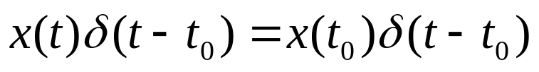
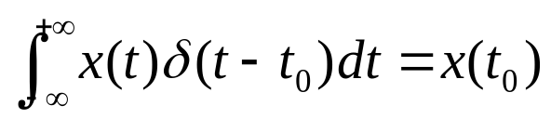
ELEMENTARY SIGNALS: UNIT IMPULSE FUNCTION
37
Sampling property
Shifting property
  Proof:

Slide 38
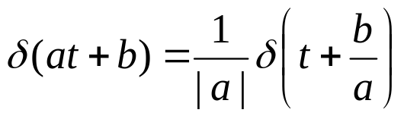
ELEMENTARY SIGNALS: UNIT IMPULSE FUNCTION
38
Scaling property
  Proof:
Notes:
rect(t/D)
rect(at/D) (area: 1/a)
lim_(D->0) = 1/a delta(t)
rect((at+b)= rect(a(t+b/a)/D)
Or:
p(t) → d to 0 → delta(t)
a P(at) → d to 0 → a delta( at)

Slide 39
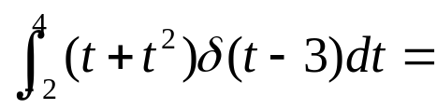

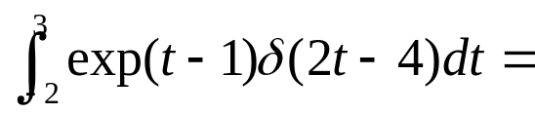
ELEMENTARY SIGNALS: UNIT IMPULSE FUNCTION
39
Examples
Notes:
3+3^2 = 12
0
tau = 2t – 4
d tau = 2 dt
t = (tau+4)/2
t = -2 ➔ tau = -8
t = 3 ➔ tau = 2
int_{-8}^2 exp(tau/2+1) delta(tau) 1/2 d tau = 1/2 exp(1)
1/2 delta(t-2)
1/2 int_{-2}^3 exp(t-1) delta(t-2) dt = 1/2 exp(1).

Slide 40







ELEMENTARY SIGNALS: SAMPLING FUNCTION
40
Sampling function
Sampling function
  Sampling function can be viewed as scaled version of sinc(x)
Sinc function

Slide 41


ELEMENTARY SIGNALS: COMPLEX EXPONENTIAL
41
Complex exponential
  Is it periodic?
Example:
  Use Matlab to plot the real part of

Slide 42
SUMMARY
42
Signals and Classifications
  Mathematical representation
  Continuous-time v.s. discrete-time
  Analog v.s. digital
  Odd v.s. even
  Periodic v.s. aperiodic
  Power v.s. energy
Basic Signal Operations
  Time shifting
  reflection
  Time scaling
Elementary Signals
  Unit step, unit impulse, ramp, sampling function, complex exponential

