Slide 1
ELEG 3124 SYSTEMS AND SIGNALS
Ch. 2 Continuous-Time Systems
Dr. Jingxian Wu
wuj@uark.edu

Slide 2
OUTLINE
Classifications of continuous-time system
Linear time-invariant system (LTI)
Properties of LTI system
System described by differential equations

Slide 3




CLASSIFICATIONS: SYSTEM DEFINITION
What is system?
  A system is a process that transforms input signals into output signals
    Accept an input
    Process the input
    Send an output (also called: the response of the system to input)
  System examples:
    Radio: input: electrical signals from air, output: music
    Robot: input: electrical control signals, output: motion or action
Continuous-time system
  A system in which continuous-time input signals are transformed to continuous-time output signals
Discrete-time system
  A system in which discrete-time input signals are transformed to discrete-time output signals.
continuous-time
System
Discrete-time
System
Continuous-time system
discrete-time system

Slide 4
CLASSIFICATIONS: SYSTEM DEFINITION
Classifications
  Linear v.s. non-linear
  Time-invariant v.s. time-varying
  Dynamic v.s. static (memory v.s. memoryless)
  Causal v.s. non-causal
  Invertible v.s. non-invertible
  Stable v.s. non-stable

Slide 5










CLASSIFICATIONS: LINEAR AND NON-LINEAR
Linear system
  Let be the response of a system to an input
  Let be the response of a system to an input
  The system is linear if the superposition principle is satisfied:
    1. the response to is
    2. the response to is
Linear
System
Linear system
Non-linear system
  If the superposition principle is not satisfied, then the system is a non-linear system

Slide 6

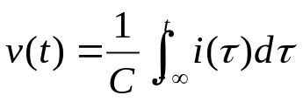
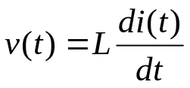
CLASSIFICATIONS: LINEAR AND NON-LINEAR
Example: check if the following systems are linear
  System 1:
  System 2: charge a capacitor. Input: i(t), output v(t)
  System 3: inductor. Input: i(t), output v(t)
Notes:
1. exp(ax1(t)+bx2(t)) = exp(ax1(t)) * exp(bx2(t)
ay1(t)+by2(t) = a exp(x1(t)) + b exp(x2(t))
2. i(t) = c dv(t)/dt
V(t) = 1/C int_{-inf}^t i(tau) d tau
3. v(t) = L d i(t)/dt

Slide 7



CLASSIFICATIONS: LINEAR AND NON-LINEAR
Example
  System 4:
  System 5:
  System 6:

Slide 8
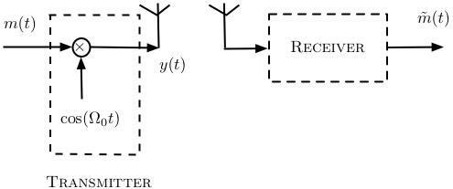
CLASSIFICATIONS: LINEAR V.S. NON-LINEAR
Example:
  Amplitude Modulation:
    Is it linear?
Amplitude modulation

Slide 9




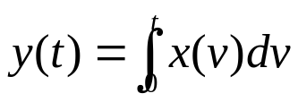
CLASSIFICATIONS: TIME-VARYING V.S. TIME-INVARIANT
Time-invariant
  A system is time-invariant if a time shift in the input signal causes an identical time shift in the output signal
Time-invariant
System
Time-invariant
System
Time-invariant system
Examples
  y(t) = cos(x(t))
Notes:
TI
TV

Slide 10

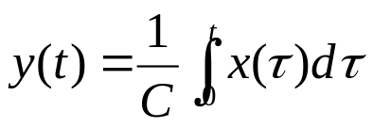
CLASSIFICATIONS: MEMORY V.S. MEMORYLESS
Memoryless system
  If the present value of the output depends only on the present value of input, then the system is said to be memoryless (or instantaneous).
  Example: input x(t): the current passing through a resistor
  output y(t): the voltage across the resistor
  The output value at time t depends only on input value at time t.
System with memory
  If the present value of the output depends on not only present value of input, but also previous input values, then the system has memory.
  Example: capacitor, current: x(t), output voltage: y(t)
  the output value at t depends on all input values before t

Slide 11
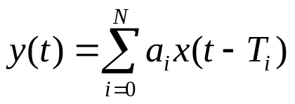

CLASSIFICATIONS: MEMORY V.S. MEMORYLESS
Examples: determine if the systems has memory or not

Slide 12


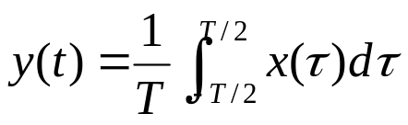


CLASSIFICATIONS: CAUSAL V.S. NON-CAUSAL
Causal system
  A system is causal if the output depends only on values of input for
    The output depends on only input from the past and present
  Example
Non-causal system
  A system is non-causal if the output depends on the input from the future (prediction).
  Examples:
  The output value at t depends on the input value at t + a (from future)
  All practical systems are causal.

Slide 13


CLASSIFICATION: INVERTIBILITY
Invertible
  A system is invertible if
    by observing the output, we can determine its input.
System
Inverse
System
invertible system
  Question: for a system, if two different inputs result in the same output, is this system invertible?
Example
  If two different inputs result in the same output, the system is non-invertible
Notes:
z(t) = 1/2 y(t) = 1/2 * 2x(t) = x(t)
y(t) = cos x(t)
y(t) = cos (x(t) + 2pi)

Slide 14




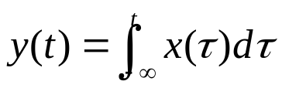
CLASSIFICATION: STABILITY
Bounded signal
  Definition: a signal x(t) is said to be bounded if
Bounded-input bounded-output (BIBO) stable system
  Definition: a system is BIBO stable if, for any bounded input x(t), the response y(t) is also bounded.
Example: determine if the systems are BIBO stable
Notes:
|y(t)|<exp[|x(t)|] < exp(B) < inf
x(t) = u(t)
y(t) = int_0^t 1 d tau = t -> inf

Slide 15
OUTLINE
Classifications of continuous-time system
Linear time-invariant system (LTI)
Properties of LTI system
System described by differential equations

Slide 16


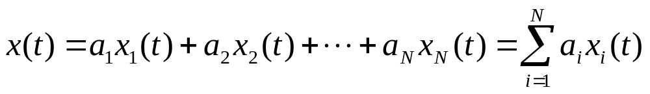
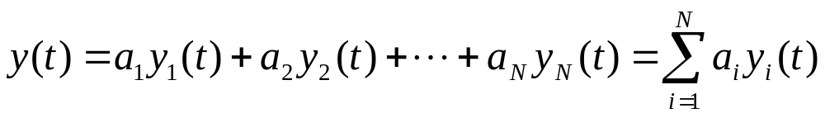


LTI: DEFINTION
Linear time-invariant (LTI) system
  Definition: a system is said to be LTI if it’s linear and time-invariant
System
system
  Linear
  Input:
  Output:
  Time-invariant
  Input:
  Output:

Slide 17


LTI: IMPULSE RESPONSE
Impulse response of LTI system
  Def: the output (response) of a system when the input is a unit impulse function (delta function).
    Usually denoted as h(t)
System
LTI system
For system with an arbitrary input x(t), we want to find out the output y(t).
  Method 1: differential equations
  Methods 2: convolution integral
  Methods 3: Laplace transform, Fourier transform,

Slide 18
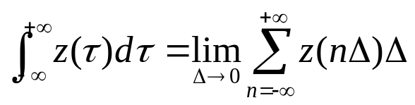
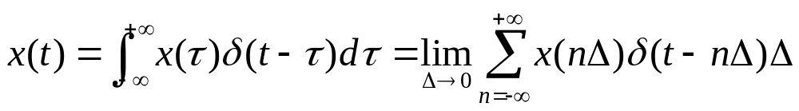
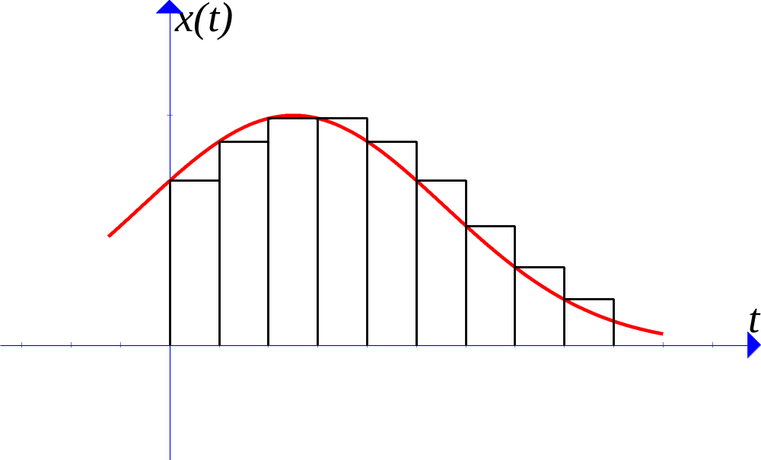
LTI: CONVOLUTION
Derivation
  Any signal can be approximated by the sum of a sequence of delta functions
integration

Slide 19




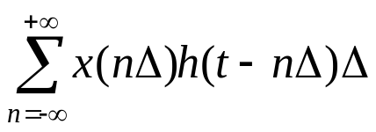
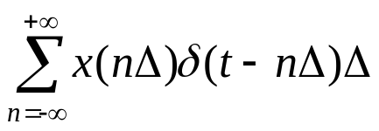
LTI: CONVOLUTION
Derivation
  Any signal can be approximated by the sum of a sequence of delta functions
System
  Time invariant
System
  Linear
System
LTI system

Slide 20
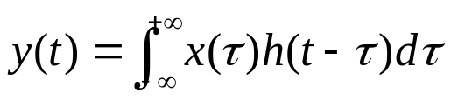

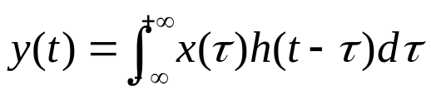

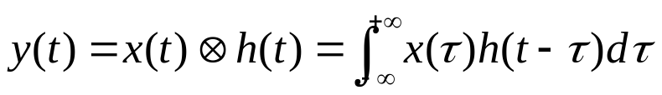


LTI: CONVOLUTION
Convolution
System
LTI system
  Definition: the convolution of two signals x(t) and h(t) is defined as
  The operation of convolution is usually denoted with the symbol
h(t)
LTI system
For LTI system, if we know input x(t) and impulse response h(t),
Then the output is

Slide 21



LTI: CONVOLUTION
Examples

Slide 22



LTI: CONVOLUTION
Examples
LTI system

Slide 23
LTI: CONVOLUTION
Example
  Obtain the impulse response of a capacitor and use it to find the unit-step response by using convolution. Assume the input is the current, and the output is the voltage. Let C = 1F.
Notes:
i(t) = C d v(t)/dt
v(t) = 1/C int i( tau) d tau
H(t) = 1/C u(t)

Slide 24

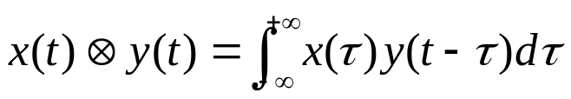


LTI: CONVOLUTION PROPERTIES
Commutativity
  Proof:
h(t)
⬅➔
x(t)
commutativity
Notes:
Int_{-inf}^{inf} x(tau) y(t – tau) d tau
Let z = t – tau, then dz = - d tau
Tau = t – z
= int_{-inf}^{inf} x (t-z) y(z) dz
= int y(tau) x(t-tau) d tau = y(t) * x(t)

Slide 25





LTI: CONVOLUTION PROPERTIES
Associativity
  proof
⬅➔
Associativity
Notes:
Int int x(tau) h1( alpha – tau) h2(t-alpha) d tau d alpha
= Int int x(tau) h1(beta) h2(t-beta – tau) d beta d tau
= int x(tau) [int h1(beta) h2(t-tau-beta) d beta] d tau
= int x(tau) h(t-tau) d tau

Slide 26

LTI: CONVOLUTION PROPERTIES
Distributivity
  proof
+
⬅➔
Distributivity

Slide 27







LTI: CONVOLUTION PROPERTIES
Examples
+
LTI system

Slide 28
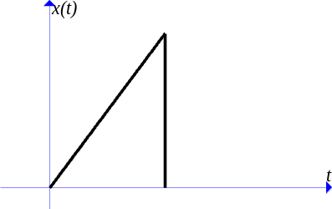
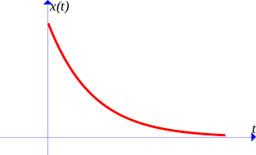
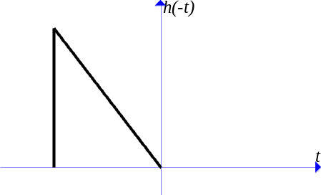


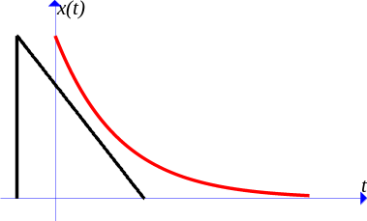


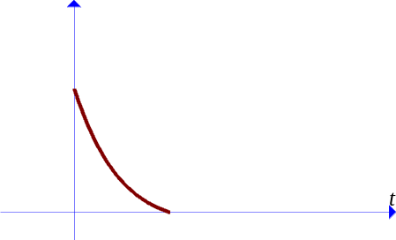


LTI: GRAPHICAL CONVOLUTION
Graphical interpretation of convolution
  1. Reflection
  2. Shift
  2. Shift
  3. Multiplication
  4. Integration

Slide 29

LTI: GRAPHICAL CONVOLUTION
Example

Slide 30
OUTLINE
Classifications of continuous-time system
Linear time-invariant system (LTI)
Properties of LTI system
System described by differential equations

Slide 31




LTI PROPERTIES
Memoryless LTI system
  Review: present output only depends on present input
  The impulse response of Memoryless LTI system is
Causal LTI system
  Review: output depends on only current input and past input.
  The impulse response of causal LTI system must satisfy:
  Why?
Notes:
Y(t) = int x(tau) h(t-tau) = int_{-inf}^t x(tau) h(t-tau) dtau + int_{t}^{inf} x(tau) h(t-tau) d tau

Slide 32





LTI PROPERTIES
Invertible LTI Systems
  Review: a system is invertible iff (if and only if) there is an inverse system that, when connected in cascade with the original system, yields an output equal to original system input
h(t)
g(t)
  For invertible LTI systems with IR (impulse response) , there exists inverse system such that
  Example: find the inverse system of LTI system

Slide 33
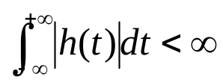
LTI PROPERTIES
BIBO Stable LTI state
  Review: a system is BIBO stable iff every bounded input produces a bounded output.
  LTI system: an LTI system is BIBO stable iff
    Proof:

Slide 34


LTI PROPERTIES
Examples
  Determine: causal or non-causal, memory or memoryless, stable or unstable
  1.
  2.
  3.

Slide 35
OUTLINE
Classifications of continuous-time system
Linear time-invariant system (LTI)
Properties of LTI system
System described by differential equations

Slide 36
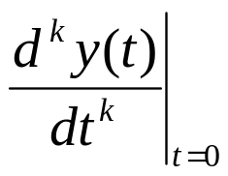

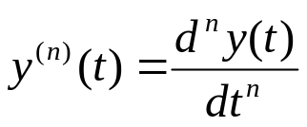
DIFFERENTIAL EQUATIONS
LTI system can be represented by differential equations
  Initial conditions:
  Notation: n-th derivative:

Slide 37



DIFFERENTIAL EQUATION
Example:
  Consider a circuit with a resistor R = 1 Ohm and an inductor L = 1H, with a voltage source v(t) = Bu(t), and is the initial current in the inductor. The output of the system is the current across the inductor.
    Represent the system with a differential equation.
    Find the output of the system with and
Notes:
V_L(t) = L di(t)/dt
V(t) = R*i(t) + L di(t)/dt
Bu(t) = i(t) + d i(t)/dt
i(0) = I_0
i(t) = [I_0 e^(-t) + B(1-e^(-t))] u(t)

Slide 38



DIFFERENTIAL EQUATION
Zero-state response
  The output of the system when the initial conditions are zero
  Denoted as
Zero-input response
  The output of the system when the input is zero
  Denoted as
The actual output of the system

Slide 39
DIFFERENTIAL EQUATION
Example
  Find the zero-state output and zero-input response of the RL circuit in the previous example.
Notes:
Zs: B(1-e^{-t}) u(t)
ZI: I0 exp(-t) u(t)

