Slide 1
ELEG 3124 SYSTEMS AND SIGNALS
Ch. 4 Fourier Series
Dr. Jingxian Wu
wuj@uark.edu

Slide 2
OUTLINE
Introduction
Fourier series
Properties of Fourier series
Systems with periodic inputs

Slide 3
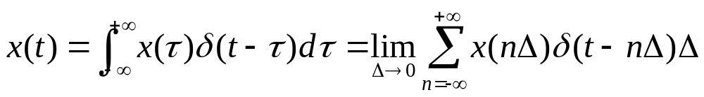
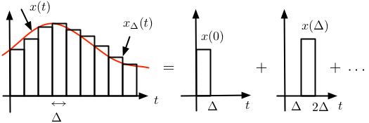
INTRODUCTION: MOTIVATION
Motivation of Fourier series
  Convolution is derived by decomposing the signal into the sum of a series of delta functions
    Each delta function has its unique delay in time domain.
    Time domain decomposition

Slide 4
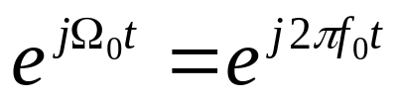
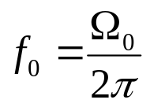
INTRODUCTION: MOTIVATION
Can we decompose the signal into the sum of other functions
  Such that the calculation can be simplified?
  Yes. We can decompose periodic signal as the sum of a sequence of complex exponential signals ➔ Fourier series.
  Why complex exponential signal? (what makes complex exponential signal so special?)
    1. Each complex exponential signal has a unique frequency ➔ frequency decomposition
    2. Complex exponential signals are periodic

Slide 5

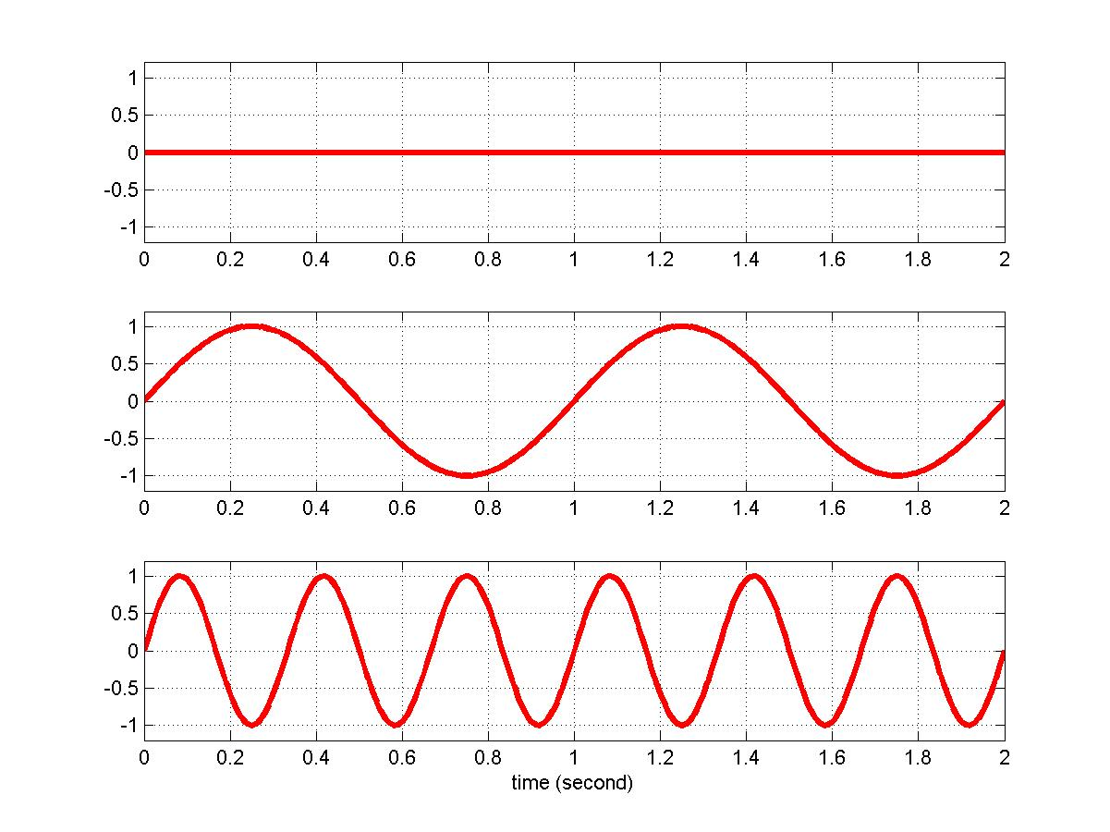
INTRODUCTION: REVIEW
Complex exponential signal
  Complex exponential function has a one-to-one relationship with sinusoidal functions.
  Each sinusoidal function has a unique frequency: f
What is frequency?
  Frequency is a measure of how fast the signal can change within a unit time.
    Higher frequency ➔ signal changes faster
f = 0 Hz
f = 1 Hz
Department of Engineering Science
Sonoma State University
f = 3 Hz

Slide 6

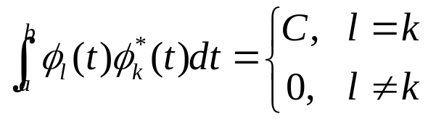



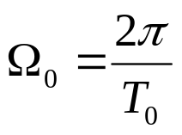
INTRODUCTION: ORTHONORMAL SIGNAL SET
Definition: orthogonal signal set
  A set of signals, , are said to be orthogonal over an interval (a, b) if
Example:
  the signal set: are orthogonal over the interval , where

Slide 7
OUTLINE
Introduction
Fourier series
Properties of Fourier series
Systems with periodic inputs

Slide 8

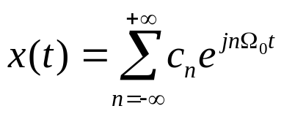
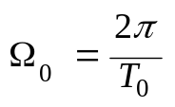

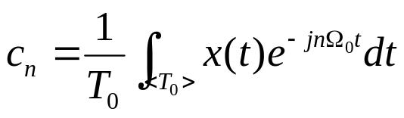

FOURIER SERIES
Definition:
  For any periodic signal with fundamental period , it can be decomposed as the sum of a set of complex exponential signals as
    , Fourier series coefficients
derivation of

Slide 9

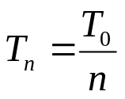





FOURIER SERIES
Fourier series
  The periodic signal is decomposed into the weighted summation of a set of orthogonal complex exponential functions.
  The frequency of the n-th complex exponential function:
    The periods of the n-th complex exponential function:
  The values of coefficients, , depend on x(t)
    Different x(t) will result in different
    There is a one-to-one relationship between x(t) and
⬅➔
  For a periodic signal, it can be either represented as s(t), or represented as

Slide 10
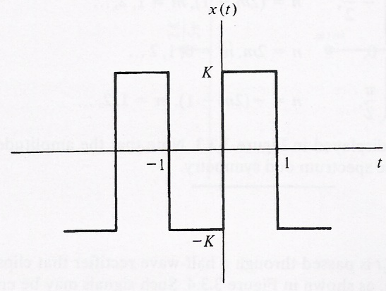
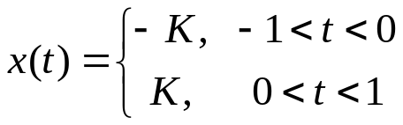
FOURIER SERIES
Example

Slide 11

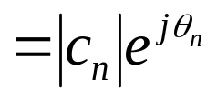

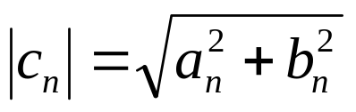
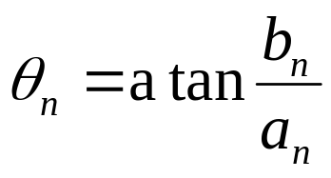
FOURIER SERIES
Amplitude and phase
  The Fourier series coefficients are usually complex numbers
  Amplitude line spectrum: amplitude as a function of
  Phase line spectrum: phase as a function of

Slide 12
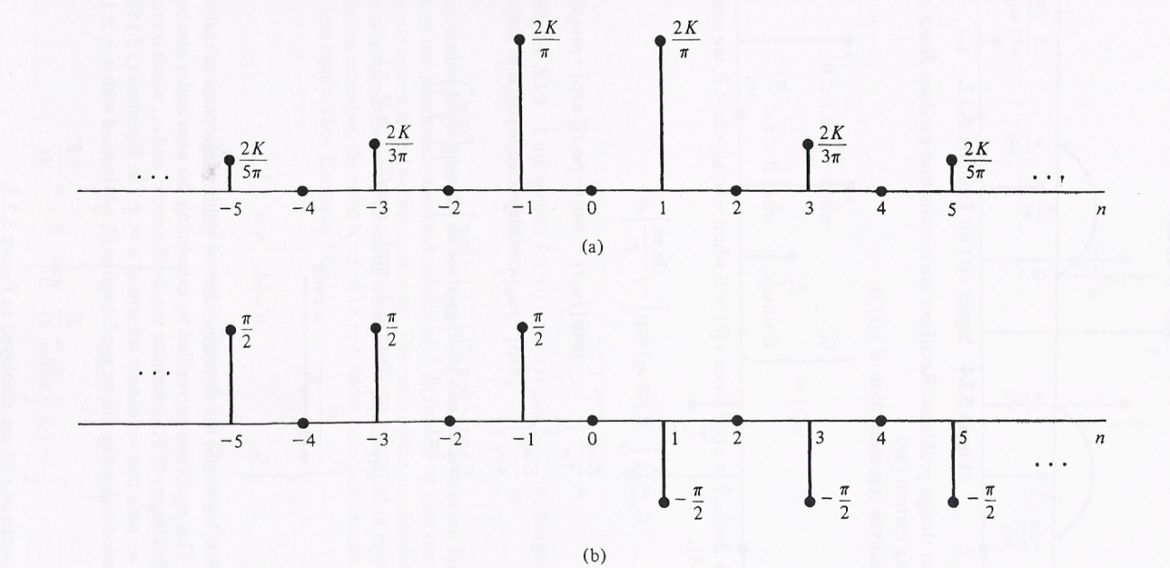


FOURIER SERIES: FREQUENCY DOMAIN
Signal represented in frequency domain: line spectrum
amplitude
phase
  Each has its own frequency
  The signal is decomposed in frequency domain.
  is called the harmonic of signal s(t) at frequency
  Each signal has many frequency components.
    The power of the harmonics at different frequencies determines how fast the signal can change.

Slide 13
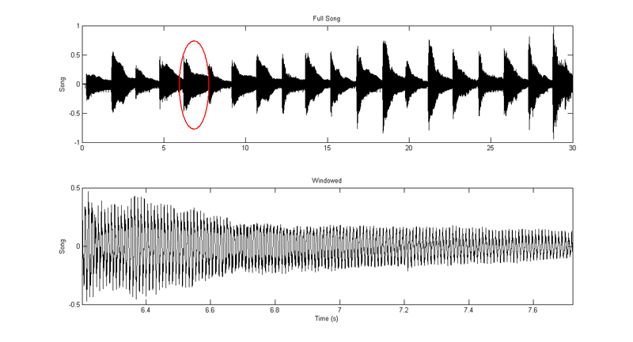
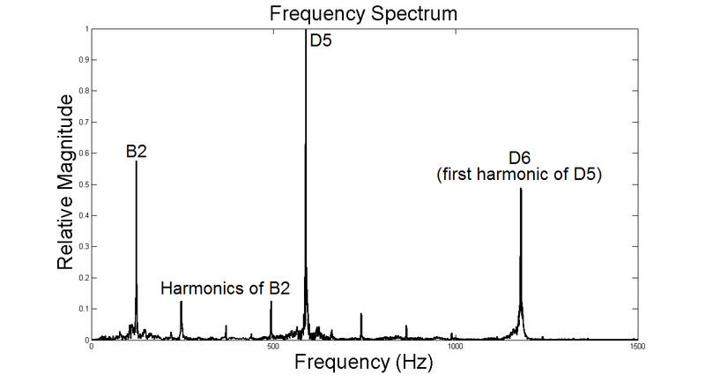
FOURIER SERIES: FREQUENCY DOMAIN
Example: Piano Note
B2: 123.47 Hz
B3: 246.94 Hz
D5: 587.33 Hz
D6: 1,174.66 Hz

Slide 14

FOURIER SERIES
Example
  Find the Fourier series of

Slide 15
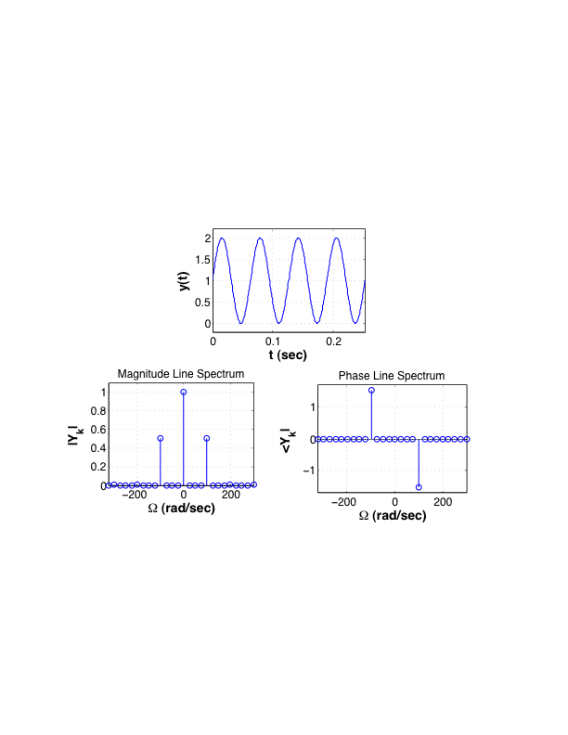


FOURIER SERIES
Example
  Find the Fourier series of

Slide 16
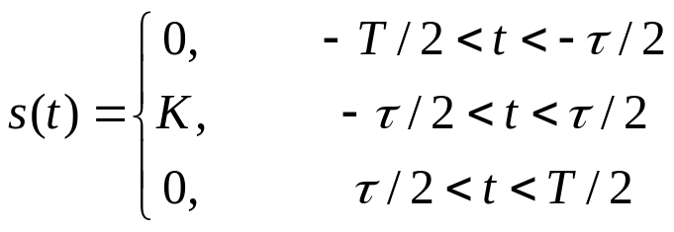
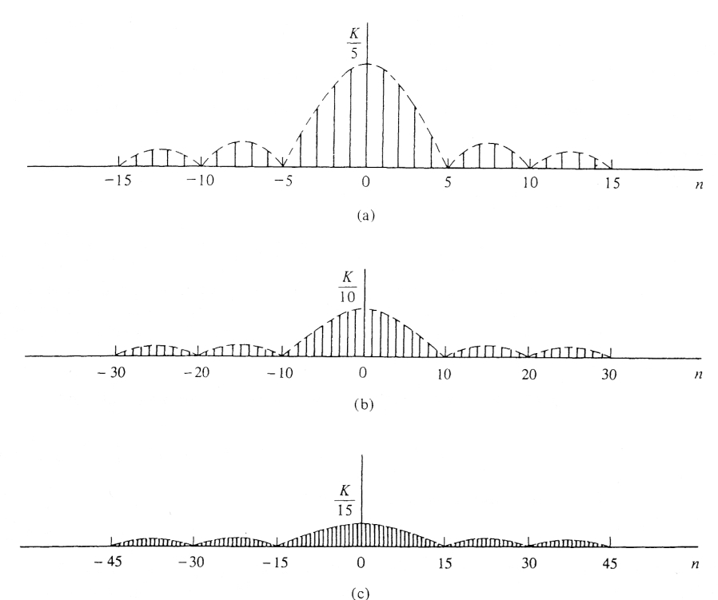
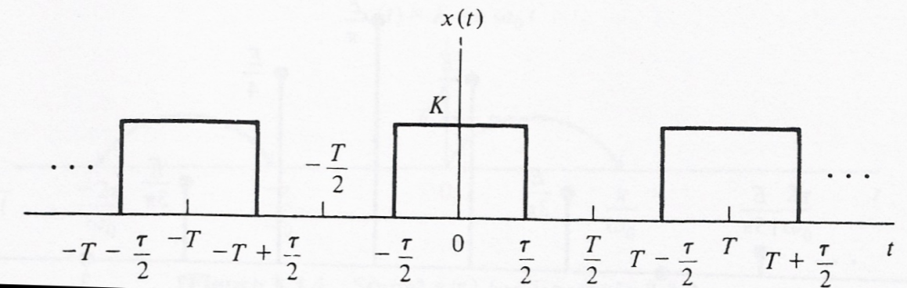


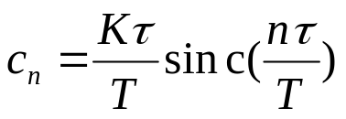

FOURIER SERIES
Example
  Find the Fourier series of
frequency domain

Slide 17
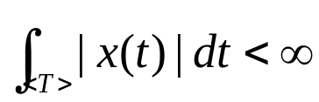
FOURIER SERIES: DIRICHLET CONDITIONS
Can any periodic signal be decomposed into Fourier series?
  Only signals satisfy Dirichlet conditions have Fourier series
Dirichlet conditions
  1. x(t) is absolutely integrable within one period
  2. x(t) has only a finite number of maxima and minima.
  3. The number of discontinuities in x(t) must be finite.

Slide 18
OUTLINE
Introduction
Fourier series
Properties of Fourier series
Systems with periodic inputs

Slide 19
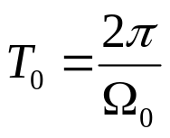
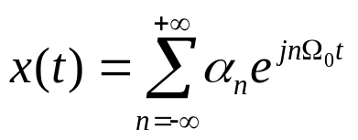
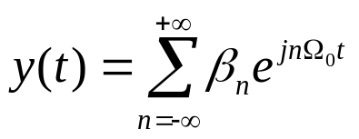
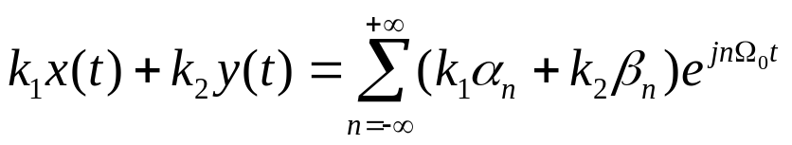



PROPERTIES: LINEARITY
Linearity
  Two periodic signals with the same period
  The Fourier series of the superposition of two signals is
  If
    then

Slide 20


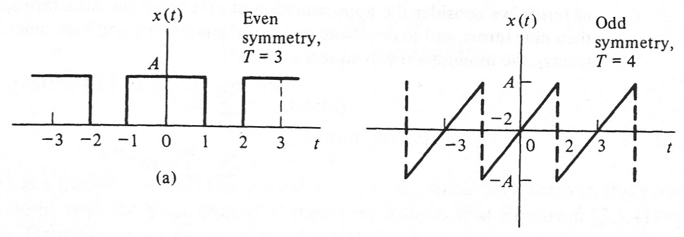
PROPERTIES: EFFECTS OF SYMMETRY
Symmetric signals
  A signal is even symmetry if:
  A signal is odd symmetry if:
  The existence of symmetries simplifies the computation of Fourier series coefficients.

Slide 21
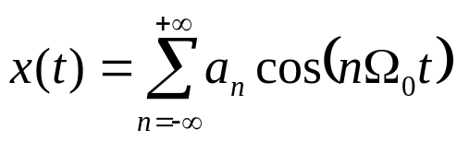
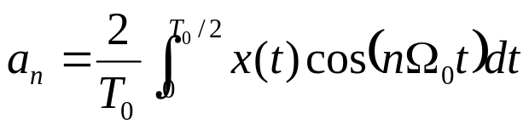
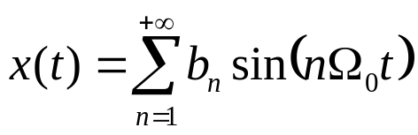
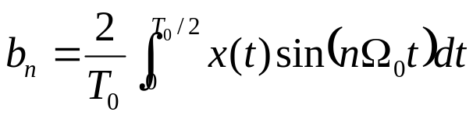
PROPERTIES: EFFECTS OF SYMMETRY
Fourier series of even symmetry signals
  If a signal is even symmetry, then
Fourier series of odd symmetry signals
  If a signal is odd symmetry, then

Slide 22
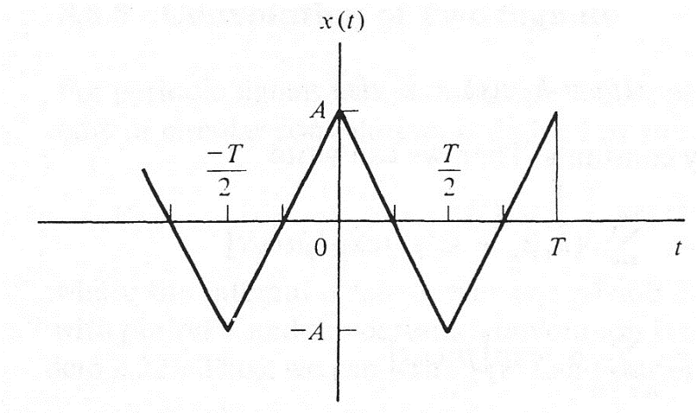
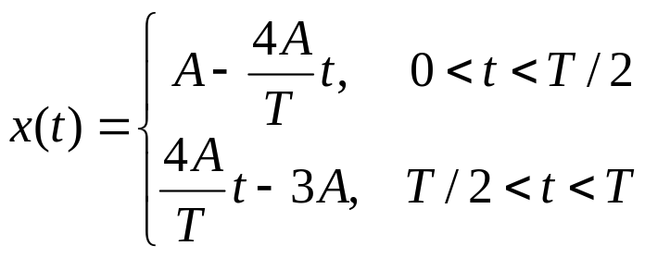
PROPERTIES: EFFECTS OF SYMMETRY
Example

Slide 23



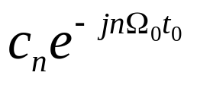


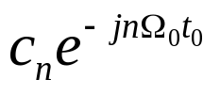
PROPERTIES: SHIFT IN TIME
Shift in time
  If has Fourier series , then has Fourier series
if
⬅➔
, then
⬅➔
  Proof:

Slide 24
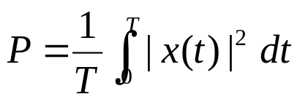

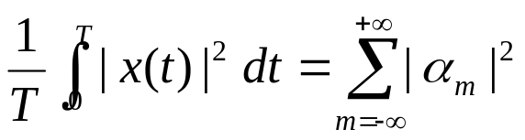
PROPERTIES: PARSEVAL’S THEOREM
Review: power of periodic signal
Parseval’s theorem
if
⬅➔
then
  Proof:
  The power of signal can be computed in frequency domain!

Slide 25

PROPERTIES: PARSEVAL’S THEOREM
Example
  Use Parseval’s theorem find the power of

Slide 26
OUTLINE
Introduction
Fourier series
Properties of Fourier series
Systems with periodic inputs

Slide 27




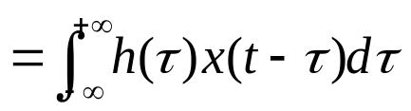
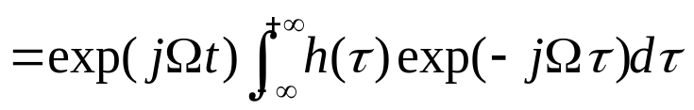
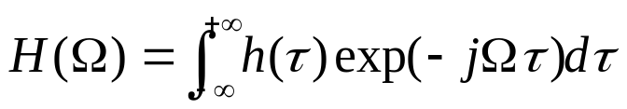

PERIODIC INPUTS: COMPLEX EXPONENTIAL INPUT
LTI system with complex exponential input
Transfer function
  For LTI system with complex exponential input, the output is
  It tells us the system response at different frequencies

Slide 28

PERIODIC INPUT
Example:
  For a system with impulse response
  find the transfer function

Slide 29
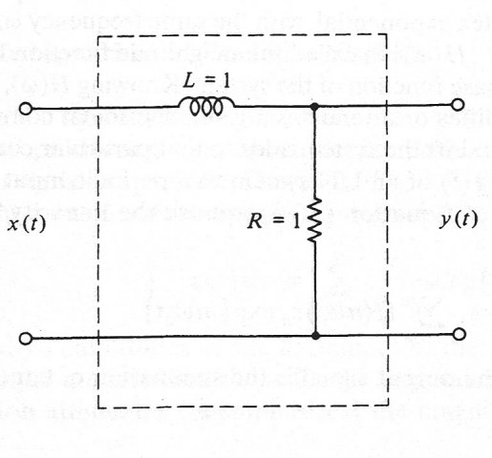
PERIODIC INPUT:
Example
  Find the transfer function of the system shown in figure.
Notes:
V_l(t) = L di(t)/dt
i(t) = y(t)/R
V_l(t) = L/R dy(t)/dt
X(t) = L/R dy(t)/dt + y(t)
dy(t)/dt + R/L y(t) = R/L x(t)
X(t) = exp( j wt)
Y(t) = exp(jwt)H(w)
Jw H(w) exp(jwt) + R/L exp(jwt) H(w) = R/L exp(jwt)
H(w) = R/L/(R/L + jw) = 1/(1 + j w L/R)

Slide 30
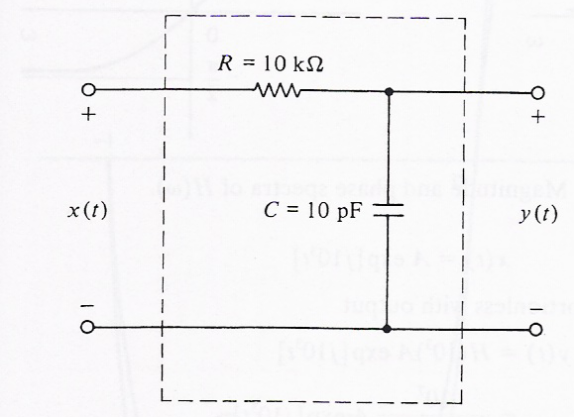
PERIODIC INPUTS
Example
  Find the transfer function of the system shown in figure
Notes:
RC dy(t)/dt + y(t) = x(t)
RC jw exp(jwt) H(w) + exp(jwt)H(w) = exp(jwt)
H(w) = 1/(1 + j w RC)

Slide 31
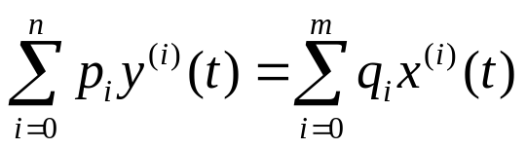
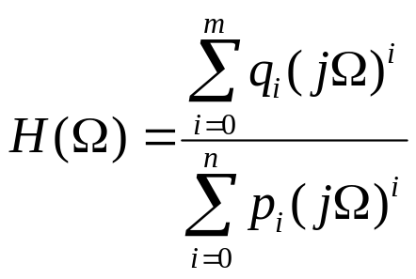
PERIODIC INPUTS: TRANSFER FUNCTION
Transfer function
  For system described by differential equations

Slide 32
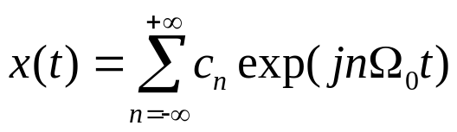
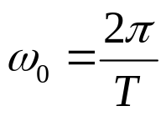

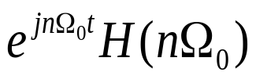



PERIODIC INPUTS
LTI system with periodic inputs
  Periodic inputs:
linear:
For system with periodic inputs, the output is the weighted
sum of the transfer function.

Slide 33




PERIODIC INPUTS
Procedures:
  To find the output of LTI system with periodic input
    1. Find the Fourier series coefficients of periodic input x(t).
    2. Find the transfer function of LTI system
period of x(t)
    3. The output of the system is

Slide 34

PERIODIC INPUTS
Example
  Find the response of the system when the input is
Notes:
H(w) = 1/(1 + jw L/R) = 1/(1+jw)
X(t) = 2(exp(jt)+exp(-jt)) – [exp(j2t)+exp(-j2t)]
Y(t) = 2 exp(jt)/(1+j) + 2 exp(-jt)/(1-j) – exp(j2t)/(1+2j)-exp(-j2t)/(1-2j)

Slide 35

PERIODIC INPUTS
Example
  Find the response of the system when the input is shown in figure.
Notes:
Cn = [1-(-1)^n] K/(j n pi) = 2K/(j pi) * 1/n, n odd
Y(t) = 2K/(j pi)*\sum_{n odd} 1/n H(n pi) exp(j n pi t)
= 2K/(j pi)*\sum_{n odd} 1/n 1/(1 + j n pi R C) exp(j n pi t)

Slide 36


PERIODIC INPUTS: GIBBS PHENOMENON
The Gibbs Phenomenon
  Most Fourier series has infinite number of elements→ unlimited bandwidth
    What if we truncate the infinite series to finite number of elements?
      The truncated signal, , is an approximation of the original signal x(t)

Slide 37







PERIODIC INPUTS: GIBBS PHENOMENON

Slide 38

FOURIER SERIES
Analogy: Optical Prism
  Each color is an Electromagnetic wave with a different frequency

