Slide 1
ELEG 3124 SYSTEMS AND SIGNALS
Ch. 5 Fourier Transform
Dr. Jingxian Wu
wuj@uark.edu

Slide 2
OUTLINE
Introduction
Fourier Transform
Properties of Fourier Transform
Applications of Fourier Transform

Slide 3
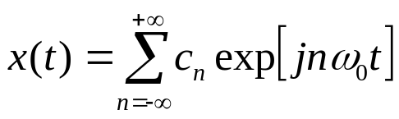
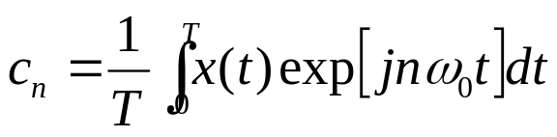
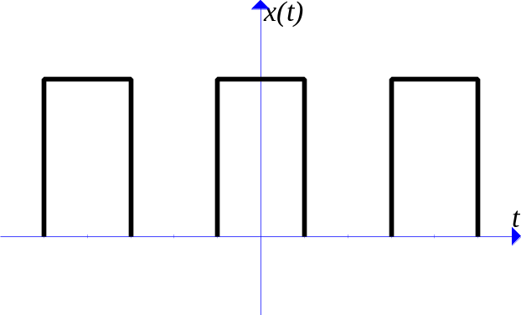
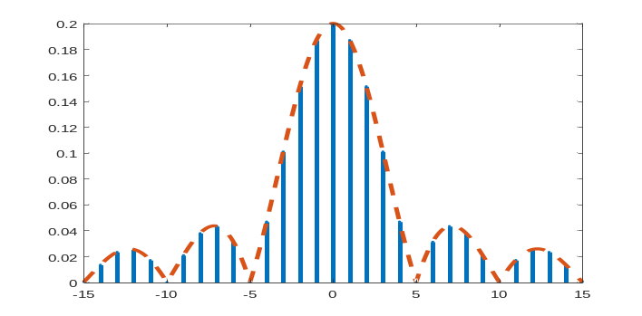
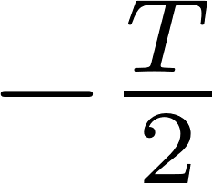
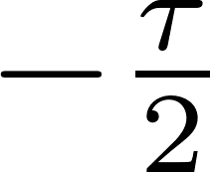


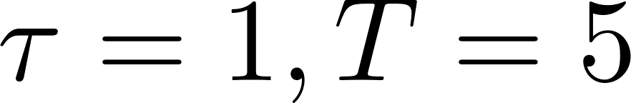

INTRODUCTION: MOTIVATION
Motivation:
  Fourier series: periodic signals can be decomposed as the summation of orthogonal complex exponential signals
    each harmonic contains a unique frequency: n/T
Time domain
Frequency domain
    time domain ⬅➔ frequency domain
How about aperiodic signals ?

Slide 4

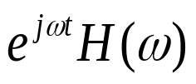

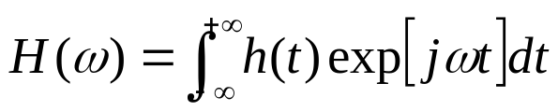

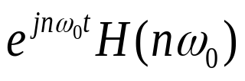
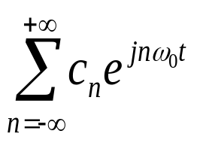
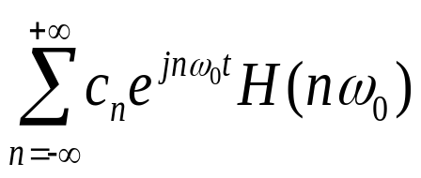

INTRODUCTION: TRANSFER FUNCTION
System transfer function
System with periodic inputs

Slide 5
OUTLINE
Introduction
Fourier Transform
Properties of Fourier Transform
Applications of Fourier Transform

Slide 6
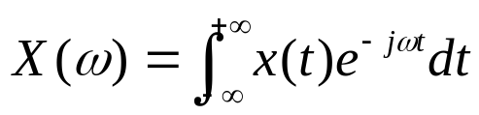

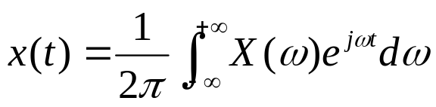


FOURIER TRANSFORM
Fourier Transform
  given x(t), we can find its Fourier transform
Inverse Fourier Transform
  given , we can find the time domain signal x(t)
  signal is decomposed into the “weighted summation” of complex exponential functions. (integration is the extreme case of summation)
⬅➔

Slide 7

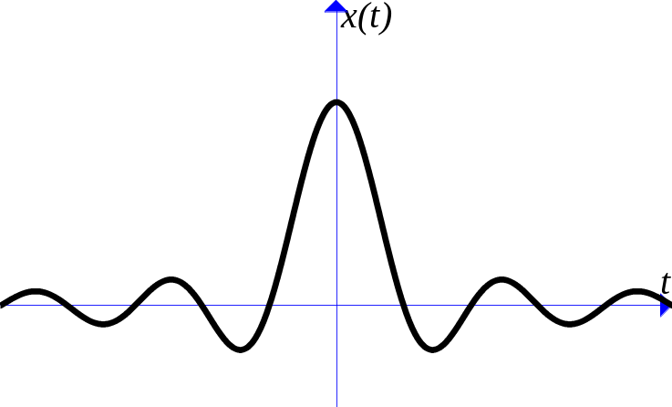
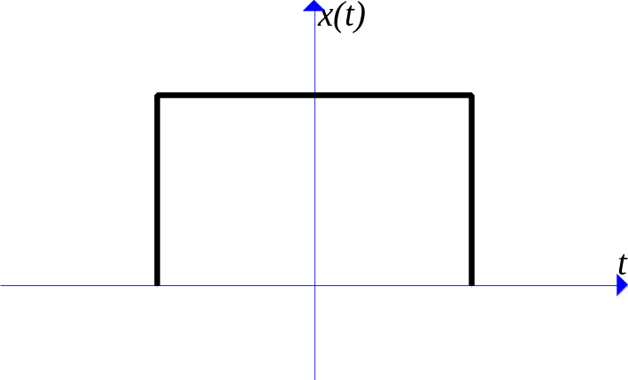

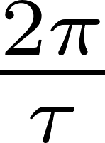
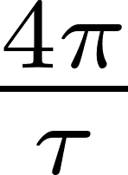
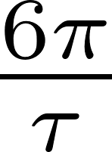
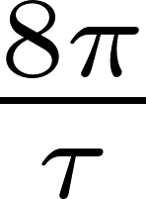
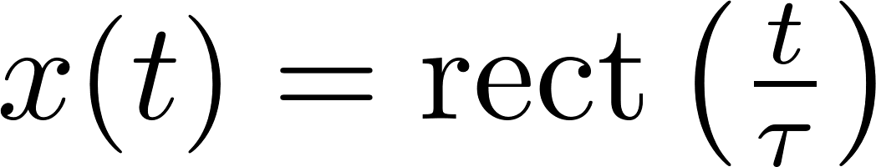
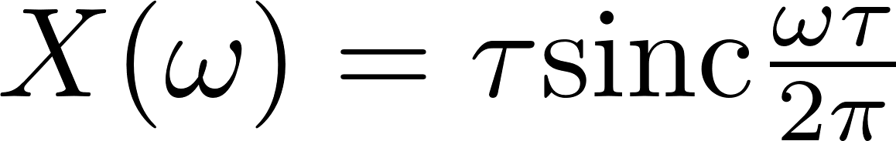
FOURIER TRANSFORM
Example
  Find the Fourier transform of
Notes:
X(w) = 2/omega*sin(omega*tau/2) = sin(pi *(omega*tau)/(2pi))/[pi (omega*tau/(2 pi))] * tau
=tau*sinc(omega * tau/(2pi))

Slide 8


FOURIER TRANSFORM
Example
  Find the Fourier transform of
Notes:
2a/(a^2 + w^2)

Slide 9

FOURIER TRANSFORM
Example
  Find the Fourier transform of
Notes:
1/(a+jw)

Slide 10

FOURIER TRANSFORM
Example
  Find the Fourier transform of
Notes:
Exp(-jwa)

Slide 11
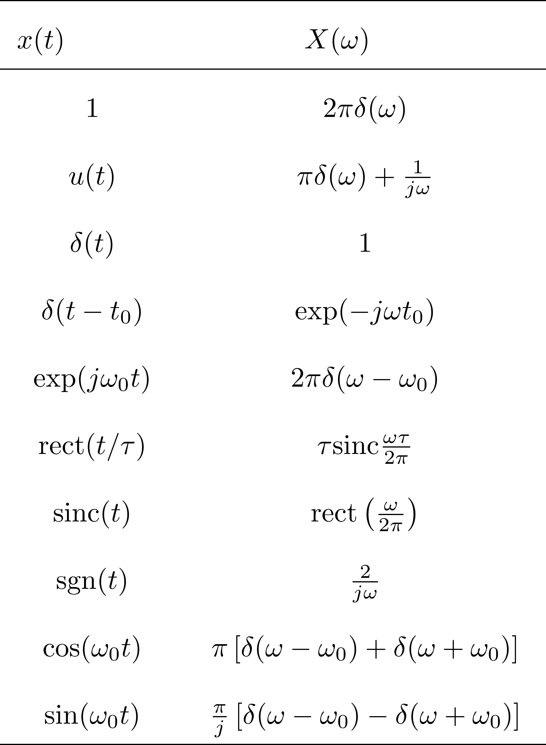
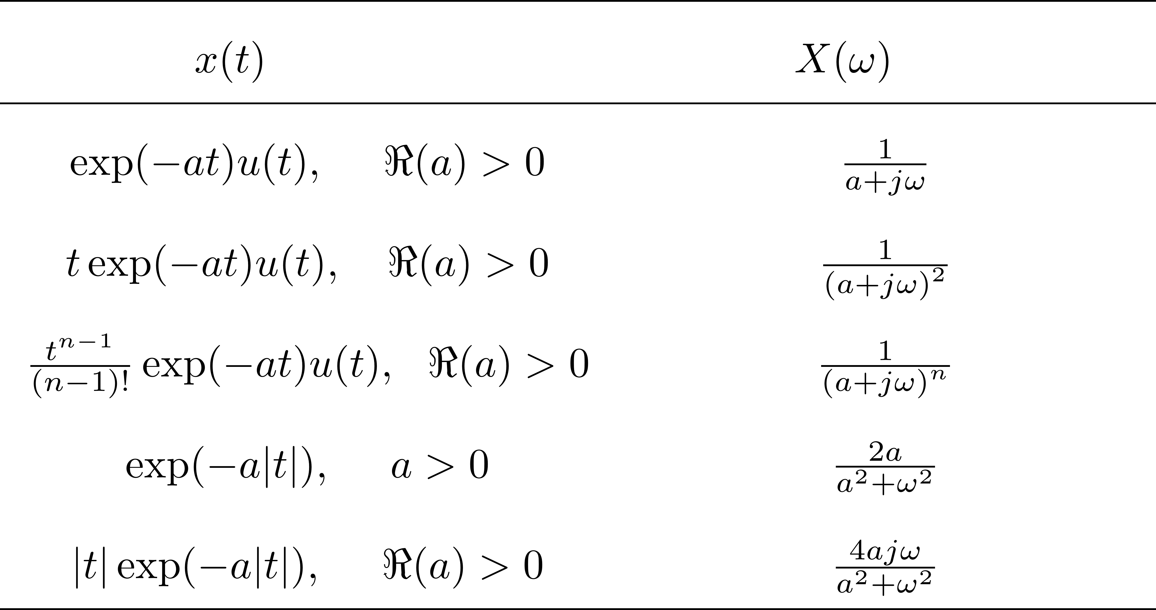
FOURIER TRANSFORM: TABLE

Slide 12
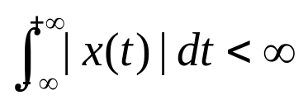

FOURIER TRANSFORM
The existence of Fourier transform
  Not all signals have Fourier transform
  If a signal have Fourier transform, it must satisfy the following two conditions
    1. x(t) is absolutely integrable
    2. x(t) is well behaved
      The signal has finite number of discontinuities, minima, and maxima within any finite interval of time.
Example

Slide 13
OUTLINE
Introduction
Fourier Transform
Properties of Fourier Transform
Applications of Fourier Transform

Slide 14



PROPERTIES: LINEARITY
Linearity
  If
  then
Example
  Find the Fourier transform of

Slide 15








PROPERTY: TIME-SHIFT
Time shift
  If
  Then
Time shift
  If
  Then
phase shift
Review: complex number
  Phase shift of a complex number c by :
time shift in time domain ➔ frequency shift in frequency domain

Slide 16

PROPERTY: TIME SHIFT
Example:
  Find the Fourier transform of
Notes:
X_1(omega) = tau*sinc(omega * tau/(2pi))

Slide 17
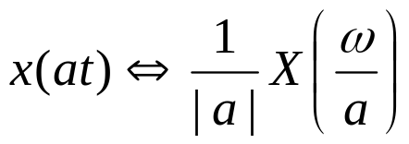


PROPERTY: TIME SCALING
Time scaling
  If
  Then
Example
  Let , find the Fourier transform of
Notes:
½*X(-w/2)*exp(-j2w)

Slide 18

PROPERTY: SYMMETRY
Symmetry
  If , and is a real-valued time signal
  Then

Slide 19
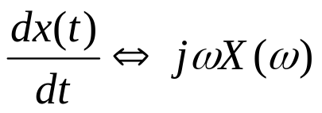
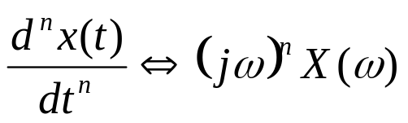
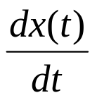
PROPERTY: DIFFERENTIATION
Differentiation
  If
  Then
Example
  Let , find the Fourier transform of

Slide 20

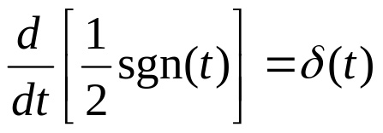
PROPERTY: DIFFERENTIATION
Example
  Find the Fourier transform of
  (Hint: )
Notes:
U(t) = ½*[sgn(t)+1]
Delta(t) = d u(t)/dt = ½ * d sgn(t) /dt
1 = ½* jw * X(w)
X(w) = 2/(jw)
-------------------------------------------------
X(t) = u(t)
Delta(t) = d u(t)/dt
1 = jw * X(w)
X(w) = 1/(jw)

Slide 21






PROPERTY: CONVOLUTION
Convolution
  If ,
  Then
time domain
frequency domain

Slide 22


PROPERTY: CONVOLUTION
Example
  An LTI system has impulse response
  If the input is
  Find the output
Notes:
H(w) = 1/(a+jw)
X(w) = (a-b)/(b+jw) + (c-a)/(c+jw)
Y(w) = (a-b)/((a+jw)*(b+jw)) + (c-a)/((a+jw)*(c+jw))
=-1/(a+jw)+1/(b+jw)-1/(c+jw)+1/(a+jw)
Y(t) = [-exp(-at)+exp(-bt)-exp(-ct)+exp(-at)]*u(t)

Slide 23

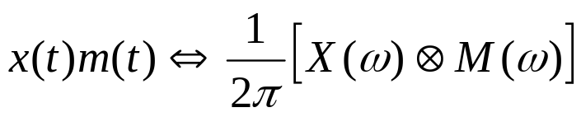
PROPERTY: MULTIPLICATION
Multiplication
  If ,
  Then
Notes:
Y(w) = 1/(2*pi)*X(w) conv M(w) = 1/(2*pi)*\int X(alpha) M(w – alpha) d alpha
Y(t) = 1/(2*pi) \int Y(w) exp(jwt) dw
= 1/(2*pi) *1/(2*pi) \int \int X(alpha) M(w-alpha) exp(jwt) dw d alpha
= 1/(2*pi) *1/(2*pi) \int \int X(alpha) M(w-alpha) exp(j(w-alpha)t) exp(j alpha t) dw d alpha
= x(t) m(t)

Slide 24


PROPERTY: DUALITY
Duality
  If
  Then
Notes:
g(t) = 1/(2pi)*int G(w) exp(jwt) dw
g(w) = 1/(2pi)*int G(t) exp(jwt) dt
g(-w) = 1/(2pi)*int G(t) exp(-jwt) dt

Slide 25
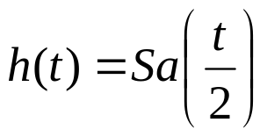
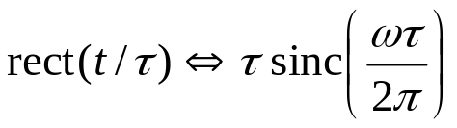
PROPERTY: DUALITY
Example
  Find the Fourier transform of
  (recall: )
Notes:
Sa(pi t) = sinc(t)
Sa(t/2) = sinc(t/2pi)
g(t) = Rect(t/tau) ←→ G(w) = tau sinc(tau w/(2 pi))
tau sinc(tau t/(2 pi)) ←→ 2 pi g(-w) = 2pi rect(-w/tau)
Sinc(t/2pi) ←→ 2 pi rect(w)

Slide 26


PROPERTY: DUALITY
Example
  Find the Fourier transform of
  Find the Fourier transform of
Notes:
2pi delta(w)
Delta(t+w0) ==exp(j w w0)
exp(j w0 t) == 2 pi delta(-w+w0)
Exp(j w0 t) == 2 pi delta(w-w0)

Slide 27
PROPERTY: SUMMARY

Slide 28


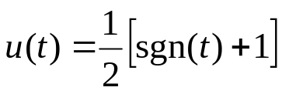
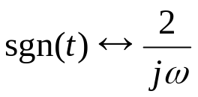
PROPERTY: EXAMPLES
Examples
  1. Find the Fourier transform of
  2. Find the Fourier transform of
Notes:
x(t) = ½ exp(jw0t)+1/2 exp(-jw0t)
X(w) = ½*2pi*delta(w-w0) + ½*2pi*delta(w+w0)=pi*[delta(w-w0)+delta(w+w0)]
2. u(t) = ½*[sgn(t)+1]
Sgn(t) ←→ 2/jw, w \neq 0; 0, w = 0. F[sgn(t)] = \int sgn(t) exp(0) dt = 0
1 ←→ 2pi delta(w)
U(t) ←→ 1/jw + pi delta(w)

Slide 29

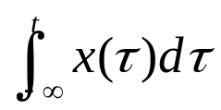
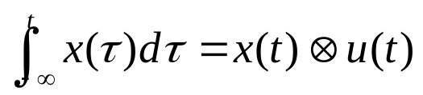
PROPERTY: EXAMPLES
Examples
  3. A LTI system with impulse response
  Find the output when input is
  4. If , find the Fourier transform of
  (Hint: )
Notes:
3. H(w) = 1/(a+jw)
X(w) = 1/jw
Y(w) = 1/[jw(a+jw)] = -1/a*1/(a+jw) + 1/a*1/jw = -1/a exp(-at)u(t) + 1/a u(t)
4. Y(w) = X(w)*[1/jw+pi*delta(w)] = X(w)/jw + pi*X(0)*delta(w)

Slide 30



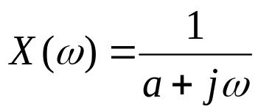
PROPERTY: EXAMPLES
Example
  5. (Modulation) If ,
  Find the Fourier transform of
  6. If , find x(t)
Notes:
X(w) conv pi*[delta(w-w0) + delta(w+w0)] = pi X(w-w0) + pi X(w + w)

Slide 31
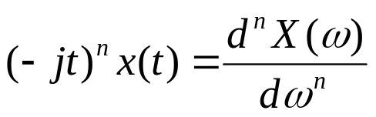
PROPERTY: DIFFERENTIATION IN FREQ. DOMAIN
Differentiation in frequency domain
  If:
  Then:
Notes:
X(w) = int x(t) exp(-jwt) dt
dX(w)/dw = int (-jt) x(t) exp(-jwt) dt

Slide 32


PROPERTY: DIFFERENTIATION IN FREQ. DOMAIN
Example
  Find the Fourier transform of
Notes:
1. Exp(-at)u(t) ←→ 1/(a+jw)
(-jt) exp(-at)u(t) ←→ -j/(a+jw)^2
t exp(-at) u(t) ←→ 1/(a+jw)^2
d/dx[1/f(x)] = -f’(x)/f^2(x)
2.

Slide 33


PROPERTY: FREQUENCY SHIFT
Frequency shift
  If:
  Then:
Example
  If , find the Fourier transform
Notes:
x(t) ←→ X(w)
Exp(jw0 t) ←→ 2 pi delta(w-w0)
x(t)m(t) ←→ 1/2pi X(w) conv M(w)
x(t) exp(j w0 t) ←→ X(w-w0)
X(w+2)= rect[(w+1)/2]

Slide 34
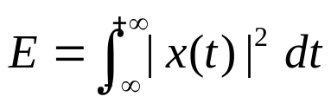
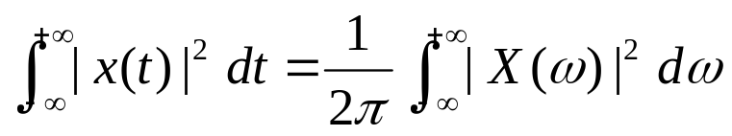
PROPERTY: PARSAVAL’S THEOREM
Review: signal energy
Parsaval’s theorem

Slide 35

PROPERTY: PARSAVAL’S THEOREM
Example:
  Find the energy of the signal
Notes:
Int 1/(a^2 + x^2) dx = 1/a * atan(x/a)
1/(2pi)*int(1/(2^2 + w^2), -inf, inf) = 1/(2pi) ½ *atan(w/2) = 1/(4pi)*(pi/2 –(-pi/2)) = 1/4

Slide 36
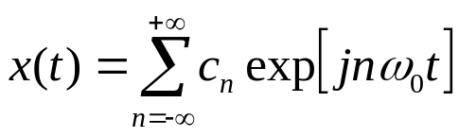
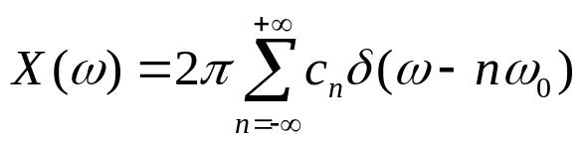
PROPERTY: PERIODIC SIGNAL
Fourier transform of periodic signal
  Periodic signal can be written as Fourier series
  Perform Fourier transform on both sides

Slide 37
OUTLINE
Introduction
Fourier Transform
Properties of Fourier Transform
Applications of Fourier Transform

Slide 38
APPLICATIONS: FILTERING
Filtering
  Filtering is the process by which the essential and useful part of a signal is separated from undesirable components.
    Passing a signal through a filter (system).
    At the output of the filter, some undesired part of the signal (e.g. noise) is removed.
  Based on the convolution property, we can design filter that only allow signal within a certain frequency range to pass through.
filter
filter
time domain
frequency domain

Slide 39
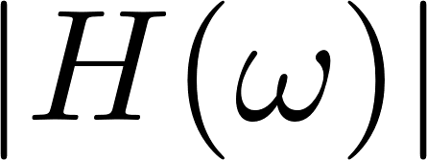
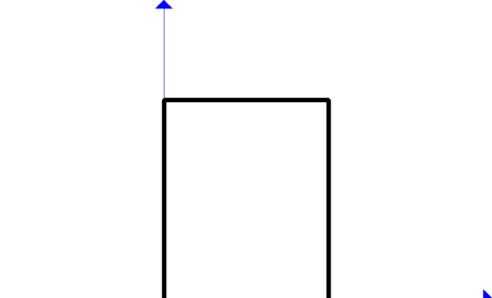
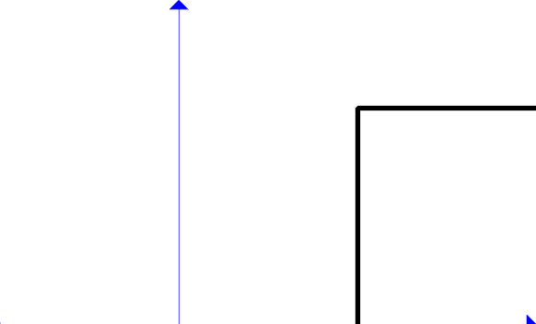

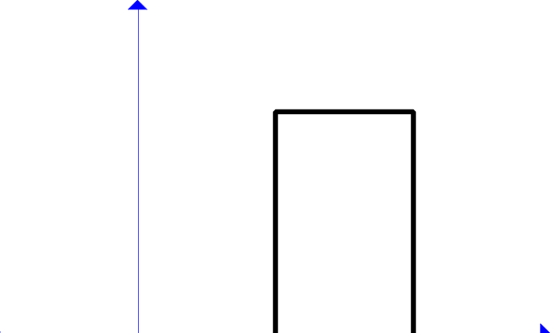
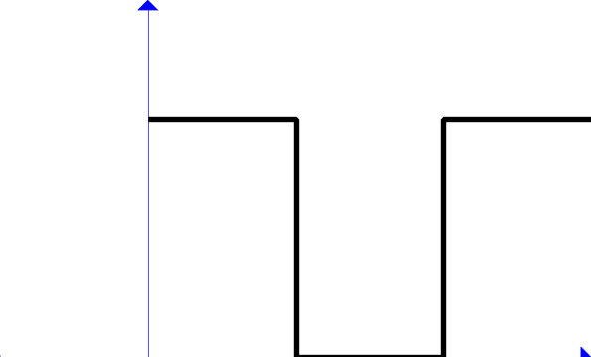
APPLICATIONS: FILTERING
Classifications of filters
Passband
Stop
band
Stop
band
Passband
Low pass filter
High pass filter
Stop
band
Passband
Stop
band
Passband
Stop
band
Passband
Band stop (Notch) filter
Band pass filter

Slide 40
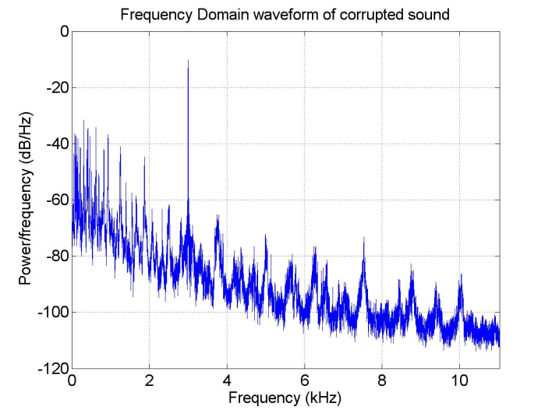
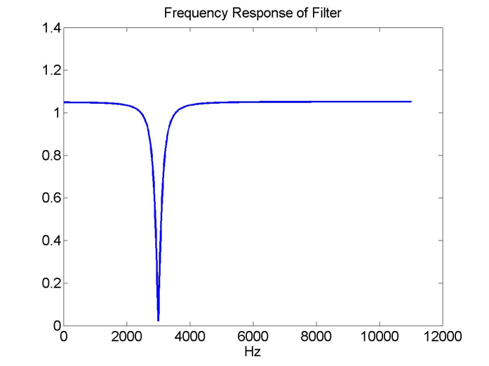

APPLICATION: FILTERING
A filtering example
  A demo of a notch filter
Corrupted sound
Filter
Filtered sound

Slide 41



APPLICATIONS: FILTERING
Example
  Find out the frequency response of the RC circuit
  What kind of filters it is?
RC circuit
Notes:
RC dy(t)/dt + y(t) = x(t)
RC jw Y(w) + Y(w) = X(w)

Slide 42











APPLICATION: SAMPLING THEOREM
Sampling theorem: time domain
  Sampling: convert the continuous-time signal to discrete-time signal.
sampling period
Sampled signal

Slide 43





APPLICATION: SAMPLING THEOREM
Sampling theorem: frequency domain
  Fourier transform of the impulse train
    impulse train is periodic
Fourier series
    Find Fourier transform on both sides
    Time domain multiplication ➔ Frequency domain convolution

Slide 44







APPLICATION: SAMPLING THEOREM
Sampling theorem: frequency domain
  Sampling in time domain ➔ Repetition in frequency domain
Time domain
Frequency domain

Slide 45






APPLICATION: SAMPLING THEOREM
Sampling theorem
  If the sampling rate is twice of the bandwidth, then the original signal can be perfectly reconstructed from the samples.
Frequency domain

Slide 46
APPLICATION: AMPLITUDE MODULATION
What is modulation?
  The process by which some characteristic of a carrier wave is varied in accordance with an information-bearing signal
Information
bearing signal
modulation
Modulated signal
Carrier wave
Three signals:
  Information bearing signal (modulating signal)
    Usually at low frequency (baseband)
    E.g. speech signal: 20Hz – 20KHz
  Carrier wave
    Usually a high frequency sinusoidal (passband)
    E.g. AM radio station (1050KHz) FM radio station (100.1MHz), 2.4GHz, etc.
  Modulated signal: passband signal

Slide 47




APPLICATION: AMPLITUDE MODULATION
Amplitude Modulation (AM)
  A direct product between message signal and carrier signal
Mixer
Local
Oscillator
Amplitude modulation

Slide 48









APPLICATION: AMPLITUDE MODULATION
Amplitude Modulation (AM)
Amplitude modulation

