Slide 1
ELEG 3124 SYSTEMS AND SIGNALS
Ch. 5 Laplace Transform
Dr. Jingxian Wu
wuj@uark.edu

Slide 2
OUTLINE
Introduction
Laplace Transform
Properties of Laplace Transform
Inverse Laplace Transform
Applications of Laplace Transform

Slide 3


INTRODUCTION
Why Laplace transform?
  Frequency domain analysis with Fourier transform is extremely useful for the studies of signals and LTI system.
    Convolution in time domain ➔ Multiplication in frequency domain.
  Problem: many signals do not have Fourier transform
  Laplace transform can solve this problem
    It exists for most common signals.
    Follow similar property to Fourier transform
    It doesn’t have any physical meaning; just a mathematical tool to facilitate analysis.
      Fourier transform gives us the frequency domain representation of signal.

Slide 4
OUTLINE
Introduction
Laplace Transform
Properties of Laplace Transform
Inverse Lapalace Transform
Applications of Fourier Transform

Slide 5
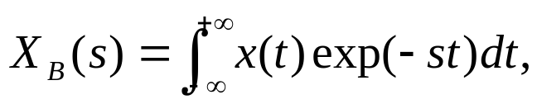







LAPLACE TRANSFORM: BILATERAL LAPLACE TRANSFORM
Bilateral Laplace transform (two-sided Laplace transform)
  is a complex variable
  s is often called the complex frequency
  Notations:
  : a function of time t → x(t) is called the time domain signal
  a function of s → is called the s-domain signal
    S-domain is also called as the complex frequency domain
Time domain v.s. S-domain

Slide 6
LAPLACE TRANSFORM
Time domain v.s. s-domain
  : a function of time t → x(t) is called the time domain signal
  a function of s → is called the s-domain signal
    S-domain is also called the complex frequency domain
  By converting the time domain signal into the s-domain, we can usually greatly simplify the analysis of the LTI system.
  S-domain system analysis:
    1. Convert the time domain signals to the s-domain with the Laplace transform
    2. Perform system analysis in the s-domain
    3. Convert the s-domain results back to the time-domain

Slide 7

LAPLACE TRANSFORM: BILATERAL LAPLACE TRANSFORM
Example
  Find the Bilateral Laplace transform of
Region of Convergence (ROC)
  The range of s that the Laplace transform of a signal converges.
  The Laplace transform always contains two components
    The mathematical expression of Laplace transform
    ROC.
Notes:
1/(s+a), Re(s) > -a

Slide 8

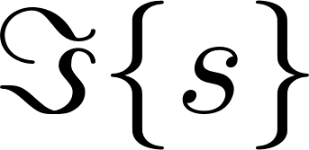


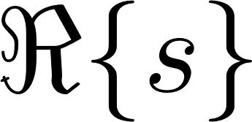
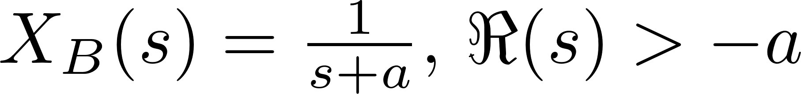

LAPLACE TRANSFORM: BILATERAL LAPLACE TRANSFORM
Example
  Find the Laplace transform of

Slide 9
LAPLACE TRANSFORM: BILATERAL LAPLACE TRANSFORM
Example
  Find the Laplace transform of

Slide 10
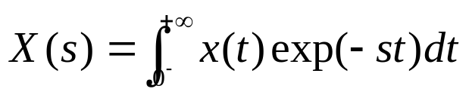

LAPLACE TRANSFORM: UNILATERAL LAPLACE TRANSFORM
Unilateral Laplace transform (one-sided Laplace transform)
  :The value of x(t) at t = 0 is considered.
  Useful when we dealing with causal signals or causal systems.
    Causal signal: x(t) = 0, t < 0.
    Causal system: h(t) = 0, t < 0.
  We are going to simply call unilateral Laplace transform as Laplace transform.

Slide 11


LAPLACE TRANSFORM: UNILATERAL LAPLACE TRANSFORM
Example: find the unilateral Laplace transform of the following signals.
  1.
  2.

Slide 12



LAPLACE TRANSFORM: UNILATERAL LAPLACE TRANSFORM
Example
  3.
  4.
  5.

Slide 13
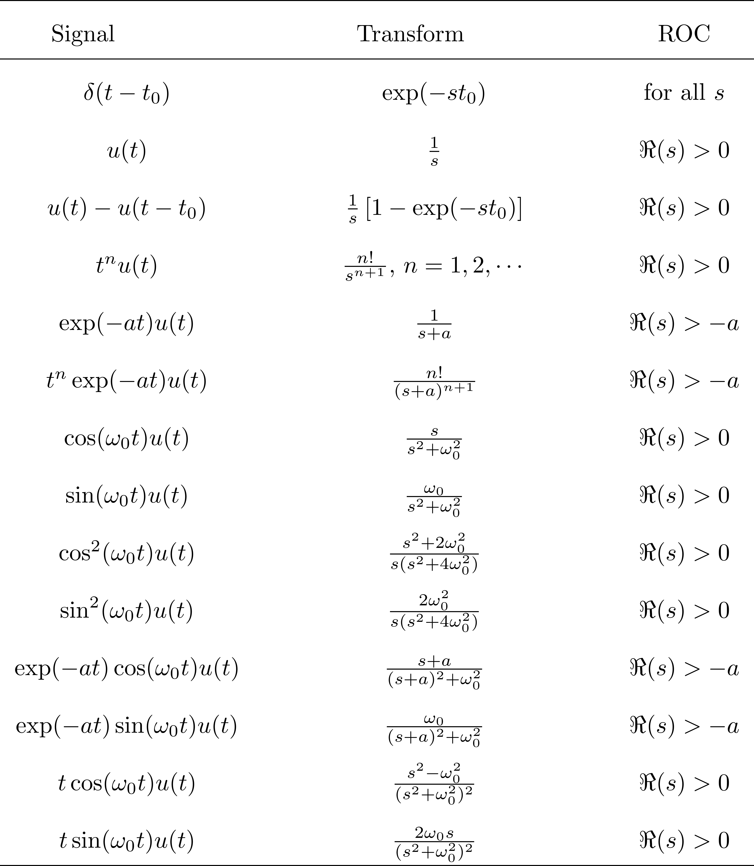
LAPLACE TRANSFORM: UNILATERAL LAPLACE TRANSFORM

Slide 14
OUTLINE
Introduction
Laplace Transform
Properties of Laplace Transform
Inverse Lapalace Transform
Applications of Fourier Transform

Slide 15




PROPERTIES: LINEARITY
Linearity
  If
  Then
  The ROC is the intersection between the two original signals
Example
  Find the Laplace transfrom of
Notes:
A/s + B/(b+s), Re(s) > max(0, -b

Slide 16



PROPERTIES: TIME SHIFTING
Time shifting
  If and
  Then
  The ROC remain unchanged
Notes:
= u(t) – u(t-2a) ←→ 1/s - 1/s*exp(-2a)
1/s*[1-exp(-2as)], Re(s) > 0

Slide 17




PROPERTIES: SHIFTING IN THE s DOMAIN
Shifting in the s domain
  If
  Then
Example
  Find the Laplace transform of
Notes:
X(s-s0) = int x(t) exp(-(s-s0)t) dt
Cos(w0 t + theta) ←→ s cos(theta)-w0 sin(theta)/(s^2 + w0^2)

Slide 18

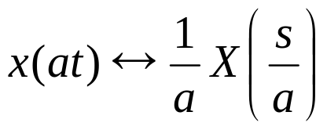


PROPERTIES: TIME SCALING
Time scaling
  If
  Then
Example
  Find the Laplace transform of

Slide 19

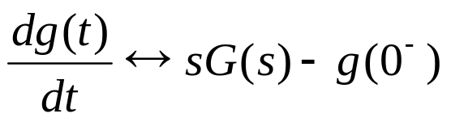
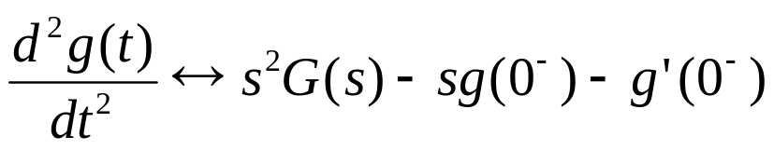
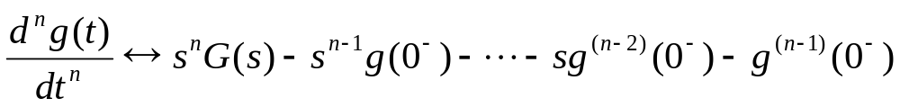


PROPERTIES: DIFFERENTIATION IN TIME DOMAIN
Differentiation in time domain
  If
  Then
Example
  Find the Laplace transform of
Notes:
2w^2/(s*(s^2 + 4w^2)), Re(s) > 0

Slide 20



PROPERTIES: DIFFERENTIATION IN TIME DOMAIN
Example
  Use Laplace transform to solve the differential equation
Notes:
Y(s) = 4/(s^2+3s+2) = -4/(s+2)+4/(s+1)
Y(t) = -4 exp(-2t)u(t) + 4 exp(-t)u(t)

Slide 21
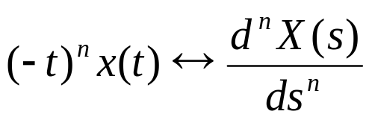

PROPERTIES: DIFFERENTIATION IN S DOMAIN
Differentiation in s domain
  If
  Then
Example
  Find the Laplace transform of
Notes:
dn/ds^n (1/s) = (-1)^n n!/s^{n+1}

Slide 22



PROPERTIES: CONVOLUTION
Convolution
  If
  Then
  The ROC of is the intersection of the ROCs of X(s) and H(s)

Slide 23
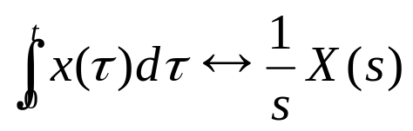

PROPERTIES: INTEGRATION IN TIME DOMAIN
Integration in time domain
  If
  Then
Example
  Find the Laplace transform of

Slide 24
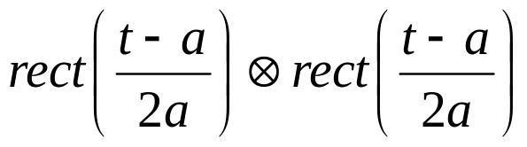
PROPERTIES: CONVOLUTION
Example
  Find the convolution
Notes:
r(t) <-> 1/s^2
1/s^2 [1-2*exp(-2as)+exp(-4as)]<-> r(t) – 2r(t-2a) + r(t-4a)

Slide 25

PROPERTIES: CONVOLUTION
Example
  For a LTI system, the input is , and the output of the system is
  Find the impulse response of the system
Notes:
U(t) <-> 1/s
Tu(t) <-> 1/s^2
Tu(t)exp(2t) <-> 1/(s-2)^2
1/(s+1)-1/(s+2)+1/(s+2)^2+1/(s+2)-1/(s+3)

Slide 26

PROPERTIES: CONVOLUTION
Example
  Find the Laplace transform of the impulse response of the LTI system described by the following differential equation
  assume the system was initially relaxed ( )

Slide 27
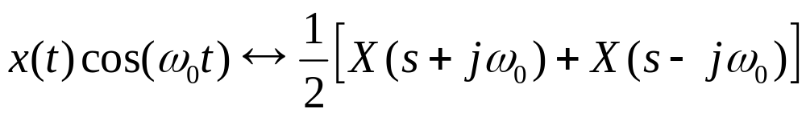
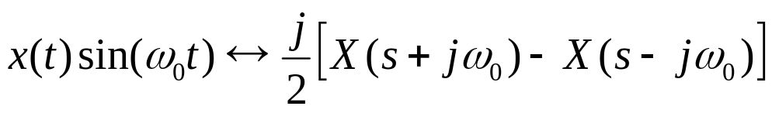
PROPERTIES: MODULATION
Modulation
  If
  Then
Notes:
X(t) exp(jwt) <-> X(s-jw)
X(t)exp(-jwt) <-> X(s+jw)

Slide 28

PROPERTIES: MODULATION
Example
  Find the Laplace transform of
Notes:
w0/((s+a)^2+w0^2)

Slide 29


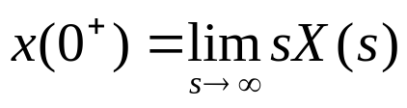

PROPERTIES: INITIAL VALUE THEOREM
Initial value theorem
  If the signal is infinitely differentiable on an interval around
  then
must be in ROC
  The behavior of x(t) for small t is determined by the behavior of X(s) for large s.

Slide 30
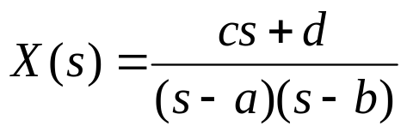
PROPERTIES: INITIAL VALUE THEOREM
Example
  The Laplace transform of x(t) is
  Find the value of

Slide 31
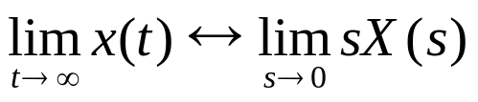


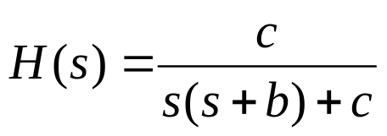

PROPERTIES: FINAL VALUE THEOREM
Final value theorem
  If
  Then:
must be in ROC
Example
  The input is applied to a system with transfer function , find the value of

Slide 32
PROPERTIES

Slide 33
OUTLINE
Introduction
Laplace Transform
Properties of Laplace Transform
Inverse Lapalace Transform
Applications of Fourier Transform

Slide 34
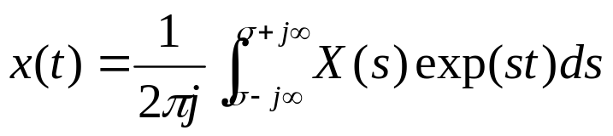
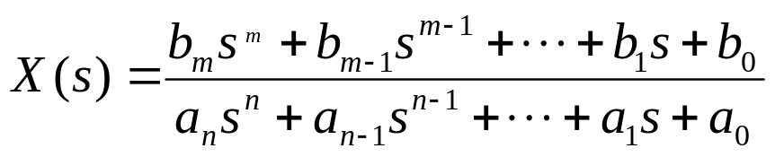
INVERSE LAPLACE TRANSFORM
Inverse Laplace transform
  Evaluation of the above integral requires the use of contour integration in the complex plan ➔ difficult.
Inverse Laplace transform: special case
  In many cases, the Laplace transform can be expressed as a rational function of s
  Procedure of Inverse Laplace Transform
    1. Partial fraction expansion of X(s)
    2. Find the inverse Laplace transform through Laplace transform table.

Slide 35
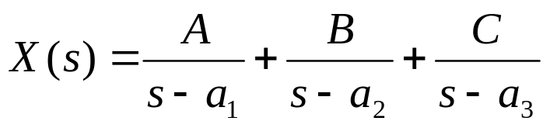
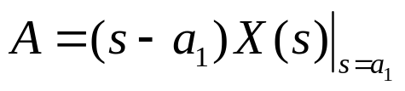
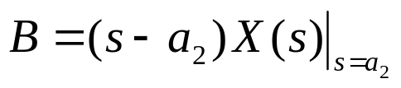
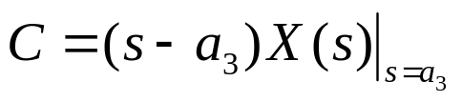
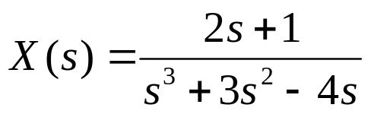
INVERSE LAPLACE TRANSFORM
Review: Partial Fraction Expansion with non-repeated linear factors
Example
  Find the inverse Laplace transform of

Slide 36
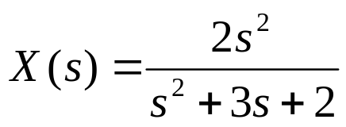
INVERSE LAPLACE TRANSFORM
Example
  Find the Inverse Laplace transform of
If the numerator polynomial has order higher than or equal to the order of denominator polynomial, we need to rearrange it such that the denominator polynomial has a higher order.

Slide 37
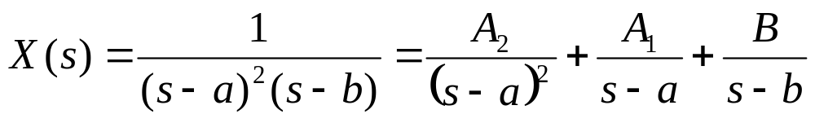
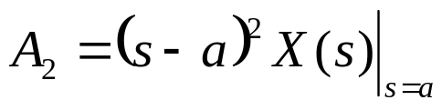
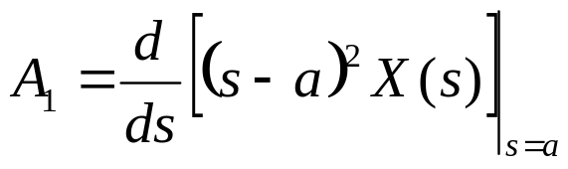

INVERSE LAPLACE TRANSFORM
Partial Fraction Expansion with repeated linear factors

Slide 38
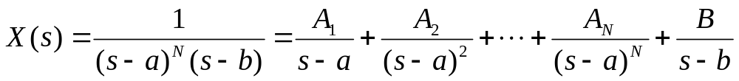
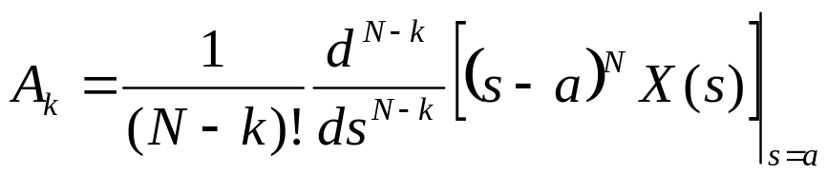

INVERSE LAPLACE TRANSFORM
High-order repeated linear factors

Slide 39
OUTLINE
Introduction
Laplace Transform
Properties of Laplace Transform
Inverse Lapalace Transform
Applications of Laplace Transform

Slide 40
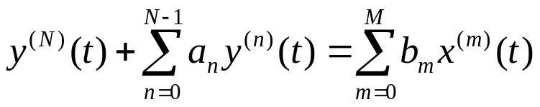
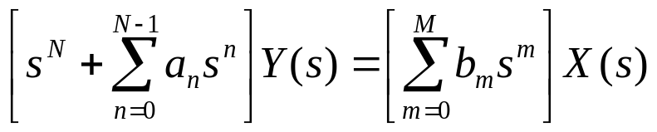
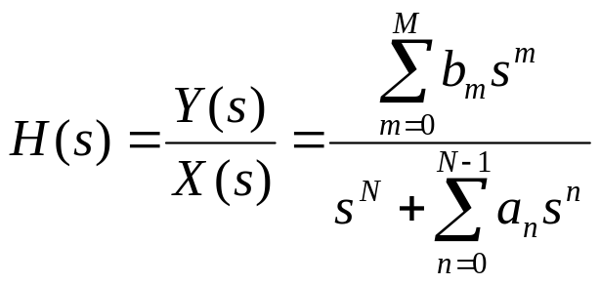
APPLICATION: LTI SYSTEM REPRESENTATION
LTI system
  System equation: a differential equation describes the input output relationship of the system.
  S-domain representation
  Transfer function

Slide 41
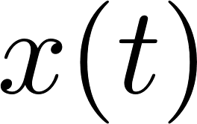

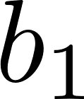
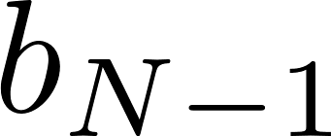

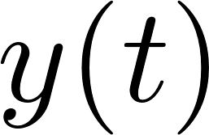

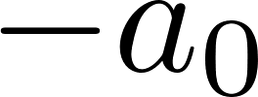


APPLICATION: LTI SYSTEM REPRESENTATION
Simulation diagram (first canonical form)
Simulation diagram

Slide 42
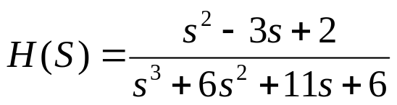
APPLICATION: LTI SYSTEM REPRESENTATION
Example
  Show the first canonical realization of the system with transfer function

Slide 43
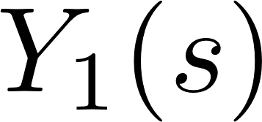
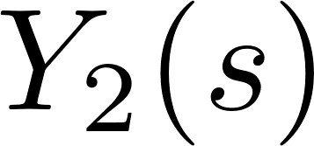
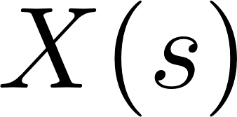
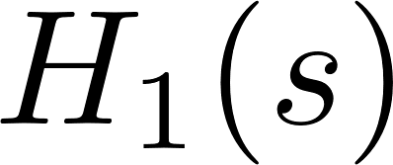
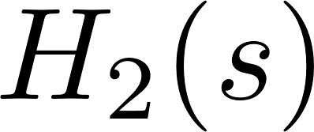



APPLICATION: COMBINATIONS OF SYSTEMS
Combination of systems
  Cascade of systems
  Parallel systems

Slide 44
APPLICATION: LTI SYSTEM REPRESENTATION
Example
  Represent the system to the cascade of subsystems.

Slide 45

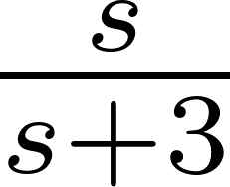
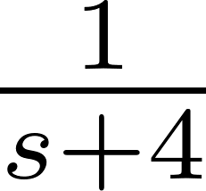
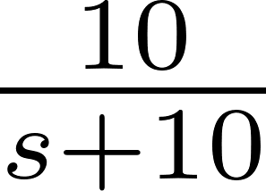
APPLICATION: LTI SYSTEM REPRESENTATION
Example:
  Find the transfer function of the system
LTI system

Slide 46
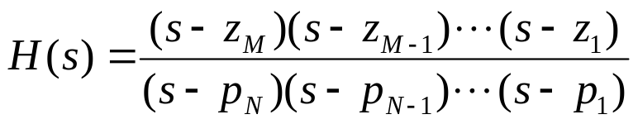


APPLICATION: LTI SYSTEM REPRESENTATION
Poles and zeros
  Zeros:
  Poles:

Slide 47





APPLICATION: STABILITY
Review: BIBO Stable
  Bounded input always leads to bounded output
The positions of poles of H(s) in the s-domain determine if a system is BIBO stable.
  Simple poles: the order of the pole is 1, e.g.
  Multiple-order poles: the poles with higher order. E.g.

Slide 48








APPLICATION: STABILITY
Case 1: simple poles in the left half plane
Impulse response
If all the poles of the system are on the left half plane, then the system is stable.

Slide 49




APPLICATION: STABILITY
Case 2: Simple poles on the right half plane
Impulse response
If at least one pole of the system is on the right half plane, then the system is unstable.

Slide 50


APPLICATION: STABILITY
Case 3: Simple poles on the imaginary axis
If the pole of the system is on the imaginary axis, it’s unstable.

Slide 51




APPLICATION: STABILITY
Case 4: multiple-order poles in the left half plane
stable
Case 5: multiple-order poles in the right half plane
unstable
Case 6: multiple-order poles on the imaginary axis
unstable

Slide 52

APPLICATION: STABILITY
Example:
  Check the stability of the following system.
Notes:
>> roots([1, 6, 13])
ans =
-3.0000 + 2.0000i
-3.0000 - 2.0000i

