Slide 1
ELEG 3124 Signals & Systems
Ch. 6 Discrete-Time System
Dr. Jingxian Wu
wuj@uark.edu

Slide 2
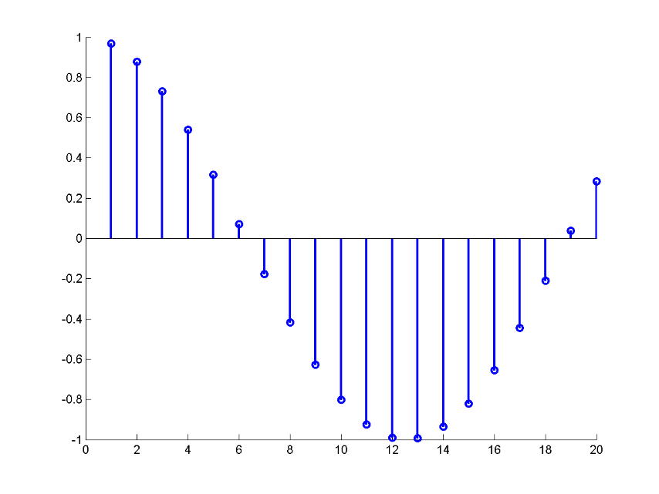
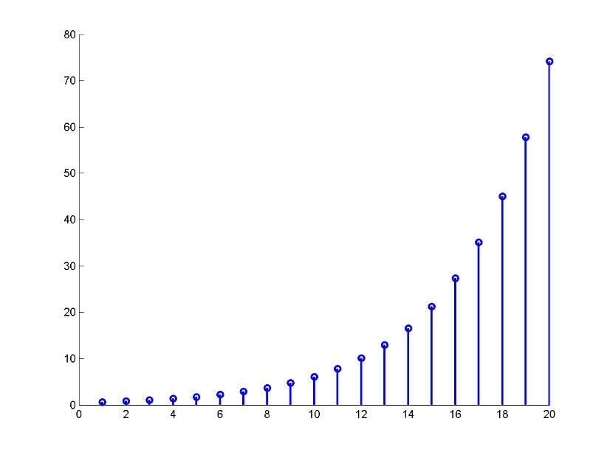
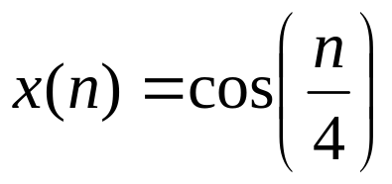
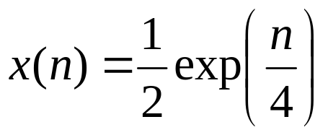
SIGNAL
Discrete-time signal
  The time takes discrete values

Slide 3
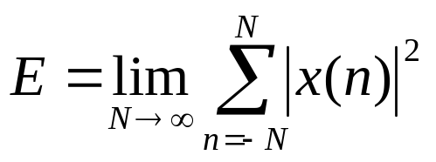
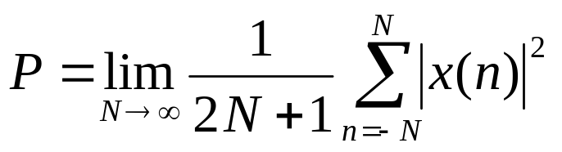


SIGNAL: CLASSIFICATION
Energy signal v.s. Power signal
  Energy:
  Power:
  Energy signal:
  Power signal:

Slide 4


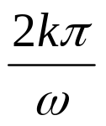


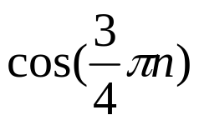
SIGNAL: CLASSIFICATION
Periodic signal v.s. aperiodic signal
  Periodic signal
    The smallest value of N that satisfies this relation is the fundamental periods.
  Is periodic?
  is periodic if is integer for integer k.
  Example:

Slide 5
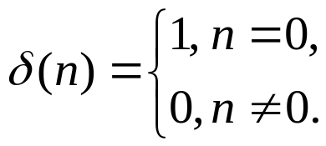
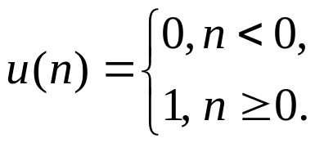

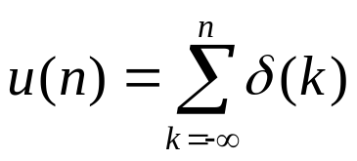
SIGNAL: ELEMENTARY SIGNAL
Unit impulse function
Unit step function
Relation between unit impulse function and unit step function

Slide 6

SIGNAL: ELEMENTARY SIGNAL
Exponential function
Complex exponential function

Slide 7
OUTLINE
Discrete-time signals
Discrete-time systems
Z-transform

Slide 8



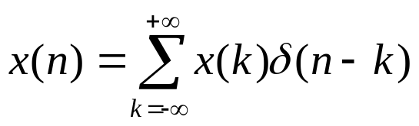


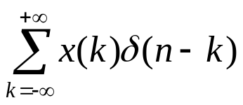
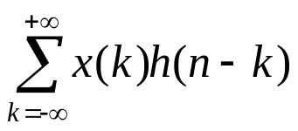
SYSTEM: IMPULSE RESPONSE
Impulse response of LTI system
  The response of the system when the input is
System
LTI system
System response for arbitrary input
  Any signal can be decomposed as the sum of time-shifted impulses
  Time invariant
System
LTI system
  Linear
System
LTI system

Slide 9


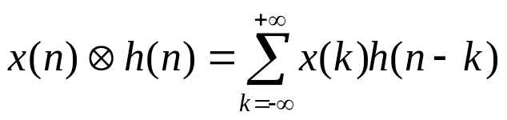



SYSTEM: CONVOLUTION SUM
Convolution sum
  The convolution sum of two signals and is
Response of LTI system
  The output of a LTI system is the convolution sum of the input and the impulse response of the system.
LTI system

Slide 10




SYSTEM: CONVOLUTION SUM
Example
  1.
  2.
Notes:
\sum_a^b r^n = (r^a – r^{b+1})/(1-r)

Slide 11

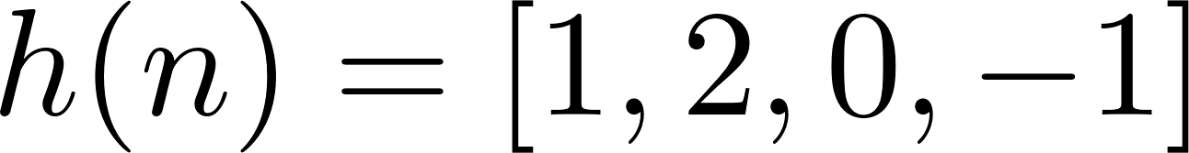

SYSTEM: CONVOLUTION SUM
Example:
  Let be two
  sequences, find

Slide 12
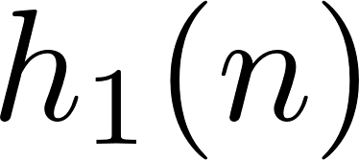
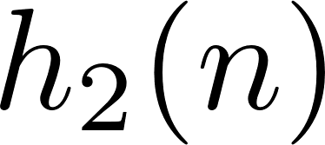
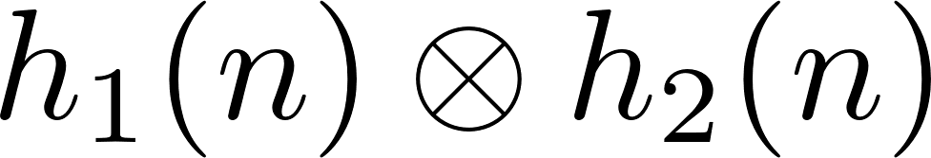
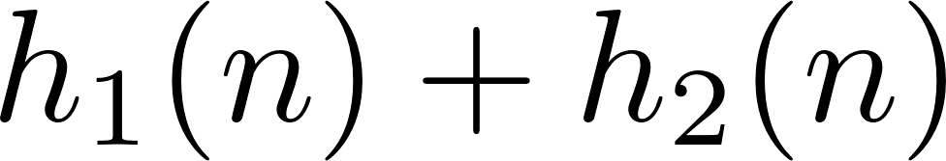
STSTEM: COMBINATION OF SYSTEMS
Combination of systems
⬅➔
Two systems in series
+
⬅➔
Two systems in parallel

Slide 13
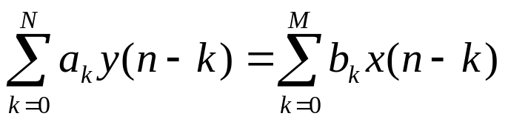
SYSTEM: DIFFERENCE EQUATION REPRESENTATION
Difference equation representation of system

Slide 14
OUTLINE
Discrete-time signals
Discrete-time systems
Z-transform

Slide 15
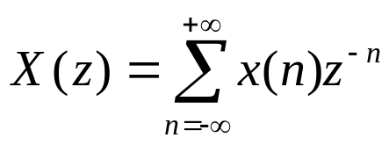
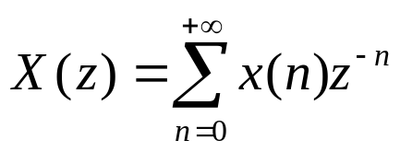
Z-TRANSFORM
Bilateral Z-transform
Unilateral Z-transform
Z-transform:
  Ease of analysis
  Doesn’t have any physical meaning (the frequency domain representation of discrete-time signal can be obtained through discrete-time Fourier transform)
  Counterpart for continuous-time systems: Laplace transform.

Slide 16

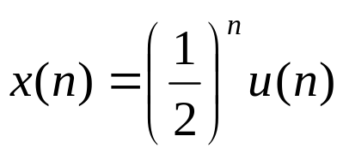
Z-TRANSFORM
Example: find Z-transforms
  1.
  2.

Slide 17
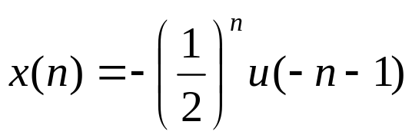
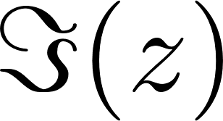
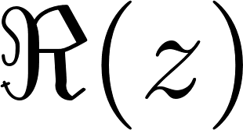
Z-TRANSFORM
Example
  3.
Region of convergence (ROC)
Region of convergence

Slide 18


Z-TRANSFORM: CONVERGENCE
Convergence of causal signal
Convergence of anti-causal signal

Slide 19


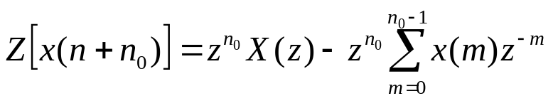
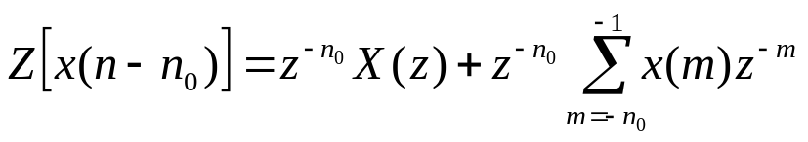
Z-TRANSFORM: TIME SHIFTING PROPERTY
Time Shifting
  Let be a causal sequence with the Z-transform
  Then
Notes:
\sum_{n=0}^\infty x(n+n0) z^{-n}
m = n+n0

Slide 20
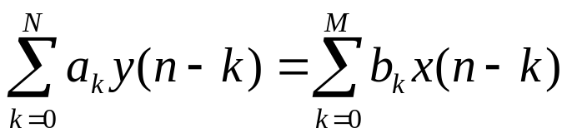
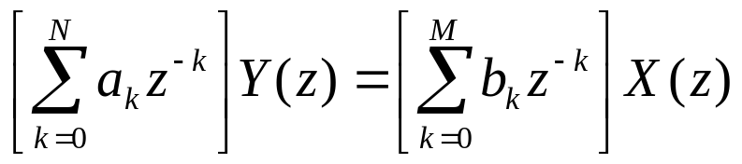
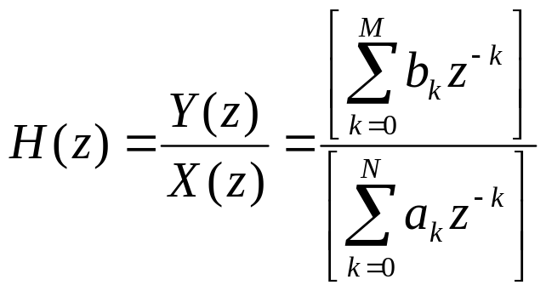
Z-TRANSFORM: LTI SYSTEM
LTI System
  Difference equation representation
  Z-domain representation
  Transfer function

Slide 21
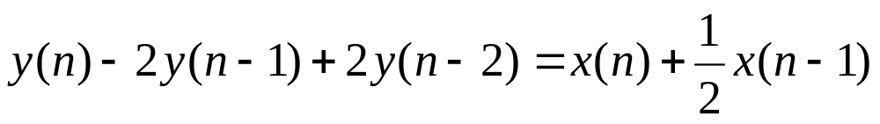
Z-TRANSFORM: LTI SYSTEM
Example
  Find the transfer function of the system described by the following difference equation

Slide 22
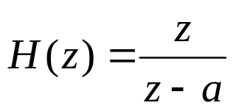


Z-TRANSFORM: STABILITY
Stability
  A LTI system is BIBO stable is all the poles are within the unit circle (|a| < 1)
  A LTI system is unstable is at least one pole is on or outside of the unit circult ( )

