Slide 1
ELEG 3143 Probability & Stochastic Process
Ch. 1 Probability
Dr. Jingxian Wu
wuj@uark.edu

Slide 2
OUTLINE
Applications
Elementary Set Theory
Random Experiments
Probability
Conditional probability
Independence
Bayes’ Formula
Bernoulli trials

Slide 3
APPLICARTIONS
Why probability?
  Most real world events have uncertain (or random) outcomes
    flipping a coin
    Tossing dices
    Football games
    Blackjack
    Expected lifetime of iPhone
    The actual resistance of a 100 Ohm resistor
    ……
  How do we characterize these random events?
  Can we predict the outcome of a random event?

Slide 4
APPLICATIONS
Probability Theory
  provides a complete set of mathematical tools and theories that can accurately and precisely describe the statistical behaviors of the random phenomenon.
  It is a branch of Mathematics
  It has a wide rang of applications to Engineers.

Slide 5
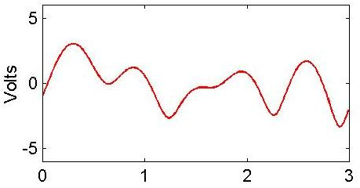
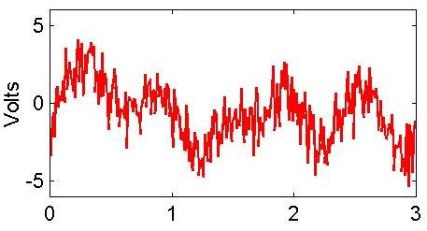
APPLICATIONS
Random input signals
  The input for a system might be random
    E.g. the number of vehicles passing through a certain check points as an input to a traffic control system (e.g. duration of traffic lights)
    E.g. temperature fluctuations as an input to a heating system
    E.g. Music signals as an input to your stereo system
Random system characteristics
  The system itself has random characteristics
    E.g. The components inside a system has random values
      A 100 Ohm resistor might have an actual value of 101 Ohm
    E.g. Noise: random electrical disturbance caused by the random movement of electronics
      It is present at all electrical systems
Electrical
System
input
output

Slide 6
APPLICATIONS
System reliability
  What is the expected life cycle of a given system?
  What is the probability of failure of a system?
    Warranty duration, insurance policy, etc.
Random sampling
  It might be too costly to inspect every single elements
  Only sample a small population, then deduce the general behavior from the sample results
    E.g. survey
    E.g. product inspection for quality control
  How to design the random sampling process?
Computer simulation
  A cost effective and efficient way to test the performance of a system
  Random inputs, random system parameters (e.g. random component value, random disturbance, …)

Slide 7
OUTLINE
Applications
Elementary Set Theory
Random Experiments
Probability
Conditional probability
Independence
Bayes’ Formula
Bernoulli trials

Slide 8









SET THEORY
Set
  A collection of elements
  Example:
    E is a set
    is an element of the set E
  A subset of E is any set all of whose elements are also elements of E
    Example:
    is a subset of E,
    G = {1} is a subset of E,
    Any set is a subset of itself
  Empty set:
    A set that does not have any element
    Empty set is a subset of any set
  Space S: the largest set of interests for a given application
    E.g. toss a coin, S ={H, T}
    E.g. throw a die, S = {1, 2, 3, 4, 5, 6}

Slide 9



SET THEORY: VENN DIAGRAM
Venn diagram
  A geometric representation, where the space S is represented by a square and the sets are represented by closed plane figures inside the square.
  E.g.
  If and , then A = B
S
C
B
A
A, B

Slide 10

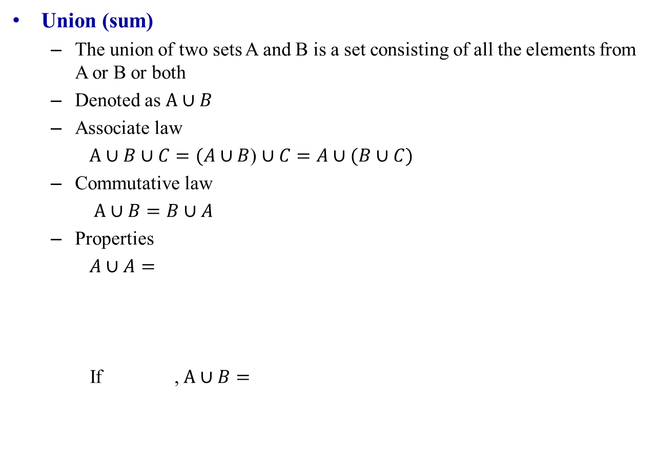


SET THEORY
Union (sum)
  The union of two sets A and B is a set consisting of all the elements from A or B or both
  Denoted as $A∪B$
  Associate law
  $A∪B∪C=(A∪B$) $∪C=A∪(B∪C)$
  Commutative law
  $A∪B=B∪A$
  Properties
  $A∪A=$
  If , $A∪B=$
S
A
B
  $$A∪S=$$
  $$A∪φ=$$

Slide 11








SET THEORY
Intersection (product)
  The intersection of two sets is the set consisting of all the elements from both sets.
  Denoted as
  Associative law
  Commutative law
  Properties
  if ,
  Mutually exclusive (disjoint)
  A and B are mutually exclusive if
$$A∩B$$
S
  $A∩B∩C=(A∩B$)$∩C=A∩(B∩C)$
A
B
$$A∩B=B∩A$$
  $$A∪A=$$
  $$A∪S=$$
  $$A∪φ=$$
$$A∩B=$$
$$A∩B=φ$$

Slide 12


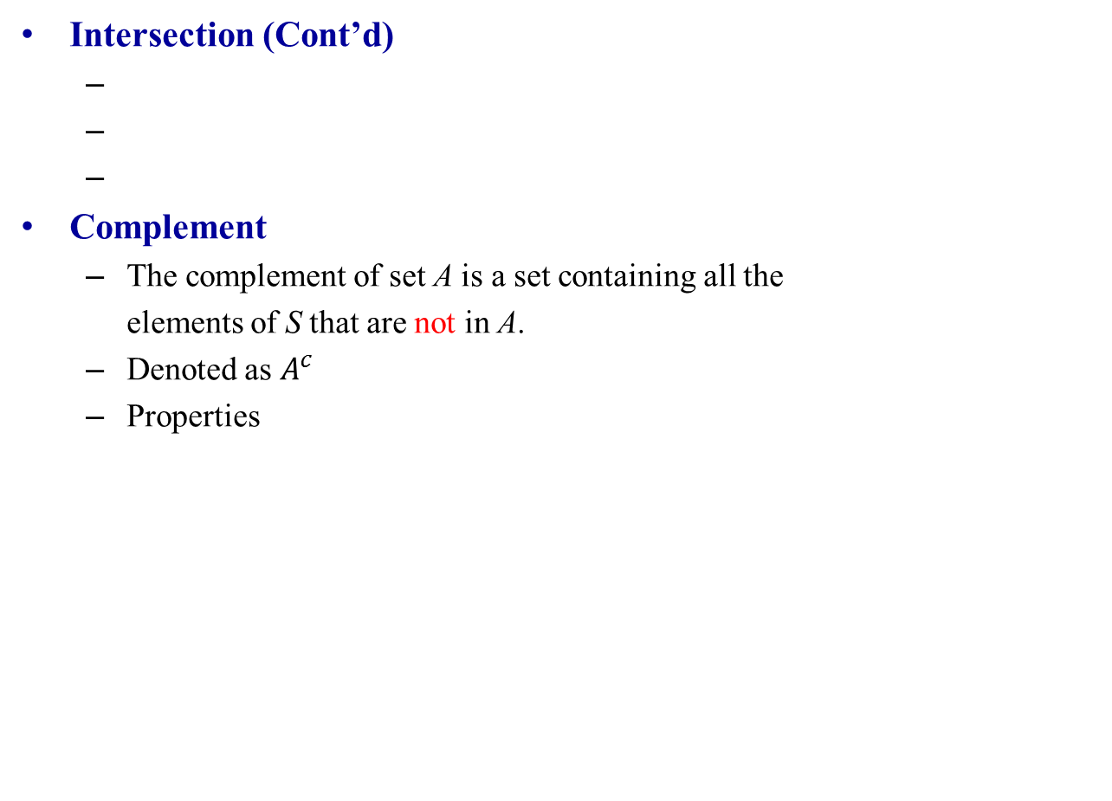



SET THEORY
Intersection (Cont’d)
Complement
  The complement of set A is a set containing all the
  elements of S that are not in A.
  Denoted as $A^{c}$
  Properties
S
A
B
C
$$φ^{c}=$$
$$S^{c}=$$
$${{(A}^{c})}^{c} =$$
A
Ā
$$A ∪A^{c} =$$
$$A ∩A^{c} =$$

Slide 13




SET THEORY
Complement (Cont’d)
  If , then
  DeMorgan’s Laws
$$B^{c}$$
$$A^{c}$$

Slide 14

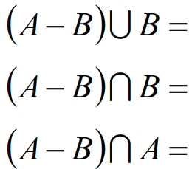



SET THEORY
Difference
  The difference of two sets, A-B, is a set consisting of the elements of A that are not in B.
  Examples
S
A
B

Slide 15

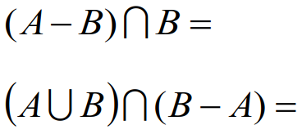


SET THEORY
Example
  S = {1, 2, 3, 4, 5, 6}
  A = {2, 4, 6}, B = {1, 2, 3, 4}, C = {1, 3, 5}
$({A∪B)}^{c}$ =
$({A∩B)}^{c}$=

Slide 16



SET THEORY
Example
  If A and B are subset of the same space S
    Simplify the following notation
$A^{c}∩(A−B)$=
Notes:
A intersect B, empty, A intersect B

Slide 17
OUTLINE
Applications
Elementary Set Theory
Random Experiments
Probability
Conditional probability
Independence
Bayes’ Formula
Bernoulli trials

Slide 18

RANDOM EXPERIMENT
Experiment:
  An action that results in an outcome.
Random experiment
  An experiment in which the outcome is uncertain before the experiment is performed.
Sample space S: the set of all possible outcomes of a random experiment
  Examples:
    Flipping a coin
      S = { H, T}
    Flipping two coins
      S = {(H, H), (H, T), (T, H), (T, T)}
    Throwing a die
      S = {1, 2, 3, 4, 5, 6}
    Lifetime of a car
      S = [0, )
Outcome: each element in the sample space

Slide 19
RANDOM EXPERIMENT
Random events: any subset E of the sample space S
  E.g. throwing a die
    E1 = {3}: the event that 3 appears
    E2 = {2, 4, 6}: the event that an even number appears.
  Elementary random event:
    An elementary event is one for which there is only one element in the event
      E.g. flipping a coin, {H} is an elementary event
      E.g. tossing a dice, {4} is an elementary event
      E.g. measuring a voltage, {2.37} Volt is an elementary event
  Composite event
    An event that might have several possible outcomes
      E.g. tossing a die, “even” is a composite event, it includes the elementary outcomes {2, 4, 6}
      E.g. measuring a voltage, “greater than 0” is a composite event, in includes all the elementary outcomes (0, )

Slide 20
RANDOM EXPERIMENT
Trial
  A single performance of an experiment
  Example: A coin is tossed 3 times, with outcomes H, H, T → 3 trials.
    The 1st trial results in H, the 2nd trial results in H, the 3rd trial results in T
  Example: Measure temperature twice, with outcomes 72.3 F, 71.8 F → 2 trials
  Once a trial is performed, the result of the trial is deterministic (not random)

Slide 21
RANDOM EXPERIMENT
Classification: Discrete v.s. Continuous
  Discrete random experiment: the number of outcomes are countable (i.e., the outcomes can be put in a one-to-one correspondence with integers),
    E.g. flipping a coin {H, T},
    It is possible a discrete random experiment has infinite possible outcomes
      E.g. count the number of atoms in an object: {1, 2, 3, …}
      E.g. count the number of stars: {1, 2, 3, …}
  Continuous random experiment: the number of outcomes are not countable
    E.g. lifetime of a car [0, )
    E.g. randomly pick a real number in the range between [0, 1]
    Continuous random experiment always has infinite outcomes

Slide 22
OUTLINE
Applications
Elementary Set Theory
Random Experiments
Probability
Conditional probability
Independence
Bayes’ Formula
Bernoulli trials

Slide 23
PROBABILITY
Probability
  Assign a number between [0, 1] to each random event of a sample space, such that the number is a measure of how likely the event is.
    E.g. flipping a coin. Assign 0.5 to H, 0.5 to T
      0.5 is the probability of H, 0.5 is the probability of T
    E.g. tossing a die with events {1, 2} (2 or less)
      1/3 is the probability of “2 or less”
    It is a mapping from a random event to a number between [0, 1]
    Random event (a subset of S) ➔ [0, 1]
  There are several different definitions of probability
    Relative-frequency approach
    Axiomatic approach

Slide 24



PROBABILITY: RELATIVE-FREQUENCY
Relative-frequency
  Example: consider a random experiments with sample space: S ={A, B, C}. Perform the experiments for a total of N = 1,000 times
    Event {A} occurs N_{A} = 500 times
    Event {B} occurs N_{B} = 300 times
    Event {C} occurs N_{C} = 200 times
    N_{A} + N_{B} +N_{c} = N
    The relative frequency of {A} is
    The relative frequency of {B} is
    The relative frequency of {C} is
    The more trials we perform, the more accurate the result is.

Slide 25
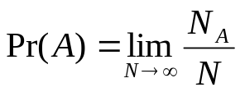

PROBABILITY: RELATIVE-FREQUENCY DEFINITION
Relative-frequency
  The probability of event {A}
  The sum of the probabilities of all the events

Slide 26
PROBABILITY: RELATIVE FREQUENCY
Example
  Consider a bin contains 100 diodes. Among them, 20 are known to be bad.
  Pick 1 diode from the bin
    Sample space
    Probability that the picked one is bad

Slide 27




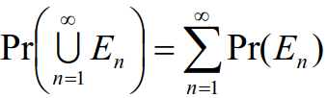
PROBABILITY: AXIOMATIC DEFINITION
Definition: Probability
  Consider a random experiment with sample space S. For each event E of the sample space S, we assign it a positive number Pr(E), which satisfies the following properties
    1.
    2.
    3. For any sequence of events that are mutually exclusive
  Then Pr(E) is called as the probability of event E.

Slide 28
PROBABILITY
Example
  Toss a die.
    Sample space
    The probability of getting a number 3
    The probability of getting an even number

Slide 29



PROBABILITY
Probability of complement events
  Events E and are always mutually exclusive
Probability of two events
  Consider a sample space S with two events E and F. The probability that either E or F happens (the probability of all outcomes either in E or F)
$$E^{c}$$
  $$\operatorname{Pr}\left(E\right)+\operatorname{Pr}\left(E^{c}\right)=$$

Slide 30



PROBABILITY
The probability of two events: consider a sample space S with two events E and F
  The probability either E or F happens (the probability that the outcome is either in E or F)
  The probability that both E and F happens (the probability that the outcome is in both E and F)
    Also denoted as
    Called the joint probability

Slide 31


PROBABILITY
Property
    Proof:
      Recall:

Slide 32
PROBABILITY
Property
  Proof:

Slide 33



PROBABILITY
Example
  Toss 2 different coins,
  E = {(H, H), (H, T)}, F = {(H, H), (T, H)}, G={(T, T)}

Slide 34
OUTLINE
Applications
Elementary Set Theory
Random Experiments
Probability
Conditional probability
Independence
Bayes’ Formula
Bernoulli trials

Slide 35


CONDITIONAL PROBABILITY
Joint probability
  Consider a sample space S with two events E and F. The probability that both E and F happens (the probability of all outcomes in both E and F)
    Also denoted as

Slide 36
CONDITIONAL PROBABILITY
Example
  Consider an urn contains 100 resistors of different resistance and power ratings. The number of the different types are listed as follows
  Pick 1 resistor
  What is the probability that the resistor has a power rating of 1 W?
  What is the probability that the resistor has a resistance of 10 Ohm?
  What is the probability that the resistor is 10 Ohm with 1 W rating?
 | 1 Ohm | 10 Ohm | 100 Ohm | Totals
1 W | 10 | 20 | 30 | 60
10 W | 10 | 20 | 10 | 40
Totals | 20 | 40 | 40 | 100

Slide 37
CONDITIONAL PROBABILITY
Conditional Probability
  Pr(E|F): Given the condition that the event F occurred, the probability that E occurs.
  Example:
    (Cont’d from the previous example) Pick one resistor. If the picked resistor has a 1W rating, what is the probability that the resistor is 10 Ohm?
    Pr(10 Ohm|1W) =
    Pr(10Ohm, 1W) =Pr(10 Ohm|1W)Pr(1W)
 | 1 Ohm | 10 Ohm | 100 Ohm | Totals
1 W | 10 | 20 | 30 | 60
10 W | 10 | 20 | 10 | 40
Totals | 20 | 40 | 40 | 100

Slide 38
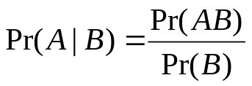
CONDITIONAL PROBABILITY
Conditional Probability

Slide 39
CONDITIONAL PROBABILITY
Example
  Consider a bin contains 100 diodes. Among them, 20 are known to be bad. Pick 2 diodes from the bin
    Sample space
    The probability that the 1st one is bad
    If the 1st one is bad, what is the probability that the 2nd one is bad?
    If the 1st one is good, what is the probability that the 2nd one is bad?
    The probability that both are bad.
    The probability that the 1st one is good, the 2nd one is bad.

Slide 40
CONDITIONAL PROBABILITY
Example
  Cards numbered 1 through 10 are placed in a hat. Pick one card. If we are told that the number on the card is at least 5. What is the probability that the card is 10?

Slide 41
CONDITIONAL PROBABILITY
Example
  Suppose an urn contains 7 black balls and 5 white balls. We draw 2 balls from the urn without replacement. What is the probability that both balls are black?

Slide 42
CONDITIONAL PROBABILITY
Example
  Alice can take either Chemistry or Physics. If Alice takes Chemistry, the probability that she will get an A is 0.5. If she takes Physics, the probability that she will get an A is 0.6. If Alice decides which course to take by flipping a fair coin. What is the probability that Alice gets an A in Chemistry?

Slide 43
OUTLINE
Applications
Elementary Set Theory
Random Experiments
Probability
Conditional probability
Independence
Bayes’ Formula
Bernoulli trials

Slide 44








INDEPENDENCE
Independence
  Two events, A and B, are independent, if and only if
  If A and B are independent
  Independent mutually exclusive
    A and B are independent
    A and B are mutually exclusive

Slide 45
INDEPENDENCE
Example
  Toss a fair coin twice. Are the two trials independent?
  Suppose an urn contains 7 black balls and 5 white balls. We draw 2 balls from the urn without replacement. Are the result of the 1st draw independent of the 2nd draw?

Slide 46
INDEPENDENCE
Example
  Toss 2 dice. Define event A as getting a 5, and event B as getting a 7.
    Are A and B independent?
    Are A and B mutually exclusive?
Example
  Toss 2 dice. Define event A as getting an odd number, and event B as getting a 7.
    Are A and B independent?
    Are A and B mutually exclusive?
Notes:
1. Pr(A) = 4/36 = 1/9. (1, 4), (2, 3), (3, 2), (4, 1),
Pr(B) = 6/36 = 1/6. (1, 6), (6, 1), (2, 5), (5, 2), (3, 4), (4, 3)
Pr(AB) = 0
Pr(AUB) = Pr(A) + Pr(B) – Pr(AB)
2. Pr(A) = ½
Pr(B) = 1/6
Pr(AB) = Pr(B) = 1/6
Pr(AUB) = Pr(A)

Slide 47
INDEPENDENCE
Example
  A deck of 52 cards. Let A be the event of selecting an Ace, and let B be the event of selecting a Heart. 1. Are A and B independent? Are A and B mutually exclusive?
    4 suits: {club, spade, heart, diamond}
    13 denominations: {Ace, 2, 3, 4, 5, 6, 7, 8, 9, 10, Jack, Queen, King}
Notes:
Pr(A) = 1/13
Pr(B) = ¼
Pr(AB) = 1/52

Slide 48






INDEPENDENCE
Pairwise independence
  A sequence of events are called pairwise independent if any pair of events are independent
Independence
  A sequence of events are independent if any subset of the sequence are independent
  Example

Slide 49
INDEPENDENCE
Example
  Let a ball be drawn from an urn containing 4 balls, numbered 1, 2, 3, 4. Let E = {1, 2}, F = {1, 3}, G = {1, 4}.
    Are E, F, G pairwise independent?
    Are E, F, G independent?

Slide 50
INDEPENDENCE: COMBINED EXPERIMENT
Combined experiment
  Example: a combined experiment is performed in which a coin is flipped and a single die is rolled.
    Write the sample space.
    Let A be the event of obtaining a head and a number 3 or less. Find the probability of A.
Notes:
(H, 1) (H, 2) (H, 3) (H, 4) (H, 5) (H, 6)
(T, 1) (T, 2) (T, 3) (T, 4) (T, 5) (T, 6)
¼
P(H) = ½
P({1, 2, 3} = 1/2

Slide 51





INDEPENDENCE: COMBINED EXPERIMENT
Combined experiment
  Two or more experiments are performed together, forming a combined experiment.
  Experiment 1 has a sample space
  Experiment 2 has a sample space
  Then the sample space of the combined experiment is
    is called the Cartesian product of and

Slide 52
OUTLINE
Applications
Elementary Set Theory
Random Experiments
Probability
Conditional probability
Independence
Bayes’ Formula
Bernoulli trials

Slide 53


BAYES’ FORMULA
Total probability
  If we know P(A|B), how do we find out P(A)
    Conditional probability ➔ Unconditional probability
  Suppose are mutually exclusive events and
    Proof

Slide 54
BAYES’ FORMULA
Example
  Consider two urns. The 1st contains 3 white and 7 black balls. The 2nd contains 8 white and 2 black balls. We flip a fair coin and then draw a ball from the 1st urn if the coin is head, and draw a ball from the 2nd urn if the coin is tail.
    What is the probability drawing from the 1st urn?
    What is the probability of drawing a black ball from the 1st urn?
    What is the probability of drawing a black ball from the 2nd urn?
    What is the probability of drawing a black ball?
Notes:
A draw a black ball
B drawing from the 1st urn
P(B) = ½;
P(A|B) = 7/10;
P(A|Bc) = 2/20;
P(A) = P(A|B)P(B)+P(A|Bc)P(Bc) = 7/10*1/2 + 2/10*1/2 = 9/20

Slide 55
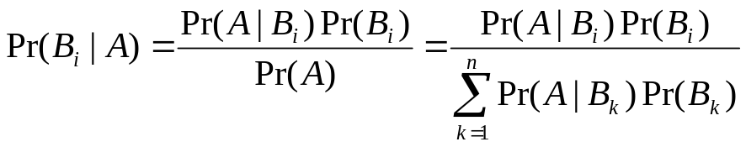
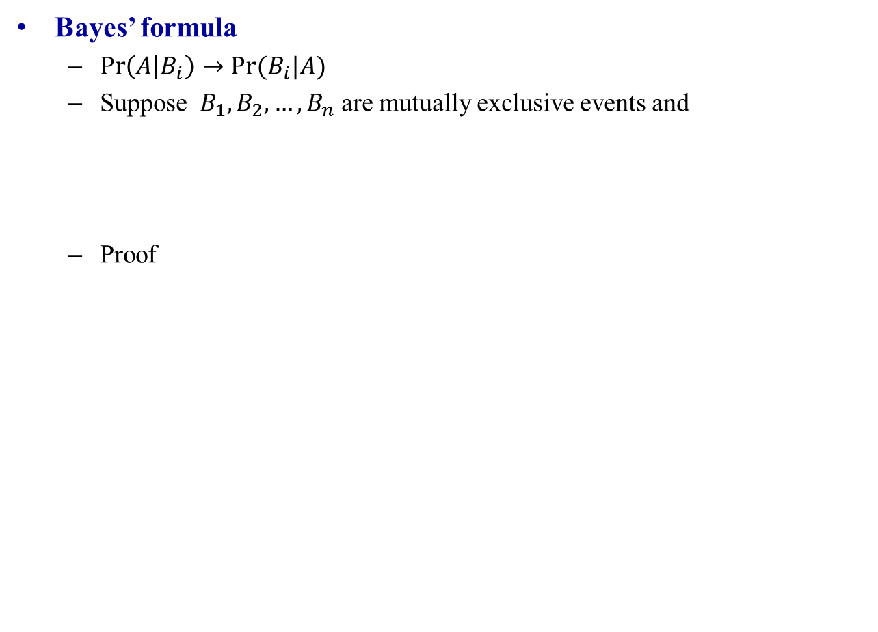

BAYES’ FORMULA
Bayes’ formula
  $\operatorname{Pr}\left(A | B_{i}\right)→Pr⁡(B_{i}|A)$
  Suppose $B_{1},B_{2},…,B_{n}$ are mutually exclusive events and
  Proof
  $$B_{1}∪B_{2}∪…∪B_{n}=S$$

Slide 56
BAYES’ FORMULA
Example
  Consider two urns. The 1st contains 3 white and 7 black balls. The 2nd contains 8 white and 2 black balls. We flip a fair coin and then draw a ball from the 1st urn if the coin is head, and draw a ball from the 2nd urn if the coin is tail.
    If we draw a black ball, what is the probability that we draw it from the 1st urn?
    If we draw a black ball, what is the probability that we draw it from the 2nd urn?
Notes:
A draw a black ball
B drawing from the 1st urn
P(B) = ½;
P(A|B) = 7/10;
P(A|Bc) = 2/20;
P(A) = P(A|B)P(B)+P(A|Bc)P(Bc) = 7/10*1/2 + 2/10*1/2 = 9/20
P(B|A) = P(A|B)P(B)/P(A) = 7/20*1/2/(9/20) = 7/40/(18/40) = 7/18

Slide 57
BAYES’ FORMULA
Example
  Alice can take either Chemistry or Physics. If Alice takes Chemistry, the probability that she will get an A is 0.5. If she takes Physics, the probability that she will get an A is 0.6. If Alice decides which course to take by flipping a fair coin. If Alice gets an A, what is the probability that she takes Chemistry?

Slide 58
BAYES’ FORMULA
Example
  A manufacture buys components in equal amount from 4 different suppliers. The probability that components from supplier 1 are bad is 0.05, that components from supplier 2 are bad is 0.1, that components from supplier 3 are bad is 0.2, that components from supplier 4 are bad is 0.15,
    The probability that a component is bad.
    If a component is bad, the probability that it is from supplier 2.
Notes:
B: bad
A2: supplier 2
P(A|B)
P(B|A) = 0.1
P(B|Ac) = 0.05
P(A) = 0.5
P(Ac) = 0.5
P(B) = 0.05*0.25+0.1*0.25+ 0.2*0.25 + 0.15*0.25 = 0.125
P(A2|B) = 0.1*0.25/0.125 = 0.2

Slide 59
BAYES’ FORMULA
Example
  A lab blood test to detect a certain disease. If the disease is present, the test can detect it 95% of the time. However, the test also gives a “false positive” result for 1% of the healthy person being tested (that is, if a healthy person is tested, then, with probability 0.01, the result will imply the person has the disease). Assume 0.5% of the population actually has the disease. If the test result of a person is positive, what is the probability that the person actually has the disease?
Notes:
A: disease
B1: positive
B2: negative
Pr(A|B) = ?
Pr(B|A) = 0.95
Pr(B|Ac) = 0.01
Pr(A) = 0.005
Pr(B) = Pr(B|A)Pr(A) + Pr(B|Ac)Pr(Ac) = 0.95*0.005+0.01*0.995 = 0.0147
Pr(A|B) = Pr(B|A)*Pr(A)/Pr(B) = (0.95*0.005)/0.0147 = 0.3231 = 32.31%

Slide 60
OUTLINE
Applications
Elementary Set Theory
Random Experiments
Probability
Conditional probability
Independence
Bayes’ Formula
Bernoulli trials

Slide 61

BERNOULLI TRIALS
Bernoulli trials
  Consider an experiment with event A, and Pr(A) = p.
  Repeat the experiment n times, what is the probability that event A happens exactly k times?
  The composite events that there are exactly k event A in n trials:
  The probability of one of the events
  How many such events are there?
    Choose k position out of n positions (example, k = 2, n = 4)
Notes:
AcAcAA, AcAAcA, AcAAAc, AAcAcA, AAcAAc, AAAcAc
4!/(2!2!) = 24/4 = 6

Slide 62
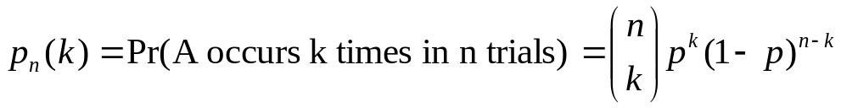
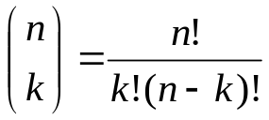
BERNOULLI TRIALS
Bernoulli trials

Slide 63
BERNOULLI TRIALS
Example
  Toss an unfair coin 6 times. The probability of Head is 0.3.
    What is the probability that the head occurs twice?
    What is the probability that the head occurs more than once?

