Slide 1
ELEG 3143 Probability & Stochastic Process
Ch. 2 Discrete Random Variables
Dr. Jingxian Wu
wuj@uark.edu

Slide 2
OUTLINE
Random Variable
Discrete Random Variable
Families of Discrete Random Variables
Moments

Slide 3
RANDOM VARIABLE
Random variable (RV)
  A function, which assigns a unique numerical value to each possible outcome in the sample space of a random experiment
  A mapping from the sample space to some real numbers.
  sample space S ➔ real number R

Slide 4
RANDOM VARIABLE
Random variable
  Examples
    Toss a coin. S = {H, T}
    Define random variable X such that
      X = 1, if the outcome is H
      X = 0, if the outcome is T
    A mapping from the sample space to some real numbers
      Event {H} → X = 1
      Event {T} → X = 0
    The value of the random variable, X, is random. The actual value of X depends on the outcome of the experiment
    We can assign probability to each value of the random variable
      Pr(X = 1) = Pr({H}) = 0.5
      Pr(X = 0) = Pr({T}) = 0.5

Slide 5
RANDOM VARIABLE
Example
  Consider an experiment of tossing 2 fair coins. Define the RV, Y, as the number of heads appearing.
    Find the mapping from the sample space to the value of Y
    Find the probability of the different values of Y
Capital letter is used to represent an RV
Small letter is used to represent a deterministic value of an RV.

Slide 6
RANDOM VARIABLE
Example
  Suppose that there is an unfair coin with a probability p of coming up heads. We perform an experiment, in which we flip the coin, until the first head appears. Define an RV, N, as the number of flips required.
    1. Find the mapping from the sample space to the RV
    2. Find the probability of the RV.

Slide 7


RANDOM VARIABLE
Discrete RV v.s. continuous RV
  Consider a random variable X
  If X has countable number values, then X is a discrete RV
    E.g. toss a coin, X = 0 if H, X = 1 if T
    E.g. Defined the RV N as the number of flips required to get the head of a coin
  If X has uncountable number of values, then X is a continuous RV
    E.g. Define the RV X as the current temperature
Example
  Consider the lifetime of a car
    Define the RV, X, as the lifetime of the car
      Then X is a continuous RV,
    Define the RV, Y, as follows
      If the car has a life longer than 2 years → Y = 1
      If the car has a life shorter than 2 years → Y = 0
      Then Y is a discrete RV,

Slide 8
OUTLINE
Random Variable
Discrete Random Variable
Families of Discrete Random Variables
Moments

Slide 9



DISCRETE RV
Discrete RV
  A random variable that can take at most a countable number of possible values.
Probability mass function (PMF)
  Consider a discrete RV X, which can take any one of the following values:
  The probability mass function of X is defined as
  Example
    Flip an unfair coin with the probability p of coming up head. Define an RV X, such that H → X = 1; T → X = 0. What is the PMF?

Slide 10
DISCRETE RV
Example
  Consider an urn with 3 black balls, 5 red balls, and 8 white balls. Randomly pick 1 ball. Define an RV X as:
    black ball → X = 1, red ball → X = 2, white ball → X = 3
    Find the PMF.

Slide 11


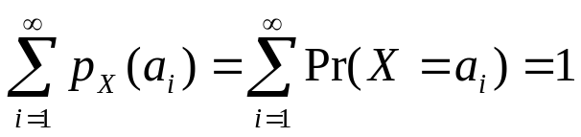
DISCRETE RV
PMF
  For an RV , since X must take one of the values of

Slide 12


DISCRETE RV
Cumulative distribution function (CDF)
  All called distribution function
  The probability that the RV, X, is less than or equal to a deterministic number, x
    capital letter X: Random variable (has random values)
    Small letter x: deterministic variable (has fixed value)
    E.g.

Slide 13
DISCRETE RV
Example
  Flip an unfair coin with the probability p of coming up head. Define an RV X, such that H → X = 1; T → X = 0. What is the CDF?

Slide 14
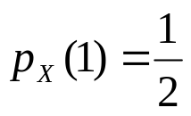
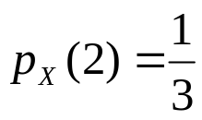
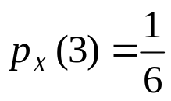
DISCRETE RV
Example
  Suppose X has a PMF given by
    Find and plot the CDF.

Slide 15






DISCRETE RV
Properties of CDF
  is a non-decreasing function of x

Slide 16
OUTLINE
Random Variable
Discrete Random Variable
Families of Discrete Random Variables
Moments

Slide 17


DISCRETE RV
Bernoulli RV
  Consider an experiment, whose outcome can be classified as either a “success” or as a “failure”. The probability of success is p. Define an RV X such that
    Success → X = 1
    Failure → X = 0.
    Then X is called a Bernoulli RV
  The PMF
  The CDF
  Recall Bernoulli trials
    Perform the experiment independently for N times

Slide 18
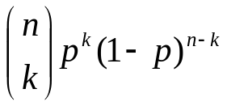

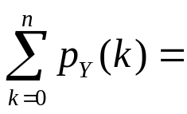
DISCRETE RV
Binomial RV
  Perform n independent trials, each of which results in a “success” with probability p. Define the RV Y as the total number of successes that occur in the n trials. Then Y is a binomial RV.
  PMF
  The summation of PMF

Slide 19




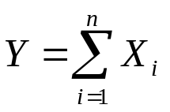
DISCRETE RV
Relationship between Bernoulli RV and Binomial RV
  Consider an experiment, whose outcome can be classified as either a “success” or as a “failure”. The probability of success is p. The Bernoulli RV, X, is defined as
    Success → X = 1
    Failure → X = 0.
  Perform n independent trials, each of which results in a “success” with probability p. Define the RV Y as the total number of successes that occur in the n trials. Then Y is a binomial RV.
    Each trial results in a Bernoulli RV
  The relationship between the Bernoulli RV , and the Binomial RV Y

Slide 20
DISCRETE RV
Example
  It is known that any item produced by a certain machine will be defective with probability 0.1, independently of any other item. What is the probability that in a sample of 3 items, at most one will be defective?
Notes:
0.972

Slide 21
DISCRETE RV
Binomial RV
  On a multiple-choice exam with 4 possible answers for each of the 5 questions. What is the probability that a student would get 4 or more correct answers just by guessing?

Slide 22


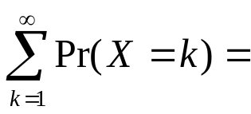
DISCRETE RV
Geometric RV
  Suppose that independent trials, each having probability p of being success. The experiment is performed until a success occurs. Define X as the number of trials required until the first success. Then X is said to be a geometric RV.
  PMF
  The sum of Geometric PMF

Slide 23

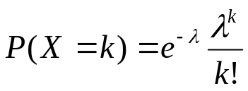
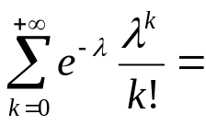
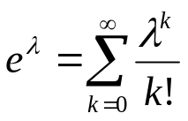
DISCRETE RV
Poisson RV
  A random variable X, taking on the values 0, 1, 2, ……, is said to be a Poisson random variable with parameter > 0, if the PMF can be written as
Sum of Poisson PMF

Slide 24

DISCRETE RV
Example
  If the number of accidents occurring on a highway each day is a Poisson RV with parameter . What is the probability that at least 1 accident occur today?

Slide 25


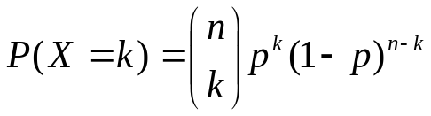

DISCRETE RV: SUMMARY
Bernoulli RV
Binomial RV
Geometric RV
Poisson RV

Slide 26
OUTLINE
Random Variable
Discrete Random Variable
Families of Discrete Random Variables
Moments

Slide 27
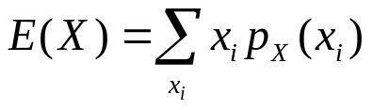
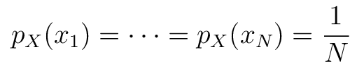
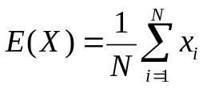

MOMENTS
The expected value, or mean, of a discrete RV, X, is
  The summation is performed over all the possible values of X.
  Also called as: expected value, mean, average, first moment
  Interpretation
    The weighted average of the random variable
    If the random variable takes all the values with equal probability, that is, , then
    Given more weight to more probable values, and vice versa
  Also denoted as

Slide 28
MOMENTS
Example
  Consider an unfair coin with Pr(H) = 0.3. Define the RV X, such that X = 0 if H, and X = 1 if T. Find the mean of X. (Bernoulli RV)
  Find the mean of a geometric RV with parameter p.

Slide 29
MOMENTS
Example
  Find the mean of a binomial RV with parameters n, k, and p

Slide 30

MOMENTS
Example
  Find the mean of the Poisson RV with the parameter

Slide 31
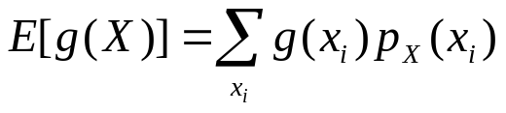

MOMENTS
Expected value of any function of X
  E(X): the expectation operator
  The variable of the expectation operator must be a random variable
    X is an RV
    g(X) is an RV
  Also denoted as

Slide 32

MOMENTS
Example
  Consider a gambling game of throwing 3 fair coins. Let X be the RV denoting the number of heads. The payoff is , e.g. the Casino pays $0 for 0 H, $1 for 1H, $4 for 2H, and $9 for 3H. If the Casino charges $3.5 per play, will you play the game?

Slide 33

MOMENTS
The expectation operator is a linear operator
  Consider two random variables X and Y and two constants a and b, we have
    Proof:

Slide 34
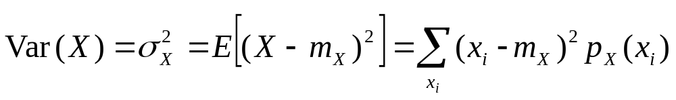

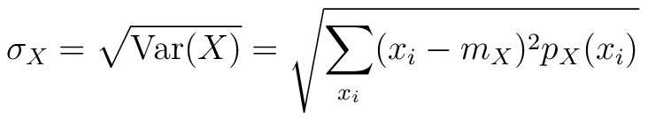
MOMENTS
Variance
  The variance of a discrete RV X is
  Also called: the 2nd central moment of X
  Standard deviation:
  Physical interpretation
    How far away the random variable is from its expected value
    A larger variance ➔ more uncertainty
    Zero-variance ➔ the RV is deterministic (no randomness)

Slide 35
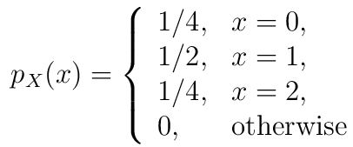
MOMENTS
Example
  Consider a discrete RV with PMF
    Find the mean and variance.

Slide 36


MOMENTS
Properties of variance

Slide 37
MOMENTS
Example
  Find the variance of the Bernoulli RV
  Consider a deterministic variable x = 3. What is the mean and variance?

Slide 38
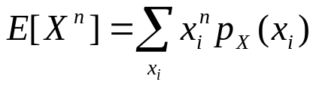


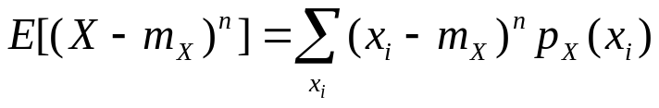


MOMENTS
The n-th moment of the random variable X
  1st moment: mean
  2nd moment:
The n-th central moment of the random variable X
  1st central moment:
  2nd central moment: variance
The combination of all the moments, n = 1, 2, …., gives a complete description of the random variable

