Slide 1
ELEG 3143 Probability & Stochastic Process
Ch. 2 Random Variables
Dr. Jingxian Wu
wuj@uark.edu

Slide 2
OUTLINE
Random Variable
Discrete Random Variable
Continuous Random Variable
Moments of Discrete RV
Moments of Continuous RV
Functions of one RV

Slide 3
RANDOM VARIABLE
Random variable (RV)
  A function, which assigns a unique numerical value to each possible outcome of a random experiment
  A mapping from the sample space to some real numbers.
  Example
    Toss a coin. S = {H, T}
    Define random variable X such that
      X = 1, if the outcome is H
      X = 0, if the outcome is T
    A mapping from the sample space to some real numbers
      Event {H} → X = 1
      Event {T} → X = 0
    The value of the random variable, X, is random. The actual value of X depends on the outcome of the experiment
    We can assign probability to each value of the random variable
      P(X = 1) = P({H}) = 0.5
      P(X = 0) = P({T}) = 0.5

Slide 4
RANDOM VARIABLE
Example
  Consider an experiment of tossing 2 fair coins. Define the RV, Y, as the number of heads appearing.
    Find the mapping from the sample space to the value of Y
    Find the probability of the different values of Y
Capital letter is used to represent an RV
Small letter is used to represent a deterministic RV.

Slide 5
RANDOM VARIABLE
Example
  Suppose that there is an unfair coin with a probability p of coming up heads. We perform an experiment, in which we flip the coin, until the first head appears. Define an RV, N, as the number of flips required.
    1. Find the mapping from the sample space to the RV
    2. Find the probability of the RV.

Slide 6
RANDOM VARIABLE
Discrete RV v.s. continuous RV
  Consider a random variable X
  If X has countable number values, then X is a discrete RV
    E.g. toss a coin, X = 0 if H, X = 1 if T
    E.g. Defined the RV N as the number of flips required to get the head of a coin
  If X has uncountable number of values, then X is a continuous RV
    E.g. Define the RV X as the current temperature
Example
  Consider the lifetime of a car
    Define the RV, X, as the lifetime of the car
      Then X is a continuous RV,
    Define the RV, Y, as follows
      If the car has a life longer than 2 years → Y = 1
      If the car has a life shorter than 2 years → Y = 0
      Then Y is a discrete RV,

Slide 7
OUTLINE
Random Variable
Discrete Random Variable
Continuous Random Variable
Moments of Discrete RV
Moments of Continuous RV
Functions of one RV

Slide 8
DISCRETE RV
Discrete RV
  A random variable that can take at most a countable number of possible values.
Probability mass function (PMF)
  Consider a discrete RV X, which can take any one of the following values:
  The probability mass function of X is defined as
  Example
    Flip an unfair coin with the probability p of coming up head. Define an RV X, such that H → X = 1; T → X = 0. What is the PMF?

Slide 9
DISCRETE RV
Example
  Consider an urn with 3 black balls, 5 red balls, and 8 white balls. Randomly pick 1 ball. Define an RV X as:
    black ball → X = 1, red ball → X = 2, white ball → X = 3
    Find the PMF.

Slide 10
DISCRETE RV
PMF
  For an RV , since X must take one of the values of
Cumulative distribution function (CDF)
  All called distribution function
  The probability that the RV, X, is less than or equal to a deterministic number, x
    capital letter X: Random variable (has random values)
    Small letter x: deterministic variable (has fixed value)
    E.g.

Slide 11
DISCRETE RV
Example
  Flip an unfair coin with the probability p of coming up head. Define an RV X, such that H → X = 1; T → X = 0. What is the CDF?

Slide 12
DISCRETE RV
Example
  Suppose X has a PMF given by
    Find and plot the CDF.

Slide 13
DISCRETE RV
Properties of CDF
  is a non-decreasing function of x

Slide 14
DISCRETE RV
Bernoulli RV
  Consider an experiment, whose outcome can be classified as either a “success” or as a “failure”. The probability of success is p. Define an RV X such that
    Success → X = 1
    Failure → X = 0.
    Then X is called a Bernoulli RV
  The PMF
  The CDF
  Recall Bernoulli trials
    Perform the experiment independently for N times

Slide 15
DISCRETE RV
Binomial RV
  Perform n independent trials, each of which results in a “success” with probability p. Define the RV Y as the total number of successes that occur in the n trials. Then Y is a binomial RV.
  PMF
  The summation of PMF

Slide 16
DISCRETE RV
Relationship between Bernoulli RV and Binomial RV
  Consider an experiment, whose outcome can be classified as either a “success” or as a “failure”. The probability of success is p. The Bernoulli RV, X, is defined as
    Success → X = 1
    Failure → X = 0.
  Perform n independent trials, each of which results in a “success” with probability p. Define the RV Y as the total number of successes that occur in the n trials. Then Y is a binomial RV.
    Each trial results in a Bernoulli RV
  The relationship between the Bernoulli RV , and the Binomial RV Y

Slide 17
DISCRETE RV
Example
  It is known that any item produced by a certain machine will be defective with probability 0.1, independently of any other item. What is the probability that in a sample of 3 items, at most one will be defective?
Notes:
0.972

Slide 18
DISCRETE RV
Binomial RV
  On a multiple-choice exam with 4 possible answers for each of the 5 questions. What is the probability that a student would get 4 or more correct answers just by guessing?

Slide 19
DISCRETE RV
Geometric RV
  Suppose that independent trials, each having probability p of being success. The experiment is performed until a success occurs. Define X as the number of trials required until the first success. Then X is said to be a geometric RV.
  PMF
  The sum of Geometric PMF

Slide 20
DISCRETE RV
Poisson RV
  A random variable X, taking on the values 0, 1, 2, ……, is said to be a Poisson random variable with parameter > 0, if the PMF can be written as
Sum of Poisson PMF

Slide 21
DISCRETE RV
Example
  If the number of accidents occurring on a highway each day is a Poisson RV with parameter . What is the probability that at least 1 accident occur today?

Slide 22
DISCRETE RV: SUMMARY
Bernoulli RV
Binomial RV
Geometric RV
Poisson RV

Slide 23
OUTLINE
Random Variable
Discrete Random Variable
Continuous Random Variable
Moments of Discrete RV
Moments of Continuous RV
Functions of one RV

Slide 24
CONTINUOUS RV
Continuous RV
  If a random variable can take an unaccountable number of values, then the random variable is a continuous random variable.
  Examples of continuous RV
    The daily average temperature
    The expected lifetime of a computer
    The amplitude of noise in an electronic component
    ……

Slide 25
CONTINUOUS RV
Cumulative distribution function (distribution function)
  The cumulative distribution function (CDF) of a continuous RV is
    The probability that the RV X is smaller than or equal to x
  Recall: the CDF of a discrete RV Y is
  Properties of CDF
  is a non-decreasing function of x

Slide 26
CONTINUOUS RV
Example
  A particular random variable has a probability distribution function given by
    What is the probability that
    What is the probability that
    What is the probability that

Slide 27
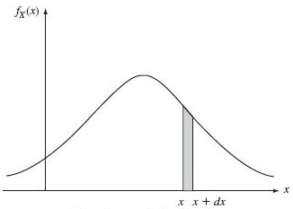
CONTINUOUS RV
Probability density function (pdf)
  The “density” of probability
  Review: differentiation
  Interpretation:

Slide 28
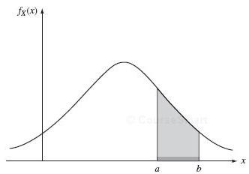
CONTINUOUS RV
Relationship between pdf and CDF
  Review: integration
    finding the area under the integrand

Slide 29
CONTINUOUS RV
Properties of pdf

Slide 30
CONTINUOUS RV
Example
  The pdf of a RV X has the form
    The value of a
    the probability that
    The probability that

Slide 31
CONTINUOUS RV
Uniform distribution
  A random variable X is said to be uniformly distributed over the interval (a, b) if its pdf is given by
    The RV has equal probability of being any number inside (a, b)

Slide 32
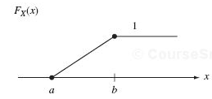
CONTINUOUS RV
Uniform distribution
  CDF of a uniform RV

Slide 33
CONTINUOUS RV
Example
  A continuous RV X is uniformly distributed between (3, 8). Find the following probability

Slide 34
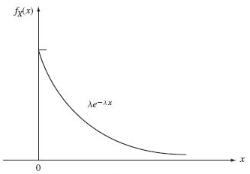
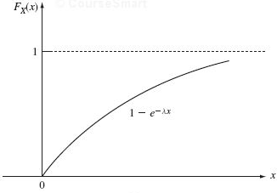
CONTINUOUS RV
Exponential RV
  The pdf of an exponential RV with parameter
  The CDF of an exponential RV

Slide 35
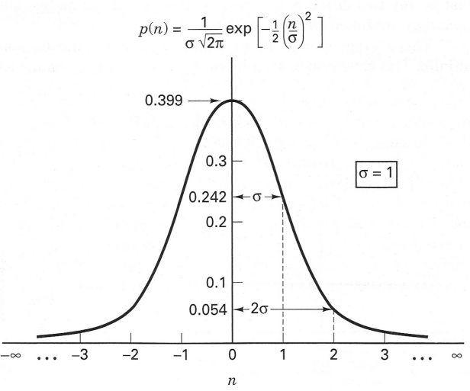
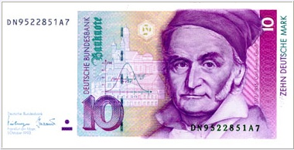
CONTINUOUS RV
Normal RV (Gaussian RV)
  A Gaussian RV X with parameters and

Slide 36
OUTLINE
Random Variable
Discrete Random Variable
Continuous Random Variable
Moments of Discrete RV
Moments of Continuous RV
Functions of one RV

Slide 37
MOMENTS: DISCRETE RV
The expected value, or mean, of a discrete RV, X, is
  The summation is performed over all the possible values of X.
  Expected value, mean, average, first moment
  Interpretation
    The weighted average of the random variable
    If the random variable takes all the values with equal probability, that is, , then
    Given more weight to more probable values, and vice versa
  Also denoted as

Slide 38
MOMENTS: DISCRETE RV
Example
  Consider an unfair coin with Pr(H) = 0.3. Define the RV X, such that X = 0 if H, and X = 1 if T. Find the mean of X. (Bernoulli RV)
  Find the mean of a geometric RV with parameter p.

Slide 39
MOMENTS: DISCRETE RV
Example
  Find the mean of a binomial RV with parameters n, k, and p

Slide 40
MOMENTS: DISCRETE RV
Example
  Find the mean of the Poisson RV with the parameter

Slide 41
MOMENTS: DISCRETE RV
Expected value of any function of X
  E(X): the expectation operator
  The variable of the expectation operator must be a random variable
    X is an RV
    g(X) is an RV
  Also denoted as

Slide 42
MOMENTS: DISCRETE RV
Example
  Consider a gambling game of throwing 3 fair coins. Let X be the RV denoting the number of heads. The payoff is , e.g. the Casino pays $0 for 0 H, $1 for 1H, $4 for 2H, and $9 for 3H. If the Casino charges $3.5 per play, will you play the game?

Slide 43
MOMENTS: DISCRETE RV
Variance
  The variance of a discrete RV X is
  Also called: the 2nd central moment of X
  Standard deviation:
  Property
  Physical interpretation
    How far away the random variable is from its expected value

Slide 44
MOMENTS: DISCRETE RV
Example
  Find the variance of the Bernoulli RV
  Consider a deterministic variable x = 3. What is the mean and variance?

Slide 45
MOMENTS: DISCRETE RV
The n-th moment of the random variable X
  1st moment: mean
  2nd moment:
The n-th central moment of the random variable X
  1st central moment:
  2nd central moment: variance
The combination of all the moments, n = 1, 2, …., gives a complete description of the random variable

Slide 46
OUTLINE
Random Variable
Discrete Random Variable
Continuous Random Variable
Moments of Discrete RV
Moments of Continuous RV
Functions of one RV

Slide 47
MOMENTS: DISCRETE RV
The expected value, or mean, of a continuous RV, X, is
  Recall: discrete RV
  Expected value, mean, average, first moment
  Interpretation
    The weighted average of the random variable
    Recall: integration is an extreme case of summation.
  Also denoted as

Slide 48
MOMENTS: CONTINOUS RV
Example
  The mean of an RV X uniformly distributed in (a, b)

Slide 49
MOMENTS: CONTINOUS RV
Example
  The mean of an exponential RV with parameter

Slide 50
MOMENTS: CONTINUOUS RV
Expected value of any function of X
  Recall: discrete RV
  E(X): the expectation operator
  The variable of the expectation operator must be a random variable
    X is an RV
    g(X) is an RV
  Also denoted as

Slide 51
MOMENTS: CONTINUOUS RV
Variance
  The variance of a continuous RV X is
  Recall: discrete RV
  Also called: the 2nd central moment of X
  Standard deviation:
  Property
  Physical interpretation
    How far away the random variable is from its expected value

Slide 52
MOMENTS: DISCRETE RV
The n-th moment of the random variable X
  1st moment: mean
  2nd moment:
The n-th central moment of the random variable X
  1st central moment:
  2nd central moment: variance
The combination of all the moments, n = 1, 2, …., gives a complete description of the random variable

Slide 53
MOMENTS: CONTINUOUS RV
Example
  Find the variance of an RV X uniformly distributed on (a, b)

Slide 54
MOMENTS
Example
  Consider a random variable , where A, f are constants, and is uniformly distributed in . Find the expected value of Y.

Slide 55
CONTINUOUS RV
Normal RV (Gaussian RV)
  Find the mean and variance
  The Gaussian RV is completely determined by its first 2 moments.
    No true for other RVs.

Slide 56
MOMENTS: CONTINUOUS RV
Gaussian RV
  Define: Q function
  For a Gaussian RV X with mean m and variance . What is the probability that X < m -

Slide 57
OUTLINE
Random Variable
Discrete Random Variable
Continuous Random Variable
Moments of Discrete RV
Moments of Continuous RV
Functions of one RV

Slide 58
FUNCTIONS OF ONE RV
Example
  X is an RV with pdf . Let Y = a X + b, where a and b are constants. What is the pdf of Y?
  If X is a Gaussian RV with mean 0 and variance 1. Find the pdf of

Slide 59
FUNCTIONS OF ONE RV
Example
  If X is a Gaussian RV with mean 0 and variance 1. Find the pdf of

Slide 60
FUNCTIONS OF ONE RV
Example
  Let X be an exponential RV with parameter . Find the pdf of

