Slide 1
ELEG 3143 Probability & Stochastic Process
Ch. 3 Continuous Random Variables
Dr. Jingxian Wu
wuj@uark.edu

Slide 2
OUTLINE
Continuous Random Variable
Family of continuous RV
Moments of Continuous RV
Gaussian RV
Functions of one RV

Slide 3
CONTINUOUS RV
Continuous RV
  If a random variable can take an unaccountable number of values, then the random variable is a continuous random variable.
  Examples of continuous RV
    The daily average temperature
    The expected lifetime of a computer
    The amplitude of noise in an electronic component
    ……

Slide 4


CONTINUOUS RV
Cumulative distribution function (distribution function)
  The cumulative distribution function (CDF) of a continuous RV is
    The probability that the RV X is smaller than or equal to x
  Recall: the CDF of a discrete RV Y is

Slide 5





CONTINUOUS RV
Properties of CDF
  is a non-decreasing function of x

Slide 6
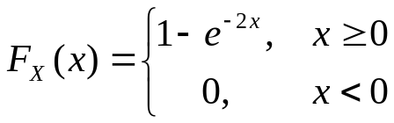



CONTINUOUS RV
Example
  A particular random variable has a probability distribution function given by
    What is the probability that
    What is the probability that
    What is the probability that

Slide 7
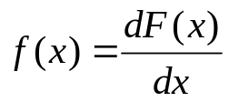
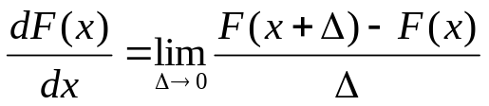
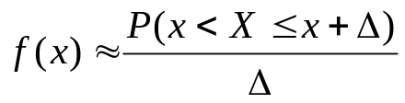
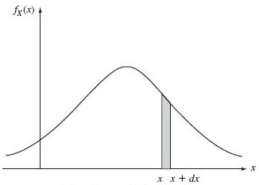

CONTINUOUS RV
Probability density function (pdf)
  The “density” of probability
  Review: differentiation
  Interpretation:

Slide 8
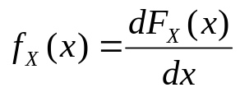




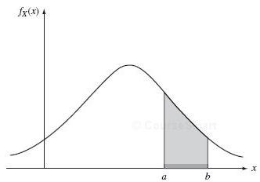
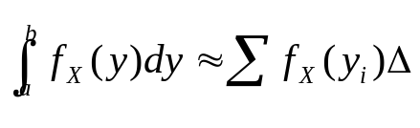
CONTINUOUS RV
Relationship between pdf and CDF
  Review: integration
    finding the area under the integrand

Slide 9




CONTINUOUS RV
Properties of pdf

Slide 10



CONTINUOUS RV
Example
  The pdf of a RV X has the form
    The value of a
    the probability that
    The probability that

Slide 11
OUTLINE
Continuous Random Variable
Family of continuous RV
Moments of Continuous RV
Gaussian RV
Functions of one RV

Slide 12
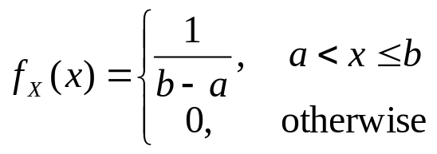
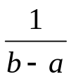


CONTINUOUS RV
Uniform distribution
  A random variable X is said to be uniformly distributed over the interval (a, b) if its pdf is given by
    The RV has equal probability of being any number inside (a, b)

Slide 13
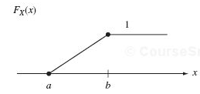
CONTINUOUS RV
Uniform distribution
  CDF of a uniform RV

Slide 14



CONTINUOUS RV
Example
  A continuous RV X is uniformly distributed between (3, 8). Find the following probability

Slide 15

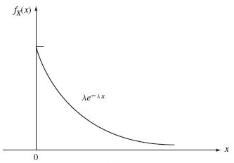
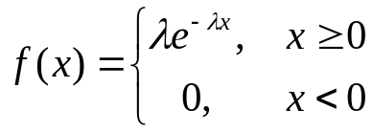
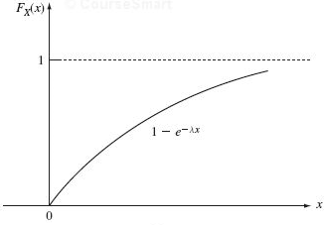
CONTINUOUS RV
Exponential RV
  The pdf of an exponential RV with parameter
  The CDF of an exponential RV

Slide 16
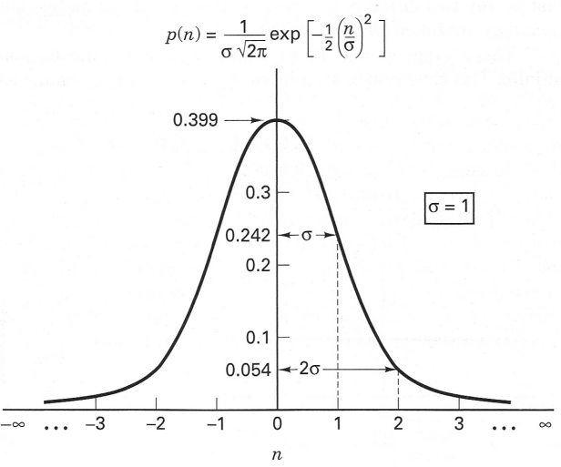


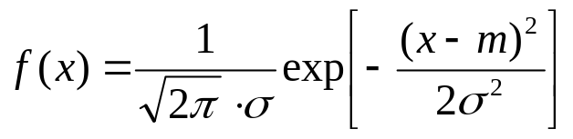
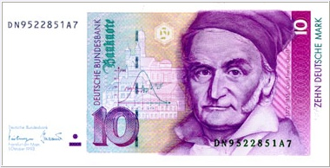
CONTINUOUS RV
Normal RV (Gaussian RV)
  A Gaussian RV X with parameters and

Slide 17
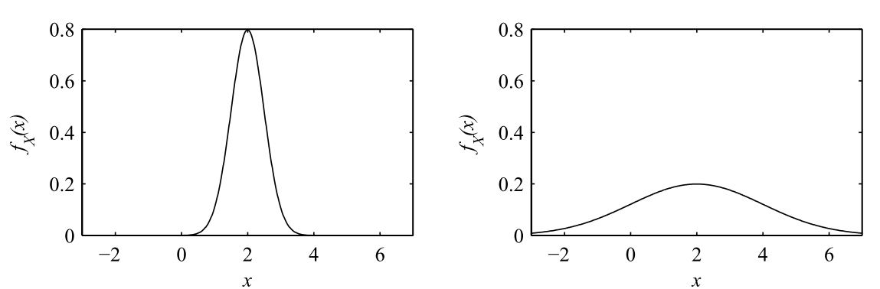


CONTINUOUS RV
Normal RV (Gaussian RV)

Slide 18
OUTLINE
Continuous Random Variable
Family of continuous RV
Moments of Continuous RV
Gaussian RV
Functions of one RV

Slide 19
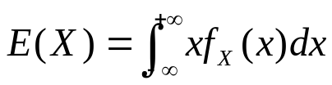
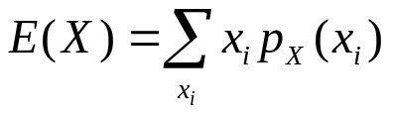

MOMENTS: DISCRETE RV
The expected value, or mean, of a continuous RV, X, is
  Recall: discrete RV
  Also known as: expected value, mean, average, first moment
  Interpretation
    The weighted average of the random variable
    Recall: integration is an extreme case of summation.
  Also denoted as

Slide 20
MOMENTS: CONTINOUS RV
Example
  The mean of an RV X uniformly distributed in (a, b)

Slide 21

MOMENTS: CONTINOUS RV
Example
  The mean of an exponential RV with parameter

Slide 22
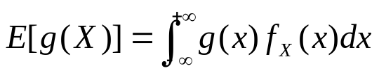
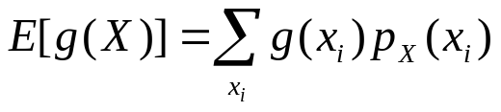

MOMENTS: CONTINUOUS RV
Expected value of any function of X
  Recall: discrete RV
  E(X): the expectation operator
  The variable of the expectation operator must be a random variable
    X is an RV
    g(X) is an RV
  Also denoted as

Slide 23
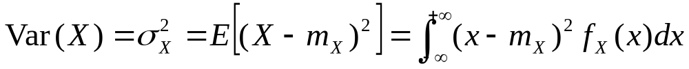
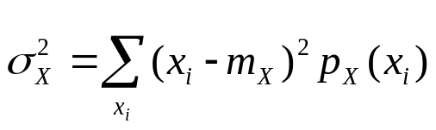

MOMENTS: CONTINUOUS RV
Variance
  The variance of a continuous RV X is
  Recall: discrete RV
  Also called: the 2nd central moment of X
  Standard deviation:
  Physical interpretation
    How far away the random variable is from its expected value

Slide 24


MOMENTS: CONTINUOUS RV
Properties of variance

Slide 25
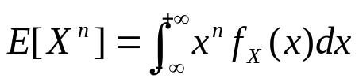


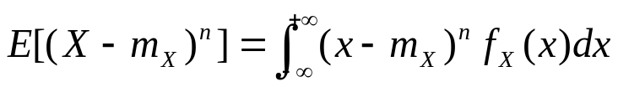


MOMENTS: CONTINUOUS RV
The n-th moment of the random variable X
  1st moment: mean
  2nd moment:
The n-th central moment of the random variable X
  1st central moment:
  2nd central moment: variance
The combination of all the moments, n = 1, 2, …., gives a complete description of the random variable

Slide 26
MOMENTS: CONTINUOUS RV
Example
  Find the variance of an RV X uniformly distributed on (a, b)

Slide 27



MOMENTS
Example
  Consider a random variable , where A, f are constants, and is uniformly distributed in . Find the expected value of Y.

Slide 28
OUTLINE
Continuous Random Variable
Family of continuous RV
Moments of Continuous RV
Gaussian RV
Functions of one RV

Slide 29


GAUSSIAN RV
Normal RV (Gaussian RV)
  The mean and variance are
  The Gaussian RV is completely determined by its first 2 moments.
    Not true for other RVs.

Slide 30
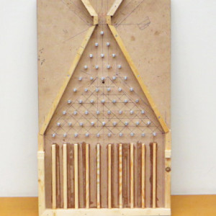
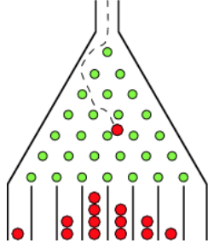
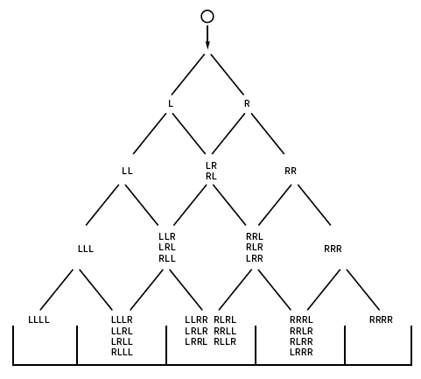
GAUSSIAN RV
Galton board
  A video demonstration
https://www.youtube.com/watch?v=xDIyAOBa_yU

Slide 31
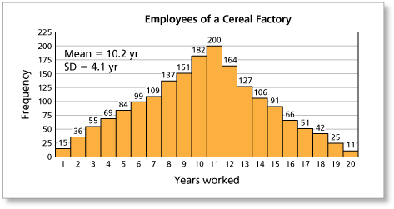
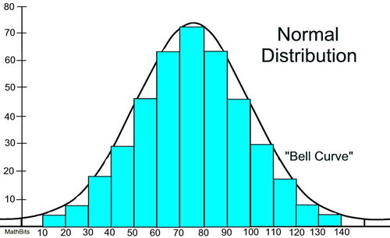
GAUSSIAN RV
Probability density function (pdf) v.s. Histogram
  years worked of 1820 employees in a cereal factory
  When the bin width goes to 0, histogram ➔ pdf

Slide 32





GAUSSIAN RV
Notation of Gaussian RV
  A Gaussian RV X with mean and variance is denoted as
Standard Gaussian RV
  A Gaussian RV with
  Denoted as

Slide 33




GAUSSIAN RV
A linear transformation of a Gaussian RV is still Gaussian
  Consider . Define a new RV
  Then Y is still Gaussian distributed
Converting a Gaussian RV to a standard Gaussian RV
  If
  Then

Slide 34



GAUSSIAN RV
CDF of standard Gaussian random variable
  Let be a standard Gaussian random variable, then the CDF of Z is
Complementary CDF (CCDF) of standard Gaussian random variable
  Let

Slide 35
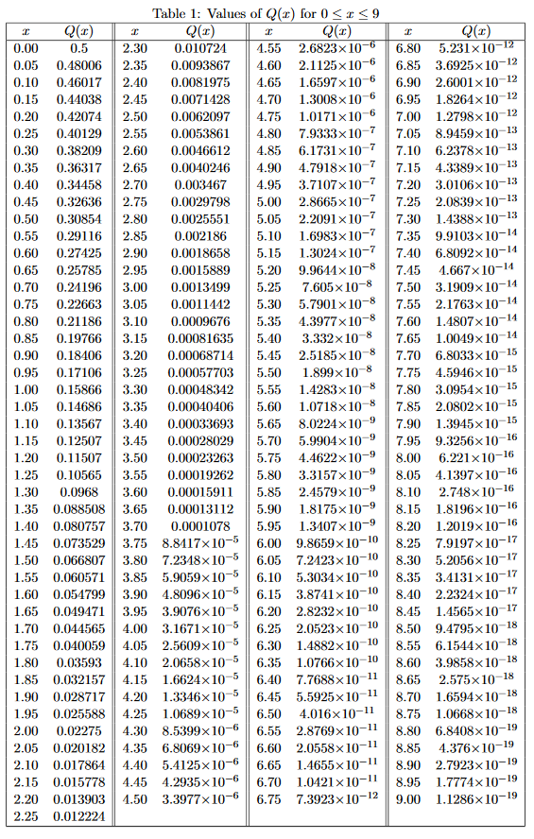

GAUSSIAN RV
Q-function table

Slide 36
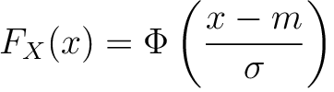
GAUSSIAN RV
CDF of Gaussian Random Variable
  Let , then the CDF of X is

Slide 37


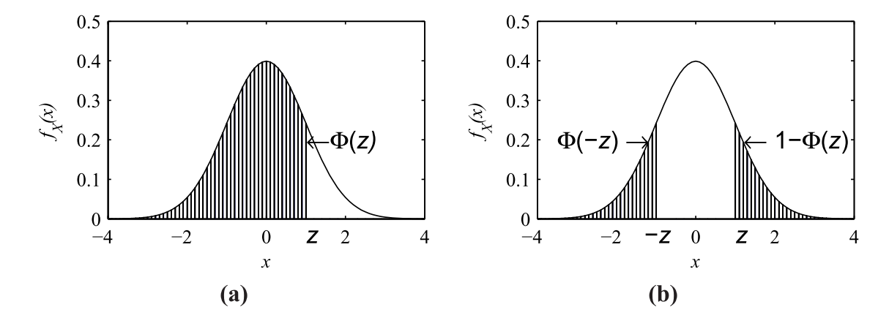
GAUSSIAN RV
Symmetric property of the Gaussian-Q function

Slide 38



GAUSSIAN RV
Example
  Consider , what are the probability for the following events

Slide 39
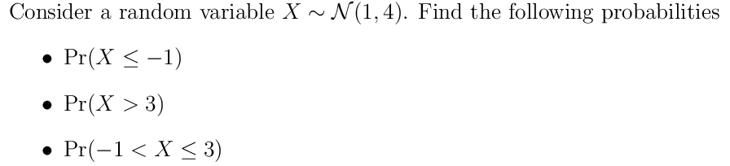
GAUSSIAN RV
Example

Slide 40
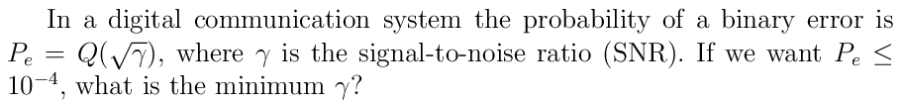
GAUSSIAN RV
Example

Slide 41
OUTLINE
Continuous Random Variable
Family of continuous RV
Moments of Continuous RV
Gaussian RV
Functions of one RV

Slide 42

FUNCTIONS OF ONE RV
Example
  X is an RV with pdf . Let Y = a X + b, where a and b are constants. What is the pdf of Y?

Slide 43

FUNCTIONS OF ONE RV
Example
  If X is a Gaussian RV with mean 0 and variance 1. Find the pdf of

Slide 44

FUNCTIONS OF ONE RV
Example
  If X is a Gaussian RV with mean 0 and variance 1. Find the pdf of

Slide 45

FUNCTIONS OF ONE RV
Example
  Let X be an exponential RV with parameter . Find the pdf of

