Slide 1
ELEG 3143 Probability & Stochastic Process
Ch. 4 Multiple Random Variables
Dr. Jingxian Wu
wuj@uark.edu

Slide 2
OUTLINE
Two discrete random variables
Two continuous random variables
Statistical independence and correlation
Functions of two random variables
Moment generating function

Slide 3
TWO DISCRETE RANDOM VARIABLES
Joint PMF of two discrete random variables
  Consider two discrete RVs, X and Y. The joint probability mass function (PMF) of X and Y is defined as

Slide 4
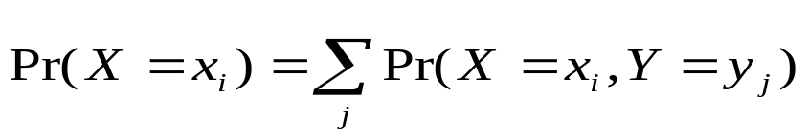
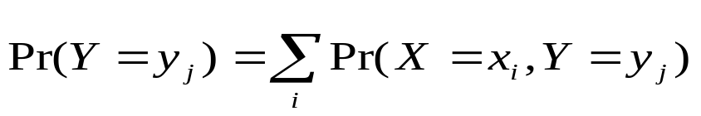
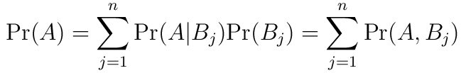

TWO DISCRETE RANDOM VARIABLES
Marginal PMF:
  the PMF of each individual RV (exactly the same as in Ch. 2)
  Joint PMF → marginal PMF (using the total probability equation)
    the summation is over all the possible value of Y
    the summation is over all the possible value of X
  Recall: total probability

Slide 5
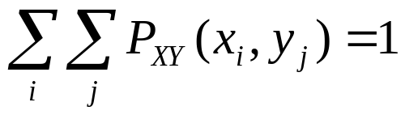
TWO DISCRETE RV
Example
  Consider an urn contains 4 white balls and 6 black balls. Pick two balls without replacement. Let X denote the result from the first pick, and Y the result from the 2nd pick, i.e., define two random variables (X, Y) as
  {(B, B)} → (X=0, Y=0), {(B, W)}→ (X=0, Y=1),
  {(W, B)}→ (X=1, Y=0), {(W, W)} →(X = 1,Y = 1)
  (a) Find the joint PMF
  (b) Find the marginal PMF of X
  (c) Find the marginal PMF of Y

Slide 6
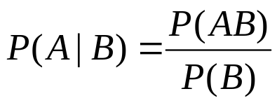





TWO DISCRETE RV
Review: conditional probability
  Two events A and B
Conditional PMF
  Given event B, what is the probability that ?
  E.g. two RV X and Y
    B:
    B: Y > y

Slide 7

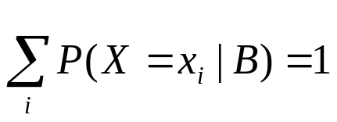
TWO DISCRETE RV
Example
  Consider an urn contains 4 white balls and 6 black balls. Pick two balls without replacement. Let X denote the result from the first pick, and Y the result from the 2nd pick, i.e., define two random variables (X, Y) as
  {(B, B)} → (X=0, Y=0), {(B, W)}→ (X=0, Y=1),
  {(W, B)}→ (X=1, Y=0), {(W, W)} →(X = 1,Y = 1)
  Find

Slide 8

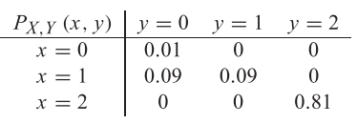
TWO DISCRETE RV
Example
  The joint PMF of two RV X and Y are given as follows. Find the marginal PMF and the conditional PMF

Slide 9
OUTLINE
Two discrete random variables
Two continuous random variables
Statistical independence and correlation
Functions of two random variables
Moment generating function

Slide 10


TWO CONTINUOUS RANDOM VARIABLES
Joint CDF
  The joint cumulative distribution function (CDF) of two random variables X and Y is defined as
    The above definition is true for both discrete RV and continuous RV
Marginal CDF
  The CDF of each individual RV (exactly the same as in Ch. 2)
  joint CDF → marginal CDF
    Why?

Slide 11



TWO CONTINUOUS RV
Example

Slide 12
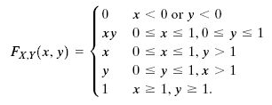
TWO CONTINUOUS RV
Example
  Two RVs X and Y have a joint CDF as follows. Find the CDF of X

Slide 13
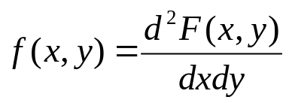

TWO CONTINUOUS RV
Joint pdf of two continuous RVs

Slide 14
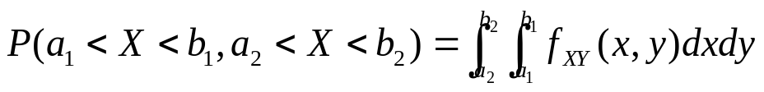
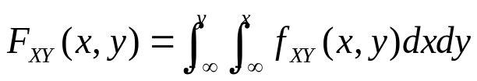
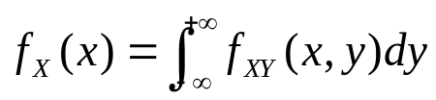
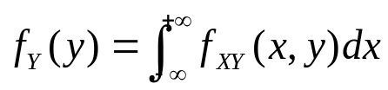
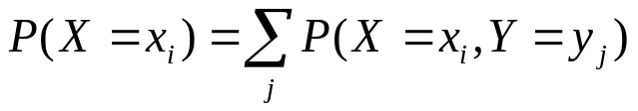
TWO CONTINUOUS RV
Properties of joint pdf
  Probability
  CDF
  Marginal pdf
    Recall: marginal PMF for discrete RV

Slide 15

TWO CONTINUOUS RV
Example
  Two RVs with joint pdf given as follows
    Find the marginal pdf of X
    The probability that X > 0.5 and Y < 0.3

Slide 16

TWO CONTINUOUS RV
Example
  Two RVs with the joint pdf as follows
    Find the constant c
    Find the marginal pdf of x and y

Slide 17
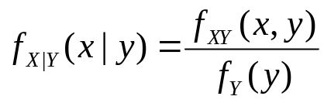

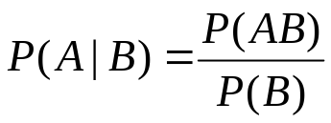

TWO CONTINUOUS RV
Conditional probability
  Recall

Slide 18

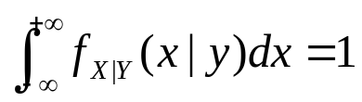
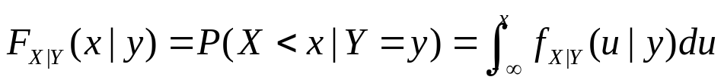



TWO CONTINUOUS RV
Conditional pdf
  Conditional pdf is still a pdf
  Difference between and

Slide 19



TWO CONTINUOUS RV
Example
  Two RVs with joint pdf as follows
  Find
  Find
  Find

Slide 20
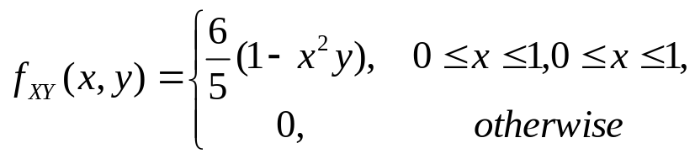

TWO CONTINUOUS RV
Example
  Two RVs with a joint pdf as follows
    Find
    Verify that

Slide 21
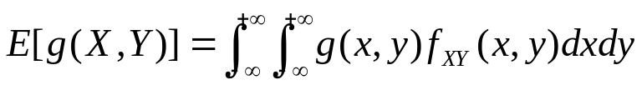

TWO CONTINUOUS RVS
Joint moment
Linearity of the expectation operator
  Proof:

Slide 22


TWO CONTINUOUS RVS
Example
  Two RVs X and Y with mean and . Define Z = 2X + 5Y + 7. Find E[Z].

Slide 23
OUTLINE
Two discrete random variables
Two continuous random variables
Statistical independence and correlation
Functions of two random variables
Moment generating function

Slide 24
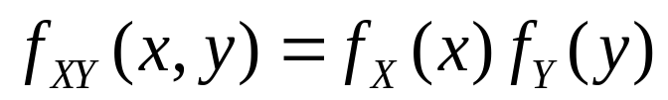
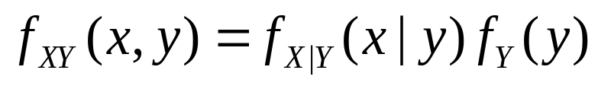
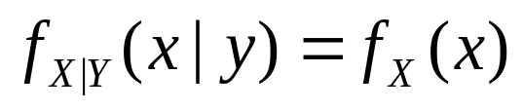

INDEPENDENCE AND CORRELATION
Independence
  Tow continuous RVs are called independent if and only if
  Recall: for two RVs X and Y
    Therefore, if X and Y are independent, then
  Recall: two events A and B are independent if and only if

Slide 25
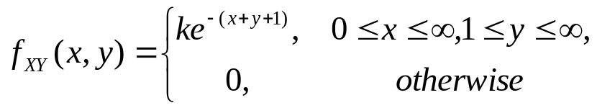
INDEPENDENCE AND CORRELATION
Example
  Two RVs with joint pdf as follows
    Find the value of k
    Are they independent

Slide 26
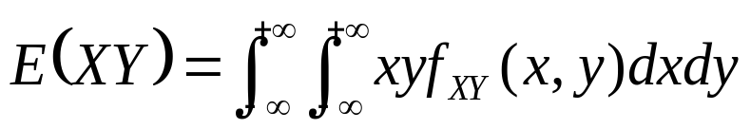


INDEPENDENCE AND CORRELATION
Correlation
  The correlation between two RVs X and Y is defined as
Covariance
  The covariance between two RVs X and Y is defined as
    Recall: variance of X:

Slide 27
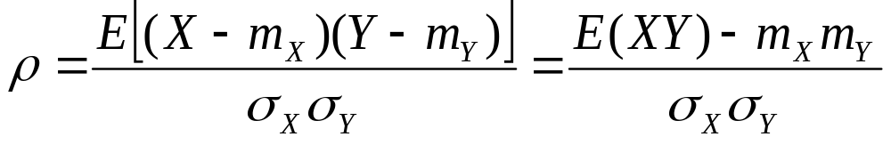
INDEPENDENCE AND CORRELATION
Correlation coefficient (normalized covariance)
  The correlation coefficient of two RV X and Y is defined as

Slide 28
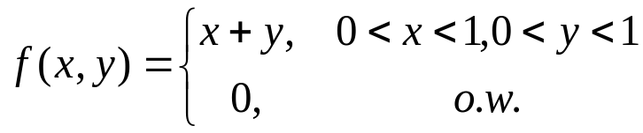
INDEPENDENCE AND CORRELATION
Example
  Consider two RVs with the joint pdf as
    Find the correlation, covariance, and the correlation coefficient

Slide 29


INDEPENDENCE AND CORRELATION
Uncorrelated
  Two RVs X and Y are said to be uncorrelated if
  If two RVs are uncorrelated, then the covariance is , their correlation coefficient is .
Independence ≠ correlation
  Independent → uncorrelated (it’s not true the other way around)
    If X and Y are independent
  If two RVs are uncorrelated, they might not be independent.

Slide 30




INDEPENDENCE AND CORRELATION
Example
  Let be uniformly distributed in .
    Are they uncorrelated?

Slide 31


INDEPENDENCE AND CORRELATION
Example
  Two independent RVs, X and Y, have variance . Find the variance of U = 2X + 3Y.

Slide 32
OUTLINE
Two discrete random variables
Two continuous random variables
Statistical independence and correlation
Functions of two random variables
Moment generating function

Slide 33

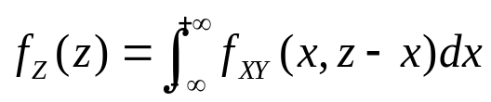
FUNCTIONS OF TWO RVS
pdf of the sum of two RVs
  Consider two RVs X and Y, with the joint pdf
  Define a new RV Z = X + Y. What is the pdf of Z?
  Sol: Find the CDF of Z, then differentiate it with respect to z.

Slide 34
FUNCTIONS OF TWO RVS
Pdf of the sum of two independent RVs
  If X and Y are independent, then the pdf of Z = X+Y is
    The pdf of Z is the convolution of the pdfs of X and Y

Slide 35
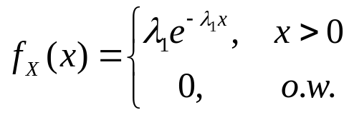
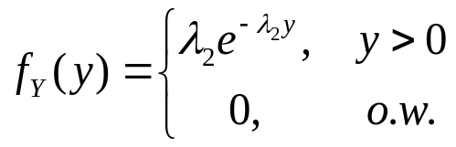
FUNCTIONS OF TWO RVS
Example
  Two independent RVs have pdf as
    Find the pdf of Z = X + Y

Slide 36





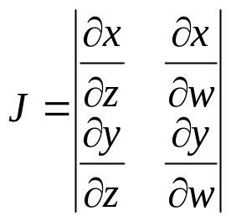
FUNCTIONS OF TWO RVS
Pdf of functions of two RVs
  Consider two RVs, X and Y, with joint pdf
  Let ,
  Or, inversely,
  The joint pdf of Z and W is

Slide 37
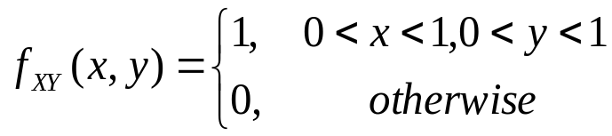
FUNCTION OF TWO RVS
Example
  Two random variables X and Y have a joint pdf
  Find the pdf of Z = XY

Slide 38
FUNCTIONS OF TWO RVS
Example
  A box contains resistors whose values are independent and uniformly distributed between 10 Ohm and 20 Ohm. If two resistors are selected in random and connected in series
    The pdf of the resistance of the serial circuit.

Slide 39
OUTLINE
Two discrete random variables
Two continuous random variables
Statistical independence and correlation
Functions of two random variables
Moment generating function

Slide 40



MOMENT GENERATING FUNCTION
Moment generating function (MGF)
  The moment generating function of a random variable X is
  Calculation of MGF for a continuous RV
    This is the Laplace transform of the pdf.
  Calculation of MGF for a discrete RV

Slide 41

MOMENT GENERATING FUNCTION
Example:
  Find the MGF of the exponential RV

Slide 42
MOMENT GENERATING FUNCTION
Example
  Find the MGF of a Bernoulli RV with parameter p

Slide 43

MOMENT GENERATING FUNCTION
Theorem
  We can calculate the n-th moment of a random variable X by using its MGF as

Slide 44
MOMENT GENERATING FUNCTION
Example
  Find the first and second moments of an exponential RV by using the MGF

Slide 45

MOMENT GENERATING FUNCTION
MGF of sum of independent RVs

Slide 46


MOMENT GENERATING FUNCTION
Example
  For a Poisson RV with PMF
    The MGF is
  Find the distribution of the sum of N independent Poisson RVs

Slide 47
MOMENT GENERATING FUNCTION
Example

