Slide 1
ELEG 3143 Probability & Stochastic Process
Ch. 4 Several Random Variables
Dr. Jingxian Wu
wuj@uark.edu

Slide 2
OUTLINE
Two discrete random variables
Two continuous random variables
Statistical independence and correlation
Functions of two random variables

Slide 3
TWO DISCRETE RANDOM VARIABLES
Joint PMF of two discrete random variables
  Consider two discrete RVs, X and Y. The joint probability mass function (PMF) of X and Y is defined as

Slide 4
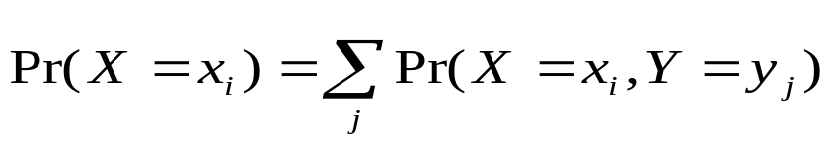
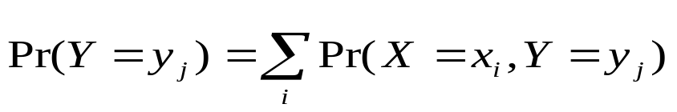
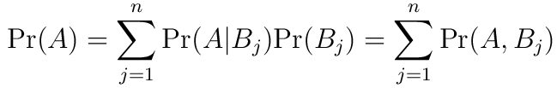

TWO DISCRETE RANDOM VARIABLES
Marginal PMF:
  the PMF of each individual RV (exactly the same as in Ch. 2)
  Joint PMF → marginal PMF (using the total probability equation)
    the summation is over all the possible value of Y
    the summation is over all the possible value of X
  Recall: total probability

Slide 5
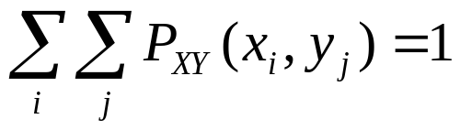
TWO DISCRETE RV
Example
  Consider an urn contains 4 white balls and 6 black balls. Pick two balls without replacement. Let X denote the result from the first pick, and Y the result from the 2nd pick, i.e., define two random variables (X, Y) as
  {(B, B)} → (X=0, Y=0), {(B, W)}→ (X=0, Y=1),
  {(W, B)}→ (X=1, Y=0), {(W, W)} →(X = 1,Y = 1)
  (a) Find the joint PMF
  (b) Find the marginal PMF of X
  (c) Find the marginal PMF of Y

Slide 6
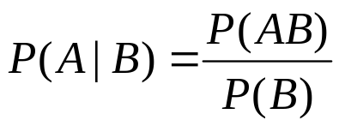





TWO DISCRETE RV
Review: conditional probability
  Two events A and B
Conditional PMF
  Given event B, what is the probability that ?
  E.g. two RV X and Y
    B:
    B: Y > y

Slide 7

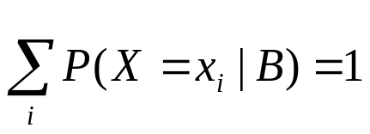
TWO DISCRETE RV
Example
  Consider an urn contains 4 white balls and 6 black balls. Pick two balls without replacement. Let X denote the result from the first pick, and Y the result from the 2nd pick, i.e., define two random variables (X, Y) as
  {(B, B)} → (X=0, Y=0), {(B, W)}→ (X=0, Y=1),
  {(W, B)}→ (X=1, Y=0), {(W, W)} →(X = 1,Y = 1)
  Find

Slide 8

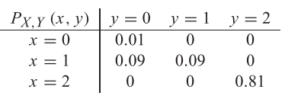
TWO DISCRETE RV
Example
  The joint PMF of two RV X and Y are given as follows. Find the marginal PMF and the conditional PMF

Slide 9
OUTLINE
Two discrete random variables
Two continuous random variables
Statistical Independence and correlation
Functions of two random variables

Slide 10



TWO CONTINUOUS RANDOM VARIABLES
Joint CDF
  The joint cumulative distribution function (CDF) of two random variables X and Y is defined as
    The above definition is true for both discrete RV and continuous RV
Marginal CDF
  The CDF of each individual RV (exactly the same as in Ch. 2)
  joint CDF → marginal CDF
    Why?

Slide 11



TWO CONTINUOUS RV
Example

Slide 12
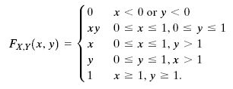
TWO CONTINUOUS RV
Example
  Two RVs X and Y have a joint CDF as follows. Find the CDF of X

Slide 13
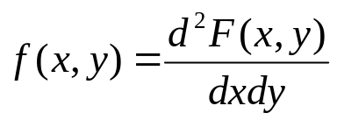
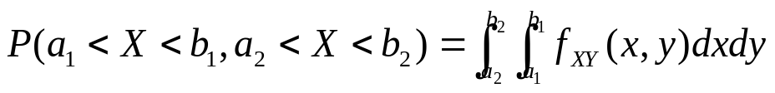
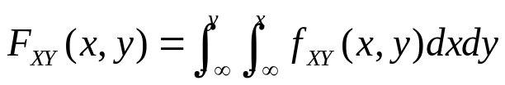
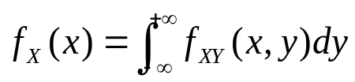
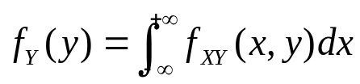
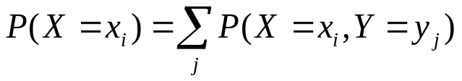
TWO CONTINUOUS RV
Joint pdf of two continuous RVs
  Probability
  CDF
  Marginal pdf
    Recall: marginal PMF for discrete RV

Slide 14

TWO CONTINUOUS RV
Example
  Two RVs with joint pdf given as follows
    Find the marginal pdf of X
    The probability that X > 0.5 and Y < 0.3

Slide 15

TWO CONTINUOUS RV
Example
  Two RVs with the joint pdf as follows
    Find the constant c
    Find the marginal pdf of x and y

Slide 16
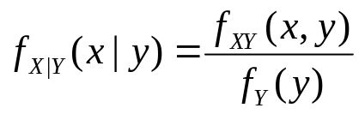

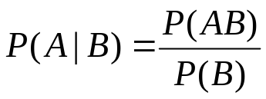

TWO CONTINUOUS RV
Conditional probability
  Recall
  Proof:

Slide 17

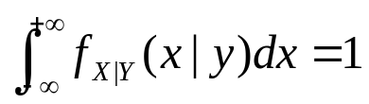
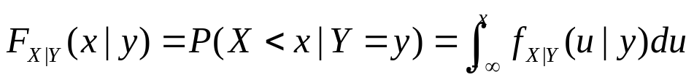



TWO CONTINUOUS RV
Conditional pdf
  Conditional pdf is still a pdf
  Please be careful about the difference between and

Slide 18



TWO CONTINUOUS RV
Example
  Two RVs with joint pdf as follows
  Find
  Find
  Find

Slide 19
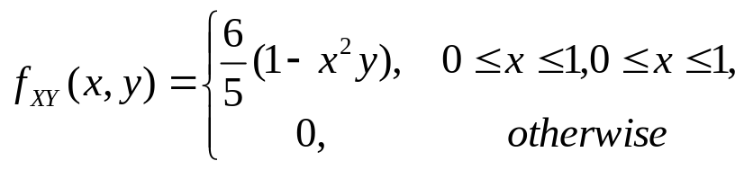

TWO CONTINUOUS RV
Example
  Two RVs with a joint pdf as follows
    Find
    Verify that

Slide 20
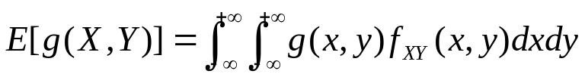

TWO CONTINUOUS RVS
Joint moment
Linearity of the expectation operator
  Proof:

Slide 21


TWO CONTINUOUS RVS
Example
  Two RVs X and Y with mean and . Define Z = 2X + 5Y + 7. Find E[Z].

Slide 22
OUTLINE
Two discrete random variables
Two continuous random variables
Statistical Independence and correlation
Functions of two random variables

Slide 23
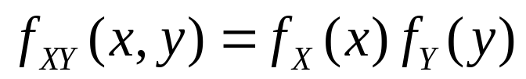
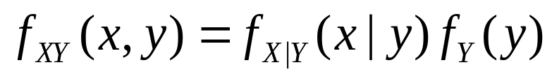
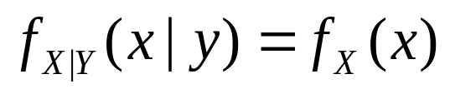
INDEPENDENCE AND CORRELATION
Independence
  Tow continuous RVs are called independent if and only if
  Recall: for two RVs X and Y
    Therefore, if X and Y are independent, then

Slide 24
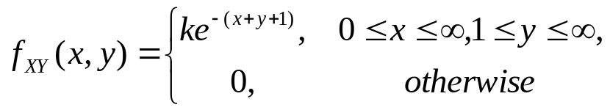
INDEPENDENCE AND CORRELATION
Example
  Two RVs with joint pdf as follows
    Find the value of k
    Are they independent

Slide 25
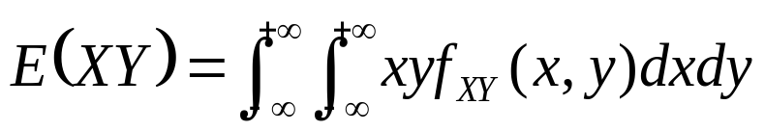


INDEPENDENCE AND CORRELATION
Correlation
  The correlation between two RVs X and Y is defined as
Covariance
  The covariance between two RVs X and Y is defined as
    Recall: variance of X:

Slide 26
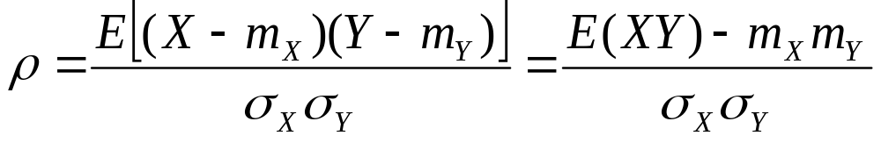
INDEPENDENCE AND CORRELATION
Correlation coefficient (normalized covariance)
  The correlation coefficient of two RV X and Y is defined as

Slide 27
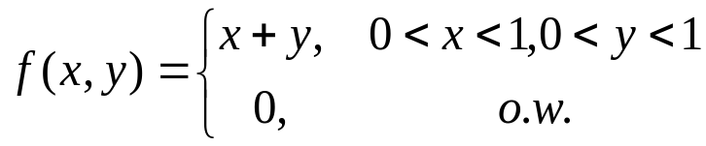
INDEPENDENCE AND CORRELATION
Example
  Consider two RVs with the joint pdf as
    Find the correlation, covariance, and the correlation coefficient

Slide 28


INDEPENDENCE AND CORRELATION
Uncorrelated
  Two RVs X and Y are said to be uncorrelated if
  If two RVs are uncorrelated, then the covariance is , their correlation coefficient is .
Independence ≠ correlation
  Independent → uncorrelated (it’s not true the other way around)
    If X and Y are independent
  If two RVs are uncorrelated, they might not be independent.

Slide 29




INDEPENDENCE AND CORRELATION
Example
  Let be uniformly distributed in .
    Are they uncorrelated?

Slide 30


INDEPENDENCE AND CORRELATION
Example
  Two independent RVs, X and Y, have variance . Find the variance of U = 2X + 3Y.

Slide 31
OUTLINE
Two discrete random variables
Two continuous random variables
Statistical Independence and correlation
Functions of two random variables

Slide 32

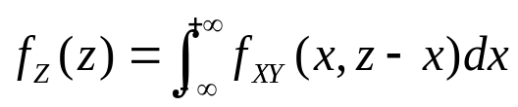
FUNCTIONS OF TWO RVS
pdf of the sum of two RVs
  Consider two RVs X and Y, with the joint pdf
  Define a new RV Z = X + Y. What is the pdf of Z?
  Sol: Find the CDF of Z, then differentiate it with respect to z.

Slide 33
FUNCTIONS OF TWO RVS
Pdf of the sum of two independent RVs
  If X and Y are independent, then the pdf of Z = X+Y is
    The pdf of Z is the convolution of the pdfs of X and Y

Slide 34
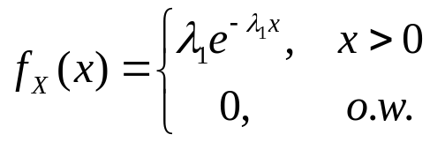
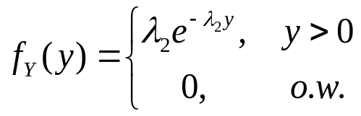
FUNCTIONS OF TWO RVS
Example
  Two independent RVs have pdf as
    Find the pdf of Z = X + Y

Slide 35





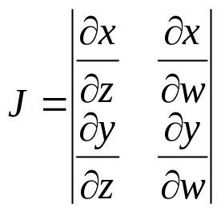
FUNCTIONS OF TWO RVS
Pdf of functions of two RVs
  Consider two RVs, X and Y, with joint pdf
  Let ,
  Or, inversely,
  The joint pdf of Z and W is

Slide 36
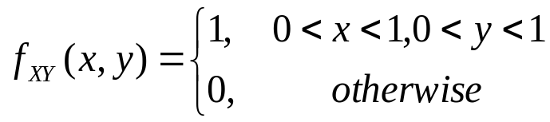
FUNCTION OF TWO RVS
Example
  Two random variables X and Y have a joint pdf
  Find the pdf of Z = XY

Slide 37
FUNCTIONS OF TWO RVS
Example
  A box contains resistors whose values are independent and uniformly distributed between 10 Ohm and 20 Ohm. If two resistors are selected in random and connected in series
    The pdf of the resistance of the serial circuit.

