Slide 1
ELEG 3143 Probability & Stochastic Process
Ch. 5 Elements of Statistics
Dr. Jingxian Wu
wuj@uark.edu

Slide 2
OUTLINE
Introduction: what is statistics?
Sample mean and sample variance
Confidence intervals
Hypothesis testing

Slide 3
INTRODUCTION
Statistics
  A bridge between the probability theory and the real world
  The science of gathering and analyzing data, and with the drawing of conclusions or inferences from the data.
    Example
      1. collect data about the life span of all females in US
      2. analyze the data to find out:
        What is the average (mean) female life span in US?
        What is the variance of the female life span?
        What is the distribution of the female life span?
    Example
      1. consider a communication system transmitting -1 and 1
      2. received signal is distorted by noise (e.g., Tx a 1, Rx a 0.2)
      3. Based on the noisy received information, find out what was transmitted (1 or -1)

Slide 4
INTRODUCTION
Classifications of statistics
  Sampling theory:
    How to select samples from some collection of data that is too large to be examined completely.
  Estimation theory:
    Make some estimation or prediction based on the data that are available (e.g. estimate the average life span)
  Hypothesis testing
    Attempts to decide which of two or more hypotheses about the data are true (e.g. find out whether a 1 or -1 are transmitted in a communication system)

Slide 5
OUTLINE
Introduction: what is statistics?
Sample mean and sample variance
Confidence interval
Hypothesis testing

Slide 6
SAMPLE MEAN AND VARIANCE
Definition: population
  the collection of ALL objects or elements under study.
  E.g. measure the female life span in US
    member: the life span of one female in US (can be modeled as an RV: X)
    Population: the life spans of ALL the females in US
  Most of the time, it is extremely difficult and expensive, if not impossible, to get the data for the entire population.
  We take a limited number of samples to represent the population
Definition: random sample (or, sample)
  A random sample is part of the population that has been selected at random.
    E.g. Consider a population with N members. We can randomly pick
    n << N members. The n members form a sample of the population.
    All members of the population are equally likely being picked.
    The picks are independent of each others.

Slide 7

SAMPLE MEAN AND VARIANCE
Random sample
  Consider a random sample with n members
  Each member is a random variable
  The n random variables are mutually independent
  The n random variables are identically distributed
  With the random sample, we can infer (estimate) the properties of the population with N >> n members
    E.g. mean, variance, distribution, etc.
  Intuitively, the larger the value of n, the better the estimation.
    We will prove this intuition.

Slide 8
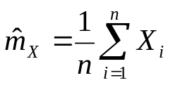





SAMPLE MEAN AND VARIANCE
Sample mean
  The sample mean of is
  It is an estimation of the actual mean of the population
  is a random variable, because it is a function of n RVs
The first moment of the sample mean
Definition: unbiased estimator
  The mean of the estimation is the same as its true value
  The sample mean is an unbiased estimation of the mean

Slide 9
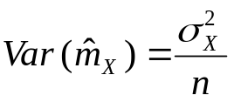
SAMPLE MEAN AND VARIANCE
The 2nd central moment (variance) of the sample mean
  Recall: variance measures the deviation from the mean
    The smaller the variance, the less the randomness
    If variance is 0, then the RV is a constant
  The larger the sample size n, the more accurate the estimation.
Notes:
Demo sample_mean_Gaussian
Demo sample_mean_Bernoulli

Slide 10
SAMPLE MEAN AND VARIANCE
Example
  A population of 10 resistors is to be tested. The true standard deviation is 5 Ohm, and the true mean is 100 Ohm.
    How large must be the sample size, if we want to obtain a sample mean, whose standard deviation is 2% of the true population mean?
    If the sample size is 8, what is the standard deviation of the sample mean?

Slide 11
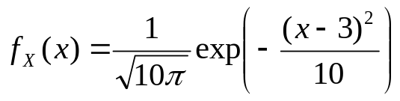
SAMPLE MEAN AND VARIANCE
Example
  The sample of a random time function follows a pdf given as follows:
  The function is sampled so as to obtain independent sample values. How many sample values are required to obtain a sample mean, whose standard deviation is 1% from the true mean?

Slide 12
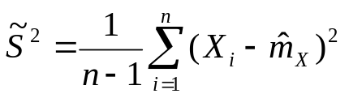




SAMPLE MEAN AND VARIANCE
Sample variance
  The sample variance of is defined as
  The is used to make an unbiased estimator .
  is a random variable.
First moment of the sample variance
  The sample variance is an unbiased estimation of
Notes:
E[(X_i-m) – 1/n \sum_{k=1}^n (X_k-m)]^2 = E(X_i-m)^2 + 1/n^2 \sum sigma^2 + 2/n E(X_i-m)^2 = (n-1)/n sigma^2

Slide 13
SAMPLE MEAN AND VARIANCE
Example
  Consider 5 random numbers: 0.3, 0.2, 0.8, 0.7, 0.9
    1. Find the sample mean and sample variance
    2. If the 5 random numbers are randomly picked from a population of random numbers that are uniformly distributed in [0, 1], find the variance of the sample mean.

Slide 14
SAMPLE MEAN AND VARIANCE
Example
  Write a Matlab program to generate 100 independent random numbers. The random number are samples of uniformly distributed random variable in (0, 10). (1) Write functions to find the sample mean and sample variance. (2) What is the variance of the sample mean?
  %------------------------------
  % main.m
  clear all;
  random_sample = 10*rand (1, 100); % generate 100 random numbers
  sample_mean = find_sample_mean(random_sample);
  sample_var = find_sample_var(random_sample);
  %--------------------------------
  % find_sample_mean.m
  function output = find_sample_mean(input)
  n_sample = length(input);
  output = sum(input)/n_sample;

Slide 15
SAMPLE MEAN AND VARIANCE
Example (Cont’d)
  %--------------------------------
  % find_sample_var.m
  function output = find_sample_var(input)
  % find out how many members are in the sample
  n_sample = length(input);
  % calculate the sample mean
  sample_mean = find_sample_mean(input);
  % calculate the sample variance
  output = sum( (input-sample_mean).^2 )/(n_sample-1);

Slide 16
OUTLINE
Introduction: what is statistics?
Sample mean and sample variance
Confidence interval
Hypothesis testing

Slide 17




CONFIDENCE INTERVAL
Central Limit Theorem
  Let be a random sample of size n. They are independent and identically distributed with mean and variance . When ,
  the sample mean, , converges in distribution to a Gaussian
  distribution with mean and variance .
  When n is large (n > 30), follows approximately to a Gaussian distribution, regardless of the distribution of

Slide 18



CONFIDENCE INTERVAL
Confidence interval
  Example: estimate the mean, , of a population of data.
    The sample mean, , is an RV
    thus it could be quite different from the true mean.
  Specify an interval that is highly likely to contain the true value of
    E.g. It is 99% likely that the true value of is in the interval
    is called the 99% confidence interval of the mean

Slide 19


Confidence Interval
  Confidence interval v.s. sample mean
    Sample mean attempts to use a single number, , to represent the sample mean
      The sample mean is an RV, thus it could be quite different from the true mean.
      How much can we trust this single number estimation?
    Confidence interval, instead, attempts to specify an interval that is highly likely to contain the true value of the estimation.
  The confidence interval for the estimation of the parameter m is defined as , such that

Slide 20
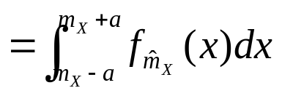



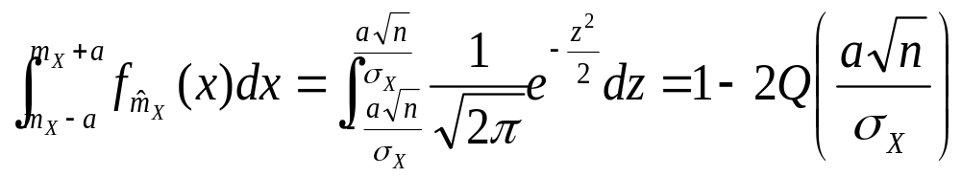
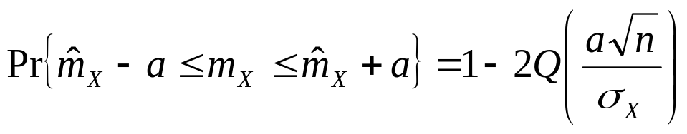
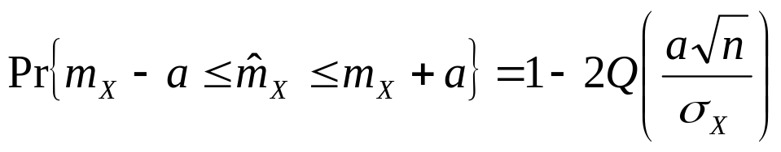
CONFIDENCE INTERVAL
Confidence Interval (Cont’d)
  Based on the central limit theorem, is Gaussian distributed with mean
  and variance
Notes:
P(

Slide 21
CONFIDENCE INTERVAL
Example
  A very large population of resistor values has a true mean of 100 Ohm and a standard deviation of 5 Ohm. Find the 95% confidence interval (confidence limits) on the sample mean if the sample size is 100.
  Q(1.96) = 0.025

Slide 22
OUTLINE
Introduction: what is statistics?
Sample mean and sample variance
Confidence interval
Hypothesis testing

Slide 23
HYPOTHESIS TESTING
Hypothesis testing
  Testing an assertion about a population based on a random sample.
  Example:
    Hypothesis: a given coin is fair
    Test: flip the coin 100 times, count the number of heads
      If the coin is fair, we expect approximately 50 heads.
      E.g. if the number of heads is in [47, 53], the hypothesis is true. The hypothesis is false otherwise.
      The interval [47, 53] is chosen arbitrarily. How to systematically choose the interval?
  Example:
    Hypothesis: the light bulb from a certain manufacture can last 1000 hrs.
    Test: take 50 light bulbs, measure their life, and find the sample mean
      If the sample mean is greater than t hrs, the hypothesis is true.
      How do we determine the value t? 900 hrs? 950 hrs? 999 hrs?

Slide 24





HYPOTHESIS TESTING
Hypothesis testing:
  Null hypothesis
    The hypothesis to be tested
  Alternative hypothesis
    The complement (opposite) of the null hypothesis
  Example:
    Test the hypothesis that a given coin is fair.
    Test the hypothesis that a lightbulb can last 1,000 hours
    Test the hypothesis that a certain patient does not have cancer

Slide 25


HYPOTHESIS TESTING
Errors
  Type I error: Reject when is true
    False positive, false alarm
  Type II error: Accept when is false
    False negative

Slide 26
HYPOTHESIS TESTING
Hypothesis testing: significance testing
  Test a hypothesis about a parameter p of a random variable X
    Example: test whether a coin is fair
      X: Bernoulli RV with parameter p: P(X=1)=p, P(X=0)=1-p
      : p = 0.5 (the coin is fair).
  Objective: accept or reject the hypothesis based on a random sample

Slide 27



HYPOTHESIS TESTING
Example
  A certain coin is claimed to be fair with a 95% confidence interval. To test the hypothesis, we flip the coin 100 times, and find the sample mean, . If , can we accept the claim?
  Sol: Hypothesis: this is a fair coin → ,
  find out if is in the 95% confidence interval
Notes:
A*sqrt(100)/0.5 = 1.96 → a = 0.10 -> [0.40, 0.60]

Slide 28
HYPOTHESIS TESTING
Example:
  A resistor manufacture is testing the quality of a batch of resistors with nominal value 1K Ohm, with a 95% confidence level. A sample of 100 resistors are tested, and the sample mean is 1040 Ohm, and the sample standard deviation is 100 Ohm. Do the resistors pass the quality check?

Slide 29
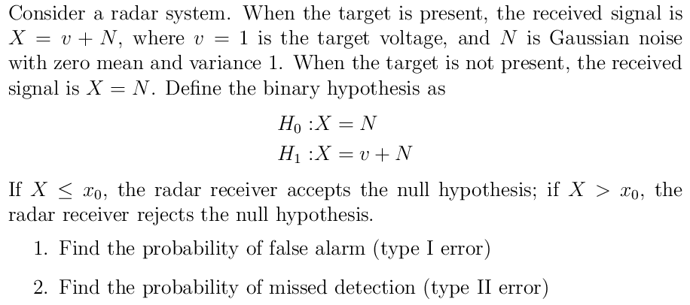
HYPOTHESIS TESTING
Binary hypothesis testing: Example

Slide 30
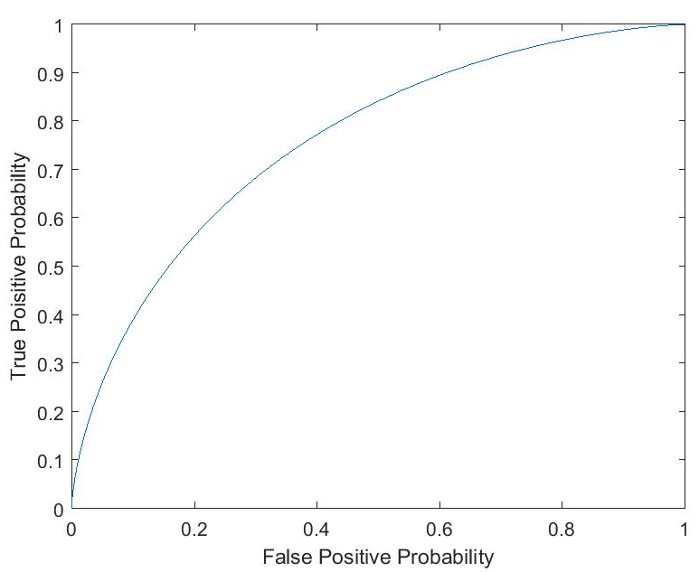
HYPOTHESIS
Receiver operating characteristics (ROC) curve
  Plot true positive probability (complement of type II error) as a function of false positive probability (type I error)

