Slide 1
ELEG 3143 Probability & Stochastic Process
Ch. 6 Stochastic Process
Dr. Jingxian Wu
wuj@uark.edu

Slide 2
OUTLINE
Definition of stochastic process (random process)
Description of continuous-time random process
Description of discrete-time random process
Stationary and non-stationary
Two random processes
Ergodic and non-ergodic random process
Power spectral density

Slide 3
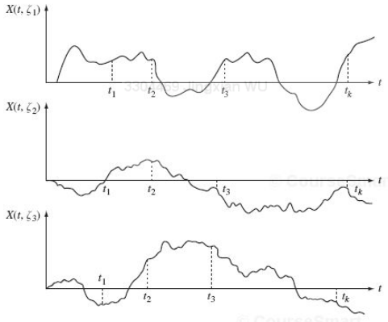
DEFINITION
Stochastic process, or, random process
  A random variable changes with respect to time
    Example: the temperature in the room
      At any given moment, the temperature is random: random variable
      The temperature (the value of the random variable) changes with respect to time.

Slide 4



DEFINITION
Stochastic process (random process)
  Recall: Random variable is a mapping from random events to real number: , where is a random event
  Stochastic process is a random variable changes with time
    Denoted as:
    It is a function of random event , and time t.
    Recall: random variable is a function of random event

Slide 5


DEFINITION
Stochastic process (random process)
  Fix time: is a random variable
    pdf, CDF, mean, variance, moments, etc.
  fix event: is a deterministic time function
    Defined as a realization of a random process
    Or: a sample function of a random process
Ensemble domain
time domain

Slide 6






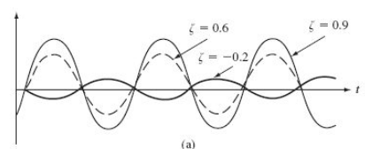
DEFINITION
Example
  Let be a Gaussian random variable with 0 mean and unit variance, then
  is a random process .
    If we fix , we get a Gaussian random variable
      The pdf of is:
    If we fix , we get sample function
      It is a deterministic function of time

Slide 7
DEFINITION
Stochastic process:
  A random variable changes with respect to time
Sample function:
  A deterministic time function associated with outcome
Ensemble:
  The set of all possible time functions of a stochastic process.

Slide 8




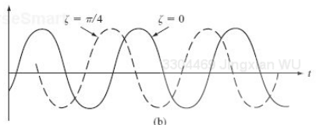
DEFINITION
Example
  Let be a random variable uniformly distributed between , then
  is a random process, where A is a constant. At Find the mean and variance of

Slide 9


DEFINITION
Example
  Let be a random variable uniformly distributed between , and
  a Gaussian random variable with 0 mean and variance . Then
  is a random process. and are independent.
  Find the mean and variance of the random process at

Slide 10



DEFINITION
Continuous-time random process
  The time is continuous
  E.g.
Discrete-time random process
  The time is discrete
  E.g.
Continuous random process
  At any time, is a continuous random variable
  E.g. , is Gaussian distributed
Discrete random process
  At any time, is a discrete random variable
  E.g. , is a Bernoulli RV

Slide 11


DEFINITION
Classifications
  Continuous-time v.s. discrete-time
  Continuous v.s. discrete
  Stationary v.s. non-stationary
  Wide sense stationary (WSS) v.s. non-WSS
  Ergodic v.s. non-ergodic
Simple notation
  Random variable: , usually denoted as
  Random process: , usually denoted as

Slide 12
OUTLINE
Definition of stochastic process (random process)
Description of continuous-time random process
Description of discrete-time random process
Stationary and non-stationary
Two random processes
Ergodic and non-ergodic random process
Power spectral density

Slide 13
DESCRIPTION
How do we describe a random process?
  A random variable is fully characterized by its pdf or CDF.
  How do we statistically describe random process?
    E.g.
  We need to describe the random process in both the ensemble domain and the time domain
Descriptions of the random process
  Joint distribution of time samples: joint pdf, joint CDF
  Moments: mean, variance, correlation function, covariance function

Slide 14

DESCRIPTION
Joint distribution of time samples
  Consider a random process
  Let
  joint CDF:
  Joint pdf:
  A random process is fully specified by the collections of all the joint CDFs (or joint pdfs) for any n and any choice of sampling instants.
    For a continuous-time random process, there will be infinite such joint CDFs.

Slide 15
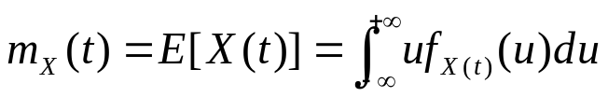
DESCRIPTION
Moments of time samples
  Provide a partial description of the random process
  For most practical applications it is sufficient to have a partial description.
Mean function
  The mean function is a deterministic function of time.
Variance function

Slide 16



DESCRIPTION
Example
  For a random process , where A is a random variable with mean and variance . Find the mean function and variance function of X(t) .

Slide 17



DESCRIPTION
Autocorrelation function (ACF)
  The autocorrelation function of a random process X(t) is defined as the
  It describes the correlation of the random process in the time domain
    How are two events happened at different times related to each other.
      E.g. if there is a strong correlation between the temperature today and the temperature tomorrow, then we can predict tomorrow’s temperature by using today’s observation.
      E.g. the text in a book can be considered as a discrete random process
        Stochasxxx
        We can easily guess the contents in xxx by using the time correlation.
  is the second moment of

Slide 18


DESCRIPTION
Autocovariance function
  The autocovariance function of a random process X(t) is defined as the

Slide 19



DESCRIPTION
Example
  Consider a random process , where A is a random variable with mean and variance . Find the autocorrelation function and autocovariance function.
Notes:
cos(x)cos(y)=[cos(x+y)+cos(x-y)]/2

Slide 20



DESCRIPTION
Example
  Consider a random process , where A is a random variable with mean and variance . is uniformly distributed in
  . A and are independent.
  Find the autocorrelation function and autocovariance function.

Slide 21
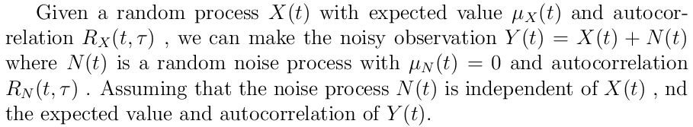
DESCRIPTION
Example

Slide 22
OUTLINE
Definition of stochastic process (random process)
Description of continuous-time random process
Description of discrete-time random process
Stationary and non-stationary
Two random processes
Ergodic and non-ergodic random process
Power spectral density

Slide 23



DESCRIPTION
Discrete-time random process (random sequence)
  A discrete-time random process
    E.g.
  Joint PMF
  Joint CDF

Slide 24
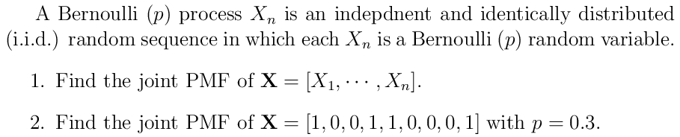
DESCRIPTION
Bernoulli process

Slide 25

DESCRIPTION
Moments of time samples
  Provide a partial description of the random process
  For most practical applications it is sufficient to have a partial description.
Mean function
  The mean function is a deterministic function of time.
Variance function
  It is a deterministic function of time

Slide 26
DESCRIPTION
Example
  For a Bernoulli (p) process, find the mean function and variance function.

Slide 27


DESCRIPTION
Autocorrelation function of a random sequence
Autocovariance function of a random sequence

Slide 28
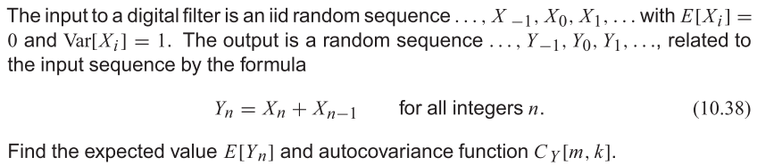
DESCRIPTION
Example

Slide 29
OUTLINE
Definition of stochastic process (random process)
Description of continuous-time random process
Description of discrete-time random process
Stationary and non-stationary
Two random processes
Ergodic and non-ergodic random process
Power spectral density

Slide 30


STATIONARY RANDOM PROCESS
Stationary random process
  A random process, X(t), is stationary if the joint distribution of any set of samples does not depend on the time origin.
    For any value of and , and for any choice of

Slide 31





STATIONARY RANDOM PROCESS
1st order distribution
  If X(t) is a stationary random process, then the first order CDF or pdf must be independent of time
    The samples at different time instant have the same distribution.
  Mean:
    For a stationary random process, the mean is independent of time

Slide 32




STATIONARY RANDOM PROCESS
2nd order distribution
  If X(t) is a stationary random process, then the 2nd order CDF and pdf are:
  The 2nd order distribution only depends on the time difference between the two samples
  Autocorrelation function
  Autocovariance function:
    For a stationary random process, the autocorrelation function and autocovariance function only depends on the time difference:

Slide 33
STATIONARY RANDOM PROCESS
Stationary random process
  In order to determine whether a random process is stationary, we need to find out the joint distribution of any group of samples
  Stationary random process → the joint distribution of any group of time samples is independent of the starting time
  This is a very strict requirement, and sometimes it is difficult to determine whether a random process is stationary.

Slide 34


STATIONARY RANDOM PROCESS
Wide-Sense Stationary (WSS) Random Process
  A random process, X(t), is wide-sense stationary (WSS), if the following two conditions are satisfied
    The first moment is independent of time
    The autocorrelation function depends only on the time difference
  Only consider the 1st order and 2nd order distributions

Slide 35
STATIONARY RANDOM PROCESS
Stationary v.s. Wide-Sense Stationary
  If X(t) is stationary ➔ X(t) is WSS
    It is not true the other way around
  Stationary is a much stricter condition. It requires the joint distribution of any combination of samples to be independent of the absolute starting time
  WSS only considers the first moment (mean is a constant) and second order moment (autocorrelation function depends only on the time difference)

Slide 36


STATIONARY RANDOM PROCESS
Example
  A random process is described by
  where A is a random variable uniformly distributed between [-3, 3], B is an RV with zero mean and variance 4, and is a random variable uniformly distributed in . A, B, and are independent. Find the mean and autocorrelation function. Is X(t) WSS?

Slide 37






STATIONARY RANDOM PROCESS
Autocorrelation function of a WSS random process
  is the average power of the signal X(t)
  is an even function
    Cauchy-Schwartz inequality
  If is non-periodic, then

Slide 38

STATIONARY RANDOM PROCESS
Example
  Consider a random process having an autocorrelation function
    Find the mean and variance of X(t)

Slide 39


STATIONARY RANDOM PROCESS
Example
  A random process Z(t) is
    Where X(t) is a WSS random process with autocorrelation function
    Find the autocorrelation function of Z(t). Is Z(t) WSS?

Slide 40
STATIONARY RANDOM PROCESS
Example
  A random process X(t) = At + B, where A is a Gaussian random variable with 0 mean and variance 16, and B is uniformly distributed between 0 and 6. A and B are independent. Find the mean and auto-correlation function. Is it WSS?

Slide 41
OUTLINE
Definition of stochastic process (random process)
Description of continuous-time random process
Description of discrete-time random process
Stationary and non-stationary
Two random processes
Ergodic and non-ergodic random process
Power spectral density

Slide 42





TWO RANDOM PROCESSES
Two random processes
  X(t) and Y(t)
Cross-correlation function
  The cross-correlation function between two random processes X(t) and Y(t) is defined as
  Two random processes are said to be uncorrelated if for all and
  Two random processes are said to be orthogonal if for all and
Cross-covariance function
  The cross-covariance function between two random processes X(t) and Y(t) is defined as

Slide 43


TWO RANDOM PROCESSES
Example
  Consider two random processes and
  . Are they uncorrelated?
Notes:
Sinx cos y = ½ [sin(x+y)+sin(x-y)]

Slide 44




TWO RANDOM PROCESSES
Example
  Suppose signal Y(t) consists a desired signal X(t) plus noise N(t) as
  Y(t) = X(t) + N(t)
  The autocorrelation functions of X(t) and N(t) are: and , respectively. The mean function of X(t) and N(t) are: and , respectively. Find the cross-correlation between X(t) and Y(t).

Slide 45
OUTLINE
Definition of stochastic process (random process)
Description of continuous-time random process
Description of discrete-time random process
Stationary and non-stationary
Two random processes
Ergodic and non-ergodic random process
Power spectral density

Slide 46
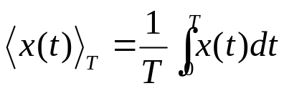

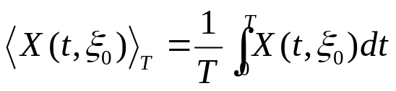

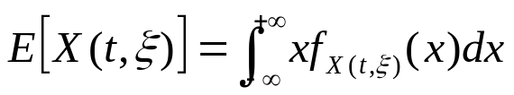
ERGODIC RANDOM PROCESS
Time average of a signal x(t)
Time average of a sample function of the random process
Ensemble average (mean) of a random process
Ensemble domain
time domain

Slide 47

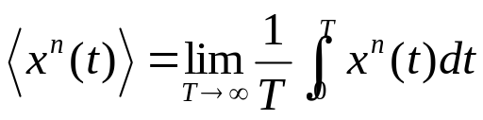
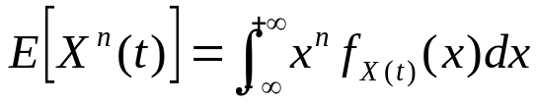
ERGODIC RANDOM PROCESS
Ergodic random process
  A stationary random process is also an ergodic random process if the n-th order ensemble average is the same as the n-th order time average.
  If a random process is ergodic, we can find the moments by performing time average over a single sample function.
  Ergodic is only defined for stationary random process
    If a random process is ergodic , then it must be stationary
      Not true the other way around

Slide 48

ERGODIC RANDOM PROCESS
Example
  Consider a random process
  where A is a Gaussian RV with 0 mean and variance 4. Is it ergodic?

Slide 49



ERGODIC RANDOM PROCESS
Mean ergodic
  A WSS random process is mean ergodic if the ensemble average is the same as the time average.
  Mean ergodic v.s. ergodic
    Ergodic: for stationary process
    Mean ergodic: for WSS process
    If a random process is ergodic, then it must be mean ergodic
      Not true the other way around
  If a process is mean ergodic, it must be WSS
    Mean ergodic is defined for WSS process only.

Slide 50


ERGODIC RANDOM PROCESS
Example
  Consider a random process
  where A is a non-zero constant, and is uniformly distributed between 0 and . Is it mean ergodic?

Slide 51
OUTLINE
Definition of stochastic process (random process)
Description of continuous-time random process
Description of discrete-time random process
Stationary and non-stationary
Two random processes
Ergodic and non-ergodic random process
Power spectral density

Slide 52


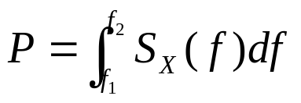
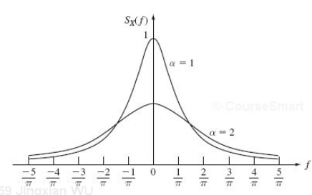
POWER SPECTRAL DENSITY
Power spectral density (PSD)
  The distribution of the power in the frequency domain.
  For a WSS random process, the PSD is the Fourier transform of the auto-correlation function
  The “density” of power in the frequency domain.
  The power consumption between the frequency range

Slide 53
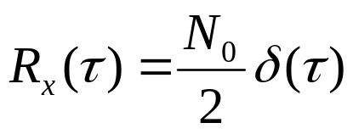
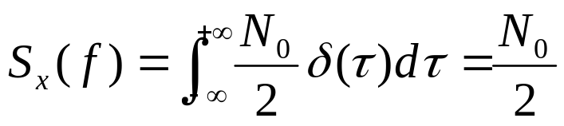



POWER SPECTRAL DENSITY
White noise
  Autocorrelation function
    any two samples in the time domain are uncorrelated.
  Power spectral density
N0/2
N0/2
f

