Slide 1
ELEG 4061 EE Design I
Dr. Jingxian Wu
wuj@uark.edu

Slide 2
GENERAL INFORMATION
Instructor: Dr. Jingxian Wu
  Email: wuj@uark.edu
  Phone: (479) 575-6584
  Office Bell 3181
Office Hours
  Tu. Th. 9:30 AM – 10:30 AM,
  By appointment
Lecture Schedule
  Bell 2291
  Th. 2:00 PM – 4:50 PM
Lab Schedule
  ENGR 119
  Th. 2:00 PM – 4:50 PM

Slide 3
TA
TA:
  Mr. Steve Yancey
  Email: swyancey@uark.edu
  Responsibility:
  Office: ENGR 119
  Office Hour:
    M. W. Th. F.: 12:00 PM – 4:00 PM
    Tu. 1:00 PM – 5:00 PM
Lab Schedule
  ENGR 119 combination: 5-3-4-1
  If there is no lecture scheduled on Tue, you must be in the lab during the scheduled time (2:00 – 4:50 PM).
  Any other time.
  Suggested lab hour: 9 hours/week

Slide 4
REFERENCES AND PREREQUISITES
References
  P. Horowitz and W. Hill, The Art of Electronics, Cambridge University Press, 2nd Ed., July 1989.
  J. Catsoulis, Designing Embedded Hardware, O’Reilley Media, 2nd Ed., May 2005.
Pre-requisties
  Microcontroller System Design (ELEG 3924)
  Basic analog and interface circuitry (ELEG 3223)
  Ability to use commercial integrate circuits in design project

Slide 5
EE DESIGN: OBJECTIVES
Objectives
  Apply knowledge gained in previous courses
    Electrical circuits and electronics
    Microcontroller and embedded systems
    Signals and systems (control system, communication system, etc.)
    Electromagnetics and Microwave
  Improve design skills
    How to design a system?
    Preparation → topic identification → proposal → design overview→ component level design → simulation and verification → component level development → system level development → system integration → debug and calibration → testing → demo and production

Slide 6
EE DESIGN: OBJECTIVES
Objectives (Cont’d)
  Address the need of a specific engineering work
    The designed system might be an independent system
    Or part of a large problem
    The final product can solve certain Engineering problem or meet certain societal needs.
  Exposed to practical design considerations
    Tradeoff among performance, complexity, cost
    Non-ideal elements
    Tolerance, optimization, form factor

Slide 7
EE DESIGN: OBJECTIVES
Objectives (Cont’d)
  Career training
    Practical engineering work
    How to find a job (job hunting, resume, interview)
    How to survive 1st year on a job
  Broader impacts
    Understand the impacts of specific engineering work on a large process and/or society
    Address certain needs
    Environmental impact: power consumption, electromagnetic interference (EMI)
    ……

Slide 8
EE DESIGN: OBJECTIVES
Objectives (Cont’d)
  Presentation skills
    Oral presentation
    How to write a proposal?
    How to write a report?
  Team work skills
    How to communicate with other team members
    How to collaborate with other team members
    How to manage a project?
      E.g. divide a big project into several sub-projects
      Planning (schedule)
      Monitor the project progress

Slide 9
EE DESIGN: REQUIREMENTS
Project requirements:
  The final product can solve a practical engineering problem, or meet certain needs.
  Must have clearly defined objectives
  Apply knowledge learned from two or more EE courses
    Electronics, Microcontroller, Programming, Control, Energy, Signal and System, Microwave, etc.
  Must have hardware components
    Software project by itself cannot be used as a stand alone EE design project.
    Software can be part of a bigger project.
  Must involves actual design
    E.g. design interface circuitry; design software; design a new system structure.
  The final demo must function properly
    meet most design objectives
    If the final demo does not work, a student will not be able to graduate.

Slide 10
EE DESIGN: DESIGN PROCESS
Design process
  1. Identify a project
  2. Project proposal
  3. Design Overview
  4. Component level design
  5. Simulation, Development, review and revision
  6. Component development and debug
  7. System development and integration
  8. System level debug and calibration
  9. Testing
  10. Demo and Production
  Red: EE Design I
  Green: EE Design II

Slide 11
EE DESIGN: DESIGN PROCESS
1. Identify a project
  Form a group of 2 ~ 3 students
  Final mutual interests
  Talk to professors in different research areas
    Electronics
    Digital Design and Embedded Systems
    Communication and Digital Signal Processing
    Power and Energy
    Microwave
    Control Systems
    Nano-technologies
    ……
  Practical and reasonable
    Don’t be too ambitious
    Don’t be too simple
    Something you can finish in 1 year.
  Discuss with the instructor and TA

Slide 12
EE DESING: DESIGN PROCESS
2. Project Proposal
  What is the objective of the project?
    Functional description
    Electrical specification you try to meet or exceed
  How do you plan to design the project?
    Divide the project into individual tasks (task 1, task 2, …)
    The description of each task (or components)
    Use figures and diagrams where approriate
  Project management plan
    Who is responsible for what
    Timeline
  Required instrumentation and part list
    What instrument will be needed?
    What electronic component will be needed?
    A proposal template is attached at the end of the syllabus.

Slide 13
EE DESING: DESIGN PROCESS
2. Project Proposal (Cont’d)
  Format:
    Title page (project title, students, advisor, date)
    Abstract
    1. Introduction
      Motivation
      Design Goals
    2. Design Overview
      Functional description
      System Structure
      Components and tasks
      …
    3. Management Plan
    4. Components and Instrument
    References
  One proposal/group. Each student must explicitly point out which part he wrote.
    E.g. 2.3 Design of the Interface Circuitry (student 1)

Slide 14
EE DESING: DESIGN PROCESS
3. Design Overview
  Identify system structure
    Block diagram of the entire system
  Break the system into several sub-systems/components
    Block diagram of each individual sub-system/component
    Functional description of each sub-system
    How do you plan to implement each sub-system
  Define interface of the sub-systems
  Define interface of the entire system
  Break the work among group memebers.

Slide 15
EE DESIGN: DESIGN PROCESS
4. Component Design
  Design the schematics and sketch of the components
  Indentify the parts and components that will be needed for this project
  Purchase the necessary components and parts
    Allowance: $100/student
    Submit all purchase order to your TA (links to the components you want to buy)
    Free samples can be obtained from major companies
  Install software development environment
  Get familiar with development environment and development kits (if applicable)
  Start programming of basic operational software

Slide 16
EE DESIGN: DESIGN PROCESS
5. Simulation, Development, Review and Revision
  Verification
    Build prototype of some of the components
    Verify the operations of the prototypes
  Simulation
    Component level simulation
    System level simulation
  Critical review
    Revise system requirements
    Revise system design
    Revise component design
    Lesson learned

Slide 17
EE DESIGN: PROGRESS REPORTS
Progress reports
  Report the current status and progress of the projects
  There are 3 progress reports
    1. design overview
    2. component level design
    3. simulation, verification, development and review
    The desired contents can be found in their respective slides
    A new report can be written by adding contents/revising the previous report.
  Final report
    A comprehensive report that covers the design of the entire project.
    It should include all the design details that are presented in the Proposal and Progress Reports
    Reflect the updated design objectives and tasks.

Slide 18
EE DESING: PROGRESS REPORTS
Progress report format
  Cover page
  1. Objectives
  2. Designs and results
    The actual designs
    Prototype measurement
    Simulation results
  3. Project status
    Current status of the project
    Progress v.s. plan
  4. Future work
    What do you plan to do next
  Appendix (programs)
  References

Slide 19
EE DESIGN: FINAL REPORT
Final report format
  Title page
  Abstract
  Table of Contents
  List of Figures
  List of Tables
  Nomenclature
  1. Introduction
    1.1 Motivation for Project
    1.2 Goals for Project
  2. Theoretical Background
  3. Design Objectives
  4. Design Implementation
  5. Results and Conclusions
  Appendix
  Reference
  Acknowledgement
  A template is attached at the end of the syllabus

Slide 20
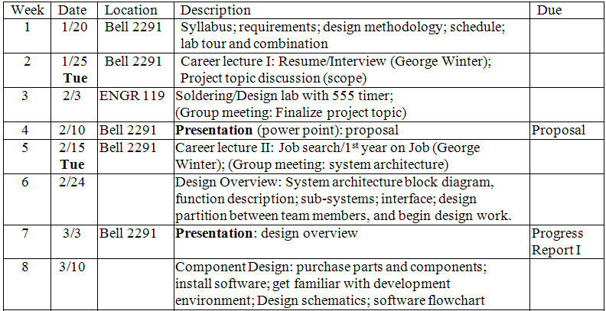
SCHEDULE

Slide 21
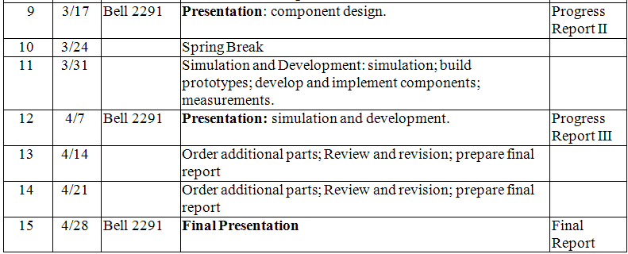
SCHEDULE

Slide 22
GRADING POLICY
Grades Percentage
  Proposal (written) 15%
  Progress Report I 15%
  Progress Report II 15%
  Progress Report III 15%
  Final Report 20%
  Presentation (PPT) 20%
Grades
  A: 90 ≤ grade ≤ 100
  B: 80 ≤ grade < 90
  C: 70 ≤ grade < 80
  D: 60 ≤ grade < 70
  F: 0 ≤ grade < 60

Slide 23
GRADING POLICY
Due dates for report will be strictly enforced. Late submission within one week after due will receive a 20% deduction; no credit if submitted one week past due.
One report/group. Students within the same group should divide the report writing based on the tasks. Each student should explicitly specify which section is written by him/her.

