Slide 1
ELEG 4071 EE Design II
Dr. Jingxian Wu
wuj@uark.edu

Slide 2
GENERAL INFORMATION
Instructor: Dr. Jingxian Wu
  Email: wuj@uark.edu
  Phone: (479) 575-6584
  Office: Bell 3181
Office Hours
  Tu. Th. 9:30 AM – 10:30 AM,
  By appointment
Lecture Schedule
  Bell 2291
  Tu. 2:00 PM – 4:50 PM

Slide 3
TA
TA:
  Mr. Steve Yancey
  Email: swyancey@uark.edu
  Responsibility:
  Office: ENGR 119
  Office Hour:
    M. W. Th. F.: 12:00 PM – 4:00 PM
    Tu. 1:00 PM – 5:00 PM
Lab Schedule
  ENGR 119 combination: 5-3-4-1
  If there is no lecture scheduled on Tue, you must be in the lab during the scheduled time (2:00 – 4:50 PM).
  Any other time.
  Suggested lab hour: 9 hours/week

Slide 4
REFERENCES AND PREREQUISITES
References
  P. Horowitz and W. Hill, The Art of Electronics, Cambridge University Press, 2nd Ed., July 1989.
  J. Catsoulis, Designing Embedded Hardware, O’Reilley Media, 2nd Ed., May 2005.
Pre-requisties
  Microcontroller System Design (ELEG 3924)
  Basic analog and interface circuitry (ELEG 3223)
  Ability to use commercial integrate circuits in design project

Slide 5
EE DESIGN: OBJECTIVES
Objectives
  Apply knowledge gained in previous courses
    Electrical circuits and electronics
    Microcontroller and embedded systems
    Signals and systems (control system, communication system, etc.)
    Electromagnetics and Microwave
  Improve design skills
    How to design a system?
    Preparation → topic identification → proposal → design overview→ component level design → simulation and verification → component level development → system level development → system integration → debug and calibration → testing → demo and production

Slide 6
EE DESIGN: OBJECTIVES
Objectives (Cont’d)
  Address the need of a specific engineering work
    The designed system might be an independent system
    Or part of a large problem
    The final product can solve certain Engineering problem or meet certain societal needs.
  Exposed to practical design considerations
    Tradeoff among performance, complexity, cost
    Non-ideal elements
    Tolerance, optimization, form factor

Slide 7
EE DESIGN: OBJECTIVES
Objectives (Cont’d)
  Career training
    Practical engineering work
    How to find a job (job hunting, resume, interview)
    How to survive 1st year on a job
  Broader impacts
    Understand the impacts of specific engineering work on a large process and/or society
    Address certain needs
    Environmental impact: power consumption, electromagnetic interference (EMI)
    ……

Slide 8
EE DESIGN: OBJECTIVES
Objectives (Cont’d)
  Presentation skills
    Oral presentation
    How to write a proposal?
    How to write a report?
  Team work skills
    How to communicate with other team members
    How to collaborate with other team members
    How to manage a project?
      E.g. divide a big project into several sub-projects
      Planning (schedule)
      Monitor the project progress

Slide 9
EE DESIGN: DESIGN PROCESS
Design process
  1. Identify a project
  2. Project proposal
  3. Design Overview
  4. Component level design
  5. Simulation, Development, review and revision
  6. Component development and debug (weeks 1 ~ 7)
  7. System development and integration (weeks 8 ~ 11)
  8. Debug and calibration (weeks 12 ~ 13)
  9. Testing (Week 14)
  10. Demonstration (Weeks 15 ~ 16)
  Red: EE Design I
  Green: EE Design II

Slide 10
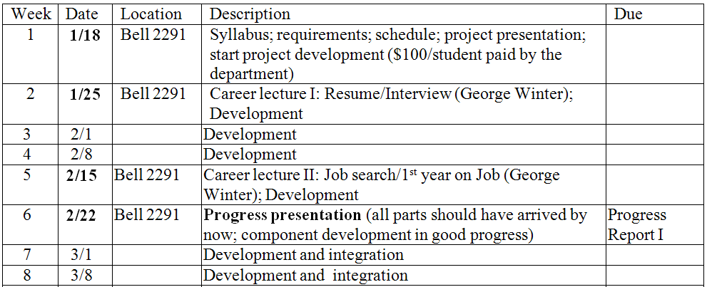
EE DESIGN: SCHEDULE

Slide 11
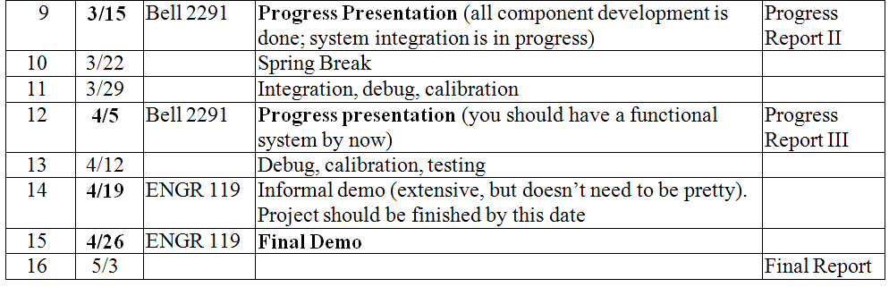
EE DESIGN: SCHEDULE

Slide 12
EE DESIGN: PROGRESS REPORTS
Progress reports
  Report the current status and progress of the projects
  Doesn’t need to be long. Report your current progress
  Format
    Cover page
    1. Objectives
    2. Description of designs and results
      What did you develop during the past few weeks
      Measurement and simulation results
      Does the designed component meet specifications?
    3. Project status
      Current status of the project
      Progress v.s. plan
    4. Future work
      What do you plan to do next
    Appendix (programs)
    References
  Each group also needs to give a power point presentation on the development progress.

Slide 13
EE DESING: FINAL REPORT
Final report
  A comprehensive report that includes everything about the project
  Follow the same format as the EE Design I Final Report
    Title page
    Abstract
    Table of Contents
    List of Figures
    List of Tables
    Nomenclature
    1. Introduction
      1.1 Motivation for Project
      1.2 Goals for Project
    2. Theoretical Background
    3. Design Objectives
    4. Design Implementation
    5. Results and Conclusions
    Appendix
    Reference
    Acknowledgement

Slide 14
GRADING POLICY
Grades Percentage
  Progress Reports (written) 10%
  Progress Report Presentation 15%
  Final Report 20%
  Informal Demo 10%
  Final Demo 20%
  Finished Projects v.s. requirements 15%
  Lab station clean 5%
Grades
  A: 90 ≤ grade ≤ 100
  B: 80 ≤ grade < 90
  C: 70 ≤ grade < 80
  D: 60 ≤ grade < 70
  F: 0 ≤ grade < 60
  I: final demo is not successful

Slide 15
GRADING POLICY
If the final demo is not working, students will receive an ‘I’ grade, and will not be able to graduate.
Due dates for report will be strictly enforced. Late submission within one week after due will receive a 20% deduction; no credit if submitted one week past due.
One report/group. Students within the same group should divide the report writing based on the tasks. Each student should explicitly specify which section is written by him/her.

