Slide 1
Space Encoded Adaptive Transmit Diversity for HSDPA System
Jingxian Wu

Slide 2
Outline
Background & Transmitter Structure
Review of Existing Transmit Diversity Algorithms
Our Approach: Space Encoded Adaptive Transmit Diversity
Simulation Results
Conclusions & Current Work Status

Slide 3





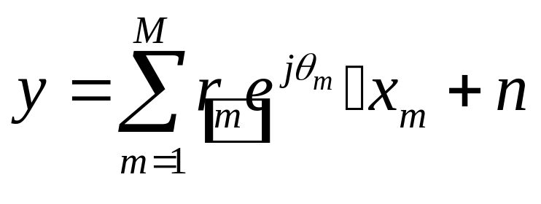
Background & System Structure
Simplified Diagram of HSDPA Transmitter
Tx
Diversity
?
Turbo
Encoder
Interleaver
Modulator
…
Transmitted Symbol
Channel fading
Additive noise

Slide 4
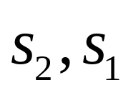
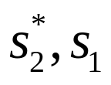
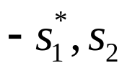

Review of Existing Transmit Diversity
Space Time Block Coding (Alamouti, 1998)
Adaptive Space Time Coding (Huawei, 2002)
More (TxAA, Optimum Beamforming, MRT, …)
Tx 1
STBC
Encoder
Tx 2
Tx 1
STBC
Encoder
Tx 2
Feedback

Slide 5
Existing Problems
Full rate orthogonal STBC is only suitable for systems with exactly two transmit antennas.
  3GPP systems will employ 2-4 transmit antennas.
Requires large amount of feedback information in the feedback channel – bandwidth inefficient
  ASTTD: (2 x 1) real-valued vector.
  TxAA: (M x 1) complex-valued vector.
Objectives
Better Performance
Less Feedback
More Tx Antennas

Slide 6
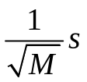
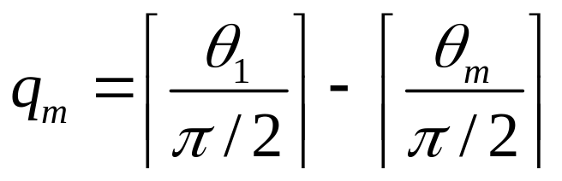
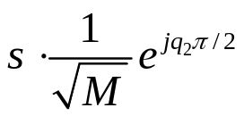
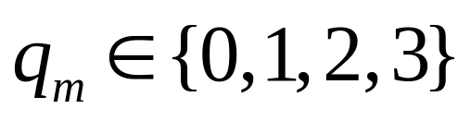
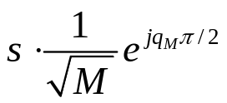

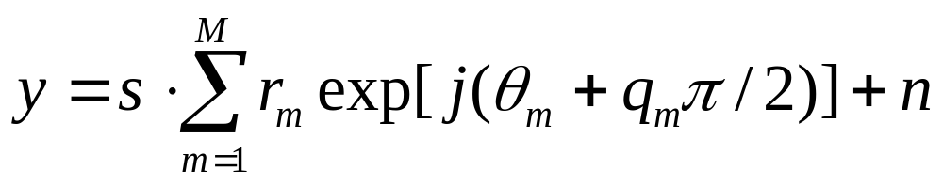
Our Approach: Space Encoded Tx Diversity
Space
Encoder
Tx 1
Tx 2
…
Tx M
2M-2 bits Feedback
Feedback

Slide 7
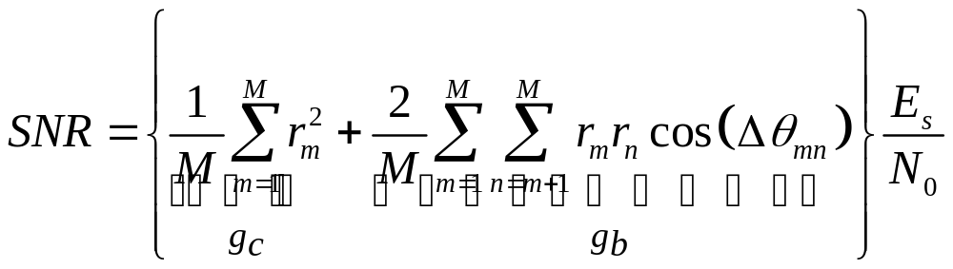
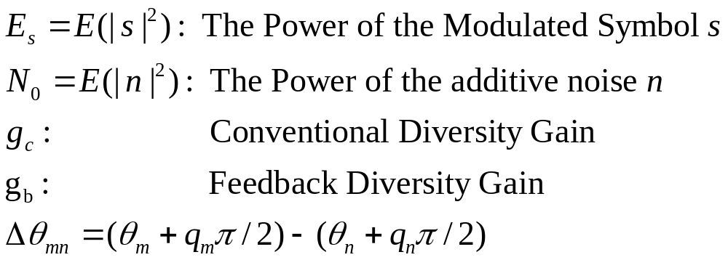
Our Approach: Space Encoded Tx Diversity
Signal to Noise Ratio (SNR)

Slide 8

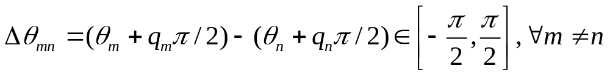
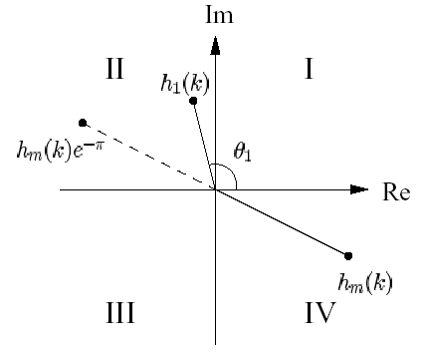

Our Approach: Space Encoded Tx Diversity
Computation of the Feedback Information
  Objective: Adjusting so that
  Method:

Slide 9
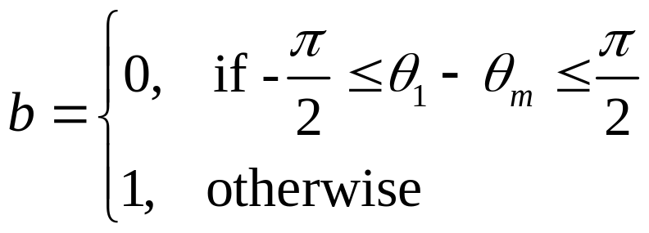

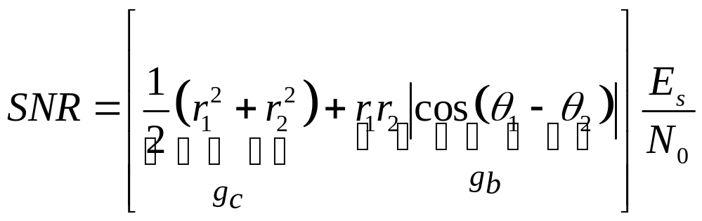
Our Approach: Space Encoded Tx Diversity
Special Case: System with 2 Tx Antennas
SNR
Space
Encoder
Feedback

Slide 10
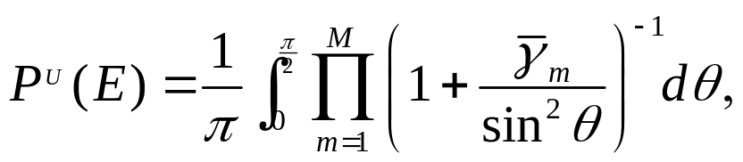
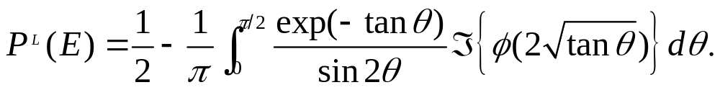
Performance Analyses
Symbol Error Rate (SER)
  Upper Bound
  Lower Bound

Slide 11
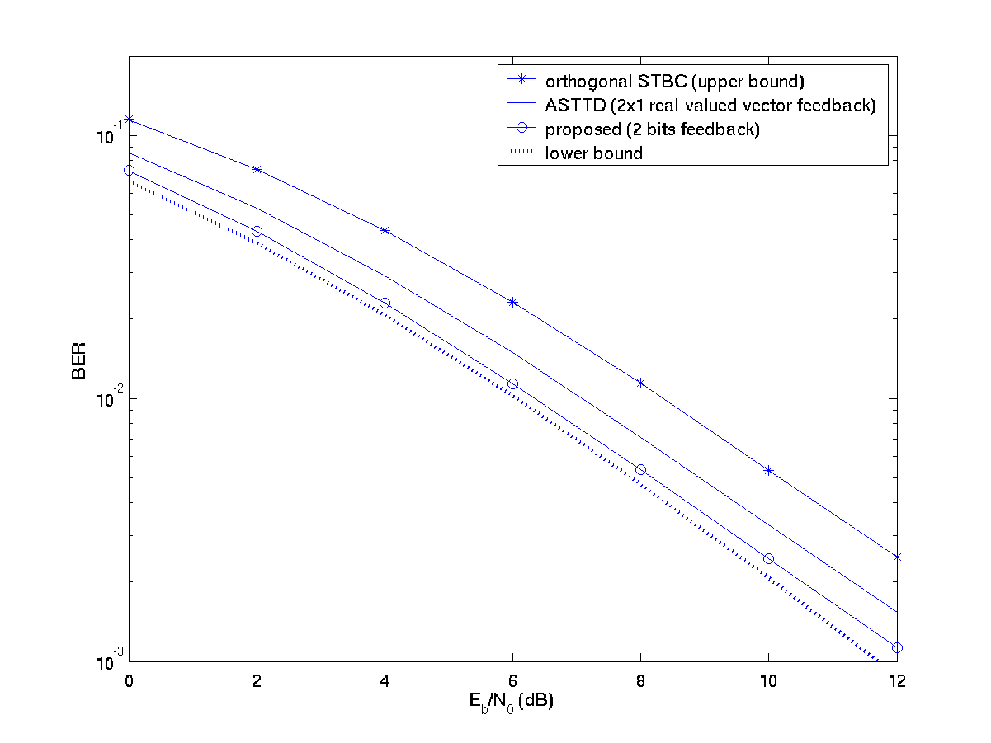
Simulation Results
Uncoded System with BPSK, 2 Tx Antennas

Slide 12
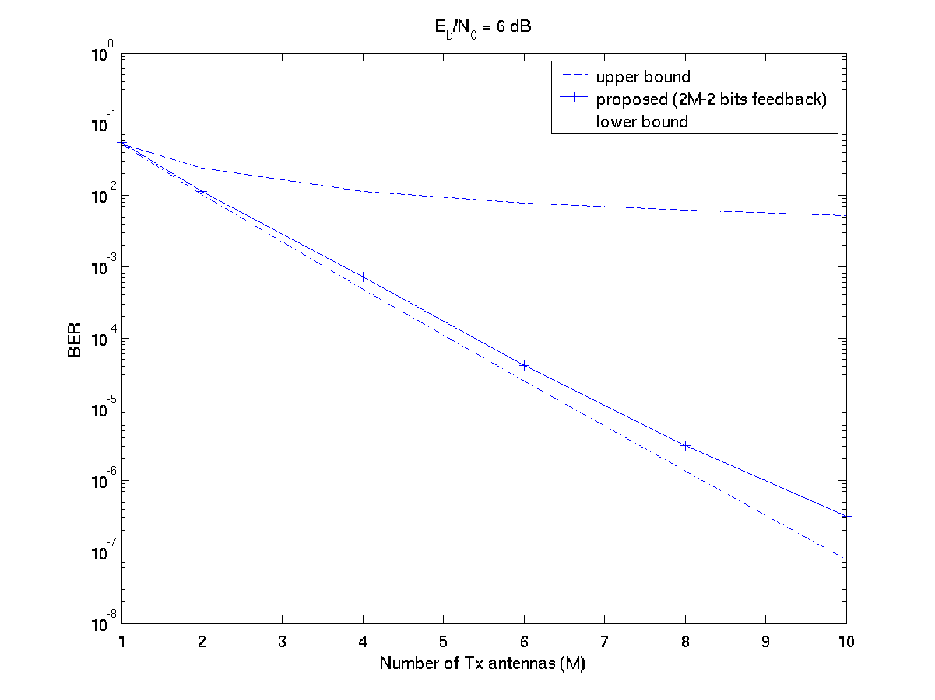
Simulation Results
Uncoded System with BPSK, SNR = 6 dB

Slide 13
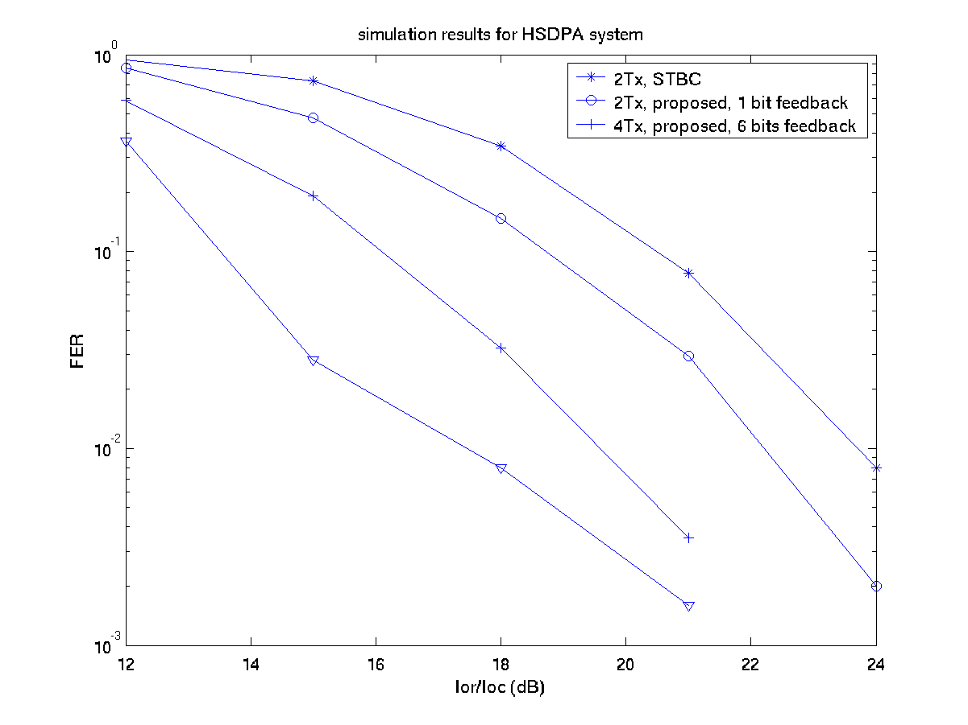
Simulation Results
HSDPA System

Slide 14
Conclusions & Current Work Status
Features of the new transmit diversity scheme
  Simple linear operations at both the transmitter and receiver
  Requires only a small amount of feedback information – 1 bit or 2(M-1) bits feedback
  Can be employed for systems with arbitrary number of Tx antennas.
  Outperforms open loop transmit diversity and some closed loop transmit diversity, which requires more feedback than our approach.
Current Work Status
  Space-time Encoded Transmit Diversity – Even less feedback information.

