Slide 1
ELEG 4603/5173L Digital Signal Processing
Ch. 1 Discrete-Time Signals and Systems
Dr. Jingxian Wu
wuj@uark.edu

Slide 2
OUTLINE
Classifications of discrete-time signals
Elementary discrete-time signals
Linear time-invariant (LTI) discrete-time systems
Causality and stability
Difference equation representation of LTI systems

Slide 3


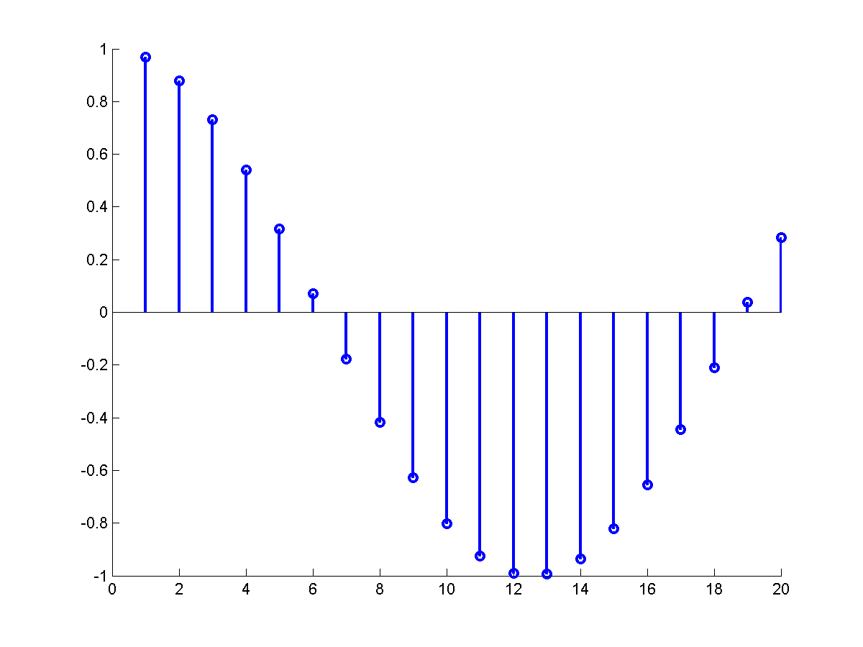
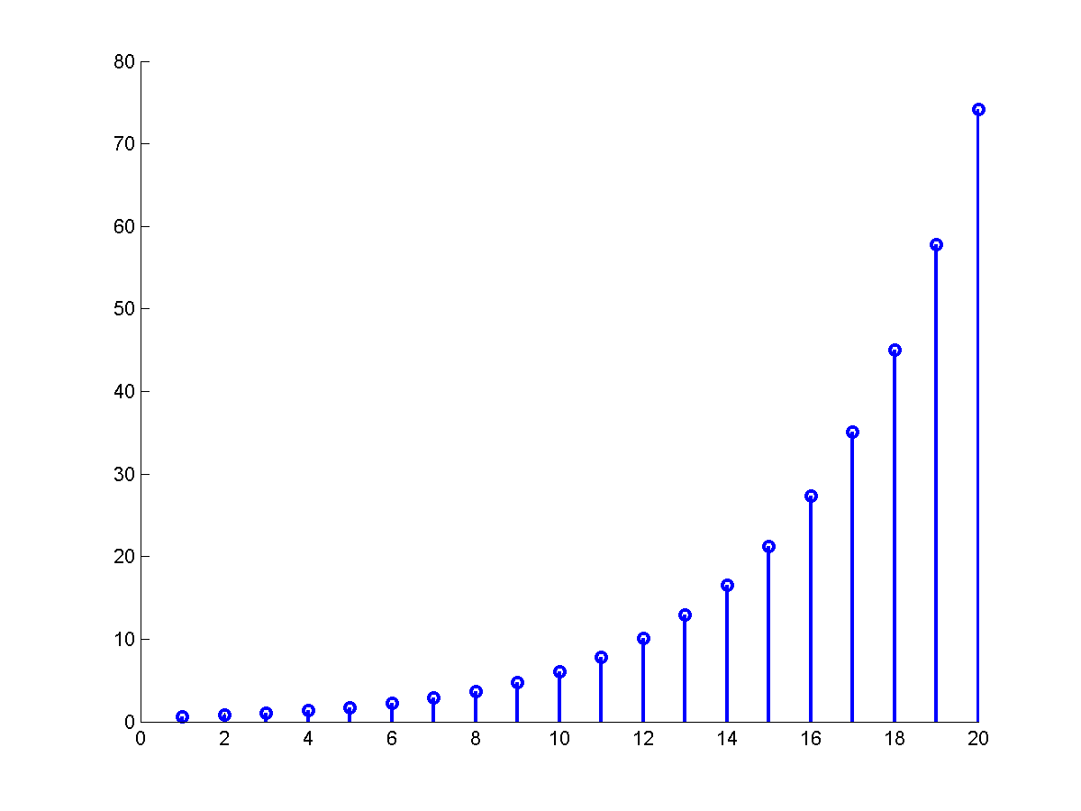
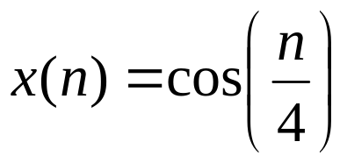
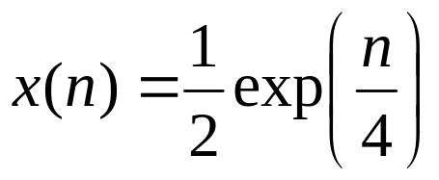
SIGNAL CLASSICIATION
Discrete-time signal
  A signal that is defined only at discrete instants of time.
  Represented as

Slide 4

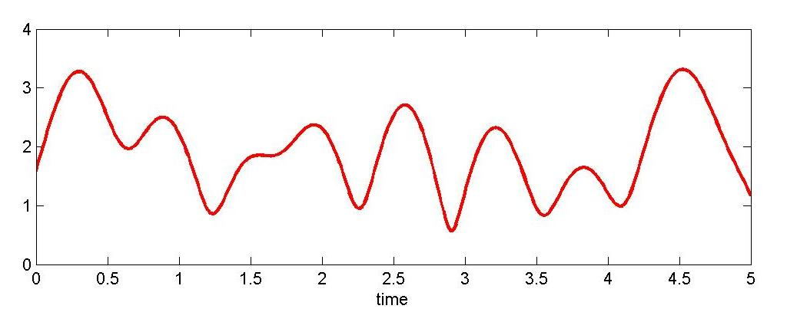
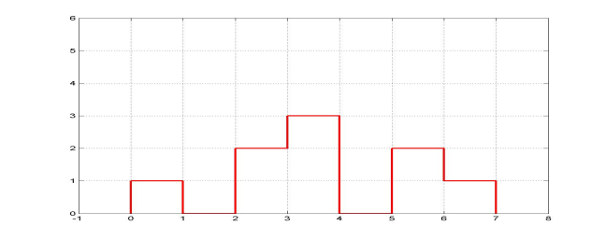
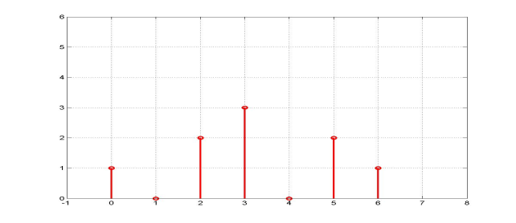
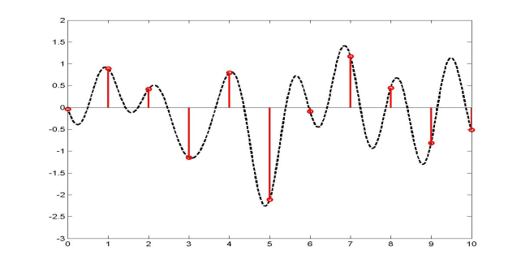
SIGNAL CLASSICIATION
4
Review: Analog v.s. digital
  Continuous-time signal
    continuous-time, continuous amplitude→ analog signal
      Example: speech signal
    Continuous-time, discrete amplitude
      Example: traffic light
  Discrete-time signal
    Discrete-time, discrete-amplitude → digital signal
      Example: Telegraph, text, roll a dice
    Discrete-time, continuous-amplitude
      Example: samples of analog signal,
      average monthly temperature
3
2
2
1
1
0
0
3
2
2
1
1
0
0

Slide 5





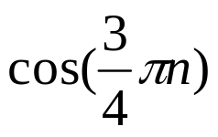
SIGNAL CLASSIFICATION
Periodic signal v.s. aperiodic signal
  Periodic signal
    The smallest value of N that satisfies this relation is the fundamental periods.
  Is periodic?
  is periodic if is an integer, and the smallest N is the fundamental period.
  Example:

Slide 6





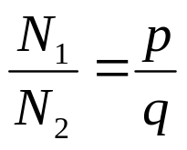

SIGNAL CLASSIFICATION
Sum of two periodic signals
: fundamental period
: fundamental period
is periodic if both and are periodic. Assume
where p and q are not divisible of each other. The period is

Slide 7
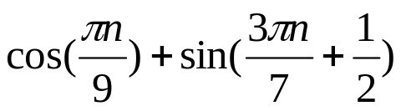
SIGNAL CLASSIFICATION
Example:
  Is the signal periodic? If it is, what is the fundamental period?
Notes:
N1 = 18, N2 = 14
N1/N2 = 18/14 = 9/7
N = 18*7 = 14*9 = 126

Slide 8
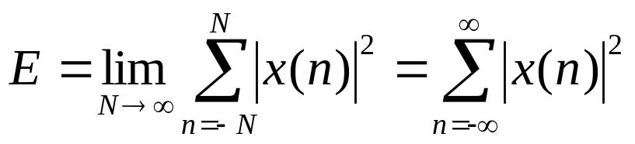
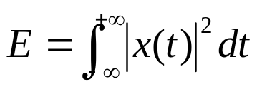

SIGNAL CLASSIFICATION
Energy signal
  Energy:
  Review: energy of continuous-time signal
  Energy signal:

Slide 9
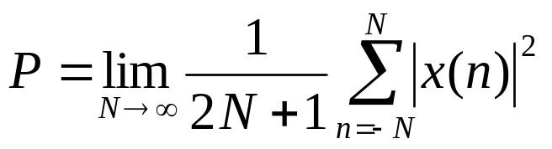
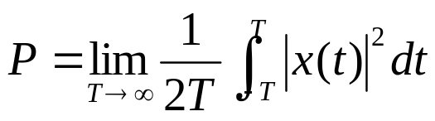

SIGNAL CLASSIFICATION
Power signal
  Power of discrete-time signal
  Review: power of continuous-time signal
  Power signal:

Slide 10


SIGNAL CLASSIFICATION
Example
  Determine if the discrete-time exponential signal is an energy signal or power signal
Notes:
Geometric sequence
\sum_{k=m}^n q^k = [q^m – q^(n+1)]/(1-q), q \neq 1
16/3

Slide 11
OUTLINE
Classifications of discrete-time signals
Elementary discrete-time signals
Linear time-invariant (LTI) discrete-time systems
Causality and stability
Difference equation representation of LTI systems

Slide 12

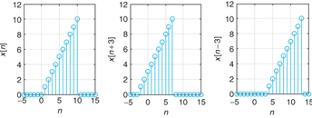




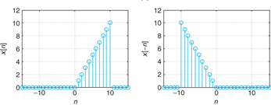
ELEMENTARY SIGNALS
Basic signal operations
  Time shifting
    shift the signal to the right by k samples
  Reflecting
    Reflecting x(n) with respect to n = 0.

Slide 13
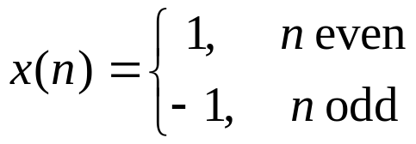


ELEMENTARY SIGNALS
Basic signal operations
  Time scaling
    Example: Let
    Find ,

Slide 14

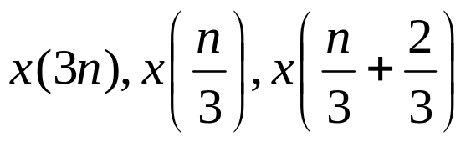
ELEMENTARY SIGNALS
Basic signal operations
  Time scaling
    Example:
    the always points to x(0)
    find

Slide 15
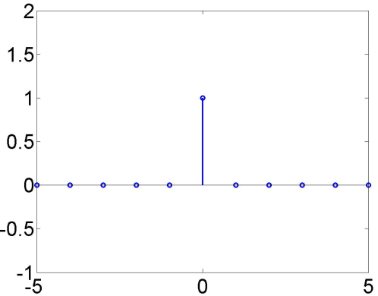
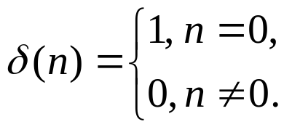
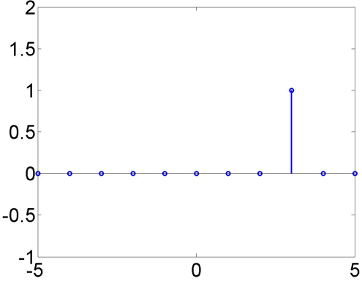
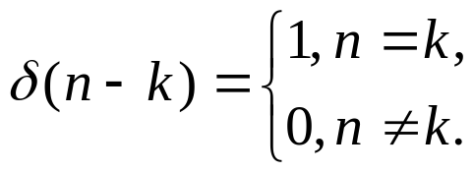
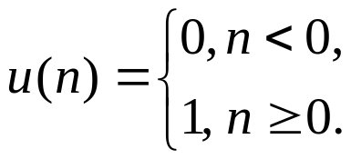
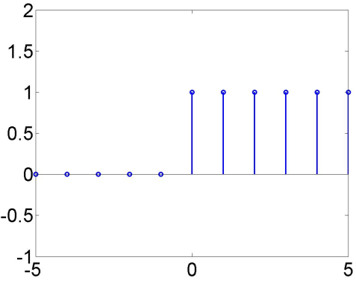

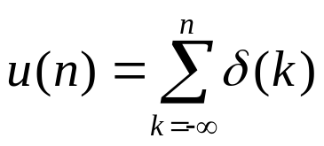
ELEMENTARY SIGNALS
Unit impulse function
  time shifting
Unit step function
Relation between unit impulse function and unit step
function

Slide 16

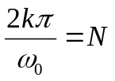
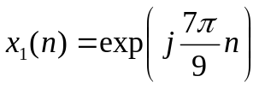
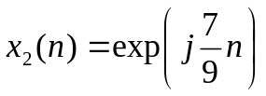
ELEMENTARY SIGNALS
Exponential function
Complex exponential function
  x(n) is periodic if is an integer, and the smallest integer N is the fundamental period.
Example
  Are the following signals periodic? If periodic, find fundamental period.

Slide 17
OUTLINE
Classifications of discrete-time signals
Elementary discrete-time signals
Linear time-invariant (LTI) discrete-time systems
Causality and stability
Difference equation representation of LTI systems

Slide 18










DISCRETE-TIME SYSTEMS
Linear system
  Consider a system with the following input-output relationship
  The system is linear if it meets the superposition principle
System
System
System
Time-invariant system
  Consider a system with the following input-output relationship
  The system is time-invariant if a time-shift at the input leads to the same time-shift at the output
System
System

Slide 19


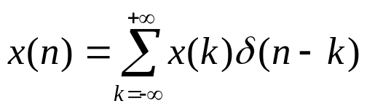
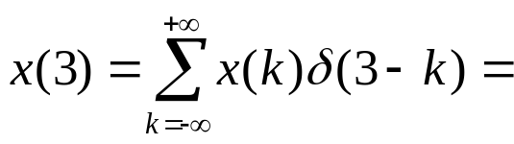
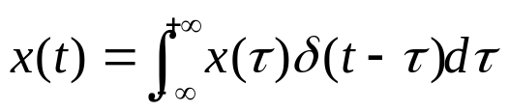
DISCRETE-TIME SYSTEM
Impulse response of a LTI system
  The response of the system when the input is
System
Any arbitrary discrete-time signal can be decomposed as weighted summation of the unit impulse functions
  Why?
  E.g.
  Recall:

Slide 20


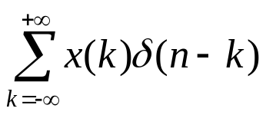
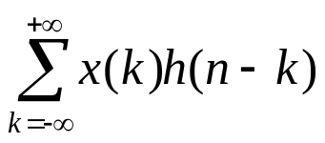
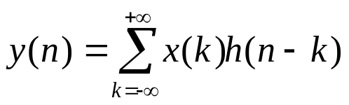

DISCRETE-TIME SYSTEM
LTI response to arbitrary input
  Any arbitrary signal can be written as
  Time-invariant
  Linear
LTI
LTI
LTI

Slide 21


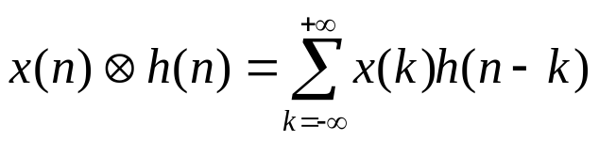



DISCRETE-TIME SYSTEM
Convolution sum
  The convolution sum of two signals and is
Response of LTI system
  The output of a LTI system is the convolution sum of the input and the impulse response of the system.

Slide 22




DISCRETE-TIME SYSTEM
Examples
  1.
  2.
Notes:
x(n-m)
[ beta^(n+1)-alpha^(n+1)]/(beta-alpha)

Slide 23
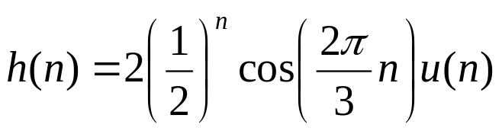
DISCRETE-TIME SYSTEM
Example
  3. Find the step response of the system with impulse response

Slide 24



DISCRETE-TIME SYSTEM
Example:
  Let be two
  sequences, find
Notes:
Example
X = [0, 1, 2]
H = [-1, (-2), -3, -4]
Y = [0 -1 -4 -7 -10 -8]

Slide 25





DISCRETE-TIME SYSTEM
Properties: commutativity
h(n)
⬅➔
x(n)

Slide 26





DISCRETE-TIME SYSTEM
Properties: associativity
⬅➔

Slide 27

DISCRETE-TIME SYSTEM
Distributivity
+
⬅➔

Slide 28
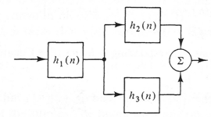



DISCRETE-TIME SYSTSEMS
Example
  Consider a system shown in the figure. Find
  the overall impulse response.

Slide 29
OUTLINE
Classifications of discrete-time signals
Elementary discrete-time signals
Linear time-invariant (LTI) discrete-time systems
Causality and stability
Difference equation representation of LTI systems

Slide 30




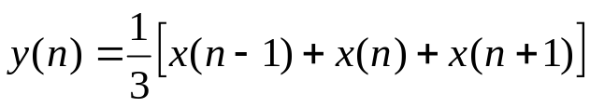
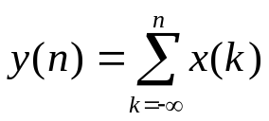
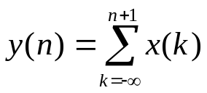
CAUSALITY AND STABILITY
Causal system
  A discrete-time system is causal if the output depends only on values of input for
    The output does not depend on future input.
  Example:
    determine whether the following systems are causal.

Slide 31
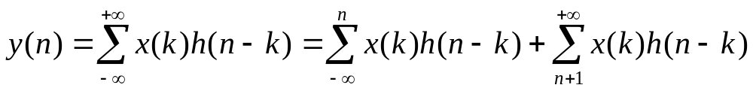




CAUSALITY AND STABILITY
Causality of LTI system
  An LTI system is causal if and only if h(n)=0 for n < 0
    Why?
  A signal x(n) is causal if x(n)=0 for n < 0.
  Example:
    For LTI systems with impulse responses given as follows. Find if the systems are casual.

Slide 32
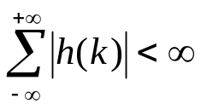
CAUSALITY AND STABILITY
Bounded-input bounded-output (BIBO) stable
  a system is BIBO stable if, for any bounded input x(n), the response y(n) is also bounded.
BIBO stability of LTI system
  An LTI discrete-time system is BIBO stable if
    Why?

Slide 33





CAUSALITY AND STABILITY
Example
  For an LTI system with impulse responses as follows. Are they BIBO stable?

Slide 34
OUTLINE
Classifications of discrete-time signals
Elementary discrete-time signals
Linear time-invariant (LTI) discrete-time systems
Causality and stability
Difference equation representation of LTI systems

Slide 35
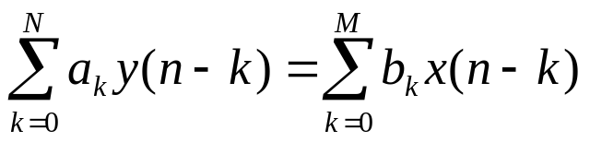
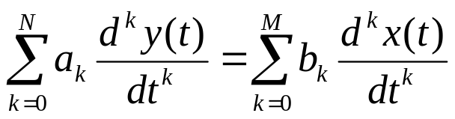
DIFFERENCE EQUATION
Difference equation representation of LTI discrete-time system
  Any LTI discrete-time system can be represented as
  Review: any LTI continuous-time system can be represented as

Slide 36
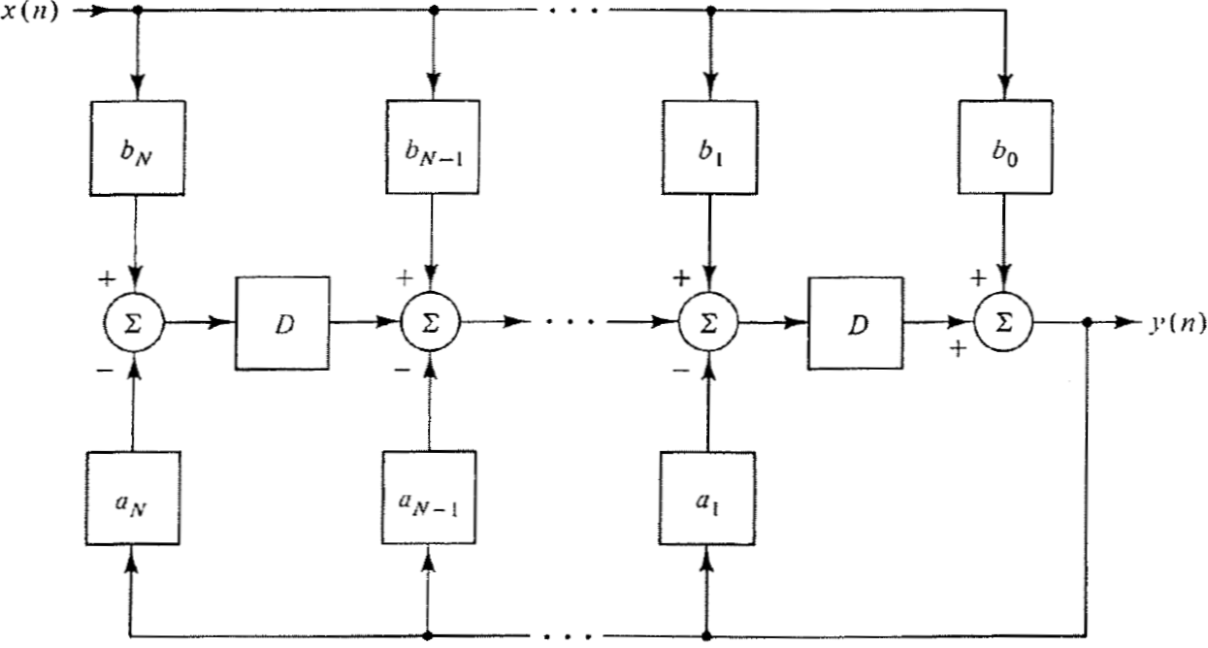
DIFFERENCE EQUATION
Simulation diagram

Slide 37
DIFFERENCE EQUATION
Example
  Draw the simulation diagram of the LTI system described by the following difference equation

Slide 38

DIFFERENCE EQUATION
Example
  The impulse response of an LTI system is
    Find the difference equation representation
    Draw the simulation diagram.
Notes:
Y(n) = \sum_{k=0}^3 h(k) x(n-k)
y(n) = 5 x(n-3) +3 x(n-1)+2 x(n)

