Slide 1
ELEG 5173L Digital Signal Processing
Ch. 2 The Z-Transform
Dr. Jingxian Wu
wuj@uark.edu

Slide 2
OUTLINE
The Z-Transform
Properties
Inverse Z-Transform
Z-Transform of LTI system

Slide 3
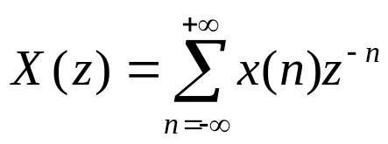
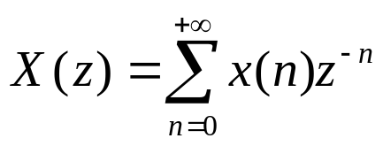
Z-TRANSFORM
Bilateral Z-transform
Unilateral Z-transform
Z-transform:
  Can simplify the analysis of discrete-time LTI systems
    Analyze the system in z-domain instead of time domain
  Doesn’t have any physical meaning (the frequency domain representation of discrete-time signal can be obtained through discrete-time Fourier transform)
  Counterpart for continuous-time systems: Laplace transform.

Slide 4

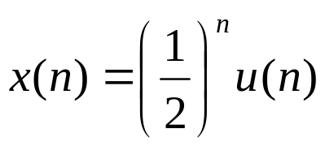
Z-TRANSFORM
Example: find Z-transforms
  1.
  2.
Notes:
1). 1
2). X(z) = z/(z-1/2), |z| > 1/2

Slide 5
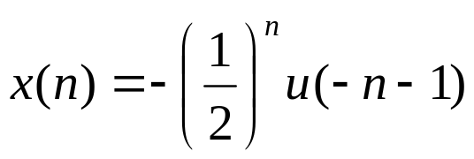
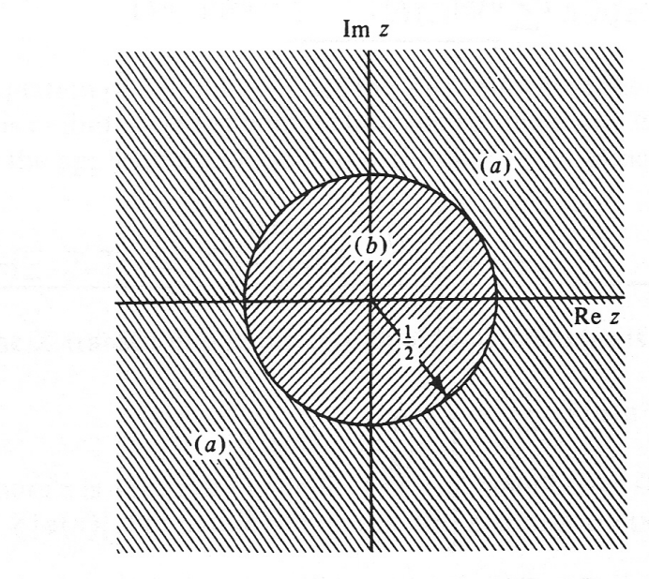
Z-TRANSFORM
Example
  3.
Region of convergence (ROC)
Notes:
m = -n
X(z) = -2z/(2z-1) = z/(z-1/2), |z| < 1/2

Slide 6


Z-TRANSFORM: CONVERGENCE
ROC of causal signal
ROC of anti-causal signal

Slide 7
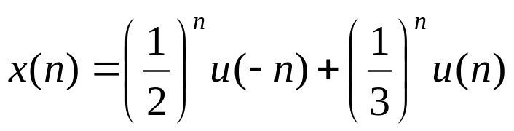
Z-TRANSFORM
Example: find the Z-transforms for the following signals
Notes:
1/(1-2z) + z/(z-1/3), 1/3<|z|<1/2

Slide 8
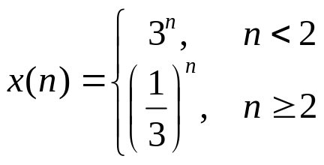
Z-TRANSFORM
Example: find the Z-transforms for the following signals
Notes:
(3/z)/(1-z/3)+1/(3z)*1/(3z-1)
1/3 < |z| < 3

Slide 9
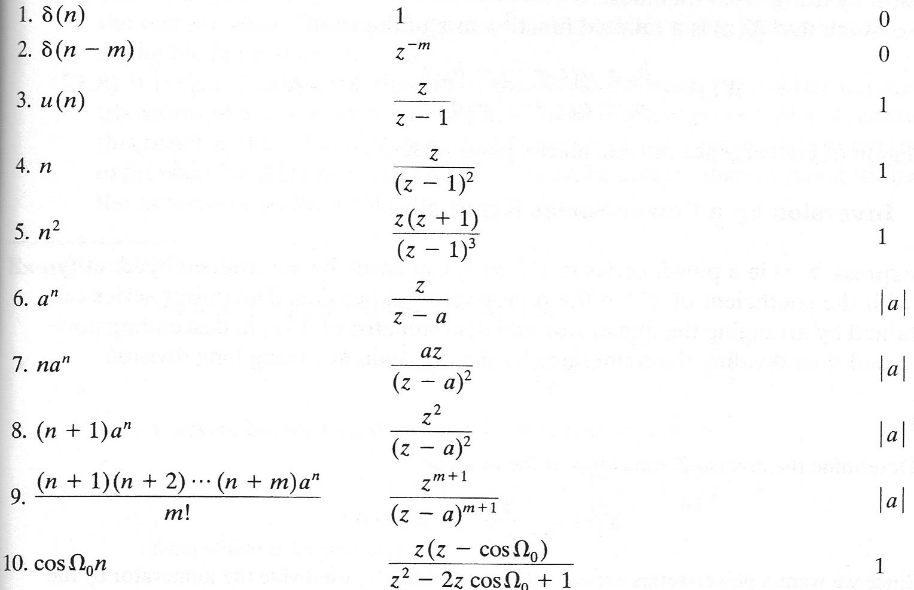
Z-TRANSFORM: TRANSFORM TABLE

Slide 10
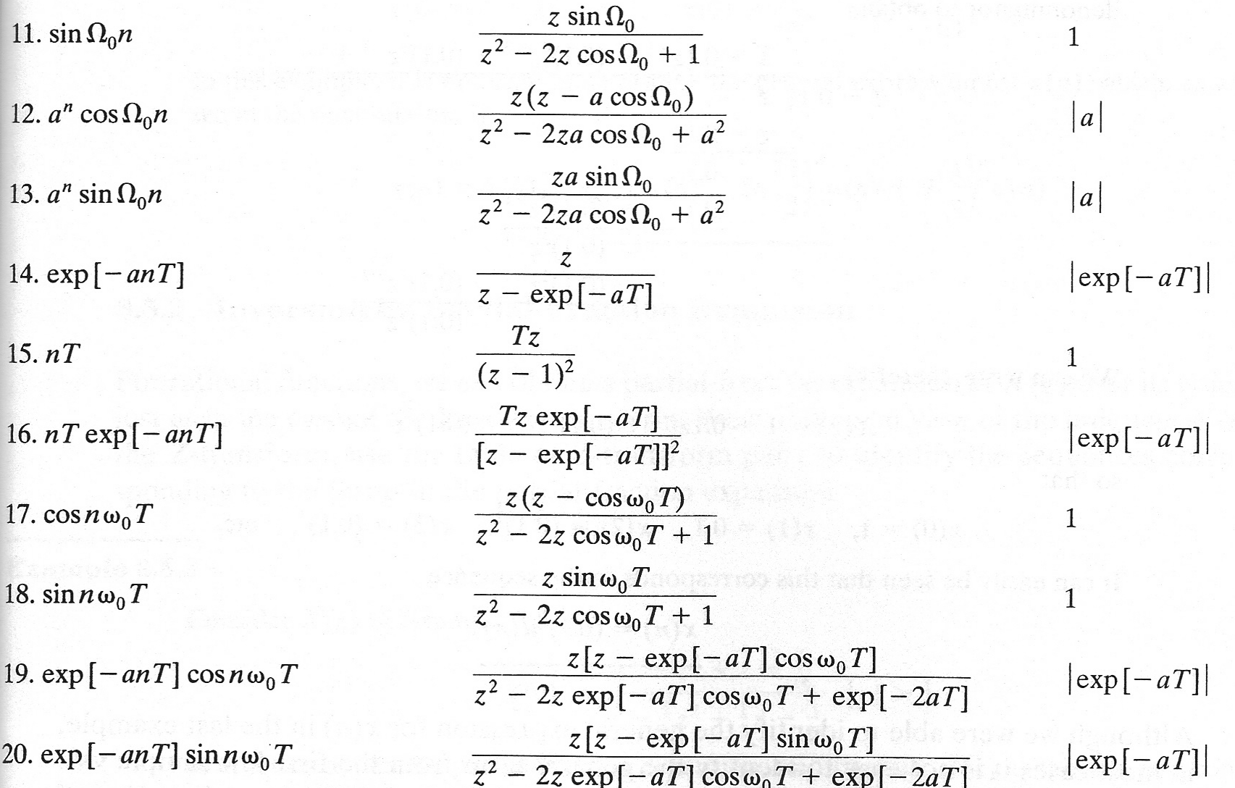
Z-TRANSFORM: TRANSFORM TABLE

Slide 11
OUTLINE
The Z-Transform
Properties
Inverse Z-Transform
Z-Transform of LTI system

Slide 12


PROPERTIES
Linearity
  If
  Then

Slide 13


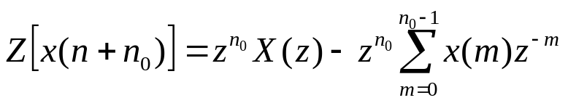
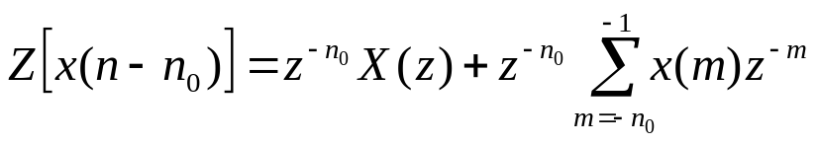
PROPERTIES
Time Shifting
  Let be a causal sequence with the Z-transform
  Then
Notes:
\sum_{n=0}^\infty x(n+n0) z^{-n}
m = n+n0

Slide 14

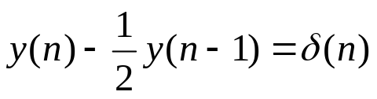
PROPERTIES
Example
  Solve the difference equation with initial condition
Notes:
y(n-1) ←→ Y(z)z^{-1} + y(-1) z^{-2}
Y(z) = (1+ 3/2 z^(-2))/(1-1/2 z^(-1)) = 1/(1-1/2 z^(-1)) + 3/2 z^(-2)/(1 – ½ z^{-1})
a^n u(n) ←→ 1/(1-az^{-1})
a^n u(n-2) ←→ a^2 z^{-2}/(1- az^{-1})
y(n) = (1/2)^n u(n) + 6 (1/2)^n u(n-2)

Slide 15


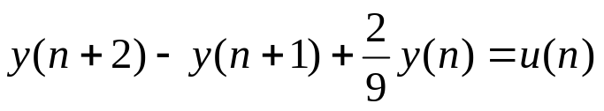
PROPERTIES
Example
  Solve the difference equation with initial condition
Notes:
y(n+2) ←→z^2 Y(z)-z^2-z
y(n+1) ←→z Y(z)-z

Slide 16


PROPERTIES
Frequency scaling
  If
  Then

Slide 17

PROPERTIES
Example
  Find the Z-transform of
Notes:
a^n u(n) ←→ 1/(1-az^(-1))
Cos(wn) ←→ ½*1/(1-e^(jw) z^(-1)) + ½*1/(1-e^(-jw) z^(-1)) = z(z-cosw)/(z^2 – 2z cosw + 1), |z|>1
a^n cos(wn) ←→ (z -> a^-1 z)
|a^(-1) z| > 1➔ |z| > a

Slide 18
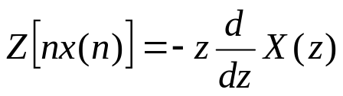
PROPERTIES
Differentiation with respect to z
  If
  Then

Slide 19

PROPERTIES
Example
  Find the Z-transform of
Notes:
Nu(n) = z/(z-1)^2
N^2 u(n) = z(z+1)/(z-1)^3

Slide 20


PROPERTIES
Initial value
Final value

Slide 21
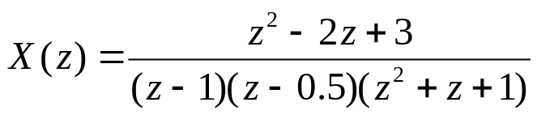
PROPERTIES
Example
  Find the initial value and final value of the following signal.
Notes:
X(0) = 0
X(inf) = 4/3

Slide 22





PROPERTIES
Convolution
  If
  Then
Example
  Find the convolution of the following two sequences
Notes:
[1 5 5 -5 -6 4 1 -2]

Slide 23
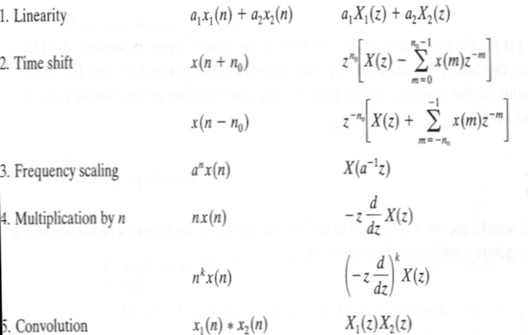
PROPERTIES

Slide 24
OUTLINE
The Z-Transform
Properties
Inverse Z-Transform
Z-Transform of LTI system

Slide 25
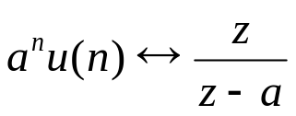
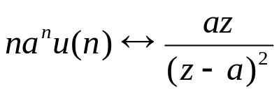
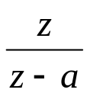
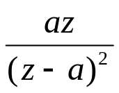
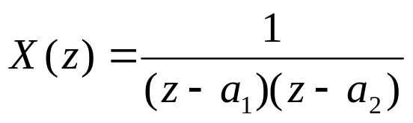
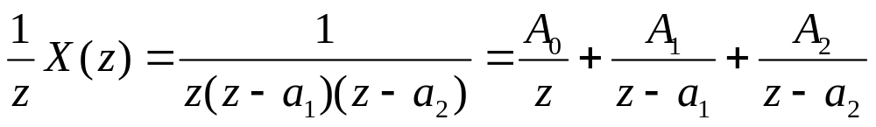
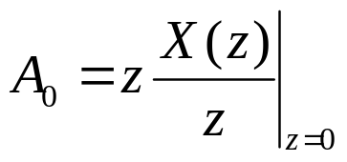
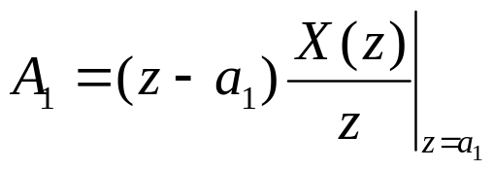
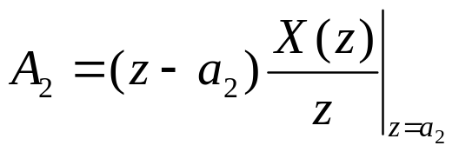
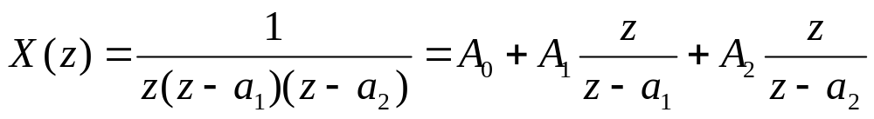
INVERSE Z-TRANSFORM
Review
Inverse Z-Transform by partial fraction expansion
  Expand X(z) in the form of , , etc.

Slide 26
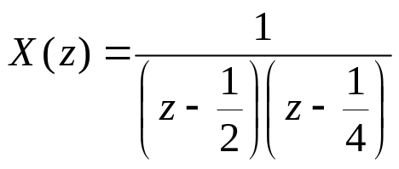
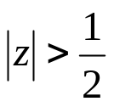
INVERSE Z-TRANSFORM
Example
  Find the inverse Z-Transform of
Notes:
A0 = 8, A1 = 8, A2 = -16
8 delta(n) + 8*(1/2)^n u(n) – 16 (1/4)^n u(n)

Slide 27
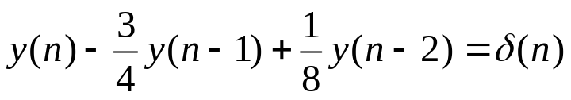
INVERSE Z-TRANSFORM
Solve the difference equation
Notes:
Y(z) = z^2/(z^2 – ¾ z + 1/8) = z^2/[(z-1/4)(z-1/2)]
Y(z)/z = z/[(z-1/4)(z-1/2)] = A/(z-1/4) + B/(z-1/2)
A = -1
B = 2
Y(z) = -z/(z-1/4) + 2 z/(z-1/2)
y(n) = -(1/4)^n u(n) + 2 (1/2)^n u(n)

Slide 28

INVERSE Z-TRANSFORM
Example
  Find the convolution
Notes:
X(z) = Z^2/[(z-a)(z-b)]
X(z)/z = z/[(z-a)(z-b)]
[a^(n+1) – b^(n+1)]/(a-b) u(n)

Slide 29


INVERSE Z-TRANSFORM
Example
  Find the following convolutions

Slide 30
OUTLINE
The Z-Transform
Properties
Inverse Z-Transform
Z-Transform of LTI system

Slide 31


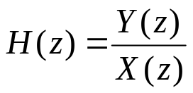
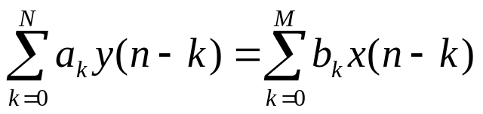
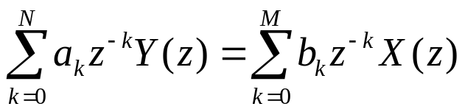
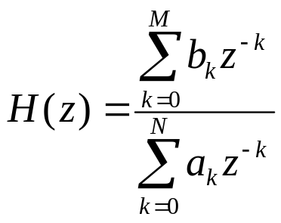
LTI SYSTEM
Transfer function of discrete-time LTI system
  ad
Transfer function of discrete-time LTI system
  Z-transform on both sides:

Slide 32
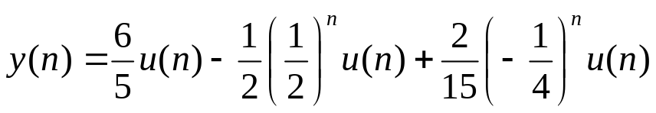
LTI SYSTEM
Example
  Let the step response of a LTI system be as follows. Find the transfer function
Notes:
Y(z) = 6/5z/(z-1) – ½ z/(z-1/2) + 2/15 z/(z+1/4)
X(z) = z/(z-1)
H(z) = Y(z)/X(z) = 6/5 – ½ (z-1)/(z-1/2) + 2/15 (z-1)/(z+1/4)
(Z-1)/(z-1/2) = z/(z-1/2) – 1/(z-1/2) = z/(z-1/2) – z^(-1) z/(z-1/2) → (1/2)^n u(n) – (½)^(n-1) u(n-1)

Slide 33
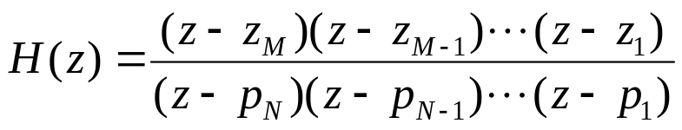


LTI SYSTEM
Zeros and poles
  Zeros:
  Poles:
Stability
  A discrete-time LTI system is stable if all the poles are inside the unit circle.
  A discrete-time LTI system is unstable if at least one pole is on or outside the unit circle.
  Review: a continuous-time LTI system is stable if all the poles are on the left half plane.

Slide 34
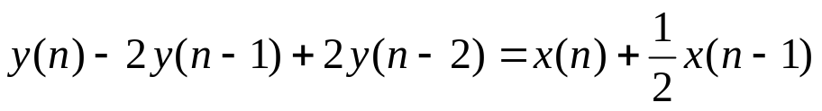
LTI SYSTEM
Example
  Consider a LTI system described by the difference equation. Find the transfer function and the zeros and poles. Is the system stable?
Notes:
H(z) = z(z+1/2)/[(z-(1+j))(z-(1-j))]

Slide 35
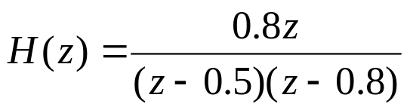
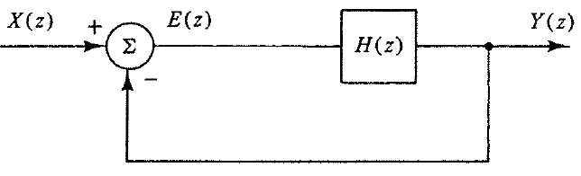
LTI SYSTEM
Example
  Find the transfer function of the system shown in the following diagram. If k = 1, is the system stable?
Notes:
Y(z)/X(z) = H(z)/[H(z) + 1] = 0.8kz/[z^2 – (1.3-0.8k)z + 0.4]

Slide 36
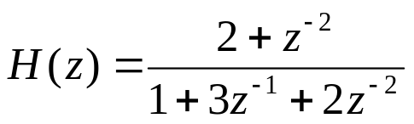
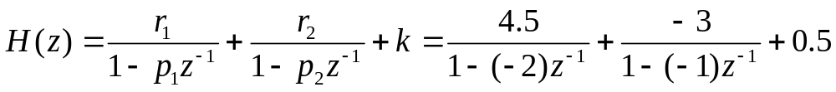
LTI SYSTEM
Matlab
  Example
% numerator coefficients
b = [2, 0, 1];
% denominator coefficients
a = [1, 3, 2];
[r, p, k] = residuez(b, a)
r = [4.5, -3], p =[-2, -1], k = 0.5

Slide 37
LTI SYSTEM
Matlab
  Example (Cont’d)
% numerator coeffcients
b = [2, 0, 1];
% denominator coefficients
a = [1, 3, 2];
% partial fraction expansion
[r, p, k] = residuez(b, a)
% find the zeros
z = roots(b);
% plot the poles and zeros
zplane(b, a);
% find the output to the system with an input x
x = [2, 1, -2, 3];
y = filter(b, a, x);

Slide 38
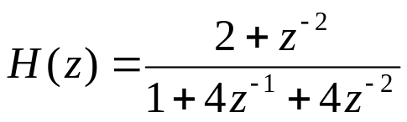
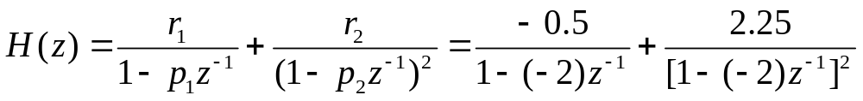
LTI SYSTEM
Matlab
  Example (multiple poles)
% numerator coeffcients
b = [2, 0, 1];
% denominator coefficients
a = [1, 4, 4];
% partial fraction expansion
[r, p, k] = residuez(b, a)
r = [-0.5, 2.25], p =[-2, -2], k = 0

