Slide 1
ELEG 5173L Digital Signal Processing
Ch. 3 Discrete-Time Fourier Transform
Dr. Jingxian Wu
wuj@uark.edu

Slide 2
OUTLINE
The Discrete-Time Fourier Transform (DTFT)
Properties
DTFT of Sampled Signals
Upsampling and downsampling

Slide 3
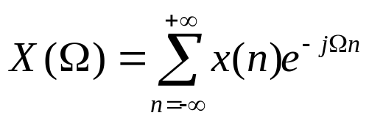

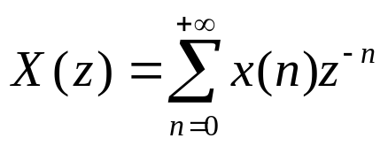


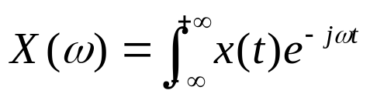

DTFT
Discrete-time Fourier Transform (DTFT)
  (radians): digital frequency
Review: Z-transform:
  Replace z with .
Review: Fourier transform:
  (rads/sec): analog frequency

Slide 4

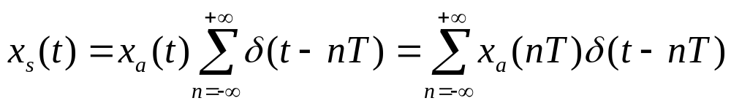

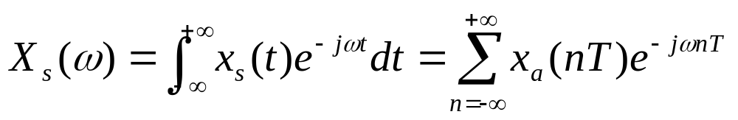




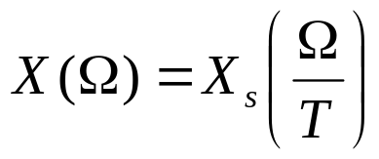
DTFT
Relationship between DTFT and Fourier Transform
  Sample a continuous time signal with a sampling period T
  The Fourier Transform of
  Define:
    digital frequency (unit: radians)
    analog frequency (unit: radians/sec)
  Let
Notes:
Delta(t) ←→ 1
Delta(t-nT) ←→ exp(-jnwt)

Slide 5
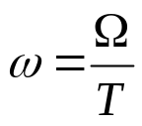

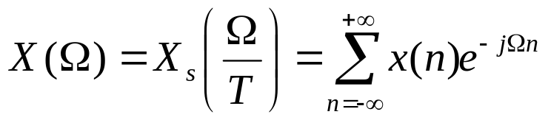
DTFT
Relationship between DTFT and Fourier Transform (Cont’d)
  The DTFT can be considered as the scaled version of the Fourier transform of the sampled continuous-time signal

Slide 6





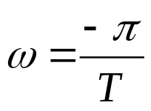
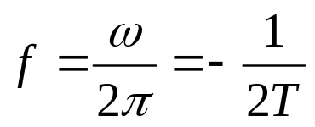

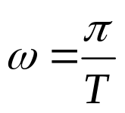
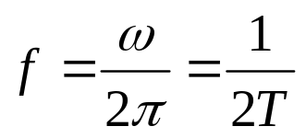

DTFT
Discrete Frequency
  Unit: radians (the unit of continuous frequency is radians/sec)
  is a periodic function with period
  We only need to consider for
    For Fourier transform, we need to consider
  → →
  → →

Slide 7


DTFT
Example: find the DTFT of the following signal
  1.
  2.
Notes:
1). 1
2). X(z) = z/(z-1/2), |z| > 1/2

Slide 8

DTFT
Example
  Find the DTFT of
Notes:
(1-exp(-j*Omega*N))/(1-exp(-j*Omega))

Slide 9

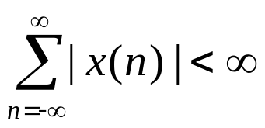
DTFT
Example
  Find the DTFT of the following signal
Existence of DTFT
  The DTFT of x(n) exists if x(n) satisfies
Notes:
1/Alpha*exp(jomega)/(1-1/alpha*exp(jomega))+1/(1-alpha*exp(-jomega))

Slide 10
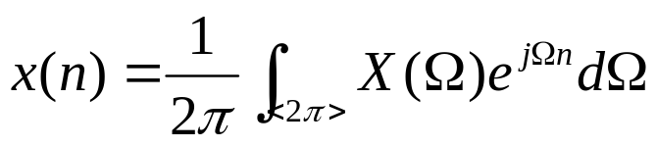

DTFT
Inverse DTFT
Example
  Find the inverse DTFT of
Notes:
Exp(-j Omega_0 n)

Slide 11

DTFT
Example
  Find the DTFT of

Slide 12
OUTLINE
The Discrete-Time Fourier Transform (DTFT)
Properties
DTFT of Sampled Signals
Upsampling and downsampling

Slide 13



PROPERTIES
Periodicity
Linearity
  If
  Then

Slide 14



PROPERTIES
Time shifting
  If
  Then
Frequency shifting
  If
  Then

Slide 15
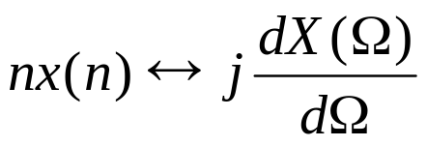
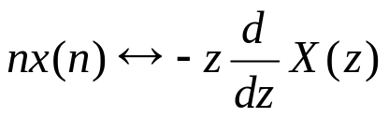


PROPERTIES
Differentiation in Frequency
  If
  Then
  Review
Example
  Find the DTFT of
Notes:
Alpha^n u(n) ←→ 1/(1-alpha exp(-jw))
jdX(w)/dw = -exp(-jw)/(1-alpha exp(-jw))^2

Slide 16



PROPERTIES
Convolution
  If
  Then
Example
  Find the frequency response of the system

Slide 17
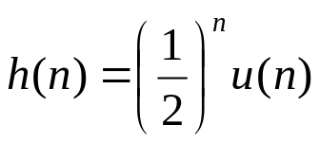
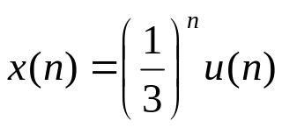
PROPERTIES
Example
  A LTI system with impulse response
  if the input is
  Find the output

Slide 18
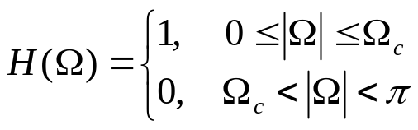

PROPERTIES
Example
  The frequency response of an ideal low pass filter is
  find the impulse response.
  (1) Assume . If the sampling rate of the input signal is 1 KHz, what is the cutoff frequency for the analog signal?
  (2) If the sampling rate of the input signal is 2 KHz, what is the cutoff frequency of the analog signal?
Notes:
Sin(n Omega_c)/(n pi) = omega_c/pi*sinc(n*omega_c/pi)
250 Hz
500 Hz

Slide 19

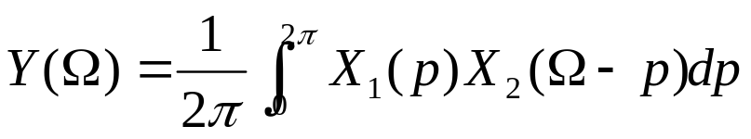
PROPERTIES
Modulation
  If
  Then

Slide 20
OUTLINE
The Discrete-Time Fourier Transform (DTFT)
Properties
Application: DTFT of Sampled Signals
Upsampling and downsampling

Slide 21
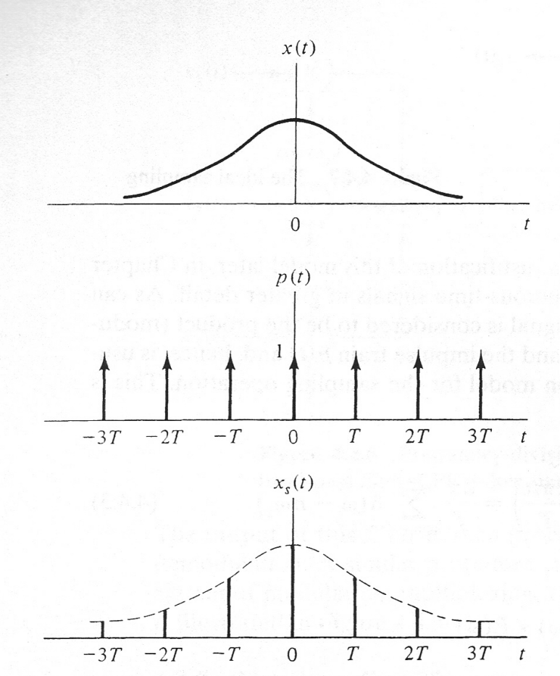

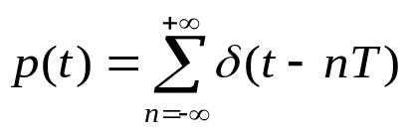

APPLICATION: SAMPLING THEOREM
Sampling theorem: time domain
  Sampling: convert the continuous-time signal to discrete-time signal.
sampling period

Slide 22
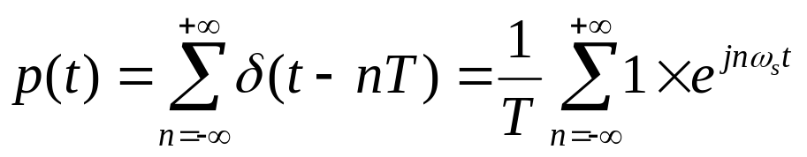
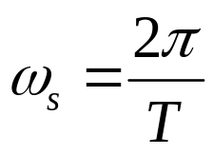
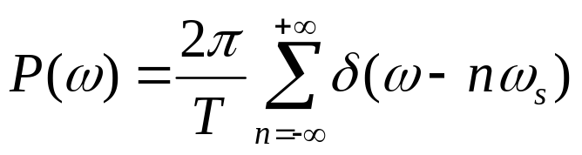
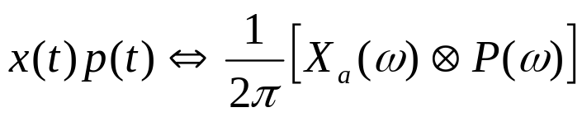
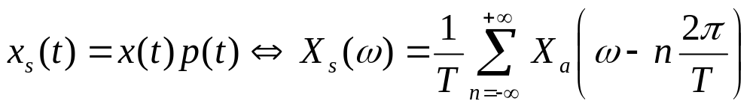
APPLICATION: SAMPLING THEOREM
Sampling theorem: frequency domain
  Fourier transform of the impulse train
    impulse train is periodic
Fourier series
    Find Fourier transform on both sides
    Time domain multiplication ➔ Frequency domain convolution

Slide 23
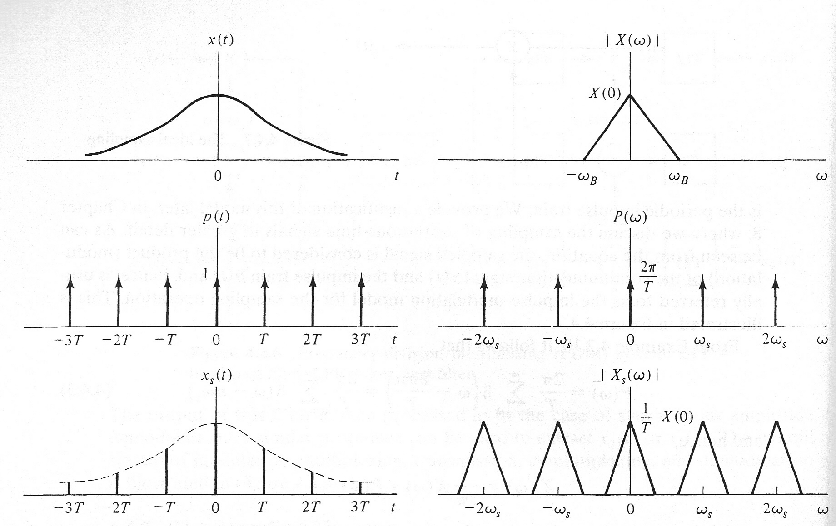
APPLICATION: SAMPLING THEOREM
Sampling theorem: frequency domain
  Sampling in time domain ➔ Repetition in frequency domain

Slide 24

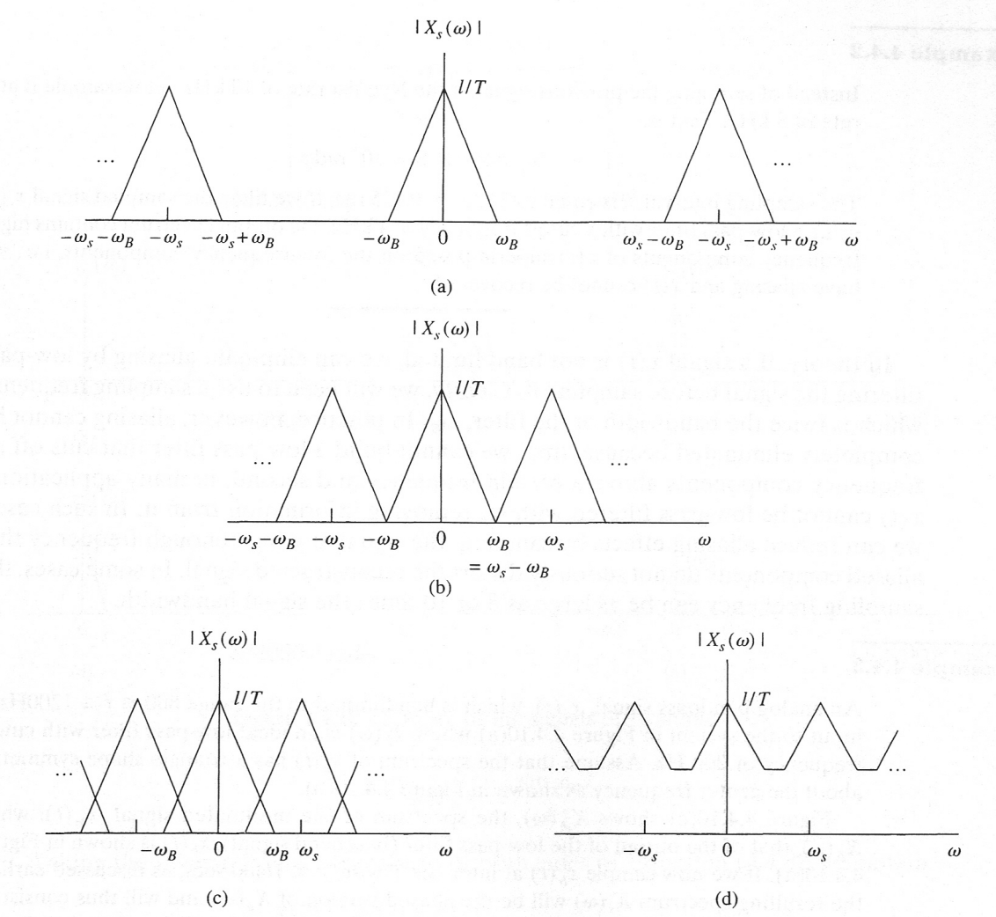


APPLICATION: SAMPLING THEOREM
Sampling theorem
  If the sampling rate is twice of the bandwidth, then the original signal can be perfectly reconstructed from the samples.
aliasing
Department of Engineering Science
Sonoma State University

Slide 25




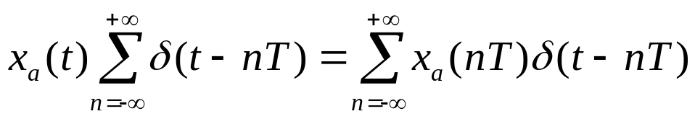
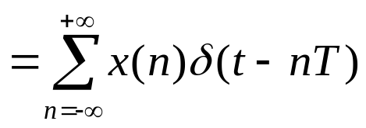

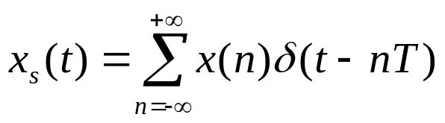
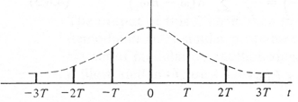
APPLICATION: SAMPLING THEOREM
Analog signal v.s. sampled signal v.s. discrete-time signal
Discrete-time signal
Samples of continuous-time signal

Slide 26
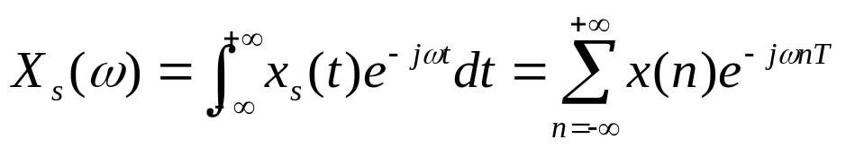
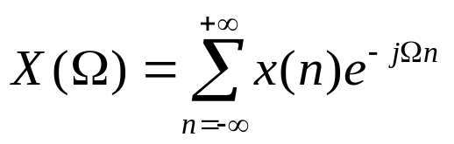
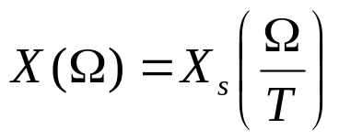
APPLICATION: SAMPLING THEOREM
Fourier transform of sampled signal
DTFT of discrete-time signal
Relationship
DTFT of discrete-time signal
Fourier transform of continuous-time signal

Slide 27

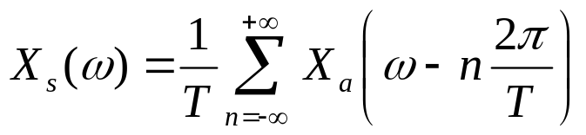
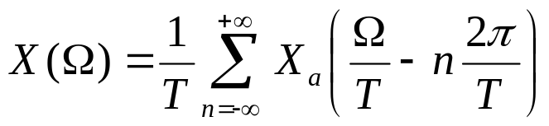
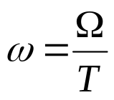
APPLICATION: SAMPLING THEOREM
Relationship among

Slide 28



APPLICATION: SAMPLING THEOREM
Example
  Consider the analog signal with Fourier transform shown in the figure. The signal has a one-sided bandwidth 5 Hz. The signal is sampled with a sampling period .
  Draw and
1
Notes:
w_0= 5*2pi = 10 pi
w_s = 2*pi/(25e-3) = 80 pi
Omega_0 = 10 pi*25e-3= 0.25 pi

Slide 29

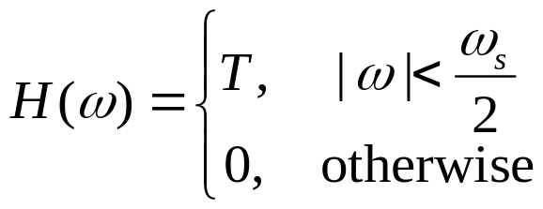
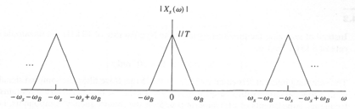
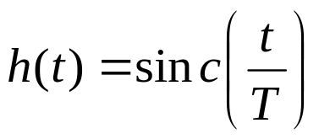
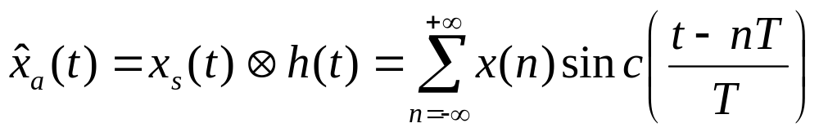
APPLICATION: SAMPLING THEOREM
Reconstruction of sampled signal
  If there is no aliasing during sampling, the analog signal can be reconstructed by passing the sampled signal through an ideal low pass filter with cutoff frequency

Slide 30
OUTLINE
The Discrete-Time Fourier Transform (DTFT)
Properties
Application: DTFT of Sampled Signals
Upsampling and downsampling

Slide 31





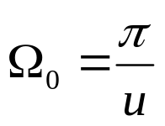

UPSAMPLING AND DOWNSAMPLING
Sampling rate conversion
  In many applications, we may have to change the sampling rate of a signal as the signal undergoes successive stage of processing.
    E.g.
Rate
conversion
Sampling period
  If is a low pass filter with the cut-off frequency being
  then what is the largest value of ?
Notes:
W0 = Omega0/T1=pi/(uT1)
2pi/T2 >= 2w0 = 2pi/(uT1)
T2 <= uT1

Slide 32
UPSAMPLING AND DOWNSAMPLING
Sampling rate conversion
  Sampling rate conversion can be directly performed in the digital domain
  Downsampling (decimation)
    Reduce the sampling frequency (less samples per unit time)
  Upsampling (interpolation)
    Increase the sampling frequency (more samples per unit time)

Slide 33











UPSAMPLING AND DOWNSAMPLING
Downsampling (decimation)
  Assume a digital signal, , is obtained by sampling an analog signal at a sampling period T (or a sampling frequency 1/T).
  The signal can also be sampled with a sampling period MT (or a lower sampling frequency 1/(MT) )
  Relationship between and
  is the downsampled (or decimated) version of
    can be obtained by picking one sample out of every M consecutive samples of x(n) → decimation.

Slide 34
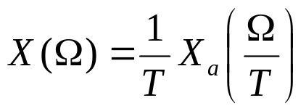


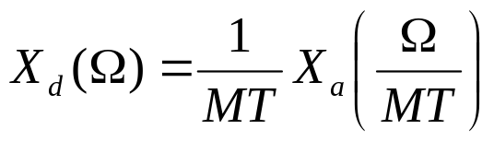
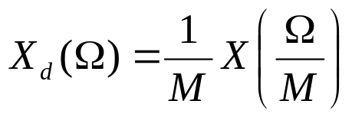
UPSAMPLING AND DOWNSAMPLING
Downsampling (decimation): frequency domain
  Assume all the sampling rates are higher than the Nyquist sampling rate
  The DTFT of x(n) with a sampling period T
  The DTFT of with a sampling period MT

Slide 35
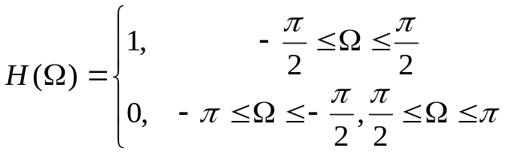
UPSAMPLING AND DOWNSAMPLING
Example
  Consider the frequency response of an ideal low pass filter
    Determine h(n)
    If we downsample h(n) with a factor of M = 2. Find the downsampled response in both the time and frequency domains.
Notes:
X_d(Omega) = 1/M X(Omega/M)

Slide 36











UPSAMPLING AND DOWNSAMPLING
Upsampling (interpolation)
  Assume a digital signal, , is obtained by sampling an analog signal at a sampling period T (or a sampling frequency 1/T).
  Upsampling by a factor of L
    Inserting L-1 zeros between the original samples
  The effective sampling period of the upsampled signal (sampling rate: )

Slide 37

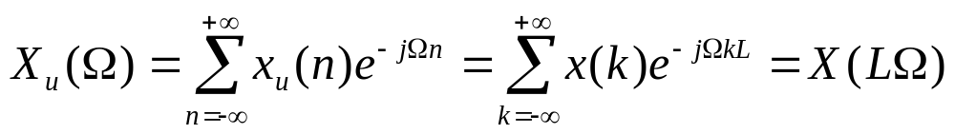

UPSAMPLING AND DOWNSAMPLING
Upsampling (interpolation): frequency domain
  The DTFT of with a sampling period T/L
    The DTFT of is compressed in the frequency domain

Slide 38
UPSAMPLING AND DOWNSAMPLING
Example
  A discrete pulse is given by x(n) = u(n)-u(n-4). Suppose we upsample x(n) by a factor of L = 3. Find the DTFT of the original and upsampled signals.
Notes:
Xu(Omega) = X(L Omega)

