Slide 1
ELEG 5173L Digital Signal Processing
Ch. 4 The Discrete Fourier Transform
Dr. Jingxian Wu
wuj@uark.edu

Slide 2
OUTLINE
The Discrete Fourier Transform (DFT)
Properties
Fast Fourier Transform
Applications

Slide 3
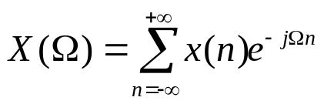






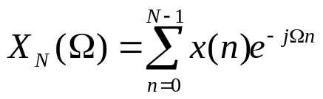
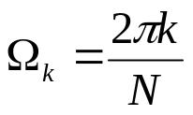


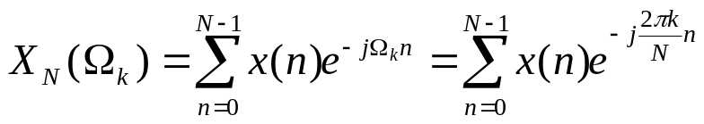
DISCRETE FOURIER TRANSFORM (DFT)
Review DTFT: Discrete-time Fourier transform
  Limitations for computer implementation:
    1. Infinite number of time domain samples
      Requires infinite memory
    2. is a continuous variable
      We can only approximate in a computer
  Possible solutions:
    1. limit the number of time domain samples
    2. Sample in the frequency domain:

Slide 4
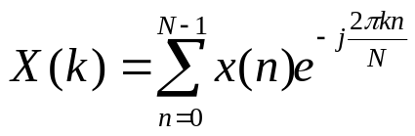

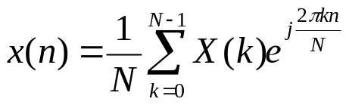
DISCRETE FOURIER TRANSFORM (DFT)
Discrete Fourier Transform (DFT)
  Finite number time domain samples
  Discrete frequency domain signal
Inverse Discrete Fourier Transform (IDFT)

Slide 5


DFT
Periodicity in the frequency domain
  Recall: the DTFT is periodic
  The DFT is periodic with period N
    Proof
  Time domain sampling leads to frequency domain repetition.

Slide 6

DFT
Periodicity in the time domain
  The time domain signal from the IDFT is also periodic with period N
  Proof
  frequency domain sampling leads to time domain repetition.

Slide 7



DFT
Example
  Find the DTFT of
  Find the DFT of
  Plot the DTFT, and plot the DFT when N = 5, 10, 20, and 50, respectively.
Notes:
a_1(1-q^N)/(1-q)

Slide 8

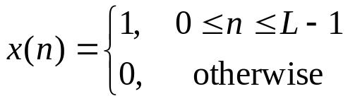
DFT
Example
  A finite-duration sequence of length L is given as follows. Find the N-point DFT of this sequence for . Plot the frequency response.

Slide 9
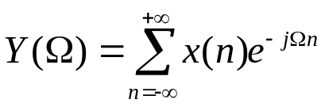
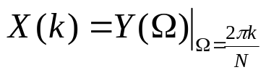
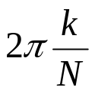
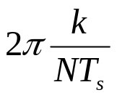
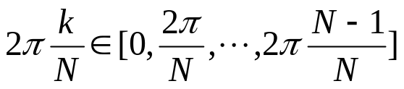
DFT
Relationship between DFT and DTFT
  DFT
  DTFT
  Relationship
    DFT index k → angular digital frequency radians
    DFT index k → angular analog frequency radians/sec

Slide 10
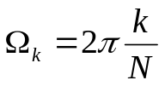
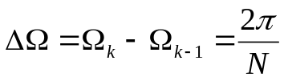
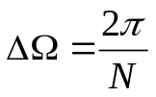
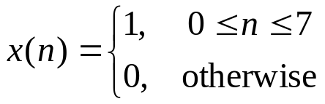
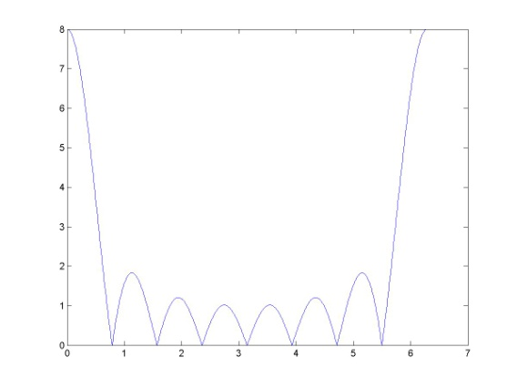
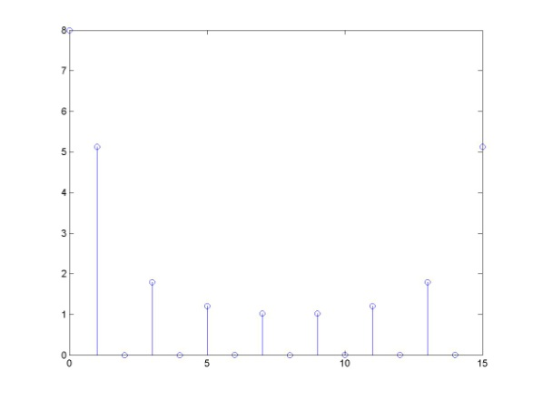
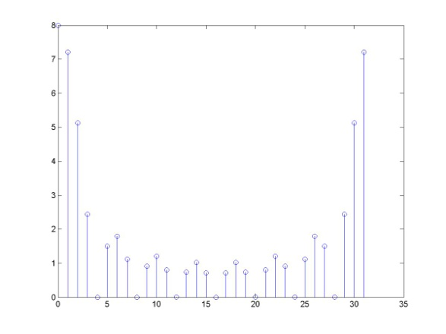
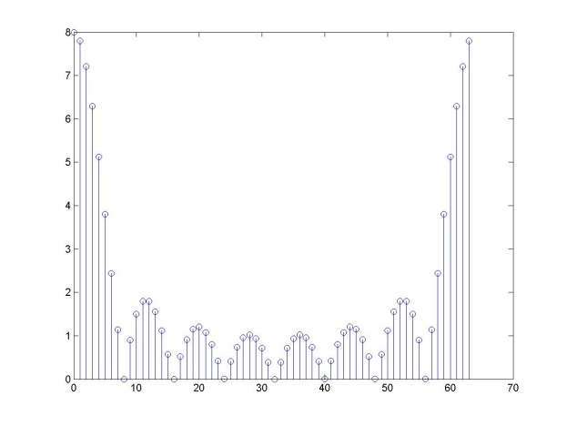
DFT
Frequency domain resolution
  Freq. domain resolution: Space between 2 freq. domain samples
  Larger N → smaller → better frequency domain resolution
  Example:
DTFT
DFT N=32
DFT N=64
DFT N=16

Slide 11
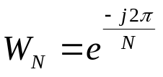
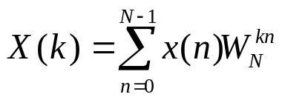

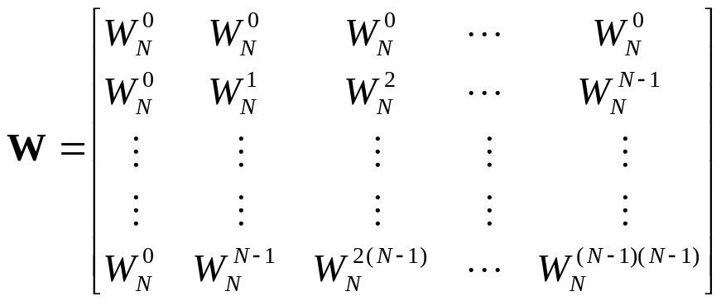
DFT
Matrix representation of DFT
  DFT: let
  Define DFT matrix
    The ( k+1, n+1)-th element is

Slide 12
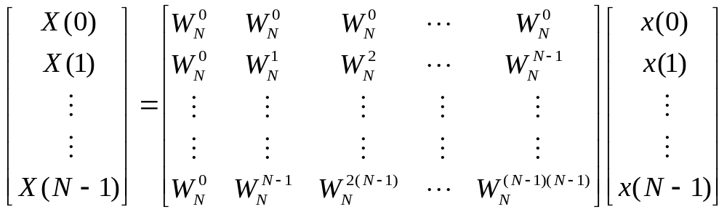

DFT
Matrix representation of DFT

Slide 13
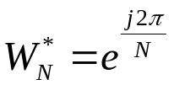
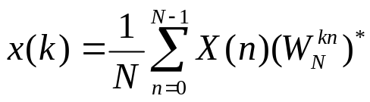

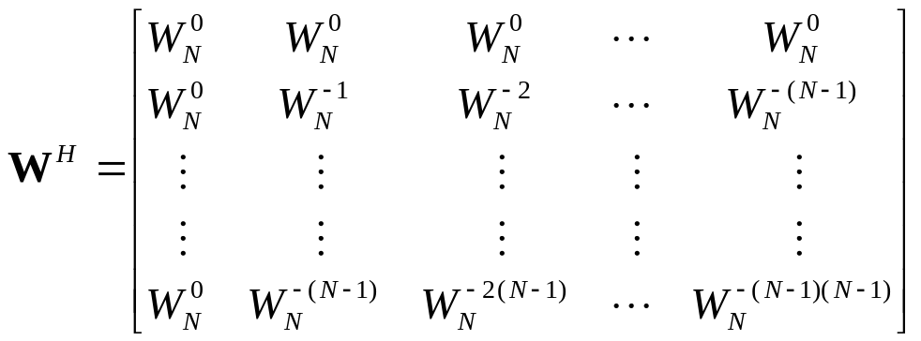

DFT
Matrix representation of IDFT
  DFT: let
  Define IDFT matrix
    The ( k, n)-th element is
    : the complex transpose of W (transpose the matrix, then take the complex conjugate of all the elements)

Slide 14
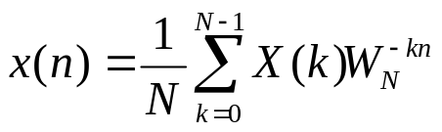
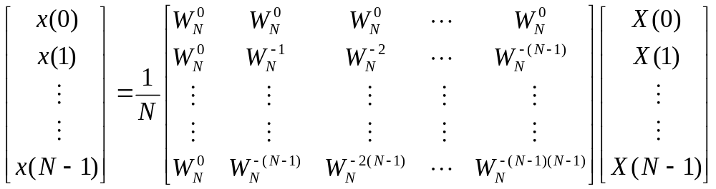
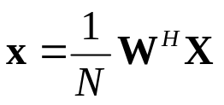
DFT
Matrix representation of IDFT

Slide 15
OUTLINE
The Discrete Fourier Transform (DFT)
Properties
Fast Fourier Transform
Applications

Slide 16





PROPERTIES
Linearity
Periodicity
  If
  Then

Slide 17










PROPERTIES
Circular shift
  circular shifting a length-N signal, x(n), to the right by positions
  Example: N = 4
  , where p is an integer chosen such that
  Why circular shift?
    Recall: in DFT, x(n) is periodic in N

Slide 18
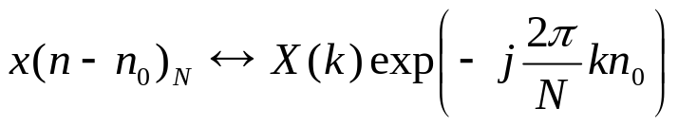
PROPERTIES
Time shifting
  If
  Then
  This is a circular shift
    because x(n) is periodic in N

Slide 19

PROPERTIES
Example
  Consider a sequence
  Find the DFT
  If we circular shift x to the right by two locations, find the new sequence and its DFT

Slide 20
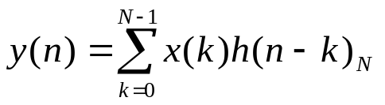









PROPERTIES
Circular convolution
  The circular convolution between two length-N sequences x(n) and h(n) is
  Graphical interpretation for N = 4

Slide 21


PROPERTIES
Example
  Find the circular convolution of the following two sequences

Slide 22


PROPERTIES
Example
  Find the circular convolution of the two sequences

Slide 23
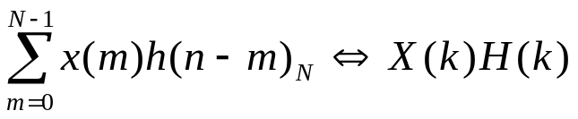
PROPERTIES
Circular convolution and DFT
  Consider two length-N sequences x(n) and h(n). There N-point DFTs are X(k) and H(k), respectively.
  Circular convolution in the time domain is equivalent to multiplication in the discrete frequency domain

Slide 24
PROPERTIES
Example
  Find the circular convolution of the two sequences by using DFT
Example
  Find the circular convolution of the
Notes:
X(k) = [6 0 2 0]
H(k) = [10, -2+2j, -2, -2-2j]
Y(k) = [60, 0, -4, 0]
y(n) = [14 16 14 16]

Slide 25
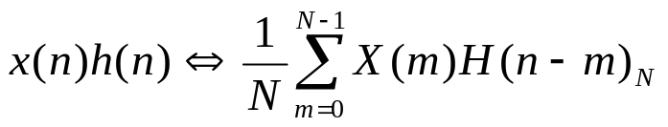
PROPERTIES
Multiplication of two sequences
  Consider two length-N sequences x(n) and h(n). Their N-point DFTs are X(k) and H(k), respectively.
  Multiplication in the time domain is equivalent to circular convolution in the discrete frequency domain

Slide 26


PROPERTIES
Example
  Consider two length-N sequences. Find the circular convolution of their 4-point DFTs.
Notes:
Y(n) = [6, 6, 5, 12]
Y(k) = [29, 1+6j, -7, 1-6j]
X(k) N H(k) = Y(k)*4

Slide 27


PROPERTIES
Time-reversal
  If the N-point DFT of x(n) is X(k), then
  Example
    If the 6-point DFT of x(n) is X(k) = [3, -2, 4, -1, 5]. Find the DFT of

Slide 28
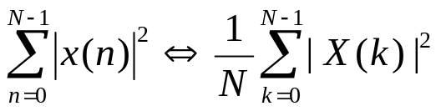
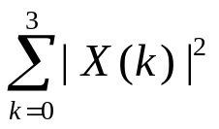

PROPERTIES
Parseval’s theorem
  If the N-point DFT of x(n) is X(k), then
  Example
    If , find

Slide 29
OUTLINE
The Discrete Fourier Transform (DFT)
Properties
Fast Fourier Transform
Applications

Slide 30


FFT
Fast Fourier Transform (FFT)
  A faster implementation of DFT (NOT a new transform!)
  The result is exactly the same as DFT, just the implementation is faster.
Complexity of DFT
  For each k, there are N complex multiplications
  The above formula needs to be performed N times for k = 0, 1, …, N-1
  Total number of complex multiplications:
  Total number of complex multiplications for FFT:

Slide 31
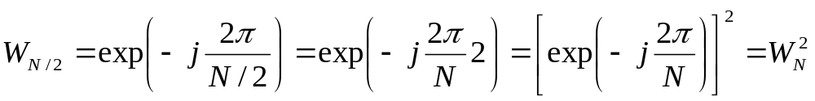


FFT
FFT
  There are many different ways of implementing FFT
    Decimation in time
    Decimation in frequency
    …
  It utilizes the following property

Slide 32
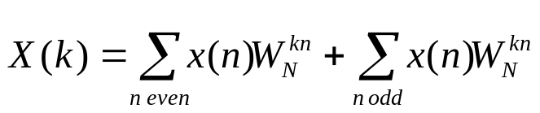
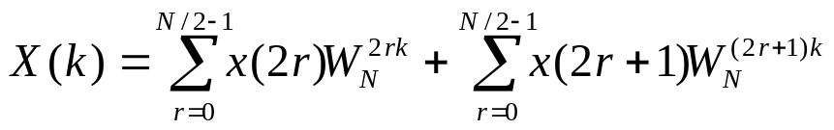


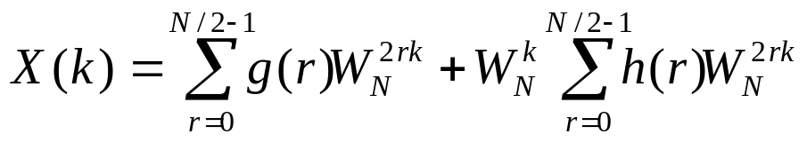
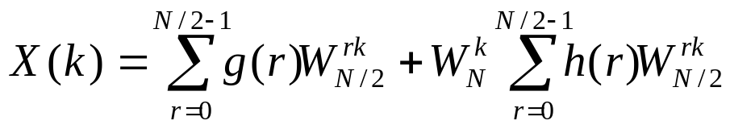

FFT
FFT: decimation in time
let

Slide 33





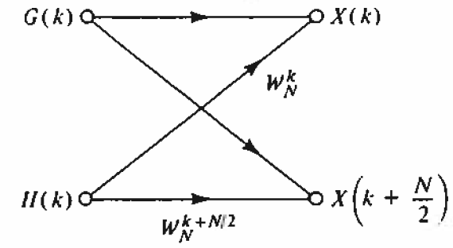
FFT
FFT: decimation in time (cont’d)
  G(k) is the N/2-point DFT of the even-indexed samples
  H(k) is the N/2-point DFT of the odd-indexed samples
  Based on periodicity
  Butterfly

Slide 34
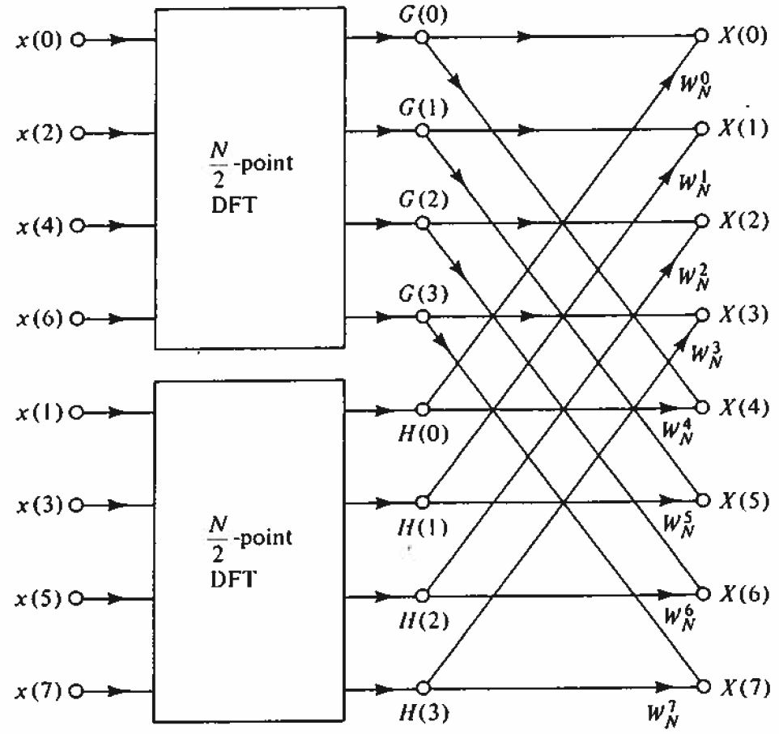
FFT
FFT: decimation in time
  The N-point DFT is decomposed into:
    2 N/2-point DFTs
    N complex multiplications

Slide 35
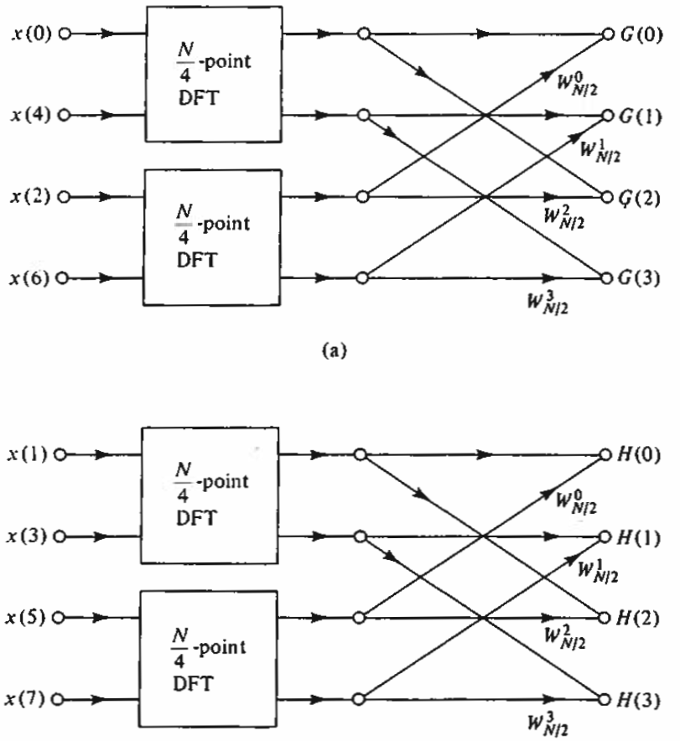
FFT
FFT: decimation in time
  Each N/2-point DFT can be decomposed into
    2 N/4-point DFTs
    N/2 complex multiplications

Slide 36
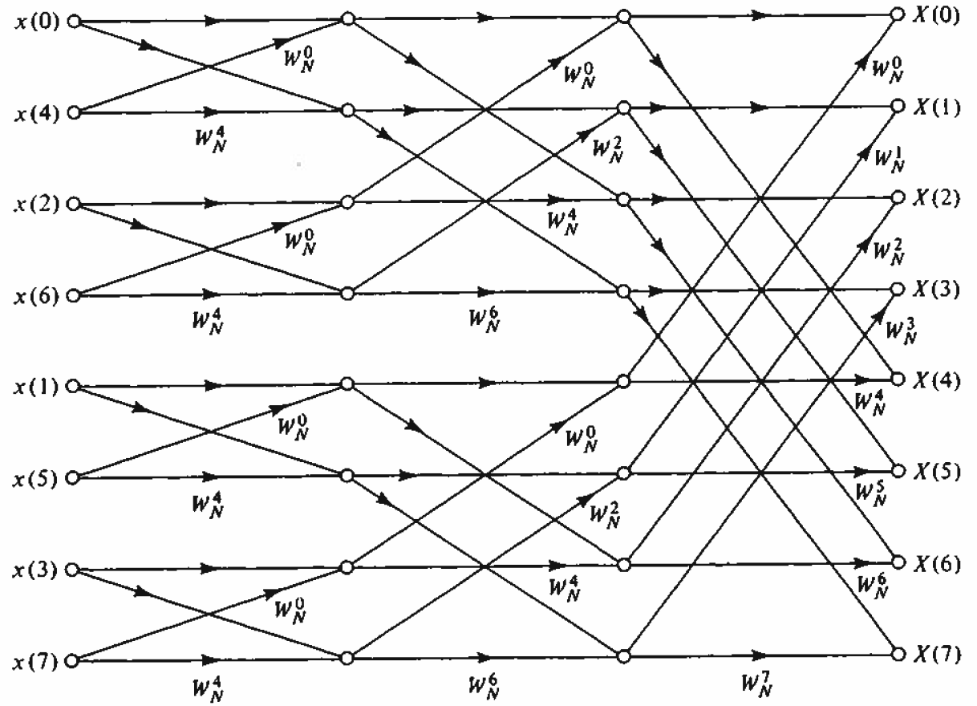


FFT
FFT: Decimation in time
  Example 8-point FFT
  Each stage requires N complex multiplications
  There are stages
  Total number of complex multiplications

Slide 37
OUTLINE
The Discrete Fourier Transform (DFT)
Properties
Fast Fourier Transform
Applications

Slide 38
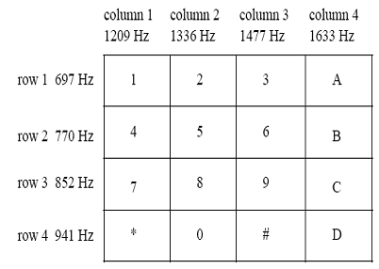
APPLICATIONS
Dual-tone multi-frequency (DTMF)
  In the touch tone telephone, pressing each key on the telephone will generate a DTMF signal
    The signal contains two frequencies

Slide 39
APPLICATIONS
DTMF
  Example
    There is a DTMF signal with sampling frequency Fs = 8 KHz. The duration of the signal is 0.4 s. Performing FFT on the signal, and there are two peaks in the frequency domain at k = 308 and k = 484
    How many samples are in the signal?
    What is the resolution of the analog freuqency (in Hz)?
    What are the analog frequencies (in Hz) corresponding to the two peaks?
Notes:
0.4/(1/8000) = 3200
Omega = 2*pi/N*Fs, F = Omega/(2pi) = Fs/N = 8000/3200 = 2.5 Hz
k/N*Fs = 308/3200*8000 = 770 Hz
k/N*Fs = 484/3200*8000 = 1210 Hz

Slide 40
APPLICATIONS
DTMF
  Example
    There is a DTMF signal with sampling frequency Fs = 8 KHz. The duration of the signal is 0.5 s. The signal is generated by pressing the key ‘9’. Performing FFT on the signal. Which digital frequency indices (k) corresponding to the peaks in the frequency domain?
Notes:
N = 0.5*8000 = 4000
F1 = 852
F2 = 1477
F1 = k1/N*8000 → k1 = F1*N/Fs = 852*4000/8000 = 426
K2 = F2*N/Fs = 1477*4000/8000 = 738.5 = 739

