Slide 1
ELEG 5173L Digital Signal Processing
Ch. 5 Digital Filters
Dr. Jingxian Wu
wuj@uark.edu

Slide 2
OUTLINE
FIR and IIR Filters
Filter Structures
Analog Filters
FIR Filter Design
IIR Filter Design

Slide 3
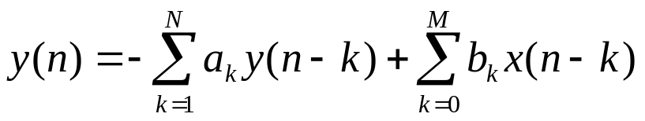
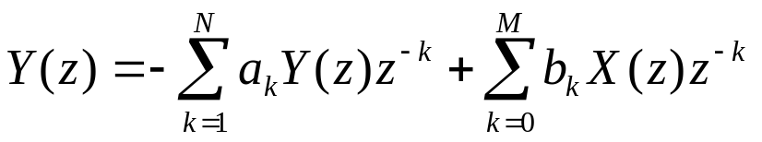
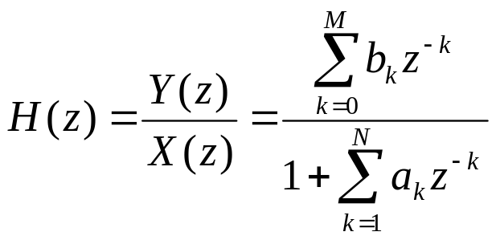
FIR V.S. IIR
LTI discrete-time system
  Difference equation in time domain
  Transfer function in z-domain

Slide 4
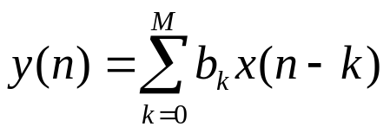
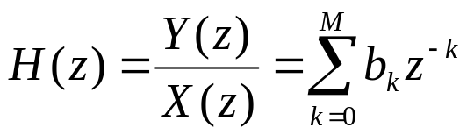

FIR V.S. IIR
Finite impulse response (FIR)
  difference equation in the time domain
  Transfer function in the Z-domain
  Impulse response
    The impulse response is of finite length → finite impulse response

Slide 5


FIR V.S. IIR
Infinite impulse response (IIR)
  Difference equation in the time domain
  Transfer function in the z-domain
  Impulse response can be obtained through inverse-z transform, and it has infinite length
Notes:
1/(1-az^{-1}) ←→ a^n u(n)

Slide 6
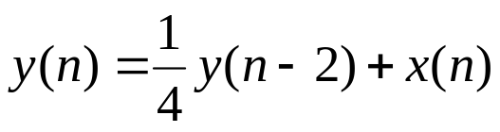
FIR V.S. IIR
Example
  Find the impulse response of the following system. Is it a FIR or IIR filter? Is it stable?
Notes:
1/(1-1/4*z^(-2))
stable

Slide 7
FIR V.S. IIR
Example
  Find the impulse response of the following system. Is it a FIR or IIR filter? Is it stable?
Notes:
H(z) = 1-2z^(-2)+5z^(-3)
H(n) = delta(n) – 2 delta(n-2) + 5 delta(n-3)

Slide 8
OUTLINE
FIR and IIR Filters
Filter Structures
Analog Filters
FIR Filter Design
IIR Filter Design

Slide 9
FILTER STRUCTURE: FIR
A FIR filter can be implemented in different structures
  Direct-form structure
  Cascade-form structure
  Lattice structure
  Frequency sampling
  ……

Slide 10
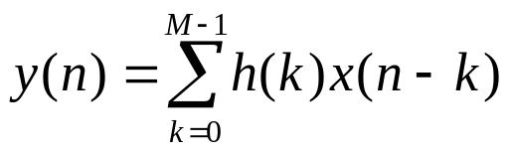
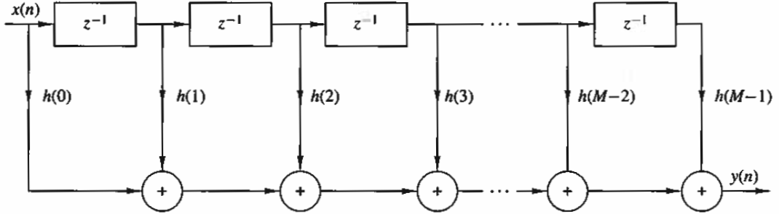
FILTER STRUCTURE: FIR
FIR: Direct-form
  Also called tapped-delay-line filter, or transversal filter
Order of the filter: M

Slide 11


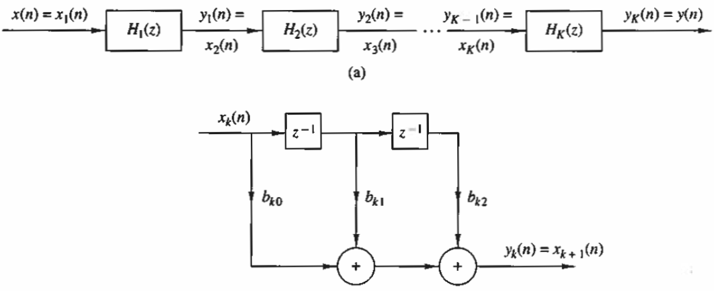
FILTER STRUCTURE: FIR
FIR: Cascade-form
  Factor the transfer function into the product of second-order FIR systems
    Where

Slide 12

FILTER STRUCTURE: FIR
Example
  Draw the direct-form and cascade-form structures of the following filter

Slide 13
FILTER STRUCTURE: IIR
An IIR filter can be implemented in various structures
  Direct-form I
  Direct-form II
  Transposed structure
  Cascade-form structure
  Parallel-form structure
  Lattice structure
  ……

Slide 14
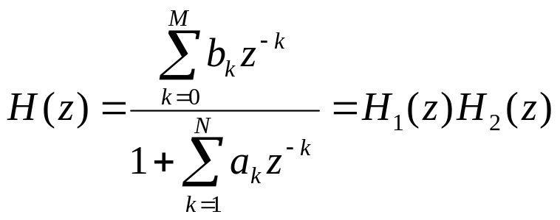
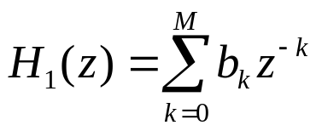
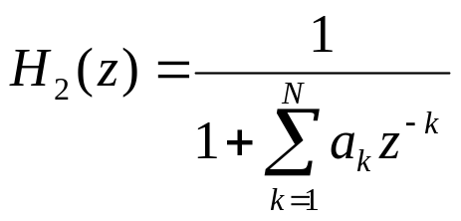
FILTER STRUCTURE: IIR
IIR: Direct-form I

Slide 15
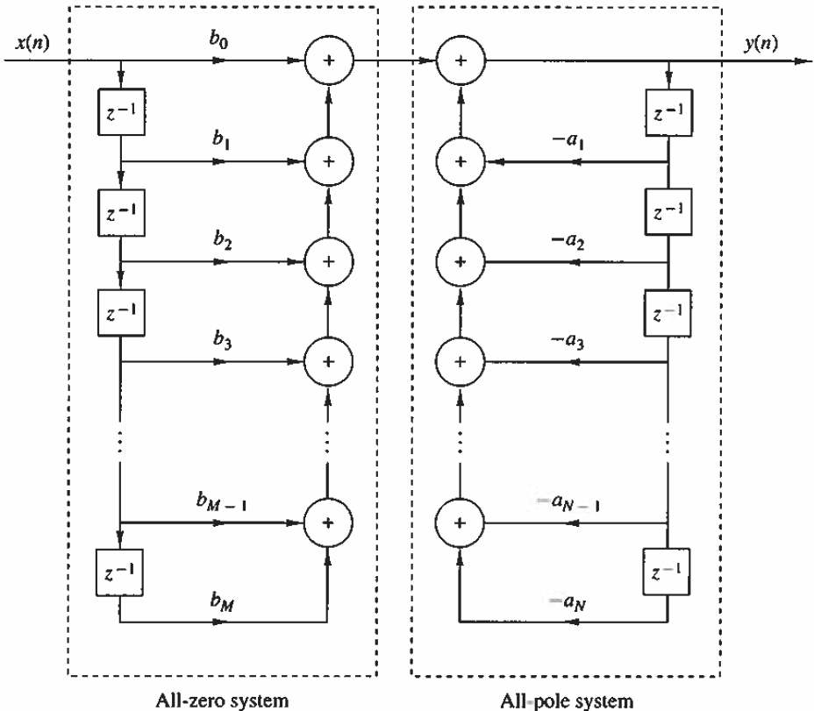


FILTER STRUCTURE: IIR
IIR: Direct-form I

Slide 16



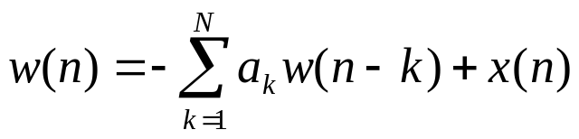
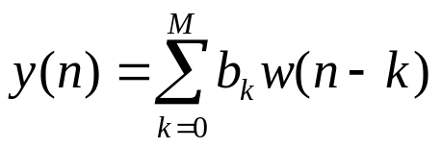
FILTER STRUCTURE: IIR
IIR: Direct-form II
  Put before
    Difference equation of
    Difference equation of
    Both involve the delay of w(n)

Slide 17
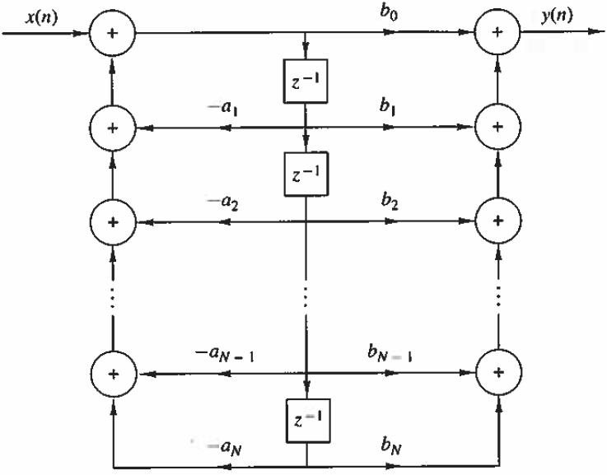
FILTER STRUCTURE: IIR
IIR: Direct-form II

Slide 18
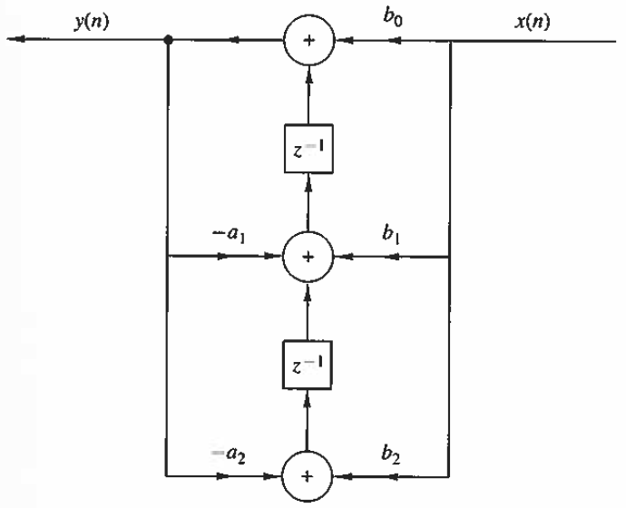
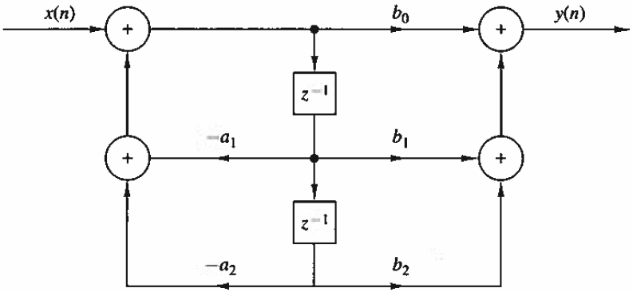
FILTER STRUCTURE: IIR
IIR: Transposed structure
  Transposition theorem: For a given filter structure, if we apply the following transposition: (1) reverse the direction of all signal flows; (2) replace all the adders with intersections, and vice versa; and (3) interchange the input and output, then the transposed system is the same as the original system.

Slide 19
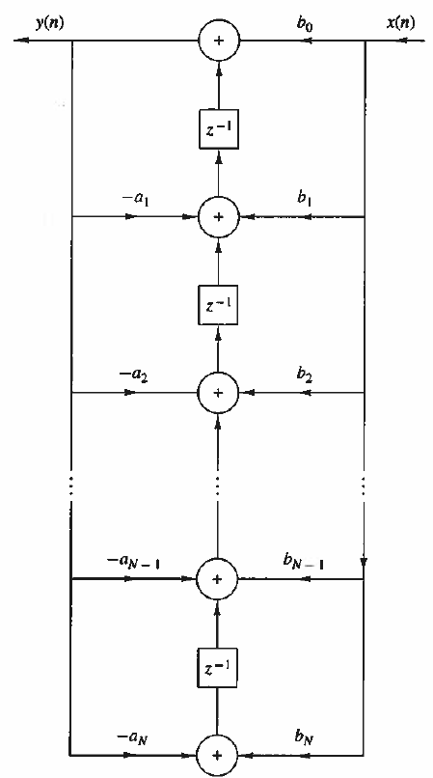
FILTER STRUCTURE: IIR
IIR: transposed structure of direct-form II

Slide 20
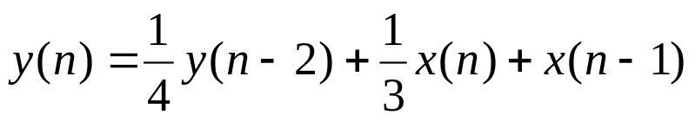
FILTER STRUCTURE
Example
  Draw the direct-form I, direct-form II, and transposed direct-form II of the filter

Slide 21
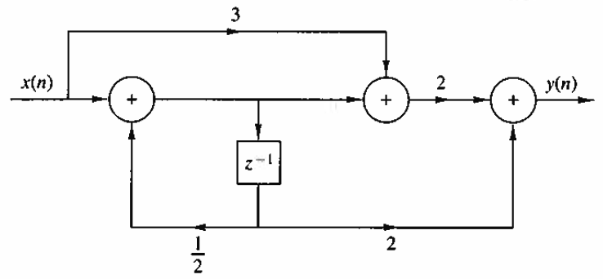
FILTER STRUCTURE
Example
  Find the difference equation and transfer function of the filter
  Represent the filter in direct-form II
Notes:
W(z) = X(z)+1/2*W(z)/z → W(z) = X(z)/(1-1/2*1/z)
Y(z) = 2*W(z)/z+2(3X(z)+W(z))

Slide 22
OUTLINE
FIR and IIR Filters
Filter Structures
Analog Filters
FIR Filter Design
IIR Filter Design

Slide 23
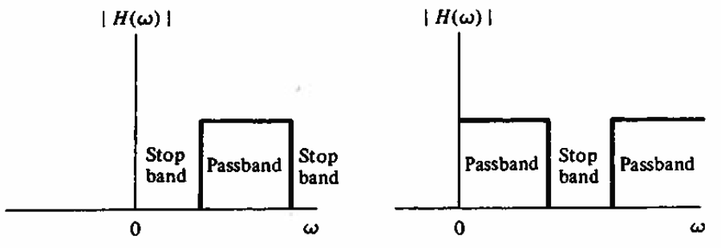
ANALOG FILTERS
Ideal filter
  Ideal analog filter
  Ideal digital filter
  In practice, we cannot implement filter characteristics with abrupt transitions
    E.g. the impulse response of ideal low pass filter is sinc(t), which is non-causal.

Slide 24




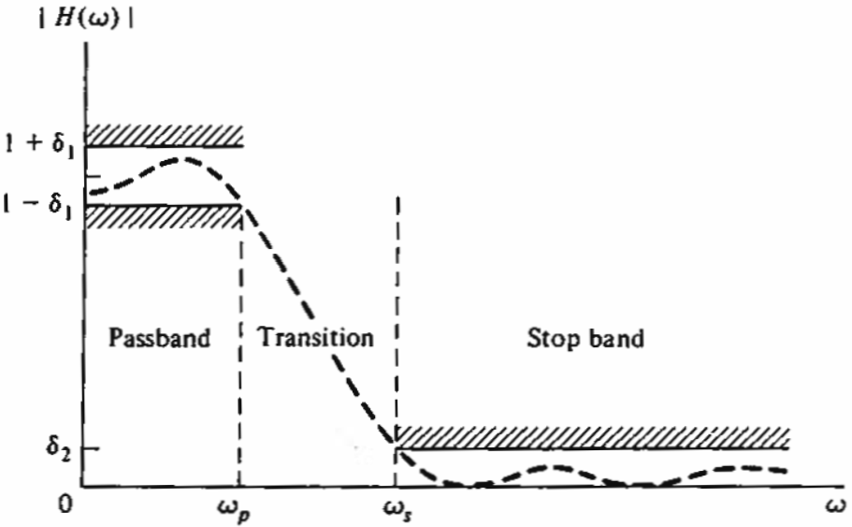
ANALOG FILTERS
Practical low pass filter
  Passband cutoff frequency:
  Stop band cutoff frequency:

Slide 25
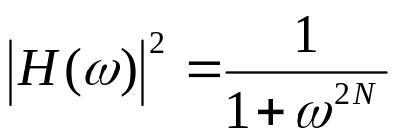
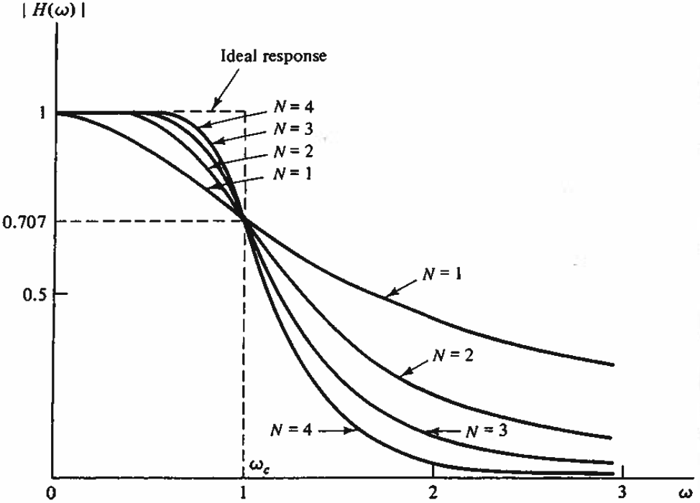
ANALOG FILTERS
Butterworth filter

Slide 26
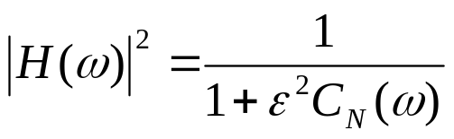
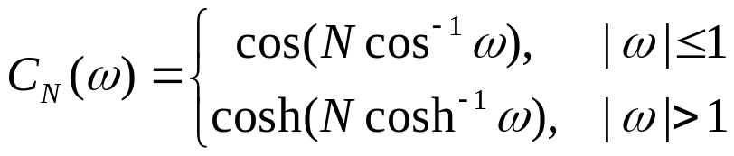
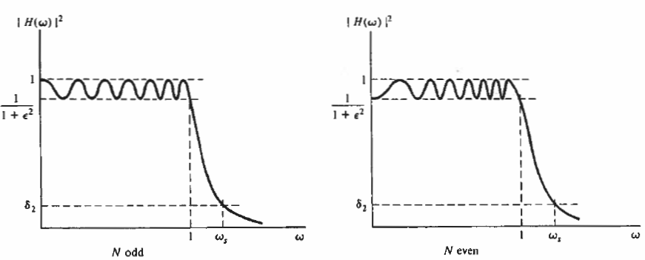
ANALOG FILTERS
The Chebyshev Filter

Slide 27
OUTLINE
FIR and IIR Filters
Filter Structures
Analog Filters
FIR Filter Design
IIR Filter Design

Slide 28




FIR FILTER DESIGN
Linear phase filter
  A filter is called a linear phase filter if its transfer function can be expressed as
    Where A is a constant
    The phase: , is a linear function of
  Example
    Is the following filter a linear phase filter?

Slide 29

FIR FILTER DESIGN
Linear phase filter (Cont’d)
  A linear phase filter introduces the same amount of delay, A, to all the frequencies (the same group delay)
    If the phase is not linear, then frequency components at different frequencies will experience different delays → phase distortion
  A subset of FIR filters can have linear phase
    IIR filters do not have linear phase → IIR filter will introduce phase distortion
    Not all FIR filters have linear phase

Slide 30

FIR FILTER DESIGN
Linear phase filter
  If a length-N FIR filter is symmetric with the middle of the filter, i.e.
    Then the filter has linear phase
  Example
  h(n) = [1 2 3 3 2 1], h(n) = [1 2 3 4 3 2 1], h(n) = [2, 0, 0, 2]
  Proof
Notes:
H(w) = \sum_{n=0}^{N/2-1} h(n) exp(-j2 pi n w) + \sum_{n=N/2}^{N-1} h(n) exp(-j2 pi n w)
= \sum_{n=0}^{N/2-1} h(n) exp(-j2 pi n w) + \sum_{m=0}^{N/2-1} h(N-1-m) exp(-j2 pi (N-1-m) w)
= \sum_{n=0}^{N/2-1} h(n) exp(-j2 pi n w) + \sum_{n=0}^{N/2-1} h(n) exp(j2 pi n w)exp(-j2 pi (N-1) w)
= \sum_{n=0}^{N/2-1} h(n) [ exp(-j2 pi n w) + exp(j2 pi n w) exp(-j2 pi (N-1) w) ]
= exp(-j 2 pi (N-1)/2 w) \sum_{n=0}^{N/2-1} h(n) [ exp(-j2 pi n w) exp(j2 pi (N-1)/2 w) + exp(j2 pi n w) exp(-j2 pi (N-1)/2 w)]
= exp(-j 2 pi (N-1)/2 w) \sum_{n=0}^{N/2-1} h(n) 2 cos (2 pi (n+(N-1)/2) w)
Phase(H(w)) = exp(-j 2 pi (N-1)/2 w)

Slide 31



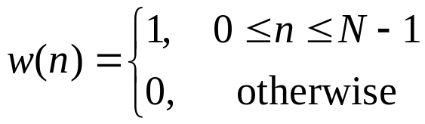

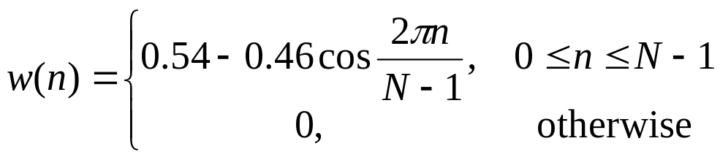
FIR FILTER DESIGN
FIR filter design with window
  1. Find the desired frequency response (DTFT)
  2. Perform Inverse DTFT, find the impulse response
    The impulse response usually has infinite length
  3. truncate to finite length by multiplying it with a window function
    E.g. rectangular window
    Different windows can be used to reduce the negative effects of truncation
      Rectangular window, Hamming window, Hanning window, Bartlett window, Kaiser window, etc.
      Hamming window

Slide 32

FIR FILTER DESIGN
Example
  Design a 9-point FIR filter to approximate a low pass filter with cut-off frequency
Notes:
0.2sinc(0.2n)

Slide 33
FIR FILTER DESIGN
Example
% order of the filter
N = 9;
% cut-off frequency
Omega_c = 0.2*pi;
n = [-(N-1)/2:(N-1)/2];
% impulse response
hdn = Omega_c/pi*sinc(Omega_c/pi*n);
%wd = window(@rectwin, N).';
wd = window(@hamming, N).';
hn = hdn.*wd;

Slide 34
OUTLINE
FIR and IIR Filters
Filter Structures
Analog Filters
FIR Filter Design
IIR Filter Design

Slide 35



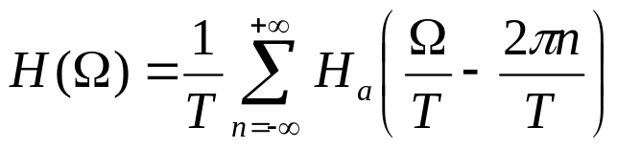

IIR FILTER DESIGN
IIR Filter design methods
  1. impulse invariance
  2. bilinear transformation
Method 1: Impulse invariance
  Directly sample the impulse response of an analog filter
  If the impulse response and frequency response of the analog filter are
    Then the impulse response and DTFT of the IIR filter are
      It will cause spectrum aliasing if the analog filter has a bandwidth larger than

Slide 36





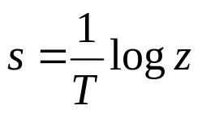
IIR FILTER DESIGN
Method 1: Impulse invariance
  Analog filter:
  Digital filter:
  Relationship between s and z
Notes:
Omega = wT
Z = exp(j Omega) = exp(j w T) = exp(sT)

Slide 37





IIR FILTER DESIGN
Method 2: Bilinear transformation
  Use bilinear transformation to overcome aliasing
  Procedure:
    1. From the digital filter specifications, find the corresponding analog filter specifications by using the bilinear transformation
    2. Find the corresponding analog filter
    3. Find the equivalent digital filter

Slide 38
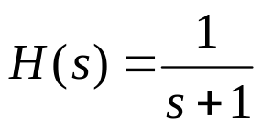
IIR FILTER DESIGN
Example
  If the transfer function of an analog filter is
    Find the equivalent digital filter by using bilinear transformation. Assume the sampling frequency is 1000 Hz

Slide 39
IIR FILTER DESIGN
Example
% analog Butterworth filter, in the form of zeros and poles
% cut-off frequency 1 rad/s
[z,p,k] = buttap(2); % creates a 2-pole Butterworth filter
% transfer function
[num,den] = zp2tf(z,p,k); % poles & zeros to transfer function
% need to transform the cutoff frequency to 100 Hz (200 rad/sec)
wc = 200*pi;
[num,den] = lp2lp(num,den,wc);
% sampling frequency 1000 Hz
Fs = 1000;
% generate the digital filter with the bilinear transformation
[numd,dend] = bilinear(num,den,Fs);
freqz(numd, dend)

