Slide 1
ELEG 5173L Digital Signal Processing
Introduction to TMS320C6713 DSK
Dr. Jingxian Wu
wuj@uark.edu

Slide 2
ANALOG V.S DIGITAL
Analog signal processing (ASP)
  Analog signal processing is achieved by using analog components such as:
    Resistor, capacitor, inductor
  Sensitive to
    inherent tolerances, temperature, voltage changes and mechanical vibrations
    They can dramatically affect the effectiveness of the analogue circuitry
Digital signal processing (DSP)
  High precision
  High tolerance to noise
  Short development time
  High flexibility
  Low power consumption
Digital signal processing techniques are now so powerful that sometimes it is extremely difficult, if not impossible, for analogue signal processing to achieve similar performance.

Slide 3
DSP
Digital Signal Processor (DSP)
  A digital signal processor is a specialized microprocessor with an architecture optimized for the fast operational needs of digital signal processing
  It is a special type of microprocessor
    Have instructions designed specifically for digital signal processing
Use a DSP when the following are required:
  Cost saving.
  Smaller size.
  Low power consumption.
  Processing of many “high” frequency signals in real-time.
Use a general purpose microprocessor (e.g. Intel Core 2 Duo) when the following are required:
  Large memory.
  Advanced operating systems.

Slide 4
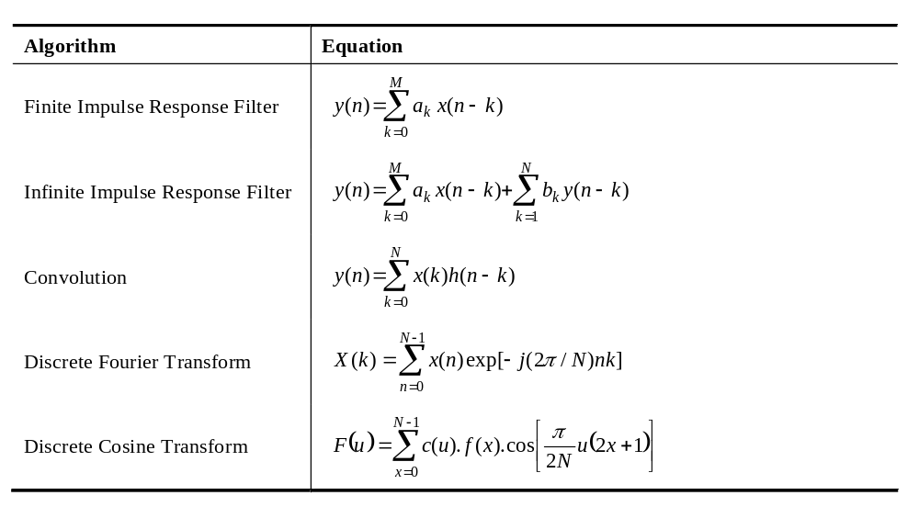
DSP
DSP
  The key operation in digital signal processing is sum of products (SOP) or multiply and accumulation (MAC)

Slide 5
DSP
DSP are optimized for MAC operations
  Multiplication and addition are done in hardware and in one cycle.
  Example: 4-bit multiply (unsigned).
Hardware
Microcode
1011
x 1110
1011
x 1110
10011010
0000
Cycle 1
1011.
Cycle 2
1011..
Cycle 3
1011...
Cycle 4
10011010
Cycle 5
DSP
general purpose microprocessor

Slide 6
TEXAS INSTRUMENTS’ TMS320 FAMILY
C2000
C5000
C6000
Lowest Cost
Control Systems
Motor Control
Storage
Digital Ctrl Systems
Efficiency
Best MIPS per
Watt / Dollar / Size
Wireless phones
Internet audio players
Digital still cameras
Modems
Telephony
VoIP
Performance &
Best Ease-of-Use
Multi Channel and Multi Function App's
Comm Infrastructure
Wireless Base-stations
DSL
Imaging
Multi-media Servers
Video

Slide 7
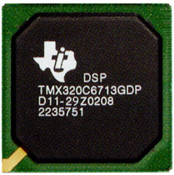
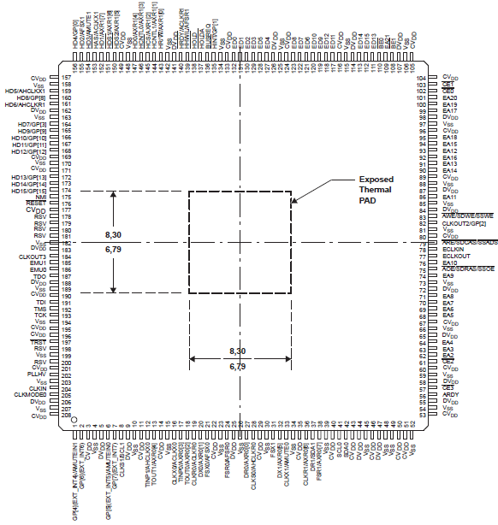
TMS320C6713
TMS320C6713
  Very-long-instruction-word (VLIW) architecture
    Suited for numerically intensive algorithms.
  8 instructions can be fetched per clock cycle
    E.g. clock rate 225 MHz, clock period = 1/225 MHz = 4.44 ns
    8 instructions can be fetched every 4.44 ns.
  264 KB internal memory.
  6 Arithmetic and logic units (ALUs)
  2 multiplier units
  32 bit address bus (up to 4 GB memory)
  2 sets of 32-bit registers
  Capable of both fixed point and floating point processing.

Slide 8
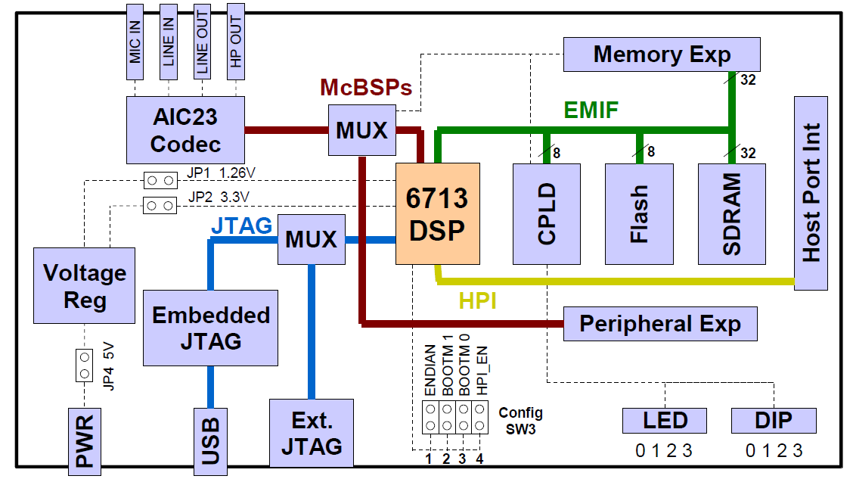
TMS320C6713 DSK
TMS320C6713 DSK
  a low-cost development platform designed to speed the development of applications based on TI´s TMS320C6713 DSP
  512K Flash and 16MB SDRAM
  DSP operating at 225 MHz
  An AIC32 stereo codec
CPLD: Complex Programmable Logic Device
McBSP: Multi-channel buffered serial ports
Notes:
dual in-line package (DIP)
SDRAM: synchronous dynamic RAM
JTAG: Joint Test Action Group
AIC23

Slide 9
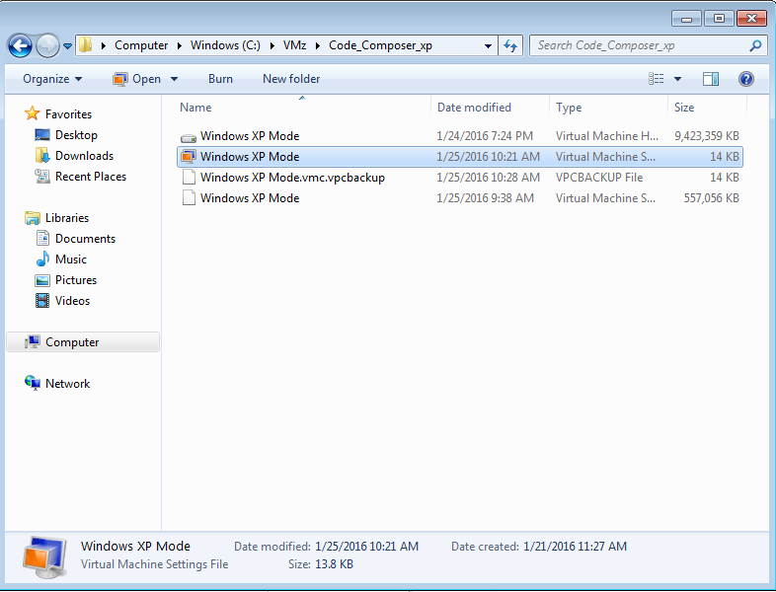
DEVELOPMENT ENVIROMENT
Getting started:
  1. launch windows XP mode
  Start → Computer→ windows (C:)→ VMz → Code_Composer_xp → windows XP Mode
  2. plug the DSK to PC through USB port, power DSK on.

Slide 10
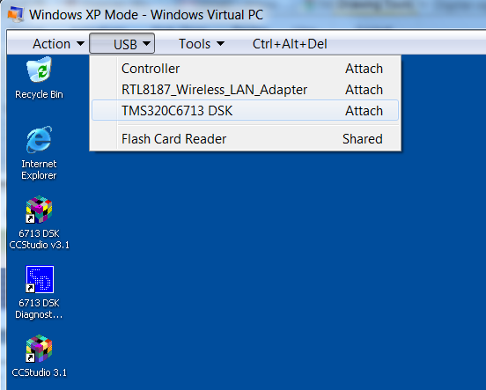

DEVELOPMENT ENVIROMENT (cont’d)
Getting started:
  3. in Windows XP mode, USB → TMS320C6713DSK Attach
  4. on Windows XP mode desktop, launch
  6713DSK CCStudio V3.1
  5. If a “Waiting for USB enumeration” dialog box show up,
  repeat step 3.
  6. In CC Studio 3.1, Debug → Connect. If successful,
  the left lower corner of CC Studio 3.1 should be changed from to
  If any of the above step does not work, try to unplug DSK, shut down Windows XP mode, and try steps 1 – 6 again.

Slide 11
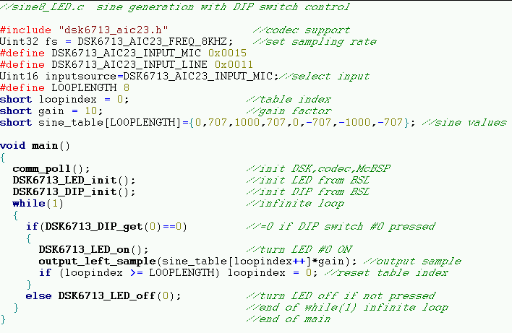
EXAMPLE
sin8_LED.c

Slide 12
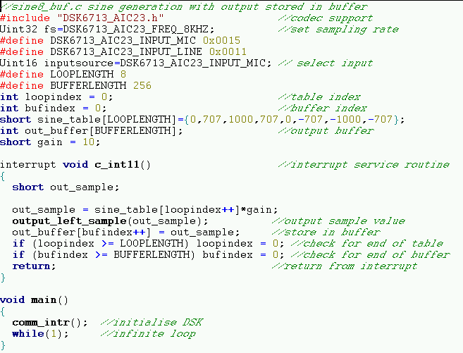
EXAMPLE
sin8_buf.c
  AIC23 will generate an interrupt at every sample instant
  fs = 8KHz: 8,000 interrupts will be generated by the AIC23
  Every time an interrupt is generated, c_int11 will be executed.

