Slide 1
ELEG4623/ELEG5663 Communication Theory
Ch. 0 Introduction
Dr. Jingxian Wu
wuj@uark.edu

Slide 2
OUTLINE
Historical Background
Elements of a Communication System
Digital Communication v.s. Analog Communication
Underpinning Theories of Communication Systems

Slide 3
HISTORICAL BACKGROUND
Historical Background
  1838: Cooke and Wheatstone build the telegraph
  1844: Morse demonstrates the telegraph line between Baltimore, MD and Washington, DC
  1858: the first transatlantic cable is laid (fails after 26 years)
  1864: Maxwell predicts electromagnetic radiation
  1876: Bell develops and patents the telephone
  1887: Hertz verifies Maxwell’s theory
  1894: Lodge demonstrates wireless communication over a distance of 150 yards.
  1901: Marconi transmits and receives the first transatlantic wireless signals.
  1920: KDKA, Pittsburgh, PA, begins the first scheduled radio broadcasts
  1926: Baird and Jenkins demonstrate television
  1933: Armstrong invents frequency modulation (FM)
  1935: Watson-Watt develops the first practical radar

Slide 4
HISTORICAL BACKGROUND
Historical Background (Cont’d)
  1948: Shannon publishes his work on information theory.
  1953: NTSC color television is introduced in the U.S.
  1961: Stereo FM broadcasts begin in the U.S.
  1962: Satellite communication begins with Telstar I (between U.S. and Europe)
  1963-66: Error-correction codes and adaptive equalization for high-speed digital communications are developed.
  1971: ARPANET (prototype of Internet) was put in service
  1972: Motorola demonstrates the cellular telephone.
  1980: Bell System fiber-optic communication is developed.
  1981: FCC adopts rules creating commercial cellular telephone service
  1985: ARPANET renamed Internet
  1988-1989: installation of trans-Pacific and trans-Atlantic optical cables for light-wave communications.
  1990: World Wide Web was introduced
  1990 – Present: digital communication systems widely deployed

Slide 5
OUTLINE
Historical Background
Elements of a Communication System
Digital Communication v.s. Analog Communication
Underpinning Theories of Communication Systems

Slide 6



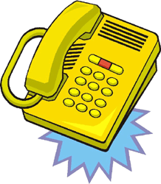
ELEMENTS
Communication system:
  A system designed to transfer information
source
Transmitter
Channel
Receiver
destination
Use electrical signal to transmit information from one location to another location.

Slide 7
ELEMENTS
Transmitter (input transducer)
  Convert the message from the source to an electrical signal suited to the characteristics of the transmission channel.
  It involves operations such as modulation, coding, etc.
Channel
  The electrical medium that bridges the distance from source to destination.
  Wired channel: twisted pair, coaxial cable
  Wireless channel: electromagnetic waves, visible light, laser beam.
  Channel introduces undesirable effects to the signal
    Attenuation: the signal power progressively decreases as the distance increases
    Thermal noise: unwanted electrical disturbance due to the random movement of electrons.
    Interference: unwanted electrical signals from other electrical/mechanical systems.
    distortion: waveform perturbation caused by imperfect response of the system to the input signal.

Slide 8
ELEMENTS
Receiver (output transducer)
  Convert the received electrical signal to its original format (e.g. audio, video).
  It involves operations such as demodulation, decoding, filtering, etc.

Slide 9
ELEMENTS
The operation of any communication system relies on two resources
  Transmitted power: the average power of the transmitted signal
  Channel bandwidth: the frequency range of the channel that allows the signal to pass through.
  Both resources are limited.
  The objective of communication system design is to achieve better communication qualities with less resource
    E.g. less transmitted power ➔ longer battery life
    E.g. less bandwidth ➔ more users in a certain frequency range.

Slide 10
OUTLINE
Historical Background
Elements of a Communication System
Digital Communication v.s. Analog Communication
Underpinning Theories of Communication Systems

Slide 11

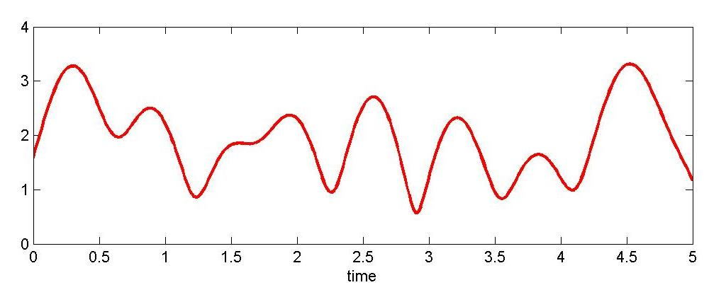
ANALOG V.S. DIGITAL
Analog Message
  A message that is defined on a continuum, i.e., the signal can take infinitely many values.
  Waveform fidelity is important.
  Example: human speech.
Analog Signal
  The electrical signal used to represent analog message
…

Slide 12

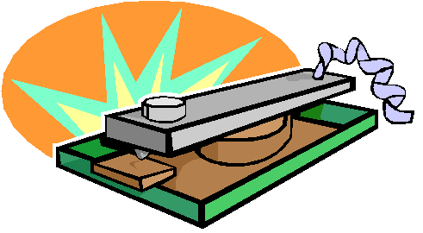
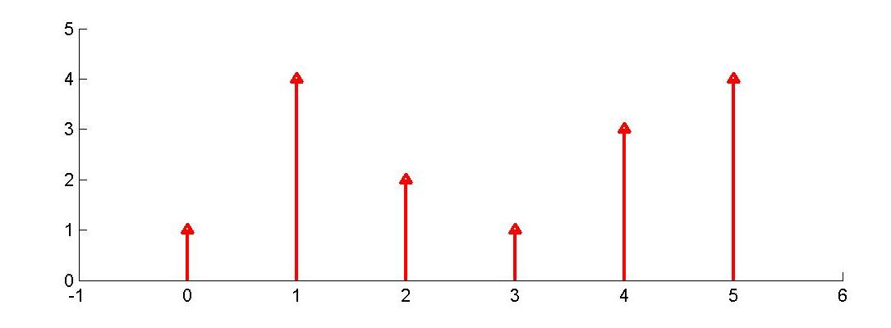
ANALOG V.S. DIGITAL
Digital Message
  A Message that has finitely many possible values.
  Example: traffic lights Telegraph
Digital Signal
  The electrical signal used to represent digital message.

Slide 13
ANALOG V.S. DIGITAL
Usually, digital signals are used for digital message
  E.g., computer bit on Ethernet wire
Also, analog signals are used for analog message
  E.g., voice over telephone wire
However, one can use analog signal to carry digital message
  E.g., computer bits over telephone wire via a Modem
Also, analog message can be converted to digital message, then digitalized message can be carried by digital signal.
  Through sampling and quantization
  E.g., audio in a MP3 player
Also, digital message can be converted to analog message, then the converted message can be carried by analog signal.
  Through interpolation
  E.g., photo from digital camera displayed on a regular TV

Slide 14
ANALOG V.S. DIGITAL
Analog Communication System
  Transfers information from an analog message source to a destination (sink)
    Analog message is transmitted in channel
    Recover analog message at receiver
  Objective: keep the fidelity of the analog waveform.
  Example: AM/FM radio
Digital Communication System
  Transfers information from a digital message source to a destination (sink)
    Digital message is transmitted in channel.
    Recover digital message at receiver
  Objective: Recover the digital message at the receiver.
    Waveform fidelity is no longer important.
  Example: Computer Network.

Slide 15

ANALOG V.S. DIGITAL
When two people are talking with each other face by face, is this an analog communication system or digital communication System? What if they talk over cell phone?
Blah blah …
?????
What matters is what kind of message is transmitted in channel.

Slide 16
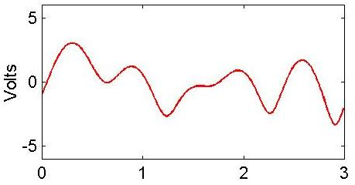
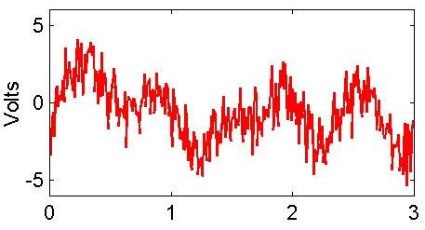
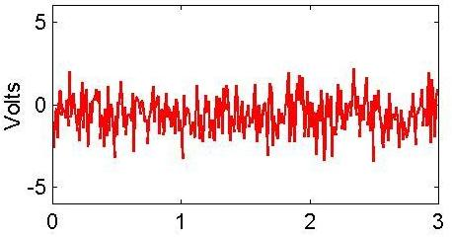
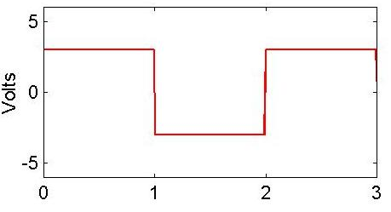
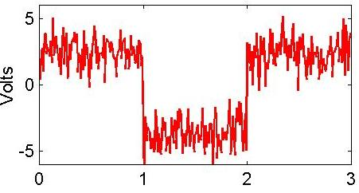
ANALOG V.S. DIGITAL
‘1’
‘1’
‘1’
‘1’
‘0’
‘0’

Slide 17
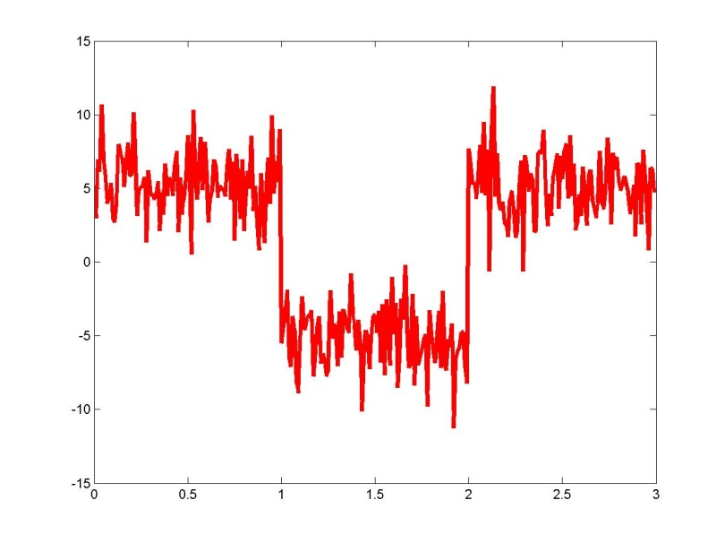
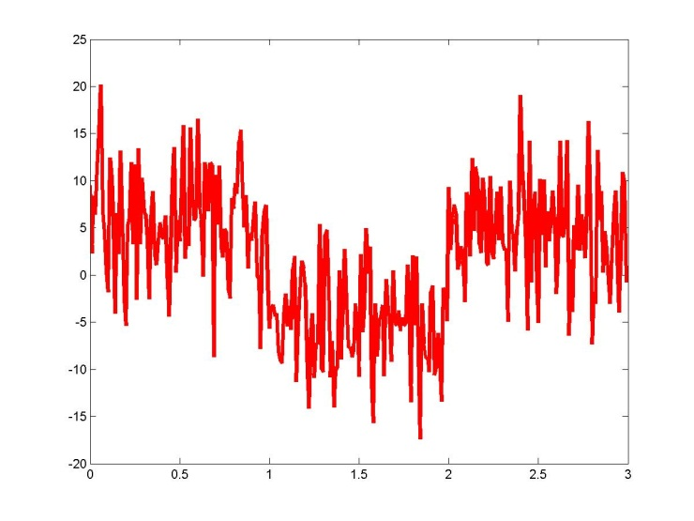
ANALOG V.S. DIGITAL: SNR
Signal to noise ratio (SNR): The ratio of the signal power to the noise power at the receiver.
  SNR = S/N, with S being the signal power, and N being the noise power observed by the receiver.
  High SNR ➔ Signal is strong, and noise is weak ➔ Better communication quality.
  Improve SNR ➔ Improve Tx power ➔ More power consumption
High SNR
Low SNR

Slide 18


ANALOG V.S. DIGITAL: SNR
SNR is usually defined in the unit of dB (decibel)
  Linear value: SNR = S/N (no unit)
  dB value: SNR(dB) = dB
  S/N = 2 ➔ SNR (dB) = = 3dB
Example:
  The proper operation of the 1st generation cell phone system (Analog) needs to maintain an SNR of approximately 18dB.
  The proper operation of the 2nd generation cell phone system (Digital) needs to maintain an SNR of approximately 14dB.
  Low SNR requirement ➔ Low Tx power ➔ Long battery life.
  Even with less SNR requirement, the communication quality of the 2nd generation system is much better than that of the 1st generation system

Slide 19
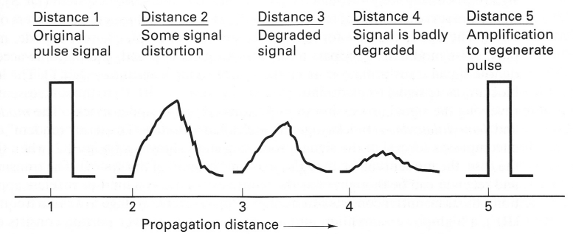

ANALOG V.S. DIGITAL
Advantages of digital signals
  Less susceptible to distortion and interference than analog signals.
Regenerative repeaters
  Digital circuits are more reliable and can be produced at a lower cost than analog circuits.
  Digital system are more flexible than analog system
    Microprocessor, VLSI (very large scale integrated circuits), DSP (Digital signal processor), TDM (time division multiplexing)
  Different types of digital signals can be multiplexed together.
  Can be protected via digital signal processing techniques.
  Better security (encryption).
Digital Binary
  Binary signal is a type of digital signal
  digital signal can take more than two discrete values
    E.g. traffic lights (red, yellow, green), English alphabet (26 letters)

Slide 20
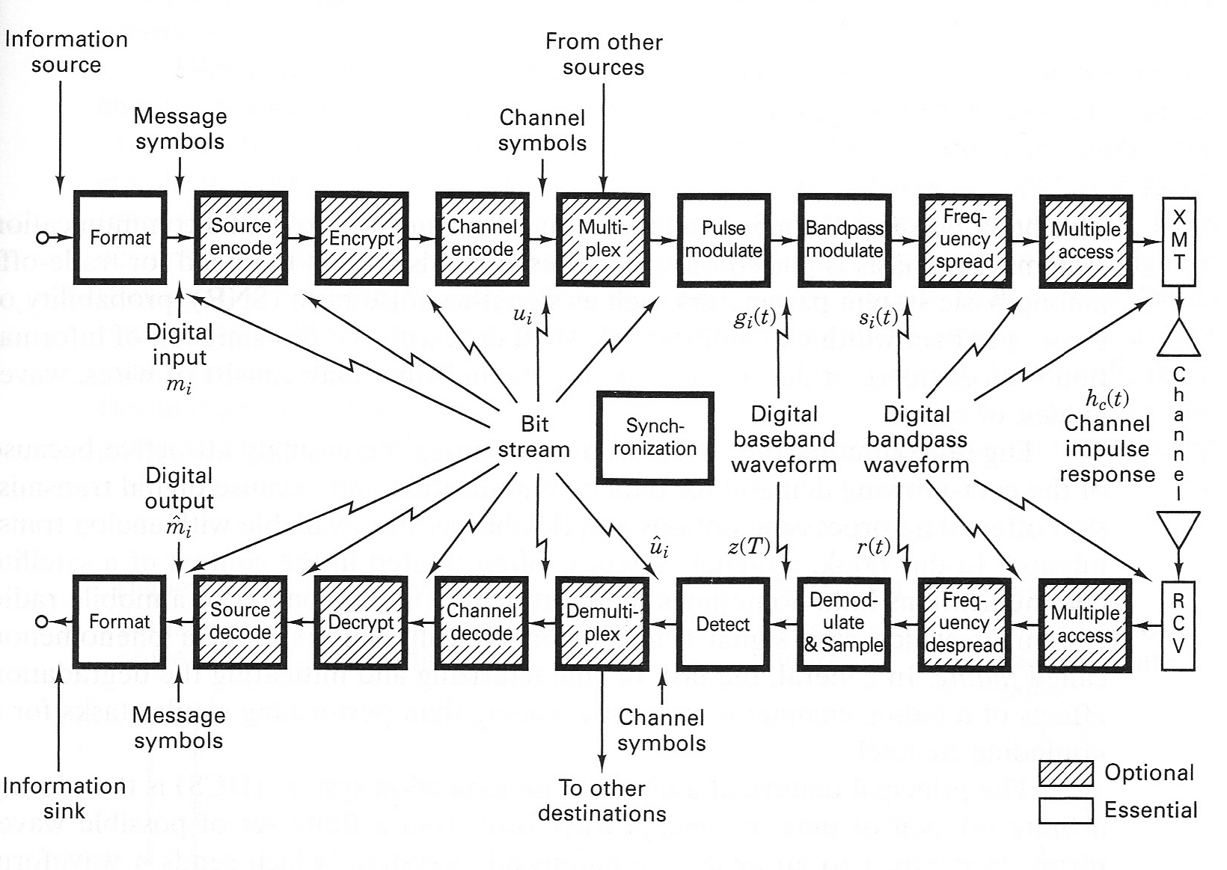
DIGITAL COMMUNICATION BLOCK DIAGRAM

Slide 21
OUTLINE
Historical Background
Elements of a Communication System
Digital Communication v.s. Analog Communication
Underpinning Theories of Communication Systems

Slide 22
UNDERPINNING THEORIES
Essential theories for communication system
  Fourier analysis
    Analyze the signal in the frequency domain
  Modulation theory (linear system and signal processing)
    Fundamental to the transmission of an information-bearing signal over a communication channel.
  Detection theory (linear system and signal processing)
    Recover the original message by analyzing the noise distorted signal at the receiver
  Probability theory and random process
    Message is random
    Noise is random

