Slide 1
ELEG 5663 Communication Theory
Ch. 11 Multiplexing and Multiple Access
Dr. Jingxian Wu
wuj@uark.edu

Slide 2
OUTLINE
Introduction
Multiple access techniques
  FDMA, OFDMA
  TDMA
  CDMA
  SDMA/PDMA

Slide 3
INTRODUCTION
Communication resource
  The time and frequency that is available for communication signaling associated within a given system
  The time and frequency can be considered as a two dimensional plane
    Time as the x-axis, and frequency as the y-axis
  Sharing communication resource ➔ Sharing areas on the plane.
Multiple Access
  Multiple users share the communication resource
  Two types of multiple access
    1. The allocation of communication resources among users are fixed.
    2. The allocation of communication resources among users are dynamically allocated based on the needs of the users.
  Objective
    Design efficient resource sharing technique such that
      1. the total throughput (data rate) is maximized.
      2. No area on the time-frequency plane is wasted.

Slide 4

INTRODUCTION
There are three ways to improve communication throughput
  1. Increase EIRP or reduce system loss to improve at receiver (Link analysis)
  2. Provide more channel bandwidth.
  3. Make the allocation of the communication resource more efficient (multiple access)
Basic multiple access types
  1. Frequency division (FD): specified sub-band or frequency are allocated.
  2. Time division (TD): specified time slots are allocated.
  3. Code division (CD): users use mutually orthogonal code
  4. Space division (SD): use beam antennas pointing to different direction.
  5. Polarization division (PD): orthogonal polarization are used to separate signals.
  6. The combination of the above schemes
    E.g. FDMA/TDMA, CDMA/TDMA, CDMA/FDMA

Slide 5


INTRODUCTION
Various signals sharing the communication resource (CR) should not create unmanageable interference to each other
  The signal on one CR channel should not significantly increase the probability of error in another channel.
  Possible solutions for multiple access
    Orthogonal time domain waveforms used by different users. (TDMA)
    Orthogonal frequency domain waveforms used by different users (FDMA)

Slide 6
OUTLINE
Introduction
Multiple access techniques
  FDMA, OFDMA
  TDMA
  CDMA
  SDMA/PDMA

Slide 7
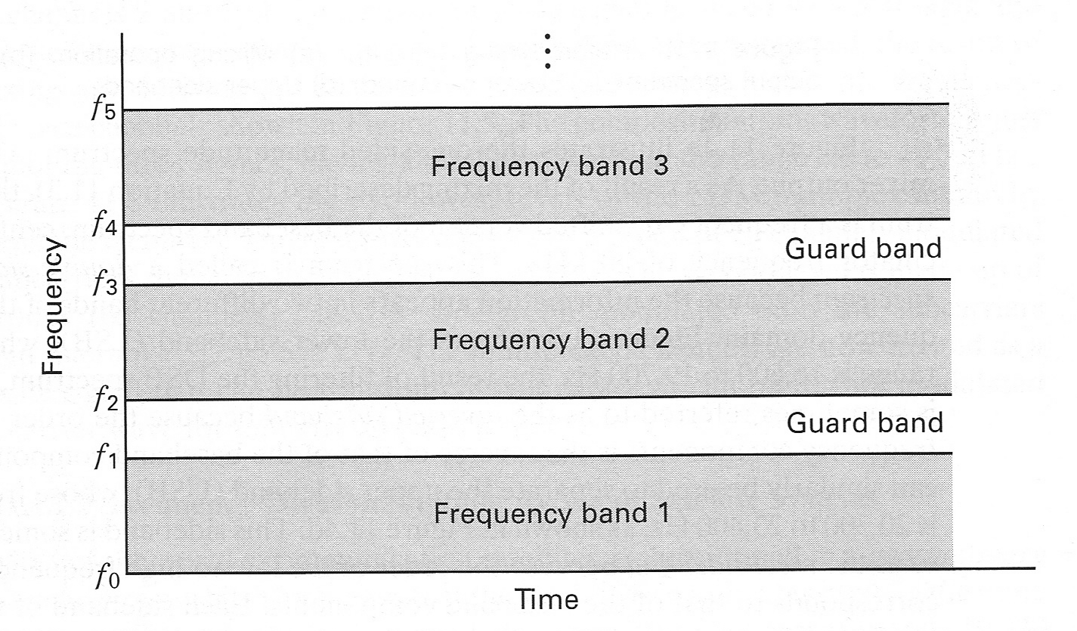
MULTIPLE ACCESS: FDMA
Frequency division multiple access (FDMA)
  Allocate different frequency bands to different users.
  Ideally, there is no overlapping between the frequency bands.
  Guard band: a buffer zone between adjacent channels to reduce adjacent channel interference.

Slide 8
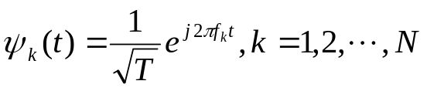


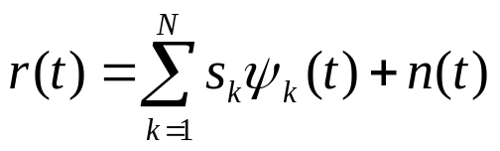
MULTIPLE ACCESS: OFDMA
Orthogonal Frequency Division Multiple Access (OFDMA)
  Mutually orthogonal frequency domain signals are used by different users.
    The signal from each user spreads the entire spectrum ➔ There is significant frequency domain overlapping among signals from different users.
    The signals from different users are orthogonal.
  Orthogonal signal set
  Signal transmitted by the k-th user
  Signal at the receiver
  The detection of the m-th user

Slide 9
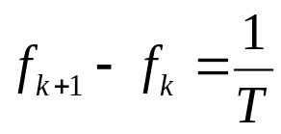
MULTIPLE ACCESS: OFDMA
The minimum frequency space between carriers

Slide 10
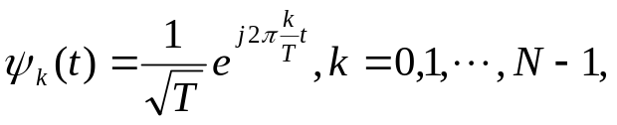

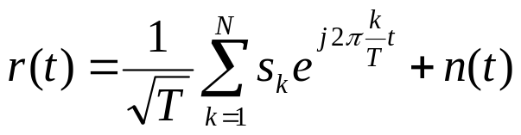

MULTIPLE ACCESS: OFDMA
OFDMA with minimum frequency spacing
  Orthogonal signal sets
  Received signal
OFDM
  Orthogonal Frequency Division Multiplexing
  If belong to the same user, the scheme is called OFDM
  A new modulation scheme that has been widely accepted by many standards.
  Advantage: robust against ISI.

Slide 11
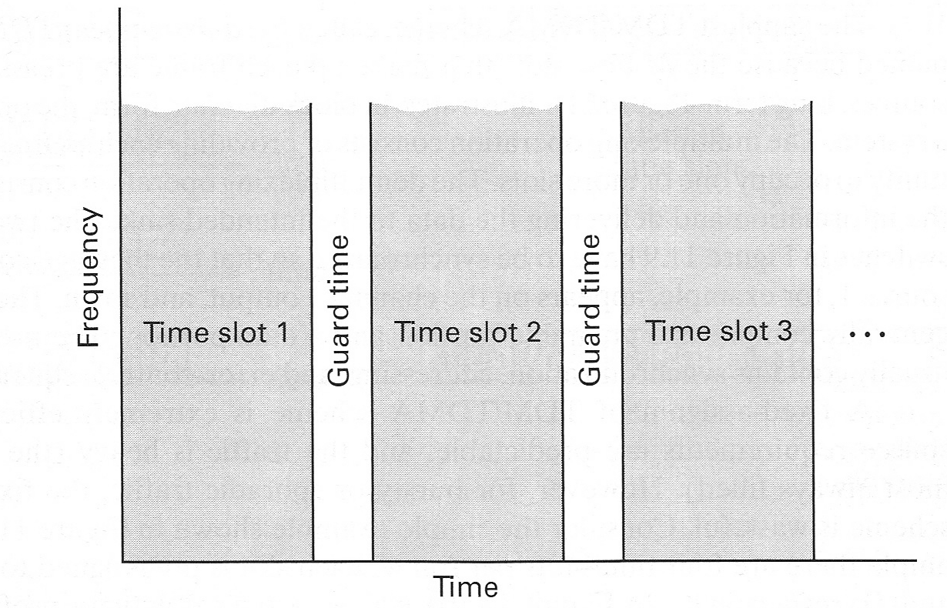
MULTIPLE ACCESS: TDMA
Frame and slots
  Frame: time is segmented into short intervals
  Slot: Each frame is further divided into slots.
Time division multiple access (TDMA)
  Different users are assigned different time slots.
  Can only be used in digital communication systems.

Slide 12
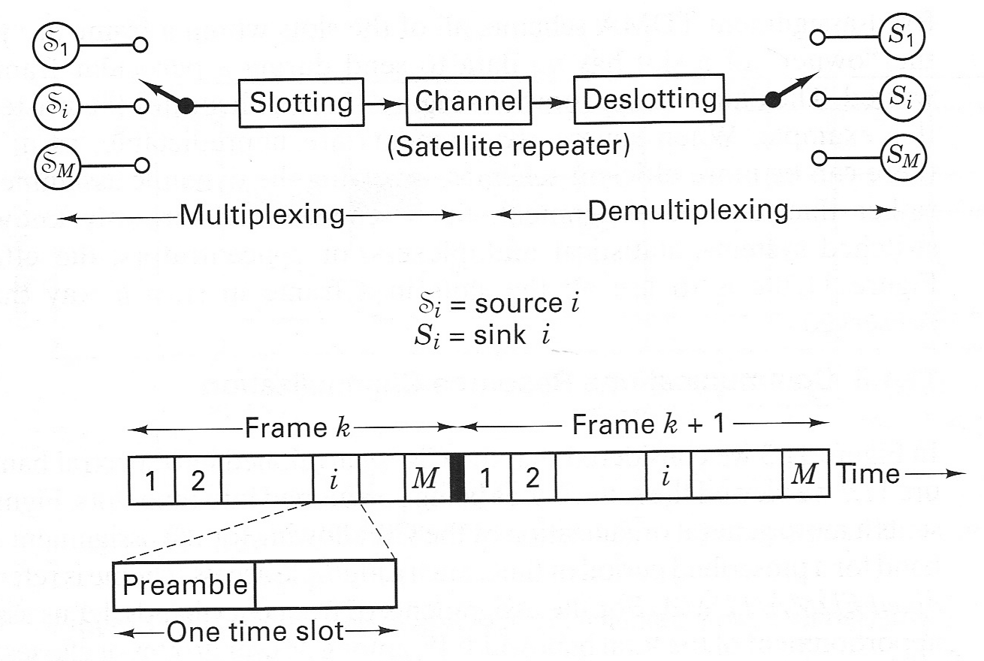
MULTIPLE ACCESS: TDMA
Fixed-assignment TDMA
  Each user is assigned one or more fixed time slots
  Efficient when the data from users are heavy.
  Inefficient when the data from users are bursty (sporadic)

Slide 13
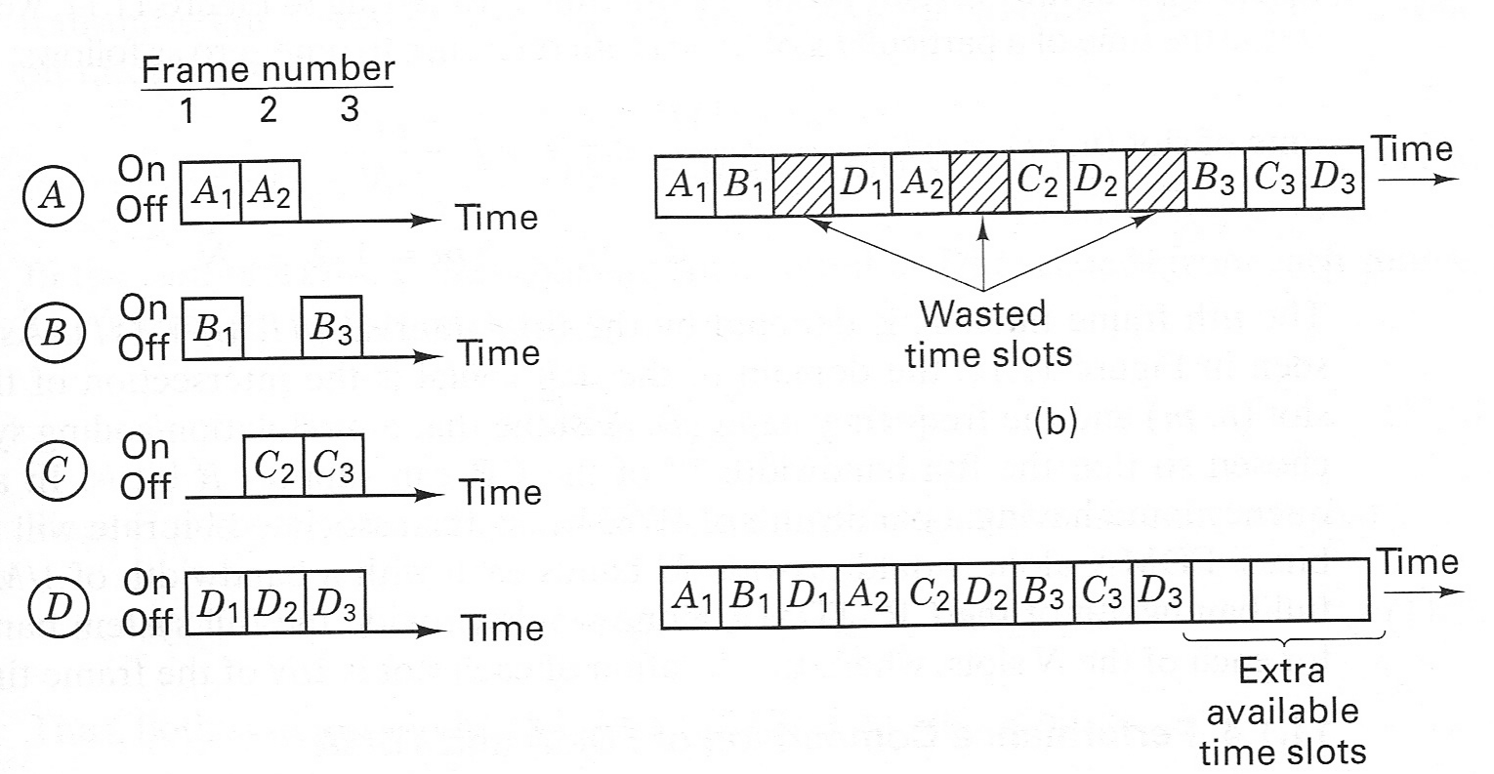
MULTIPLE ACCESS: TDMA
Dynamic-assignment TDMA (packet switching)
  A user is assigned a time-slot only when it has data to transmit
  Advantage: better utilization of channel, efficient for bursty traffic.
  Disadvantage: need extra control scheme (media access control, MAC) to determine which user should transmit

Slide 14
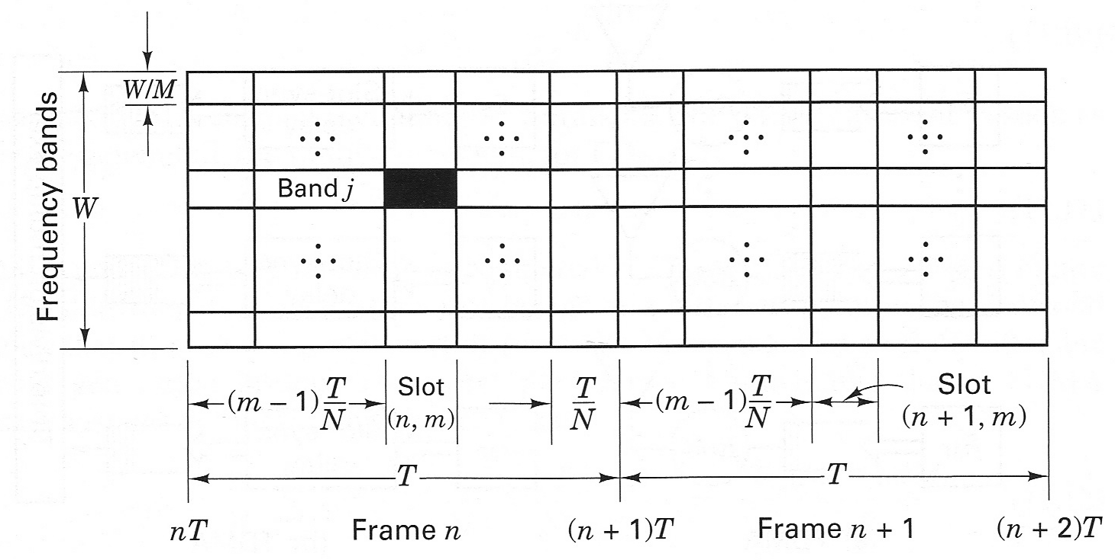
MULTIPLE ACCESS: CHANNELIZATION
Channelization
  Most practical systems use combined FDMA/TDMA

Slide 15
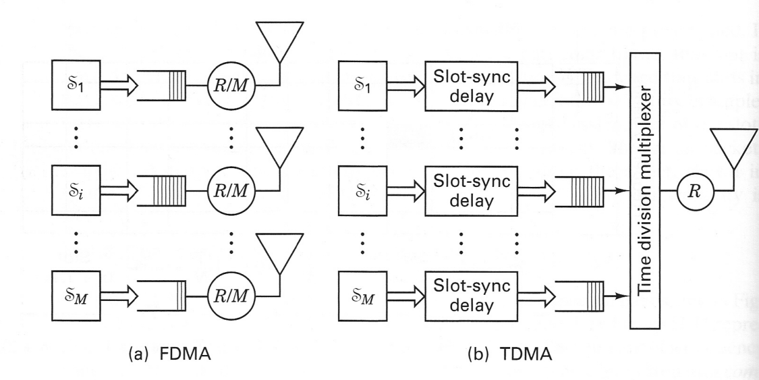
MULTIPLE ACCESS: FDMA V.S. TDMA
FDMA v.s. TDMA: Bit Rate
  Bit rate equivalence: with the same CR and same number of channels, FDMA and TDMA can support the same data rate on each channel
    Assume the size of a packet is b bits, and there are M channels.
    FDMA:
      Bit rate of one channel: b/T bps
      Total bit rate of M channels: R = M b /T bps
    TDMA
      Time are divided into M slots
      b bits are transmitted in a duration of T/M: R = b/(T/M) = Mb/T bps

Slide 16




MULTIPLE ACCESS: FDMA V.S. TDMA
FDMA V.S. TDMA: Delay
  Delay: TDMA is superior than FDMA in terms of message delay.
  Definition: message delay
    w: average waiting time prior to transmission
    transmission time (determines by the data rate)
  Transmission time for a packet of b bits
    FDMA:
    TDMA:

Slide 17


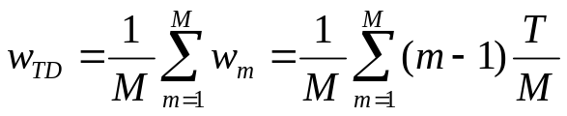
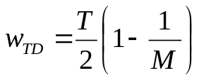
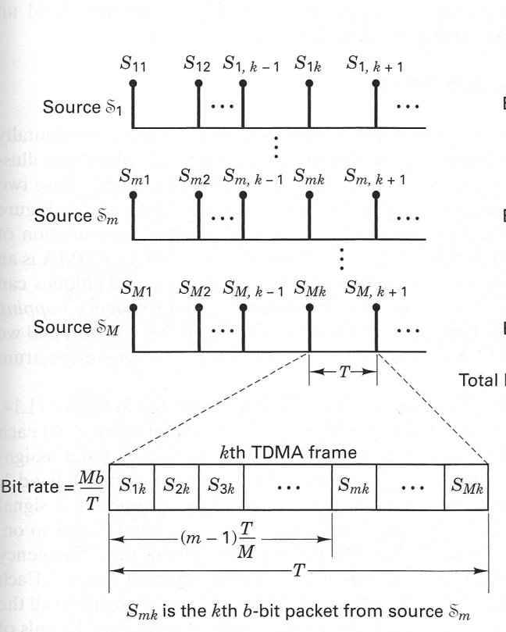
MULTIPLE ACCESS: FDMA V.S. TDMA
FDMA V.S. TDMA: Delay (Cont’d)
  Average waiting time for a packet of b bits: assume the packet arrives at the end of each frame
    FDMA:
    TDMA:
      The waiting time for the m-th user:
      Average waiting time:

Slide 18

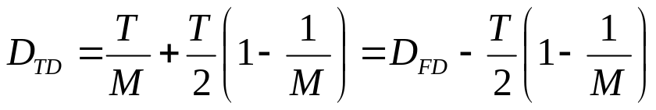
MULTIPLE ACCESS: FDMA V.S. TDMA
FDMA V.S. TDMA: Delay (Cont’d)
  Message delay for FDMA:
  Message delay for TDMA:
  TDMA has shorter message delay compared to FDMA

Slide 19
MULTIPLE ACCESS: CDMA
Code division multiple access
  The data of all users are transmitted on the same frequency band at the same time.
  Each user is assigned a unique signature code
  The receiver extract the information of one user by using the signature code of that user.
  Two types of CDMA
    Direct sequence CDMA (DS-CDMA)
    Frequency hopping CDMA (FH-CDMA)

Slide 20
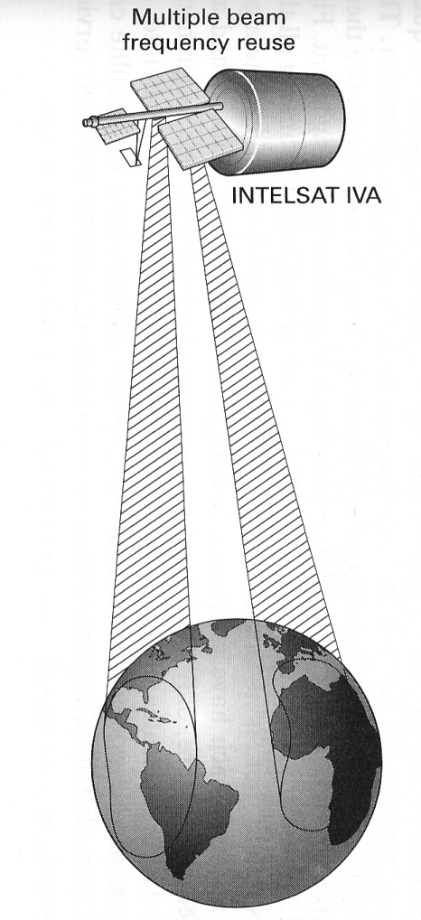
MULTIPLE ACCESS: SDMA
Space-division multiple access (SDMA)
  Use the space separation to share communication resource.
  Example: People at two different locations can access the resource of the same satellite.

