Slide 1
ELEG4623/5663 Communication Theory
Ch. 1 Signals and Spectra
Dr. Jingxian Wu
wuj@uark.edu

Slide 2
OUTLINE
Deterministic signals (Ch. 1.2, 1.3, 1.6 Appendix A)
Random Signals
Signal transmission through linear system, bandwidth

Slide 3








DETERMINISTIC: SIGNAL CLASSIFICATION
Deterministic v.s. Random
  Deterministic signal: there is no uncertainty w.r.t. signal value at any time.
    E.g.
Deterministic v.s.
  Deterministic signal: there is no uncertainty.
    E.g.
  Random signal: there is some degree of uncertainty before the signal occurs.
    E.g. noise
Periodic v.s. Nonperiodic
  A signal is called periodic in time if there exists a constant such that
  The smallest satisfying the above equation is called fundamental period.
    E.g. find the fundamental period of
Continuous-time v.s. Discrete-time signal
  Continuous-time signal: the signal is defined over continuous-time.
  Discrete-time signal: a signal that exists only at discrete-time values.
  Discrete-time signals are undefined at
Notes:
e.g. rectangular signal is continuous-time signal
Discrete-time signal doesn’t have value of 0.5 T.

Slide 4

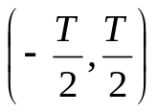

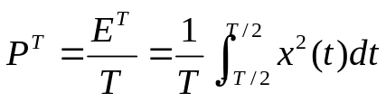


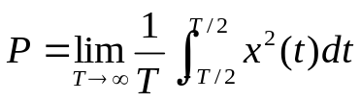
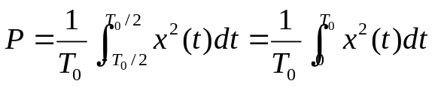

DETERMINISTIC: SIGNAL
Energy signal v.s. Power signal
  Instantaneous power of a signal
  Energy of a signal dissipated during interval
  Average power dissipated during interval
  Total Energy of signal:
    Energy signal:
  Average power of signal:
    Average power of periodic signal:
    Power signal:

Slide 5

DETERMINISTIC: SIGNAL
Example:
  Find the fundamental period.
  Find the average power.

Slide 6

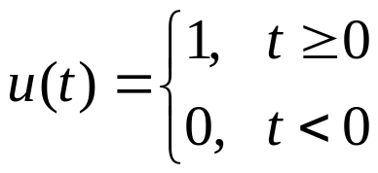




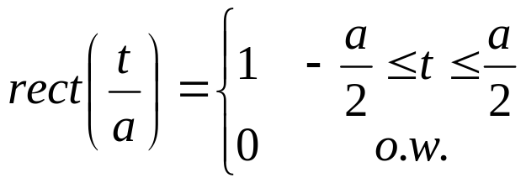


DETERMINISTIC: SIGNAL
Unit step function
Rectangular function
  rect(t) can be represented by using u(t):

Slide 7

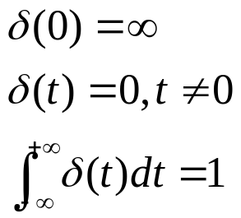

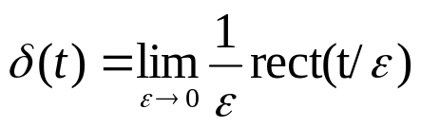




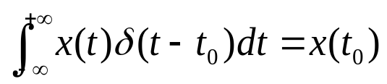

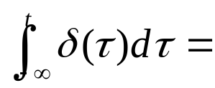
DETERMINISTIC: SIGNAL
Unit impulse function (Dirac delta function)
  delta function can be viewed as the limit of the rect function
  Sampling property
  Shifting property
  Integration of

Slide 8










DETERMINISTIC: SYSTEM
Linear system
  A system is linear if the superposition principal is satisfied.
System
System
System
Time-invariant system
  A system is time-invariant if a time shift in the input signal causes an identical time shift in the output signal
Time-invariant
System
Time-invariant
System
Linear time-invariant (LTI) system
  A system is both linear and time-invariant.

Slide 9


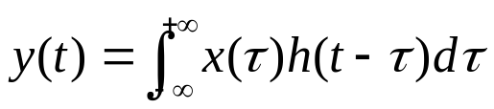

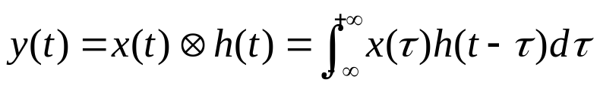

DETERMINISTIC: SYSTEM
Impulse response of LTI system
  Def: the output (response) of a system when the input is a unit impulse function (delta function). Usually denoted as h(t)
LTI
Response of LTI system to arbitrary input
System
Convolution
  Example: evaluate the convolution

Slide 10


DETERMINISTIC: SYSTEM
Example
  A system has impulse response . If the input is
  , find the output.

Slide 11
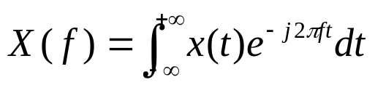
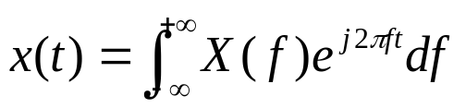
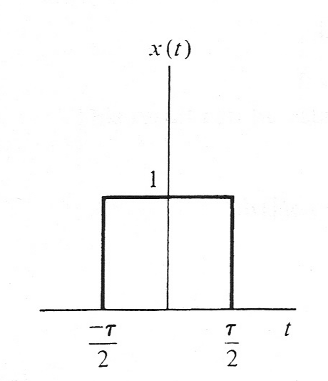

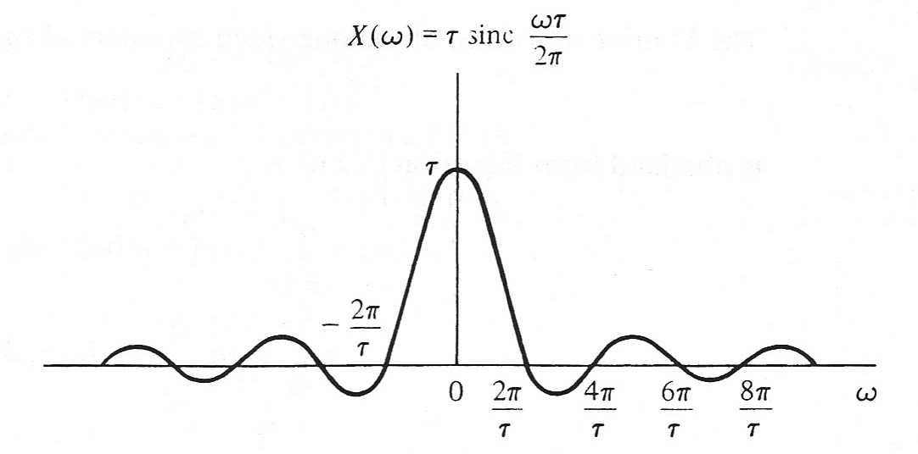

DETERMINISTIC: FOURIER ANALYSIS
Fourier transform
  Frequency domain representation of signal.
Inverse Fourier transform
Example:
  Find the Fourier transform of
Notes:
Rect(t/tau) ←→ tau sinc (f tau)

Slide 12















DETERMINISTIC: FOURIER ANALYSIS
Selected properties
  Linearity
    If
    Then
  Time shift
    If
    Then
  Duality
    If
    Then
  Convolution
    If
    Then

Slide 13




DETERMINISTIC: FOURIER ANALYSIS
Examples
  Find the Fourier transform of
  Find the Fourier transform of
  Find the Fourier transform of
  Find the Fourier transform of
Notes:
Delta(t-t0) <-> exp(-j 2 pi f t0)
Exp(-j 2 pi t t0) <-> delta(-f-t0)
Exp(-j 2 pi a t0) <-> delta(f + a)

Slide 14
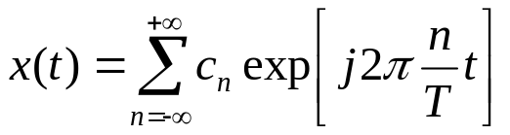

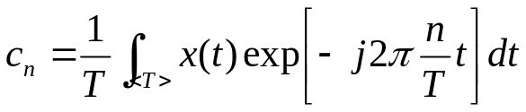
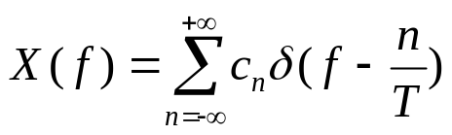

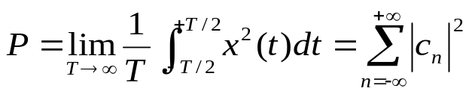
DETERMINISTIC: FOURIER ANALYSIS
Fourier series
  For any periodic signal with fundamental period T, it can be decomposed as the sum of a set of complex exponential signals as
    Fourier series coefficients:
  Fourier transform of periodic signal (perform Fourier transform on both sides of Fourier series)
Parsaval’s theorem
  Energy signal:
  Power signal:

Slide 15






DETERMINISTIC: ENERGY SPECTRAL DENSITY
Energy spectral density (ESD)
  The distribution of the signal’s energy in frequency domain.
    The “density” of energy. Unit: Joul/Hz
  E.g. 1: If the ESD of signal is , then the energy in frequency range is:
  E.g. 2: the energy in frequency range is:
  Def: If , then the ESD of energy signal is
    Why?

Slide 16
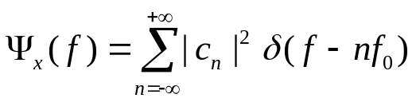



DETERMINISTIC: POWER SPECTRAL DENSITY
Power spectral density (PSD)
  The distribution of signals power in frequency domain
    The density of power (unit: watt/Hz)
  PSD of power signal is the
    : Fourier coefficient
  E.g. Find the PSD and power of

Slide 17
OUTLINE
Deterministic signals
Random Signals (Ch. 1.5)
Signal transmission through linear system, bandwidth

Slide 18



RANDOM SIGNAL
Random variable (RV):
  Random variable: X(A) represents the functional relationship between a random event A and a number X.
  Example:
    Random event A: toss coin;
    Mapping between coin toss and number:
      coin head ➔ X = 0; coin tail ➔ X = 1.
Discrete RV, probability mass function (PMF)
  Example:
    An urn has 2 black balls, 5 white balls, and 3 red balls, pick one ball out of urn
      Random event A: black ball, white ball, red ball
    RV: X: black ball ➔ X = 0; white ball ➔ X = 1; red ball ➔ X = 2.
    PMF:

Slide 19






RANDOM SIGNAL
Cumulative Distribution Function (CDF)
  The CDF of a random variable X is given by
Cumulative Distribution Function (CDF)
  The CDF of a random variable X is given by
The variable of the function
RV
The variable of the function
RV
    The probability that the RV X is less than or equal to a real number x.
  Some properties:
    The probability that the RV X is less than or equal to a real number x.
  Some properties:
  Example:
    The CDF of the RV in the previous example
Discrete RV can be characterized by PMF, CDF

Slide 20
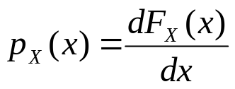



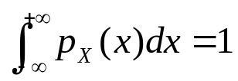
RANDOM SIGNAL
Probability Density Function (pdf)
  The “density” of probability.
    E.g. the probability that the RV :
    The probability that the RV :
  Properties of pdf
Notes:
Px(x) = [Fx(x+dx)-Fx(x)]/dx

Slide 21
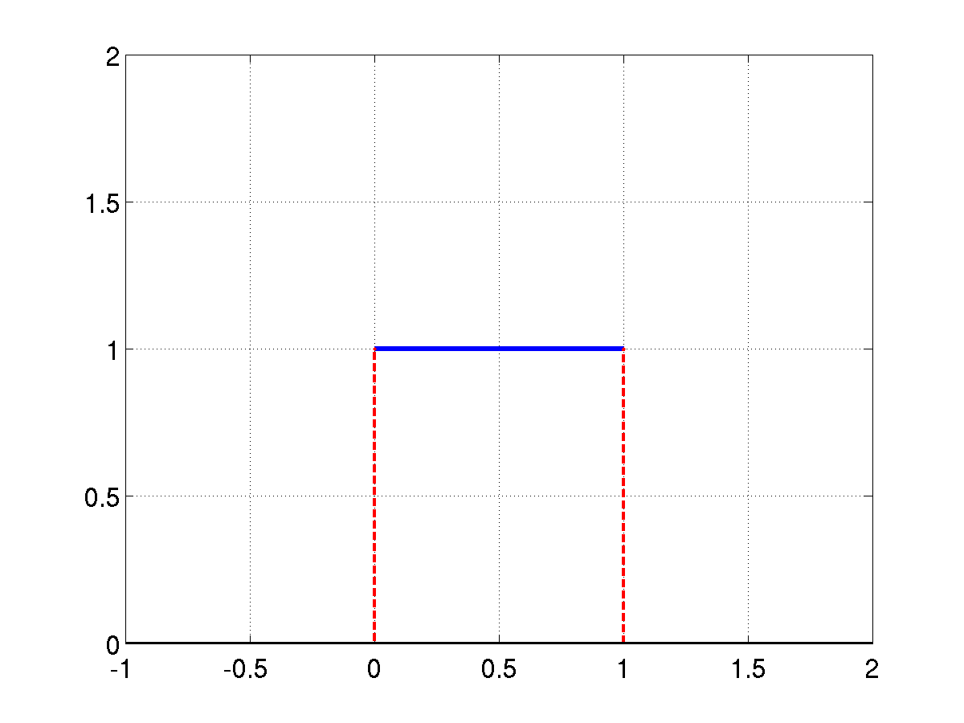
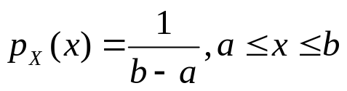

RANDOM SIGNAL
Continuous RV
  The RV can take continuous values.
  Continuous RV can be characterized by its pdf or CDF.
Uniform distribution
  pdf
  The RV X has equal probability to be
  any value in the range of

Slide 22
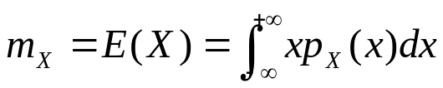


RANDOM SIGNAL
Mean (Ensemble Average, 1st moment, expected value)
  The mean value of a random variable is defined by
  Example:
    The exponential distribution has pdf
      Find its mean value.

Slide 23
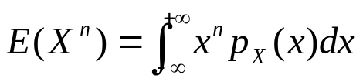
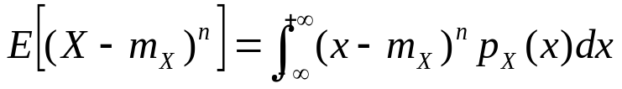


RANDOM SIGNAL
The n-th moment of a RV is defined as
The n-th central moment of a RV is defined as
Variance (average power of a zero-mean random signal)
  Second central moment.
  Standard deviation (root mean square value, rms):

Slide 24
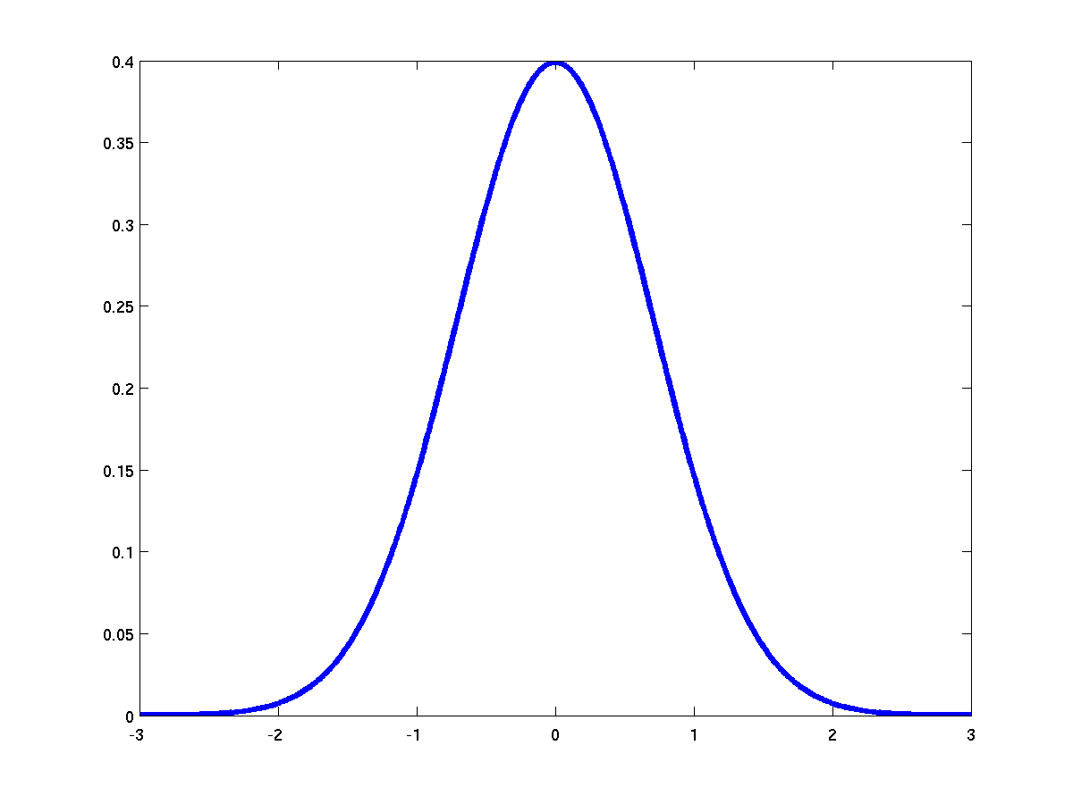
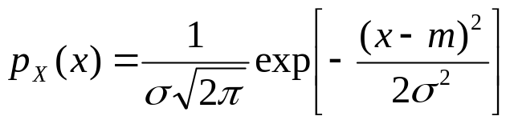


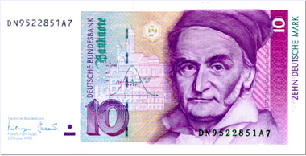
RANDOM SIGNAL
Gaussian distribution (Normal distribution)
  A random variable is Gaussian distributed if the pdf is
  Gaussian pdf is fully characterized by its mean
  m and variance
  Y = aX+b is still Gaussian
  Example: prove the mean of Gaussian RV
  is m
mean

Slide 25




RANDOM SIGNAL: JOINT DISTRIBUTION
Joint distribution
  Two RVs X, Y, the joint CDF is defined as
  Example
X | Y | Prob.
0 | 0 | 0.2
0 | 1 | 0.2
1 | 0 | 0.5
1 | 1 | 0.1
joint PMF:
marginal PMF:
marginal PMF:
conditional PMF:
(if we already know that Y = 1, what is the probability that X = 0?)
Notes:
P(X=0|Y=1) = P(X=0, Y=1)/P(Y=1)

Slide 26

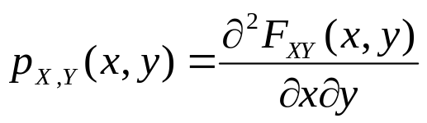
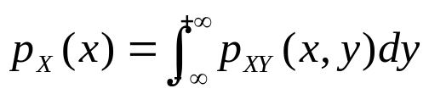
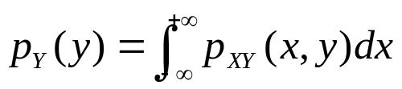

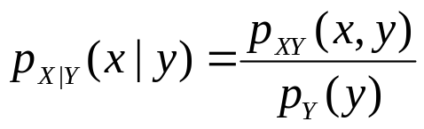
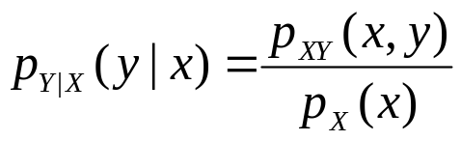
RANDOM SIGNAL: JOINT DISTRIBUTION
Independent RVs
  ⬅➔ X and Y are independent.
  Independence: there is no relationship between the two RVs.
Joint pdf
Marginal pdf
  ⬅➔ X and Y are independent
Conditional pdf

Slide 27

RANDOM SIGNAL: JOINT DISTRIBUTION
Example
  Find the marginal pdf and conditional pdf of
  Are they independent?

Slide 28
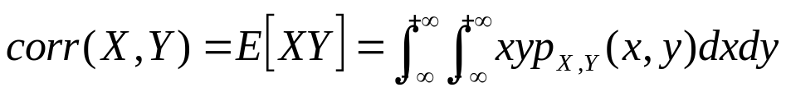

RANDOM SIGNAL: JOINT DISTRIBUTION
Correlation and covariance
  The correlation between two RVs X and Y:
  The covariance between two RVs X and Y:
Uncorrelated
  Two RVs X, Y are uncorrelated if
  If two RVs are uncorrelated, what is their covariance?
  If two RVs are independent, then they are uncorrelated. (Why?)
    But not the other way around!!!

Slide 29






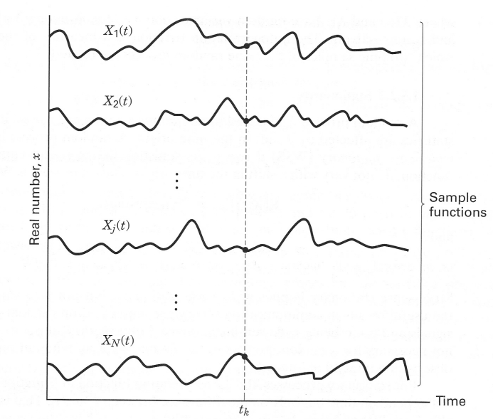
RANDOM SIGNAL: RANDOM PROCESS
Random process
  A random process can be viewed as a RV changes w.r.t. time:
    A function of two variables: X(A, t)
  Sample function:
    Each sample function corresponds to one of the random events.
    For a specific event , we have a single sample function .
    The collection of all sample functions is called ensemble.
  Random variable:
    For a specific time , we have a RV
    Random process is a collection of RVs.

Slide 30






RANDOM SIGNAL: RANDOM PROCESS
Mean (ensemble average)
  The mean is a function of time!
Autocorrelation function
  The correlation of two RVs.
  Autocorrelation function is a function of two variables
Stationary (strict)
  A random process is stationary in the strict sense if none of its properties is affected by a shift in time.
Wide-sense stationary (WSS)
  A random process is WSS if its mean and autocorrelation function do not vary with a shift in the time.
    Mean is independent of time:
    Autocorrelation depends only on time difference:

Slide 31
RANDOM SIGNAL: RANDOM PROCESS
Example:
  Consider a stationary sequence of independent binary bits. Each bit has equal probability of being or -1 or 1. The bit period is T.
  Find the mean of the random process.
  Find the average power of the random process.
Notes:
P(X(t) = -1) = 0.5 delta(x+1)
P(X(t) = 1) = 0.5 delta(x-1)
E[X(t)] = -0.5 + 0.5 = 0.
1. |t2-t1| > T
E[X(t1)X(t2)] = 1*1*P(X1=1, X2=1) + 1*(-1)*P(X1=1, X2=-1) + … = 0.
2. |t2-t1| < T
E[X1 X2] = E[X1 X2| X1 and X2 belongs to the same bit]*P(X1 X2 belong to the same bit] + E[X1 X2| X1 and X2 belong to different bit]*P*(X1 X2 belong to different bit]
E[X1 X2| X1 X2 belong to the same bit] = 1
P(X1 X2 belong to the same bit] = 1-|tau|/T

Slide 32



RANDOM SIGNAL: POWER SPECTRAL DENSITY
Power spectral density (PSD)
  The distribution of the signal’s power in the frequency domain.
    The “density” of power in the frequency domain (unit: watt/Hz).
  It allows the evaluation of signal power in a certain frequency range.
    The power in frequency range
    The power in frequency range
  PSD of a WSS random process is the Fourier transform of its autocorrelation function

Slide 33
RANDOM SIGNAL: NOISE
Noise
  Unwanted electrical signals that are always present in electrical system.
    Man-made noise: spark-plug ignition noise, switching transients, other radiating electromagnetic signal.
    Natural noise: thermal noise, elements of atmosphere, etc.
Thermal noise:
  Caused by thermal motion of electrons in all electronic components: resistors, diodes, transistors, wires, …
  Become worse with the increase of temperature.
  Thermal noise is a random process X(A, t)

Slide 34


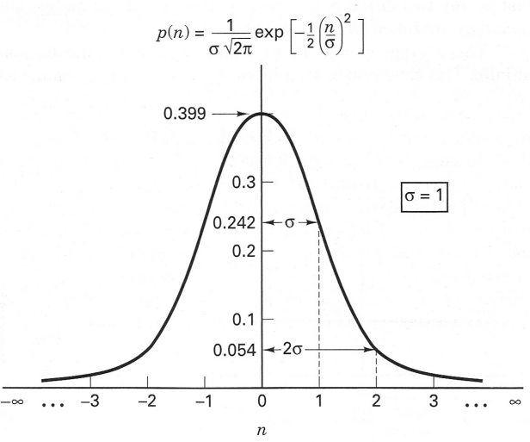
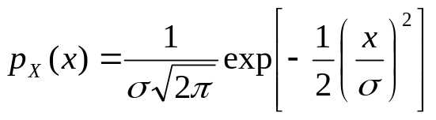
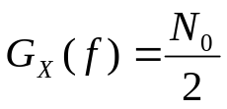

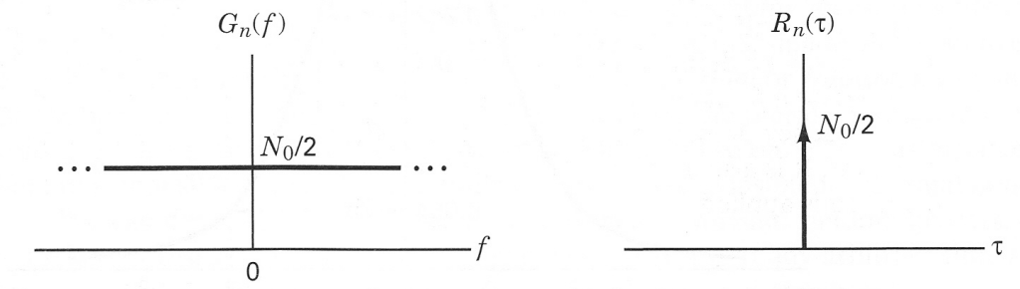
RANDOM SIGNAL: NOISE
Statistical properties of thermal noise
  At a specific time , is zero-mean Gaussian distributed
    Gaussian noise
  Its power spectral density is the same for all frequencies.
    White noise
    PSD
    Autocorrelation function:
      Any two different noise samples are uncorrelated.
    Additive White Gaussian Noise (AWGN)

Slide 35
OUTLINE
Deterministic signals
Random Signals
Signal transmission through linear system, bandwidth (Ch. 1.6, 1.7)

Slide 36






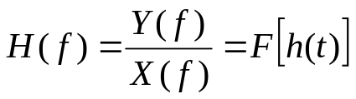


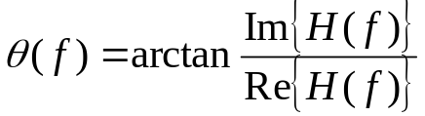
TRANSMISSION
LTI system
LTI
Frequency transfer function (frequency response)
  In general, H(f) is complex
    Magnitude response:
    Phase response:

Slide 37





TRANSMISSION
Random process passes through linear system
LTI
  If the input is a random process X(A, t), then the output is a random process Y(A, t).
  Generally speaking, Y and X follow different distributions
    However, if X is Gaussian distributed, Y is still Gaussian!
      Linear combination of Gaussian is still Gaussian.
  The PSD of X and Y are related by the following equation
    If the input is white Gaussian random process, then the output is colored Gaussian with PSD determined by H(f) ➔ this can be used to generate colored Gaussian random process.

Slide 38

TRANSMISSION: IDEAL TRANSMISSION
Ideal transmission (distortionless transmission)
  The output has some delay compared to the input
  The output has a different amplitude compared to input
  It must have the same shape as the input: no distortion.
  Frequency domain system equation:
  Transfer function:
    Amplitude response:
    Phase response:

Slide 39
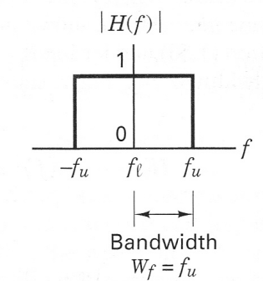
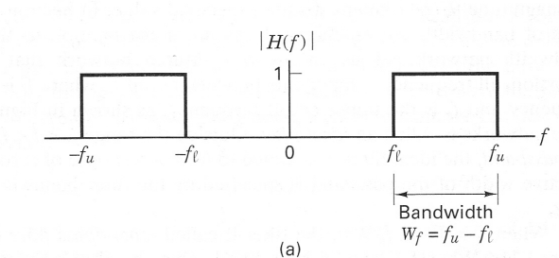
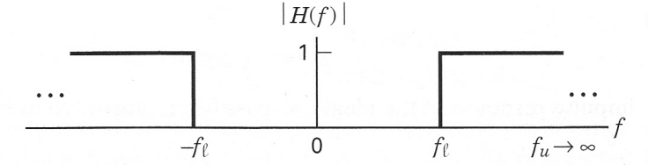
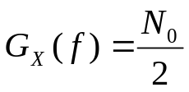

TRANSMISSION: IDEAL TRANSMISSION
Ideal filters
bandpass
lowpass
highpass
Example
  Pass a white noise with PSD through an ideal low pass filter with bandwidth . Find the autocorrelation function at the output of the filter.
Notes:
Rect(t/tau) ←→ tau sinc (f tau)
g(f) = N0/2 rect(f/2u)
g(t) ←→ G(f)
G(t) ←→ g(-f)
U N0 sinc(2ut)

Slide 40
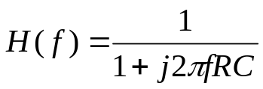
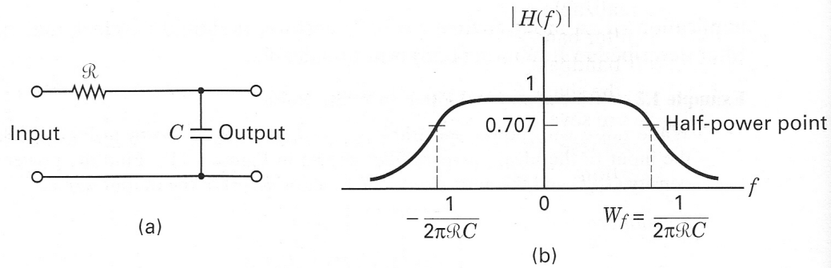



TRANSMISSION: RELIAZABLE TRANSMISSION
Example:
  RC filter
  Butterworth filter

Slide 41






TRANSMISSION: BANDWIDTH
Baseband v.s. Bandpass
  A baseband signal can be shifted to a higher frequency by multiplying it with a carrier wave
  In the frequency domain
  DSB: Double side band, USB: upper side band, LSB: lower side band
  Bandpass bandwidth is twice of baseband bandwidth.

Slide 42


TRANSMISSION: BANDWIDTH DILEMMA
Dilemma
  Strictly band limited signal imply infinite duration
  Duration limited signal has infinite bandwidth
  A signal cannot be limited in both time domain and frequency domain.
  duration limited signal is realizable ➔realizable signal is unlimited in frequency domain.

Slide 43




TRANSMISSION: BANDWIDTH DEFINITION
PSD
  (a) Half-power bandwidth:
    The interval between which that has dropped to half (3 dB) of its peak value.
  (b) Equivalent rectangular bandwidth
    The bandwidth of an equivalent rectangular filter with magnitude the same as the peak of and has the same total power of
  (c) Null-to-null bandwidth
    The width of the main spectral lobe.

Slide 44
TRANSMISSION: BANDWIDTH DEFINITION
  (d) Fractional power containment bandwidth (FCC definition)
    The occupied bandwidth is the band that leaves exactly 0.5% of the signal power above the upper band limit and exactly 0.5% of the signal power below the lower band limit. Thus 99% of the signal power is inside the occupied band.
  (e) bounded power spectral density
    Everywhere outside the specified band, G(f) must have fallen at least to a specified value (e.g. 35 dB) below its peak value.
  (f) absolute bandwidth:
    The interval between frequencies, outside of which the PSD is zero.

