Slide 1
ELEG5663 Communication Theory
Ch. 2 Formatting and Baseband Signaling
Dr. Jingxian Wu
wuj@uark.edu

Slide 2
OUTLINE
Baseband system
Formatting
Baseband modulation
Correlative coding

Slide 3
BASEBAND SYSTEM
Formatting
  The process of transforming source information into logical digital symbols (0s and 1s).
    formatting textual information
      Character encoding
    Formatting analog information
      Sampling, quantization, pulse code modulation (PCM)
  The output of formatting are logic 0s and 1s.
Baseband Signaling
  The process of transforming logic 0s and 1s into baseband electric waveforms that are compatible to the transmission media (channel).
  Baseband signal: the signal whose spectrum extends from (or near) DC up to some finite value, usually less than a few MHz.
Baseband system
  The communication system with baseband signal directly transmitted in the channel (e.g. Ethernet).

Slide 4
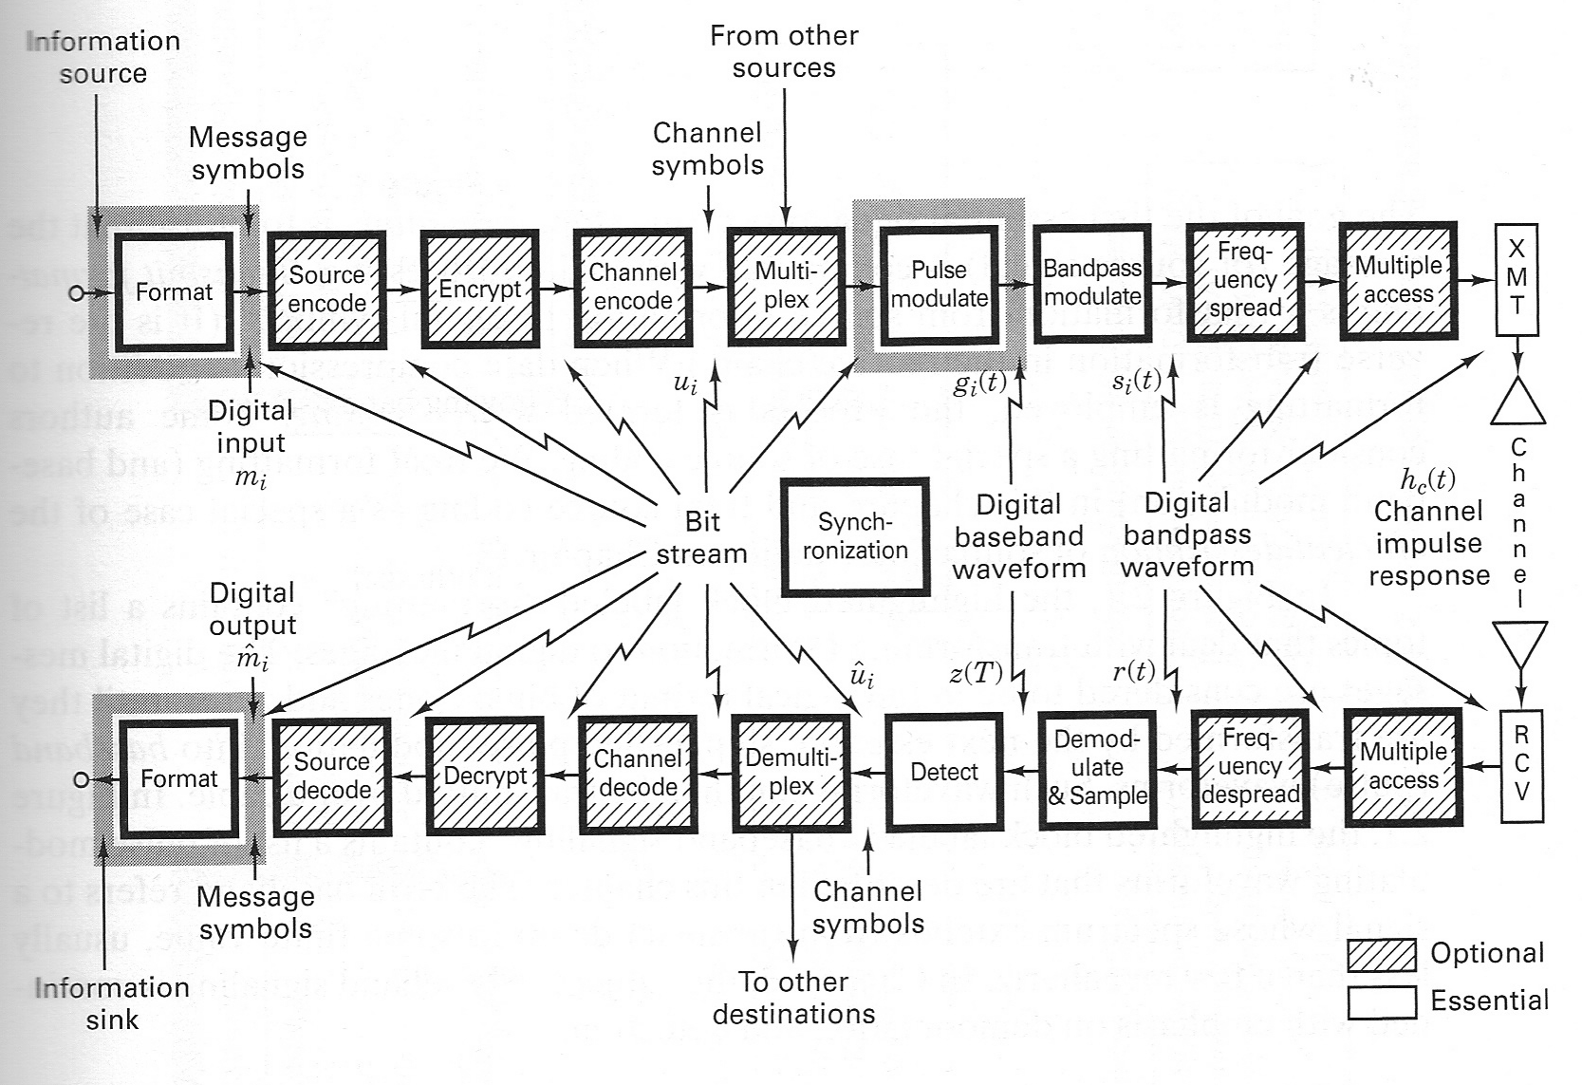
BASEBAND SYSTEM

Slide 5
OUTLINE
Baseband system
Formatting
  Formatting textual messages
  Formatting analog information
Baseband modulation
Correlative coding

Slide 6

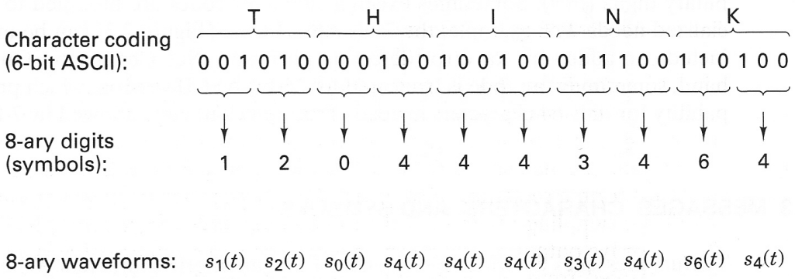
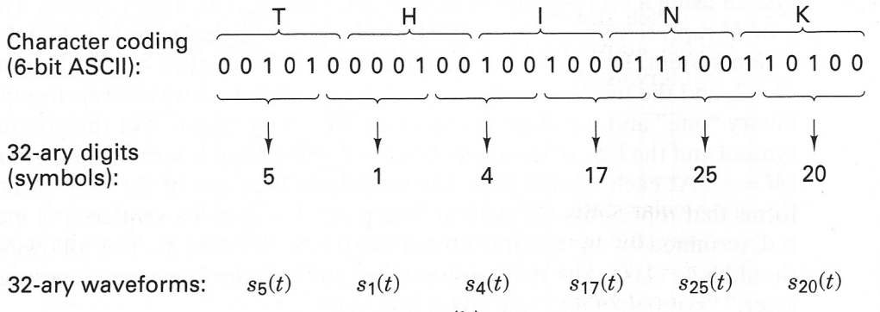
FORMATTING: TEXTUAL DATA
Character encoding
  The process of transforming text data into binary digits (bits).
  Examples:
    ASCII (7-bits, Table 2.3 of Sklar’s book).
Message, bits, and symbols
  Message: the original textual message. (‘T’)
  Bit: the encoded binary bits (e.g. 001010)
  Symbols: a combination of k bits can form symbols
    M-ary system

Slide 7
FORMATTING: ANALOG INFORMATION
Formatting analog information
  Transforming analog waveform into bits
    analog to digital conversion (ADC)
    Some information will be lost during this process.
  Sampling, quantization, PCM
Sampling
  The process of taking samples of the analog waveform in the time domain.
    Impulse sampling (ideal)
    Natural sampling
    Sample-and-hold

Slide 8
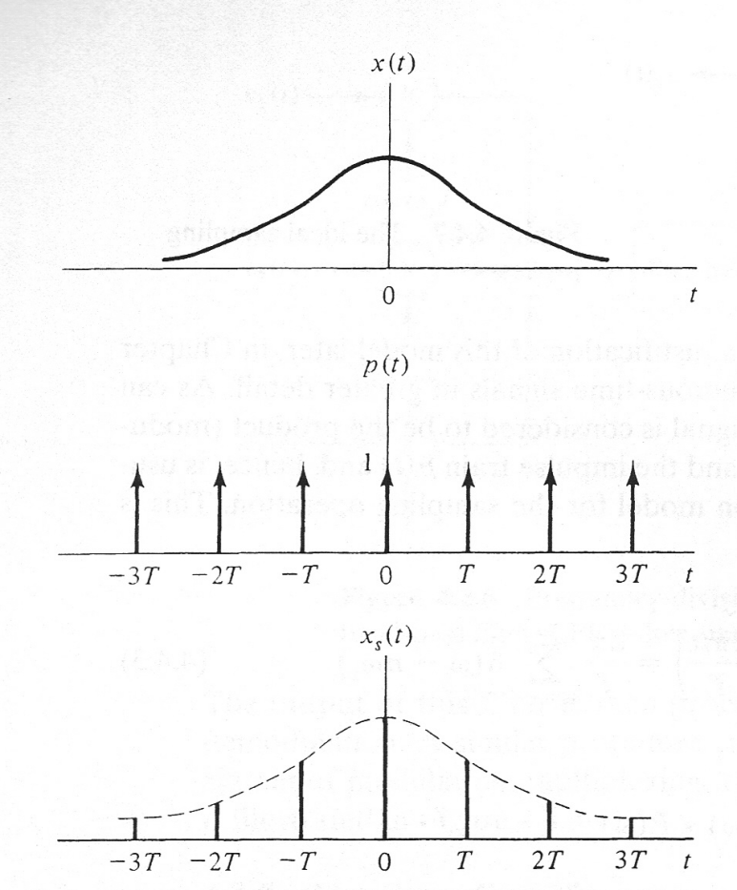

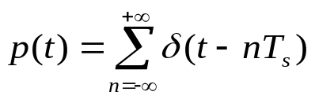
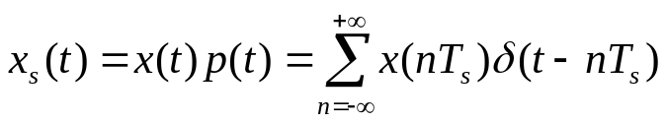
FORMATTING: SAMPLING
Impulse sampling
  Multiplication of the analog signal with a periodic train of unit impulse function.
  Time domain:
sampling period

Slide 9
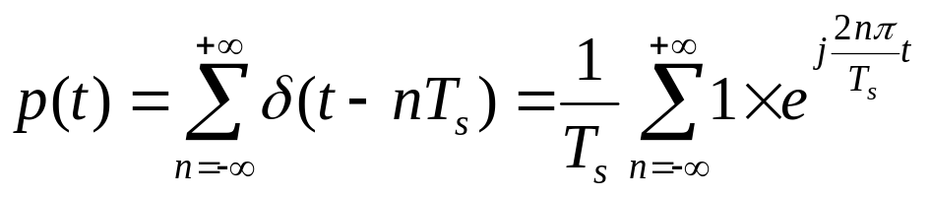
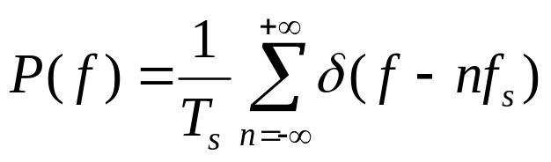

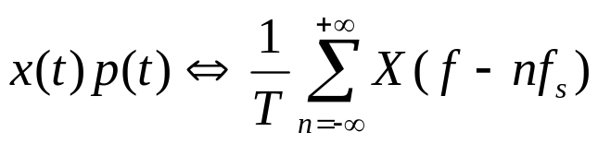
FORMATTING: SAMPLING
Impulse sampling: frequency domain
  Fourier transform of the impulse train
    impulse train is periodic
Fourier series
    Find Fourier transform on both sides
    Time domain multiplication ➔ Frequency domain convolution

Slide 10
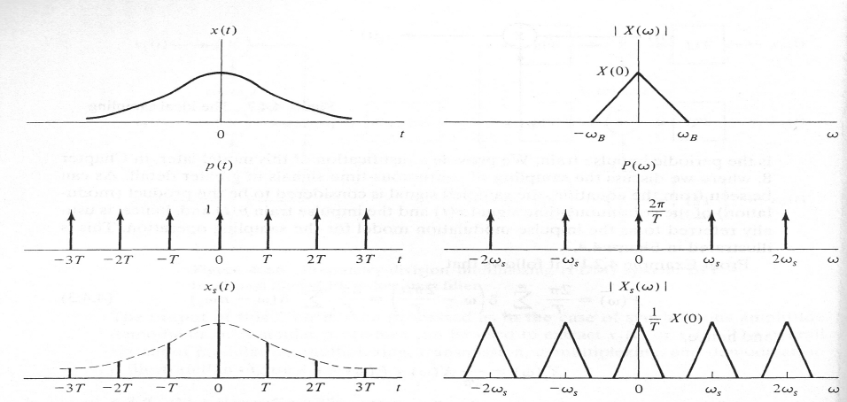

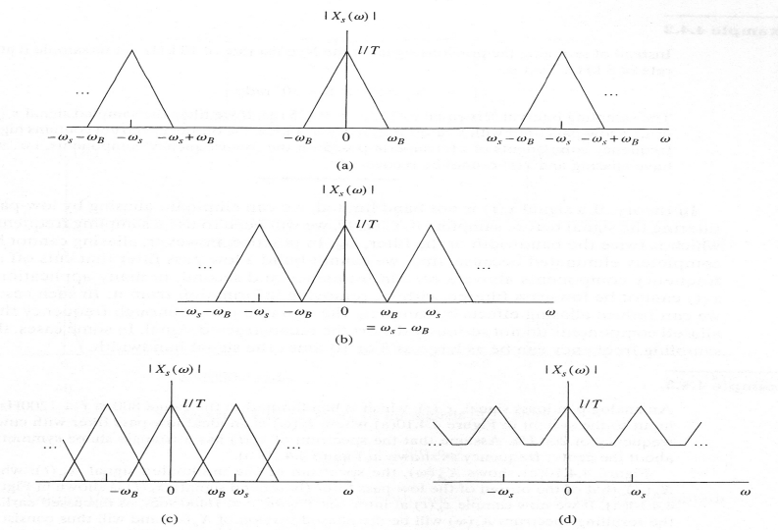



FORMATTING: SAMPLING
Impulse sampling
  Sampling in time domain ➔ Repetition in frequency domain
Sampling theorem
  If the sampling rate is twice of the bandwidth, then the original signal can be perfectly reconstructed from the samples.
oversampling
Nyquist rate
Department of Engineering Science
Sonoma State University
aliasing

Slide 11
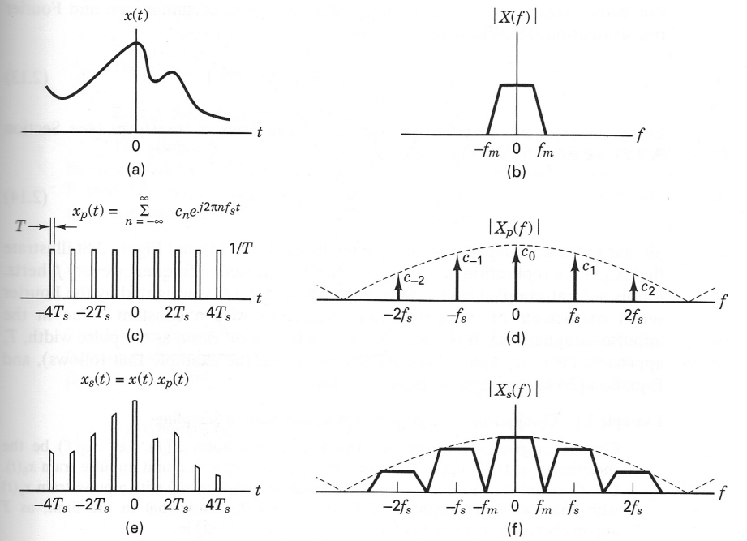
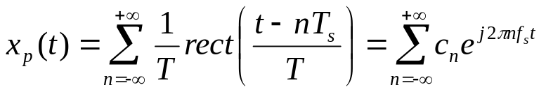
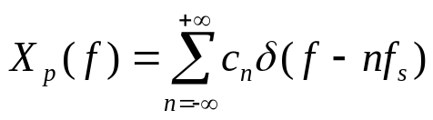
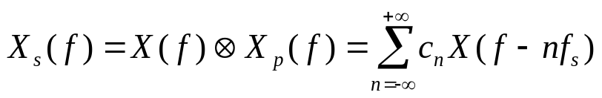
FORMATTING: SAMPLING
Natural sampling
  Multiplication of analog signal with a periodic train of rectangular pulses.
    More practical than impulse sampling
    Equivalent to using a switch.

Slide 12


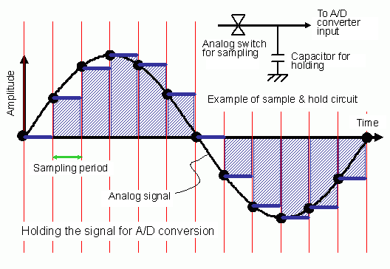
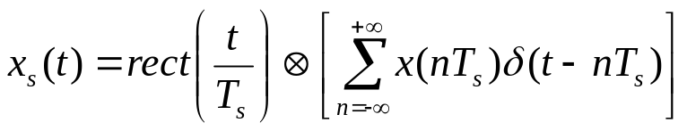

FORMATTING: SAMPLING
Sample-and-Hold (flattop sample)
  The simplest and most popular sampling method
  Can be described by the convolution of impulse sampled signal with a unity amplitude rectangular pulse of pulse width
  The spectrum is similar to that of natural sampling

Slide 13

FORMATTING: SAMPLING
Engineering consideration of sampling
  To avoid aliasing, a prefilter can be used to limit the bandwidth of signal.
  Realizable filters usually have a transition between the passband and stop band: transitional bandwidth
    Tansitional bandwidth is usually 10-20% of the signal bandwidth
  Engineer’s version of Nyquist sampling rate:
    Example: music bandwidth: 20 kHz, the engineer’s Nyquist rate is 44 ksamples/sec. The actual sampling rate used in CD: 44.1 ksamples/sec.
  Oversampling:
    Self-study Section 2.4.3 of Sklar’s book.
  Signal interface for a digital system
    Self-study Section 2.4.4 of Sklar’s book.

Slide 14
FORMATTING: QUANTIZATION
Quantization
  Why quantization?
    The output of sampler can still have infinite number of values.
  Quantization is the process to limit the samples to finite values
    E.g. 3-bit quantization ➔ 8 possible values.
    Quantized samples
    Some information will lost during quantization ➔ quantization noise.
  Types of quantization:
    Uniform quantization
    Non-uniform quantization (used to accommodate the properties of human speech).

Slide 15

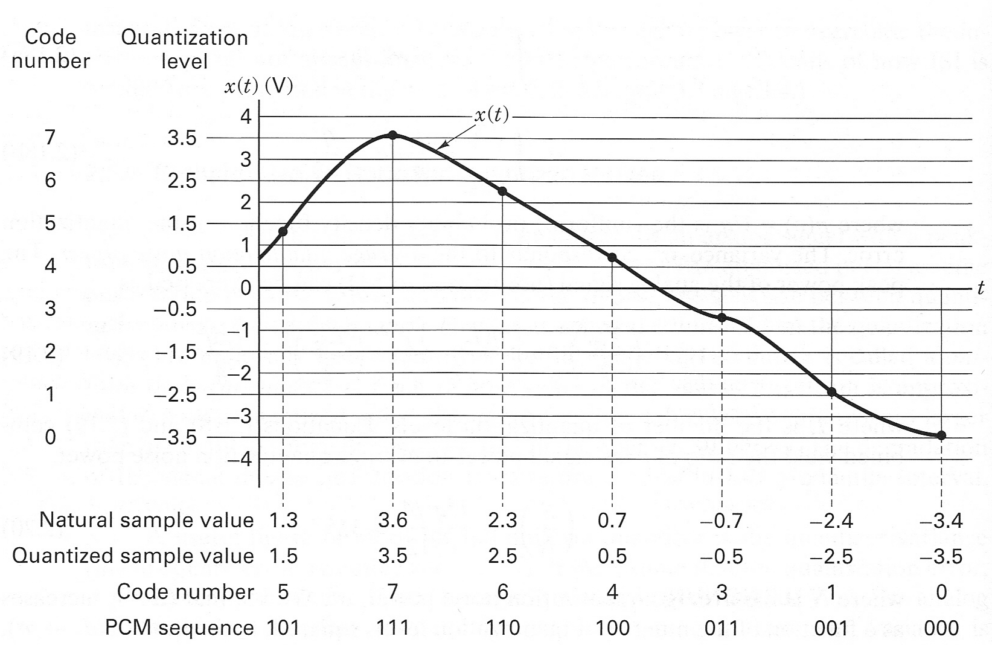
FORMATTING: QUANTIZATION
Uniform quantization
  The range of interest is divided into L levels.
    Quantile interval: step size between two adjacent levels.
    uniform quantization: quantile intervals are the same throughout.
    Each level is quantized into bits

Slide 16


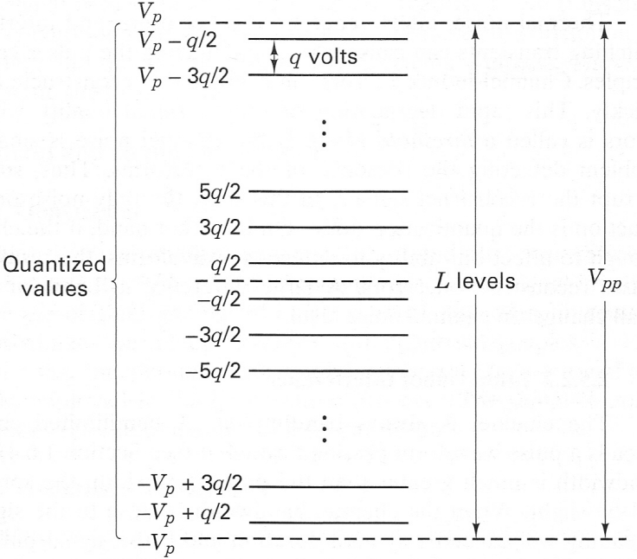

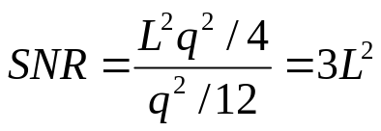
FORMATTING: QUANTIZATION
Quantization noise: relationship with SNR
  An analog signal with peak-to-peak voltage range is uniformly quantized into L levels ➔ Quantile interval q = :
  Quantization noise: the difference between actual value and quantized value
    The maximum value of e:
    The minimum value of e:
    e is uniformly distributed in
  pdf of quantization noise:
  Quantization noise variance (noise power):
  Signal power:
  Signal-to-noise ratio (SNR):
Notes:
Noise power: q^2/12
Signal power: (qL/2)^2

Slide 17

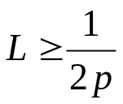
FORMATTING: QUANTIZATION
Quantization noise: relationship with
  The magnitude of the quantization distortion error can be specified as a fraction p of the peak-to-peak analog voltage
  The relationship between maximum quantization error and
  The relationship between quantization level L and p:
Notes:
Max(e) = Vpp/(2L) <= pVpp
L >= 1/(2p)

Slide 18
FORMATTING: PCM
Pulse code modulation (PCM)
  1. Sampling
    E.g. music: 44.1ksamples/sec
  2. Quantization and encoding
    E.g. 8 levels ➔ encoded into 3 bits/sample
  Data rate:
  More quantization levels ➔ higher data rate
  More quantization levels ➔ higher quantization SNR ➔ better quality

Slide 19
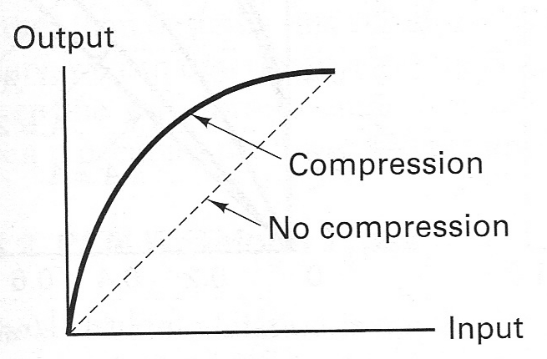
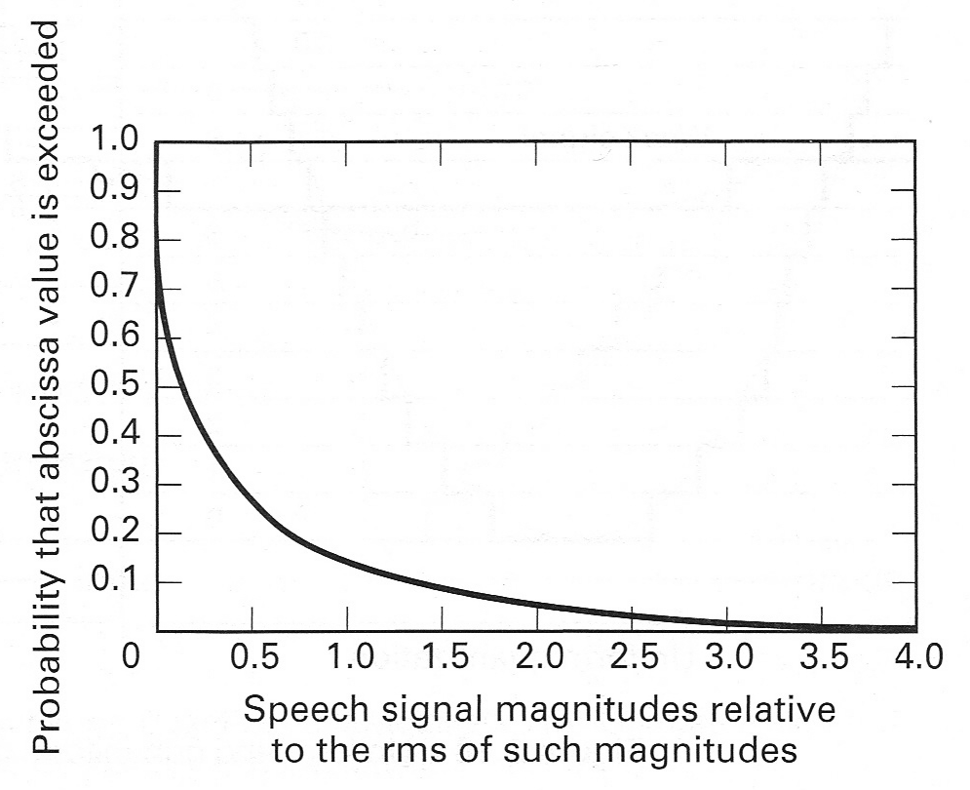
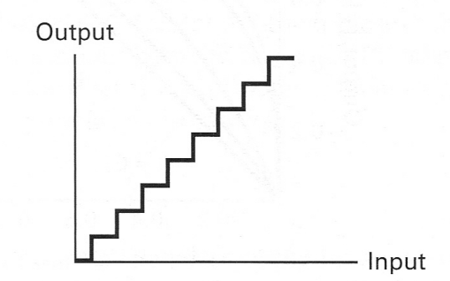
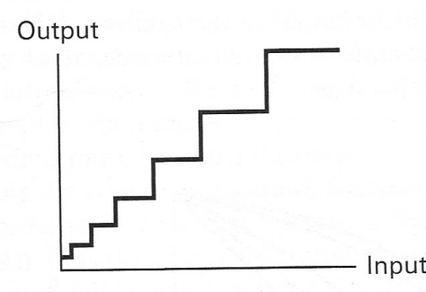
FORMATTING: QUANTIZATION
Non-uniform quantization
  The statistical property of speech signal
    50% of the time, the amplitude is less than ¼ of the rms (root mean square) value.
    Only 15% of the time does the voltage exceed the rms value.
  Small quantile levels for small value, large quantile levels for large value
    Non-uniform quantization
P(X > x)=1- F(x)
Department of Engineering Science
Sonoma State University
uniform quantization
nonuniform quantization

Slide 20
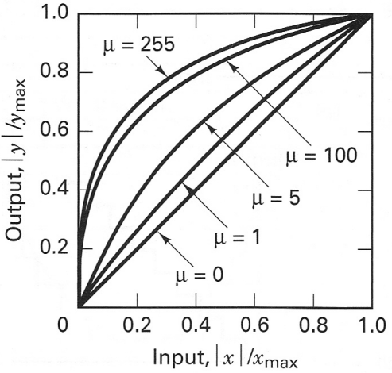

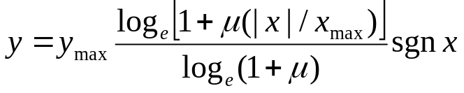
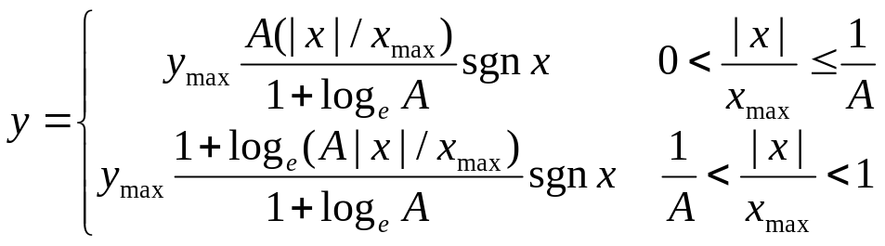
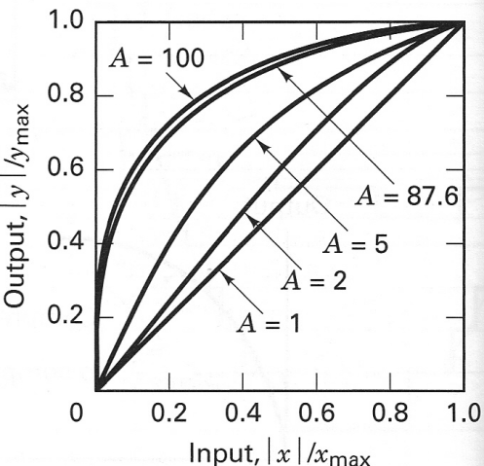
FORMATTING: QUANTIZATION
Non-uniform quantization
  1. distort the original signal:
    Steeper slope for small magnitude signal ➔ a smaller change in low magnitude signal results in more steps.
  2. the distorted signal is passed through a uniform quantizer.
  - law distortion (North America):
  A-law ditortion (Europe)

Slide 21
OUTLINE
Baseband system
Formatting
Baseband transmission
Correlative coding

Slide 22
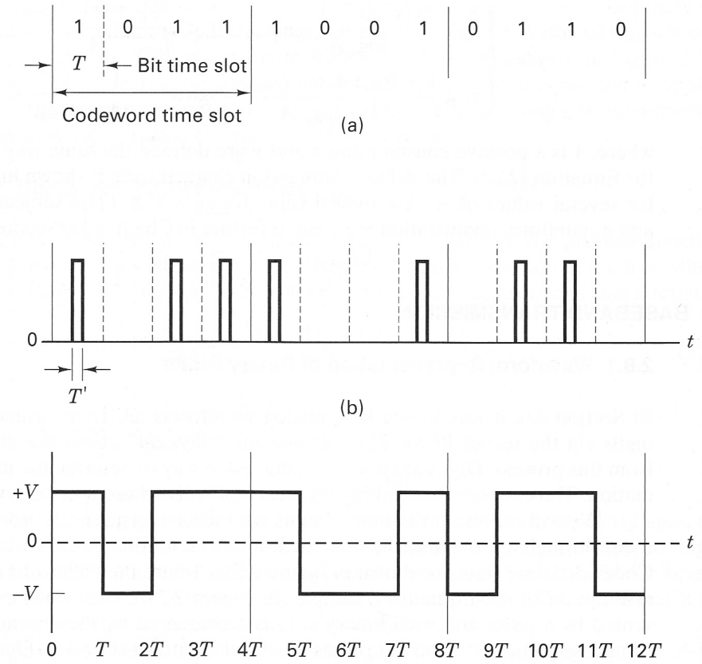
BASEBAND TRANSMISSION
Why baseband modulation
  After formatting, messages are converted to logic ‘0’s and ‘1’s.
  Baseband modulation: converting logic ‘0’s and ‘1’s to baseband electric signals that are compatible with baseband channel (pulse modulation)
  PCM waveform: when pulse modulation is applied to a binary symbol, the resulting binary waveform is called a PCM waveform
  M-ary pulse-modulation waveform: when pulse modulation is applied to a nonbinary symbol.

Slide 23
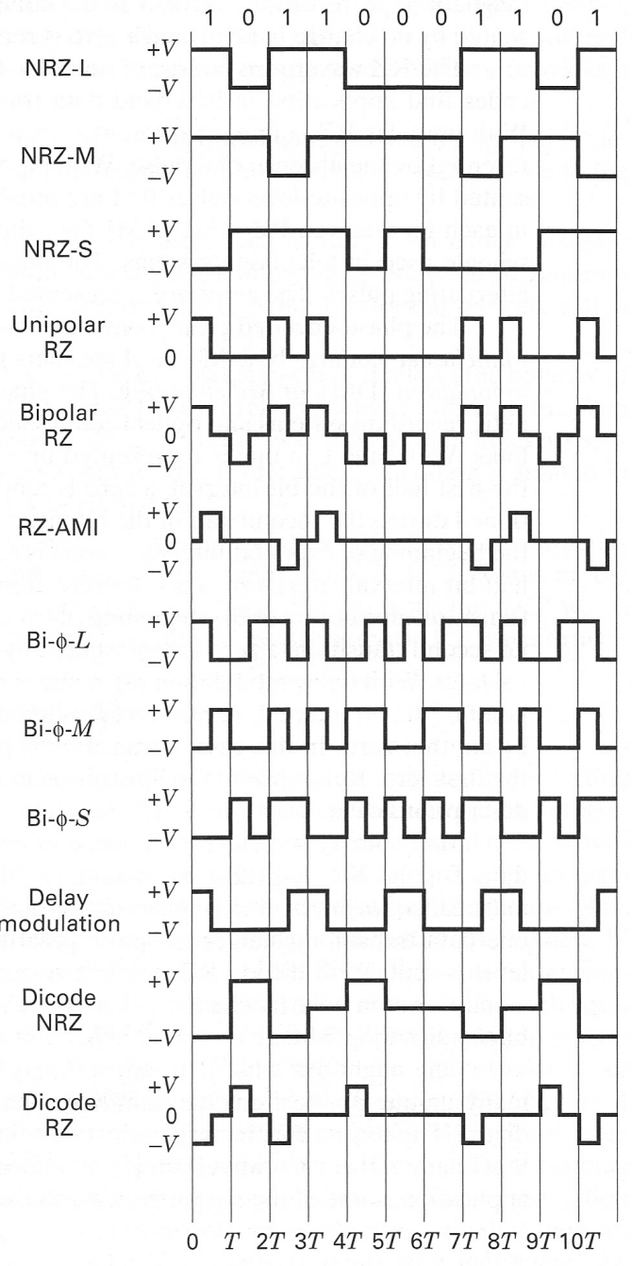



BASEBAND TRANSMISSION: PCM
PCM waveforms (line codes)
  Nonreturn-to-zero (NRZ)
    NRZ-L (level) (digital logics)
    NRZ-M (mark, ‘1’) (magnetic tape)
    NRZ-S (space, ‘0’)
  Return-to-zero (RZ) (baseband Tx)
    Unipolar RZ
    Bipolar RZ
    RZ-AMI (alternate mark inversion)
  Phase encoded
    (manchester encoding)
    (Ethernet)
    (mark, ‘1’)
    (space, ‘0’)
    DM (delay modulation, miller coding)
  Multilevel binary
    Dicode NRZ
    Dicode RZ
    Bipolar RZ
    RZ-AMI
Differential encoding

Slide 24
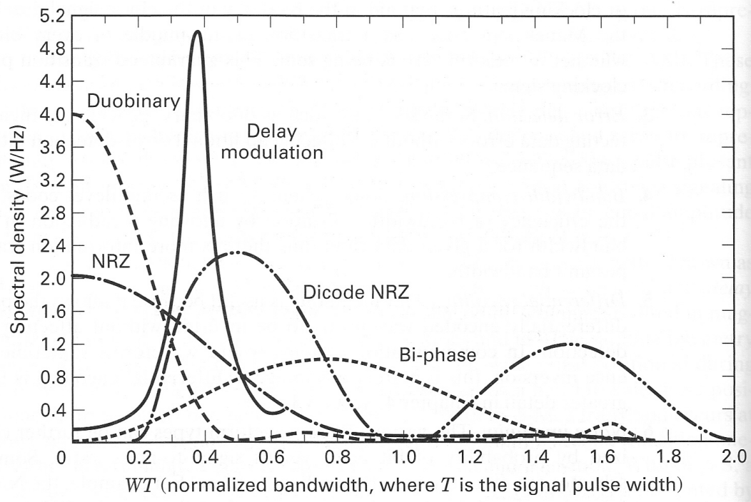
BASEBAND TRANSMISSION: PCM
Why so many PCM waveforms?
  Self-clocking:
    Manchester code has a transition in middle for synchronization.
  Bandwidth
    Less transitions ➔ less bandwidth
  Noise immunity
    NRZ waveforms have better error performance than unipolar RZ.
  DC components (mean)
    Unipolar RZ has DC components, while bipolar RZ doesn’t

Slide 25



BASEBAND: M-ARY PULSE MODULATION
M-ary pulse modulation
  The analog signal are sampled, quantized to M-ary symbols, and then modulated on to pulses.
  Classification
    Pulse amplitude modulation (PAM)
      Use the amplitude of the pulse to carry information.
      M = 2 ➔ PCM (special case of PAM when M = 2)
    Pulse position modulation (PPM)
      Using the start position of a pulse to carry information
    Pulse duration modulation (PDM), pulse width modulation (PWM)
      Using the width of a pulse to carry information.
PPM
PWM

Slide 26

BASEBAND: M-ARY PULSE MODULATION
Why multilevel?
  levels: each level (symbol) can represent k bits of information.
  If the data rate is R bit/sec, then the symbol rate is R/k symbols/sec.
  Pros:
    The transitions of signals becomes slower ➔ bandwidth becomes smaller
    Signal bandwidth is proportional to symbol rate.
    Bandwidth efficiency: symbol rate/bandwidth
  Cons:
    The receiver needs to distinguish between M different symbols instead of 2 symbols in binary modulation
    Signals are more sensitive to noise.
Tradeoff between bandwidth and performance.

Slide 27

BASEBAND: M-ARY PULSE MODULATION
Example
  An analog information with maximum frequency , is to be transmitted over an M-ary PAM system, where the number of pulse levels is M = 16. The quantization distortion is specified not to exceed 1% of the peak-to-peak analog signal.
    How many quantization levels are required?
    What is the minimum sampling rate?
    What is the bit rate?
    What is the symbol rate?
    If the actual transmission bandwidth is 12 kHz, determine the bandwidth efficiency.

Slide 28
OUTLINE
Baseband system
Formatting
Baseband transmission
Correlative coding

Slide 29



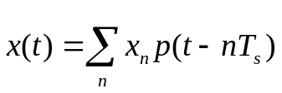
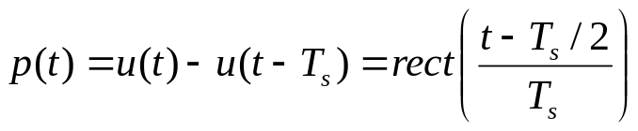
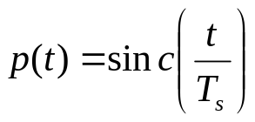
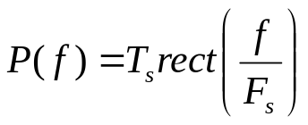
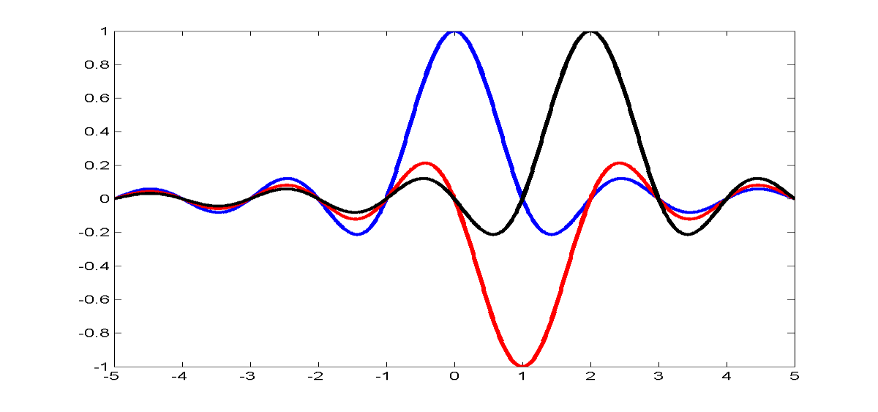
BASEBAND: CORRELATIVE CODING
Baseband signaling can be represented by passing data through a filter
  Eg. 1. Rectangular waveform:
    Bipolar PCM (unlimited bandwidth)
    0-to-null BW:
  Eg. 2. Ideal low pass filter:
    0-to-null BW:
    Ideal filter is unrealizable
1
1
-1
Notes:
Ts sinc(fTs)
0-to-null BW: 1/Ts

Slide 30
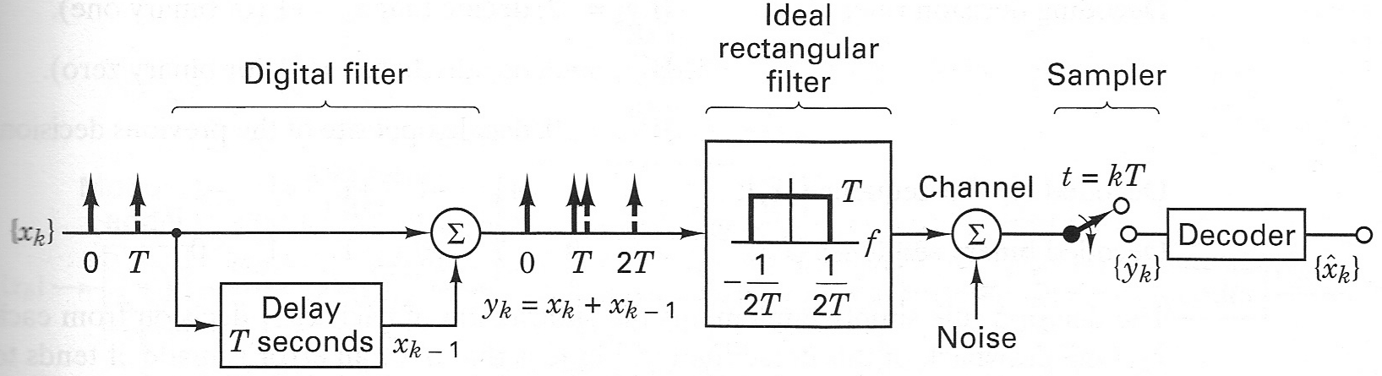
BASEBAND: CORRELATIVE CODING
Correlative coding
  also referred to as: duobinary signaling, partial response signaling.
  It can use a baseband bandwidth of W Hz to support a symbol rate of 2W symbols/sec without resorting to unrealizable ideal filter.

Slide 31











BASEBAND: CORRELATIVE CODING
Correlative encoding and decoding
  Encoder:
    1. Differential encoding of binary sequence
      Modular 2 operation:
      Differential encoding is performed over 0’s and 1’s: it will not affect signal bandwidth.
    2. Mapping binary sequence to bipolar sequence
    3. Duobinary encoding
  Decoder:
    1. Decision rule:
      If or ,
      If ,
Notes:
Why?
If x_k = 0, then w_k = w_{k-1}, 2 or -2
If x_k = 1, then w_k = -w_{k-1}, 0
In out
X_k, w_k-1 w_k, y_k
0 0 0 -2
0 1 1 2
1 0 1 0
1 1 0 0

Slide 32



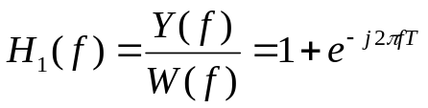
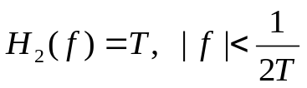
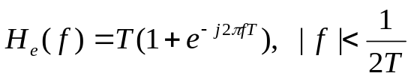
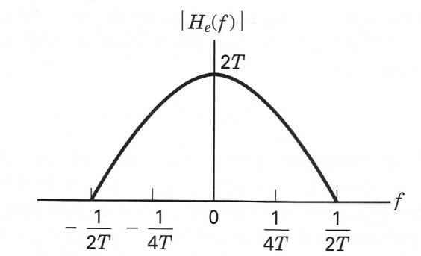


BASEBAND: CORRELATIVE CODING
Frequency domain analysis
Differential
coding
Bipolar
Mapping
Duobinary
Coding
Ideal
Rect Filter
  Time domain of duobinary coding:
  Frequency domain:
  Transfer function of duobinary coding:
  Transfer function of ideal rect filter:
  Overall response of the encoder:
Even though is an ideal filter and cannot be implemented, can be easily approximated. In reality, duobinary coding and ideal rect filter are approximated by ONE filter.
  Baseband bandwidth: 1/(2T)

Slide 33
BASEBAND: CORRELATIVE CODING
Duobinary Coding v.s. PCM
  Bandwidth for transmission data rate of 1/T bps:
    binary PAM: 0-to-null is 1/T Hz, absolute bandwidth is infinity
    Duobinary: absolute bandwidth: 1/(2T)
  Performance:
    Binary PAM: two levels
    Duobinary: three levels (worse performance compared to binary PAM)
  Tradeoff between bandwidth and performance.

