Slide 1
ELEG5663 Communication Theory
Ch. 3 Baseband Demodulation and Detection
Dr. Jingxian Wu
wuj@uark.edu

Slide 2
OUTLINE
Signals and noise
Detection of binary signals in AWGN
Matched Filter
Intersymbol Interference (ISI)
Equalization

Slide 3
SIGNAL AND NOISE
Baseband demodulation and detection
  Recover the received baseband signal from distortions caused by noise and intersymbol interference (ISI)
Equivalence theorem
  The following two operations are equivalent
    1. performing bandpass linear signal processing; 2. converting the processed signal to baseband.
    1. converting the received signal to baseband; 2. performing baseband linear signal process.
  It’s usually more expensive to perform bandpass linear signal processing.
  Baseband demodulation/detection can be used for both bandpass system and baseband system.
  Simulation of communication system is usually performed in baseband only
    Faster simulation
    Yields the same result

Slide 4
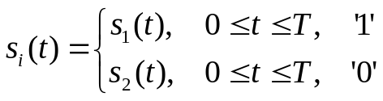



SIGNAL AND NOISE
Binary Communication System Model
  The transmitted signal over a symbol interval (0, T) is represented by
  The received signal through LTI channel
  For ideal distortionless channel,
    AWGN channel

Slide 5
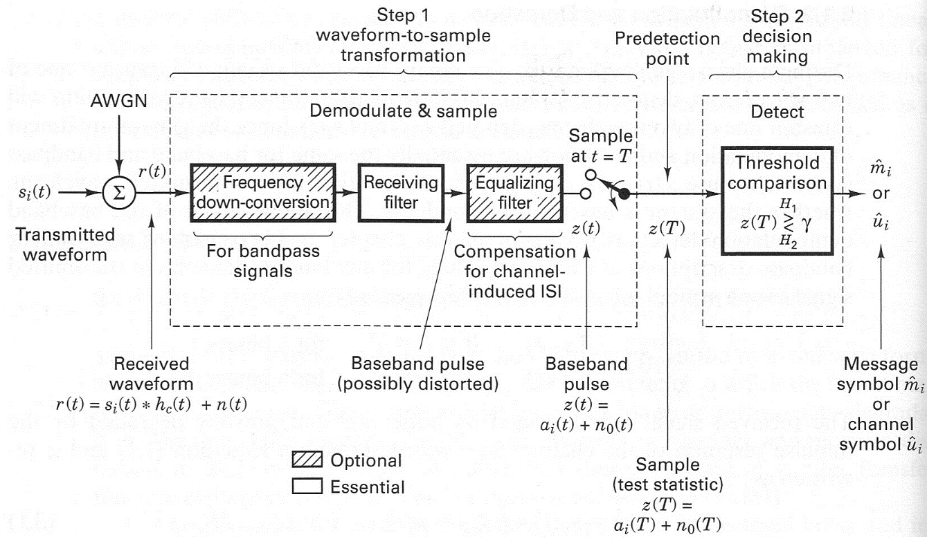
SIGNAL AND NOISE
Receiver structure
  Demodulation (frequency down-conversion, receiving filter)
    Recovers a waveform to an undistorted baseband signal
  Equalization
    Mitigates the effects caused by intersymbol interference (ISI).
  Detection
    Based on the demodulated signal, make decision of ‘1’ or ‘0’.

Slide 6



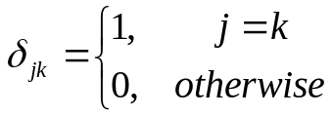



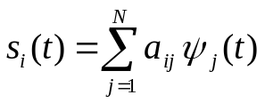
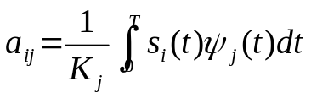
SIGNAL AND NOISE: VECTORIAL REPRESENTATION
N-dimensional Orthogonal Space
  Basis functions:
  Orthogonal functions
  If : orthonormal
  Any arbitrary finite set of waveforms
  can be expressed a linear combination of N orthogonal waveforms

Slide 7

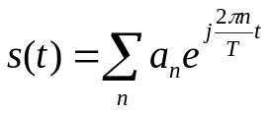






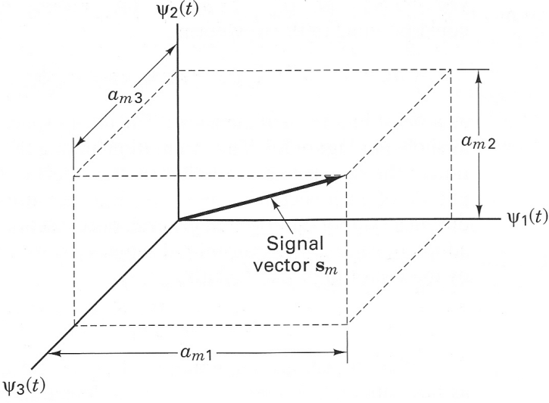
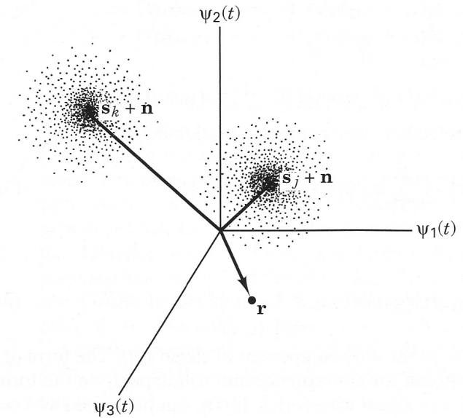
SIGNAL AND NOISE: VECTORIAL RREPSENTATION
Vectorial signal representation
  An example of orthogonal space: Fourier series
  Once the orthogonal space is chosen, there is a one-to-one mapping between and
    The signal can be equivalently represented by the vector
  Similarly, the noise, can also be represented by the vector
  The received signal, can be represented by

Slide 8
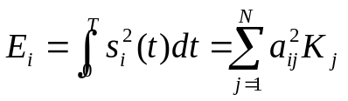
SIGNAL AND NOISE: VECTORIAL REPRESENTATION
Waveform energy
  The energy of the signal waveform over a symbol interval T
  Proof
  Generalized Parsavel’s theorem.

Slide 9
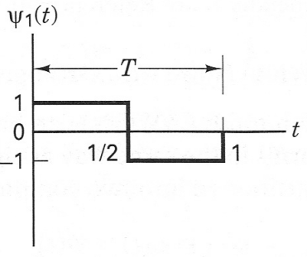
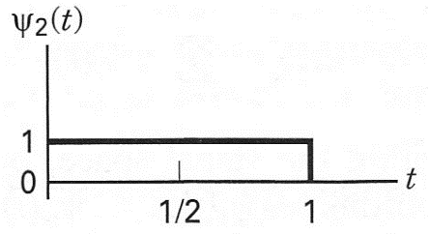
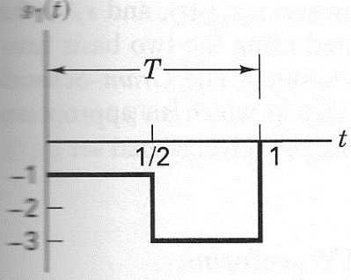
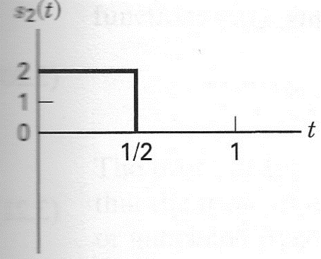
SIGNAL AND NOISE: VECTORIAL REPRESENTATION
Example

Slide 10
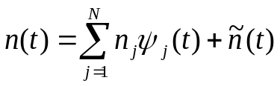
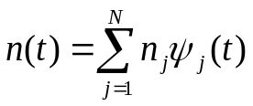




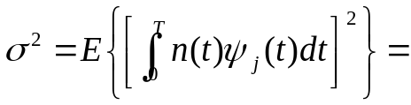
SIGNAL AND NOISE: VECTORIAL REPRESENTATION
Representation of white noise with orthogonal waveforms
  The white noise can be represented as
  doesn’t interfere with signal (we don’t need to consider it)
  has unlimited power (why?)
    But has limited power.
Variance (power) of white noise per dimension
  If the two-sided PSD of white noise is

Slide 11



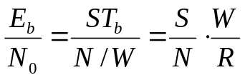
SIGNAL AND NOISE: SNR
  Normalized signal to noise ratio (SNR). The figure of merit in digital communication system.
    : energy of 1 bit
    : single-sided PSD of noise
SNR
  It allows the fair comparison between systems with different modulation levels
    E.g. a binary modulated system and a 8-ary modulated system

Slide 12
OUTLINE
Signals and noise
Detection of binary signals in AWGN
Matched Filter
Intersymbol Interference (ISI)
Equalization

Slide 13










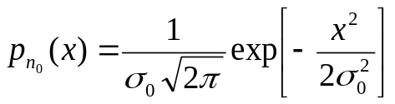
DETECTION: MAXIMUM LIKELIHOOD DETECTION
receiving
filter h(t)
After receiving filter h(t):
After sampler
  Or:
  the noise sample is obtained from linear transformation of AWGN
    is zero mean Gaussian distributed with variance

Slide 14



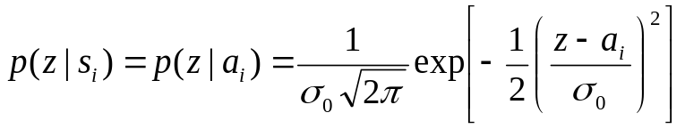
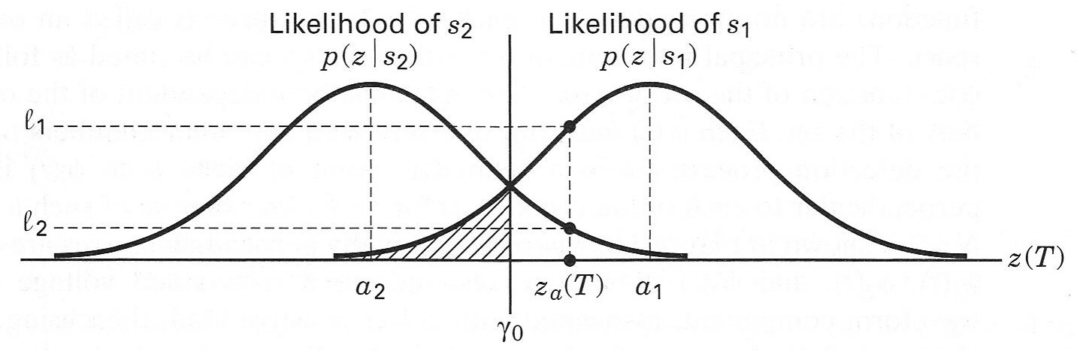
DETECTION: MAXIMUM LIKELIHOOD DETECTION
Likelihood function
  : linear transformation of Gaussian.
  When is transmitted,
likelihood function

Slide 15








DETECTION: MAXIMUM LIKELIHOOD DETECTION
Maximum likelihood receiver
  Decision rule: for a certain threshold
    When , make decision that ‘1’ is transmitted.
    When , make decision that ‘2’ is transmitted.
    How do we choose ? ➔ minimize error probability.
  The error probability when ‘1’ is transmitted.
    When is transmitted, an error will occur if
  The error probability when ‘2’ is transmitted.
    When is transmitted, an error will occur if
  Error probability:

Slide 16
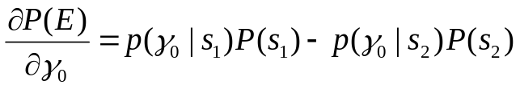
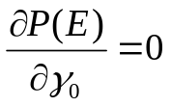
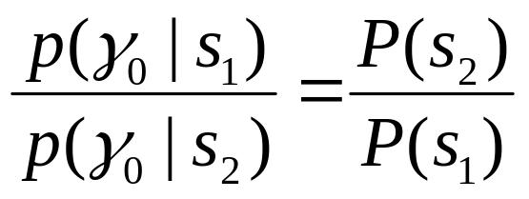
DETECTION: MAXIMUM LIKELIHOOD DETECTION
Maximum likelihood receiver (Cont’d)
  Minimize P(E)
    Differentiate P(E) with respect to
    Optimum ➔
      The optimum threshold should satisfy the following condition

Slide 17

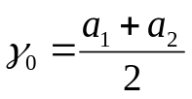
DETECTION: MAXIMUM LIKELIHOOD RECEIVER
Maximum likelihood receiver: threshold in the presence of AWGN
  : linear transformation of Gaussian.
  When is transmitted,
likelihood function
  the threshold when

Slide 18

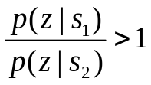
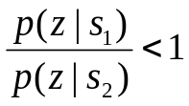


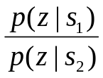
DETECTION: MAXIMUM LIKELIHOOD RECEIVER
Maximum likelihood receiver: threshold in the presence of AWGN
  The decision rule that minimize P(E) when
➔‘1’
➔‘2’
  Likelihood function:
  Likelihood ratio:

Slide 19
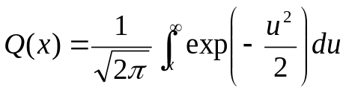

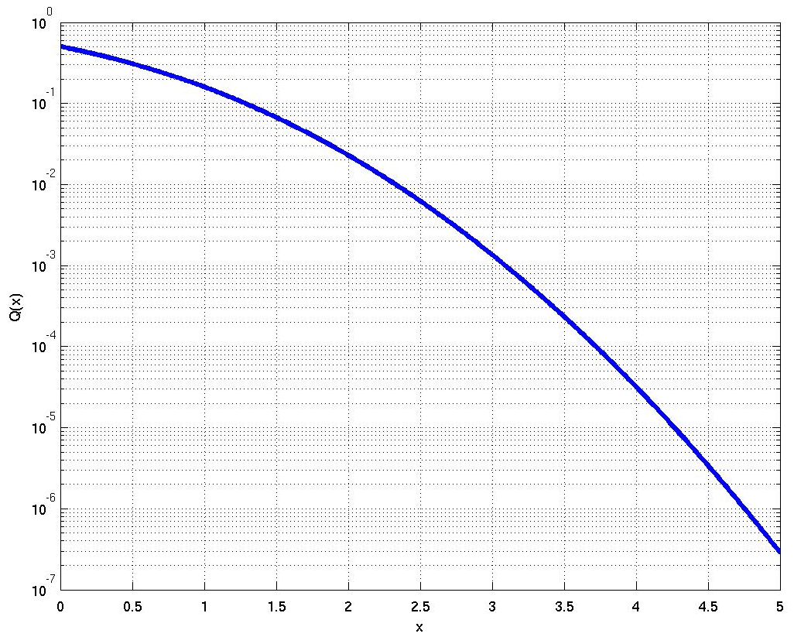


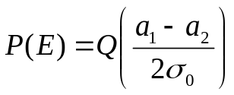
DETECTION: MAXIMUM LIKELIHOOD RECEIVER
Error probability
  Definition: Gaussian Q function:
  Error probability:

Slide 20



DETECTION: MAXIMUM LIKELIHOOD RECEIVER
Example
  Assume that in a binary digital communication system, the signal component after receiving filter and sampling is 3V when ‘1’ is transmitted, it is V when ‘0’ is transmitted. If the Gaussian noise at the output of receiving filter has unit variance. Assume ‘1’ and ‘0’ have equal probability
    1. Find the detection threshold.
    2. Find the error probability.
    3. If the output of the receiving filter and sampler is 2.4V, what should we detect?
    4. Find the values of and
    5. Write the equation that can be used to solve the threshold when P(‘1’) = 0.7, and P(‘0’) = 0.3. Solve the threshold

Slide 21
OUTLINE
Signals and noise
Detection of binary signals in AWGN
Matched Filter
Intersymbol Interference (ISI)
Equalization

Slide 22






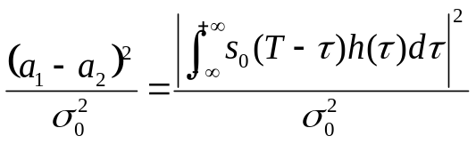
DETECTION: MATCHED FILTER
Error probability depends on
  1.
    depends on: and
  2.
    depends on: and
  We want to design receiving filter to maximize the following SNR:
h(t)

Slide 23


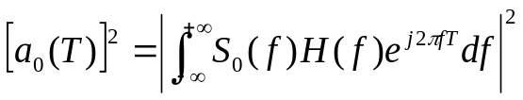
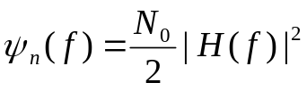
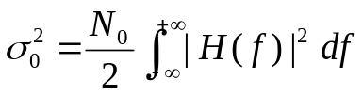


DETECTION: MATCHED FILTER
Matched filter: Design
  Signal:
inverse Fourier transform
➔
  noise:
➔
  SNR maximization
    Cauchy-Schwartz Inequality
    Equality holds if
Notes:
x(t) ←→ X(f)
x^*(-t) ←→ X^*(f)

Slide 24

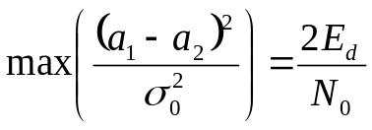

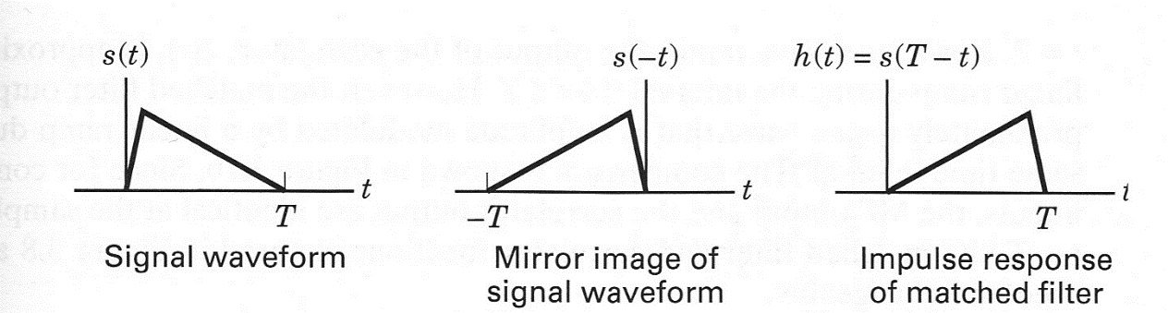
DETECTION: MATCHED FILTER
Matched filter
  The impulse response of matched filter is
Matched filter
  The impulse response of matched filter is
  The SNR at the output of the matched filter is
  the maximum output SNR depends on the input signal energy within on symbol and the PSD of noise.
    It doesn’t depend on the particular shape of the waveform

Slide 25
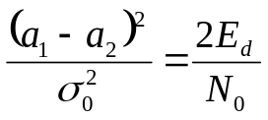
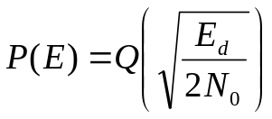

DETECTION: MATCHED FILTER
Error probability after matched filter
  Error probability
  After matched filter

Slide 26



DETECTION: BINARY SYSTEM PERFORMANCE
Unipolar signaling
        for binary ‘1’
        for binary ‘0’

Slide 27

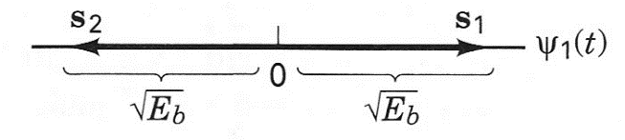
DETECTION: BINARY SYSTEM PERFORMANCE
Bipolar signaling
        for binary ‘1’
        for binary ‘0’

Slide 28


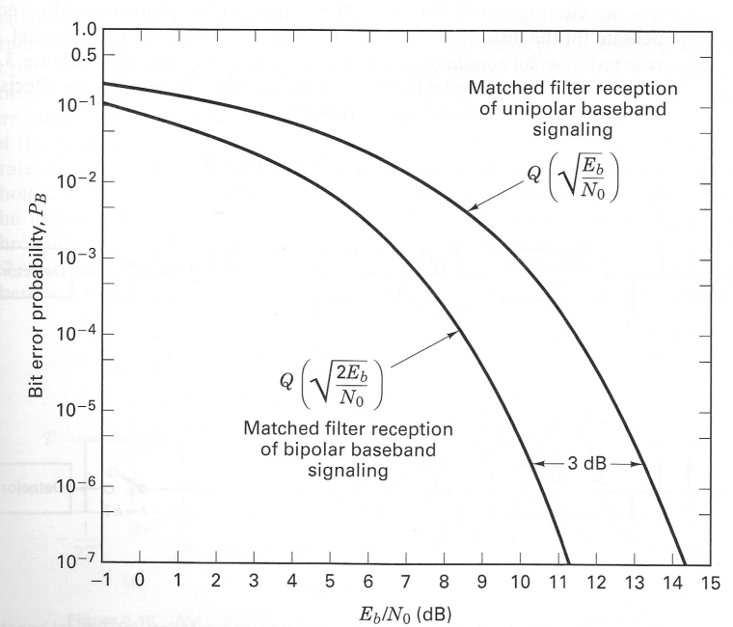
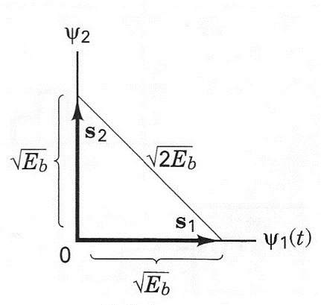

DETECTION: BINARY SYSTEM PERFORMANCE
Orthogonal signals
equals to the Euclidean distance between the constellation points.

Slide 29


DETECTION: BINARY SYSTEM PERFORMANCE
Example
  Consider NRZ binary pulses with period T are transmitted along a cable that attenuates signal by 3dB. AWGN with two-sided PSD watt/Hz. The signal is detected with a matched filter.
    1. Assume the signal amplitude is -2 V and 2 V at the transmitter. Determine the maximum data rate that can be sent with a bit error rate (BER) of ?
    2. If the data rate is 64kbps. What is the signal amplitude required at transmitter to achieve a BER of ?
Notes:
Q(3.08) = 10^{-3}

Slide 30


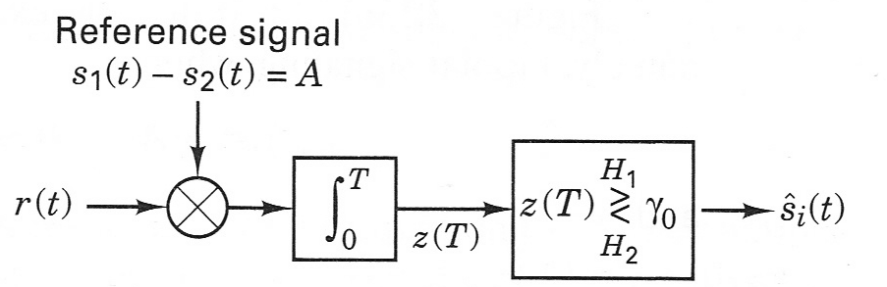
DETECTION: MATCHED FILTER
Correlation realization of matched filter
  The output of matched filter is
  The correlation between r(t) and z(t)
Notes:
Z(t) = Int r(tau) *s0(T-t+tau)
Z(T) = int r(tau)* s0(tau) dtau

Slide 31

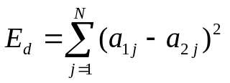



DETECTION: BINARY SYSTE PERFORMANCE
Graphic interpretation of Ed
  Vector signal representation
  is the distance between two points in an N-dimension Euclidean space

Slide 32
DETECTION: BINARY SYSTE PERFORMANCE
Graphic interpretation
  1. unipolar signal
  2. bipolar signal
  3. orthogonal signal

Slide 33
OUTLINE
Signals and noise
Detection of binary signals in AWGN
Matched Filter
Intersymbol Interference (ISI)
Equalization

Slide 34





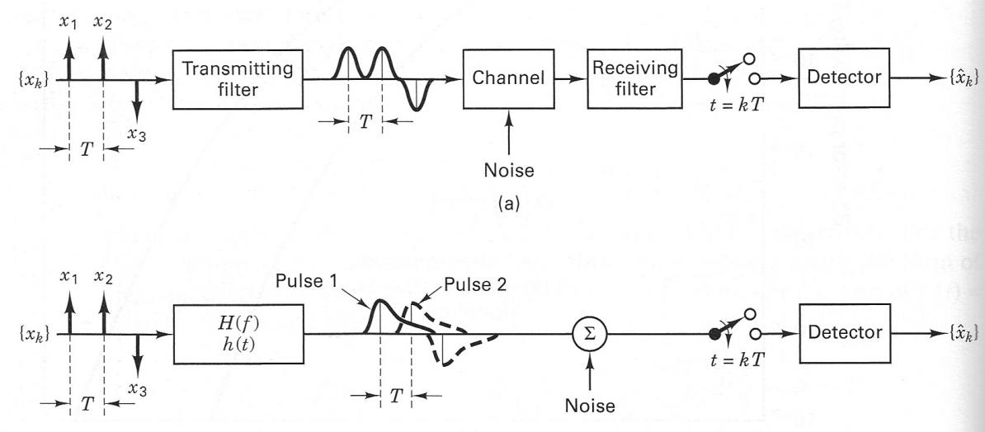






ISI
Filters in a communication system
  Composite channel impulse response (CIR), or, equivalent filter
CIR H(f)

Slide 35
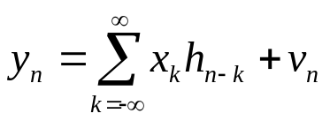
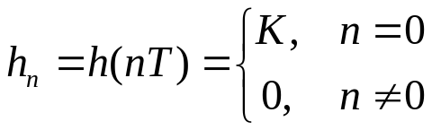
ISI
Equivalent Discrete-Time System Model
Intersymbol interference (ISI)
  Due to the effects system filtering, the received pulse can “smear” into adjacent symbol intervals, thereby interfering with other symbols.
  ISI is introduced by filtering and channel.
  ISI will degrade system performance even in the absence of noise.
Nyquist Criterion
  In order to achieve ISI-free communication, the composite impulse response (CIR) must satisfy

Slide 36
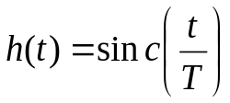
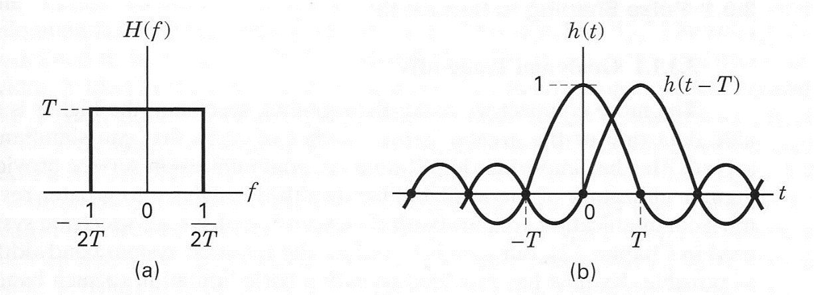

ISI: NYQUIST FILTER
Ideal Nyquist filter
  If the CIR is an ideal Nyquist filter, then the symbol can be detected without ISI.
Nyquist bandwidth constraint
  A system with bandwidth W Hz can support a maximum symbol rate of
  symbols/sec without ISI.
    What is the maximum bandwidth efficiency for M-ary modulation without ISI?

Slide 37


ISI: NYQUIST FILTER
Nyquist filter
  A general class of filters that satisfy zero ISI at the sampling points
    Ideal Nyquist filter (rectangular filter, sinc pulse) is one type of Nyquist filter
  Frequency domain:
    Ideal nyquist filter convolves with any real even-symmetric function leads to a Nyquist filter.
  Time domain
    Ideal Nyquist pulse multiplied by another time function ➔ Nyquist pulse
  Most popular Nyquist filter
    Raised cosine filter

Slide 38
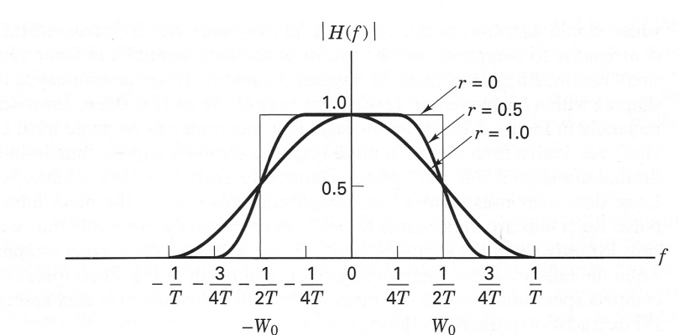
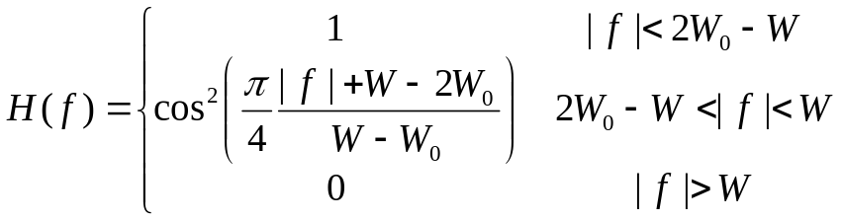





ISI: PULSE SHAPING
Pulse shaping
  Design transmit filters and receive filters such that the overall CIR, is a Nyquist pulse ➔ Reduce ISI
  Limit the bandwidth of the transmitted signal
Raised-cosine filter: frequency domain
  Frequency domain response
  W: absolute bandwidth
  minimum Nyquist bandwidth to support a symbol rate of
  excessive bandwidth
  roll-off factor

Slide 39







ISI: PULSE SHAPING
Raised-cosine filter: time domain
  Time domain response
Raised-cosine filter: roll-off factor
  ideal Nyquist filter
    Minimum bandwidth in frequency domain: ☺
    Large tail in time domain ➔ a small sampling timing error will introduce large ISI ☹
    large bandwidth: ☹
    Small tail in time domain ➔ Less susceptible to sampling timing error ☺
Baseband bandwidth
Bandpass bandwidth

Slide 40





ISI: PULSE SHAPING
Square-root raised cosine
  Raised cosine is the overall response
    is a raised cosine filter
    is a raised cosine filter
  For AWGN channel
  Square-root raised cosine filter

Slide 41

ISI: PERFORMANCE DEGRADATION
Two types of performance degradation
  1. Loss in
    Can be compensated by increasing signal power
  2. Signal distortion
    E.g. ISI
    Error floor occurs
    Cannot be compensated by increasing SNR.

Slide 42

ISI
Example
  A 4-level PAM pulse sequence has a data rate of R = 2400 bps. What is the theoretical minimum bandwidth needed for the signal without ISI?
  If the signal is passed through a raised-cosine filter with 60% excessive bandwidth. Find the bandwidth of the signal at the output of the filter
  The above sequence is modulated onto a carrier wave so that the baseband spectrum is shifted and centered at frequency . Find the DSB bandpass bandwidth.
Notes:
W0 = Rs/2 = 1200 Hz
W = (1+r)W0=1.6*1200 Hz
Wdsb = 2*W = 3.2*1200 Hz

Slide 43
OUTLINE
Signals and noise
Detection of binary signals in AWGN
Intersymbol Interference (ISI)
Matched Filter
Equalization

Slide 44


EQUALIZATION
Equalization
  Any signal processing or filtering technique that is designed to eliminate or reduce ISI.
  For AWGN channel,
    ISI-free communication can be achieved by using square-root raised cosine filter as both transmit filter and receiving filter
      is raised cosine (Nyquist filter).
  For general channel, will introduce ISI
    Equalization is required.

Slide 45
















EQUALIZATION: DISCRETE-TIME MODEL
Discrete-time system model
Tx filter
Channel
Rx filter
  Signal after Rx filter
  Signal after Sampler
  Discrete-time CIR
    Depends on: 1. Tx filter, 2. Channel, 3. Rx filter, 4. Sampling period
  Equivalent discrete-time system model

Slide 46




EQUALIZATION: DISCRETE-TIME MODEL
Discrete-time system model examples
  Example 1: AWGN channel with square root raised cosine filters

Slide 47






EQUALIZATION: DISCRETE-TIME MODEL
Discrete-time system model examples
  Example 2: Two tap equal gain channel

Slide 48







EQUALIZATION
A possible equalization method:
  At time 1, (no ISI) ➔
  At time 2, ➔
  At time 3, ➔
  Problem: if is in error, all the remaining symbols will be affected!
    Error propagation.

Slide 49

EQUALIZATION: CLASSIFICATION
Classification: based on linearity
  Linear:
    Zero-forcing (ZF), minimum mean square error (MMSE)
  Non-linear
    Decision feedback equalization (DFE)
    Maximum likelihood sequence estimation (MLSE) (Optimum)
Classification: based on nature of operation
  Transversal equalizer
    ZF, MMSE
    E.g. Choose equalization filter with frequency response
  Transversal filter + feedback filter:
    DFE
  Trellis based equalizer
    MLSE

Slide 50





EQUALIZATION: TRANSVERSAL EQUALIZER
Transversal equalizer
  Suppressing the effects of ISI by passing the received samples through a linear filter
equalizer

Slide 51




EQUALIZATION: TRANSVERSAL EQUALIZER
Transversal equalizer: Matrix representation
  Example
    Consider a transversal equalizer with 3 taps (N = 1). The ISI and noise distorted received samples are ,
    represent the transversal equalizer in matrix format

Slide 52

EQUALIZATION: TRANSVERSAL EQUALIZER
How do we determine the equalizer coefficients?
  The operation of equalizer contains two steps: 1. training, 2. transmission
  Training:
    Before transmission of the actual data, the transmitter sends a known sequence.
      Could be a single narrow pulse
      Or, a pseudo-noise sequence.
    When the training sequence arrives at receiver, it is distorted by ISI and noise ➔ The distorted training sequence contains information about the channel
    The receiver calculates the equalizer coefficients based on the ISI and noise distorted training sequence.
      ZF criterion
      MMSE criterion
  Data transmission
    Once the equalizer coefficients have been trained, the Tx can send actual data.

Slide 53







EQUALIZATION: ZF
Zero-forcing equalization
  During the training stage, calculate the transversal equalizer coefficients based on the zero-forcing criterion.
  Training sequence:
  Zero-forcing:
    Selecting such that the output of the equalizer is
      Force the elements of to be zero when

Slide 54



EQUALIZATION: ZF
Zero-forcing equalization: example
  During the training stage, a impulse is transmitted, and the received distorted samples are .
    Find the zero-forcing equalization coefficients
    Find the output of the equalizer when the distorted samples are at the input.
Department of Engineering Science
Sonoma State University
Jingxian Wu, 8/15/2007
Notes:
N = 1
Y = 0.9, 0.2, 0.0
-0.3,0.9, 0.2
0.1, -0.3, 0.9
Y^{-1} [0; 1; 0] = [-0.2140;0.9631; 0.3448]
C-1 = -0.2140
c0 = 0.9631
C1 = 0.3448
Z-1 = c-1 y0 + c0 y-1 = -0.2140*0.9+0.9631*0.2 = 2e-5
Z0 = c-1 y1 + c0y0 + c1 y-1 = -0.2140*(-0.3)+0.9631*0.9+0.3448*0.2 = 1
Z1 = c-1 y2 + c0 y1 + c1 y0 = -0.2140*0.1 + 0.9631*(-0.3) + 0.3448*0.9 = -1e-5

Slide 55






EQUALIZATION: MMSE
Minimum mean square error (MMSE) equalizer
  Minimize the mean square error (variance of error)
  Training sequence
  MMSE:
    Error:
    MSE:
    MMSE: Selecting such that the MSE, ,is minimized
    Solution:
Notes:
N = 1
Y = 0.9, 0.2, 0.0
-0.3,0.9, 0.2
0.1, -0.3, 0.9

