Slide 1
ELEG5663 Communication Theory
Ch. 4 Bandpass Modulation and Demodulation
Dr. Jingxian Wu
wuj@uark.edu

Slide 2
OUTLINE
Introduction
Bandpass Modulation
Coherent Detection
Noncoherent Detection
Complex Envelope

Slide 3



INTRODUCTION
Bandpass modulation
  Recall: baseband modulation
    Mapping digital symbols onto baseband waveforms (pulse shapes) that are compatible with channel.
  Bandpass modulation
    The baseband pulse shapes are translated to a higher frequency by using a carrier wave (a high frequency sinusoid)
Why bandpass modulate?
  To transmit a signal, antennas are usually ¼ of wavelength
    : higher frequency ➔ smaller wavelength ➔ smaller antenna.
      E.g. 3KHz baseband signal,
      1GHz bandpass signal,
  Translate the signal to a pre-allocated channel
    E.g. frequency division multiple access (FDMA)
Notes:
3e8/3e3 = 1e5 = 100,000 m = 100 km
3e8/1e9 = 0.3 m \approx 1 foot

Slide 4
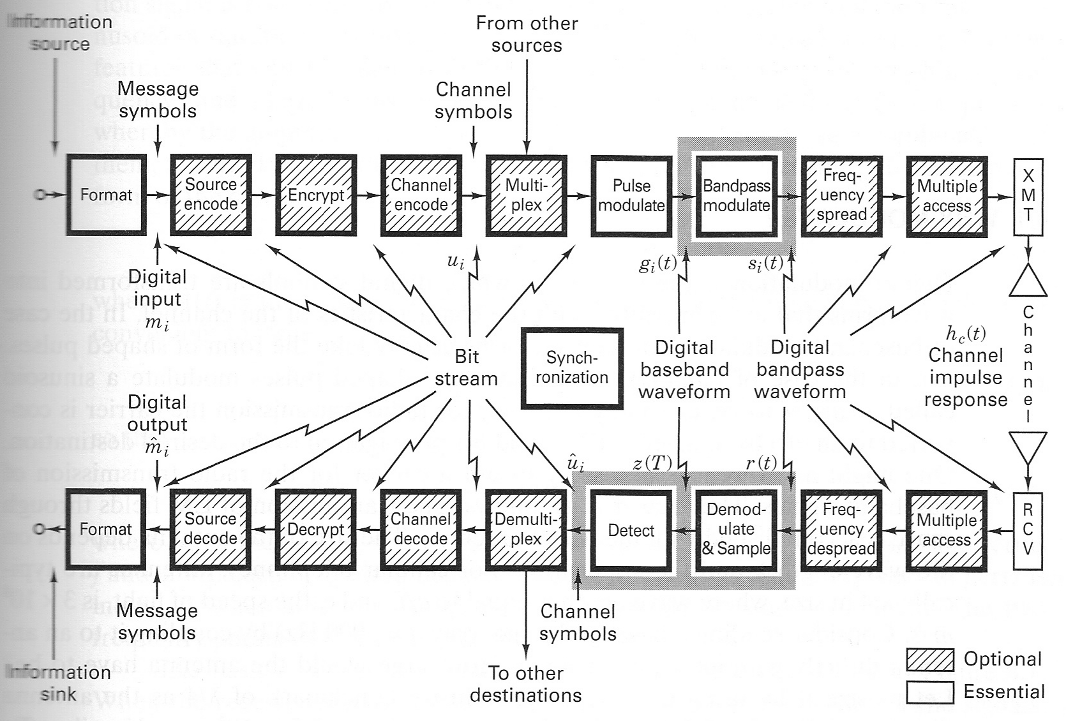
INTRODUCTION
Bandpass modulation and demodulation

Slide 5
OUTLINE
Introduction
Bandpass Modulation
Coherent Detection
Noncoherent Detection
Complex Envelope

Slide 6


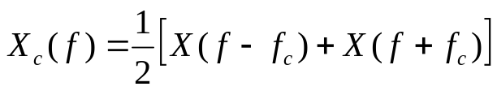
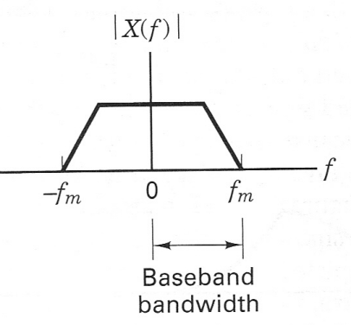
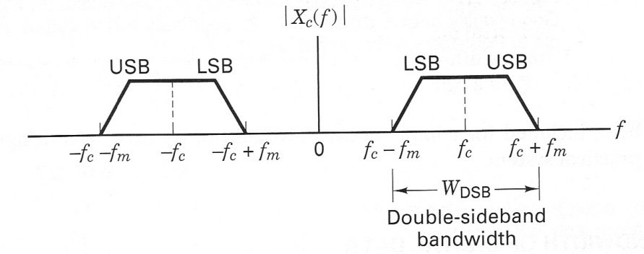
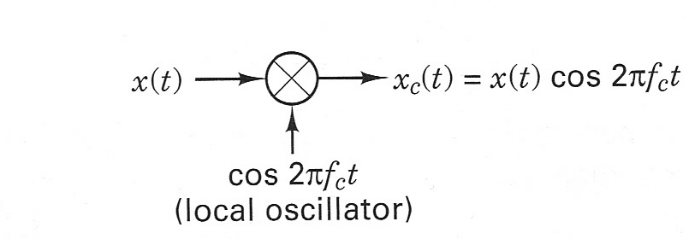
BANDPASS MODULATION
Bandpass modulation
  The amplitude, frequency, or phase of a radio frequency (RF) carrier, or a combination of them, is varied in accordance with the information to be transmitted.
  Through bandpass modulation, a baseband signal is shifted to a higher frequency.
    Example, amplitude shift keying.
    Time domain:
    Frequency domain:

Slide 7
BANDPASS MODULATION
Types of bandpass modulation
  Coherent (the receivers exploits knowledge of the carrier’s phase for detection)
    Phase shift keying (PSK)
    Frequency shift keying (FSK)
    Amplitude shift keying (ASK)
    Continuous phase modulation (CPM)
    Hybrid: Quadrature amplitude modulation (QAM)
  Noncoherent (the receivers operate without knowledge of the absolute value of the signal’s phase)
    Differential phase shift keying (DPSK)
    Frequency shift keying (FSK)
    Amplitude shift keying (ASK)
    Continuous phase modulation (CPM)
    Hybrid: Quadrature amplitude modulation (QAM)

Slide 8
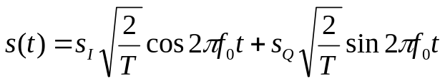

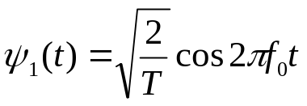
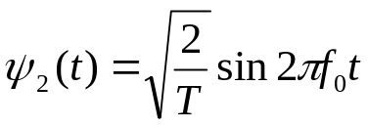








BANDPASS MODULATION: VECTOR REPRESENTATION
Most bandpass modulated signals can be represented as
  Orthogonal representation of signal
    and are orthonormal
      Proof:
  The bandpass modulated signal can be represented as
    : there is a one-to-one relationship between and the two dimensional vector

Slide 9
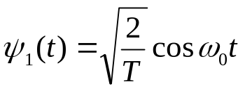
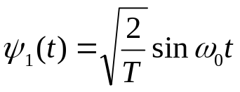



BANDPASS MODULATION: VECTOR REPRESENTATION
Vector representation of bandpass modulated signal
  Inphase component:
  Quadrature component:
  The inphase carrier, , and quadrature carrier,
  are orthonomral.
  The bandpass modulated signal can be equivalently represented as vector
Complex number representation of bandpass modulated signal
  There is a one-to-one relationship between a 2D vector and complex number
  The bandpass modulated signal can be equivalently represented as a complex number
  The complex number representation is only used
  for mathematical convenience.

Slide 10
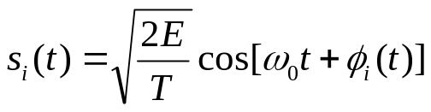



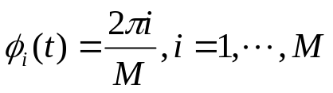
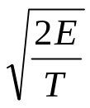
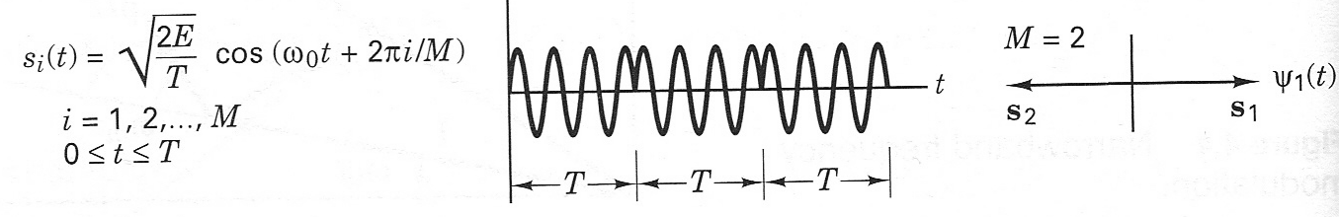
BANDPASS MODULATION: PSK
Phase shift keying (PSK)
  : carrier frequency
  Each digital symbol is mapped to a different phase
  Why ?
  An example of BPSK

Slide 11
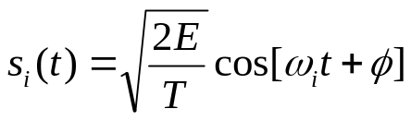


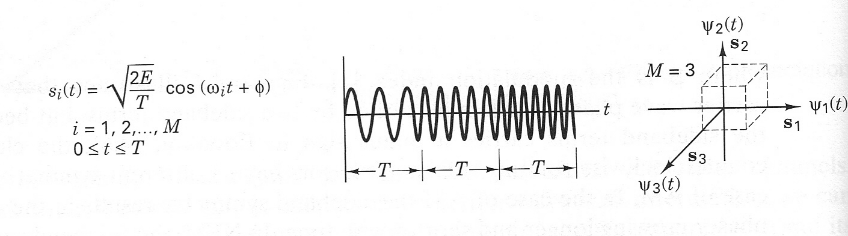
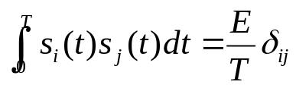
BANDPASS MODULATION: FSK
Frequency shift keying (FSK)
  Each digital symbol is mapped to a different frequency.
  The set of signals, , could be orthogonal or non-orthogonal.
  An example of orthogonal FSK.

Slide 12
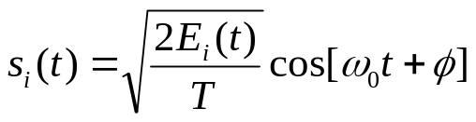
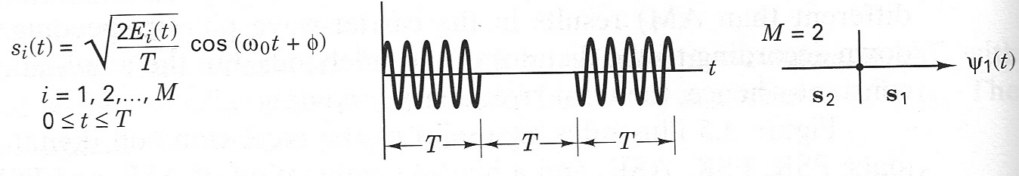
BANDPASS MODULATION: ASK
Amplitude shift keying (ASK)
  Each digital symbol is mapped to a different amplitude
  An example of BASK (on-off keying)

Slide 13
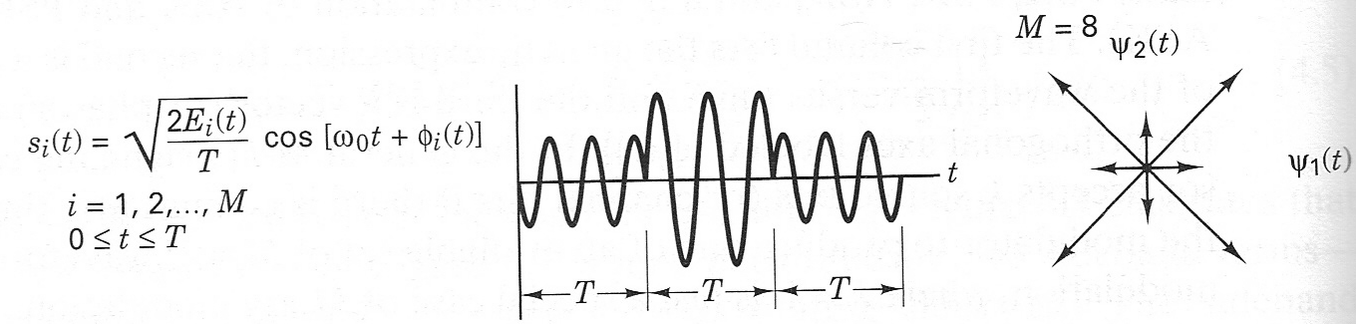
BANDPASS MODULATION: ASK
Amplitude phase keying (APK)
  Both amplitude and phase are altered by the digital symbol.
  An example of a 8-ary APK

Slide 14
OUTLINE
Introduction
Bandpass Modulation
Coherent Detection
Noncoherent Detection
Complex Envelope

Slide 15
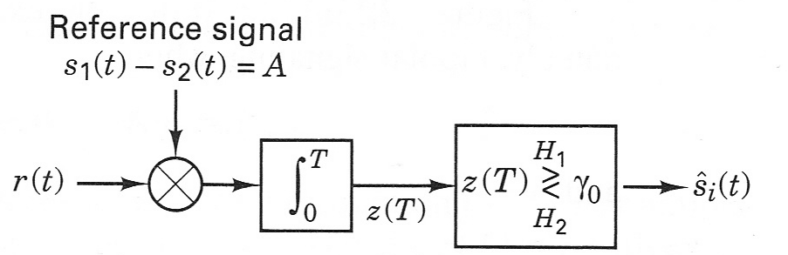
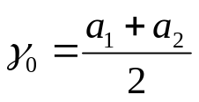


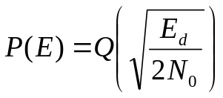

COHERENT DETECTION: BPSK
Recall: correlation receiver of binary baseband signal
  the output of correlation receiver is the same as the output of matched filter and sampler
  Bit error probability

Slide 16



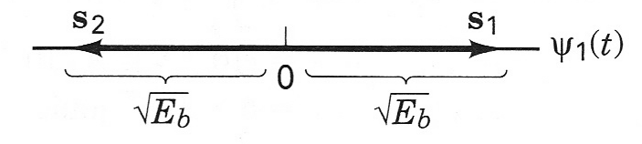
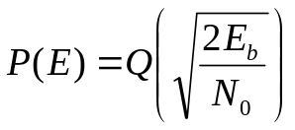
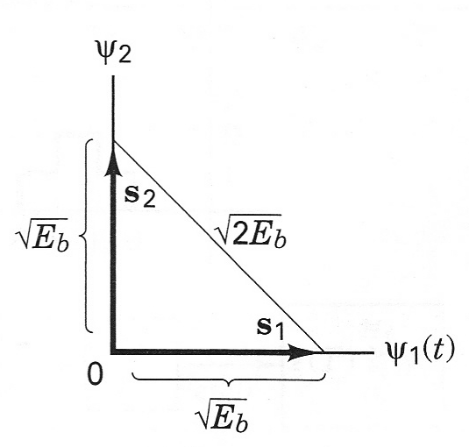
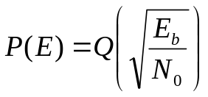

COHERENT DETECTION: BPSK
Recall: correlation receiver of binary baseband signal (Cont’d)
  Bit error probability with vector signal representation
  Bipolar signal
  Orthogonal signal
    is the squared distance between the two modulation points.

Slide 17
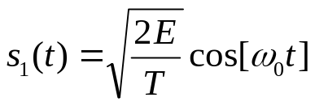
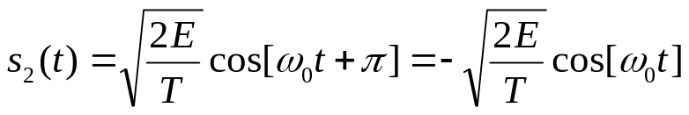
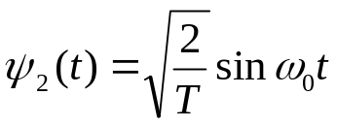


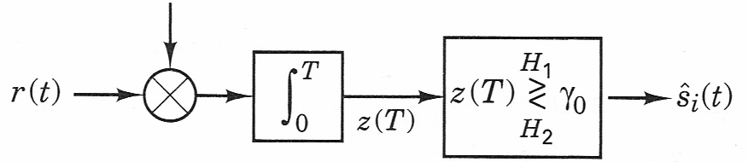


COHERENT DETECTION: BPSK
Binary Phase Shift Keying (BPSK)
  Orthogonal representation
  Correlation receiver

Slide 18
COHERENT DETECTION: BPSK
Bit error probability of BPSK

Slide 19




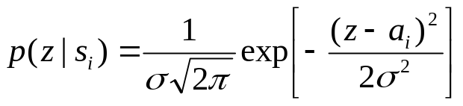




COHERENT DETECTION: BPSK
BPSK: revisit maximum likelihood detector
  Likelihood function
  Maximum likelihood detection rule:
    If , detect
    If , detect
    Equivalently:
      In the orthogonal representation of signal, choose the signal that has the smallest Euclidean distance with the received sample

Slide 20



COHERENT DETECTION: BPSK
Example
  Find the expected number of bit errors made in one day by the following continuously operating coherent BPSK receiver. The data rate is 1 kbps. The input waveforms are and where A = 2mV and the double-sided noise PSD is .

Slide 21

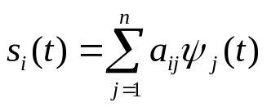






COHERENT DETECTION: MAXIMUM LIKELIHOOD
Maximum Likelihood Detection
  Signal:
  Rx Signal:
  Correlation receiver:
  Likelihood function
Maximum Likelihood
…

Slide 22

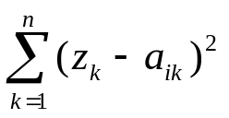




COHERENT DETECTION: MAXIMUM LIKELIHOOD
Maximum Likelihood Detection
  Choose that minimizes
Graphical Interpretation
  M-ary modulation, there are M constellation points:
  After correlation detector, there is an n-dimension point:
  Detection: choose such that the Euclidean distance is minimized

Slide 23





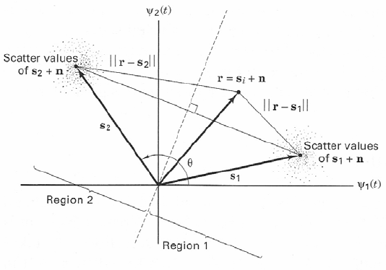
COHERENT DETECTION
Maximum Likelihood detection: 2-Dimension
  Choose such that the Euclidean distance between the vector and
  are minimized.
  Decision region example
    Whenever the received signal is located in region 1, choose signal
    Whenever the received signal is located in region 2, choose signal

Slide 24
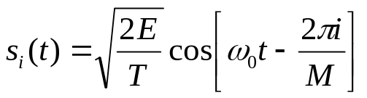
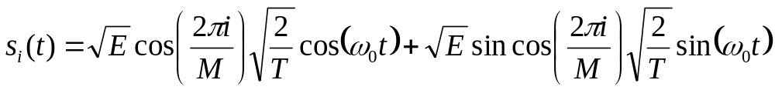
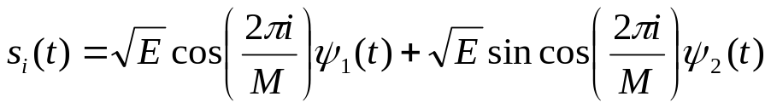
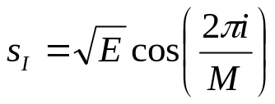
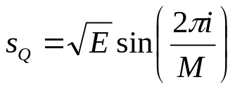
COHERENT DETECTION: MPSK
Multiple Phase Shift Keying (MPSK)
  Orthogonal representation of MPSK signals
  Inphase component
  Quadrature component

Slide 25
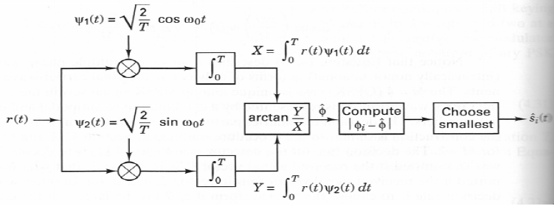


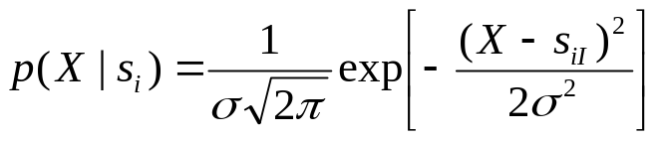
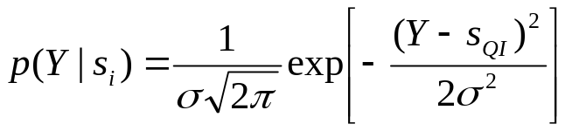
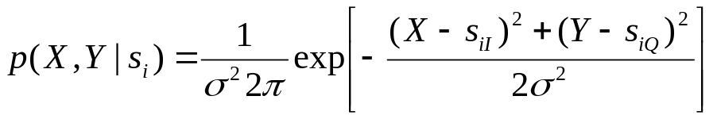

COHERENT DETECTION: MPSK
MPSK coherent detection
  Structure of receiver
  Likelihood functions
  Maximum likelihood detection
    Choose that minimizes

Slide 26
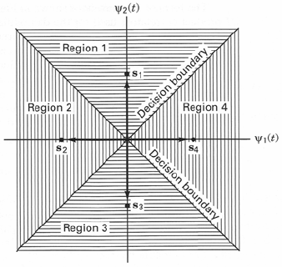








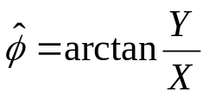
COHERENT DETECTION: MPSK
MPSK coherent detection (Cont’d)
  The distance between and
  Maximum likelihood decision rule
    Choose that minimizes the distance between and
    Equivalently, choose with phase that is closest to the phase of the signal at the output of the correlator:
      Find that minimize

Slide 27
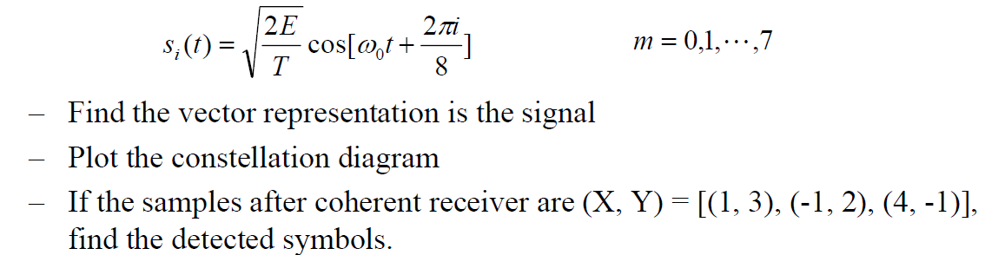
COHERENT DETECTION: MPSK
Example:
  For a system with 8PSK, if the received symbols are:

Slide 28
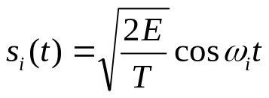


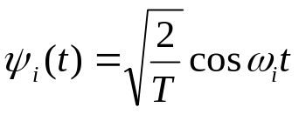

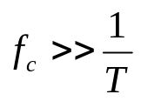


COHERENT DETECTION: MFSK
Multiple frequency shift keying (MFSK)
  The value of can be chosen such that are mutually orthogoanal ➔ orthogonal MFSK
    Orthogonal MFSK is a special case of MFSK
    We are only going to examine orthogonal MFSK
  Orthogonal MFSK
  Example: Show the following system is orthogonal BFSK if

Slide 29




COHERENT DETECTION: MFSK
Coherent receiver structure of MFSK
  Structure of a receiver
  Output of the correlation detector for MFSK
    Output of the correlation detector of MFSK is coordinate in orthogonal signal representation

Slide 30
COHERENT DETECTION: MFSK
Maximum Likelihood detection
  Choose that minimizes the Euclidean distance between
Bit error probability of BFSK

Slide 31









COHERENT DETECTION
Vector representation of bandpass communication system
  Recall vector representation of bandpass modulated signal
  The bandpass communication system is equivalently represented as the summation of signal vector and noise vector

Slide 32









COHERENT DETECTION
Maximum likelihood detection
  For AWGN with two-sided PSD
    The noise variance per dimension is
  Likelihood functions
  and are independent
  Maximize ➔ Minimize
  Minimize the Euclidean distance between the vector and

Slide 33
OUTLINE
Introduction
Bandpass Modulation
Coherent Detection
Noncoherent Detection
Complex Envelope

Slide 34







NONCOHERENT DETECTION
Why noncoherent detection?
  Coherent detection requires the exact knowledge of the phase of the received signal
  Example: BPSK
    The distance between Tx and Rx is d
    At Tx, the signal is
    At Rx, the signal is
    : the amount of time the signal travels from Tx to Rx
    : the phase of the signal at the receiver
    In order to perform coherent detection, the Rx needs to know
      can be estimated through a circuitry called phase locked loop (PLL)

Slide 35
NONCOHERENT DETECTION
Why noncoherent detection? (Cont’d)
  What if the Rx doesn’t have the knowledge of ?
  Example:
    Assume a system operates a 1GHz. If the distance between Tx and Rx is 24.075m, find out the phase of the Rx signal.
Noncoherent detection
  The Rx doesn’t require the knowledge of the absolute phase of the Rx signal.

Slide 36






NONCOHERENT DETECTION: DPSK
Differential PSK
  The information is carried by the phase difference between the current symbol and the previous symbol
    Recall: for coherent PSK, the information is carried by the absolute phase of one symbol.
  Example:
    The kth Rx symbol is
    The (k+1)th Rx symbol is
    The phase difference between the two consecutive symbols
    The information is carried by the phase difference
  The Rx doesn’t need the knowledge of the absolute phase . The information is carried by the phase difference.

Slide 37



NONCOHERENT DETECTION: DPSK
Binary DPSK
  The essence of differential detection is that the data is carried in the phase difference between two consecutive symbols
  Tx: differential encoding; Rx: differential decoding.
  Binary differential encoding
    m(k): information
    c(k): differentially encoded bit
    : modulo-2 addition
    – : complement
    The information, m(k), is carried by the difference between c(k) and c(k-1)

Slide 38


NONCOHERENT DETECTION: DPSK
Binary DPSK
  Binary differential decoding

Slide 39
NONCOHERENT DETECTION: DPSK
DPSK: pros and cons
  Pro:
    Doesn’t require the absolute value of the signal phase ➔ simpler receiver
  Con:
    Two noisy signal are compared to detect the signal ➔ there are twice as much noise as in coherent detection ➔ the performance is worse compared to coherent detection
  Trade-off between complexity and performance

Slide 40

NONCOHERENT DETECTION: FSK
Non-coherent detection of FSK

Slide 41

NONCOHERENT DETECTION: FSK
Non-coherent detection of FSK
  If has been transmitted
    What are the values at the output of the non-coherent detector of FSK?

Slide 42
NONCOHERENT DETECTION: FSK
Non-coherent detection of FSK
  The minimum tone space for non-coherent orthogonal FSK

Slide 43
NONCOHERENT DETECTION: FSK
Minimum Tone Spacing for Coherent Orthogonal FSK

Slide 44

NONCOHERENT DETECTION
Coherent detection v.s. non-coherent detection

Slide 45
OUTLINE
Introduction
Bandpass Modulation
Coherent Detection
Noncoherent Detection
Complex Envelope

Slide 46








COMPLEX ENVELOPE
Complex representation of bandpass modulated signal
  There is a one to one relationship between and
Complex envelope
  The complex baseband signal is called complex envelope
    The envelope of the bandpass signal.
  The complex envelope is the same as the vector representation of the signal up to a scaling factor

Slide 47




COMPLEX ENVELOPE
Complex envelope
  Polar representation
    Amplitude
    Phase

Slide 48



COMPLEX ENVELOPE
Bandpass modulation can be divided into two steps (Constellation)
  1. Baseband modulation:
    Transfer information (‘1’s and ‘0’s) into complex envelope
    Example: 8PSK
    1 0 0 0 1 0 1 1 1 0 0 1 0 0 0
  2. Frequency upconversion
    Multiply the complex envelope with

Slide 49

COMPLEX ENVELOPE
Quadrature implementation of a modulator
  Baseband modulation:
    Mapping ‘0’s and ‘1’s to the values of x(t) and y(t).
  Frequency upconversion:
    Upconverting the frequency of the baseband signal through quadrature modulation.

Slide 50

COMPLEX ENVELOPE
Quadrature implementation of a demodulator
  Frequency downconversion:
    Downconverting the frequency of the bandpass signal.
  Baseband demodulation:
    Mapping the baseband signal to ‘0’s and ‘1’s

Slide 51

COMPLEX ENVELOPE: D8PSK
D8PSK (Differential 8PSK)
  Baseband modulation
  Frequency upconversion

Slide 52

COMPLEX ENVELOPE: D8PSK
D8PSK Demodulation
  Frequency downconversion
  Baseband demodulation

Slide 53
OUTLINE
Introduction
Bandpass Modulation
Coherent Detection
Noncoherent Detection
Complex Envelope
Error Probability

Slide 54



ERROR PROBABILITY: BINARY MODULATION
Comparison of error performance of binary system
  BER of BPSK
  BER of coherently detected, differentially encoded binary PSK
  BER of differentially detected, differentially encoded binary PSK (DPSK)

Slide 55


ERROR PROBABILITY: BINARY MODULATION
Comparison of error performance of binary system
  BER for coherently detected binary orthogonal FSK
  BER for non-coherently detected binary orthogonal FSK

Slide 56

ERROR PROBABILITY: BINARY MODULATION
  Coherent detection PSK > coherent detection of differentially encoded PSK > Differential detection of differentially encoded PSK (DPSK) > Coherent detection of orthogonal FSK > Noncoherent detection of orthogonal FSK.

Slide 57



ERROR PROBABILITY: MPSK
Symbol error rate for MPSK
  Symbol error rate (SER): # of error symbols/# of symbols transmitted
  : symbol energy

Slide 58


ERROR PROBABILITY: MFSK
SER for MFSK

Slide 59


ERROR PROBABILITY: BER V.S. SER
Relationship between BER and SER for MPSK
  Gray encoding: two adjacent symbols differ in 1 bit
    At high SNR, most of the errors are the confusion between adjacent symbols
    At high SNR, 1 symbol error approximately corresponds to 1 bit error

Slide 60

ERROR PROBABILITY: BER V.S. SER
Relationship between BER and SER for orthogonal signals
  The relationship is exact

