Slide 1
CES 540 Digital Data Transmission
Ch. 5 Link Analysis
Dr. Jingxian Wu
Jingxian.wu@sonoma.edu

Slide 2
OUTLINE
Introduction
Channel
Received Signal Power and Noise Power
Link Budget Analysis
Noise Figure

Slide 3
INTRODUCTION
Communication Link
  The entire communication path
    Starting from information source
    Ending at information sink.
    Includes all the encoding, modulation, channel, demodulation, decoding steps involved during the transmission of the information.
Link analysis
  The calculations and tabulation of useful signal power and interfering noise power at the receiver.
    Calculate the SNR at receiver by consider all the effects through the communication link:
      Distance
      Frequency
      Temperature
      Bandwidth
      Interference
      ……

Slide 4

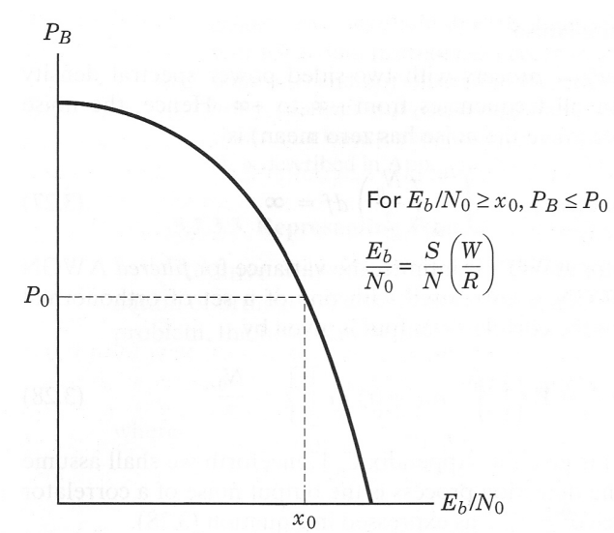
INTRODUCTION
Link budget
  The results of link analysis
  An estimation of the error performance of communication system.
  Example: find out the value of at receiver through link analysis, then find out the error probability through the BER v.s. curve.
Why link analysis?
  Find out the necessary parameters to meet certain system requirement.
  Find out whether the designed system will meet the requirements
    E.g. whether the error probability is below a certain value.
  Find out the performance constraining factors in the system
  Find out the trade-off that can be made in the system
    Adjust certain parameters to meet requirements.
  Estimate the power, cost for implementing a system.
Jingxian Wu, 8/15/2007

Slide 5
OUTLINE
Introduction
Channel
Received Signal Power and Noise Power
Link Budget Analysis
Noise Figure

Slide 6
CHANNEL
Channel
  The propagation medium of the electromagnetic signals that bear the information.
    Wired channel
      Twisted pair
      Coaxial cable
      Fiber optic cable
    Wireless channel
      Vacuum
      Air
      Water
  Different channels have different impacts on the transmitted signals.

Slide 7
CHANNEL: FREE SPACE
Free space
  An ideal RF propagation path
  The RF energy arriving at the receiver is assumed to be a function only of distance between Tx and Rx.
  Free of all hindrances to RF propagation, such as
    Absorption,
    Reflection
    Refraction
    Diffraction
    These factors will be discussed in the Wireless Communications course
  Only free space propagation will be considered in this chapter.

Slide 8
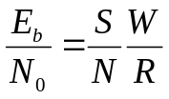
CHANNEL
Error performance degradation
  Error probability depends on and modulation scheme
  depends on
    S: average signal power
    N: average noise power
    W: bandwidth
    R: bit rate
  Signal power and noise power are affected by the channel.
  SNR degradation can be contributed by two factors
    Signal loss (the power of the signal becomes weaker)
    Noise

Slide 9
CHANNEL: SNR DEGRADATION
Sources of SNR degradation
  1. Bandlimiting loss (signal loss)
    All communication systems use filters to constrain the bandwidth of the signal to avoid interference to other users.
    This will results in signal loss.
  2. ISI (interference source)
    One symbol might smear into another symbol in time domain and cause ISI.
    Imperfect filtering, system bandwdith constraints, lost of synchronization will cause ISI.
  3. Local oscillator (LO) phase noise (signal loss and noise source)
    In coherent detection, if the phase of the reference signal is different from the phase of the received signal, it will result in signal energy loss.
    Phase fluctuations or jitter will also add noise to the signal.

Slide 10
CHANNEL: SNR DEGRADATION
Sources of SNR degradation
  4. Antenna efficiency (signal loss)
    The receiver antenna can only capture partial of the signal power.
  5. Space loss (signal loss)
    The longer the transmission distance, the weaker the received signal.
  6. Co-channel interference (noise source)
    Caused by other users/communication systems that are using the same channel
  7. Adjacent channel interference (noise source)
    Unwanted signals spilled over from neighboring channels.
  8. Thermal noise (noise source)
    Always present in communication system
  ……

Slide 11
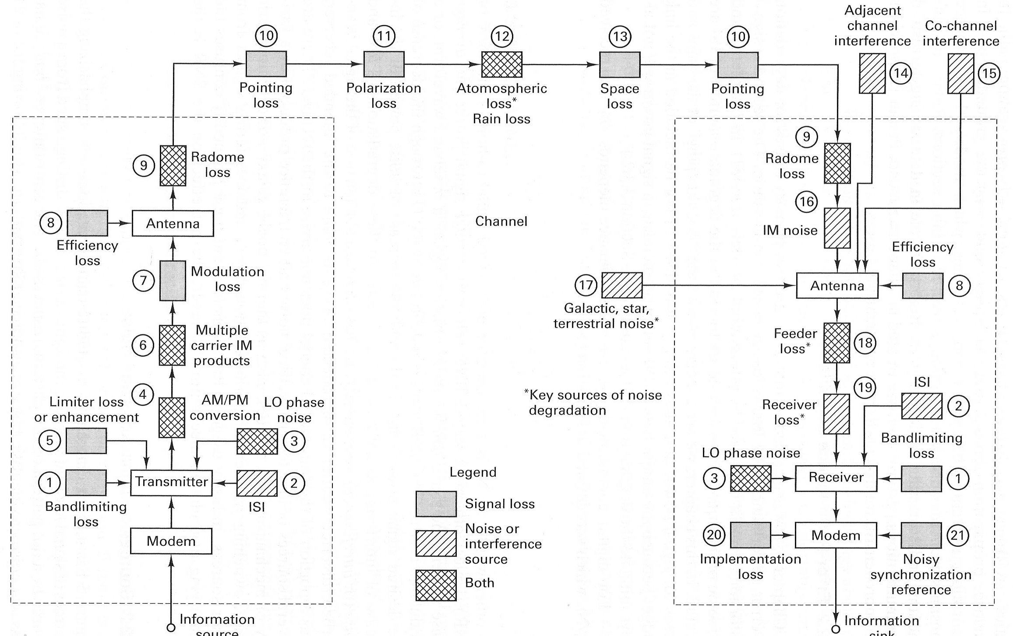
CHANNEL: SNR DEGRADATION
Department of Engineering Science
Sonoma State University
Jingxian Wu, 8/15/2007

Slide 12
OUTLINE
Introduction
Channel
Received Signal Power and Noise Power
Link Budget Analysis
Noise Figure

Slide 13
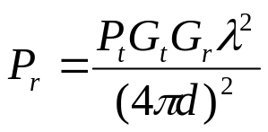




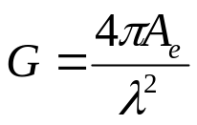




SNR: SIGANL POWER
Free space propagation equation
  : power at transmitter
  transmitter antenna gain
  receiver antenna gain
  : wavelength. (the distance of propagation within one period).
  d: distance between Tx and Rx.
Antenna gains
  : antenna effective area
    : antenna efficiency. actual antenna area.
  : wavelength. (the distance of propagation within one period)

Slide 14

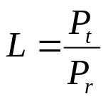
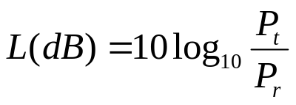

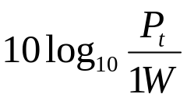
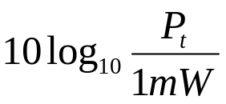
SNR: SIGANL POWER
EIRP (effective isotropic radiated power)
Pathloss
  The ratio between transmit power and receiver power
  L is always bigger than 1.
  L(dB) is always bigger than 0.
  1 (dBW) =
  1 (dBm) =

Slide 15
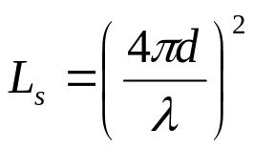
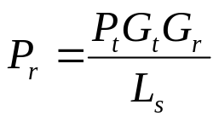
SNR: SIGANL POWER
Free space loss
  The pathloss due to free space propagation only
    DO NOT consider the effects of antenna gain
  With free space loss, the received signal power can be expressed as

Slide 16
SNR: SIGNAL POWER
Example
  A transmitter has an output of 2 W at a carrier frequency of 2 GHz. Assume that the transmitting and receiving antennas are parabolic dishes each 1 meter in diameter. Assume the efficiency of the Tx antenna is 0.6, and the efficiency of the Rx antenna is 0.4.
    1. Evaluate the gains of the two antennas.
    2. Calculate the EIRP of the transmitted signal in unit of dBW.
    3. If the Rx antenna is 30 km from the Tx antenna over a free-space path, find the free space loss
    4. Find the received signal power in unit of dBW.

Slide 17





SNR: THERMAL NOISE POWER
Thermal noise
  Caused by the thermal motion of electrons in all conductors
    Higher temperature ➔ faster electron movement ➔ larger noise power
  Modeled as: AWGN
    The PSD is flat up to Hz.
  The single sided PSD is
    : Boltzmann’s constant
    : absolute temperature in the unit of Kelvin. (0 K = -273.15 centigrade).
  Power of thermal noise for a communication system with bandwidth W

Slide 18

LINK BUDGET ANALYSIS
Example:
  A satellite system with EIRP 40 dBW, frequency of 10GHz, and data rate 10 Mbps. The distance between Tx and Rx is 38,000km. Assume the required is 10 dB, the temperature is 600 K, and the rooftop dish has an efficiency of 0.55. What is the minimum diameter of the dish?

Slide 19
OUTLINE
Introduction
Channel
Received Signal Power and Noise Power
Link Budget Analysis
Noise Figure

Slide 20



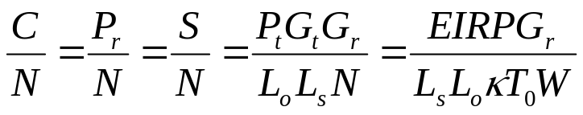

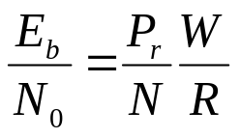
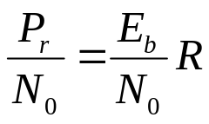
LINK BUDGET ANALYSIS: C/N
Link budget analysis
  The main quantity of interest in link budget analysis is the SNR or at receiver.
  In communication link, the receiver SNR is often called carrier-to-noise ratio (C/N).
Carrier-to-noise ratio
  If all the carrier energy is devoted to signal, then the C/N is defined as the ratio between received signal power, , and noise power,
  : all other losses and degradations not accounted for by other terms.
Relationship between C/N and

Slide 21



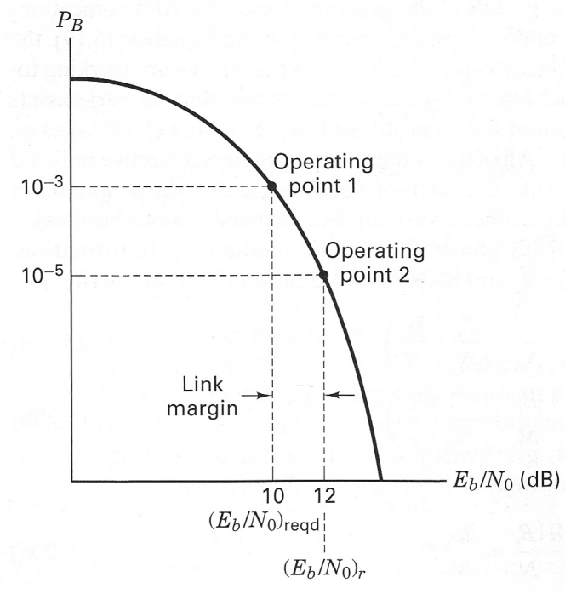
LINK BUDGET ANALYSIS: LINK MARGIN
Two values of interest
  1. Received : the actual at receiver. Denoted as
  2. Required : the required to achieve a certain error probability. Denoted as
Link margin
  To ensure the proper operation of the system, design a system with
  , thus have a safety margin.
  Link margin is defined as the difference between and
Jingxian Wu, 8/15/2007

Slide 22
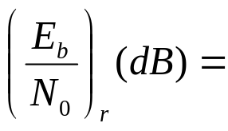

LINK BUDGET ANALYSIS
Link budget are typically in Decibles
Self-study: Section 5.4.3 and 5.4.4

Slide 23

LINK BUDGET ANALYSIS
Example
  A communication system with the following parameters: frequency is 3GHz, BPSK, BER is , data rate= 1kbps, link margin = 3dB, EIRP = 10 W, receiver antenna gain = 10 dB, distance between Tx and Rx is 4,000 km. Find the maximum allowed noise power spectral density.

Slide 24
OUTLINE
Introduction
Channel
Received Signal Power and Noise Power
Link Budget Analysis
Noise Figure

Slide 25
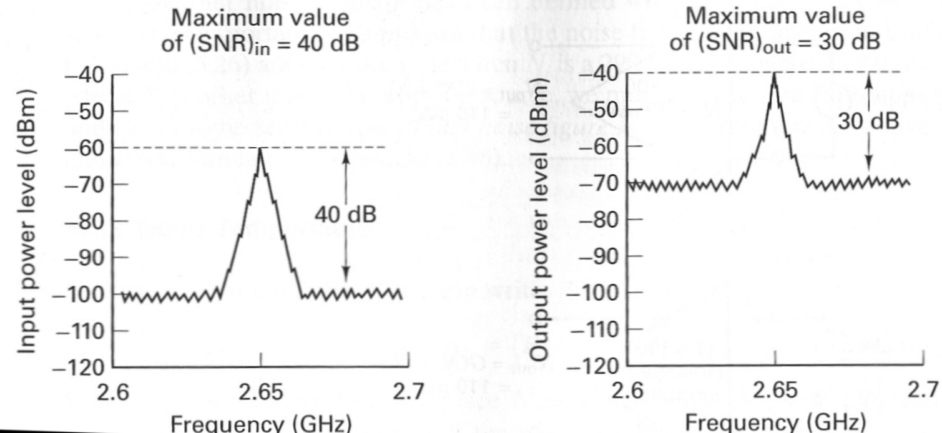
NOISE FIGURE
Operation noise figure
  At the communication receiver, the received signal needs to be amplified.
  The amplifier will
    1. Amplify the signal component and noise component.
    2. Add its own noise.
  Therefore, the SNR at the output of the amplifier is lower than the SNR at the input of the amplifier.

Slide 26
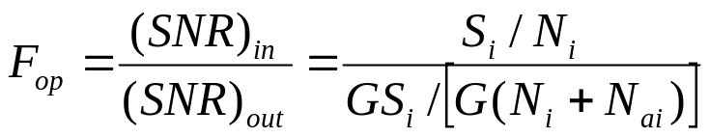



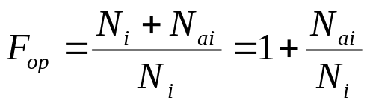

NOISE FIGURE
Operation noise figure: definition
  the SNR degradation caused by an amplifier.
    : signal power at input of amplifier
    : noise power at input of amplifier
    : noise power added by amplifier
    G : amplifier gain
  Simplify the operation noise figure equation
    Operation noise figure depends on the input noise power.
    The input noise power depends on temperature.
    Operation noise figure depends on temperature!
Noise figure:
    The value of when the input noise has the temperature of 290 K.

Slide 27
NOISE FIGURE
Example
  An amplifier has a noise figure of 4 dB, a bandwidth of 500 kHz, and an input resistance of 50 Ohm. If the input SNR = 1, find the output SNR when the amplifier is connected to a signal source of 50 Ohm at 200 K.

Slide 28


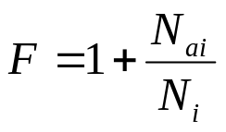




EFFECTIVE NOISE TEMPERATURE
Effective noise temperature
  The temperature that corresponds to the additional noise power, , introduced by the receiver
➔
  Characterizes the noisiness of an amplifier
  It has a one-to-one relationship with noise figure ➔ equivalent to noise figure
  an amplifier can be either characterized by noise figure, F, or effective noise temperature,
The total noise power at the output of an amplifier
  temperature of the source

Slide 29
EFFECTIVE NOISE TEMPERATURE
Example
  If an amplifier has a noise figure of 4dB, find the effective noise temperature of the amplifier.

Slide 30
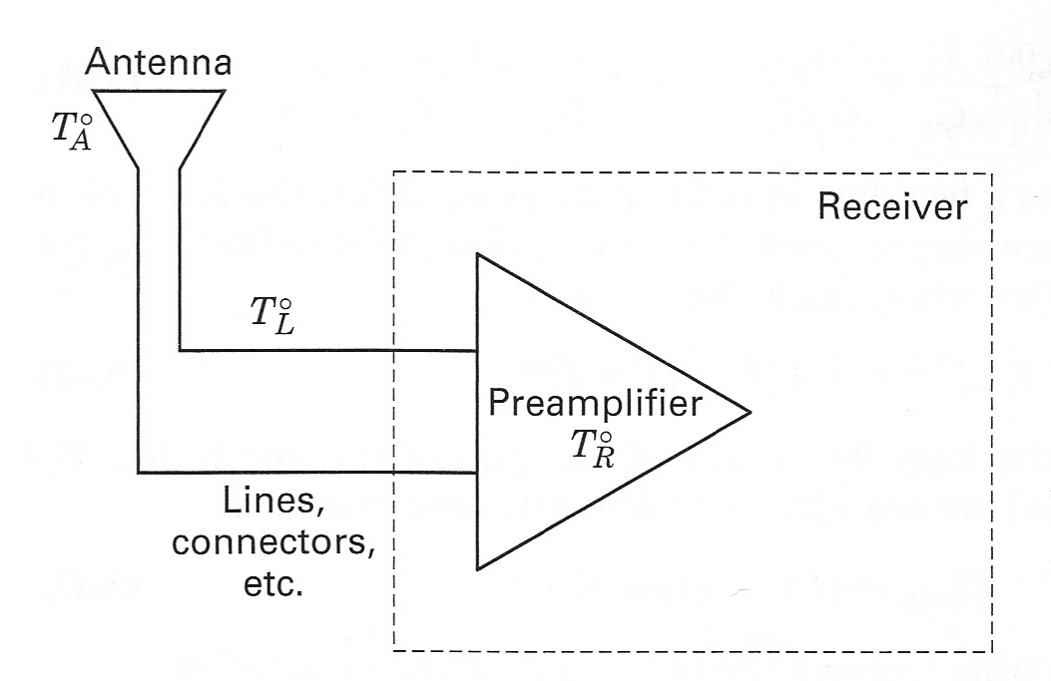





SYSTEM EFFECTIVE TEMPERATURE
Noise Power in a Communication System
  1. Antenna will insert noise to the received signal
    Antenna noise temperature:
    Noise power inserted by antenna:
  2. Amplifier will insert noise to the received signal
    Amplifier noise temperature:
    Noise power inserted by amplifier at the input :
  Total noise power before the amplifier: (from antenna alone)
  Total noise power after the amplifier: (from both antenna and amplifier)

Slide 31


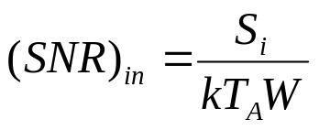
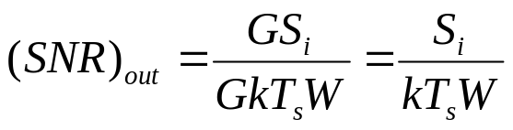
SYSTEM EFFECTIVE TEMPERATURE
System Effective Temperature
  The system effective temperature is the combination of the antenna noise temperature and the amplifier noise temperature
  Total noise power at the output of the amplifier
  SNR at the input of the amplifier
  SNR at the output of the amplifier

Slide 32





SYSTEM EFFECTIVE TEMPERATURE
Example
  A receiver front end (amplifier) has a noise figure of 10dB, a gain of 80 dB, and a bandwidth of 6MHz. The input signal power is . The antenna temperature is 150K.
    Find , ,

Slide 33

LINK BUDGET ANALYSIS
Example
  A satellite communication system uses a Tx that produces 20W of RF power at a carrier frequency of 10GHz that is fed into a 1-meter parabolic antenna. The distance to the receiving earth station is 20,000 nautical miles. The receiving system uses a 2-meter parabolic antenna and has a 100-K system noise temperature. Each antenna has an efficiency of 0.6. Also assume that the incidental losses amount to 2 dB.
    Calculate the maximum data rate that can be used if the modulation is non coherent DPSK and the bit error probability is not to exceed

Slide 34
LINK BUDGET ANALYSIS
Example
  Given the following link parameters, find the maximum allowable receiver (amplifier) noise figure. The modulation is coherent BPSK with BER of for a data rate of 10Mbps. The carrier frequency is 12GHz. The EIRP is 0 dBW. The receiving antenna diameter is 0.2 m with efficiency 0.55. The antenna temperature is 750K. The distance between Tx and Rx is 10km. The margin is 3dB and the incidental losses are assumed to be 0dB.

