Slide 1
ELEG 5663 Communication Theory
Ch. 6 Coding: PART I
Dr. Jingxian Wu
wuj@uark.edu

Slide 2
OUTLINE
Introduction
Types of Error Control
Structured Sequence
Linear Block Code
Error Detection and Correction Capability

Slide 3
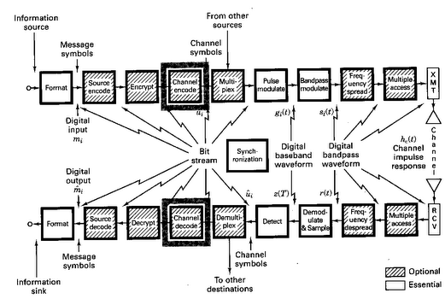
INTRODUCTION

Slide 4
INTRODUCTION
Channel Coding
  Channel coding with structured sequence
    Protect the information from channel distortions by adding structured redundancy
    Examples:
      Cyclic Redundancy Check (CRC), Linear Block Code, Convolutional Code (CC), Turbo Code, Low Density Parity Check (LDPC), etc.
Coding can only be used in digital communication systems.

Slide 5
OUTLINE
Introduction
Types of Error Control
Structured Sequence
Linear Block Code
Error Detection and Correction Capability

Slide 6
ERROR CONTROL
Error control
  Error detection and retransmission:
    detect the presence of errors at the Rx by using the structured sequence
    Rx notifies Tx about the error
    Tx retransmit the message
    Requires a two-way link between Tx and Rx
  Forward error correction (FEC)
    The Rx can correct the errors by using the structured sequence
    Only a one-way link is required.

Slide 7
ERROR CONTROL: ARQ
Automatic Retransmission Query (ARQ)
  When the Rx detects an error, it will require the Tx to retransmit the information.
  Such an error control procedure is called ARQ.
  3 types of ARQ:
    Stop-and-wait
    Continuous ARQ with pull back
    Continuous ARQ with selective repeat
Stop-and-wait ARQ
  The Rx waits for an acknowledgement (ACK) of each transmission before transmitting the next packet.

Slide 8
ERROR CONTROL: ARQ
Continuous ARQ with pullback
  The Tx transmits continuously without waiting for a ACK
  In case of NAK (negative ACK), the Tx will retransmit the error packet and all the subsequent packets
Continuous ARQ with selective repeat
  In case of NAK, the Tx will only retransmit the error packet
  More complicated operation at the Rx (re-order packets, memory)

Slide 9
OUTLINE
Introduction
Types of Error Control
Structured Sequence
Linear Block Code
Error Detection and Correction Capability

Slide 10
STRUCTURED SEQUENCE
Channel coding
  Protect the transmitted information by adding redundancy.
  E.g. repetition code:
    ‘0’: ‘000’
    ‘1’: ‘111’
Error detection
  Include only enough redundant information such that the Rx can detect an error by looking at the Rx data.
    E.g. repeat ‘1’ 2 times. Tx (1 1), Rx (0 1) ➔ Receiver knows there is an error, but couldn’t guess what is transmitted
    Send back Negative Acknowledgement (automatic-repeat query: ARQ)
Error correction
  Include enough redundant information such that the Rx can recover the original information by looking at the Rx data.
    E.g. repeat ‘1’ 3 times. Tx (1 1 1), Rx (0 1 1) ➔ Receiver will guess that (1 1 1) is transmitted ➔ detect ‘1’
    Majority decision rule ➔ minimize the probability of error.

Slide 11
STRUCTURED SEQUENCE
Linear block code (LBC)
  Every k bits of information corresponds to a codeword of length n bits
    E.g. repetitionon code 1-bit of information, 3-bit codeword
  n > k: there are (n-k) bits of redundancy
  The code is called: (n, k) linear block code
  Definition:
    code rate: r = k/n
    Measures the efficiency of the code (1-r: the percentage of redundancy)
    E.g.: (3, 1) repetition code: r = 1/3. (2, 1) repetition code: r = 1/2.
k bits information
LBC
n bits codeword

Slide 12
STRUCTURED SEQUENCE: SINGLE PARITY CHECK
Single parity check
  Adding a single parity bit to a block of data bits
  Code rate: r = k/(k+1)
  Odd parity: add a parity bit such that the summation of all the bits yields an odd result (odd number of ones)
  1 0 1 0 1 0 0 0 0 1 1 1
  Even parity: add a parity bit such that the summation of all the bits yields an even result (even number of ones)
  0 0 1 0 1 0 1 0 0 1 1 1
  Error detection only
  Will the code be able to detect even number of errors?

Slide 13
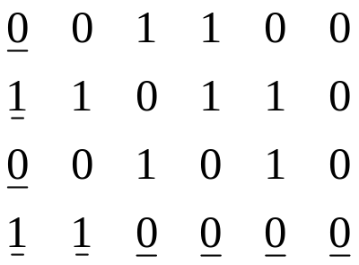
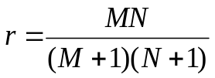
STRUCTURED SEQUENCE: RECTANGULAR CODE
Rectangular code (product code)
  Form a rectangle of message bits of M rows and N columns.
  A horizontal parity check is appended to each row
  A vertical parity check is appended to each column
  Code rate:
  Any single bit error will cause:
    A parity check error in a row
    A parity check error in a column
    The single bit error can be detected and corrected!
  Product code can detect any 1 bit error
M=3, N=5

Slide 14
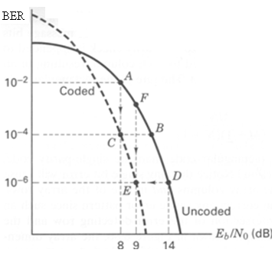
STRUCTURED SEQUENCE: WHY ERROR CORRECTION?
Trade-off 1: Error performance v.s. bandwidth
  fixing SNR and data rate
  Error correction code ➔ smaller BER
  Error correction code ➔ More bandwidth is needed to transmit (information bits + redundancy bits)

Slide 15
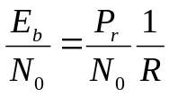


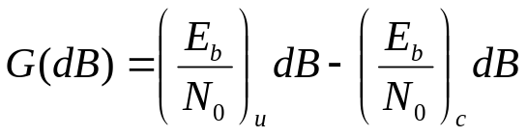
STRUCTURED SEQUENCE: WHY ERROR CORRECTION?
Trade-off 2: power v.s. bandwidth
  Fixing BER and data rate
  Error correction code ➔ smaller ➔ smaller
  Error correction code ➔ More bandwidth is needed to transmit (information bits + redundancy bits)
  Coding gain: at a given BER, coding gain is the difference in Eb/N0 between coded and uncoded system

Slide 16
STRUCTURED SEQUENCE: WHY ERROR CORRECTION?
Trade-off 3: data rate v.s. bandwidth
  Fix BER and Tx power
  Error correction code ➔ smaller ➔ bigger R
  Error correction code ➔ More bandwidth is needed to transmit (information bits + redundancy bits)

Slide 17
OUTLINE
Introduction
Types of Error Control
Structured Sequence
Linear Block Code
Error Detection and Correction Capability

Slide 18
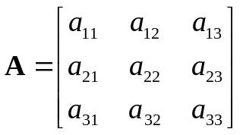
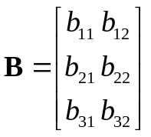
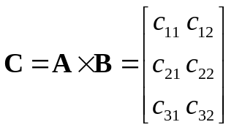


LBC: PREPARATIONS
Binary operations
  0 + 0 = 0, 0 + 1 = 1, 1 + 0 = 1, 1 + 1 = 0
  0 x 0 = 0, 0 x 1 = 0, 1 x 0 = 0, 1 x 1 = 1
Matrix operations
  The product of an m x k matrix and k x n matrix
    Has a size of m x n

Slide 19
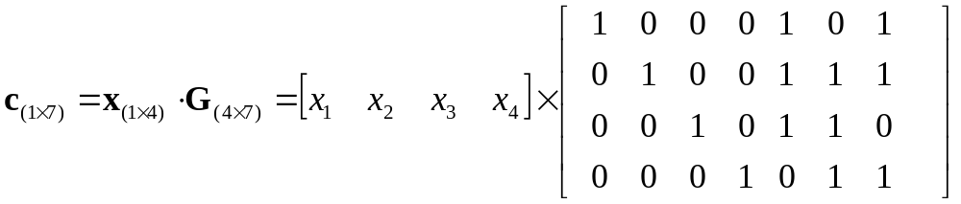
LBC: AN EXAMPLE
(7, 4) code
  4-bit information, 7-bit codeword (3-bit redundancy)
  Information vectors
    [0 0 0 0], [0 0 0 1], [0 0 1 0], [0 0 1 1], … …, [1 1 1 0], [1 1 1 1]
    2^4 = 16 possible information vectors ➔ 16 codewords
  Choose 16 codewords out of 2^7 = 128 possible 7-bit combinations.
  Codeword vector c is a linear function of information vector x
  The codeword for [0 0 0 0]:
  The codeword for [0 0 1 1]:
  The codeword for [0 1 0 1]:
Notes:
0 0 0 0 0 0 0
0 0 1 1 1 0 1
0 1 0 1 1 0 0

Slide 20



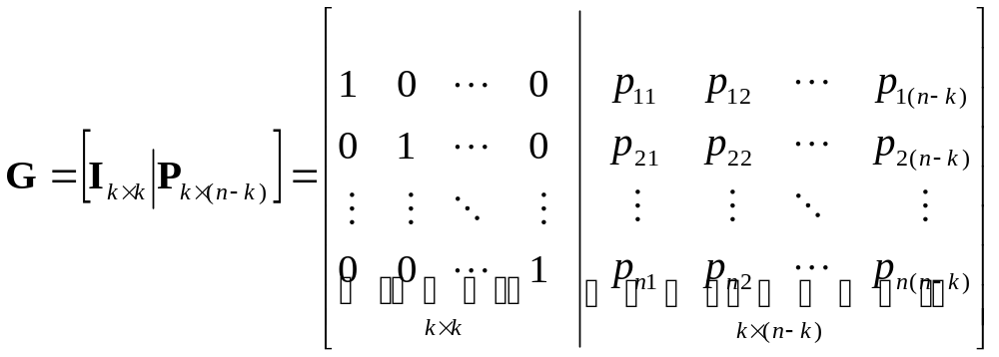
LBC: GENERATION MATRIX
(n, k) linear block code
  k-bit of information, n-bit of codeword
  Information vector (1 x k row vector)
  Codeword vector (1 x n row vector)
  Linear relationship between information vector and codeword vector
Generation matrix (size k x n matrix)
The first k bits of codeword are the same as information bits: systematic code

Slide 21
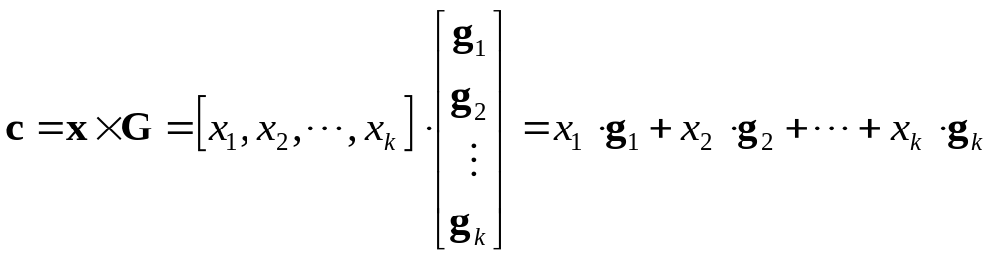
LBC: GENERATION MATRIX
Generation matrix (cont’d)
The k-th row of G
Example
  The codeword for [ 0 1 0 0]
  The codeword for [ 0 1 0 1]

Slide 22
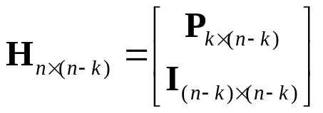
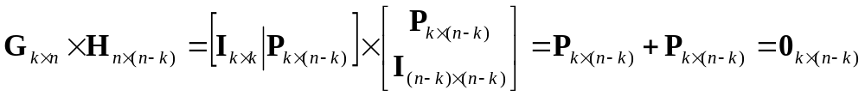

LBC: PARITY CHECK MATRIX
Parity check matrix (an n x (n-k) matrix)
The product between G and H is an all zero matrix
For any valid codeword
  Thus
  Any valid codeword multiplied by H is 0!
    The receiver can use this to detect if there is an error during transmission.

Slide 23
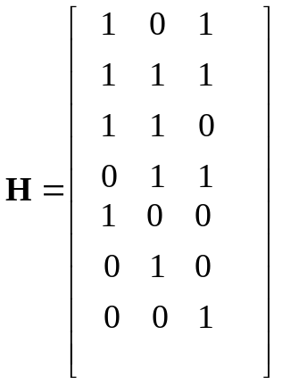
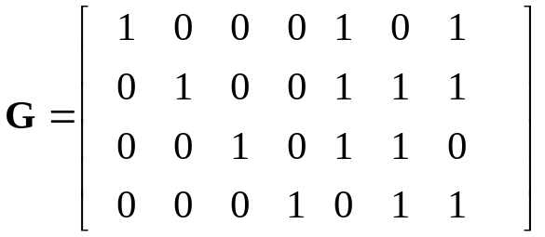
LBC: PARITY CHECK MATRIX
Parity check matrix
  y = c + 0 = [0 0 1 1 1 0 1]
  y H =
  y = c + e = [0 0 1 1 1 0 1] + [1 0 0 0 0 0 0] = [1 0 1 1 1 0 1]
  y H =
Notes:
1+0+1+0+1+0+0=1
0+0+1+1+0+0+0=0
1+0+0+1+0+0+1=1

Slide 24




LBC: SYNDROME DECODING
Received vector
codeword
error vector
Syndrome
  Syndrome: for each error pattern, there is a syndrome s
    We can guess the error pattern e by looking at the syndrome!
  Error vector: n-bit ➔ error vectors
  Syndrome: (n-k)-bit ➔ syndromes
  There are more error vectors than syndromes!
    Some error vectors might have the same syndrome
    Given syndrome, there might be more error vectors ➔ just randomly choose one.

Slide 25
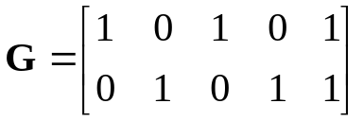

LBC: SYNDROME DECODING EXAMPLE
Example (5, 2) systematic code
  codewords
  # of error vectors:
  # of syndromes
Information: x
Codeword: c
00
00000
01
01011
10
10101
11
11110
Notes:
H = 1 0 1
0 1 1
1 0 0
0 1 0
0 0 1
2^5 = 32
2^(5-2) = 8

Slide 26
LBC: SYNDROME DECODING EXAMPLE
Example (5, 2) systematic code
  Syndromes
  1. e = [0 0 0 0 0] ➔ s =
  2. e = [0 0 0 0 1] ➔ s =
  3. e = [0 0 0 1 0] ➔ s =
  4. e = [0 0 1 0 0] ➔ s =
  5. e = [0 1 0 0 0] ➔ s =
  6. e = [1 0 0 0 0] ➔ s =
  7. e = [1 0 0 0 1] ➔ s =
  8. e = [1 0 0 1 0] ➔ s =
  9. e = [1 0 1 0 0] ➔ s =
  10. e = [1 1 0 0 0] ➔ s =
  11. ……
Notes:
H = 1 0 1
0 1 1
1 0 0
0 1 0
0 0 1
1. S = 0 0 0
2. S = 0 0 1
3. S = 0 1 0
4. S = 1 0 0
5. S = 0 1 1
6. S = 1 0 1
7. S = 1 0 0
8. S = 1 1 1
9. S = 0 0 1
10. S = 1 1 0

Slide 27
LBC: SYNDROME DECODING EXAMPLE
Example (5, 2) systematic code
  Syndrome table
syndromes
error vector
0 0 0
0 0 1
0 1 0
1 0 0
0 1 1
1 0 1
1 1 1
1 1 0
00000
00001
00010
00100
01000
10000
10010
11000
  It can correct all 1-bit error
  It can detect 2-bit error
  More than 2-bit error is beyond the capability of this (5, 2)-code
Notes:
0 0 0
0 0 1
0 1 0
1 0 0
0 1 1
1 0 1
1 1 1
1 1 0

Slide 28

LBC: STANDARD ARRAY
Standard array:
  Columns: all codewords
  Rows: all correctable error patterns
  Example: (5, 2) systematic code with
  Each row is called a coset
  The first element in a row is called a coset leader
  All elements in the same coset have the same syndrome

Slide 29
LBC: SYNDROME DECODING
Example (5, 2) systematic code
  Tx
  x = [0 1] ➔ c =
  y = c + e = c + [0 0 1 0 0] =
  Rx
  s = yH =
  e =
  c = y + e
  x =
  Tx
  x = [1 1] ➔ c =
  y = c + e = c + [1 0 0 1 0] =
  Rx
  s = yH =
  e =
  c = y + e
  x =
Notes:
Tx
C = 0 1 0 1 1
Y = 0 1 1 1 1
Rx
S = 1 0 0
E = 0 0 1 0 0
C = 0 1 0 1 1
X = 0 1
Tx
C = 1 1 1 1 0
Y = 0 1 1 0 0
Rx
S = 1 1 1
E = 1 0 0 1 0
C = 1 1 1 1 0
X = 1 1

Slide 30
LBC: SYNDROME DECODING
Example (5, 2) systematic code
  Tx
  x = [0 1] ➔ c =
  y = c + e = c + [0 0 1 1 0] =
  Rx
  s = yH =
  e =
  c = y + e
  x =
  Tx
  x = [1 1] ➔ c =
  y = c + e = c + [0 0 0 0 1] =
  Rx
  s = yH =
  e =
  c = y + e
  x =
Notes:
Tx
C = 0 1 0 1 1
Y = 0 1 1 0 1
Rx
S = 1 1 0
E = 1 1 0 0 0
C = 1 0 1 0 1
X = 1 0
Tx
C = 1 1 1 1 0
Y = 1 1 1 1 1
Rx
S = 0 0 1
E = 0 0 0 0 1
C = 1 1 1 1 0
X = 1 1

Slide 31
OUTLINE
Introduction
Types of Error Control
Structured Sequence
Linear Block Code
Error Detection and Correction Capability

Slide 32


PROPERTIES
Design of LBC
  k bits of information: possible combinations
  n bits of codeword: possible combinations
  one-to-one relationship between (k-bit information, n-bit codeword)
    Out of the possible combinations, we only need codewords
      How to choose the codeword?
  E.g. (3, 1) LBC: choose 2 codewords out of 8 possible combinations.
    ‘0’: (0 0 0), ‘1’ (1 1 1) ➔ repetition code
    ‘0’: (0 0 1), ‘1’ (1 1 0) ➔ another LBC
    ‘0’: ( 0 1 1), ‘1’ (0 1 0) ➔ another LBC
    ……
    Different LBC has different error performance, we want choose the one minimizing the error probability.

Slide 33



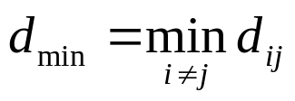
PROPERTIES: HAMMING DISTANCE
Design of LBC (Cont’d)
  Rule of thumb: we want the codewords to be as “different” as possible.
    ‘0’: (0 0 0), ‘1’ (1 1 1) ➔ repetition code: 3 bits difference
    ‘0’: ( 0 1 1), ‘1’ (0 1 0) ➔ another LBC: 1 bit difference
  Definition: Hamming distance
    The Hamming distance between two binary codewords
    is defined as the number of bits in which they differ.
    Larger Hamming distance ➔ two codewords are further apart ➔ the probability of choosing the wrong codeword is smaller ➔ better power efficiency
  Minimum Hamming distance:
    If there are more than two codewords, one Hamming distance for each pair of codewords
    E.g. the minimum Hamming distance of the (5, 2) code is:

Slide 34


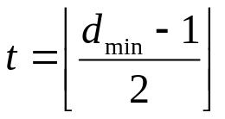


PROPERTIES: ERROR DETECTION CAPABILITY
Error detection capability
  For LBC code with minimum Hamming distance
    All error patterns with error bits less than or equal to
    can be detected (non-zero syndrome) (why?)
    All error patterns with error bits less than or equal to
    can be corrected (why?)
    E.g.
      All 1-bit error can be corrected
      All 2-bit error can be detected

Slide 35



PROPERTIES: VECTOR SUBSPACE
Vector subspace
  Vector space : the set of all length-n vectors
  Vector subspace: a subset of vector space is called a subspace if the following two conditions are met:
    1. The all-zero vector is in
    2. the sum of any two vectors in is also in (closure property)
  Example
    Vector space
      000, 001, 010, 011, 100, 101, 110, 111
    Are the following vector subspaces?
      {000, 001}
      {001, 010, 011}
      {000, 001, 010, 011}
      {000, 100, 010, 001}

Slide 36
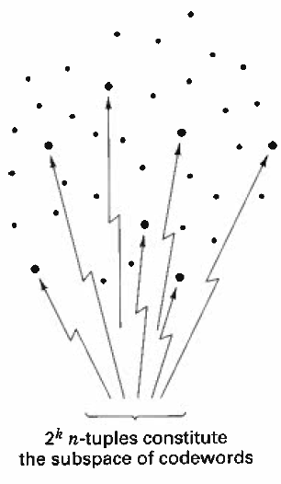

PROPERTIES: VECTOR SUBSPACE
(n, k) Linear block code
  The length-n codewords form a vector subspace of
    1. the all-zero length-n vector is a valid codeword
    2. the sum of any two codewords is still a codeword.
  Geometric representation
    We want the codewords to be as far apart as possible (maximize ).

Slide 37







PROPERTIES: OPTIMUM DECODER
Optimum decoder
  If all the codewords are equiprobable, then the optimum receiver is the maximum likelihood receiver
  E.g. AWGN channel with BPSK
    Message vector:
    Encoding:
    BPSK modulation:
    Received signal:
    BPSK demodulation:
    Decode:
    Maximum likelihood decoder: choose that can maximize the likelihood function
AWGN

Slide 38


PROPERTIES: OPTIMUM DECODER
Optimum Decoder (Cont’d)
  Likelihood function

Slide 39

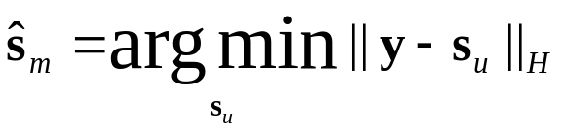
PROPERTIES: OPTIMUM DECODER
Optimum decoder (Cont’d)
  Likelihood function
    j is the Hamming distance between y and
  Since p < 1-p, maximize ➔ minimize j
    Choose that has the smallest Hamming distance with y

Slide 40
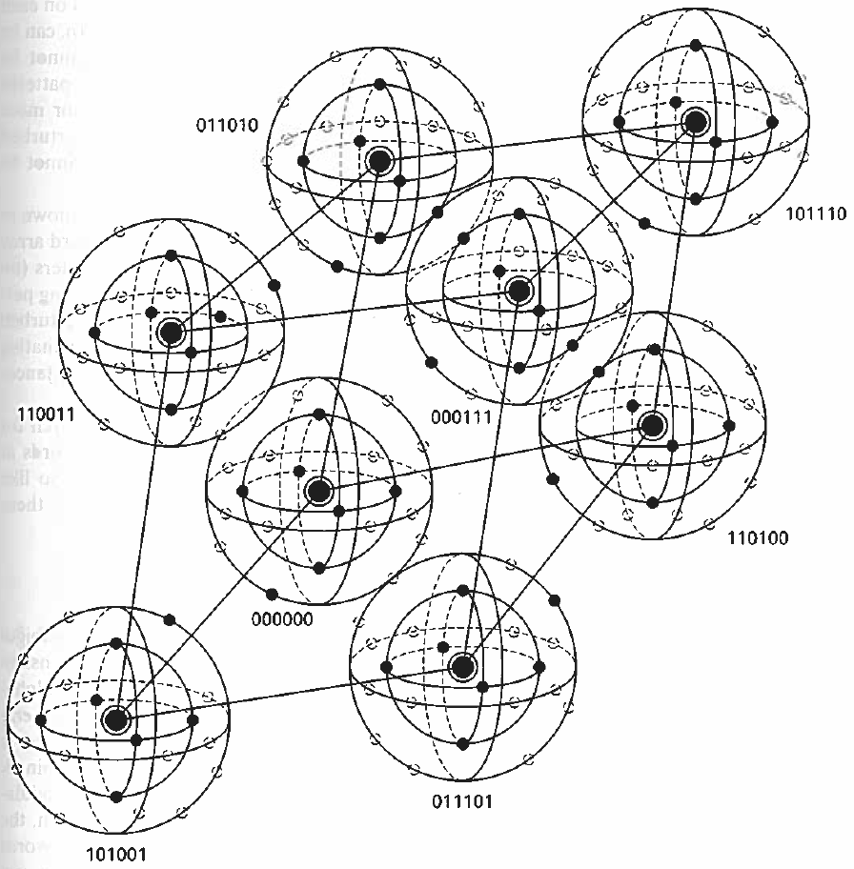
PROPERTIES: OPTIMUM DECODER
Visualization of a 6-Tuple space

Slide 41
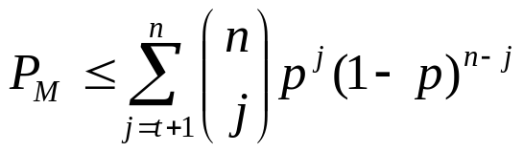
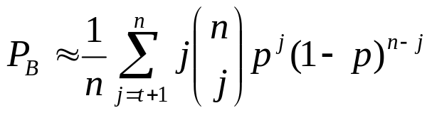
PROPERTIES: ERROR PERFORMANCE
Message error probability
  The probability that the decoder commits an erroneous decoding (the probabilities that there are more than t-bit error)
    t: the correction capability of the code
    The equality holds if all t bits errors can be corrected, but no t+1 bits errors can be corrected.
Bit error probability

Slide 42

PROPERTIES: ERROR PERFORMANCE
Example:
  Consider a (16, 8) linear block code capable of double-error corrections. Assume that BPSK is used with the received
  is 10 dB. (1) what is the message error probability? (2) what is the bit error probability?

Slide 43


PROPERTIES: SOME SPECIFIC LBC
Some specific LBC
  Hamming code
  Cyclic code
    cyclic redundancy check
  Reed-Solomon code
    Compact Disc (CD)

