Slide 1
ELEG 5663 Communication Theory
Ch. 6 Coding: PART I
Dr. Jingxian Wu
wuj@uark.edu

Slide 2
OUTLINE
Introduction
Source Coding
Channel Coding: Linear Block Code
Channel Coding: Convolutional Code
Interleaving

Slide 3
INTRODUCTION
Coding
  Source coding
    Convert analog information into digital representation
    Reduce the redundancy in the digital signal (compression)
  Channel coding
    Protect the information from channel distortions by adding redundancy.
    Cyclic Redundancy Check (CRC), Linear Block Code, Convolutional Code (CC), Turbo Code, Low Density Parity Check (LDPC), etc.
Coding can only be used in digital communication systems.
Analog or digital information
Source
Coding
Channel
Coding

Slide 4
OUTLINE
Introduction
Source Coding
Channel Coding: Linear Block Code
Channel Coding: Convolutional Code
Interleaving

Slide 5
SOURCE CODE
Why source code?
  Convert analog signal into digital signal
    Sampling and quantization, speech coding.
  Reduce redundancy in digital signal representation (compression)
    To save bandwidth ➔ improve bandwidth efficiency.
    E.g. Winzip
Source code can be classified into two categories
  Lossless source code
    No information is lost during compression
    The original information can be perfectly recovered from the compressed information.
  Source code with loss
    Some information is lost during compression
    The original information cannot be perfectly recovered after compression.
    Analog to digital conversion, JPEG, MPEG.

Slide 6
SOURCE CODE: SAMPLING
Sampling and quantization
  Convert analog information bearing signal to digital signal without significant loss of information.
Sampling theorem
  A band-limited signal with highest frequency W Hertz can be completely recovered from its samples if the sampling rate Fs is higher than 2W Hertz.
    Sampling in time-domain ➔ repetition in frequency domain.
-W
W
f
-Fs
-W
W
Fs
f
-Fs
-W
W
Fs
f
Fs > 2W
Fs < 2W

Slide 7
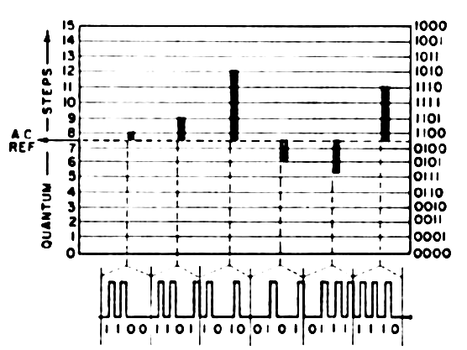
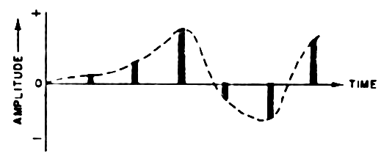
SOURCE CODE: PCM
Pulse Code Modulation (PCM): sampling and quantization
  Sampling: 8000 Samples/second (125 us/sample)
    Bandwidth of speech signal in telephone system: 4KHz.
  Quantization: represent each sample by 8-bit sequence (256 discrete levels)
  Data rate: 8000 x 8 = 64 kbps
Sampling
64kbps used in wired telephone system:
too high for wireless communication!
Quantization

Slide 8
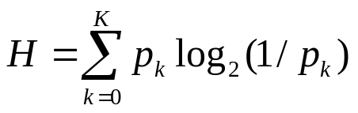

SOURCE CODE: ENTROPY
There is redundancy in the representation of information.
  Wirxlxss Commuxication (21 characters)
  For efficient information transmission, we want reduce the redundancy
  Given random data sequence, what is the maximum redundancy in the sequence?
    OR: what is the minimum # of bits that can be used to represent the original data without loss of information at receiver?
    OR: what is the maximum compression rate?
Entropy
  Entropy: the minimum # of bits required to represent one symbol from an information source
(bit/sym)
  K: total # of possible symbols (e.g. 26 English characters)
  : the probability that the k-th character is generated by the source.

Slide 9
SOURCE CODE: ENTROPY
E.g. 1: two symbols: ‘0’, ‘1’
  p0 = 0.5, p1 = 0.5
  H =
  If there are 100 binary symbols, it can be represented with bits.
E.g. 2: two symbols: ‘0’, ‘1’
  p0 = 0.9, p1 = 0.1
  H =
  If there are 100 symbols, they can be represented with bits.
E.g. 3: two symbols: ‘0’, ‘1’
  p0 = 0, p1 = 1
  H =
  If there are 100 symbols, they can be represented with bits.
E.g. 4: the entropy of English is 1.1 ~ 1.6 bits/character
  26 characters log2(26) = 4.7 bits
  Approximately 2/3 are redundant
  If there are 100 English characters, they can be represented by 160 bits
    Against: 470 bits
Notes:
0.9*log2(1/0.9) + 0.1*log2(1/0.1) = 0.9*0.15+0.1*3.32 = 0.47 bits
0*log2(1/0) + 1*log2(1)
Lim_{x to infinity} log2(x)/(x) = log2(e) lim ln(x)/(x)
= log2(e) lim (1/x)/(1) = log2(e) 0 = 0

Slide 10
SOURCE CODE: SPEECH CODING
Speech coding
  Convert analog speech signal into digital signal.
  To reduce the bit rate R as much as possible.
    R ↓ ➔ BW ↓ ➔ more users in limited spectrum
    R ↓ ➔ voice quality ↓ (in general)
  Tradeoff between bandwidth efficiency and voice quality.

Slide 11
SOURCE CODE: SPEECH CODING
Two basic speech coding schemes
  Waveform coders:
    Strive to reproduce time or frequency domain signal waveform as precisely as possible.
    Source independent
    Moderate complexity and data rates (30 ~ 50 kbps)
    e.g. PCM. Usually used in wired telephone system.
  Vocoders (also called “source code”)
    Analyze & extract key parameters using a priori knowledge of speech characteristics
      Extract speech model parameters
      Synthesize voice in Rx using model parameters
    Signal specific parameters ➔ depends on user and is less robust
    Produces very low data rates (~ 5−15 kbps)
      Very complex & computationally intensive
    Cellular & PCS applications where minimizing user BW → more users supported in finite spectrum → more $$

Slide 12
SOURCE CODE: SPEECH CODING
Vocoders
  Model the speech generation process of vocal tract of human
  Parameters of speech
    Voice pitch ➔ difficult to extract, usually < 300 Hz
    Pole frequencies ➔ resonant frequencies of vocal tract
      Centered around: 500, 1500, 2500, 3500
    Pole amplitudes ➔ relative strength at different pole frequencies
    Speech type ➔ voiced or unvoiced
      Voiced: “m”, “n”, “v” ➔ voice chord vibrations
      Unvoiced: “f”, “s” ➔ air flow through constriction
  These parameters are transmitted by the sender
    Rx uses these parameters to synthesize the human speech
  Very complicated, but low data rate: 5 ~ 13 kbps
  Source dependent
    Suitable for human speech, but not suitable to other sound (e.g. music)

Slide 13

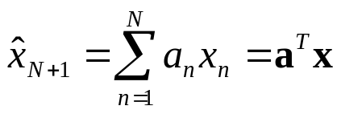


SOURCE CODE: SPEECH CODING
Linear Predictive Coders (LPC)
  A kind of time-domain vocoder
    Extract the time domain parameters of signal.
    Transmit the parameters of the signal instead of the actual waveform.
  Linear predictive: predict the future value based on current values.
    Time domain speech waveform:
    The current values and future values are correlated!
  The coefficients a are calculated at Tx based on the statistical properties of x.
    x is a random process.
  Instead of transmitting x, transmit a!
How to calculate the coefficients? – choose a to minimize the mean square error (MSE).

Slide 14
OUTLINE
Introduction
Source Coding
Channel Coding: Linear Block Code
Channel Coding: Convolutional Code
Interleaving

Slide 15
CHANNEL CODING: OVERVIEW
Channel coding
  Protect the transmitted information by adding redundancy.
  E.g. repetition code:
    ‘0’: ‘000’
    ‘1’: ‘111’
Error detection
  Include only enough redundant information such that the Rx can detect an error by looking at the Rx data.
    E.g. repeat ‘1’ 2 times. Tx (1 1), Rx (0 1) ➔ Receiver knows there is an error, but couldn’t guess what is transmitted
    Send back Negative Acknowledgement (automatic-repeat request: ARQ)
Error correction
  Include enough redundant information such that the Rx can recover the original information by looking at the Rx data.
    E.g. repeat ‘1’ 3 times. Tx (1 1 1), Rx (0 1 1) ➔ Receiver will guess that (1 1 1) is transmitted ➔ detect ‘1’
    Majority decision rule ➔ minimize the probability of error.
Department of Engineering Science
Sonoma State University
CES544
Jingxian Wu, 11/07/26

Slide 16

CHANNEL CODING: CHANNEL CAPACITY
For an AWGN channel with bandwidth B, the maximum data rate that can be supported by the channel is
Shannon’s coding theorem
  For a channel with capacity C bps and an information source generates information at a rate less than C, then there exists a channel coding technique such that the output of the source can be transmitted by the channel with arbitrarily low error rate.
Source
H < C
Channel coding
Channel
Capacity C
Department of Engineering Science
Sonoma State University
CES544
Jingxian Wu, 11/07/26

Slide 17
CHANNEL CODING: LBC
Linear block code (LBC)
  Every k bits of information corresponds to a codeword of length n bits
    E.g. repetitionon code 1-bit of information, 3-bit codeword
  n > k: there are (n-k) bits of redundancy
  The code is called: (n, k) linear block code
  Definition: code rate = (information block length)/(codeword length)
    r = k/n
    Measures the efficiency of the code (1-r: the percentage of redundancy)
    E.g.: (3, 1) repetition code: r = 1/3. (2, 1) repetition code: r = 1/2.
k bits information
LBC
n bits codeword
Department of Engineering Science
Sonoma State University
CES544
Jingxian Wu, 11/07/26

Slide 18
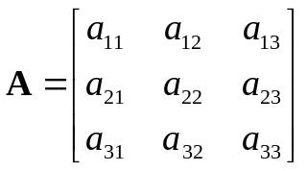
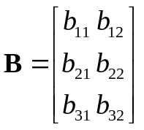
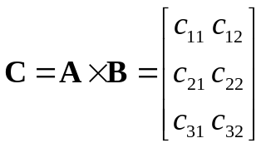


LBC: PREPARATIONS
Binary operations
  0 + 0 = 0, 0 + 1 = 1, 1 + 0 = 1, 1 + 1 = 0
  0 x 0 = 0, 0 x 1 = 0, 1 x 0 = 0, 1 x 1 = 1
Matrix operations
  The product of an m x k matrix and k x n matrix
    Has a size of m x n
Department of Engineering Science
Sonoma State University
CES544
Jingxian Wu, 11/07/26

Slide 19
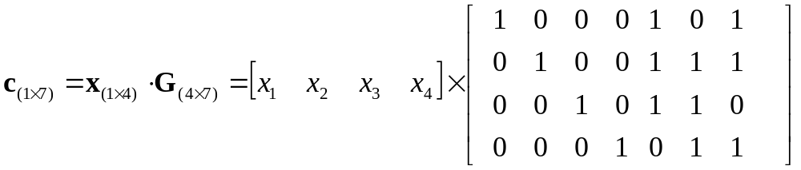
LBC: AN EXAMPLE
(7, 4) code
  4-bit information, 7-bit codeword (3-bit redundancy)
  Information vectors
    [0 0 0 0], [0 0 0 1], [0 0 1 0], [0 0 1 1], … …, [1 1 1 0], [1 1 1 1]
    2^4 = 16 possible information vectors ➔ 16 codewords
  Choose 16 codewords out of 2^7 = 128 possible 7-bit combinations.
  Codeword vector c is a linear function of information vector x
  The codeword for [0 0 0 0]:
  The codeword for [0 0 1 1]:
  The codeword for [0 1 0 1]:
Department of Engineering Science
Sonoma State University
CES544
Jingxian Wu, 11/07/26
Notes:
0 0 0 0 0 0 0
0 0 1 1 1 0 1
0 1 0 1 1 0 0

Slide 20



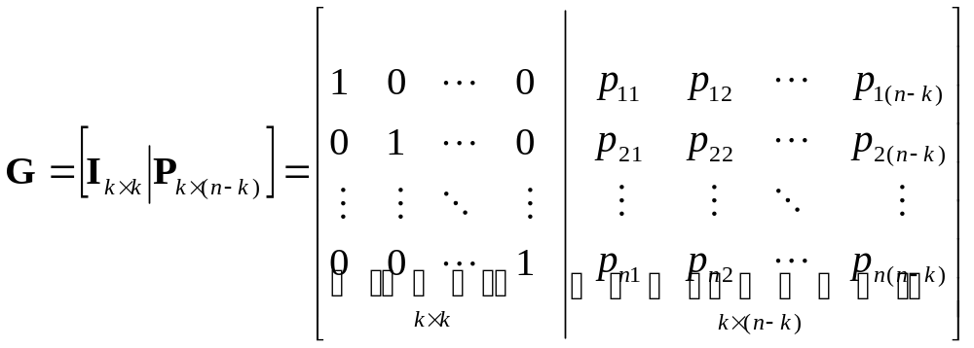
LBC: GENERATION MATRIX
(n, k) linear block code
  k-bit of information, n-bit of codeword
  Information vector (1 x k row vector)
  Codeword vector (1 x n row vector)
  Linear relationship between information vector and codeword vector
Generation matrix (size k x n matrix)
The first k bits of codeword are the same as information bits: systematic code
Department of Engineering Science
Sonoma State University
CES544
Jingxian Wu, 11/07/26

Slide 21
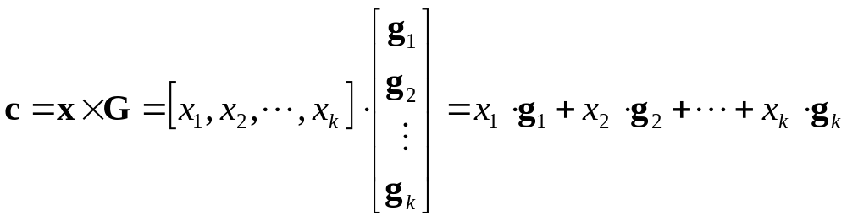
LBC: GENERATION MATRIX
Generation matrix (cont’d)
The k-th row of G
Example
  The codeword for [ 0 1 0 0]
  The codeword for [ 0 1 0 1]
Department of Engineering Science
Sonoma State University
CES544
Jingxian Wu, 11/07/26

Slide 22
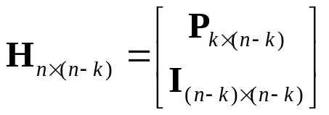
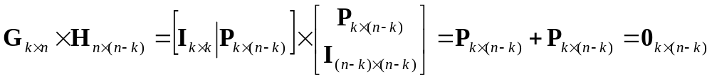

LBC: PARITY CHECK MATRIX
Parity check matrix (an n x (n-k) matrix)
The product between G and H is an all zero matrix
For any valid codeword
  Thus
  Any valid codeword multiplied by H is 0!
    The receiver can use this to detect if there is error during transmission.
Department of Engineering Science
Sonoma State University
CES544
Jingxian Wu, 11/07/26

Slide 23
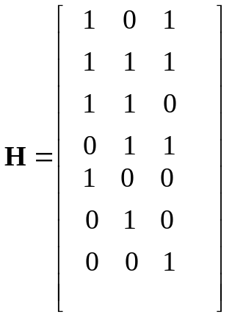
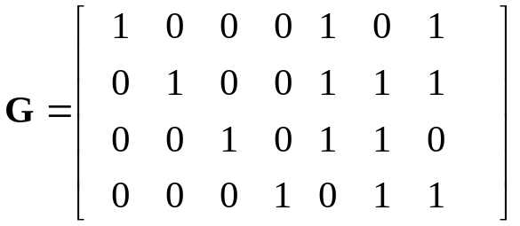
LBC: PARITY CHECK MATRIX
Parity check matrix
  y = c + 0 = [0 0 1 1 1 0 1]
  y H =
  y = c + e = [0 0 1 1 1 0 1] + [1 0 0 0 0 0 0] = [1 0 1 1 1 0 1]
  y H =
Department of Engineering Science
Sonoma State University
CES544
Jingxian Wu, 11/07/26
Notes:
1+0+1+0+1+0+0=1
0+0+1+1+0+0+0=0
1+0+0+1+0+0+1=1

Slide 24




LBC: SYNDROME DECODING
Received vector
codeword
error vector
Syndrome
  Syndrome: for each error pattern, there is a syndrome s
    We can guess the error pattern e by looking at syndrome!
  Error vector: n-bit ➔ error vectors
  Syndrome: (n-k)-bit ➔ syndromes
  There are more error vectors than syndromes!
    Some error vectors might have the same syndrome
    Given syndrome, there might be more error vectors ➔ just randomly choose one.
Department of Engineering Science
Sonoma State University
CES544
Jingxian Wu, 11/07/26

Slide 25
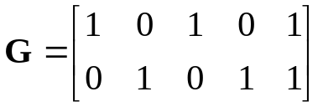

LBC: SYNDROME DECODING EXAMPLE
Example (5, 2) systematic code
  codewords
  # of error vectors:
  # of syndromes
Information: x
Codeword: c
00
00000
01
01011
10
10101
11
11110
Department of Engineering Science
Sonoma State University
CES544
Jingxian Wu, 11/07/26
Notes:
H = 1 0 1
0 1 1
1 0 0
0 1 0
0 0 1
2^5 = 32
2^(5-2) = 8

Slide 26
LBC: SYNDROME DECODING EXAMPLE
Example (5, 2) systematic code
  Syndromes
  1. e = [0 0 0 0 0] ➔ s =
  2. e = [0 0 0 0 1] ➔ s =
  3. e = [0 0 0 1 0] ➔ s =
  4. e = [0 0 1 0 0] ➔ s =
  5. e = [0 1 0 0 0] ➔ s =
  6. e = [1 0 0 0 0] ➔ s =
  7. e = [1 0 0 0 1] ➔ s =
  8. e = [1 0 0 1 0] ➔ s =
  9. e = [1 0 1 0 0] ➔ s =
  10. e = [1 1 0 0 0] ➔ s =
  11. ……
Department of Engineering Science
Sonoma State University
CES544
Jingxian Wu, 11/07/26
Notes:
H = 1 0 1
0 1 1
1 0 0
0 1 0
0 0 1
1. S = 0 0 0
2. S = 0 0 1
3. S = 0 1 0
4. S = 1 0 0
5. S = 0 1 1
6. S = 1 0 1
7. S = 1 0 0
8. S = 1 1 1
9. S = 0 0 1
10. S = 1 1 0

Slide 27
LBC: SYNDROME DECODING EXAMPLE
Example (5, 2) systematic code
  Syndrome table
syndromes
error vector
0 0 0
0 0 1
0 1 0
1 0 0
0 1 1
1 0 1
1 1 1
1 1 0
00000
00001
00010
00100
01000
10000
10010
11000
  It can correct all 1-bit error
  It can detect 2-bit error
  More than 2-bit error is beyond the capability of this (5, 2)-code
Department of Engineering Science
Sonoma State University
CES544
Jingxian Wu, 11/07/26
Notes:
0 0 0
0 0 1
0 1 0
1 0 0
0 1 1
1 0 1
1 1 1
1 1 0

Slide 28
LBC: SYNDROME DECODING
Example (5, 2) systematic code
  Tx
  x = [0 1] ➔ c =
  y = c + e = c + [0 0 1 0 0] =
  Rx
  s = yH =
  e =
  c = y + e
  x =
  Tx
  x = [1 1] ➔ c =
  y = c + e = c + [1 0 0 1 0] =
  Rx
  s = yH =
  e =
  c = y + e
  x =
Department of Engineering Science
Sonoma State University
CES544
Jingxian Wu, 11/07/26
Notes:
Tx
C = 0 1 0 1 1
Y = 0 1 1 1 1
Rx
S = 1 0 0
E = 0 0 1 0 0
C = 0 1 0 1 1
X = 0 1
Tx
C = 1 1 1 1 0
Y = 0 1 1 0 0
Rx
S = 1 1 1
E = 1 0 0 1 0
C = 1 1 1 1 0
X = 1 1

Slide 29
LBC: SYNDROME DECODING
Example (5, 2) systematic code
  Tx
  x = [0 1] ➔ c =
  y = c + e = c + [0 0 1 1 0] =
  Rx
  s = yH =
  e =
  c = y + e
  x =
  Tx
  x = [1 1] ➔ c =
  y = c + e = c + [0 0 0 0 1] =
  Rx
  s = yH =
  e =
  c = y + e
  x =
Department of Engineering Science
Sonoma State University
CES544
Jingxian Wu, 11/07/26
Notes:
Tx
C = 0 1 0 1 1
Y = 0 1 1 0 1
Rx
S = 1 1 0
E = 1 1 0 0 0
C = 1 0 1 0 1
X = 1 0
Tx
C = 1 1 1 1 0
Y = 1 1 1 1 1
Rx
S = 0 0 1
E = 0 0 0 0 1
C = 1 1 1 1 0
X = 1 1

Slide 30


LBC: PROPERTIES
Design of LBC
  k bits of information: possible combinations
  n bits of codeword: possible combinations
  one-to-one relationship between (k-bit information, n-bit codeword)
    Out of the possible combinations, we only need codewords
      How to choose the codeword?
  E.g. (3, 1) LBC: choose 2 codewords out of 8 possible combinations.
    ‘0’: (0 0 0), ‘1’ (1 1 1) ➔ repetition code
    ‘0’: (0 0 1), ‘1’ (1 1 0) ➔ another LBC
    ‘0’: ( 0 1 1), ‘1’ (0 1 0) ➔ another LBC
    ……
    Different LBC has different error performance, we want choose the one minimizing the error probability.
Department of Engineering Science
Sonoma State University
CES544
Jingxian Wu, 11/07/26

Slide 31



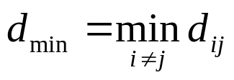
LBC: PROPERTIES
Design of LBC (Cont’d)
  Rule of thumb: we want the codewords to be as “different” as possible.
    ‘0’: (0 0 0), ‘1’ (1 1 1) ➔ repetition code: 3 bits difference
    ‘0’: ( 0 1 1), ‘1’ (0 1 0) ➔ another LBC: 1 bit difference
  Definition: Hamming distance
    The Hamming distance between two binary codewords
    is defined as the number of bits in which they differ.
    Larger Hamming distance ➔ two codewords are further apart ➔ the probability of choosing the wrong codeword is smaller ➔ better power efficiency
  Minimum Hamming distance:
    If there are more than two codewords, one Hamming distance for each pair of codewords
    E.g. the minimum Hamming distance of the (5, 2) code is:
Department of Engineering Science
Sonoma State University
CES544
Jingxian Wu, 11/07/26

Slide 32

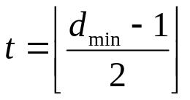


LBC: PROPERTIES
Properties
  For LBC code with minimum Hamming distance
    All error patterns with error bits less than or equal to
    can be corrected
    All error patterns with error bits less than or equal to
    can be detected (non-zero syndrome)
    E.g.
      All 1-bit error can be corrected
      All 2-bit error can be detected
Department of Engineering Science
Sonoma State University
CES544
Jingxian Wu, 11/07/26

Slide 33


LBC: SOME SPECIFIC LBC
Some specific LBC
  Hamming code
  Cyclic code
    cyclic redundancy check
  Reed-Solomon code
    Compact Disc (CD)
Department of Engineering Science
Sonoma State University
CES544
Jingxian Wu, 11/07/26

Slide 34

LBC: OPTIMUM DECODING
Optimum hard decoding of LBC code
  Make decision in favor of the codeword that has the minimum Hamming distance with the received vector.
  Example: (5, 2) code
  Tx: x = [1 1] ➔ c =
  y = c + e = c + [0 0 0 0 1] =
  Rx:
Information: x
Codeword: c
00
00000
01
01011
10
10101
11
11110
Disadvantage
  Totally, there are code words.
  For each code word, we need to perform comparisons before making a decision
    When k is large, the complexity becomes prohibitively expensive.
Department of Engineering Science
Sonoma State University
CES544
Jingxian Wu, 11/07/26

Slide 35

LBC: PROPERTIES
Tradeoff between bandwidth efficiency and power efficiency
  Bandwidth efficiency
    adding redundancy ➔ more bandwidth required for transmission of same amount of information ➔ worse bandwidth efficiency
    Coding rate: r = k/n. smaller r ➔ worse bandwidth efficiency
  Power efficiency
    Error correction ➔ at same transmission power, smaller BER ➔ better power efficiency
    Minimum Hamming distance: . Larger ➔ better power efficiency
  Use bandwidth efficiency to tradeoff power efficiency!
Department of Engineering Science
Sonoma State University
CES544
Jingxian Wu, 11/07/26

