Slide 1
ELEG 5693 Wireless Communications
Math Review
Dr. Jingxian Wu
wuj@uark.edu

Slide 2
OUTLINE
Signals and System (Fourier analysis)
Random variables and random process

Slide 3
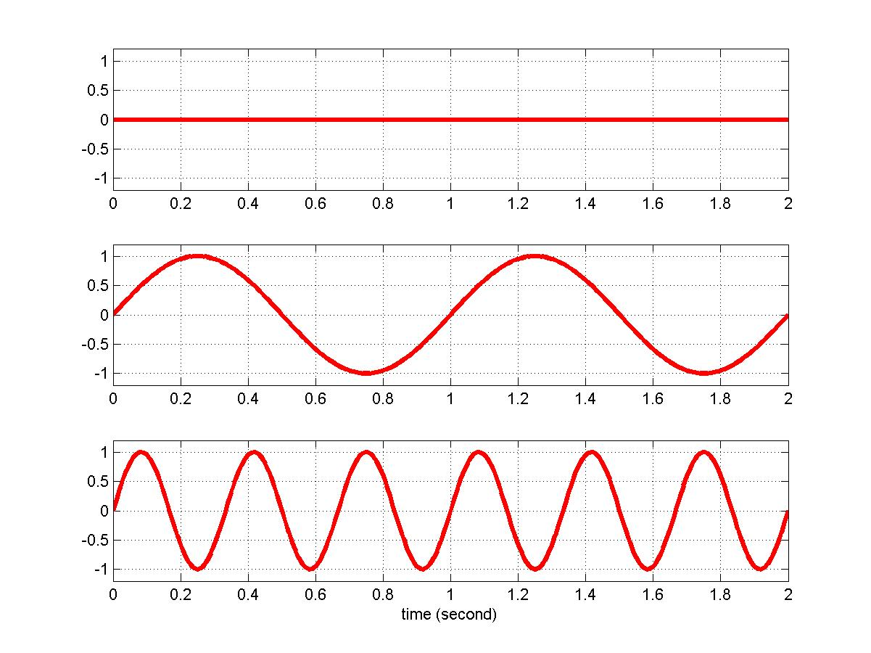
CONCEPT OF FREQUENCY
Frequency is the measurement of the number of times that a repeated event occurred in a unit time (1 second).
  Frequency measures how fast a signal can change within a unit period of time (or the measurement of the rate of change).
  High frequency ➔ the signal changes fast
In signal processing, frequency is defined based on sinusoid signal → number of cycles per second.
  Each sinusoid signal is uniquely associated with a single frequency based on its rate of change.
f = 0 Hz
f = 1 Hz
f = 3 Hz
1 second

Slide 4
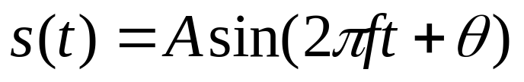



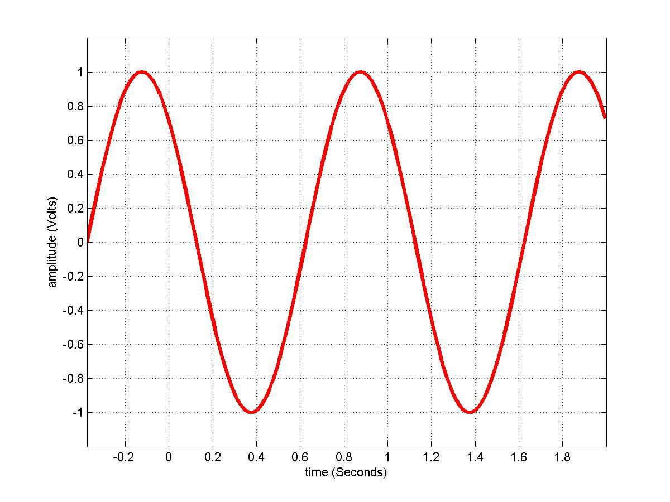


TIME DOMAIN SIGNAL
Sinusoid Signal
  f : frequency. in the unit of Hz (1/second)
  A : amplitude. maximum strength in signal, usually in unit of volts
  : phase. relative position in time
  t : time. in the unit of second
  T : period. Time for one cycle or one repetition, T=1/f.
  : Wavelength. Distance of the signal waveform propagated in one period T.
    , where v is the speed of the signal. In vacuum, it is the speed of light.
0 second
A

Slide 5
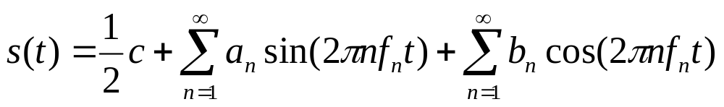
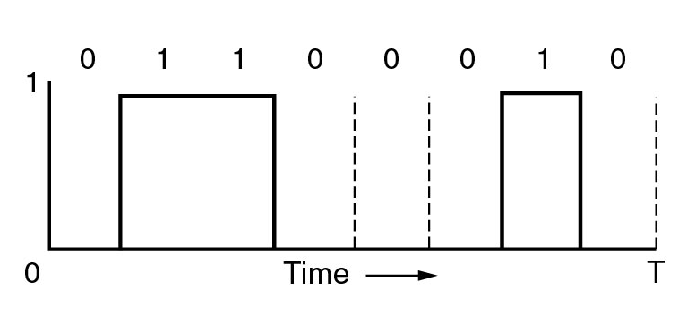
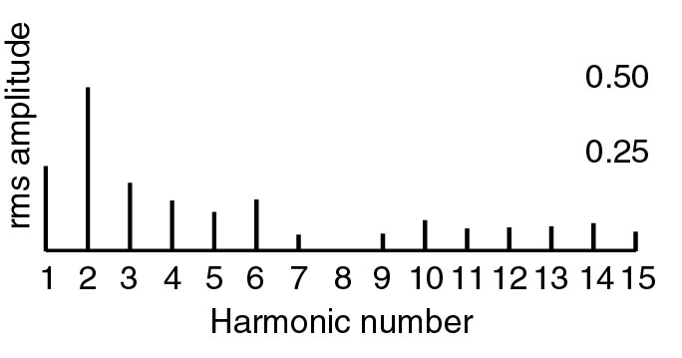


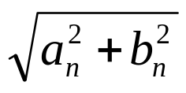
THEORY: FREQUENCY DOMAIN SIGNAL
Periodic signal can be written as the summation of a series of sinusoids (Fourier Series)
  Each sinusoid component has a unique frequency
  Each sinusoid component is called a “harmonic” of the original signal.
  There is a one to one relationship between a signal and its Fourier series.
  With Fourier series, we can represent the signal in the “Frequency Domain”
n
Time Domain
Frequency Domain

Slide 6
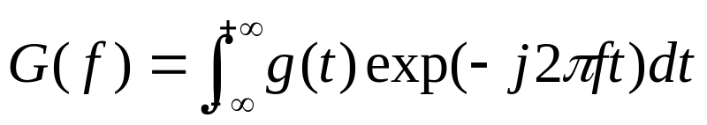
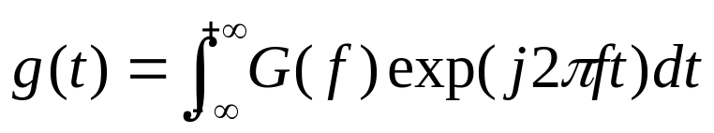


FOURIER TRANSFORM
Let g(t) be a non-periodic deterministic signal, expressed as function of t. Its frequency domain representation, G(f) , can be obtained from Fourier transform.
Fourier transform
Inverse Fourier transform

Slide 7

FOURIER TRANSFORM
Example 1:
  Find the Fourier transform of , t > 0
  Sol.

Slide 8
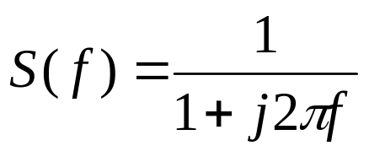
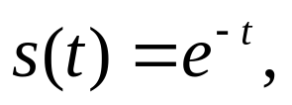

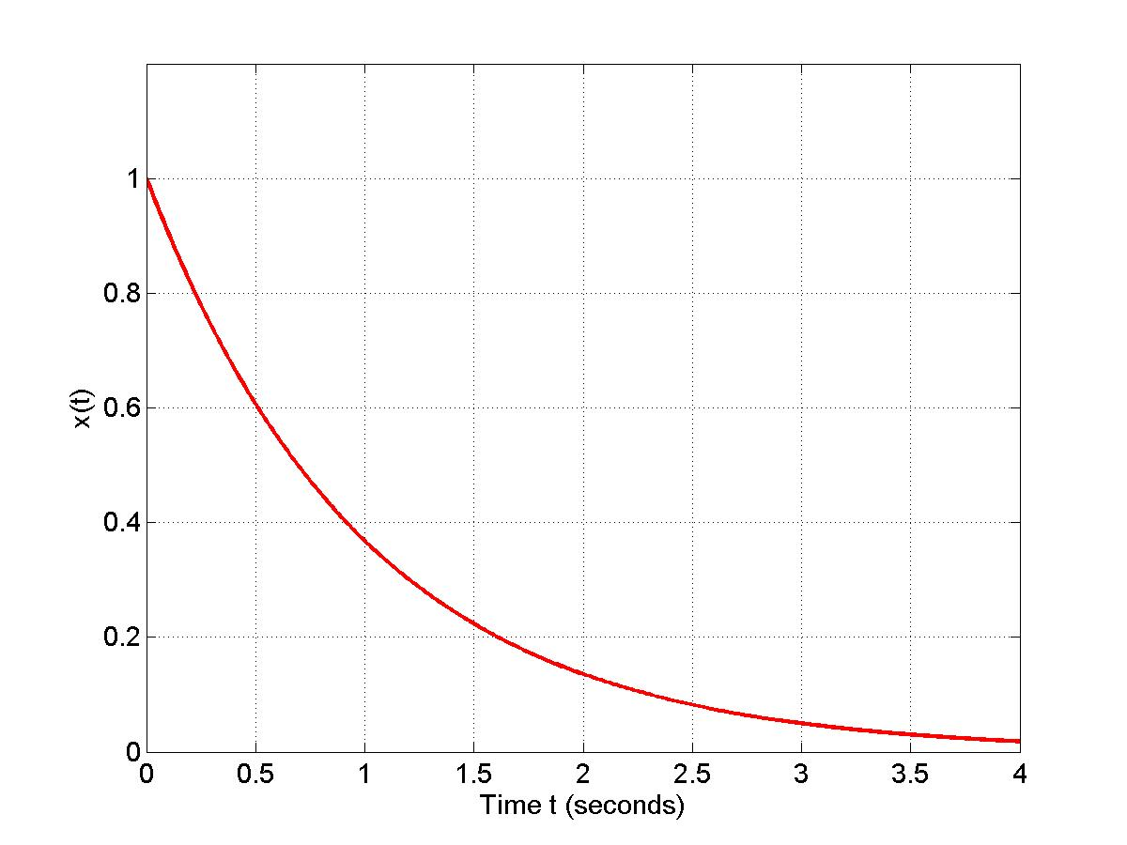
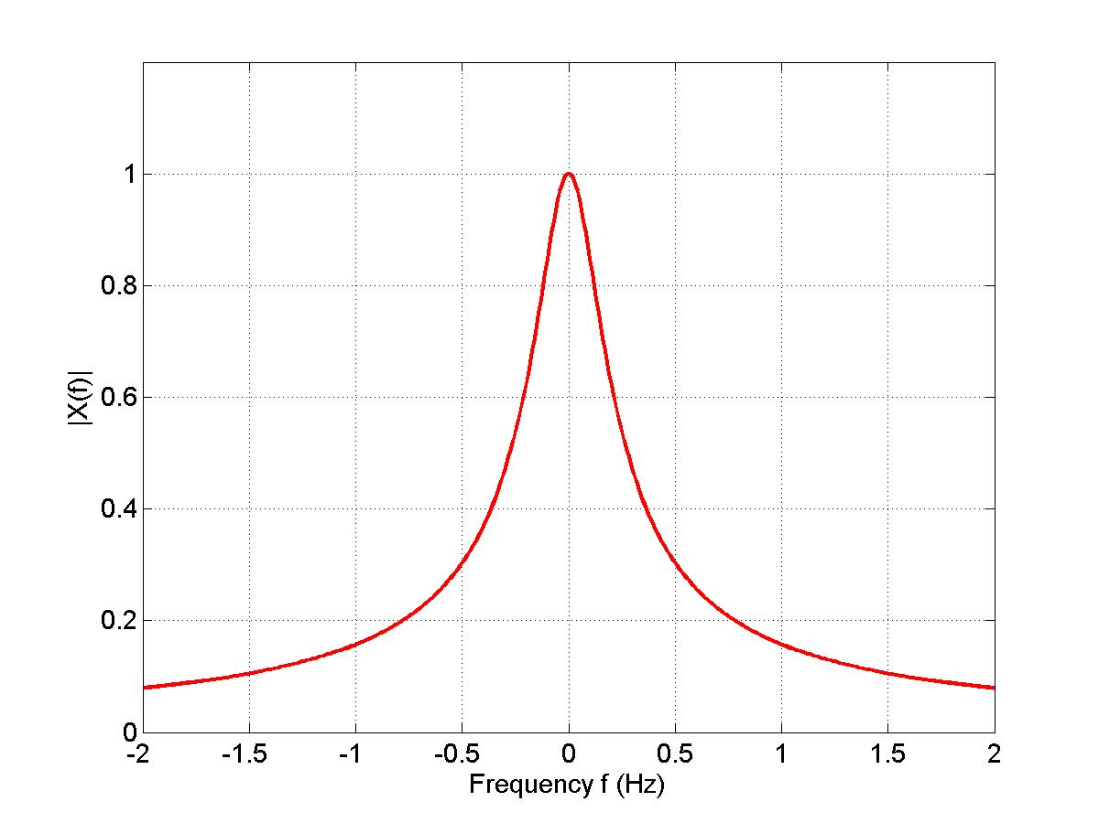
FOURIER TRANSFORM
Fourier Transform
Time Domain
Frequency Domain

Slide 9
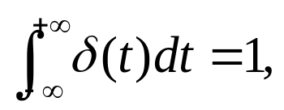



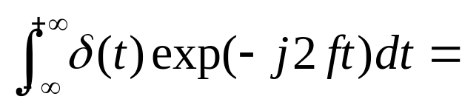


UNIT IMPULSE FUNCTION
Unit impulse function (delta function)
1
1
t
f

Slide 10






LINEAR TIME INVARIANT (LTI) SYSTEM
h(t)
The output of the LTI system is the convolution of input x(t) with the channel impulse response h(t)
Time domain convolution ➔ frequency domain multiplication

Slide 11



LTI
Example:
h(t)
Method 1:
Method 2:

Slide 12
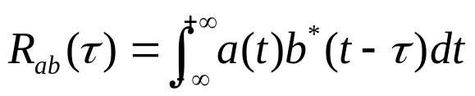
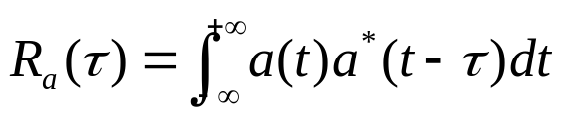
CORRELATION
The cross correlation of two deterministic, complex-valued function a(t) and b(t) is defined as
The auto-correlation of one deterministic, complex-valued function a(t) is defined as

Slide 13
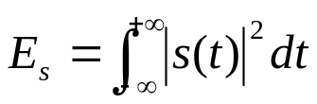


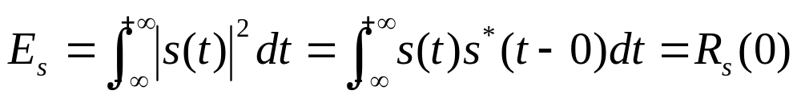
ENERGY
The energy of a signal s(t) is defined as
  If a signal has finite energy, the signal is called energy signal.
  E.g.
Relationship between energy and auto-correlation function

Slide 14
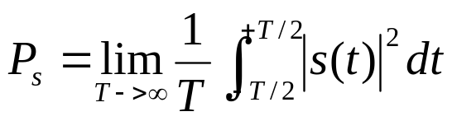
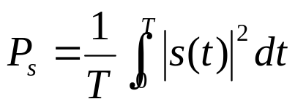


POWER
The power of a signal s(t) is defined as
  If a signal has finite power, the signal is called power signal
  For periodic signal with period T
  E.g.

Slide 15
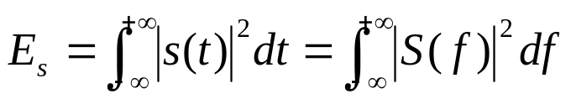

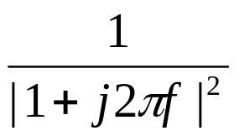
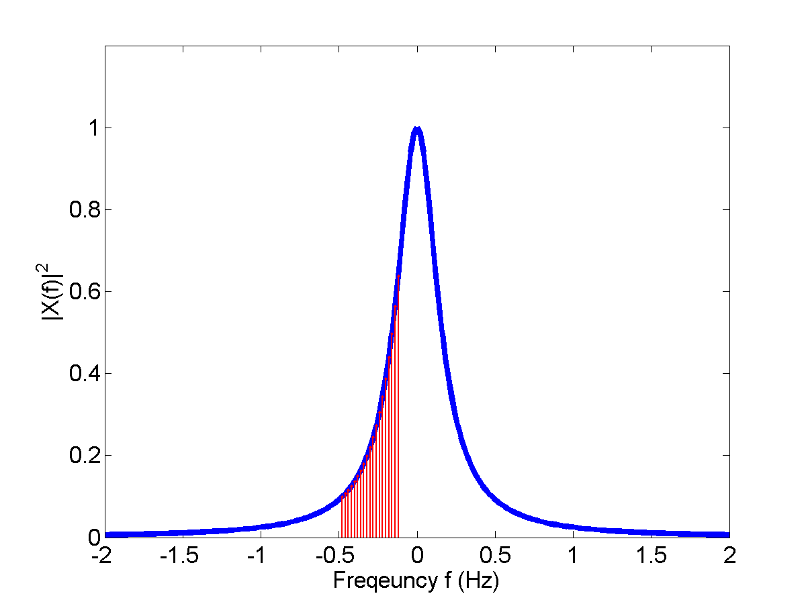
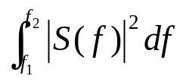

PARSEVAL’S THEOREM & ESD
is called the energy spectrum density (ESD) of the signal
  ESD represents the energy distribution in the frequency domain.
e.g. ESD of
:The signal energy in the
frequency range of

Slide 16
OUTLINE
Linear system theory (Fourier analysis)
Random variables and random process

Slide 17
DISCRETE RANDOM VARIABLES
Example 1: coin toss
  Define random variable (RV) X.
    X = 0: coin head
    X = 1: coin tail
  Probability Mass Function (PMF):
    P(X = 0) = 0.5, P(X = 1) = 0.5
Example 2: pick 1 ball from 10 balls (2 black, 3 white, 5 red)
  Define RV X
    X = 0: a black ball is picked
    X = 1: a white ball is picked
    X = 2: a red ball is picked
  PMF:

Slide 18

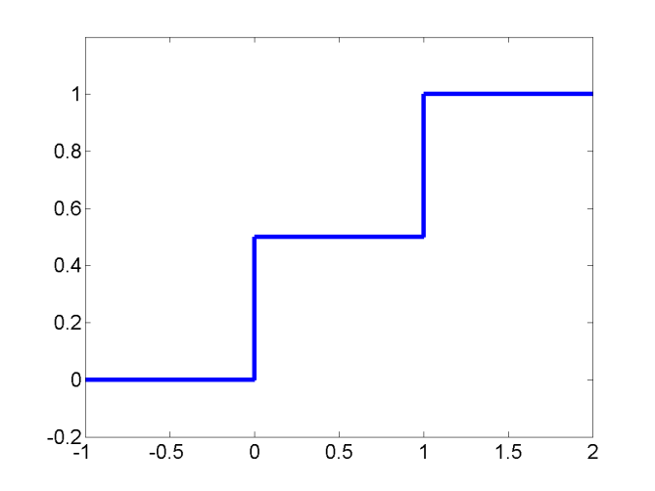
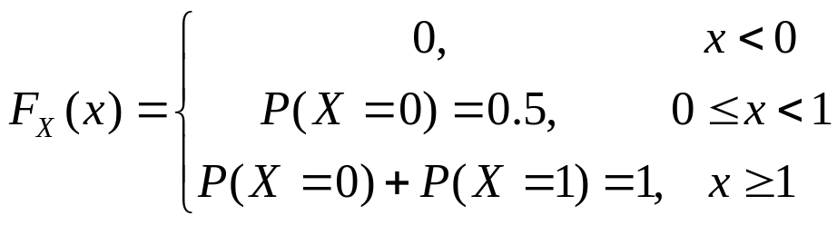
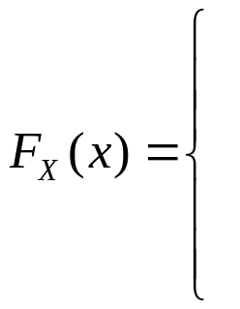
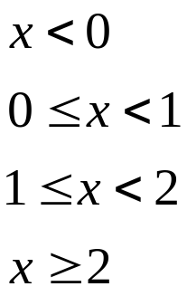
CUMLATIVE DISTRIBUTION FUNCTION (CDF)
Example 1: toss coin
Example 2: pick 1 balls from 10 balls

Slide 19


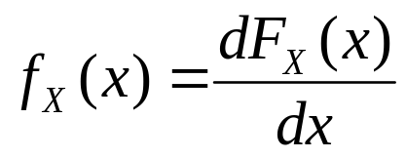

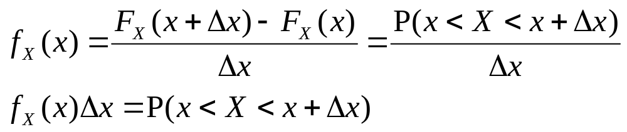

CONTINUOUS RV
RV X can take continuous values
  E.g.: X represents the average temperature
CDF
Probability density function (pdf)
Interpretation: for small ,
or, the probability that the RV X is in the range of

Slide 20
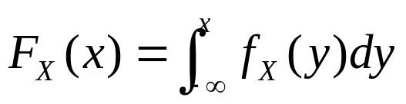
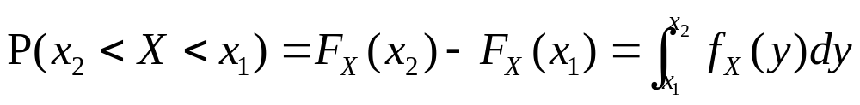
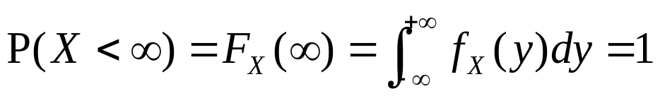
PDF AND CDF
Relationship between pdf and CDF

Slide 21
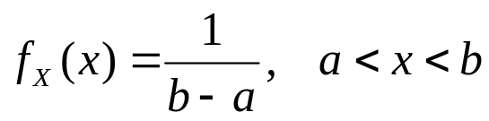
CDF AND PDF
Example:
  The pdf of uniform distribution is:
  The corresponding CDF is:
  Let a = 0, b = 1, the probability that X is in the range of [0.5, 0.6] is:

Slide 22
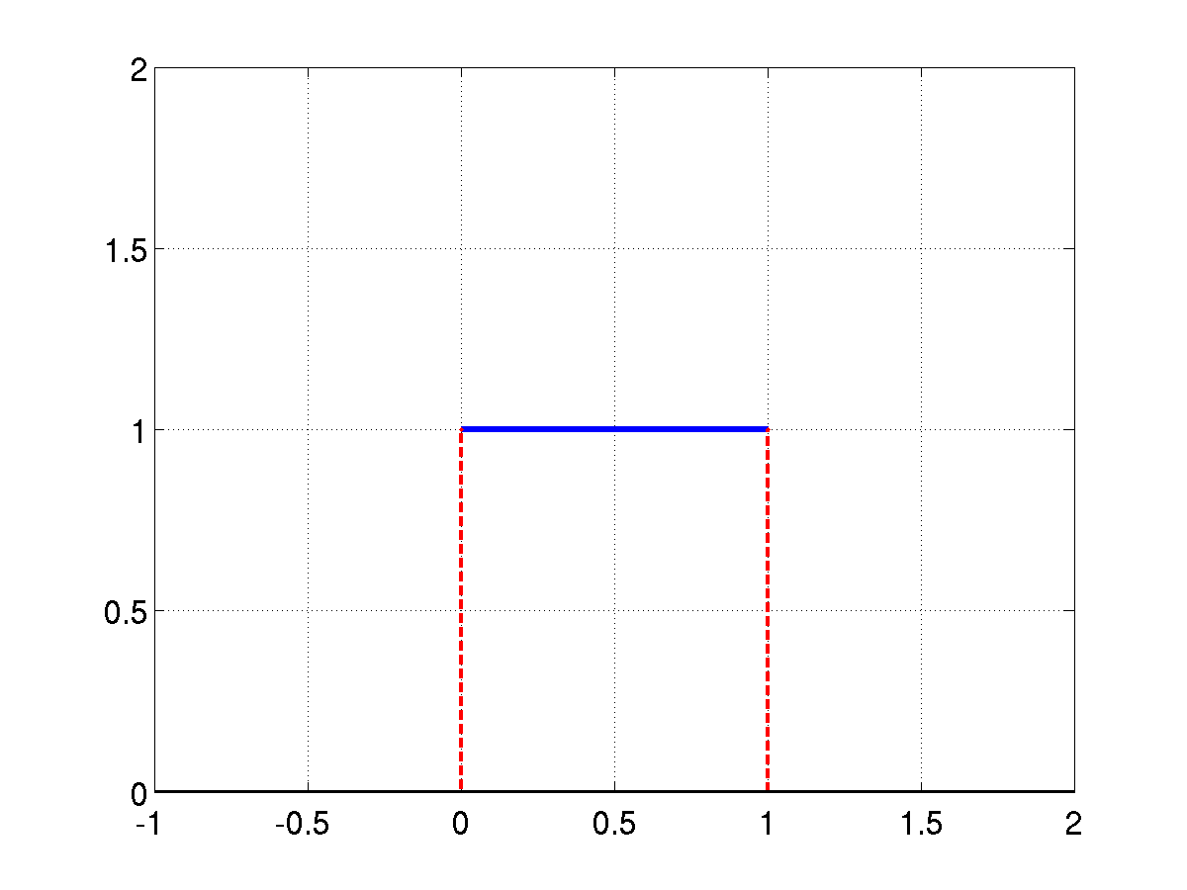
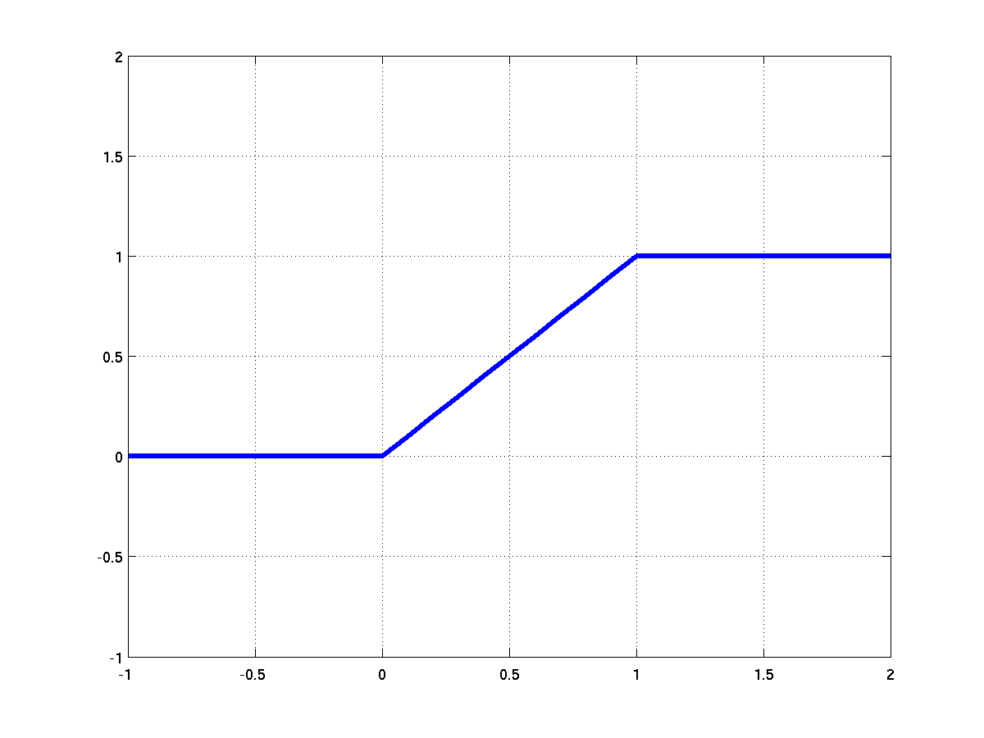
CDF AND PDF
1
1/(b-a)
0
a
b
a
b
pdf of uniform distribution
cdf of uniform distribution

Slide 23
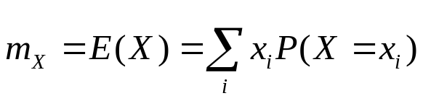
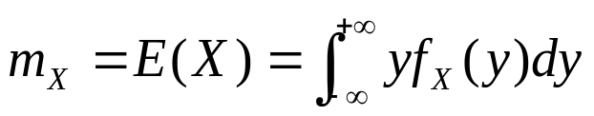
EXPECTATION (MEAN)
Discrete-time RV
  Weighted sum
Continuous-time RV
Example: find the expectation (mean) of the uniform distribution

Slide 24
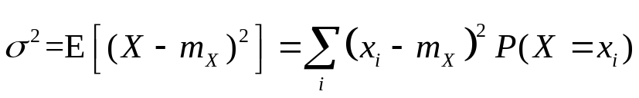
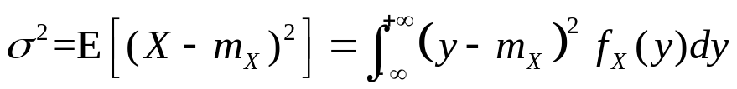
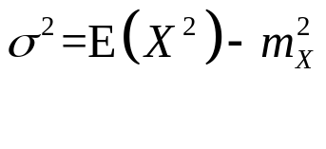
VARIANCE
Discrete RV
Continuous RV
  Proof:

Slide 25
VARIANCE
Example: find the variance of the uniform distribution
  Sol:

Slide 26
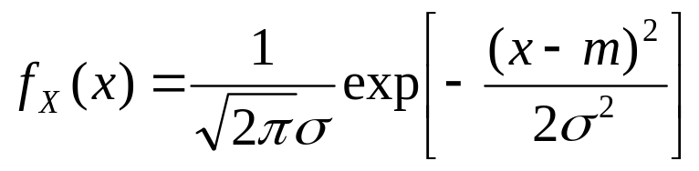

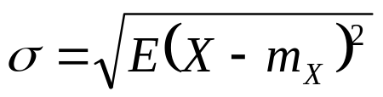
GAUSSIAN DISTRIBUTION
The pdf of Gaussian distribution is
  The pdf is determined by two parameters:
mean
standard deviation
The sum of Gaussian RVs is still Gaussian distributed

Slide 27
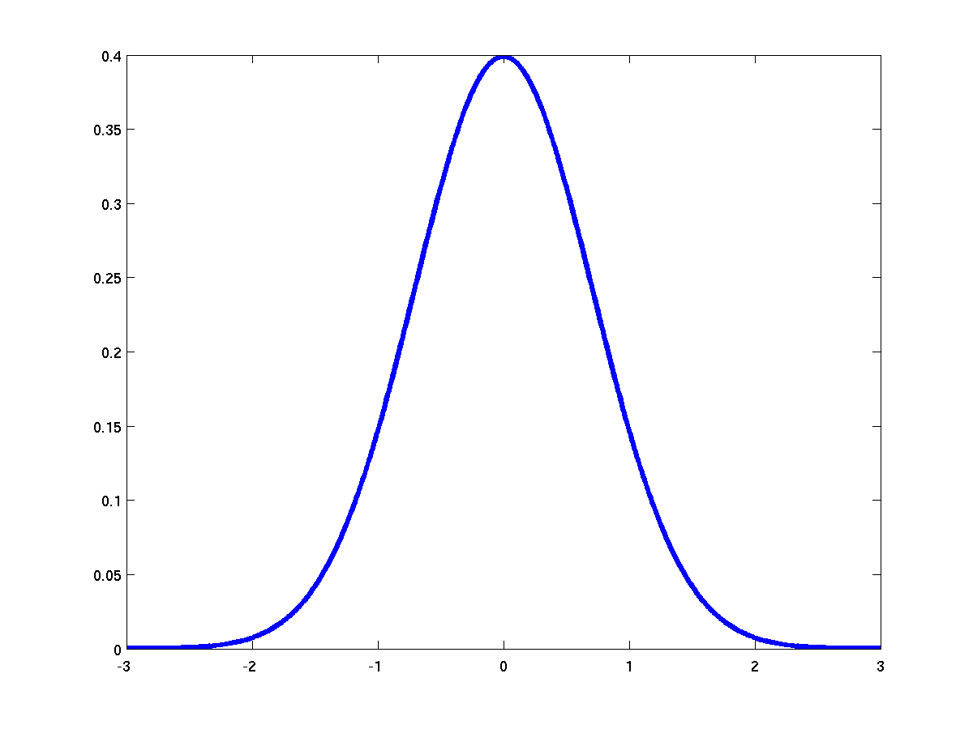
GAUSSIAN DISTRIBUTION
mean

Slide 28

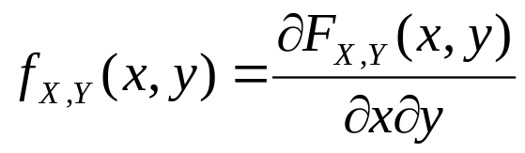
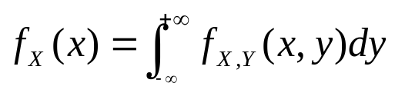
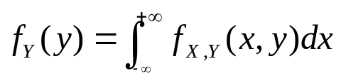
JOINT DISTRIBUTION
Consider two RVs, X, and, Y. The joint CDF of X and Y is
Joint pdf
Given the joint pdf, we can find the marginal pdf of each RV

Slide 29
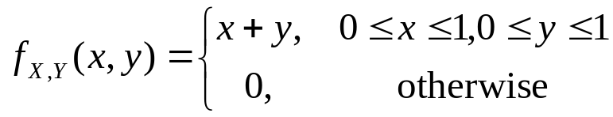


JOINT DISTRIBUTION
Example:
  Sol:
Independent
  If , then X and Y are independent.

Slide 30
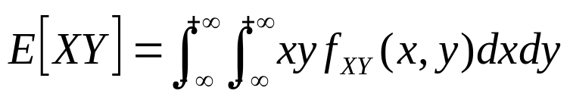

CORRELATION
The correlation of two RVs X and Y is calculated as
The covariance of two RVs X and Y is
If , then X and Y are uncorrelated.
If X and Y are independent ➔ they must be uncorrelated.
Proof:

Slide 31
CORRELATION
Example:
  Sol:
Are X, Y uncorrelated?

Slide 32




RANDOM PROCESS
Random process X(t): an RV changes w.r.t. time
  X(t) is a function of time t
  At any time instant , is a random variable.
Each realization is called a
sample function of the random
process
mean: (ensemble average)
Time (ms)
At each time instant, we have a RV

Slide 33






RANDOM PROCESS
Let be a random process,
at time , we have a RV ;
at time , we have another RV .
Then we have the joint distribution functions

Slide 34


AUTO-CORRECTION FUNCTION (ACF)
Let be a random process,
at time , we have a RV ;
at time , we have another RV .
Then we can calculate the correlation of and :
is defined as the autocorrelation function of X(t)

Slide 35



WIDE-SENSE STATIONARY (WSS)
A random process is wide-sense stationary (WSS) if the following two conditions are satisfied
1.
2.
  The first condition states that the mean of the random process is independent of time.
  The second condition states that the auto-correlation function is only dependent on the time difference between the two RVs, and it’s independent of the starting time.
    The autocorrelation function of WSS process is usually represented as

Slide 36






POWER SPECTRUM DENSITY
The power spectrum density (PSD) of WSS random process is defined as the Fourier transform of the auto-correlation function of the process
Power spectrum density represents the power distribution in the frequency domain.
E.g.
N0/2
N0/2
f

Slide 37


RANDOM PROCESS PASS THROUGH LTI
h(t)
If x(t) is a WSS random process, then y(t) is a WSS random process as well.
The relationship between mean of y(t) and mean of x(t)
The relationship between PSD of y(t) and PSD of x(t)

