Slide 1
ELEG 5693 Wireless Communications
Introduction
Dr. Jingxian Wu
wuj@uark.edu

Slide 2
OUTLINE
Background
Major modern wireless communication standards
Basic Concepts
Block diagrams of a wireless communication system

Slide 3
BACKGROUND
Wireless Communications:
  Transmit information from transmitter to receiver through the propagation of unguided electromagnetic (or acoustic) waves (channel).
Transmitter
Channel
Receiver
Wireless communication: channel is wireless!
Wireless channel imposes numerous challenges.
This course:
  How to characterize the wireless channel?
  How to efficiently and accurately transmit signal over the wireless channel? (How to format signals based on the properties of wireless channel?)

Slide 4
BACKGROUND: MILESTONES
1864. Maxwell predicted the existence of electromagnetic wave (radio wave).
1887 Hertz demonstrated the existence of radio wave.
1901 Marconi realized first across Atlantic wireless transmission (England to Canada)
1906 First radio broadcast (AM radio)
1946 First public mobile telephone systems
1948 C. Shannon, “A Mathematical Theory of Communications” was published
1981 First analog cellular system in Scandinavia.
  Prototype of current cellular systems.
  1983, Advanced Mobile Phone Service (AMPS) in North America.
2019 First 5th generation (5G) services launched in US and China

Slide 5
BACKGROUND: SPECTRUM
Radio Frequency (RF)
  1MHz to 1GHz (general classification, not absolute)
  100 MHz to 1GHz (more widely used definition)
  Applications: AM radio, FM radio, TV, some cellular telephone systems, etc.
Microwave
  1 GHz to 300 GHz (general)
  1 GHz to 100 GHz (more widely used)
  Most cellular telephone systems, wireless LAN, Satellite, etc.
Trends towards use of higher frequencies
  Maximum bandwidth ≈ 10% of carrier frequency
  More users and higher data rate
  More difficult to design ➔ more $$

Slide 6
BACKGROUND: EXAMPLES
Garage door opener
Remote control
Paging system
Cordless telephone system
Fixed microwave
  Point-to-point link for long distance telephone
  Most have been replaced by fiber optics.
Cellular telephone system
Wireless local area network (LAN)
Wireless sensor networks (WSN)
Vehicular Ad-hoc network (VANET)
Internet-of-Things (IoT)

Slide 7
OUTLINE
Background
Major modern wireless communication standards
Basic Concepts
Block diagrams of a wireless communication system

Slide 8
STANDARDS: MOBILE TELEPHONE SYSTEMS
1st generation: analog voice
  Example: Advanced Mobile Phone Service (AMPS)
2nd generation: digital voice and narrowband data
  Examples: GSM (T-Mobile, Cingular, AT&T, Verizon), D-AMPS (AT&T), IS-95 (Interim Standard-95) (Sprint)
  2.5 generation: EDGE, GPRS
3rd generation: digital voice and broadband data
  Examples: WCDMA (HSDPA), cdma2000 (EV-DO)
4th generation: broadband multimedia communication
  LTE (long term evolution)
  LTE advanced (true 4G)

Slide 9
STANDARDS: MOBILE TELEPHONE SYSTEMS
5th generation: seamless wireless coverage everywhere
  Standard: IMT-2020 (International Mobile Telecommunication 2020)
    It specifies all the requirements for 5G
  3GPP develops the actual standards that meet all IMT-2020 requirements
    NR (new radio),
    NB-IoT (narrowband Internet-of-Things),
    LTE-M (Long term evolution – Machine type communications)
  Usage scenarios:
    Enhanced Mobile Broadband (eMBB)
    Ultra-Reliable Low-Latency Communications (URLLC)
    Massive Machine-Type Communications (mMTC)

Slide 10
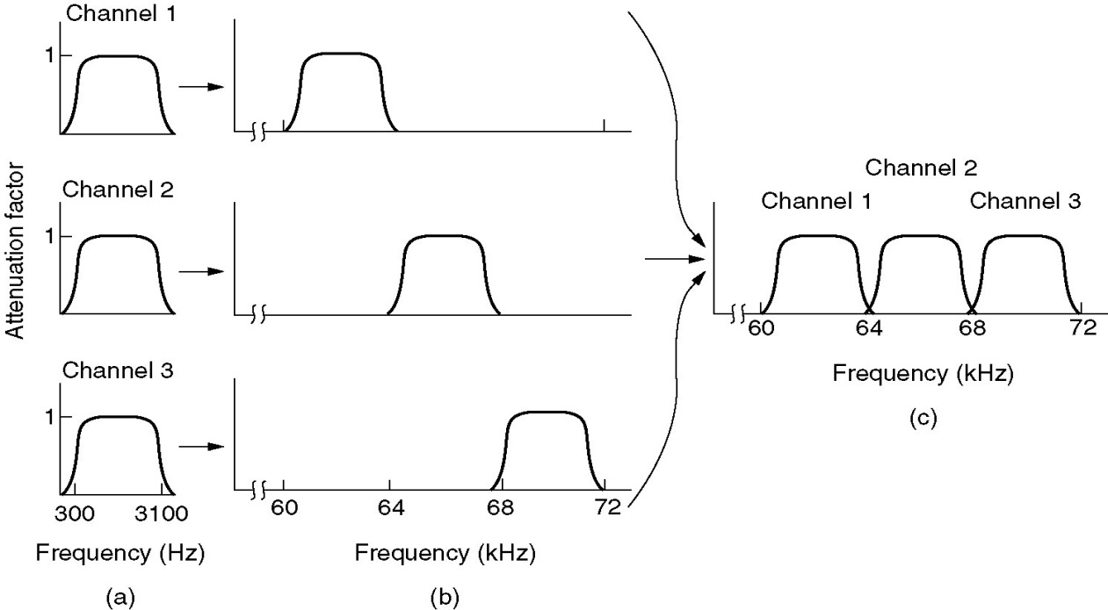
STANDARDS: MOBILE TELEPHONE SYSTEMS
AMPS
  Advanced Mobile Phone System
  1983, AT&T
  Analog voice (control information is digital)
Frequency Division Multiple Access (FDMA)
    Available spectrum divided into channels
    each user is assigned a channel
(c) The multiplexed channel
(a) The original bandwidths
(b) Bandwidths raised in frequency

Slide 11
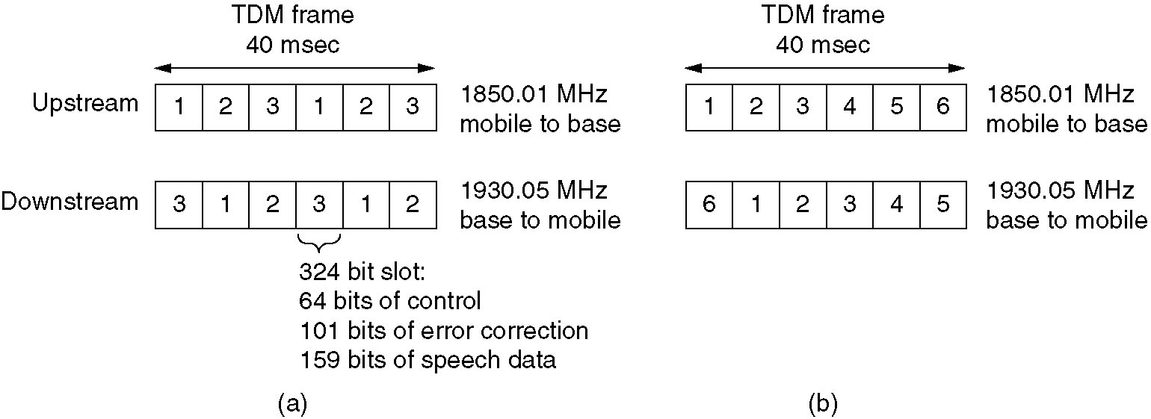
STANDARDS: MOBILE TELEPHONE SYSTEMS
D-AMPS (IS-54/136)
  Digital AMPS
  Digital voice: analog voice is digitalized and compressed by vocoder before Tx
Time Division Multiple Access (TDMA)
  Time is divided into frame, frame divided into slots
  Each user is assigned one or more slots
  TDMA is usually on top of FDMA (30 KHz channel, 6 users per channel)

Slide 12
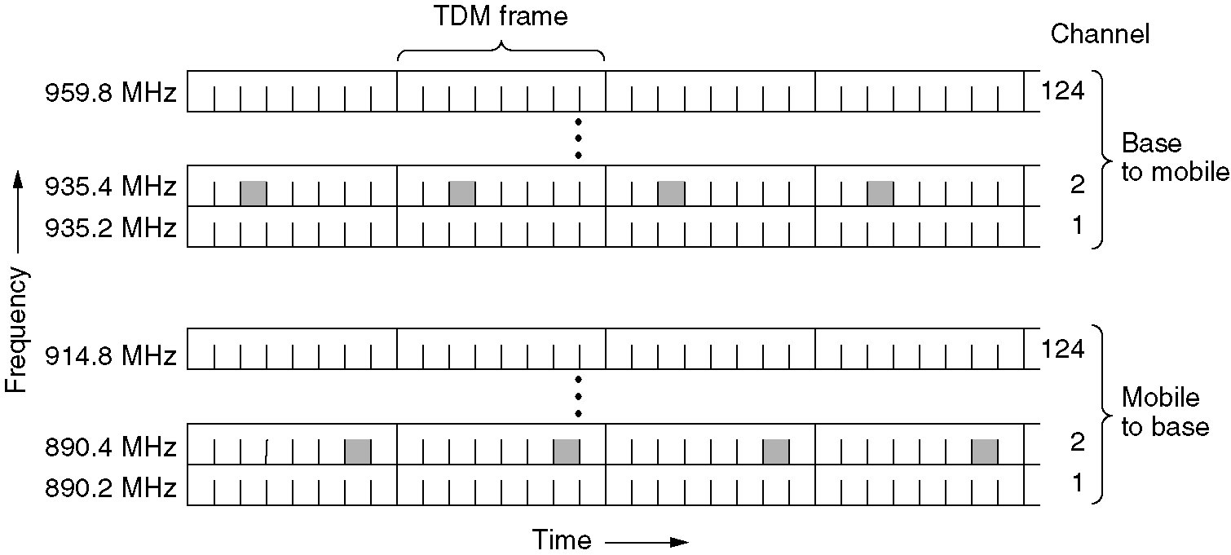
STANDARDS: MOBILE TELEPHONE SYSTEMS
GSM (Global System for Mobile communication)
  The most widely used 2nd generation system
  Similar to D-AMPS, but with different format

Slide 13
STANDARDS: MOBILE TELEPHONE SYSTEMS
IS-95 (Narrowband CDMA)
  Code Division Multiple Access
  All users Tx simultaneously using the same frequency and same time.
  Different codes are used to separate the signals from different users.
CDMA
  Each user is assigned a unique code
  The code is known at both transmitter (Tx) and receiver (Rx)
  All users Tx at the same frequency and time
  Receiver uses codes to pick up desired signals
  Also called spread spectrum
  (details will be discussed in Ch. 9)

Slide 14
STANDARDS: MOBILE TELEPHONE SYSTEMS
WCDMA (Wideband CDMA)
  Also called UMTS (Universal Mobile Telephone System)
  Proposed by Ericsson, Standardized in 3GPP
  Will mainly be used in Europe
  Data: HSDPA (High Speed Downlink Packet Access, 1.8 Mbps-7.2 Mbps)
cdma2000
  Proposed by Qualcomm, Standardized in 3GPP2
  Will mainly be used in North America
  Data: 1xEV-DO (Evolution Data Optimization, 1x: one 1.25 MHz channel, up to 4.9 Mbps in the downlink)
Both standards use CDMA
  Only some detailed technical differences

Slide 15
STANDARDS: MOBILE TELEPHONE SYSTEMS
4G: LTE (long term evolution)
  Standard finalized in 2008
  First LTE service in North America launched by Verizon in 2010.
  An upgrade of 3G UMTS
Some main features
  OFDMA (orthogonal frequency division multiple access) for downlink; FDMA for uplink
  Scalable carrier bandwidth: 1.4 MHz, 3 MHz, 5 MHz, 10 MHz, 15 MHz and 20 MHz
  Low latency: sub-5 ms latency for small packets in optimal conditions
  Peak download rate: 299.6 Mbps; Peak upload rate: 75.4 Mbps
  Cell size: tens of meters radius (femto and picocells) up to 100 km (62 miles) radius marcocells. (Typical radius 5 – 30 kms)

Slide 16
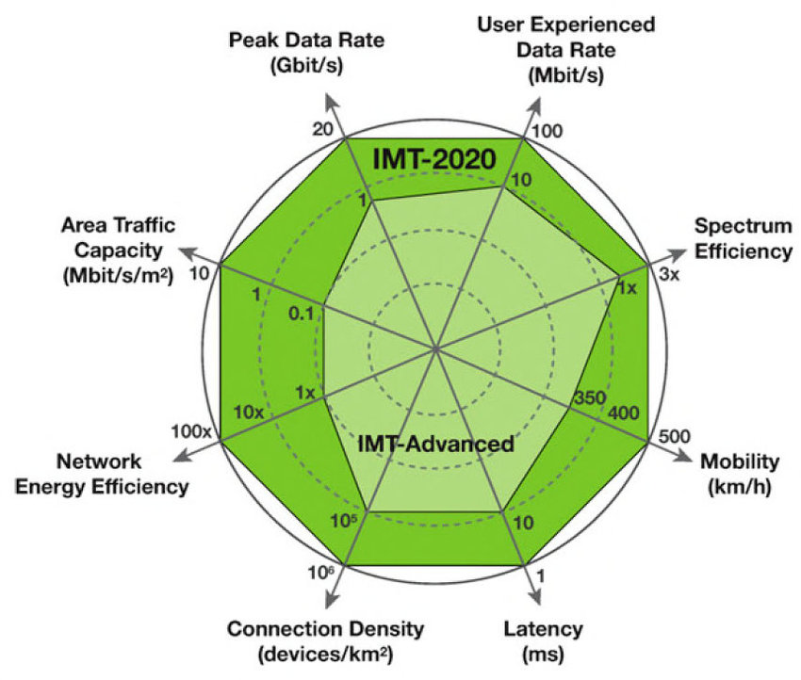
STANDARDS: MOBILE TELEPHONE SYSTEMS
5G
  IMT 2020: issued in 2015, published in 2021
  3GPP Release-18 completed in 2019

Slide 17
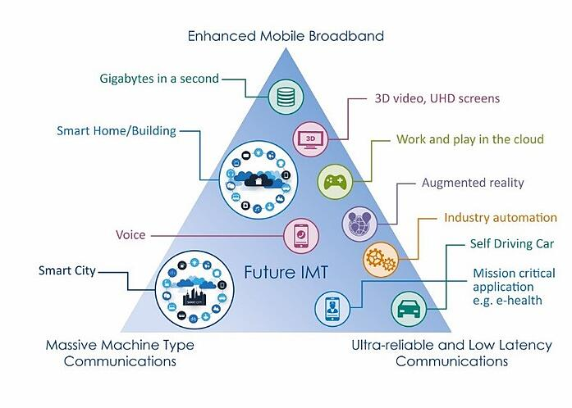
STANDARDS
5G usage scenarios
  Enhanced Mobile Broadband (eMBB)
  Ultra-Reliable Low-Latency Communications (URLLC)
  Massive Machine-Type Communications (mMTC)

Slide 18
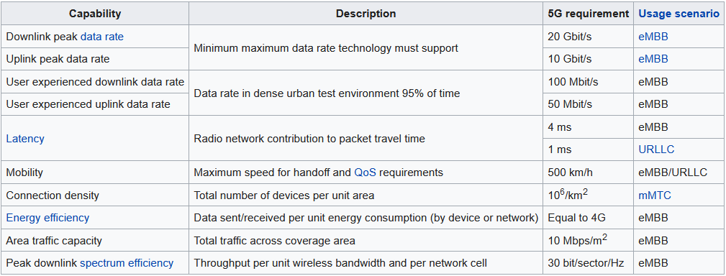
STANDARDS
5G requirements

Slide 19
STANDARDS: WIRELSS LAN
IEEE 802.11 (WiFi)
  IEEE 802.11a (Oct. 1999)
    Operating at 5.8GHz, up to 54Mbps
    Orthogonal Frequency Division Multiplex (OFDM)
  IEEE 802.11b (Oct. 1999)
    Operating at 2.4GHz, up to 11Mbps
    Direct Sequence Spread Spectrum (DSSS, CDMA)
  IEEE 802.11g (Jun. 2003)
    Operating at 2.4GHz, up to 54Mbps
    OFDM
  IEEE 802.11n (2009)
    Operating at 2.4 GHz or 5.8 GHz, up to 540 Mbps
    Channel bandwidth up to 40 MHz
    MIMO (Multiple input multiple output, up to 4 x 4)
  IEEE 802.11ac (2011 to present)
    Operating at 5.8 GHz, up to 1 Gbps for multi-station WLAN, upto 500 Mbps for a single link
    Wider bandwidth (up to 160 MHz), MIMO (up to 8x8), multi-user MIMO, high density modulation (upto 256 QAM)
  IEEE 802.11ad (2014 to present)
    60 GHz carrier frequency, upto 7 Gbps (WiGig)

Slide 20
OUTLINE
Background
Major modern wireless communication standards
Basic concepts
Block diagrams of a wireless communication system

Slide 21
CONCEPTS
In most wireless communication systems, the wireless communication occurs between mobile station (MS) and base station (BS)
  MS: Cell phone, wireless laptop, wireless PDA, etc.
  BS: wireless access point, wireless router, etc.
Downlink
  Radio channel for transmission from BS to MS
  Also called forward link
Uplink
  Radio channel for transmission from MS to BS
  Also called reverse link

Slide 22
CONCEPTS: SIMPLEX AND DUPLEX
Simplex
  Communication occurs only in one direction
  E.g. paging system
Half Duplex
  Tx can occur in either direction, but only one way at a time.
  E.g. Walki-Talki (police radio)
Full Duplex
  Tx can occur at both direction simultaneously
  E.g. Telephone.
  Two simplex ➔ One Full Duplex

Slide 23

CONCEPTS:FDD V.S TDD
Frequency Division Duplex (FDD)
  Two distinct frequencies are used for downlink and uplink.
Time Division Duplex (TDD)
  Two distinct sets of time slots at the same frequency are used for downlink and uplink
TDD TDMA, FDD FDMA
  TDMA or FDMA: multiple users use different time/frequency
  TDD or FDD: uplink and downlink (belonging to same user) use different time/frequency
  TDD can be used in FDMA, TDMA, and CDMA systems
  FDD can be used in FDMA, TDMA, and CDMA systems
  E.g. FDD and TDMA can be in one system.
e.g. AMPS: forward link: 824 ~ 849 MHz
reverse link: 869 ~ 894 MHz

Slide 24
CONCEPTS: CELLUAR
Motivations
  Early mobile phone system uses a single high Tx tower to cover a large spatial area (high tower, high power)
  Limited spectrum can only support a small number of users.
  How can we support simultaneous communications of practically unlimited number of users?
Solution: cellular concept with frequency reuse
  Many Tx towers (base station)
  Each covers a certain area: cell
  Frequencies can be reused from area to area

Slide 25
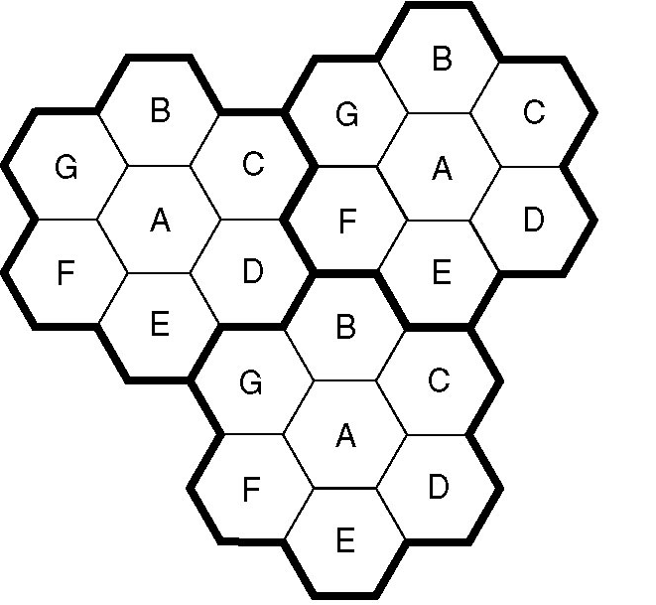
CONCEPTS: CELLULAR
Cellular Concept with Frequency Reuse
  The entire coverage area is divided into cells
  A base station (BS) in the center of each cell.
  Communication occurs between BS and Mobile Stations (MS) in cell.
  The same frequency (channels) can be reused by nearby cells ➔ Frequency Reuse
    But not by adjacent cells!➔Reduce co-channel interference (CCI).
Hexagonal shape only for the convenience of analysis
  Circle leaves gaps
Actual cell “footprint” is amorphous
  No specific shape

Slide 26
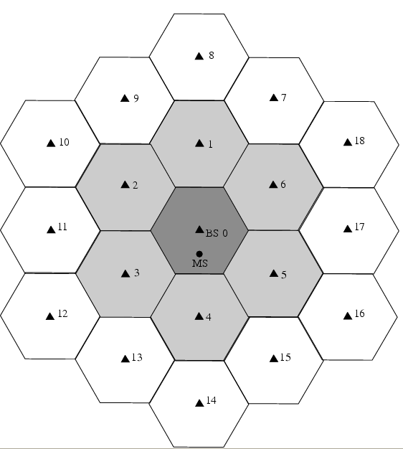
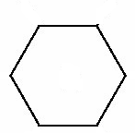
CONCEPTS: CELLULAR
Cluster
  Cluster: Group of N cells using complete set of available channels.
  Cells belonging to the same clusters use different frequencies
For hexagonal cells, the cluster size N must satisfy
  N = i^2 + i j + j^2 where i, j ≥ 1
  typical N values → 3, 7, 12
    (i, j) = (1,1) ➔ N = 1+1+1 = 3
    (i, j) = (1, 2) ➔ N = 1+2+4 = 7
    (i, j) = (2, 2) ➔ N = 4+4+4 = 12
    (i, j) = (2, 3) ➔ N = 4+6+9 = 19
Cell radius R:
  AMPS: 10 ~ 20 km
  WCDMA: 1 ~ 2 km
x=?
R
Notes:
X^2 = R^2-R^2/4 = ¾ R^2
X = sqrt(3)/2 R

Slide 27
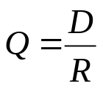
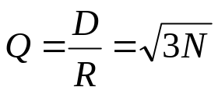

CONCEPTS: CELLULAR
Reuse factor Q:
R
  D: distance between cells using the same
  frequency
  R: cell radius
  For hexagonal cells,
D
cluster size
  E.g. N = 7, Q =
  Q ↑ ➔ spatial separation relative to cell coverage ↑ ➔ CCI ↓ ➔ Good
  Q ↑ ➔ N ↑ ➔ bigger cluster size ➔ less frequency reuse (or, less clusters) ➔ smaller capacity ➔ less users can be served ➔ Bad
  Tradeoff between: voice quality and system capacity
Notes:
X = sqrt(3)/2 R
D^2 = a^2 + b^2 - 2ab*cos(theta)
A = 2x
B = 4x
D^2 = 4x^2+16x^2 - 2*8x^2*(-1/2) = 28 x^2 = 28 *3/4 R^2 = 21 R^2
D = sqrt(21)*R
Q = D/R = sqrt(21)

Slide 28
CONCEPTS: CELLULAR
Example:
  A total of 33 MHz of bandwidth is allocated to a particular FDD cellular telephone system. The system uses two 25KHz simplex channels to provide full duplex voice and control channels. If 1MHz is dedicated to control channel. How many voice users can be supported per cell for system with reuse factor N = 7? What is the reuse factor?
  Sol:
Notes:
BW of one Full Duplex channel: 25KHz x 2 = 50 KHz
Total # of voice channels: (33-1)MHz/50KHz = 32000/50 = 640 voice channels
Total # of control channels: 1MHz/50KHz = 20 control channels
Total # of channels: 640 + 20 = 660 channels
# of voice channels per cell: 640/7 ≈ 91
# of control channels per cell: 20/7 ≈ 2
Q = sqrt(3N) = sqrt(3*7) = sqrt(21)

Slide 29
CONCEPTS: CELLULAR
Advantages of Cell with Frequency Reuse
  Limited frequency resource can be reused to support unlimited number of users
    Each cell support only limited number of users
    The number of users supported by system increase linearly with the number of cells
  Each BS only covers one cell
    Smaller Tx power at BS ➔ Less interference to other systems
    Smaller Tx power at MS ➔ Longer battery life
  A cell can be further divided into smaller cells to support more users
    Upgradability
Disadvantage:
  Cells sharing same frequency will interfere with each other ➔ co-channel interference (CCI)
  We want cells sharing same frequencies to be as further away as possible.

Slide 30
OUTLINE
Background
Major modern wireless communication standards
Basic Concepts
Block diagrams of a wireless communication system

Slide 31
SIMPLIFIED BLOCK DIAGRAM
Source Coding
Channel Coding
Modulation
Transmitter
Channel
Source Decoding
Channel Decoding
Demodulation
Equalization
Receiver

